Slide 1
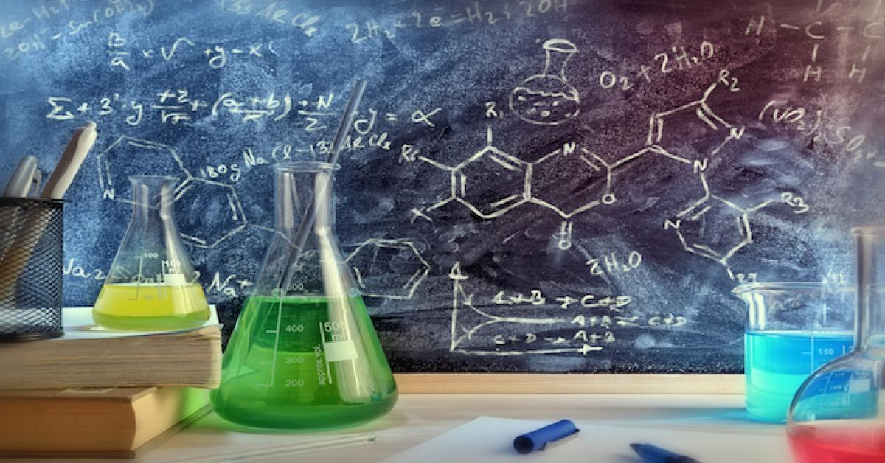
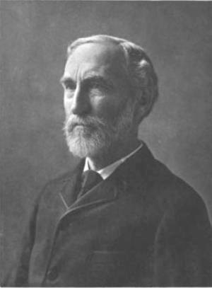
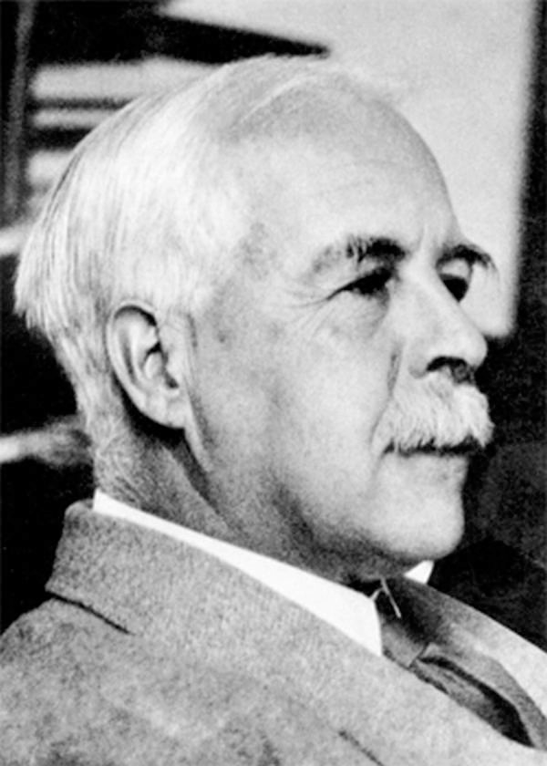
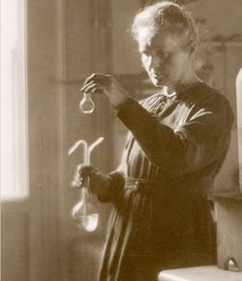
Chemistry 223 Final Exam Review
Chemistry 223
Professor Michael Russell
MAR
Last update:
7/6/26
Clockwise from top: Gibbs, Marie Curie, Lewis
Notes:
Clockwise from top: Gibbs, Marie Curie, Lewis

Slide 2


What is the A.C.S. Final?
American Chemical Society (A.C.S.): the largest professional organization in the world
A.C.S. creates exams for organic chemistry, CH 106, many others
This is a scaled exam based on national testing by A.C.S.
Your score will be scaled or raw, whichever is higher… students usually do very well on the A.C.S. exam! :)
See A.C.S. Study Guide in Companion / website
MAR

Slide 3
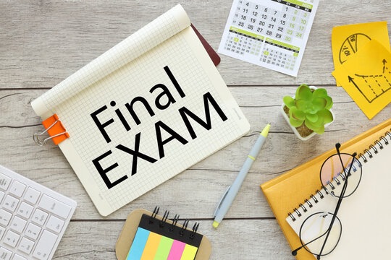

CH 223 Lecture & Lab Final Exams
Lecture Final:
28 multiple choice questions, covers all chapters. Bring: calculator, pencil, "Organic Chemistry" lab
Lab Final: Mix of QAI & QAIII labs
Work with one lab partner, 2 hours to complete, bring combined flowchart and lab procedures from QAI and QAIII
Final grades available by Friday night. Final exams not returned.
Good luck with your studying!
Let's start the review!
L1 Lab Final: Mon. 6/7, 1:10 PM AC 2507
L1 Lec Final: Wed, 6/9, 8:45 AM, AC 1303
L2 Lab Final: Wed. 6/9, 1:10 PM AC 2507
L2 Lec Final: Wed, 6/9, 3:20 PM, AC 2501
Check with instructor to ensure correct dates and times!
MAR

Slide 4
CH 223 Lecture & Lab Final Exams
Lecture Final:
28 multiple choice questions, covers all chapters. Bring: calculator, pencil, "Organic Chemistry" lab, Lab Final
Lab Final: Due at time of Lecture Final
5 short answer questions over labs from this term; released Monday morning, turn in printed copy to receive credit
Final grades available by Friday night. Final exams not returned.
Good luck with your studying!
Let's start the review!
L1: Wed, June 10, 8:45 AM AC 1303
L2: Wed. June 10, 1:10 PM, AC 2501
MAR
Check with instructor to ensure correct dates and times!

Slide 5
CH 223 Lecture & Lab Final Exams
Lecture Final:
28 multiple choice questions, covers all chapters. Bring: calculator, pencil, "Organic Chemistry" lab, Lab Final
Lab Final: Due at time of Lecture Final
5 short answer questions over labs from this term; released Monday morning, turn in printed copy to receive credit
Final grades available by Friday night. Final exams not returned.
Good luck with your studying!
Let's start the review!
L1: Wed, June 9, 8:45 AM AC 1303
L2: Wed. June 9, 1:10 PM, AC 2501
MAR
Check with instructor to ensure correct dates and times!

Slide 6
Which statement describes the composition of a neutral atom of iron-58?
26 neutrons, 32 protons, and 26 electrons
32 neutrons, 26 protons, and 26 electrons
26 neutrons, 26 protons, and 32 electrons
26 neutrons, 26 protons, and 26 electrons
Not enough information
MAR
Enter your response on
your iClicker now!
Answer = B, 32 neutrons, 26 protons, and 26 electrons
Fe: Z = 26, so 26 protons
Neutral atom, so 26 electrons
# neutrons = A - Z, or
# neutrons = 58 - 26 = 32

Slide 7
Nitrogen and oxygen form a series of oxides with the general formula N_{x}O_{y}. One of them has 46.67% N. The empirical formula for this oxide is
N₂O
NO
NO₂
N₂O₃
N₂O₅
MAR
Enter your response on
your iClicker now!
Answer = B, NO
Assume 100 g, turn into moles:
46.67 g N * (mol N / 14.01 g)
= 3.331 mol N
100% - 46.67% = 53.33% O
53.33 g O * (mol O / 16.00 g)
= 3.333 mol O
N3.331O3.333
divide both by smallest number:
N(3.331/3.331)O(3.333/3.331)
= N1.000O1.001 = NO

Slide 8
Ammonia is prepared by the reaction:
N₂(g) + 3 H₂ (g) → 2 NH₃(g)
If 10.0 mol of N₂ are mixed with 25.0 mol of H₂, the amount of NH₃ produced will be:
20.0 mol NH₃
16.7 mol NH₃
37.5 mol NH₃
25.0 mol NH₃
35.0 mol NH₃
MAR
Answer = B, 16.7 mol NH3
Limiting reactant problem - two reactants! careful!
Find yield of NH3 for both quantities:
10.0 mol N2 * (2 mol NH3 / 1 mol N2) = 20.0 mol NH3
25.0 mol H2 * (2 mol NH3 / 3 mol H2) = 16.7 mol NH3
H2 = limiting reactant, creates less NH3
N2 is the excess reactant, N2 left over at end of reaction
Enter your response on
your iClicker now!

Slide 9
Which of the compounds below would be the best conductor of electricity in aqueous solution?
CH₃CO₂H
H₃PO₄
NH₃
HBr
HIO
MAR
Enter your response on
your iClicker now!
Answer = D, HBr
HBr is a strong acid = strong electrolyte
Strong electrolytes conduct electricity
All other compounds are weak acids/bases
(and weak conductors of electricity)

Slide 10
Which equation below best represents the balanced net ionic equation for the reaction of potassium hydroxide and iron(II) chloride to give iron(II) hydroxide and potassium chloride?
2 KOH(aq) + FeCl₂(aq) → Fe(OH)₂(s) + 2 KCl(aq)
2 KOH(aq) + FeCl₂(aq) → Fe(OH)₂(aq) + 2 KCl(aq)
2 OH–(aq) + Fe²⁺(aq) → Fe(OH)₂(s)
K⁺(aq) + Cl–(aq) → KCl(aq)
MAR
Answer = C, 2 OH–(aq) + Fe²⁺(aq) → Fe(OH)₂(s)
First write out balanced "molecular" reaction:
  2 KOH(aq) + FeCl₂(aq) → Fe(OH)₂(s) + 2 KCl(aq)
  Fe(OH)2 is solid, everything else (aq)
  When writing net ionics, break up (aq), never (g), (l) or (s)
  spectator ions = Cl⁻¹(aq) and K⁺(aq) , remove to get:
2 OH–(aq) + Fe²⁺(aq) → Fe(OH)₂(s)
Enter your response on
your iClicker now!

Slide 11
Assume you dissolve 6.73 g Na₂CO₃ in enough water to make 250. mL of solution. (Molar mass of Na₂CO₃ = 106 g/mol.) What is the concentration of the sodium carbonate?
26.9 M
0.0635 M
0.254 M
0.762 M
42 M
MAR
Enter your response on
your iClicker now!
Answer = C, 0.254 M
Concentration (molarity) is "mol per Liter",
1000 mL = 1 L, so:
6.73 g * (mol Na2CO3 / 106 g) * (1/0.250 L)
[Na2CO3] = 0.254 M

Slide 12
What is the oxidation number for Mn in KMnO4?
0
+2
+4
+7
+8
MAR
Answer = D, +7
O = -2
K = +1 (MnO4⁻¹ in solution)
Sum of all oxidation must equal charge on molecule or ion, so:
+1(K) + ?(Mn) + 4*-2(O) = 0
Mn = +7 (to make all oxidation numbers go to zero)
Enter your response on
your iClicker now!

Slide 13
Calculate the enthalpy for the reaction
SiH₄(g) + 2 O₂(g) → SiO₂(g) + 2 H₂O(g)
using these values:
∆H˚_{f}[SiH₄(g)] = +34.3 kJ/mol;
∆H˚_{f}[SiO₂(g)] = -910.9 kJ/mol; and
∆H˚_{f}[H₂O(g)] = -241.8 kJ/mol
-1187.0 kJ/rxn
-1428.8 kJ/rxn
-1360.2 kJ/rxn
-2218.7 kJ/rxn
Not enough information
MAR
Answer = B, -1428.8 kJ/rxn
∆Hrxn = Σ∆Hproducts - Σ∆Hreactants
Elements in standard states: ∆H°f = 0, so:
∆Hrxn = {∆Hf(SiO2) + 2*∆Hf(H2O)} -
{∆Hf(SiH4) + 2*∆Hf(O2)}
∆Hrxn = {-910.9 + 2*(-241.8)} -
{34.3 + 2*0}
∆Hrxn = -1394.5 - 34.3 = -1428.8 kJ/rxn
Enter your response on
your iClicker now!

Slide 14
The correct general valence electronic configuration for the alkali metals is:
ns¹
ns²
ns² np¹
ns² np⁵
ns² np⁶
MAR
Enter your response on
your iClicker now!
Answer = A, ns¹
All alkali metals (Group IA) follow [core]ns¹
configurations

Slide 15
Compare the elements Na, B, Al, and C with regard to the following properties:
Which has the largest atomic radius?
Na
B
Al
C
Jq
MAR
Enter your response on
your iClicker now!
Answer = A, Na (sodium)
Atomic radii increase down and to the left
Na most "down and to the left" on periodic table

Slide 16
Compare the elements K, B, Al, and N with regard to the following properties:
Which has the largest electronegativity?
K
B
Al
N
Jq
MAR
Enter your response on
your iClicker now!
Answer = D, N (nitrogen)
Electronegativity increases up and to the right
N most "up and to the right" on periodic table

Slide 17
Which of the following is NOT a correct Lewis dot structure?
1
.
3
.
A.
N
N
C.
H
C
N
2
.
4
.
B.
N
O
D.
C
O
MAR
Enter your response on
your iClicker now!
Answer = B,
Structure is actually NO⁺
Five electron pairs shown or
10 valence electrons (ve⁻s)
NO (neutral): 5 + 6 = 11 ve⁻s
Take away electron to get NO⁺
with 10 ve⁻s total

Slide 18
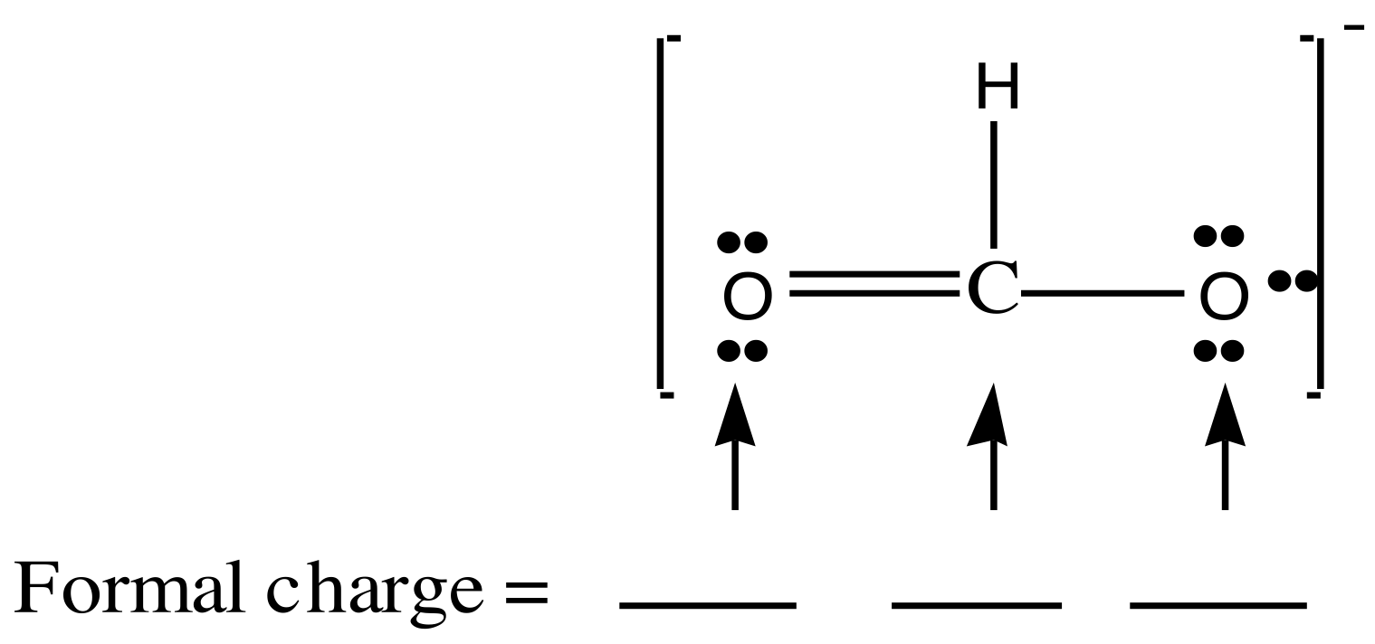

Determine the formal charges for the formate ion:
0 0 0
+1 –1 –1
+1 0 –1
0 0 –1
MAR
Enter your response on
your iClicker now!
Answer = D, 0, 0, -1
formal charge = GN - lpe - 0.5*bpe
GN = group number
lpe = lone pair electrons
bpe = bonding pair electrons
O on left:
fc = 6 - 4 - 0.5(4) = 0
C in middle:
fc = 4 - 0 - 0.5(8) = 0
O on right:
fc = 6 - 6 - 0.5(2) = -1

Slide 19
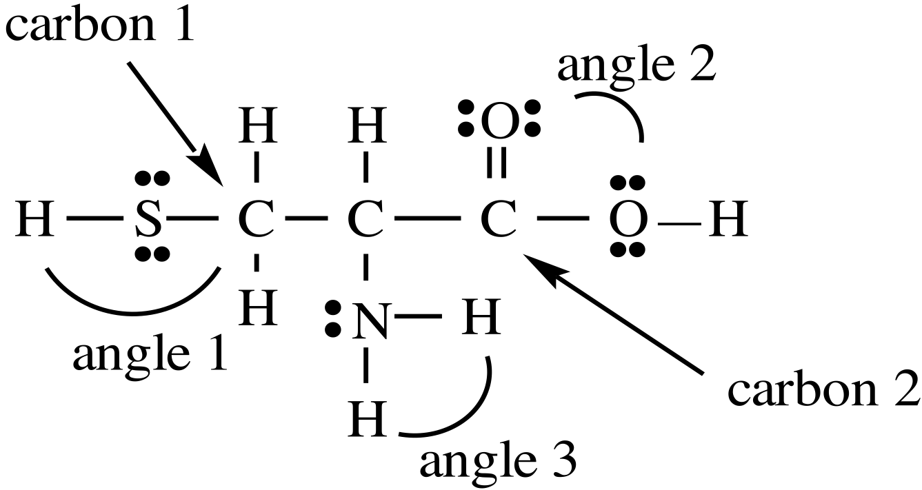
Cysteine is one of the natural amino acids.
Estimate the values of the indicated angles:
Angle 1 = 180˚ Angle 2 = 120˚ Angle 3 = 109˚
Angle 1 = 109˚ Angle 2 = 120˚ Angle 3 = 109˚
Angle 1 = 109˚ Angle 2 = 109˚ Angle 3 = 109˚
MAR
Enter your response on
your iClicker now!
Answer = B, Angle 1 = 109˚ Angle 2 = 120˚ Angle 3 = 109°
Angle 1 and 3: tetrahedral, 109°
Angle 2: trigonal planar, 120°

Slide 20
Which of the following could be an alkene?
CnH_{2n+2}O
CnH_{2n+2}
CnH_{2n}
CnH_{2n-2}
none of these
MAR
Enter your response on
your iClicker now!
Answer = C, CnH2n
Alkenes have a double bond between two carbons,
no oxygen

Slide 21
A sample of gas has a volume of 222 mL at 695 mm Hg and 0 °C. What would be the volume of this same sample of gas if it were measured at 333 mm Hg and 0 °C?
894 mL
463 mL
657 mL
359 mL
-155 mL
MAR
Answer = B, 463 mL
Can use "combined gas law",
P1V1/T1 = P2V2/T2
convert T to Kelvin (or just cancel! :), solve for V2:
V2 = P1V1T2/P2T1
V2 =695 mm Hg*222 mL * 273 K / 333 mm Hg * 273 K
V2 = 463 mL
Enter your response on
your iClicker now!

Slide 22
Gas density: Which has the greatest density at 25 °C and 1.00 atm pressure?
O₂ 32 g/mol
N₂ 28 g/mol
H₂ 2 g/mol
CO₂ 44 g/mol
Xe 131 g/mol
MAR
Answer = E, Xe
PM = dRT, or
Molar mass (M) proportional
to density (d),
largest M, largest d (at same T and P)
Largest M = Xe,
Xe has greatest density!
PM = dRT also used to find molar mass of unknown gas (d = g/L)
Enter your response on
your iClicker now!

Slide 23
Under what conditions will the ideal gas law be least effective?
high temperature and high pressure
high temperature and low pressure
low temperature and high pressure
low temperature and low pressure
it works all the time
MAR
Answer = C, low temperature and high pressure
Use Van Der Waals equation under non-ideal gas conditions
Enter your response on
your iClicker now!

Slide 24
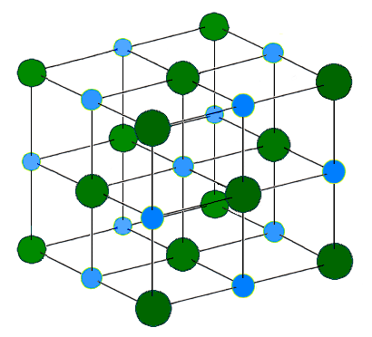
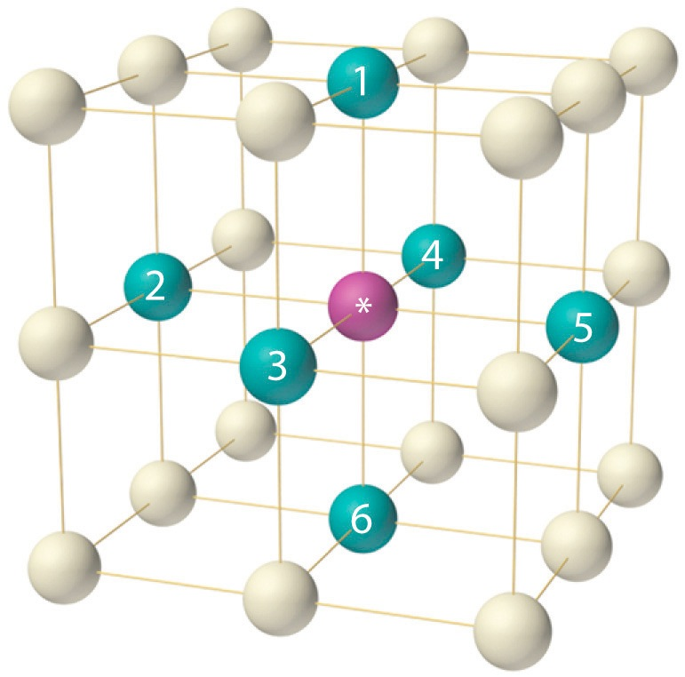
In the diagram for NaCl, the smaller blue atoms are Na and the larger green atoms are Cl. How many nearest neighbors of Cl does each Na have?
8
6
4
2
1
MAR
Answer = B, 6
6 Cl atoms "surround" each Na in an "octahedral" environment
Enter your response on
your iClicker now!

Slide 25
Which water-based solution is expected to have the higher boiling point?
0.10 molal NaCl
0.15 molal sugar
both the same
not enough information
MAR
Enter your response on
your iClicker now!
Answer = A, 0.10 m NaCl
∆T = kbp m i
i = 1 (sugar), i = 2 (NaCl, theoretical value)
Both have same k (H2O), so
∆T α m*i
∆T α 0.10 m*2 = 0.20 (NaCl)
∆T α 0.15 m*1 = 0.15 (sugar)
NaCl larger, higher boiling point

Slide 26
Erythritol occurs naturally in algae and fungi. A solution of 2.50 g of erythritol in 50.0 g of water freezes at -0.762 °C. What is the molar mass of the compound? (k_{fp}(H2O) = -1.86 °C/m)
26.9 g/mol
35.5 g/mol
122 g/mol
224 g/mol
0.0100 g/mol
MAR
Answer = C, 122 g/mol
solution = erythritol (solute) + water (solvent)
Use: ∆T = kfp m i, solve for m (i = 1)
m = ∆T/kfp = -0.762°C/-1.86 °C/m = 0.410 m
(0.410 mol / kg H2O) * 0.0500 kg H2O = 0.0205 mol
2.50 g / 0.0205 mol erythritol= 122 g/mol
Enter your response on
your iClicker now!

Slide 27
Given the initial rate data for the reaction A + B → C, determine the rate expression for the reaction.
[A] (M) [B] (M) ∆[C]/∆t (M/s)
0.10 0.20 40.
0.20 0.20 80.
0.10 0.10 40.
∆[C]/∆t = 2000[A][B]
∆[C]/∆t = 40.[A]²
∆[C]/∆t = 4.0[B]
∆[C]/∆t = 400[A]
∆[C]/∆t = #1[AC/DC]
MAR
Enter your response on
your iClicker now!
Answer = D, ∆[C]/∆t = 400[A]
rate = ∆[C]/∆t,
find orders, then k value
trial 1 vs. trial 2: [A] doubles, [B] constant, rate doubles;
∴ [A] first order
trial 3 vs. trial 1: [B] doubles, [A] constant, rate constant;
∴ [B] zero order
rate = ∆[C]/∆t = k[A]
now find k; use trial 1,
k = rate / [A] = 40./0.10 = 400, so
rate = ∆[C]/∆t = 400[A]

Slide 28
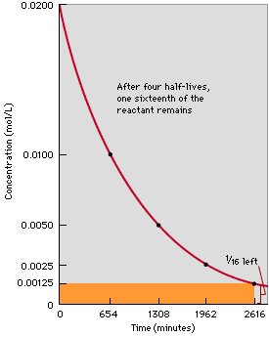
Using the graph, determine the half life of this reaction.
654 minutes
1308 minutes
1962 minutes
2616 minutes
0 minutes
MAR
Enter your response on
your iClicker now!
Answer = A, 654 minutes
half life is the time required for half of a sample to disappear

Slide 29
Radioactive iodine-131 is used to treat hyperthyroidism. It has a half-life of 8.04 days. If you begin with 8.8 micrograms, what mass remains after 32.3 days?
4.4 micrograms
2.2 micrograms
1.1 micrograms
0.54 micrograms
0.23 micrograms
MAR
Enter your response on
your iClicker now!
Answer = D, 0.54 micrograms
Use: ln (A/A0) = -kt
and
t1/2 = 0.693/k
k = 0.693 / t1/2, so:
ln (A/A0) = -(0.693/t1/2)t
ln (A/8.8μg) = -(0.693/8.04d)32.3d
solve for A:
ln (A / 8.8 μg) = -2.7841
(A / 8.8 μg) = 0.061785
A= 0.061785*8.8 μg
A = 0.54 μg

Slide 30
The reaction of NO₂(g) and CO(g) is thought to occur in two steps.
Step 1 Slow NO₂(g) + NO₂(g) → NO(g) + NO₃(g)
Step 2 Fast NO₃(g) + CO(g) → NO₂(g) + CO₂(g)
Which species is acting as a catalyst in this mechanism?
NO2
NO
CO
CO2
NO3
MAR
Enter your response on
your iClicker now!
Answer = A, NO2
Catalysts are "used up" in initial step and "re-created" in the last step
NO2 is "self-catalyzing"
NO3 is a reaction intermediate

Slide 31
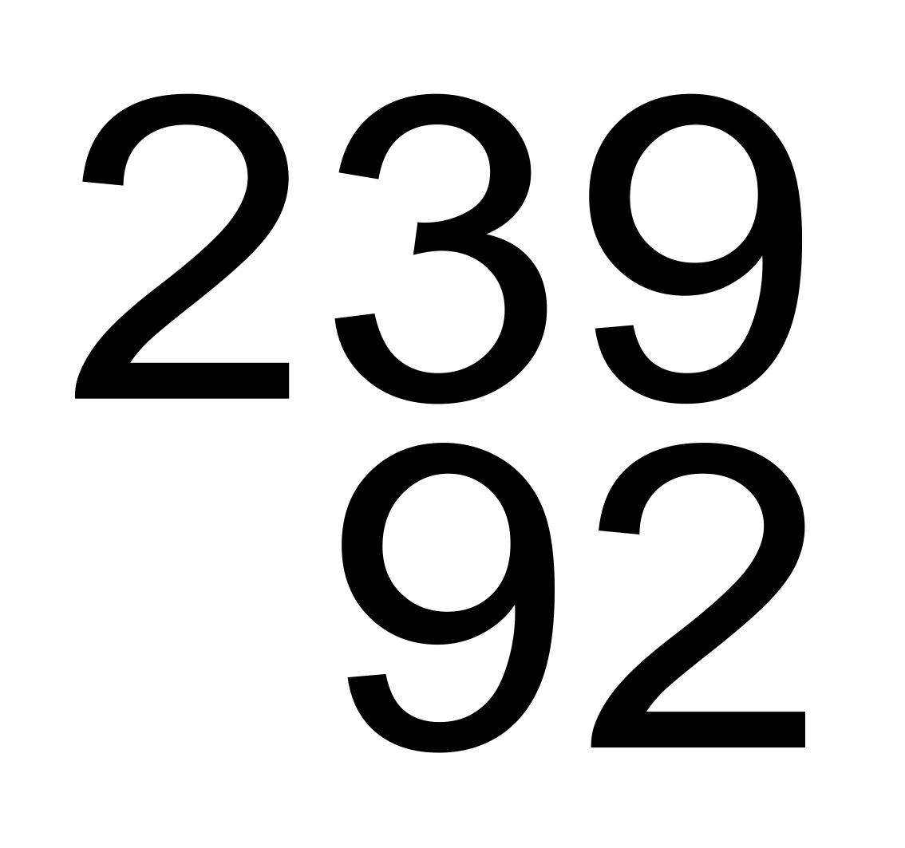
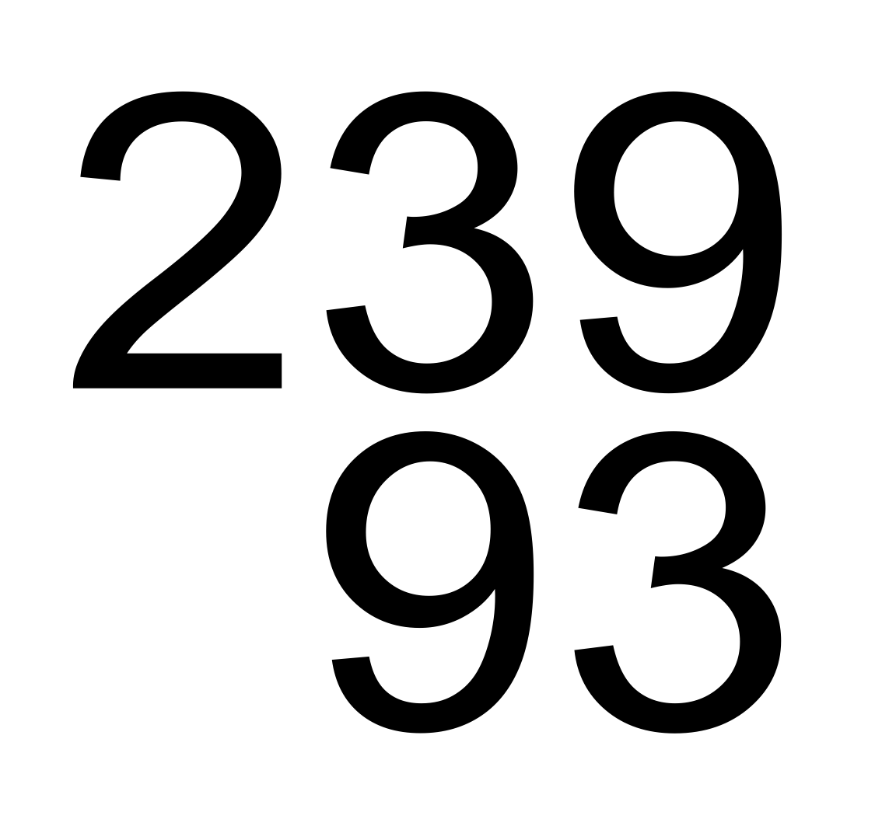
What is the unknown particle in the following nuclear reaction?
U → particle + Np
alpha
beta
gamma
neutron
positron
MAR
Enter your response on
your iClicker now!
Answer = B, beta
Sum of atomic numbers (Z) must match on both sides; same for mass numbers (A)
Atomic numbers:
92 = Z + 93, so Z = -1
Mass numbers:
239 = A = 239, so A = 0
particle is: -1⁰β, a beta particle
beta particle emission increases the atomic number!
Notes:
Non-video version!
Video: “Song of the Chemist” from Goshen College, https://www.youtube.com/watch?v=aaG2VmF0RL4#t=51, accessed April 27, 2015

Slide 32
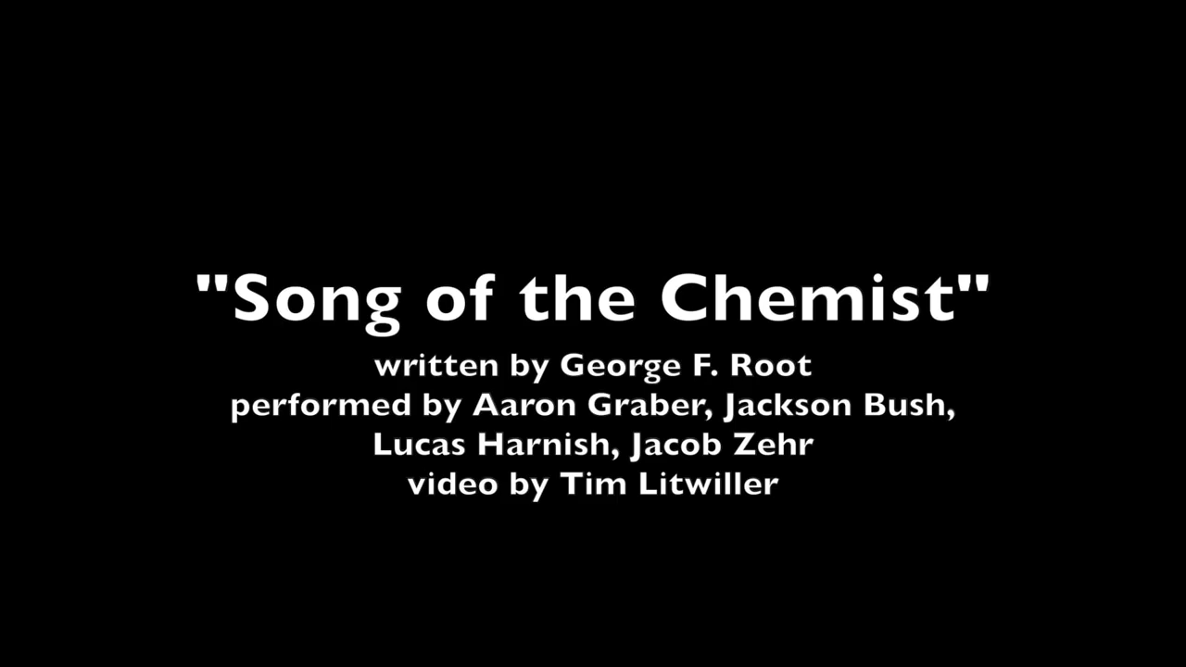
What is the unknown particle in the following nuclear reaction?
U → particle + Np
alpha
beta
gamma
neutron
positron
MAR
Enter your response on
your iClicker now!
Answer = B, beta
Sum of atomic numbers (Z) must match on both sides; same for mass numbers (A)
Atomic numbers:
92 = Z + 93, so Z = -1
Mass numbers:
239 = A = 239, so A = 0
particle is: -1⁰β, a beta particle
beta particle emission increases the atomic number!
Notes:
Video: “Song of the Chemist” from Goshen College, https://www.youtube.com/watch?v=aaG2VmF0RL4#t=51, accessed April 27, 2015

Slide 33
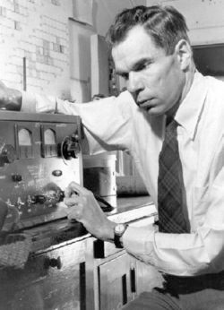
“There is beauty in discovery.
“There is mathematics in music, a kinship of science and poetry in the description of nature, and exquisite form in the molecule.
“Attempts to place different disciplines in different camps are revealed as artificial in the face of the unity of knowledge.
“All literate men and women are sustained by the philosopher, the historian, the political analyst, the economist, the scientist, the poet, the artisans and the musicians.
“It's the whole that counts.”
Glenn Seaborg, on being appointed UC Berkeley chancellor in 1958, reassuring the faculty that his interests extended beyond science:
MAR
Notes:
Video: “Song of the Chemist” from Goshen College, https://www.youtube.com/watch?v=aaG2VmF0RL4#t=51, accessed April 27, 2015

Slide 34
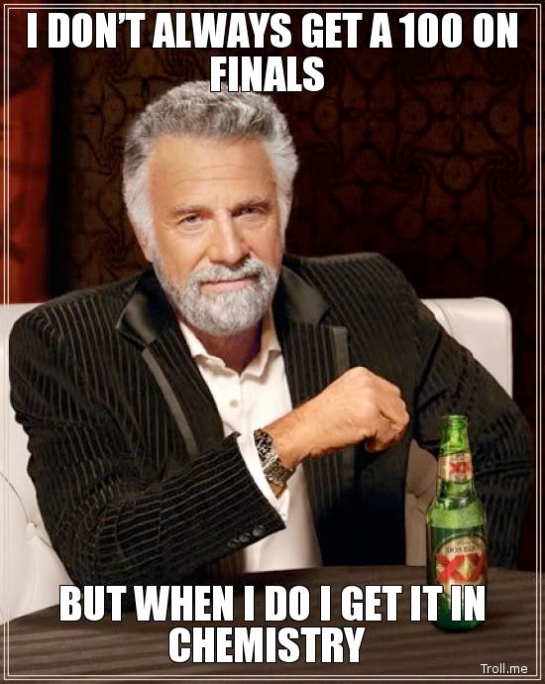
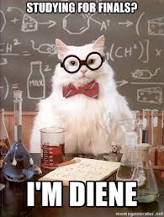
End of
Review -
good luck
with your
studying!
Need more practice?
Practice Problem Sets (Companion and online)
Concept Guides (Companion and online)
Chapter Guides (online)
End of Chapter Problems in Textbook (every other question has answer at end)
Good luck with your studying!
MAR

