Slide 1
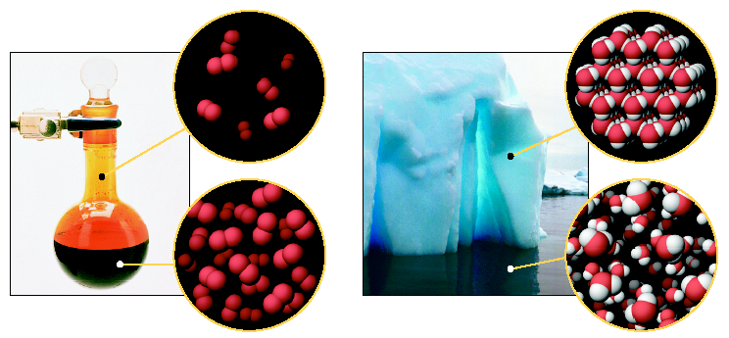
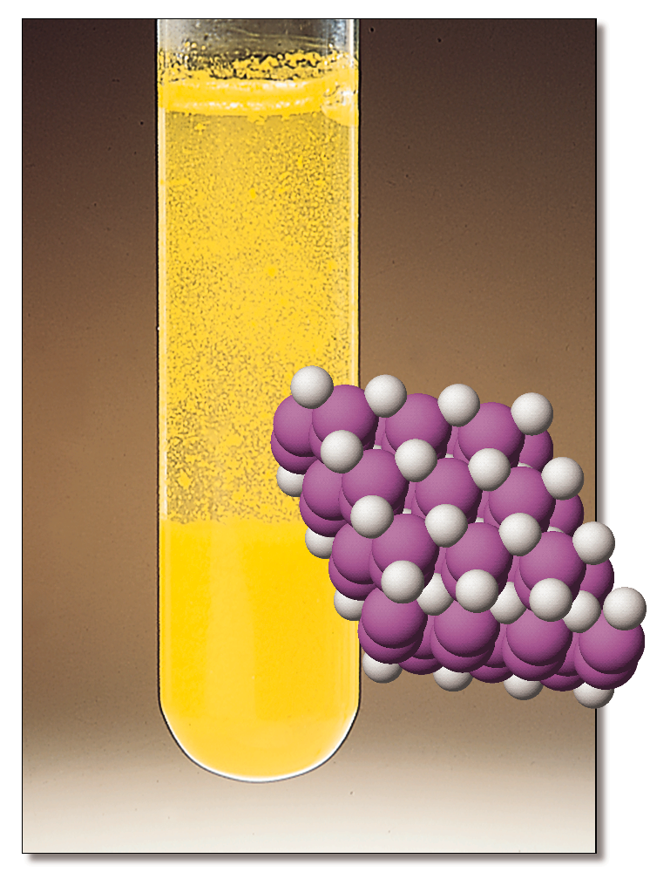
Chemistry 223 Exam II Review Chapters 15, 16 and 17
Chemistry 223
Professor Michael Russell
MAR
Last update:
4/29/24

Slide 2
Midterm II
Chapters 15, 16 and 17
Bring: calculator, pencil, scantron (50 questions / side, 100 questions total), "Qualitative Analysis of Group I Cations" lab, Exam Prep II - no open toed shoes! Safety glasses!
20 multiple choice questions, four short answer questions, ~2 hours in length
Returned Friday with "summary sheet"
Good luck with your studying!
Let's start the review!
MAR

Slide 3
Midterm II
Chapters 15, 16 and 17
For this online exam:
20 multiple choice questions, 3-4 short answer questions
Released Wednesday night, due Friday at 9 AM via email
Returned with "summary sheet" at end
Good luck with your studying!
Let's start the review!
MAR

Slide 4
Midterm II
Chapters 15, 16 and 17
For this "face to face" class (01 & H1):
Bring: calculator, pencil, "notes sheet" "Determination of Ksp.... for Ca(OH)2" lab, Exam Prep Worksheet II
20 multiple choice questions, 4 short answer questions, ~2 hours in length
Returned following lab period with "summary sheet" Good luck with your studying!
Let's start the review!
MAR

Slide 5
Midterm II
Chapters 15, 16 and 17
If this is an online class:
20 multiple choice questions, 3-4 short answer questions
Due Friday at 9 AM via email
Returned with "summary sheet" at end
Good luck with your studying!
Let's start the review!
MAR

Slide 6
Decide if a precipitate will form when mixing the indicated reagents (all concentrations are 1.0 M).
KCl(aq) + Pb(NO₃)₂(aq) → ?
Yes
No
Who knows!
MAR
Answer = A, Yes
Double displacement / precipitation reaction:
2 KCl(aq) + Pb(NO₃)₂(aq) → PbCl2(s) + 2 KNO3(aq)
Net ionic equation;
Pb²⁺(aq) + 2 Cl⁻(aq) → PbCl2(s)
Cl⁻¹, Br⁻¹, I⁻¹: soluble except with Ag⁺, Pb²⁺, Hg2⁺²
Enter your response on
your i>Clicker now!

Slide 7
If the solubility of BaF₂ is 3.6 x 10⁻³, a reasonable value for K_{sp} for BaF₂ is
3.6 x 10⁻³
7.2 x 10⁻³
1.1 x 10⁻²
1.9 x 10⁻⁷
4.7 x 10⁻⁸
MAR
Enter your response on
your i>Clicker now!
Answer = D, 1.9 x 10⁻⁷
solubility = x
Ksp = [Ba²⁺][F⁻]² = (x)(2x)² = 4x³
Ksp = 4*(3.6x10⁻³)³ = 1.9 x 10⁻⁷

Slide 8
Which lead salt has the greatest molar solubility in water at 25 °C?
PbCO₃ K_{sp} = 1.5 x 10⁻¹³
PbS K_{sp} = 8.4 x 10⁻²⁸
PbSO₄ K_{sp} = 1.8 x 10⁻⁴
MAR
Answer = C, PbSO4
Technically, solubility (x) = √Ksp for 1:1 complexes...
...but all of these are 1:1 complexes (one cation: one anion)
Largest solubility will come from largest Ksp value,
largest Ksp is PbSO4
Enter your response on
your i>Clicker now!

Slide 9
A solution contains 0.10 M K₂SO₃ and 0.30 M Na₂SO₄. Solid Ca(NO₃)₂ is added slowly. Which precipitates first, CaSO₃ or CaSO₄?
K_{sp} for CaSO₃ = 1.3 x 10⁻⁸ K_{sp} for CaSO₄ = 2.4 x 10⁻⁵
CaSO₃
CaSO₄
42
MAR
Answer = A, CaSO3
CaSO3: smaller Ksp, predict precipitates first
Find [Ca²⁺] required to begin precipitation:
CaSO3: Ksp / [SO3²⁻] = 1.3 x 10⁻⁸ / 0.10 M = 1.3 x 10⁻⁷ M Ca²⁺
CaSO4: Ksp / [SO4²⁻] = 2.4 x 10⁻⁵ / 0.30 M = 8.0 x 10⁻⁵ M Ca²⁺
Less [Ca²⁺] needed for CaSO3,
CaSO3 precipitates first!
Enter your response on
your i>Clicker now!

Slide 10
CaSO3 precipitates first as Ca²⁺ ions are added to a solution containing 0.10 M K₂SO₃ and 0.30 M Na₂SO₄. What is [SO3²⁻] as the CaSO₄ begins to precipitate?
K_{sp}(CaSO₃) = 1.3 x 10⁻⁸ K_{sp}(CaSO₄) = 2.4 x 10⁻⁵
0.10 M
0.30 M
1.6 x 10⁻⁴ M
5.4 x 10⁻⁴ M
42
MAR
Answer = C, 1.6 x 10⁻⁴ M
Find [Ca²⁺] as CaSO4 precipitates:
[Ca²⁺] = Ksp / [SO4²⁻] = 2.4 x 10⁻⁵ / 0.30 M
[Ca²⁺] = 8.0 x 10⁻⁵ M Ca²⁺
Use this value to calculate new [SO3²⁻]
using Ksp for CaSO3:
[SO3²⁻] = Ksp / [Ca²⁺] = 1.3 x 10⁻⁸ / 8.0 x 10⁻⁵ M
[SO3²⁻] = 1.6 x 10⁻⁴ M
Enter your response on
your i>Clicker now!

Slide 11
What is the pH of a saturated solution of Mg(OH)₂? (K_{sp} (Mg(OH)₂) = 5.6 x 10⁻¹²)
3.65
8.37
10.35
0.15
11.25
MAR
Enter your response on
your i>Clicker now!
Answer = C, 10.35
Find solubility from Ksp, then [OH⁻] and pH
Mg(OH)2(s) ⇄ Mg²⁺(aq) + 2 OH⁻(aq)
Ksp = [Mg²⁺][OH⁻]² = (x)(2x)² = 4x³ (x = solubility)
x = (Ksp/4)^{(1/3)} = (5.6E-12/4)^{(1/3)} = 1.1 x 10⁻⁴ M
[OH⁻] = 2x = 2.2 x 10⁻⁴ M
[H3O⁺] = Kw / [OH-] = E-14/2.2E-4 = 4.5 x 10⁻¹¹ M
pH = - log [H3O⁺] = - log (4.5E-11) = 10.35

Slide 12
A solution has [Pb²⁺] = 0.0012 M and [Cl⁻] = 0.010 M. Will PbCl₂ precipitate?
K_{sp} (PbCl₂) = 1.7 x 10⁻⁵
Yes, PbCl₂ precipitates
No, PbCl₂ does NOT precipitate
MAR
Enter your response on
your i>Clicker now!
Answer = B, No, PbCl2 does NOT precipitate
Determine Q, compare to Ksp
Q = [Pb²⁺][Cl⁻]² = (0.0012)(0.010)² = 1.2 x 10⁻⁷
Q (1.2 x 10⁻⁷) is less than Ksp (1.7 x 10⁻⁵),
Q < Ksp, no precipitate

Slide 13
Which of the following shows the correct formation constant (Kf) equation for Cr(CN)6³⁻?
Cr(CN)3(s) + 3 CN⁻¹(aq) ⇄ Cr(CN)6³⁻(aq)
Cr(NO3)3(s) + 6 NaCN(aq) ⇄ Cr(CN)6³⁻(aq) + 3 NaNO3(aq) + 3 Na⁺(aq)
Cr(CN)6³⁻(s) ⇄ Cr³⁺(aq) + 6 CN⁻¹(aq)
Cr(CN)6³⁻(aq) ⇄ Cr³⁺(aq) + 6 CN⁻¹(aq)
Cr³⁺(aq) + 6 CN⁻¹(aq) ⇄ Cr(CN)6³⁻(aq)
MAR
Enter your response on
your i>Clicker now!
Answer = E,
Kf equations: complex ion is product,
ions are reactants

Slide 14
Calculate the standard entropy change for the following reaction: CCl₄(l) + O₂(g) → CO₂(g) + 2 Cl₂(g)
* S°[CCl₄(l)] = 214.39 J/K • mol
* S°[CO₂(g)] = 213.74 J/K • mol
* S°[O₂(g)] = 205.07 J/K • mol
* S°[Cl₂(g)] = 223.08 J/K • mol
-17.36 J/K
+17.36 J/K
+240.44 J/K
-25.78 J/K
42
MAR
Answer = C, 240.44 J/K
∆S°rxn = ΣS°products - ΣS°reactants
∆S°rxn = {S°(CO2(g)) + 2*S°(Cl2(g))} - {S°(CCl4(l)) + S°(O2(g))}
∆S°rxn = {213.74 + 2*223.08} - {214.39 + 205.07}
∆S°rxn = 240.44 J/K
Enter your response on
your i>Clicker now!

Slide 15
Calculate ∆Grxn° for the following reaction: CH₄(g) + 2 O₂(g) → CO₂(g) + 2 H₂O(g) * ∆G_{f}°[CO₂(g)] = -394.4 kJ/mol * ∆G_{f}°[CH₄(g)] = -50.8 kJ/mol * ∆G_{f}°[H₂O(g)] = -228.6 kJ/mol
572.2 kJ/mol•rxn
-673.7 kJ/mol•rxn
-572.2 kJ/mol•rxn
-436.4 kJ/mol•rxn
-800.8 kJ/mol•rxn
MAR
Enter your response on
your i>Clicker now!
Answer = E, -800.8 kJ/mol•rxn
∆G°rxn = Σ∆G°products - Σ∆G°reactants
∆G°rxn = {∆G°(CO2(g)) + 2*∆G°(H2O(g))} - {∆G°(CH4(g)) + 2*∆G°(O2(g))}
∆G°rxn = {-394.4 + 2(-228.6}) - {-50.8 + 2*0}
∆G°rxn = -800.8 J/K
∆G°f for elements in standard states = 0

Slide 16
Given the following information, calculate ∆G° for the reaction below at 25 °C:
Mg(s) + 1/2 O₂(g) → MgO(s)
∆H° = -601.24 kJ/mol•rxn
∆S° = -108.36 J/K•rxn
664.5 kJ/mol•rxn
-568.9 kJ/mol•rxn
31700 kJ/mol•rxn
-528.3 kJ/mol•rxn
42
MAR
Enter your response on
your i>Clicker now!
Answer = B, -568.9 kJ/mol•rxn
∆G° = ∆H° - T∆S°
T in Kelvin, ∆S in kJ
∆G° = -601.24 kJ - 298 K * (-0.10836 kJ/K)
∆G° = -568.9 kJ/mol•rxn
Spontaneous reaction, enthalpy favored

Slide 17
A reaction has a ∆H° which is positive and a ∆S° which is positive. What can be said about the reaction spontaneity at different temperatures?
product favored at all temperatures
product favored only at high temperature
product favored only at low temperature
not product favored at any temperature
MAR
Enter your response on
your i>Clicker now!
Answer = B, product favored at high temperature
∆G° = ∆H° - T∆S°
Spontaneous means "negative ∆G"
Positive ∆H (endothermic) promotes nonspontaneity
Positive ∆S supports spontaneity
"High" temperatures make this reaction spontaneous
(i.e. when -T∆S > ∆H)

Slide 18
Calculate ∆G° at 25 °C for: 2 H₂O₂(l) → 2 H₂O(l) + O₂(g)
∆H˚(kJ/mol) S˚(J/K • mol) H₂O₂(l) -187.8 109.6 H₂O(l) -285.8 69.9 O₂(g) ----- 205.1
-157.9 kJ/mol•rxn
-192.3 kJ/mol•rxn
-37700 kJ/mol•rxn
-233.5 kJ/mol•rxn
42
MAR
Enter your response on
your i>Clicker now!
Answer = D, -233.5 kJ/mol•rxn
First: ∆H°rxn = Σ∆H°products - Σ∆H°reactants
Then: ∆S°rxn = ΣS°products - ΣS°reactants
Finally: ∆G°rxn = ∆H°rxn - T∆S°rxn
∆H°rxn = {2*∆H°(H2O(l)) + ∆H°(O2(g))} - {2*∆H°(H2O2(l))}
∆H°rxn = {2*-285.8 + 0} - {2*-187.8}
∆H°rxn = -196.0 kJ/mol
∆S°rxn = {2*S°(H2O(l)) + S°(O2(g))} - {2*S°(H2O2(l))}
∆S°rxn = {2*69.9 + 205.1} - {2*109.6}
∆S°rxn = 125.7 J/K•mol
∆G°rxn = ∆H°rxn - T∆S°rxn
∆G°rxn = -196.0 - 298K*0.1257
∆G°rxn = -233.5 kJ/mol•rxn

Slide 19
A reaction has ∆H = -96.0 kJ/mol and ∆S = -12.6 J/K•mol. If the temperature is increased slowly, at what temperature will this reaction become nonspontaneous?
It will never be spontaneous
7162 °C
762 K
7620 K
-57.6 K
MAR
Enter your response on
your i>Clicker now!
Answer = D, 7620 K
∆G°rxn = ∆H°rxn - T∆S°rxn
Let ∆G = 0, find threshold T:
∆G°rxn = 0 = ∆H°rxn - T∆S°rxn
∆H°rxn = T∆S°rxn
T = ∆H°rxn / ∆S°rxn
T = -96.0 kJ/mol / -0.0126 kJ/K•mol
T = 7620 K (7350 °C)

Slide 20
Barium sulfite is poorly soluble in water with a K_{sp} value of 8.0 x 10⁻⁷. What is ∆G° at 25 °C?
15.1 kJ/mol•rxn
34.8 kJ/mol•rxn
-34.8 kJ/mol•rxn
343 kJ/mol•rxn
42
MAR
Enter your response on
your i>Clicker now!
Answer = B, 34.8 kJ/mol•rxn
∆G° = -RT ln K
∆G° = -8.3145 * 298 K ln 8.0 x 10⁻⁷
∆G° = 34,800 J/mol•rxn = 34.8 kJ/mol•rxn

Slide 21
Balance the following reaction (pH = 8.37):
MnO4⁻ + I⁻ → MnO2 + I2
MnO4⁻ + 2 I⁻ → MnO2 + I2 + O2²⁻
8 H⁺ + 2 MnO4⁻ + 6 I⁻ → 2 MnO2 + 3 I2 + 4 H2O
8 H2O + 4 MnO4⁻ + 12 I⁻ → 4 MnO2 + 6 I2 + 16 OH⁻
4 H2O + 2 MnO4⁻ + 6 I⁻ → 2 MnO2 + 3 I2 + 8 OH⁻
MAR
Enter your response on
your i>Clicker now!
Answer = D
Balance in acid first, then base
MnO4⁻ + 4 H⁺ + 3 e- → MnO2 + 2 H2O
2 I⁻¹ → I2 + 2 e⁻
Multiply first *2, second *3, add together, no electrons:
2 MnO4⁻ + 8 H⁺ + 6 e- → 2 MnO2 + 4 H2O
6 I⁻¹ → 3 I2 + 6 e⁻
-------------------------------------
2 MnO4⁻ + 8 H⁺ + 6 I⁻¹ → 3 I2 + 2 MnO2 + 4 H2O (balanced for H⁺)
Neutralize in base, remove excess H2O
2 MnO4⁻ + 8 H⁺ + 8 OH⁻ + 6 I⁻¹ → 3 I2 + 2 MnO2 + 4 H2O + 8 OH⁻
2 MnO4⁻ + 8 H2O + 6 I⁻¹ → 3 I2 + 2 MnO2 + 4 H2O + 8 OH⁻
2 MnO4⁻ + 4 H2O + 6 I⁻¹ → 3 I2 + 2 MnO2 + 8 OH⁻

Slide 22
What is the strongest reducing agent in the list?
Half-Reaction E˚(V)
Ce⁴⁺(aq) + e- → Ce³⁺(aq) +1.61
Ag⁺(aq) + e- → Ag(s) +0.80
Hg₂²⁺(aq) + 2 e- → 2 Hg(ℓ) +0.79
Sn²⁺(aq) + 2 e- → Sn(s) -0.14
Ni²⁺(aq) + 2 e- → Ni(s) -0.25
Al³⁺(aq) + 3 e- → Al(s) -1.66
Ce⁴⁺
Al³⁺
Sn
Al
Jq
MAR
Enter your response on
your i>Clicker now!
Answer = D, Al
reducing agent = oxidized
table is listed as reductions
weakest reduction, best oxidation
Al → Al³⁺(aq) + 3 e⁻ E° = +1.66 V

Slide 23
Will Sn(s) reduce Ag⁺(aq) to Ag(s)?
Half-Reaction E˚(V)
Ag⁺(aq) + e- → Ag(s) +0.80
Sn²⁺(aq) + 2 e- → Sn(s) -0.14
Yes
No
Only if it feels like it
MAR
Answer = A, Yes
Positive E°cell values imply spontaneity
Flip Sn half reaction:
2 Ag⁺(aq) + 2 e- → 2 Ag(s) +0.80
Sn(s) → Sn²⁺(aq) + 2 e- +0.14
----------------------------------
2 Ag⁺(aq) + Sn(s) → 2 Ag(s) + Sn²⁺(aq)
E°cell = 0.80 + 0.14 = 0.94 V
Positive E, reaction occurs!
Enter your response on
your i>Clicker now!

Slide 24
Determine the equilibrium constant for the following reaction at 25 °C: Cl₂(aq) + 2I⁻(aq) → 2 Cl⁻(aq) + I₂(aq) E° = +0.825 V
1.31 x 10⁻²⁸
8.74 x 10¹³
8.03 x 10²⁷
0.217
-1.16 x 10⁵
MAR
Enter your response on
your i>Clicker now!
Answer = C, 8.03 x 10²⁷
∆G° = -RT ln K = - nFE°
ln K = nFE°/RT
ln K = (2 mol e⁻* 96485 * 0.825 V) / (8.3145 * 298 K)
ln K = 64.2527
K = e^{64.2527} = 8.03 x 10²⁷

Slide 25
A voltaic cell is created using the information below to be used in Alaska where the average temperature is 5.00 °C. Calculate the expected cell potential under these conditions.
Al(s) | Al³⁺(aq, 0.0010 M) || Ni²⁺(aq, 0.50 M) | Ni(s)
Ni²⁺(aq) + 2 e⁻ → Ni(s) -0.25 V
Al³⁺(aq) + 3 e⁻ → Al(s) -1.66 V
1.46 V
1.31 V
1.17 V
0.51 V
-1.91 V
MAR
Enter your response on
your i>Clicker now!
Answer = A, 1.46 V
Determine E° under standard conditions for:
2 Al(s) + 3 Ni²⁺(aq) → 2 Al³⁺(aq) + 3 Ni(s) (n = 6)
E° = +1.66 - 0.25 V = 1.41 V (flip Al)
Now use Nernst equation:
E = E° - (RT/nF) ln Q
E = 1.41 V - (8.3145*278 K/6*96485) ln ([Al³⁺]²/[Ni²⁺]³)
E = 1.41 V -(0.0039927) ln ([0.0010]²/[0.50]³)
E = 1.41 V -(0.0039927)*(-11.736)
E = 1.41 V + 0.046858
E = 1.46 V (1.456858…)

Slide 26
How long must a 2.00 amp current flow through a gold solution to convert 0.0100 mol of Au³⁺(aq) into Au(s)?
483 s
4.83 x 10⁴ s
965 s
1450 s
1 zillion s
MAR
Enter your response on
your i>Clicker now!
Answer = D, 1450 s
F = 96485 C/mol e⁻
A = C/s
0.0100 mol Au³⁺ * (3 mol e⁻/mol Au³⁺) * (96485 C/mol e⁻) * (s/2.00 C)
= 1450 s

Slide 27
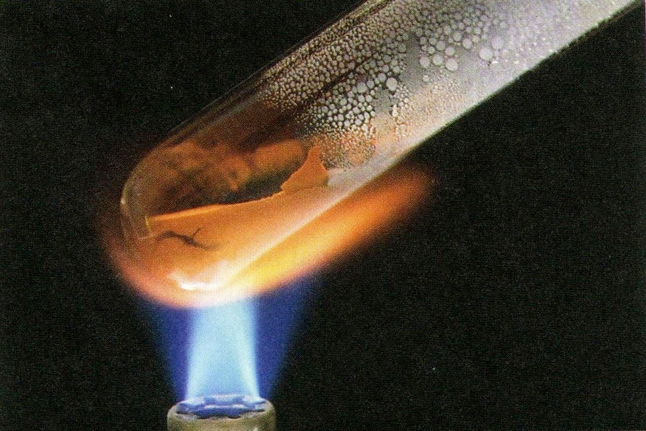
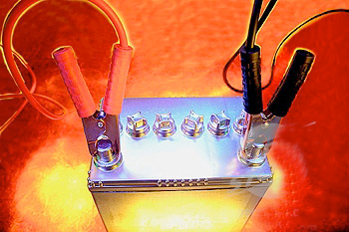
End of
Review -
good luck
with your
studying!
Need more practice?
Practice Problem Sets (online)
Concept Guides (Companion and online)
Chapter Guides (online)
End of Chapter Problems in Textbook (every other question has answer at end)
Good luck with your studying!
MAR

