Slide 1
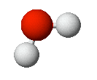
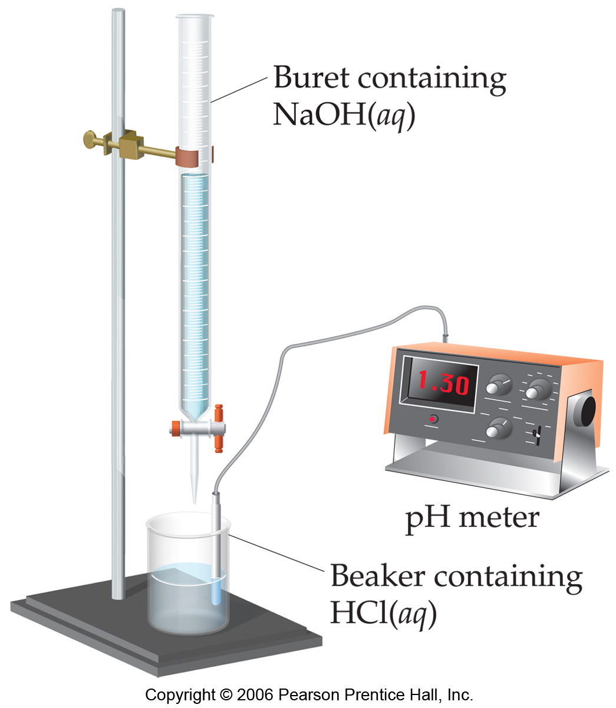
Chemistry 223 Exam I Review Chapters 13 and 14 ("Part I & II”)
+
Chemistry 223
Professor Michael Russell
MAR
Last update:
4/29/24

Slide 2
Midterm I
Chapters 13 & 14 (Pt. 1 & 2)
For this "face to face" class (01 & H1):
Bring: calculator, pencil, "notes sheet" "Acid & Base Titrations" lab, Exam Prep Worksheet I
20 multiple choice questions, 5 short answer questions, ~2 hours in length
Returned following lab period with "summary sheet" Good luck with your studying!
Let's start the review!
MAR

Slide 3
Midterm I
Chapters 13 & 14 (Pt. 1 & 2)
Bring: calculator, pencil, scantron (50 questions / side, 100 questions total), "Acid & Base Titrations" lab, Exam Prep I
20 multiple choice questions, four short answer questions, ~2 hours in length
Returned Friday with "summary sheet"
Good luck with your studying!
Let's start the review!
MAR

Slide 4
Midterm I
Chapters 13 & 14
For this online exam:
20 multiple choice questions, 3-4 short answer questions
Released Wednesday night, due Friday at 9 AM via email
Returned with "summary sheet" at end
Good luck with your studying!
Let's start the review!
MAR

Slide 5
Midterm I
Chapters 13 & 14
If this is an online class:
20 multiple choice questions, 3-4 short answer questions
Due Friday at 9 AM via email
Returned with "summary sheet" at end
Good luck with your studying!
Let's start the review!
MAR

Slide 6
We place 0.010 mol of N₂O₄(g) in a 2.0 L flask at 200 °C. After reaching equilibrium, [N₂O₄] = 0.0038 M. Calculate K_{c} for the following reaction:
N₂O₄ (g) ⇌ 2 NO₂(g)
1600
1.5 x 10⁻³
6.1 x 10⁻⁴
8.8 x 10⁻⁶
-3.1 x 10⁻³
 | N2O4 | NO2
initial | 0.0050 | 0
change | -x | +2x
equil | 0.0038 | 2x
MAR
Enter your response on
your i>Clicker now!
Answer = B,
1.5 x 10⁻³
x = 0.0050 - 0.0038
x = 0.0012
[NO2]eq = 2x = 0.0024
Kc = [NO2]² / [N2O4]
= (0.0024)² / (0.0038)
= 1.5 x 10⁻³

Slide 7
Given the following two equilibria:
NiCO₃(s) ⇌ Ni²⁺(aq) + CO₃²⁻(aq) K₁ = 6.6 x 10⁻⁹
HCO₃⁻(aq) + H₂O(l) ⇌ CO₃²⁻(aq) + H₃O⁺(aq) K₂ = 4.8 x 10⁻¹¹
calculate the equilibrium constant for the following reaction:
NiCO₃(s) + H₃O⁺(aq) ⇌ Ni²⁺(aq) + HCO₃⁻(aq) + H₂O(l)
7.3 x 10⁻³
3.2 x 10⁻¹⁹
140
1.8 x 10⁻⁹
1100
MAR
Enter your response on
your i>Clicker now!
Answer = C, 140
Reverse 2nd equation:
NiCO₃(s) ⇌ Ni²⁺(aq) + CO₃²⁻(aq)
CO₃²⁻(aq) + H₃O⁺(aq) ⇌ HCO₃⁻(aq) + H₂O(l)
carbonate cancels, get desired equation
take inverse of K2, multiply:
Knet = K1 * (1/K2) = 6.6 x 10⁻⁹ * (1/4.8 x 10⁻¹¹)
Knet = 140

Slide 8
H₂(g) + I₂(g) ⇌ 2 HI(g), Kc = 54.3
Initially, [H2] = 0.00623 M, [I2] = 0.00414 M, and [HI] = 0.0424 M. Find the equilibrium concentrations.
[H₂] = 0.00201 M, [I₂] = 0.00112 M, [HI] = 0.0643 M
[H₂] = 0.00222 M, [I₂] = 0.00168 M, [HI] = 0.0112 M
[H₂] = 0.00917 M, [I₂] = 0.00667 M, [HI] = 0.0212 M
[H₂] = 0.00676 M, [I₂] = 0.00467 M, [HI] = 0.0414 M
[H₂] = 0.00623 M, [I₂] = 0.00414 M, [HI] = 0.0424 M
 | H2 | I2 | HI
initial | 0.00623 | 0.00414 | 0.0424
change | +x | +x | -2x
equil | 0.00623 +x | 0.00414 + x | 0.0424 - 2x
MAR
Check!
Kc = (0.0414)²/{0.00676*0.00467}
Kc = 54.3
Enter your response on
your i>Clicker now!
H₂(g) + I₂(g) ⇌ 2 HI(g), Kc = 54.3
Initially, [H2] = 0.00623 M, [I2] = 0.00414 M, and [HI] = 0.0424 M. Find the equilibrium concentrations.
Step 1: Find direction of reaction using Q:
Q = [HI]²/[H2][I2] = (0.0424)² / (0.00623*0.00414) = 69.7
Q > K, reaction shifts left, toward reactants
Step 2: ICE Table:
Hint:
1 - compare Q vs K to find directionality of reaction
2 - Use ICE table to solve for equilibrium concentrations
K = [HI]²/[H2][I2] = (0.0424 - 2x)² / {(0.00623 + x)(0.00414 +x)} = 54.3
1.80E-3 - 0.170x + 4x² = 54.3{2.58E-3 + 1.04E-2x + x²}
50.3x² + 0.735x - 4.00E-4 = 0, solve quadratic formula
x = 5.25E-4 or x = -0.0151 ...no negative mass! x = 5.25E-4, so:
[H2] = 0.00623 + 5.25E-4 = 0.00676 M
[I2] = 0.00414 + 5.25E-4 = 0.00467 M
[HI] = 0.0424 - 2*5.25E-4 = 0.0414 M
Answer = D, [H₂] = 0.00676 M, [I₂] = 0.00467 M, [HI] = 0.0414 M

Slide 9
∆Hº = –18.8 kJ, K_{c} = 10.5, for:
2 CH₂Cl₂(g) ⇌ CH₄(g) + CCl₄(g)
If the temperature on the equilibrium system is suddenly decreased, the value of K_{c}:
increases
decreases
remains the same
MAR
Enter your response on
your i>Clicker now!
Answer = A, increases
Exothermic (∆H is negative), so:
2 CH₂Cl₂(g) ⇌ CH₄(g) + CCl₄(g) + heat
Temperature lowered, heat is "taken away",
Le Chatelier's Principle predicts shift to side with heat, shift to product side (right)
More products, less reactants,
K increases

Slide 10
You add 0.535 g of NaOH (MM = 40.0 g mol⁻¹) to 100.0 mL of water at 25 °C. What is [H₃O⁺] in this solution?
0.134 M
7.48 x 10⁻¹⁴ M
1.34 x 10¹³ M
6.87 x 10⁻¹² M
MAR
Enter your response on
your i>Clicker now!
Answer = B, 7.48 x 10⁻¹⁴ M
[H3O⁺] = Kw / [OH⁻]
[OH⁻] = 0.535 g * (mol / 40.0 g) / 0.100 L
[OH⁻] = 0.13375 M
[H3O⁺] = Kw / [OH⁻] = 10⁻¹⁴ / 0.13375 M
[H3O⁺] = 7.48 x 10⁻¹⁴ M

Slide 11
Considering only H₂S (Ka = 1 x 10⁻⁷) and HCN (Ka = 4 x 10⁻¹⁰), predict in which direction the following equilibrium lies:
HCN(aq) + HS⁻(aq) ⇌ CN⁻(aq) + H₂S(aq)
equilibrium lies to the left
equilibrium lies to the right
equilibrium is perfectly balanced left and right
cannot be determined
MAR
Enter your response on
your i>Clicker now!
Answer = A, Equilibrium lies to the left
Larger Ka pushes to smaller Ka
Larger Kb also pushes to smaller Kb:
Kb (CN⁻¹) = 2.5 x 10⁻⁵
Kb (HS⁻¹) = 1.0 x 10⁻⁷

Slide 12
What is [H₃O⁺] in a 0.10 M solution of HCN at 25 °C? (K_{a} for HCN = 4.0 x 10⁻¹⁰)
1.6 x 10⁻⁹ M
6.3 x 10⁻⁶ M
2.0 x 10⁻⁵ M
4.0 x 10⁻¹¹ M
0.10 M
MAR
Enter your response on
your i>Clicker now!
Answer = B, 6.3 x 10⁻⁶ M
For WA, pH = - log (Ka * Ca)^{0.5}
pH = - log (4.0 x 10⁻¹⁰ * 0.10)^{0.5}
pH = 5.20
[H3O⁺] = 10^{-pH} = 10^{-5.20}
[H3O⁺] = 6.3 x 10⁻⁶ M

Slide 13
In a 0.15 M solution of Na₂CO₃, what are [H₃O⁺], [OH⁻] and the pH? K_{b} for CO₃²⁻ is 2.1 x 10⁻⁴.
 | [H₃O⁺] | [OH⁻] | pH
A. | 5.6 x 10⁻³ | 1.8 x 10⁻¹² | 5.61
B. | 1.8 x 10⁻¹² | 5.6 x 10⁻³ | 11.75
C. | 5.6 x 10⁻³ | 1.8 x 10⁻¹² | 11.75
D. | 1.8 x 10⁻¹² | 5.6 x 10⁻³ | 5.61
MAR
Enter your response on
your i>Clicker now!
In a 0.15 M solution of Na₂CO₃, what are [H₃O⁺], [OH⁻] and the pH? K_{b} for CO₃²⁻ is 2.1 x 10⁻⁴.
Answer = B, [H₃O⁺] = 1.8 x 10⁻¹² M, [OH⁻¹] = 5.6 x 10⁻³ M, pH = 11.75
For weak bases, pH = 14 + log (Kb * Cb)^{0.5}
pH = 14 + log (2.1 x 10⁻⁴ * 0.15 M)^{0.5} = 11.75
[H3O⁺] = 10^{-pH} = 10^{-11.75}
[H3O⁺] = 1.8 x 10⁻¹² M
[OH⁻] = Kw / [H3O⁺]
[OH⁻] = 10⁻¹⁴ / 1.8 x 10⁻¹² M
[OH⁻] = 5.6 x 10⁻³ M

Slide 14
Place the following acids in order of increasing acid strength.
(a) Anilinium ion, pK_{a} = 4.60
(b) Benzilic acid, pK_{a} = 3.09
(c) Chloroacetic acid, pK_{a} = 2.98
(d) Dibromophenol, pK_{a} = 8.06
a, b, c, d
d, c, b, a
c, b, a, d
d, a, b, c
a, c, d, c
MAR
Enter your response on
your i>Clicker now!
Answer = D: d, a, b, c
Acid strength increase = larger Ka value
Larger Ka value = lower pKa value
Place acids from highest to lowest pKa
pKa: 8.06 4.60 3.09 2.98
letters: d a b c

Slide 15
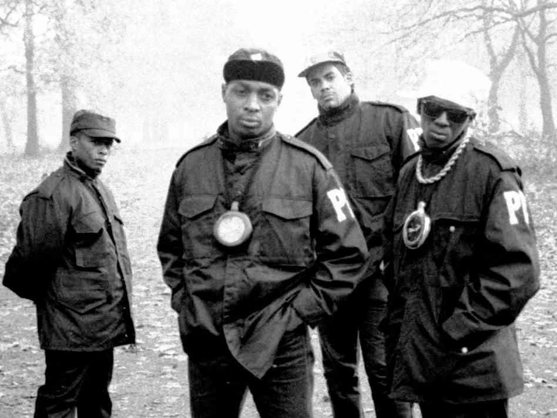
Classify the following as Lewis acids or bases.
BH3, NH3, Cl⁻¹, Al³⁺, Cr³⁺
acid, base, base, acid, acid
base, base, base, acid, acid
base, acid, acid, base, base
acid, base, acid, base, base
Public Enemy is #1!
MAR
Answer = A: acid, base, base, acid, acid
Lewis acids can accept electron pairs,
Lewis bases donate electron pairs
NH3 and Cl⁻¹ have lone pairs
BH3 - no lone pairs (and empty 2p orbital)
Group IIIA / transition metals have empty orbitals
Enter your response on
your i>Clicker now!

Slide 16
You have a solution of NH₄Cl. What effect will addition of NH₃ have on the pH of the solution?
increase pH
no effect
decrease pH
cannot tell from information given
MAR
Answer = A: Increase pH
NH3 is a base
Adding base increases pH
Enter your response on
your i>Clicker now!

Slide 17
You have a solution of NH₄Cl. What effect will addition of NaCl have on the pH of the solution?
increase pH
no effect
decrease pH
cannot tell from information given
MAR
Answer = B: no effect
NaCl contains Na⁺ and Cl⁻¹ ions
Na⁺ is conjugate of a strong base:
Na⁺ + H2O ← NaOH + H⁺
Cl⁻¹ is conjugate of a strong acid:
Cl⁻¹ + H2O ← HCl + OH⁻
Both reactions reactant favored,
no pH effect from Na⁺ and Cl⁻¹
Enter your response on
your i>Clicker now!

Slide 18
Which choice would be an ideal buffer solution?
0.20 M HCN and 0.10 M KCN
0.20 M HCl and 0.10 M KOH
0.20 M CH₃CO₂H and 0.10 M HCO₂H
0.10 HCl and 0.010 M KCl
0.10 M CH3OH and 0.10 M NaOH
MAR
Answer = A: 0.20 M HCN and 0.10 M KCN
Buffers must be weak acid/base conjugates
no strong acids or bases!
HCl and KOH strong systems
CH3CO2H has conjugate CH3CO2⁻¹
HCO2H has conjugate HCO2⁻¹
Enter your response on
your i>Clicker now!

Slide 19
What is the pH of a buffer that is composed of 0.20 M NH₄Cl and 0.20 M NH₃? (K_{a} for NH₄⁺ = 5.6 x 10⁻¹⁰)
4.85
5.65
7.00
9.25
10.05
MAR
Answer = D: 9.25
Use H-H equation:
pH = pKa + log ([NH3]/[NH4⁺])
pKa = - log Ka = - log (5.6 x 10⁻¹⁰) = 9.25
pH = pKa + log ([NH3]/[NH4⁺])
pH = 9.25 + log [(0.20 M)/(0.20 M)]
pH = 9.25 + (0)
pH = 9.25
Enter your response on
your i>Clicker now!

Slide 20
What is the pH of a buffer that is composed of 0.20 M NH₄Cl and 0.50 M NH₃? (K_{a} for NH₄⁺ = 5.6 x 10⁻¹⁰)
4.75
5.65
7.00
9.25
9.65
MAR
Answer = E: 9.65
Use H-H equation:
pH = pKa + log ([NH3]/[NH4⁺])
pKa = - log Ka = - log (5.6 x 10⁻¹⁰) = 9.25
pH = pKa + log ([NH3]/[NH4⁺])
pH = 9.25 + log [(0.50 M)/(0.20 M)]
pH = 9.25 + (+0.40)
pH = 9.65
More NH3 than previous problem,
pH is raised (more base)
Enter your response on
your i>Clicker now!

Slide 21
What volume of 0.10 M sodium acetate must be added to 100. mL of 0.10 M acetic acid (Ka = 1.8 x 10⁻⁵) to have a pH of 4.00?
100. mL
50. mL
36 mL
18 mL
9.0 mL
MAR
Answer = D: 18 mL
Use H-H equation:
pH = pKa + log (acetate/acetic acid)
pKa = - log Ka = - log (1.8 x 10⁻⁵) = 4.74
"acetate" = mol acetate = 0.10 M * Vace
"acetic acid" = mol HOAc = 0.100 L * 0.10 M
"acetic acid" = 0.010 mol
pH = pKa + log (acetate/acetic acid)
4.00 = 4.74 + log [(0.10 M * Vace)/0.010]
10^{-.74} = 0.182 = [(0.10 M * Vace)/0.010]
solve for Vace
Vace = 0.182 * 0.010 / 0.10 M = 0.0182 L
Vace = 18 mL
Enter your response on
your i>Clicker now!

Slide 22
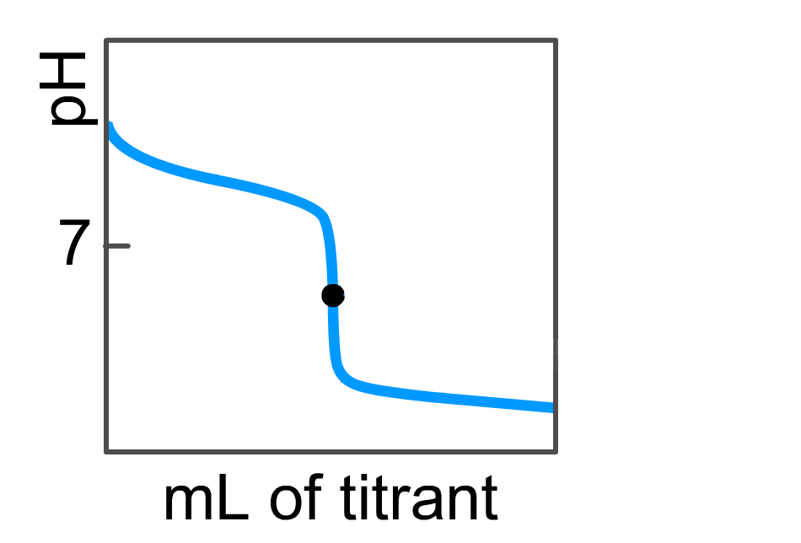
What type of titration does the graph below represent?
strong acid + strong base
strong base + strong acid
weak acid + strong base
weak base + strong acid
weak base + weak acid
pH scale: from 0 to 14
Volume scale: from 0 to 40 mL
O
MAR
Answer = D: weak base + strong acid
pH starts basic (> 7),
but equivalence point < 7,
must be a weak base
Ending pH very acidic, strong acid
Enter your response on
your i>Clicker now!

Slide 23
You mix 15.0 mL of 0.400 M HCl with 15.0 mL of 0.400 M NH₃. What is the pH of the resulting solution? (Kb = 1.8 x 10⁻⁵)
11.43
9.26
7.00
5.54
4.98
MAR
Enter your response on
your i>Clicker now!
Answer = E: 4.98
Find moles of SA and WB to discover titration region (and equation)
0.400 M * 0.0150 L = 0.00600 mol SA (HCl)
0.400 M * 0.015 L = 0.00600 mol WB (NH3)
Since mol WB = mol SA, this is the equivalence region, and pH should be < 7
pH = - log [(Kw/Kb)(nwb/(Vwb+Vsa))]^{0.5}
pH = - log [(10⁻¹⁴/1.8E-5)(0.00600/(0.0150+0.0150))]^{0.5}
pH = - log [(5.556E-10)(0.200M))]^{0.5}
pH = 4.98

Slide 24
0.40 g of NaOH (MM = 40. g/mol) are mixed with 100 mL of 0.10 M acetic acid. What is the pH of the resulting solution? (Ka = 1.8 x 10⁻⁵)
1.00
2.87
7.00
8.87
13.00
MAR
Enter your response on
your i>Clicker now!
Answer = D: 8.87
Find moles of WA and SB to discover titration region (and equation)
0.10 M * 0.100 L = 0.010 mol WA (HOAc)
0.40 g / 40. g/mol = 0.010 mol SB (NaOH)
Since mol SB = mol WA, this is the equivalence region, and pH should be > 7
pH = 14 + log [(Kw/Ka)(nwa/(VSb+Vwa))]^{0.5}
pH = 14 + log [(10⁻¹⁴/1.8E-5)(0.010/0.100)]^{0.5}
pH = 14 + log [(5.556E-10)(0.10M))]^{0.5}
pH = 8.87

Slide 25
What is the pH of the solution when 50. mL of 0.10 M HCl and 100. mL of 0.10 M NaCN are mixed? K_{a}(HCN) = 4.0 x 10⁻¹⁰
8.65
8.80
5.20
5.35
9.40
MAR
What is the pH of the solution when 50. mL of 0.10 M HCl and 100. mL of 0.10 M NaCN are mixed? K_{a}(HCN) = 4.0 x 10⁻¹⁰
Answer = E: 9.40
Find moles of SA and WB to discover titration region (and equation)
0.10 M * 0.0050 L = 0.0050 mol SA (HCl)
0.100 M * 0.10 L = 0.010 mol WB (NaCN)
Since mol WB > mol SA,
this is the pre-equivalence region, but...
notice: mol HCl = 0.5*mol WB
this is the half-equivalence region, and
pH = pKa
pKa = - log (4.0 x 10⁻¹⁰) = 9.40 = pH
pH = pKa for buffers, this is a buffer system!
Enter your response on
your i>Clicker now!

Slide 26
Add 40. mL of 0.50 M NaOH to 50.0 mL of 1.00 M NH₄Cl. What is the pH of the resulting solution? K_{b}(NH₃) = 1.8 x 10⁻⁵
4.56
4.74
7.00
9.08
10.70
MAR
Add 40. mL of 0.50 M NaOH to 50.0 mL of 1.00 M NH₄Cl. What is the pH of the resulting solution? K_{b}(NH₃) = 1.8 x 10⁻⁵
Answer = D: 9.08
Find moles of WA and SB to discover
titration region (and equation)
1.00 M * 0.0500 L = 0.0500 mol WA (NH4⁺)
0.50 M * 0.0400 L = 0.020 mol SB (NaOH)
Since mol SB < mol WA, this is the pre-equivalence region
pH = pKa + log [nsb/(nwa - nsb)]
pKa = 14 - pKb = 14 - (-log 1.8E-5)
pKa = 14 - 4.74 = 9.26
pH = pKa + log [nsb/(nwa - nsb)]
pH = 9.26 + log (0.020 / (0.0500 - 0.020)]
pH = 9.26 + (-0.176)
pH = 9.08
Enter your response on
your i>Clicker now!

Slide 27
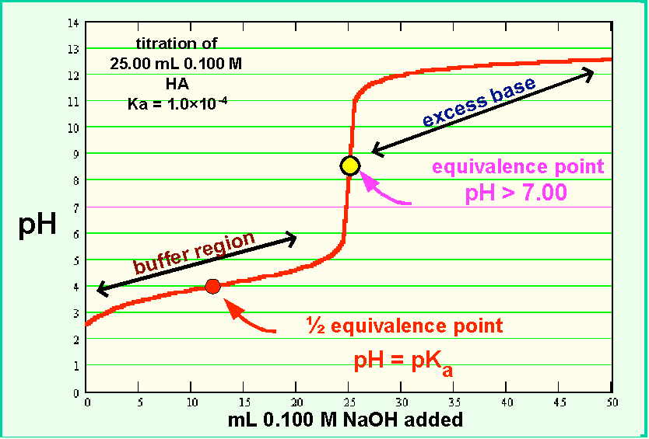
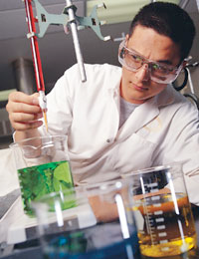
End of
Review -
good luck
with your
studying!
Need more practice?
Practice Problem Sets (online)
Concept Guides (Companion and online)
Chapter Guides (online)
End of Chapter Problems in Textbook (every other question has answer at end)
Good luck with your studying!
MAR

