Slide 1
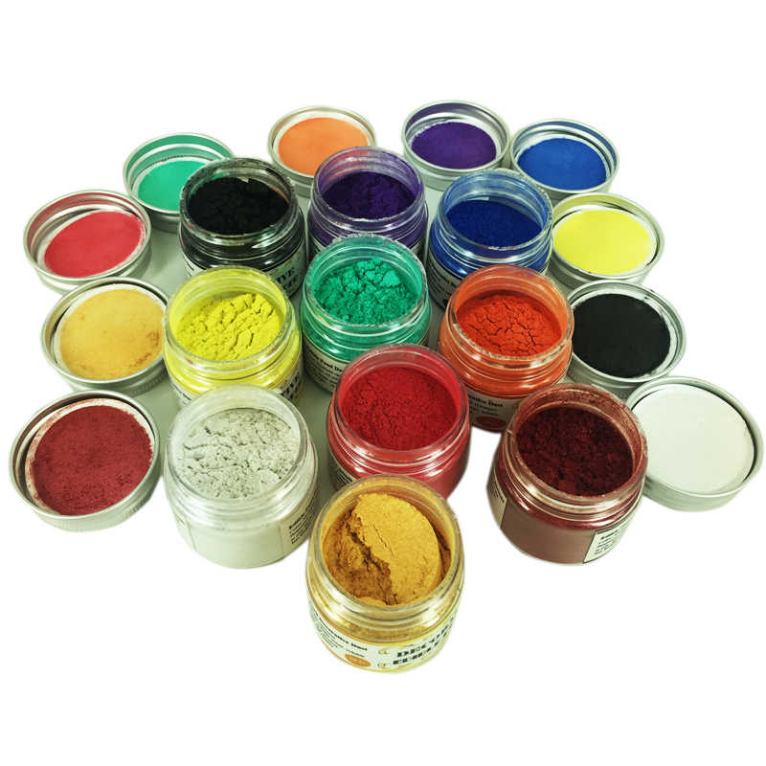
The Chemistry of the Main Group Elements Chapter 18
Chemistry 223
Professor Michael Russell
Last update:
4/29/24
MAR

Slide 2
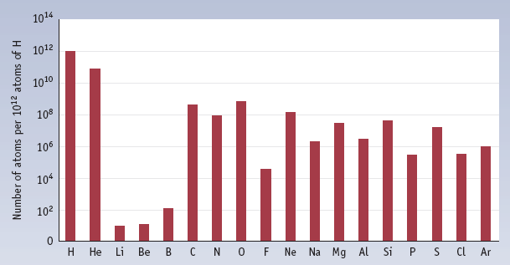
Abundance of Main Group Elements
Note low abundance of Li, Be, and B
See also alternation of abundance with atomic number.
Even atomic number = more abundant
MAR

Slide 3
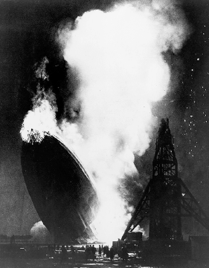
HYDROGEN CHEMISTRY
Hindenburg: A German dirigible filed with H₂ gas.
Hindenburg crashed in New Jersey after a trans-Atlantic flight in May, 1937.
Of 62 people, about half escaped uninjured.
MAR

Slide 4
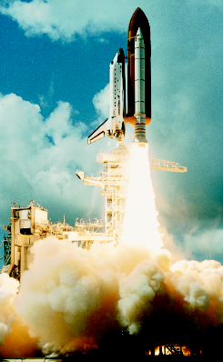
HYDROGEN CHEMISTRY
A modern use of H₂ in the Space Shuttle.
The rocket engine in the Shuttle itself is fueled by H₂ + O₂.
MAR

Slide 5
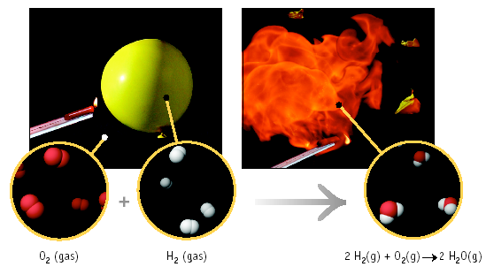
Hydrogen and Oxygen
MAR

Slide 6
Hydrogen Isotopes
¹H 1.007825 amu protium
²H = D 2.014102 deuterium
³H = T 3.016049 tritium
Half-life of tritium = 12.35 years
MAR

Slide 7
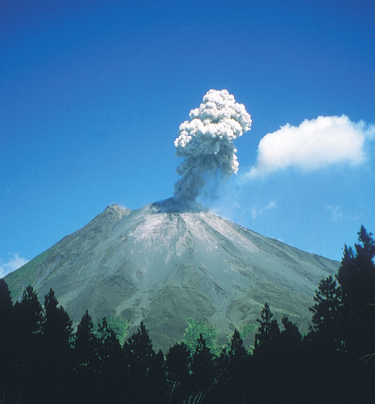
Tritium
The tritium content of ground water is used to discover the source of the water, for example, in municipal water or the source of the steam from a volcano.
MAR

Slide 8
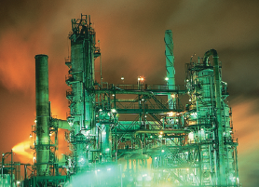
Water Gas
Also called “synthesis gas.”
Treat coal with steam
C + H₂O --> H₂ + CO
Synthesis gas is the mixture of H₂ and CO.
Much of the organic chemicals industry is changing to synthesis gas
MAR

Slide 9
Catalytic Steam Hydrocarbon Reforming
Most H₂ is now produced by the steam reforming process using methane.
C₃H₈ + 3 H₂O ⇌ 3 CO + 7 H₂
Done at 900 ˚C over a catalyst
Water gas shift reaction produces additional H₂ from CO
CO + H₂O → CO₂ + H₂
MAR

Slide 10
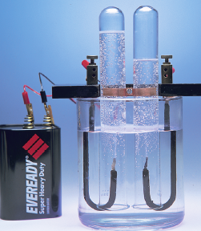
Electrolysis of Water
H₂O → H₂ + 1/2 O₂
Not widely used —
a) expensive
b) engineering problems
MAR

Slide 11
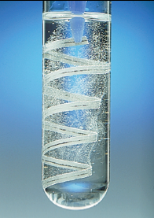
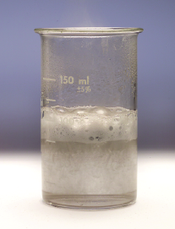
Lab Prep of H₂
Metal + Acid
Al + NaOH
MAR

Slide 12
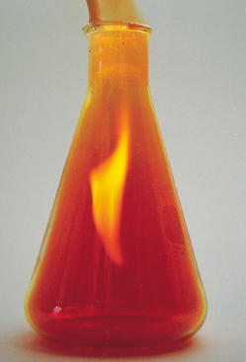
Reactions of H₂
Virtually every element (except Group 8) will form compounds with H.
See reaction with Br₂ to give HBr.
MAR

Slide 13
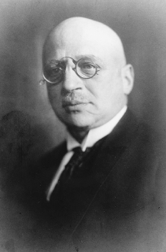
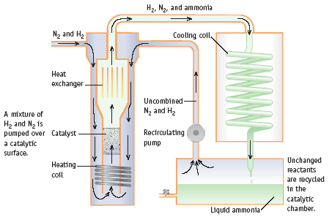
Haber Process N₂ + 3 H₂ → 2 NH₃
Fritz Haber
1868-1934
MAR

Slide 14
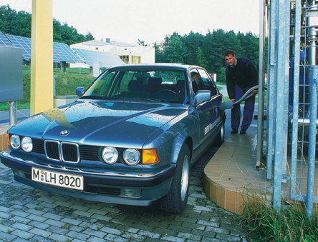
Fuel Cells: H₂ as a Fuel
Fuel cell - reactants are supplied continuously from an external source.
Cars can use electricity generated by H₂/O₂ fuel cells.
H₂ carried in tanks or generated from hydrocarbons.
MAR

Slide 15
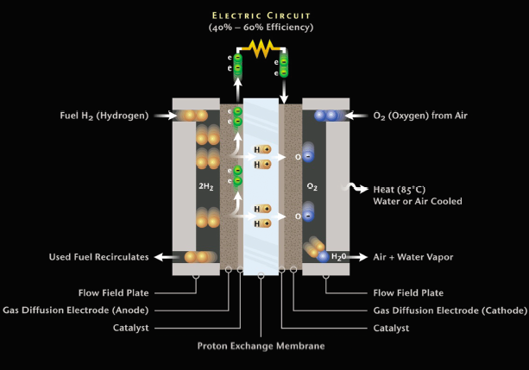
Hydrogen—Air Fuel Cell
MAR

Slide 16
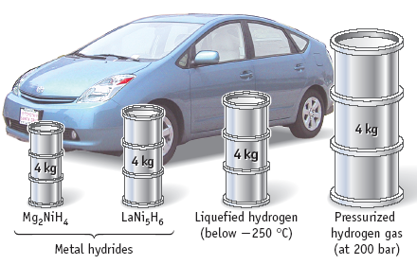
H₂ as a Fuel
Comparison of the volumes of substances required to store 4 kg of hydrogen relative to car size.
MAR

Slide 17
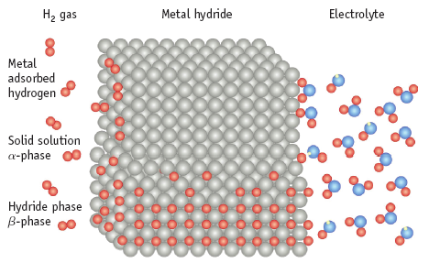
Storing H₂ as a Fuel
One way to store H₂ is to adsorb the gas onto a metal or metal alloy.
MAR

Slide 18
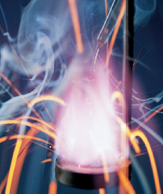
Sodium and Potassium
The important characteristic of Group 1A elements is their vigorous reaction with water.
K and water
MAR

Slide 19
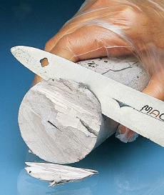
Sodium and Potassium
All of the Group 1A metals are relatively soft and can be cut with a knife.
MAR

Slide 20
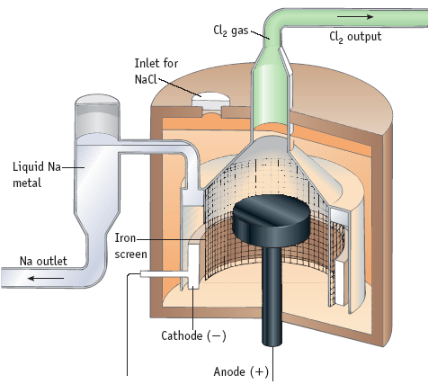
Sodium Preparation
Na is prepared by the electrolysis of molten Na in a “Downs cell”
MAR

Slide 21
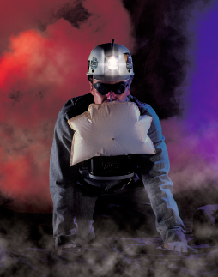
Reactions with O₂
2 Na(s) + O₂(g) → Na₂O₂ (s)
Sodium peroxide
K(s) + O₂(g) → KO₂(s)
Potassium superoxide
KO₂ used in breathing apparatus
4 KO₂(g) + 2 CO₂ (g) → 2 K₂CO₃(s) + 3 O₂(g)
MAR

Slide 22
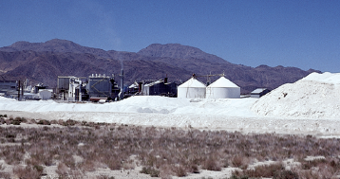
Na-Containing Compounds
Na₂CO₃: soda ash or washing soda
Used as an industrial base, in making soap, and in making glass.
Was made by “Solvay process” but now mined as trona: Na₂CO₃•NaHCO₃•2H₂O
Trona mine in CA
MAR

Slide 23
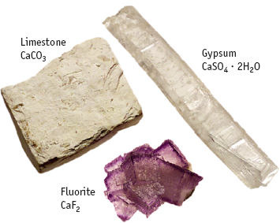
Alkaline Earth Elements
Ca and Mg 5th and 7th in abundance on Earth.
MAR

Slide 24
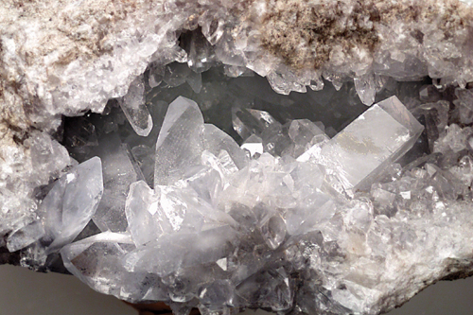
Alkaline Earth Elements Be, Ca, Mg, Sr, Ba
Celestite, SrSO₄
MAR

Slide 25
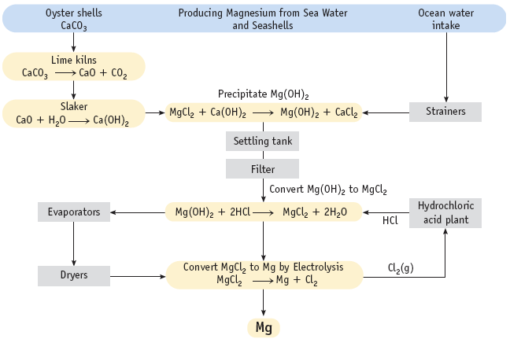
Magnesium from the Sea
MAR

Slide 26
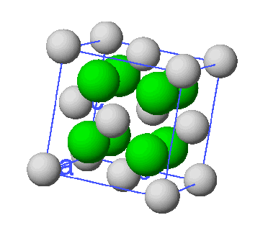
Calcium Minerals: CaF₂
CaF₂ (fluorite) used in making steel. Removes impurities from molten iron.
CaF₂ is a source of HF. CaF₂ + H₂SO₄ → 2 HF + CaSO₄
MAR

Slide 27
Calcium Minerals: CaCO₃
CaCO₃ + heat → CO₂ + CaO
Limestone is mostly CaCO₃.
Heating CaCO₃ gives lime, CaO
CaO + H₂O → Ca(OH)₂, slaked lime
Ca(OH)₂ is the most used industrial base.
CaCO₃ used in cement, fertilizer, and in making steel.
MAR

Slide 28
Calcium Minerals: CaCO₃
Mortar -- a mixture of lime, sand, and water -- has been used for hundreds of years.
Reactions involved:
CaO + H₂O → Ca(OH)₂, slaked lime
Ca(OH)₂ + CO₂ → CaCO₃ + H₂O
Sand grains bound together by CaCO₃
MAR

Slide 29
Calcium Minerals: CaCO₃
Hard water contains dissolved Ca²⁺ and Mg²⁺
CaCO₃ + H₂O + CO₂ ⇌ Ca²⁺ + 2 HCO₃⁻
If CO₂ is removed by boiling, CaCO₃ precipitates.
MAR

Slide 30
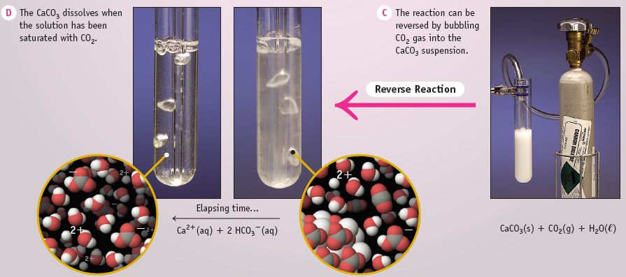
Calcium Minerals: CaCO₃
CaCO₃ dissolved in presence of CO₂
MAR

Slide 31
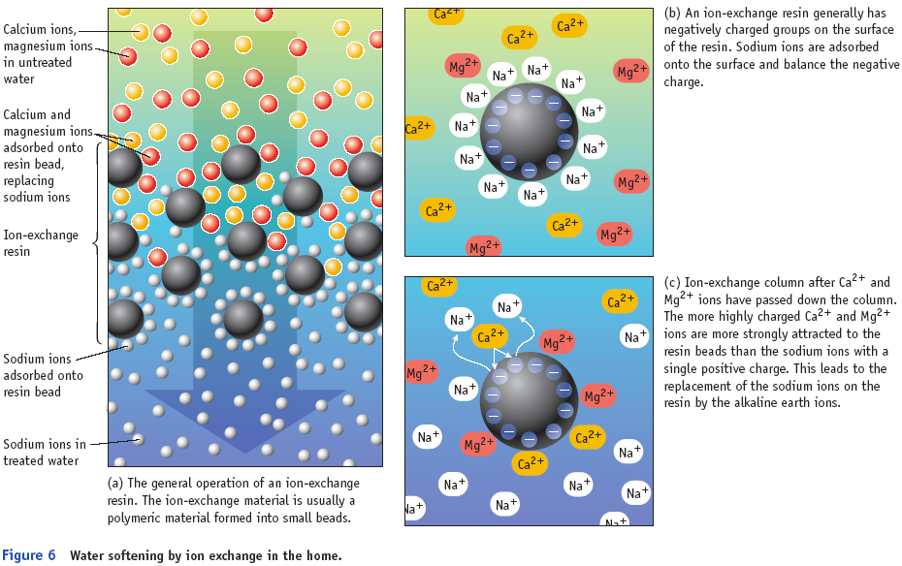
Removing Ca²⁺ an Mg²⁺ by Ion Exchange
MAR

Slide 32
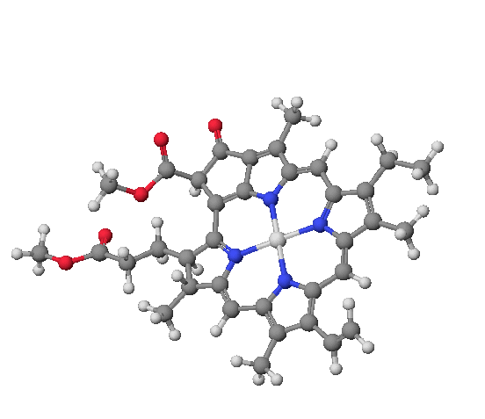
Chlorophyll, a molecule with Mg²⁺
MAR

Slide 33
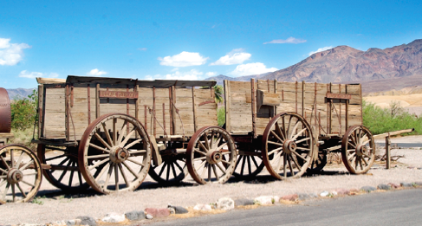
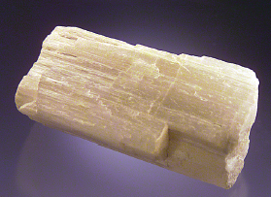
Group 3A Chemistry
Boron, aluminum, gallium, indium, thallium
“20 mule team borax” wagon in Death Valley and a borax sample
MAR

Slide 34
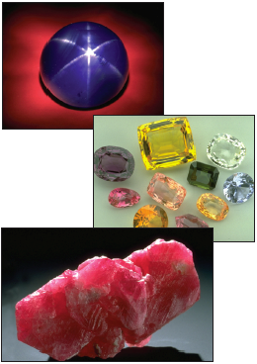
Gems & Minerals
Sapphire: Al₂O₃ with Fe³⁺ or Ti³⁺ impurity gives blue whereas V³⁺ gives violet.
Ruby: Al₂O₃ with Cr³⁺ impurity
MAR

Slide 35
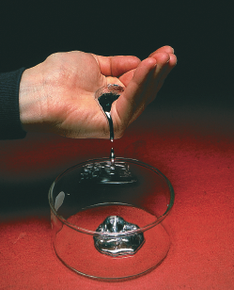
Group 3A—General Aspects
All have ns²np¹
Maximum oxidation number is +3
But Tl⁺ exists and is poisonous
All are metals except B
Abundances vary greatly
B 10 ppm
Al 82,000 ppm
Ga 18 ppm
In/Tl < 1
Gallium
MAR

Slide 36
Group 3A—General Aspects
Diagonal relation
Li Be B
Mg Al Si
Al and Be are similar in that both form amphoteric hydroxides and inert oxides.
B and Si form acidic hydroxides [B(OH)₃ and Si(OH)₄] and both form volatile hydrides (B₂H₆ and SiH₄)
MAR

Slide 37
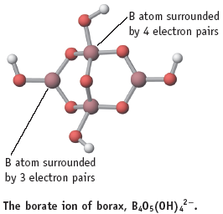
Sources of the Elements
Boron—borax, Na₂B₄O₇•10H₂O
Has been used for centuries to braze metals (and mummify the dead).
Production of ca. 2.6 x 10⁶ tons annually
MAR

Slide 38
Boron Recovery
B₂O₃ + 3 Mg → 2 B + 3 MgO
Impure B produced this way
2 BBr₃ + 3 H₂ → 2 B + 6 HBr
BBr₃ vapor + H₂ over hot Ta wire gives B whiskers.
MAR

Slide 39
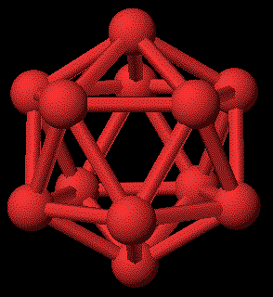
Elemental Boron
Pure boron consists of interconnected icosahedra
MAR

Slide 40
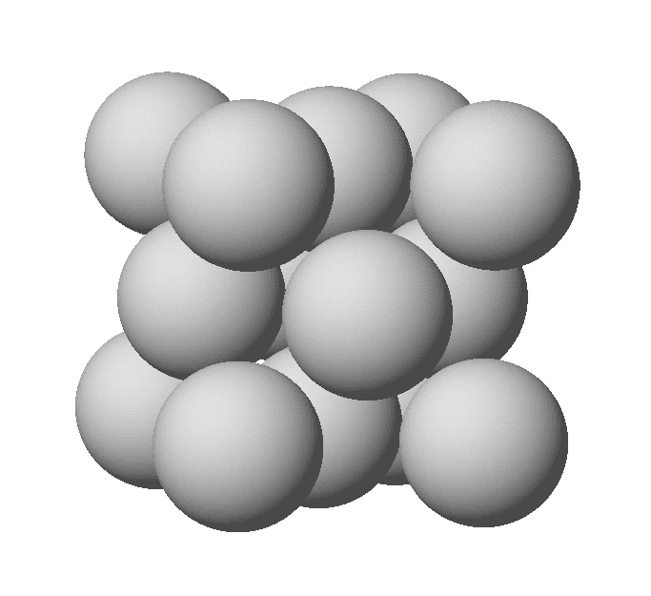
Aluminum
95% of the 90 million tons of bauxite mined is used in the Bayer process to give Al₂O₃ (corundum)
90% of the oxide is converted to Al metal
Unit cell of Al
MAR

Slide 41
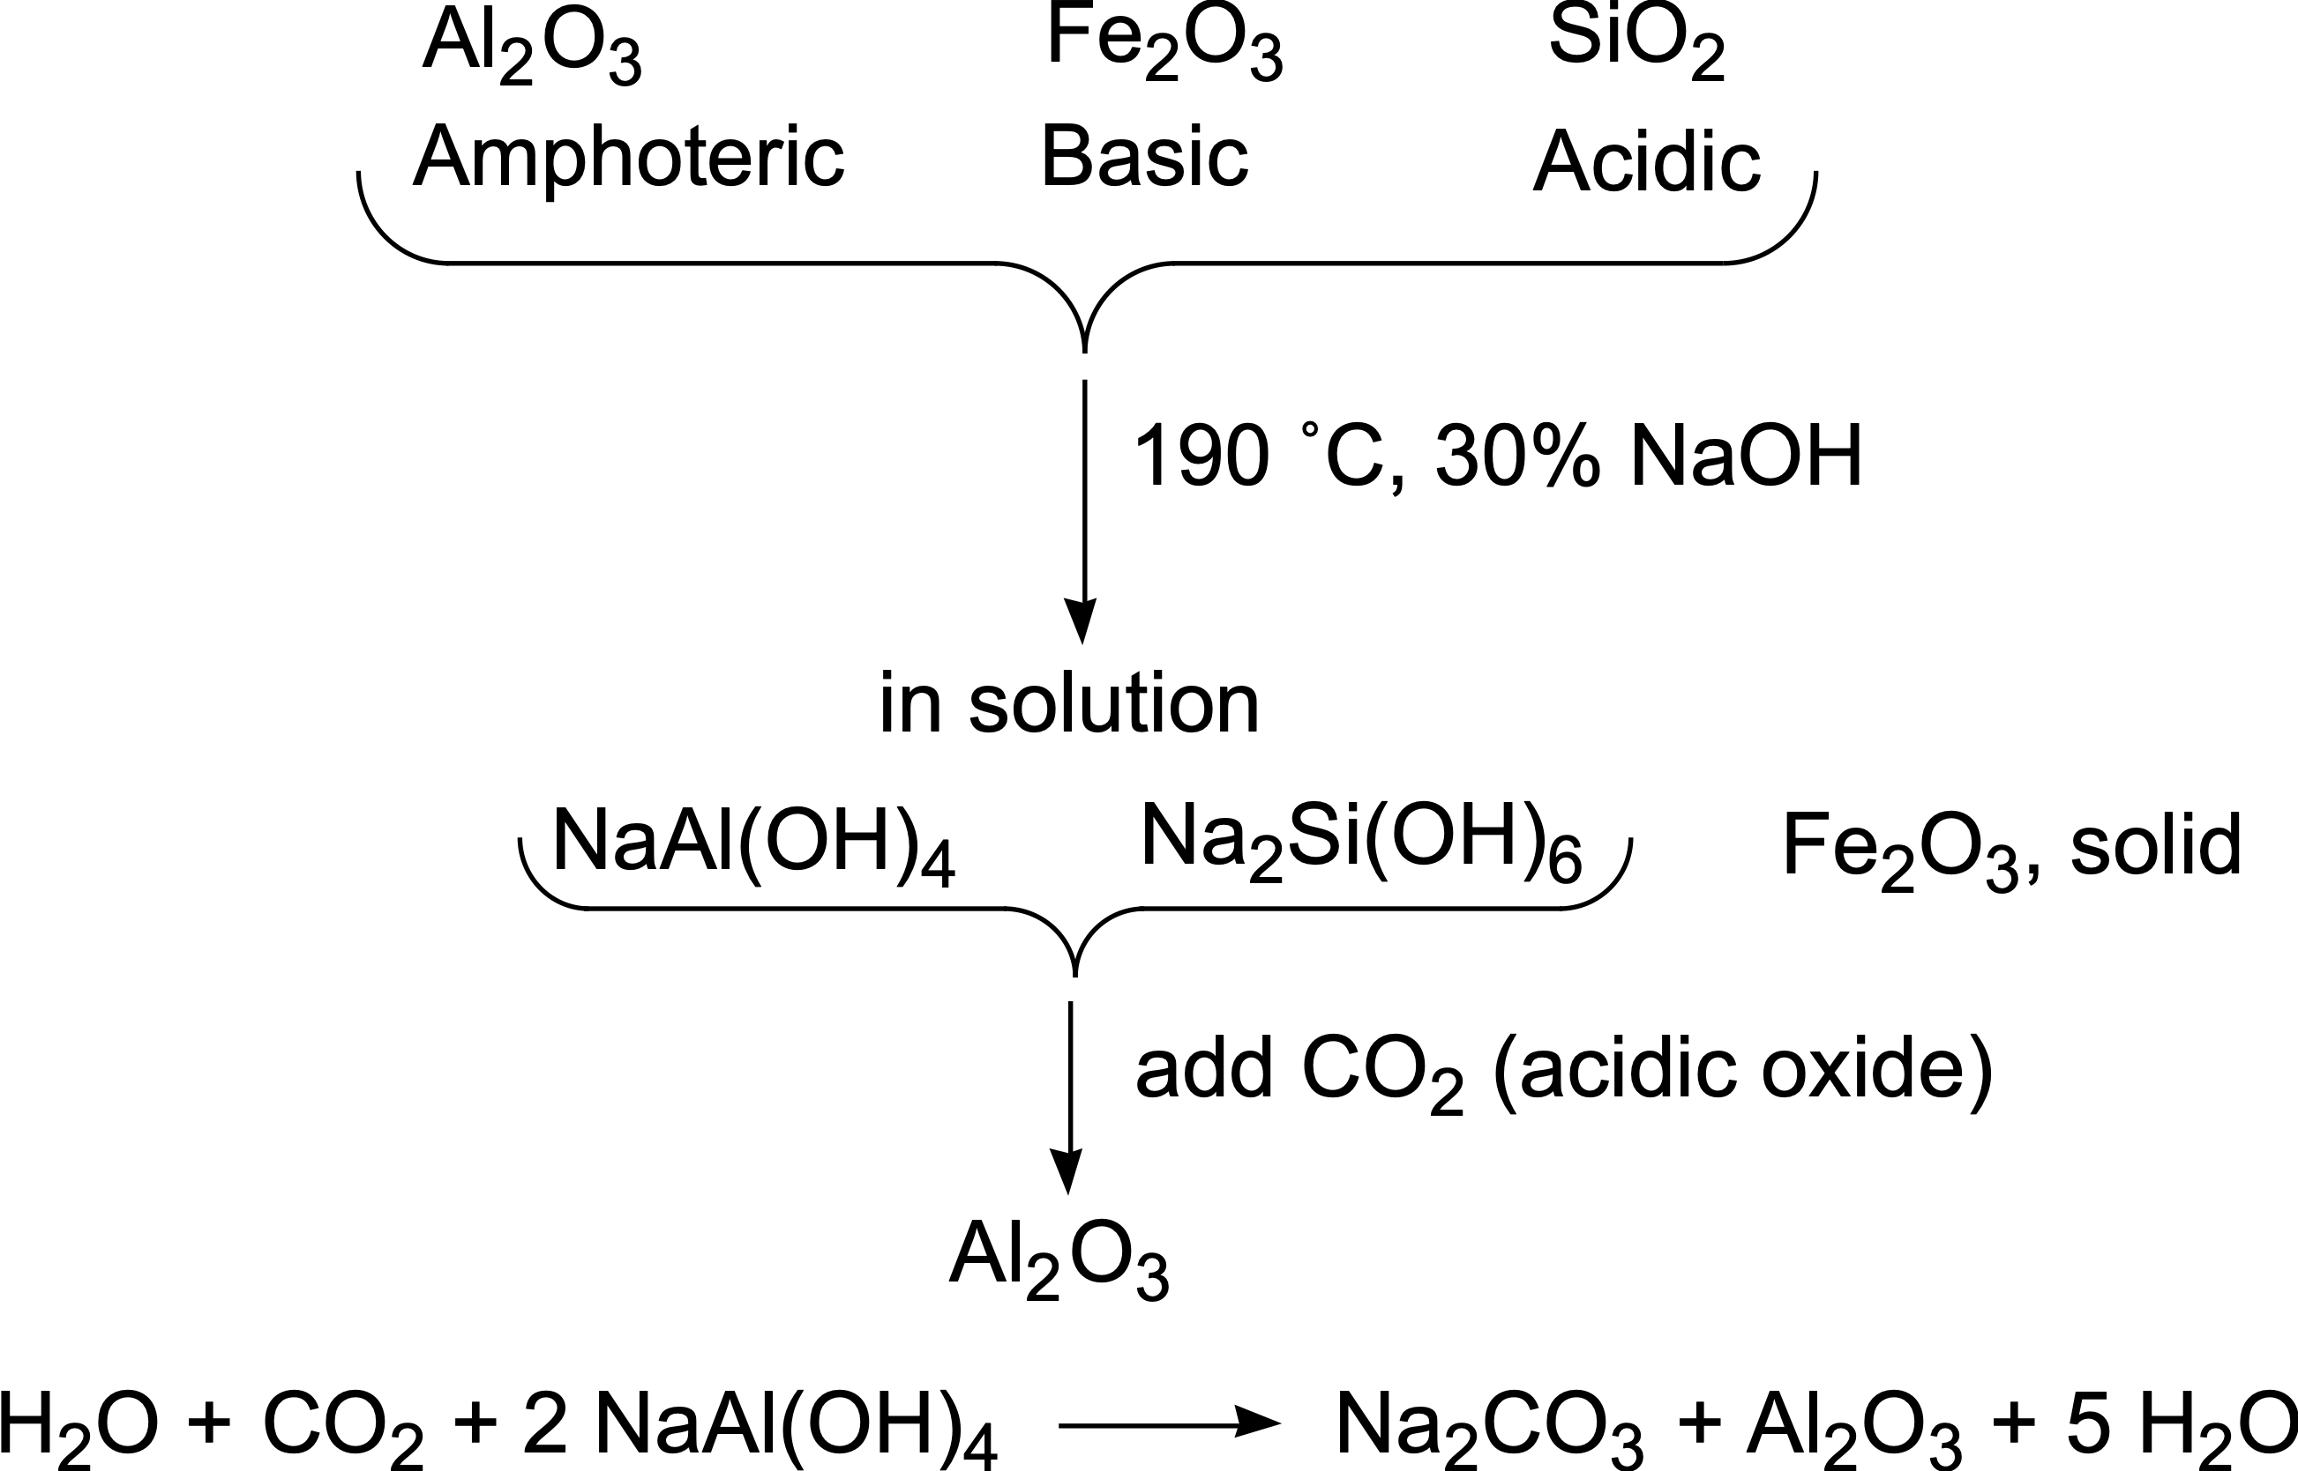
Aluminum—Bayer Process
MAR

Slide 42
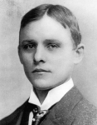
Aluminum Metal
Al obtained by electrolysis of Al₂O₃/Na₂AlF₆ mixture
Na₂AlF₆ is CRYOLITE
Called the Hall-Heroult process
Charles M. Hall (1863-1914)
http://www.oberlin.edu/chem/history/cmh/cmharticle.html
MAR

Slide 43
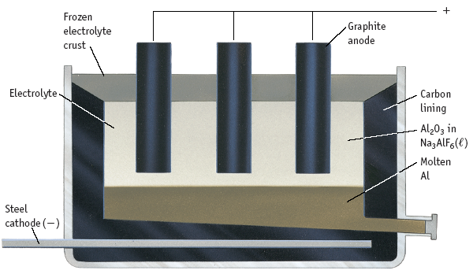
Al Production by Electrolysis
MAR

Slide 44
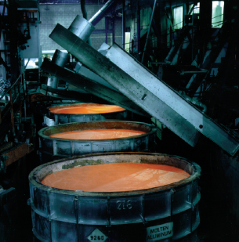
Aluminum Metal
Main use is as structural material
Strength, low density, corrosion resistance
Strength improved by ALLOYING
Mn: cooking utensils, furniture, roofing
Cu: truck and plane parts
MAR

Slide 45
Aluminum Metal
Corrosion resistance due to aluminum oxide coating.
4 Al(s) + 3 O₂(g) → 2 Al₂O₃(s)
∆H˚ = – 3351 kJ
This illustrates the great reducing power of aluminum.
MAR

Slide 46
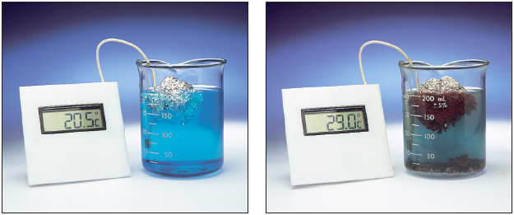
Corrosion of Aluminum
Al is oxidized by Cu²⁺ in a NaCl solution.
Al metal can be oxidized if the protective Al₂O₃ coating is breached.
MAR

Slide 47
Aluminum Metal
4 Al(s) + 3 O₂(g) → 2 Al₂O₃(s)
∆H˚ = -3351 kJ
Solid booster rocket fuel for Space Shuttle uses Al as reducing agent and NH₄ClO₄ as oxidizer.
MAR

Slide 48
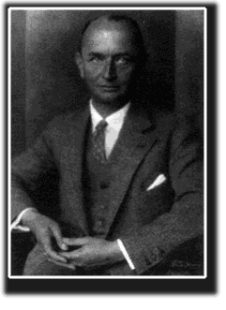
Group 3A Hydrides—Boranes
Boranes = B_{x}H_{y}
Began in 1912 with Alfred Stock
See Stock’s book “Hydrides of Boron and Silicon”
Good account of Hg poisoning from Hg fumes in the lab
Alfred Stock, 1876-1946
MAR

Slide 49
Mercury Poisoning
“Among the unpleasant accidents must be reckoned the fact that, through years of working with mercury apparatus, my collaborators contracted chronic mercurial poisoning. …[It] reveals itself as an affection of the nerves, causing headaches, numbness, mental lassitude, depression, and loss of memory; such are very disturbing to one engaged in an intellectual occupation.”
Alfred Stock, “Hydrides of Boron and Silicon”, 1933
MAR

Slide 50
Diborane, B₂H₆
2 NaBH₄ + 2 H₃PO₄ →
B₂H₆ + 2 NaH₂PO₄ + 2 H₂
2 NaBH₄ + I₂ (in ether) →
B₂H₆ + 2 NaI + H₂
Mp = -165.5 ˚C and Bp = -87.55 ˚C
∆H˚_{f} = +35.6 kJ/mol
B₂H₆ + 3 O₂ --> B₂O₃ + 3 H₂O + 2165 kJ
Higher ∆H_{combustion} than any other fuel (per gram) than H₂
MAR

Slide 51
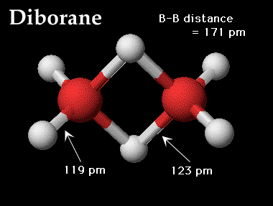
Diborane Structure
An “electron-deficient” or "twisted metal" compound
12 valence e- but 8 “apparent” bonds.
External H-B-H angle = 121.8˚
Internal H-B-H angle = 96.5˚
MAR

Slide 52
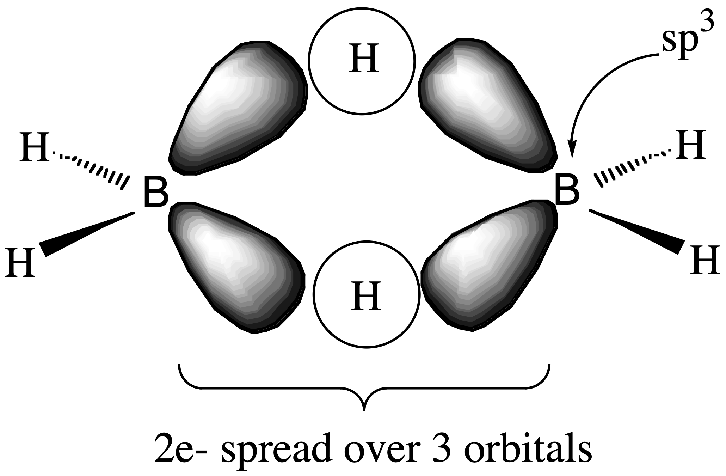
3-Center, 2-Electron Bond
MAR

Slide 53
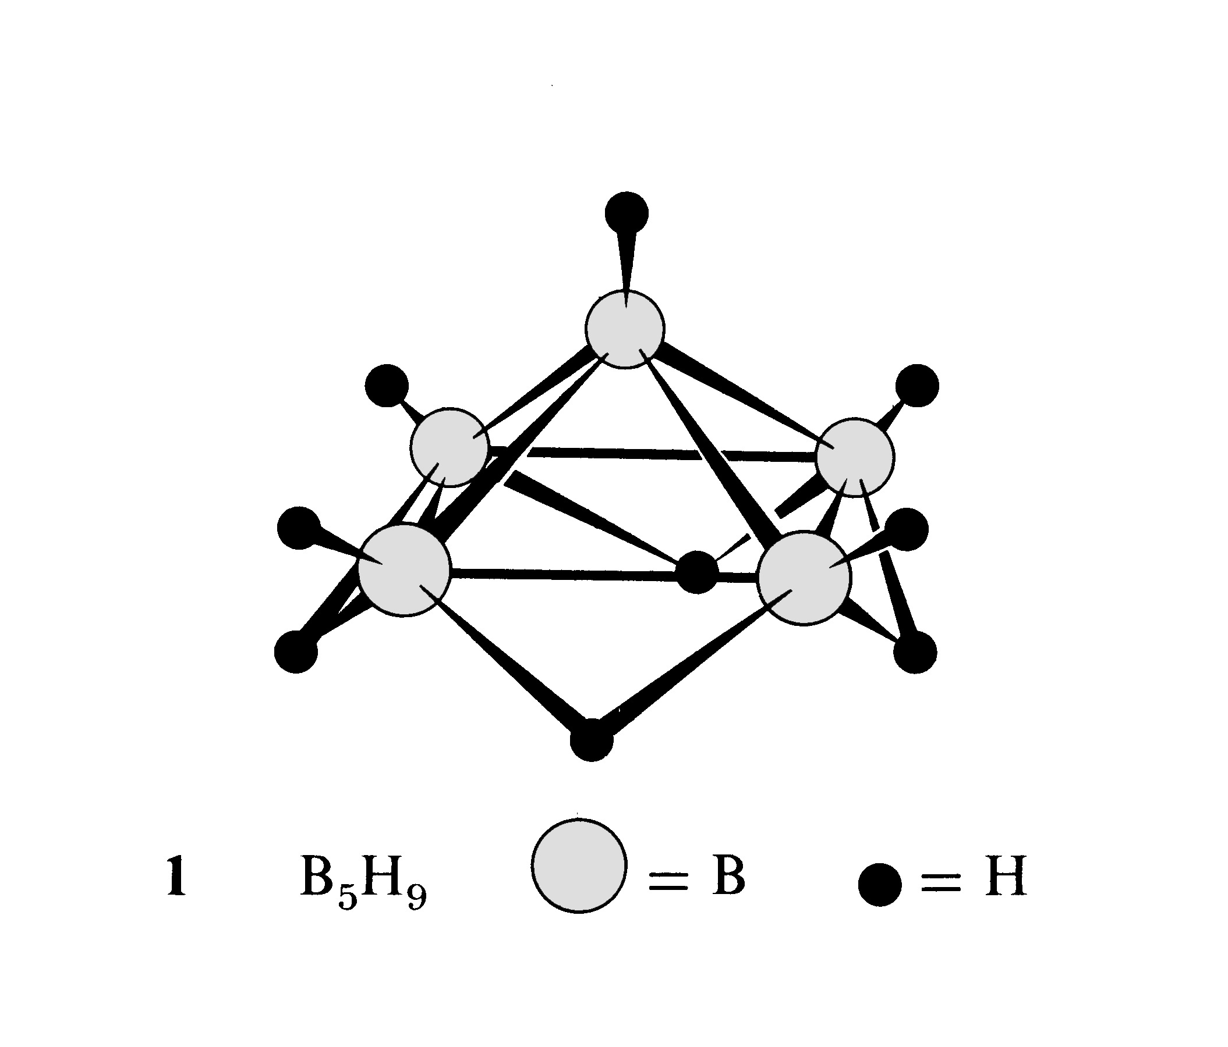
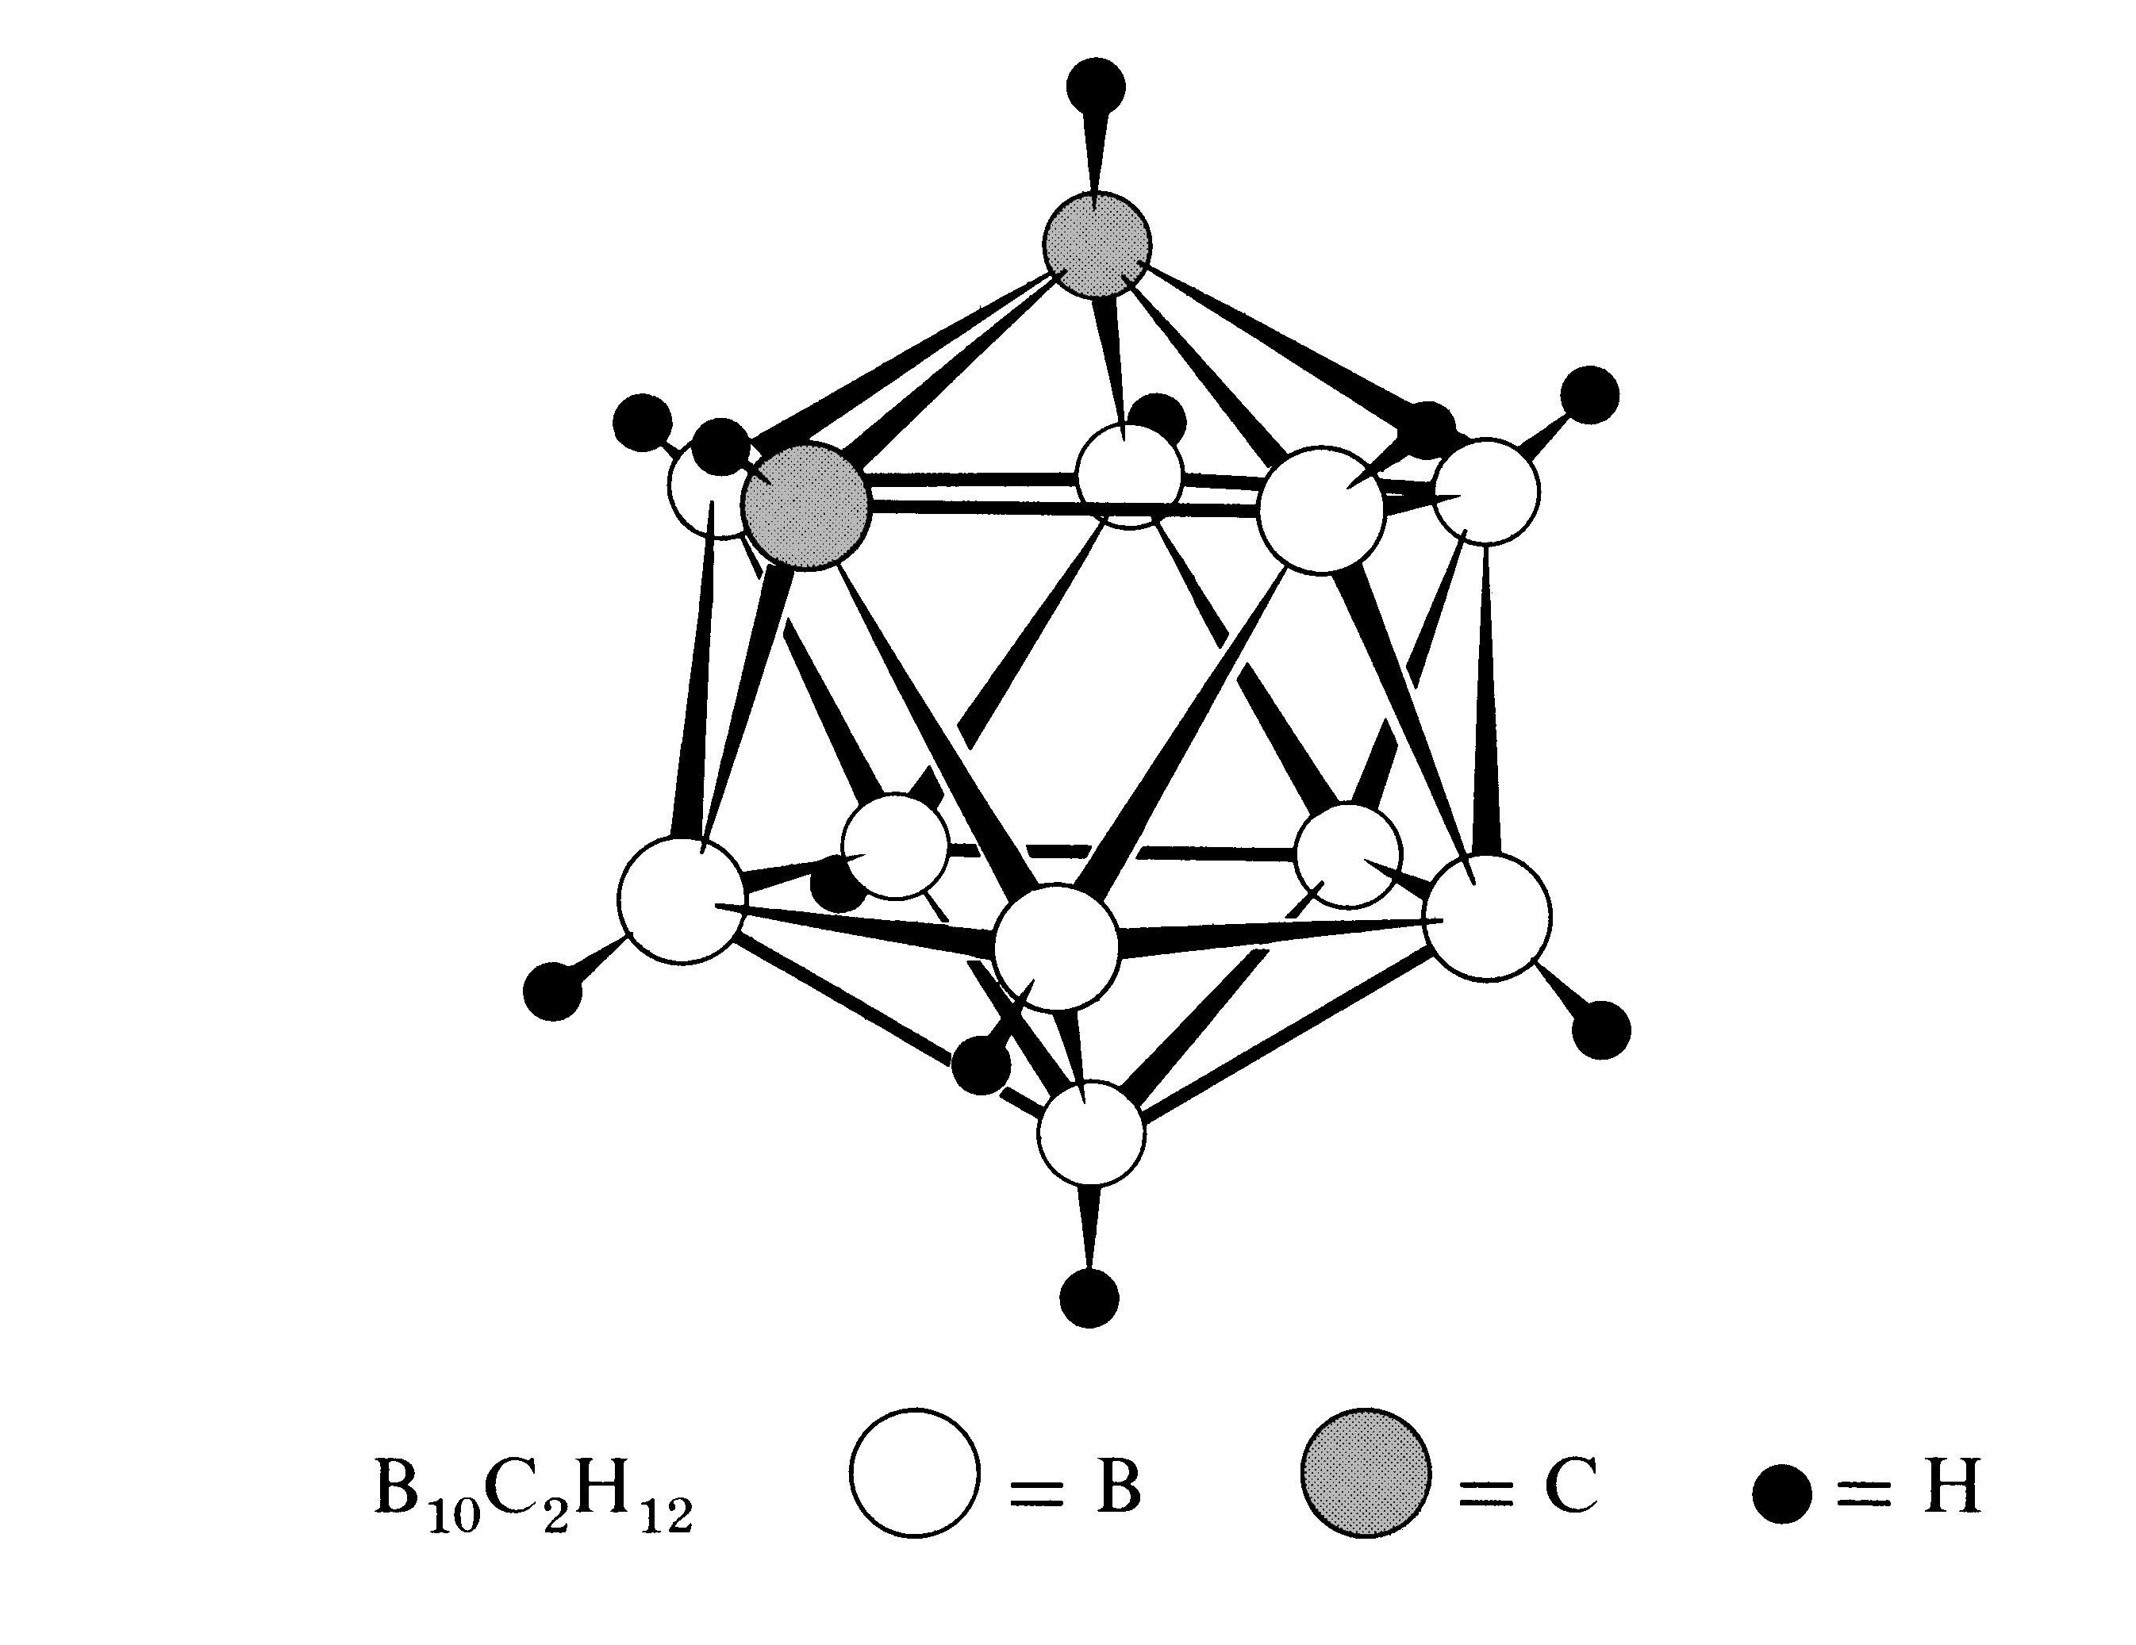
HIGHER BORANES
Boranes with more than 2 B atoms can be like spider webs or closed cages.
MAR

Slide 54
Commercial Uses of BH Compounds
Important compound = NaBH₄
Used to bleach wood pulp
Electrode-less plating of metals onto plastics
BH₄⁻ + 8 OH⁻ → H₂BO₃⁻ + 5 H₂O + 8 e⁻
E˚ = +1.24 V
Used as reducing agent in organic chemistry
MAR

Slide 55
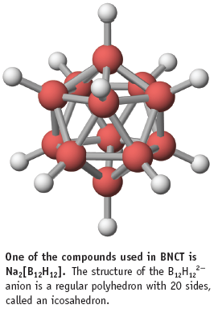
BNCT Boron Neutron Capture Therapy
¹⁰B isotope (not ¹¹B) has the ability to capture slow neutrons
In BNCT, tumor cells preferentially take up a boron compound, and subsequent irradiation by slow neutrons kills the cells via the energetic ¹⁰B --> ⁷Li neutron capture reaction (that produces a photon and an alpha particle)
¹⁰B + ¹n → ⁷Li + ⁴He + photon
MAR

Slide 56
Group 3A Hydroxides
B(OH)₃ is an acid
B(OH) ₃ + H₂O → B(OH)₄⁻ + H⁺
K_{a} = 7.3 x 10⁻¹⁰
Al(OH)₃ and Ga(OH)₃ are amphoteric
Al³⁺(aq) is a weak acid
Al(H₂O)₆³⁺ → [Al(H₂O)₅(OH)]²⁺ + H⁺
K_{a} = 7.9 x 10⁻⁶
MAR

Slide 57
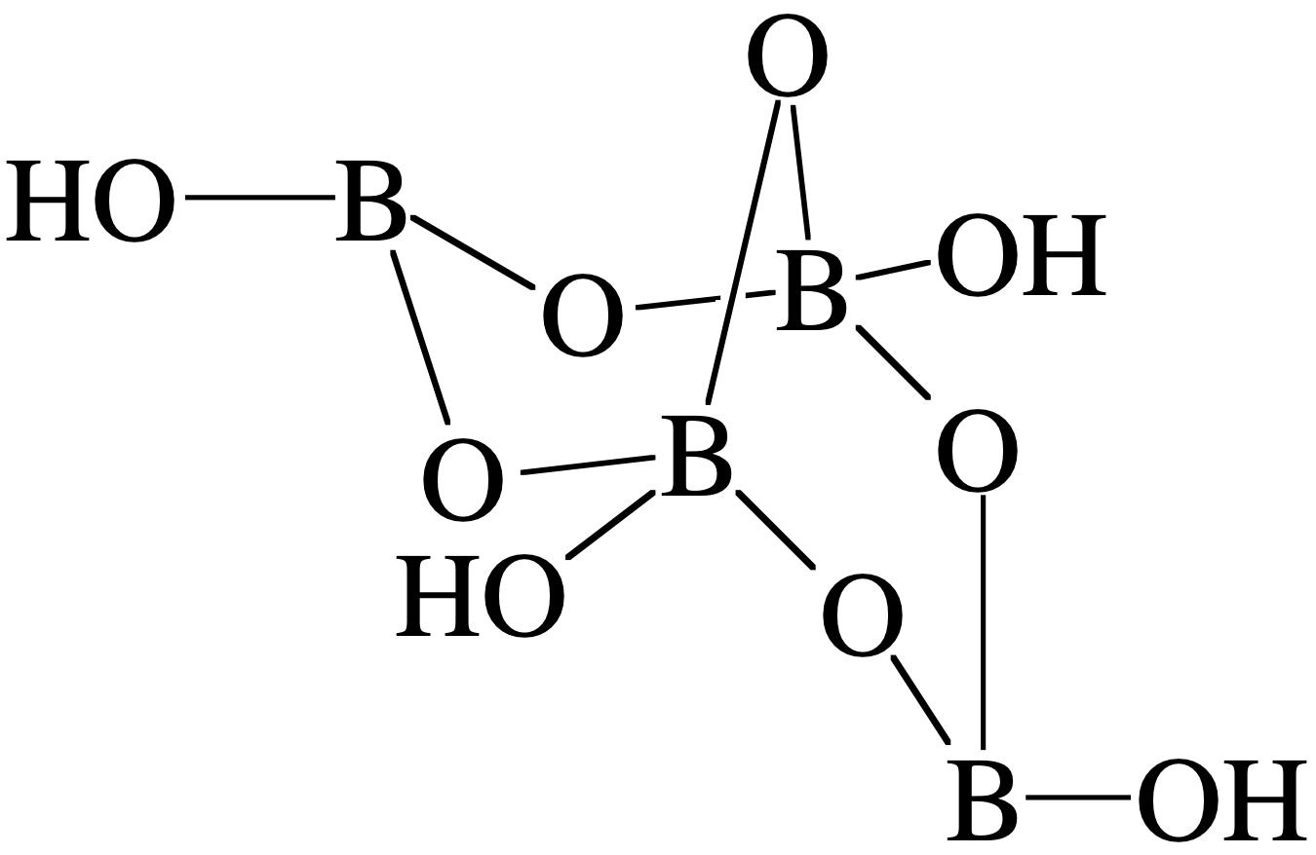
Boron-Oxygen Compounds
Boron is never found in nature bonded to any other element than O.
Borax, Na₂B₄O₇•10H₂O
Na₂[B₄O₅(OH)₄]•H₂O
Note 6-membered rings
All borates are fragments of of this structure.
MAR

Slide 58
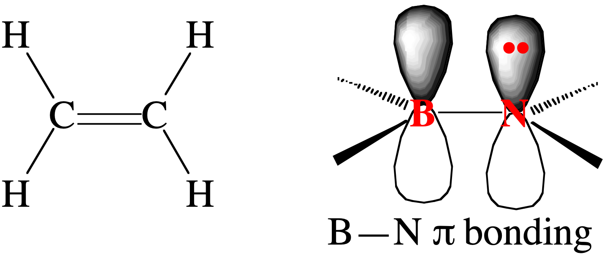
Boron-Nitrogen Compounds
Element B C N
Valence e- 3 4 5
Electroneg. 2.0 2.5 3.0
Radius 88 77 70 pm
MAR

Slide 59
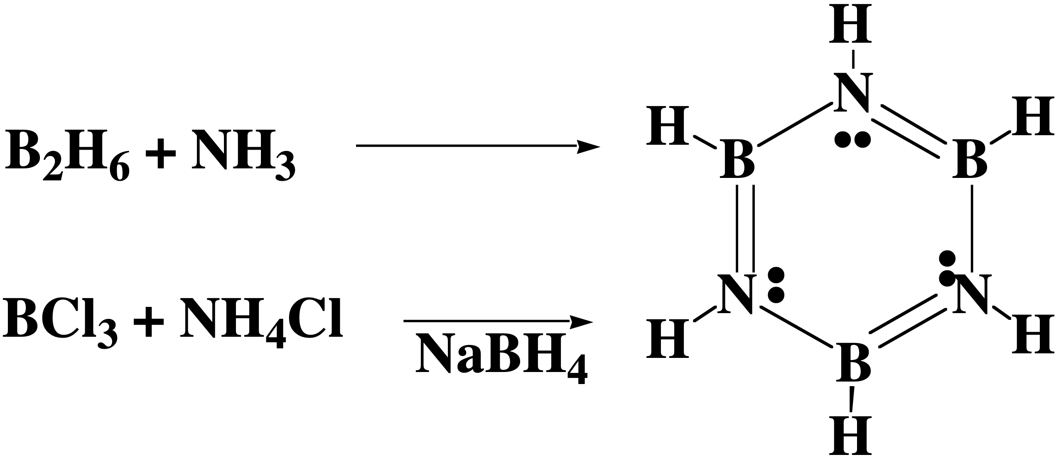
Borazine—Analog of Benzene
Borazine: Mol. wt. = 80.5
Mp = -57 ˚C; Bp = 55 ˚C
B—N = 144 pm
Benzene: Mol. wt. = 78.1
Mp = 6 ˚C; Bp = 80 ˚C
C—C = 142 pm
MAR

Slide 60
Boron Halides
Mp, ˚C Bp, ˚C
BF₃ -127.1 -99.9
BCl₃ -107 12.5
BBr₃ -46 91.3
BI₃ 49.9 210
All are volatile
Monomeric - contrast with BX₃ and Al₂X₆
MAR

Slide 61
All Form Lewis Acid-Base Complexes
Order of Lewis acidity: BF₃ < BCl₃ < BBr₃ < BI₃
MAR

Slide 62
All Form Lewis Acid-Base Complexes
Order of Lewis acidity: BF₃ < BCl₃ < BBr₃ < BI₃
Order of acidity is inverse of expectation due to a small degree of B—X π bonding
MAR

Slide 63
Aluminum Halides
Compound AlF₃ AlCl₃ AlBr₃ AlI₃
Mp, ˚C 1290 192.4 97.8 189.4
Subl. Temp. 1272 180 256 382
Synthesis
Al₂O₃ + 6 HF → 2 AlF₃ + 3 H₂O
2 Al + 3 X₂ → 2 AlX₃ (for X = Cl, Br, I)
MAR

Slide 64
Synthesis of Al₂Br₆ 2 Al + 3 Br₂ → Al₂Br₆
MAR

Slide 65
Aluminum Fluoride
AlF₃ is a lattice of Al³⁺ and F⁻ ions
Octahedral Al³⁺
F⁻ bridges
Found in cryolite, Na₂AlF₆
MAR

Slide 66
AlX₃ where X = Cl, Br, I
Solid AlCl₃ is a layer lattice of 6-coordinate Al³⁺ ions.
At mp the solid volume increases 85% and electrical conductivity decreases
In liquid and gas phase AlCl₃ is dimer.
AlBr₃ and AlI₃ are dimers in all phases.
MAR

Slide 67
Aluminum in Water Purification
Aluminum sulfate is the most important Al compound after Al(OH)₃ and Al₂O₃.
Used in paper industry and as a flocculent in water purification.
As pH increases, associated species form. Their large charge nucleates fine, suspended dirt particles.
MAR

Slide 68
Aluminum Hydroxide & Oxide
Many different forms
α−Al₂O₃ Corundum
α -AlO(OH) Diaspore
α -Al(OH)₃ Bayerite
γ -Al₂O₃
γ -AlO(OH) Boehmite
γ -Al(OH)₃ Gibbsite
MAR

Slide 69
Corundum: α-Al₂O₃
Very hard—so used as an abrasive in sandpaper and toothpaste
Emery = Al₂O₃ + Fe₂O₃ / SiO₂
Chemically inert and insulating
Used in refractories and ceramics
MAR

Slide 70
Group 4A
C, Si, Ge, Sn, Pb
General features
Moving away from metallic character
ns²np² configurations
“inert pair” effect leads to Ge²⁺, Sn²⁺, Pb²⁺
MAR

Slide 71
Carbon Allotropes: Graphite
Layers of 6-member carbon rings.
sp² C atoms
Extended π bonding throughout the layers.
MAR

Slide 72
Carbon Allotropes: Diamond
6-member carbon rings.
Tetrahedral sp³ C atoms
Bonding extends throughout the crystal.
MAR

Slide 73
Properties of Graphite and Diamond
Allotrope Graphite Diamond
Density 2.266 3.514 g/cm³
Hardness <1 10 Mohs
∆H˚_{f} 0 +1.90 kJ/mol
Graphite has high electrical conductivity
Diamond—has highest thermal conductivity of any known material
MAR

Slide 74
Graphite
Uses of natural graphite
Steelmaking
Refractories, crucibles
Lubricants
Brake linings
Pencil lead
About 75000 tons/year
MAR

Slide 75
Graphite
Artificial graphite
SiO₂ + C → (SiC) + CO₂
SiC (2500 ˚C) → Si + C
Used for electrodes, crucibles, motor brushes, fibers
About 350,000 tons/year
MAR

Slide 76
Coke & Carbon Black
Heat coal in absence of air → coke
About 370 x 10⁶ tons/year
Steelmaking
Carbon black—incomplete combustion of hydrocarbons
> 10 million tons/day!
93% in tires (3 kg in car tire and 9 kg in truck tire)
~3% in printing ink
MAR

Slide 77
Activated Charcoal
Made by burning carbon in high oxygen atmosphere.
Leaves small holes with diameters of 1-8 nanometers
Surface area of 1 g of charcoal can be about 1000 m².
Used in water and air filters.
MAR

Slide 78
Carbon Allotropes: Fullerenes
5- and 6-member carbon rings.
C atoms are bound into a sphere with 60 C atoms.
MAR

Slide 79
C₆₀, Bucky Ball
MAR

Slide 80
Screen 3.2
MAR

Slide 81
Silicon
Quartz or sand + high purity coke → Si
SiO₂ + 2 C → Si + 2 CO
Making very pure silicon:
Si + Cl₂ → SiCl₄
SiCl₄ + Mg → MgCl₂ + Si
To purify the silicon, it is zone-refined
MAR

Slide 82
Tin, Sn
Sn is relatively expensive, but used because it resists corrosion.
About 40% used in “tin plate”
“Tin cans” have 0.0004 - 0.025 mm layer of Sn on iron
About 30 x 10⁹ cans plated annually in US
MAR

Slide 83
Tin Alloys
Solder: 1/3 Sn and 2/3 Pb
Bronze: 5-10% Sn + Cu
Pewter: 90-95% Sn, 1-8% Sb, and < 3% Cu
Bearing metal: 80-90% Sn, 5% Cu, and Pb
MAR

Slide 84
Tin
Tin metal can be recovered by electrolysis of an aqueous solution of tin(II) chloride.
Cl₂ is formed at the anode
Sn is formed at the cathode
MAR

Slide 85
Lead, Pb
Most abundant of the “heavy metals”
Romans used it in “plumbing”
the word comes from the Latin name for the element
Main ore is galena, PbS
MAR

Slide 86
Producing Lead
2 PbS + 3 O₂ → 2 PbO + 2 SO₂(g)
PbO + C → Pb + CO
Galena
PbS
MAR

Slide 87
Lead Storage Batteries
About 60% of the batteries sold are Pb storage batteries
ANODE:
Pb(s) + HSO₄⁻ → PbSO₄(s) + H⁺(aq) + 2e-
CATHODE:
PbO₂(s) + 3 H⁺(aq) + HSO₄⁻(aq) + 2e- → PbSO₄(s) + 2 H₂O
MAR

Slide 88
Carbon-Oxygen Compounds
CO—used as reducing agent in metal purification—the Mond process
NiO + 4 CO (at 50 ˚C) → Ni(CO)₄ (liq)
Ni(CO)₄ (at 230 ˚C) → pure Ni + 4 CO
MAR

Slide 89
Carbon-Oxygen Compounds
CO₂ — over 30 x 10⁶ tons produced in US/year
1/2 used as refrigerant and propellant in aerosols
1/4 used to “carbonate” soft drinks
CO₂ is a “greenhouse” gas
MAR

Slide 90
Silicon-Oxygen Compounds
SiO₂ is not like CO₂
Reason is that 2 Si=O bonds are weaker (~640 kJ each) than 4 Si-O bonds (464 kJ each)
Also orbital overlap to form Si=O is not efficient.
Most common form is alpha-quartz
Less pure forms are rose quartz, smoky quartz, amethyst, citrine.
MAR

Slide 91
Silicon Dioxide
All silicon-oxygen compounds have corner-shared SiO₄ tetrahedra
α-Quartz has interlinked helical chains of SiO₄ tetrahedra.
Helices can be right- or left-handed, so crystals are optically active.
Large SiO₂ crystal
MAR

Slide 92
Citrine Quartz
MAR

Slide 93
Quartz
Quartz is a key electronic material, 2nd only to Si in volume.
Citrine and amethyst have Fe²⁺/Fe³⁺ impurities in quartz that give color.
MAR

Slide 94
Quartz
Quartz consists of interlinked chains of SiO₄ units
MAR

Slide 95
Piezoelectricity
Quartz exhibits the property of piezoelectricity.
The production of an electric dipole when the crystal is deformed.
Piezoelectric effect is used to control oscillators in electric circuits such as watches and radios.
MAR

Slide 96
Hydrothermal Growth of Quartz
Most quartz used commercially is synthetic
At 350-400 ˚C and 1-4 kilobars, SiO₂ dissolves slightly in 1 M NaOH
3 SiO₂ + 2 OH⁻ → Si₃O₇²⁻ + H₂O
SiO₂ crystallizes on quartz seed crystals.
“Hydrothermal Synthesis of Crystals,” Robert A. Laudise, Chemical & Engineering News, Vol.65 (39), 30, 1987
MAR

Slide 97
Synthetic Quartz
Blue from Co²⁺ ions and brown from Fe²⁺ ions.
MAR

Slide 98
Silicates
Silicates have chains of SiO₄ tetrahedra, often linked into a sheet structure.
Sheet structure in mica
MAR

Slide 99
Clays
Clays have sheets of SiO₄ tetrahedra bound to sheets of AlO₆ octahedra.
A large variety of clays
MAR

Slide 100
Clays
Remedies for stomach upset can contain clays.
Clays absorb toxins.
The large disk is baked clay from Africa; used medicinally.
MAR

Slide 101
Glass
When quartz is melted, it forms silica glass.
Add CaO and Na₂CO₃ → ordinary glass
See Corning Glass Museum: www.cmog.org
MAR

Slide 102
Soda-Lime Glass
Most common type and least expensive
60-75% silica, 12-18% soda, 5-12% lime
Poor resistance to sudden temperature changes and to corrosive chemicals
MAR

Slide 103
Lead Glass
About 20% PbO
Relatively soft
High refractive index gives it brilliance
Used for art glass and electrical applications
MAR

Slide 104
Borosilicate Glass
Any silicate glass with at least 5% B₂O₃
High resistance to temperature change and chemical corrosion
Pipelines, light bulbs, photochromic glasses, sealed-beam headlights, lab ware, baking ware
MAR

Slide 105
Photochromic Glass
Glass contains AgCl and CuCl
Cl⁻ + light → Cl + e-
Darkening reaction
e- + Ag⁺ → Ag (s)
Reversing reactions
Cl + Cu⁺ → Cu²⁺ + Cl⁻
Cu²⁺ + Ag → Cu⁺ + Ag⁺
MAR

Slide 106
Colored Glass
Old glass often colored due to impurities
Fe²⁺ gives blue-green
Fe³⁺ gives yellow-green
Colored glass
Blue glass: Co²⁺
Purple: Mn²⁺
Fe²⁺ + Cr salts --> green wine bottles
Fe²⁺ + S --> brown
U²⁺: yellow
Se²⁻: red (as in traffic lights)
MAR

Slide 107
Silicones: organosilicon polymers
MAR

Slide 108
Silicones
2 CH₃Cl + Si → SiCl₂(CH₃)₂
Also produces SiCl₃(CH₃), SiCl (CH₃)₃, and SiCl₄
Patented by E. G. Rochow of GE in 1945
Eugene Rochow
MAR

Slide 109
Silicones
(CH₃)₃SiCl + 2 H₂O →
(CH₃)₃Si—O—Si(CH₃)₃ + 2 HCl
R₂SiCl₂ + 2 H₂O → HO—SiR₂—OH + 2 HCl
2 HO—SiR₂—OH →
HO—SiR₂—O—SiR₂—OH + H₂O
Units link to give polymers!
MAR

Slide 110
Silicones
Properties of silicones
Good thermal and oxidative stability
Resistant to high and low temperatures
Water repellent
Antistick and antifoam properties
Resistant to UV radiation and weathering
Physiologically inert (*see breast implant studies)
Can be made into oils, greases, emulsions, elastomers, and resins
MAR

Slide 111
Silicones
Production of >350,000 tons annually
1000 different products
65-70% fluid silicones
25-30% elastomers
5-10% resins
MAR

Slide 112
Silicones: Fluids
Cosmetics — suntan lotion, lipstick
Antifoams — sewage treatment
Antifroth — cooking oil
Car polish
Lubricants
Release agents
MAR

Slide 113
Silicones: Elastomers
SiO₂ added to linear dimethylpolysiloxane
Retains inertness, flexibility, elasticity, and strength up to 250 ˚C and down to –100 ˚C.
Industrial sealants, belts and gaskets, medical tubing, space suits, etc.
MAR

Slide 114
Silicones: Resins
Pure silicone resins are poly(organosiloxanes) with a large proportion of branched siloxyl groups
Used as raw materials for paints, binders and in building preservation.
Electrical industry: insulating lacquers
High temperature enamels
MAR

Slide 115
Chemistry of Main Group Elements Groups 5A-8
Red and white P
Sodium chloride
MAR

Slide 116
Group 5A
Nitrogen, phosphorus, arsenic, antimony, and bismuth
N exists as N₂ molecules. Others have more complex forms.
MAR

Slide 117
Nitrogen
N₂ is quite unreactive owing to the NN triple bond.
Atmosphere is about 80% N₂
N₂ easily liquefied. Boils at -196 ⁰C.
Used as a refrigerant
MAR

Slide 118
Nitrogen Oxides, N₂O
NH₄NO₃ → N₂O + 2 H₂O
N₂O, nitrous oxide (dinitrogen oxide), used as an anesthetic.
Soluble in fats. Used as propellant in whipped cream cans.
MAR

Slide 119
Nitrogen Oxides, NO
NO, nitrogen oxide, is present in polluted air.
NO = 11 valence e⁻
Implicated in biological processes
Reacts readily with O₂ to give NO_{2.}
MAR

Slide 120
Nitrogen Oxides, NO₂
HNO₃ → 2 N₂O + H₂O + 1/2 O₂
NO₂, nitrogen dioxide, is a brown gas in equilibrium with N₂O₄, a colorless gas.
A common air pollutant
MAR

Slide 121
Oxidation of NH₃
NH₃ gas is oxidized on Pt surface in air to NO
4 NH₃ + 5 O₂ → 4 NO + 6 H₂O
Pt wire catalyzes reaction. Heat of reaction causes wire to glow.
MAR

Slide 122
Commercial Prep of HNO₃
NH₃ is oxidized on Pt surface in air to NO and NO₂. NO₂ in water gives HNO₃.
MAR

Slide 123
Nitric Acid, HNO₃
NO₂ in water gives HNO₃ (and HNO₂)
Better prepared from: 2 NaNO₃ + H₂SO₄ → 2 HNO₃ + Na₂SO₄
MAR

Slide 124
Nitric Acid, HNO₃
HNO₃ readily reacts with almost all metals -- except Al -- to give metal nitrate and NO₂
Cu
Al
MAR

Slide 125
Phosphorus
Originally prepared from human waste
Now obtained from the reduction of P-containing minerals such as Ca₃(PO₄)₂.
“The Alchymist”
MAR

Slide 126
Phosphorus Allotropes
White = P₄ tetrahedron
Red = polymer of P₄ tetrahedra
MAR

Slide 127
Phosphorus Reactions
Yellow phosphorus spontaneously burns in air.
P₄(s) + 5 O₂(g) → P₄O₁₀(s)
Product: tetraphosphorus decaoxide.
MAR

Slide 128
Phosphorus Oxides
MAR

Slide 129
Phosphorus Reactions
Phosphorus reacts readily (is oxidized) with chlorine to give PCl₃ and PCl₅.
MAR

Slide 130
Phosphorus Reactions
A match head contains an oxidizing agent (KClO₃) and P₄S₃.
The striking strip on a match box contains red P.
Redox reaction lights the match.
MAR

Slide 131
Group 6A Oxygen, Sulfur, Selenium, Tellurium, Polonium
O₂ condenses to a pale blue liquid at -183 ºC
MAR

Slide 132
Oxygen Allotropes
Liquid O₂ is paramagnetic and clings to a magnet.
Ozone, O₃, is made by passing O₂ through electric discharge.
MAR

Slide 133
Sulfur
The most stable allotrope of S is a crown-shaped ring of 8 S atoms.
MAR

Slide 134
Polymeric Sulfur
Heating S to the melting point causes the rings to open and a polymeric allotrope forms.
MAR

Slide 135
Sulfuric Acid
Sulfur is found in pure form in underground deposits along the coast of the U.S. It is recovered by pumping superheated steam into the beds to melt the S.
MAR

Slide 136
Sulfuric Acid, H₂SO₄
Sulfur is burned in air to give SO₂ and then SO₃.
SO₃ reacts with water → H₂SO₄
H₂SO₄ is the chemical produced in the largest amount in the U.S.
MAR

Slide 137
Black Smokers
Vents -- BLACK SMOKERS -- in the bottom of the world’s oceans are a source of metal sulfides.
MAR

Slide 138
Sulfide-Containing Minerals
Orpiment
As₂S₃
MAR

Slide 139
Sulfide-Containing Minerals
FeS, iron pyrite
Fool’s gold
MAR

Slide 140
Sulfide-Containing Minerals
Stibnite
Sb₂S₃
MAR

Slide 141
Sulfide-Containing Minerals
Lead sulfide, PbS, galena
MAR

Slide 142
Sulfur Oxides
SO₂ is produced by burning sulfur in oxygen.
MAR

Slide 143
Sulfur Oxides
SO₂ is produced by treatment of metal sulfides with O₂.
2 ZnS + 3 O₂ → 2 ZnO + 2 SO₂
Also produced by burning fossil fuels
About 2 x 10⁸ tons of sulfur oxides are released into the atmosphere by human activities annually.
MAR

Slide 144
Group 7A -- Halogens Fluorine, Chlorine, Bromine, Iodine, Astatine
Diatomic elements: Cl₂ gas, liquid Br₂, and solid I₂
MAR

Slide 145
Group 7A, Halogens Fluorine, Chlorine, Bromine, Iodine, Astatine
Cl is the most abundant in Group 7A.
Occurs in the sea and in salt (NaCl) deposits.
MAR

Slide 146
Commercial Preparation of Chlorine
Electrolysis of NaCl(aq) in a membrane cell.
MAR

Slide 147
Commercial Preparation of Chlorine
Anode: 2 Cl⁻(aq) → Cl₂(g) + 2e⁻
Cathode: 2 H₂O(liq) + 2e⁻ → H₂(g) + 2 OH⁻(aq)
MAR

Slide 148
Lab Preparation of Chlorine
Oxidation of NaCl with strong oxidant (K₂Cr₂O₇)
Cl₂ gas bubbles into water.
MAR

Slide 149
Lab Preparation of Iodine
2 I⁻ + 4 H⁺ + MnO₂ → Mn²⁺ + I₂ + 2 H₂O
Mixture of NaI and MnSO₄
Mixture of NaI and MnSO₄
Add H₂SO₄; reaction produces I₂.
MAR

Slide 150
Reaction of Cl₂ and Na
MAR

Slide 151
Reaction of Cl₂ and Fe
MAR

Slide 152
Reaction of Br₂ and Al
Bromine reacts with metals to give metal bromides
MAR

Slide 153
Reactions of Halogens
Halogens react with nonmetals and metals to give covalent or ionic halides.
MAR

Slide 154
End of Chapter 18
See:
Chapter Eighteen Study Guide
MAR

Slide 155
Important Equations, Constants, and Handouts
from this Chapter:
This chapter is intended as a review of the concepts found in CH 221, CH 222 and CH 223.
If you see something you do not recognize, talk to the instructor!

Slide 156
End of Chapter Problems: Test Yourself
You will need a table of thermodynamic data found in
CH 223 Problem Set #5
Write a balanced chemical equation for the preparation of H2 (and CO) by the reaction of CH4 and water. Using a table of thermodynamic data, calculate ∆H°, ∆G°, and ∆S° for this reaction.
Calcium oxide, CaO, is used to remove SO2 from power plant exhaust. These two compounds react to give solid CaSO3. What mass of SO2 can be removed using 1.2 x 10³ kg of CaO?
Aluminum dissolves readily in hot aqueous NaOH to give the aluminate ion, Al(OH)4¹⁻, and H2. Write a balanced equation for this reaction. If you begin with 13.2 g of Al, what volume (in milliliters) of H2 gas is produced when the gas is measured at 735 mm Hg and 22.5 °C? The reaction: 2 Al(s) + 2 NaOH(aq) + 6 H2O(l) → 2 Na⁺(aq) + 2 Al(OH)4¹⁻(aq) + 3 H2(g)
If an electrolytic cell for producing F2 operates at 5.00 x 10³ amps (at 10.0 V), what mass of F2 can be produced per 24-hour day? Assume the conversion of F⁻¹ to F2 is 100%.
How would you extinguish a sodium fire in the laboratory? What is the worst thing you could do?

Slide 157
End of Chapter Problems: Answers
∆H° = 205.9 kJ ,∆G° = 141.9 kJ, ∆S° = 214.7 J/K
1.4 x 10⁶ g SO2
1.84 x 10⁴ mL
8.51 x 10⁴ g F2
Use an inert dry chemical fire extinguisher - do NOT pour water on the sodium fire, this would create flammable hydrogen gas!
You will need a table of thermodynamic data found in
CH 223 Problem Set #5

