Slide 1
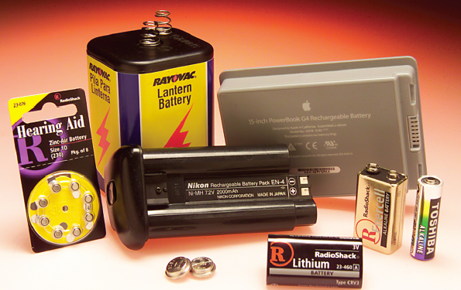
ELECTROCHEMISTRY Chapter 17
Chemistry 223
Professor Michael Russell
MAR
Last update:
4/29/24

Slide 2
TRANSFER REACTIONS
Atom / Group transfer
HOAc(aq) + H₂O(l) → OAc⁻¹(aq) + H₃O⁺(aq)
Electron transfer
Cu(s) + 2 Ag⁺(aq) → Cu²⁺(aq) + 2 Ag(s)
MAR

Slide 3
TRANSFER REACTIONS
Electron Transfer Reactions:
Cu(s) + 2 Ag⁺(aq) → Cu²⁺(aq) + 2 Ag(s)
Cu(s) → Cu²⁺(aq) + 2 e⁻
and
2 Ag⁺(aq) + 2 e⁻ → 2 Ag(s)
MAR

Slide 4
Electron Transfer Reactions
Electron transfer reactions are oxidation-reduction or redox reactions.
Redox reactions can result in the generation of an electric current or be caused by imposing an electric current.
Therefore, this field of chemistry is often called ELECTROCHEMISTRY.
MAR

Slide 5
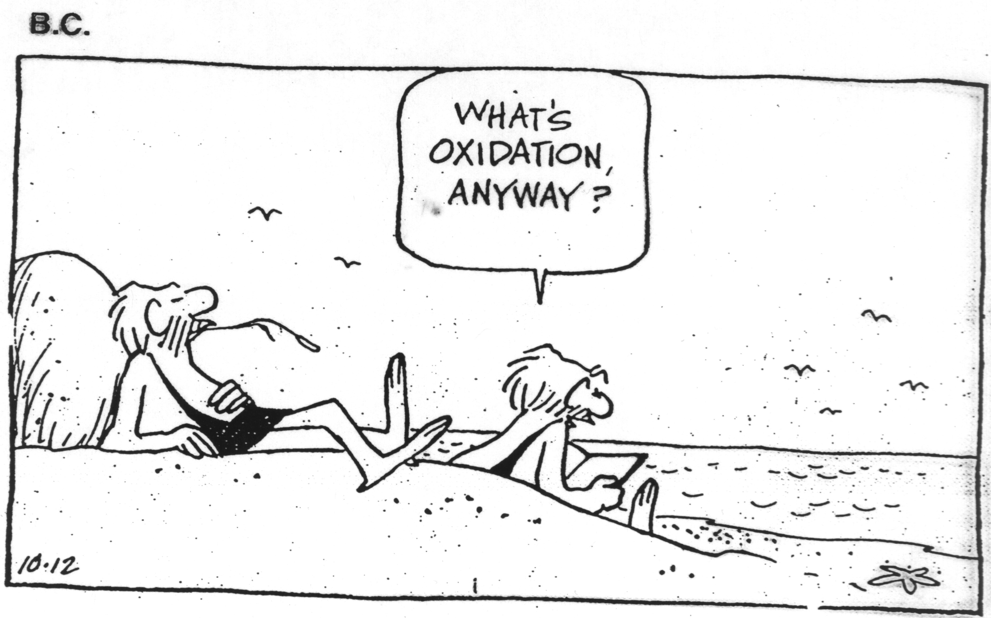
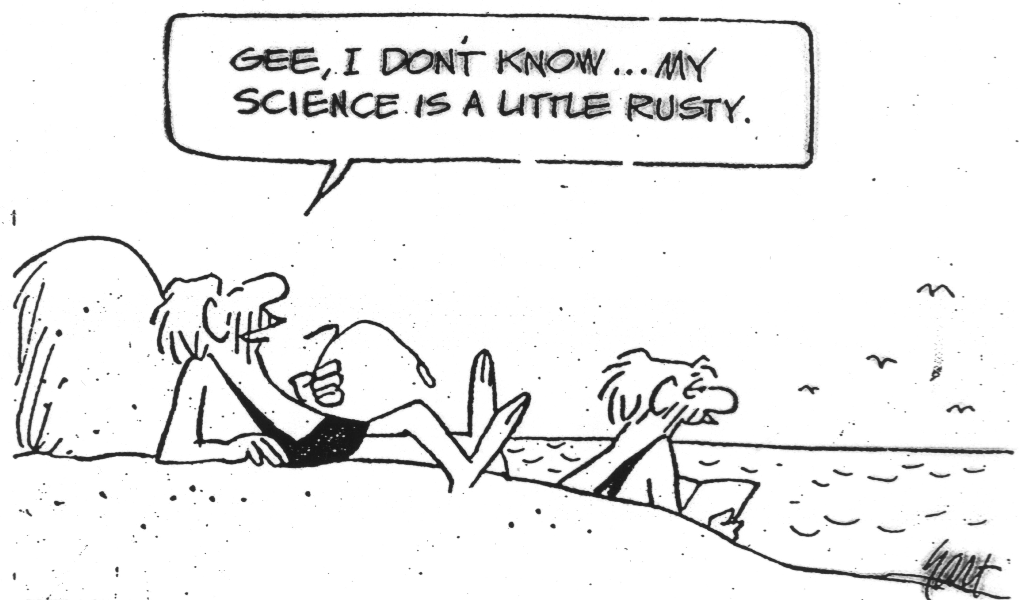
Blast from the Past!
MAR

Slide 6
Review of Terminology for Redox Reactions
OXIDATION - loss of electron(s) by a species; increase in oxidation number.
REDUCTION - gain of electron(s); decrease in oxidation number.
OXIDIZING AGENT - electron acceptor; species is reduced.
REDUCING AGENT - electron donor; species is oxidized.
MAR

Slide 7
LEO says GER
MAR

Slide 8
LEO says GER
Lose Gain
Electrons Electrons
Oxidized Reduced
Zn(s) → Zn²⁺ + 2e- Oxidized
Cu²⁺ + 2e- → Cu(s) Reduced
Can also use "OIL RIG":
OIL = "Oxidation is Losing" (electrons)
RIG = "Reduction is Gaining" (electrons)
MAR
Which species is being oxidized in the following reaction:
Ni(s) + 2 Ag⁺(aq) → Ni²⁺(aq) + 2 Ag(s)
Ni(s)
Ag⁺(aq)
Ni²⁺(aq)
Ag(s)
not a redox reaction
Enter your response on
your i>Clicker now!
Answer = A,
Ni(s)
Ni(s) → Ni²⁺(aq) + 2 e⁻,
Ni(s) losing electrons

Slide 9
OXIDATION-REDUCTION REACTIONS
Direct Redox Reaction
Oxidizing and reducing agents in direct contact.
Cu(s) + 2 Ag⁺(aq) → Cu²⁺(aq) + 2 Ag(s)
MAR

Slide 10
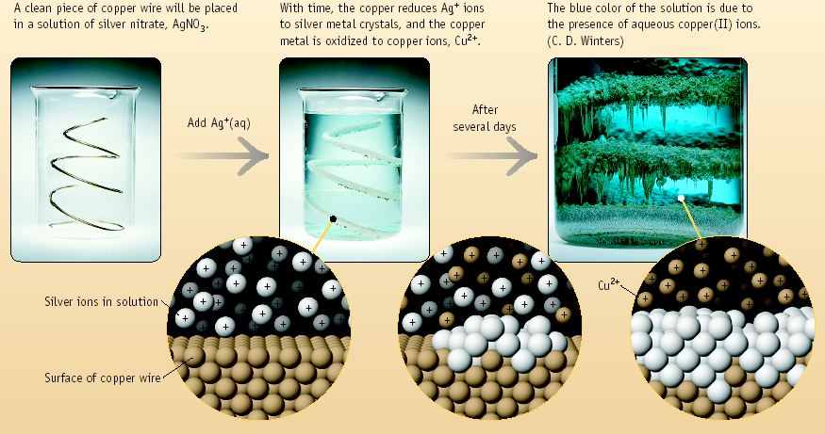
Copper + Silver Ion
MAR

Slide 11
OXIDATION-REDUCTION REACTIONS
Indirect Redox Reaction
A battery functions by transferring electrons through an external wire from the reducing agent to the oxidizing agent.
MAR

Slide 12
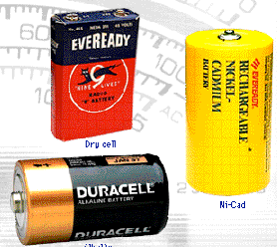
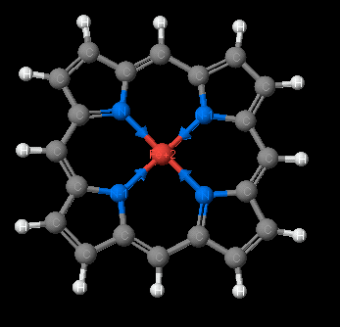
Why Study Electrochemistry?
Batteries
Corrosion
Industrial production of chemicals such as Cl₂, NaOH, F₂ and Al
Biological redox reactions
A rusted car
MAR
The heme group

Slide 13
Electrochemical Cells
An apparatus that allows a redox reaction to occur by transferring electrons through an external connector.
Product favored reaction ---> voltaic or galvanic cell ----> electric current created
Reactant favored reaction ---> electrolytic cell ---> electric current used to cause chemical change
Batteries are voltaic cells
MAR

Slide 14
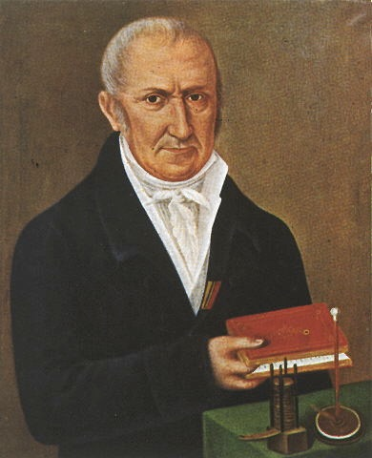
Famous Electrochemists
Alessandro Volta, 1745-1827, Italian scientist and inventor.
Luigi Galvani, 1737-1798, Italian scientist and inventor.
MAR

Slide 15
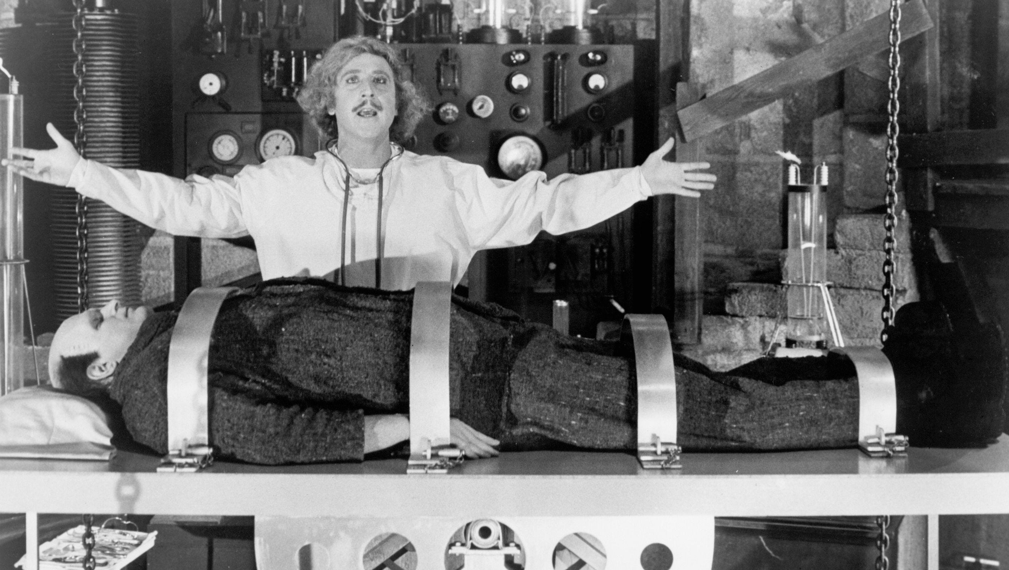
Frankenstein
MAR

Slide 16
Balancing Equations for Redox Reactions
Some redox reactions have equations that must be balanced by special techniques.
MnO₄⁻ + 5 Fe²⁺ + 8 H⁺
→ Mn²⁺ + 5 Fe³⁺ + 4 H₂O
Mn = +7
Fe = +2
Mn = +2
Fe = +3
MAR
See: Redox Reactions Handout
What is the oxidation number on the vanadium atom in VO2⁺¹?
+1
+2
+3
+4
+5
Enter your response on
your i>Clicker now!
Answer = E,
+5
Sum of ox numbers = charge,
O almost always -2,
Ox(V) + 2(-2) = +1,
Ox(V) = +5

Slide 17
Balancing Equations
Consider the reduction of Ag⁺ ions with copper metal.
Cu + Ag⁺ --gives--> Cu²⁺ + Ag
MAR

Slide 18
Balancing Equations
Step 1: Divide the reaction into half-reactions, one for oxidation and the other for reduction.
Ox Cu → Cu²⁺
Red Ag⁺ → Ag
Step 2: Balance each for mass. Already done in this case.
Step 3: Balance each half-reaction for charge by adding electrons.
Ox Cu → Cu²⁺ + 2e-
Red Ag⁺ + e- → Ag
MAR

Slide 19
Balancing Equations
Step 4: Multiply each half-reaction by a factor that means the reducing agent supplies as many electrons as the oxidizing agent requires.
Reducing agent Cu → Cu²⁺ + 2e-
Oxidizing agent 2 Ag⁺ + 2 e- → 2 Ag
Step 5: Add half-reactions to give the overall equation.
Cu + 2 Ag⁺ → Cu²⁺ + 2 Ag
The equation is now balanced for both charge and mass.
MAR

Slide 20
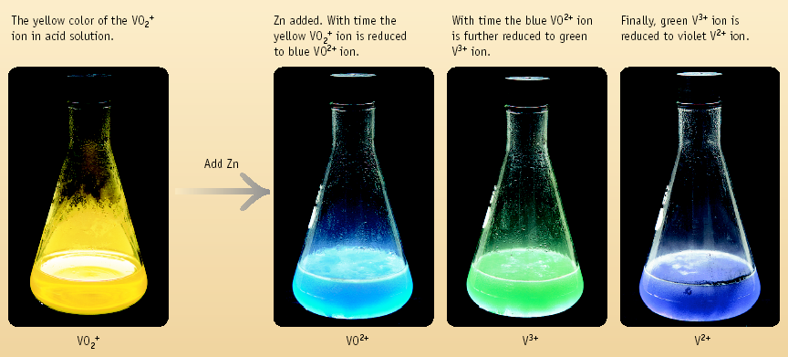
Reduction of VO₂⁺ with Zn
MAR

Slide 21
Balancing Equations
Balance the following in acidic solution-
VO₂⁺ + Zn → VO²⁺ + Zn²⁺
Step 1: Write the half-reactions
Ox Zn → Zn²⁺
Red VO₂⁺ → VO²⁺ (V⁵⁺ → V⁴⁺)
Step 2: Balance each half-reaction for mass.
Ox Zn → Zn²⁺
Red VO₂⁺ → VO²⁺ + H₂O
MAR

Slide 22
Balancing Equations
Balance the following in acidic solution-
VO₂⁺ + Zn → VO²⁺ + Zn²⁺
Step 1: Write the half-reactions
Ox Zn → Zn²⁺
Red VO₂⁺ → VO²⁺ (V⁵⁺ --> V⁴⁺)
Step 2: Balance each half-reaction for mass.
Ox Zn → Zn²⁺
Red 2 H⁺ + VO₂⁺ → VO²⁺ + H₂O
Add H₂O on O-deficient side and add H⁺ on other side for balancing hydrogen
MAR

Slide 23
Balancing Equations
Step 3: Balance half-reactions for charge.
Ox Zn → Zn²⁺ + 2e-
Red e- + 2 H⁺ + VO₂⁺ → VO²⁺ + H₂O
Step 4: Multiply by an appropriate factor.
Ox Zn → Zn²⁺ + 2e-
Red 2 e- + 4 H⁺ + 2 VO₂⁺ → 2 VO²⁺ + 2 H₂O
Step 5: Add half-reactions
Zn + 4 H⁺ + 2 VO₂⁺ → Zn²⁺ + 2 VO²⁺ + 2 H₂O
MAR
How many electrons flow between the Sn(s) and Ag⁺(aq)?
Sn(s) + 2 Ag⁺(aq) → Sn²⁺(aq) + 2 Ag(s)
0
1
2
3
4
Enter your response on
your i>Clicker now!
Answer = C,
2 electrons
Sn(s) → Sn²⁺(aq) + 2 e⁻,
2 Ag⁺(aq) + 2 e⁻ → 2 Ag(s)

Slide 24
Balancing Equations
Balance the following in basic solution-
MnO₄¹⁻ + HO₂⁻ → MnO₄²⁻ + O₂
Step 1: Write the half-reactions
Ox HO₂⁻ → O₂ (peroxide: O⁻¹ → O⁰)
Red MnO₄¹⁻ → MnO₄²⁻ (Mn⁷⁺ → Mn⁶⁺)
Step 2: Balance each half-reaction for mass.
Red MnO₄¹⁻ → MnO₄²⁻
Ox HO₂⁻ → O₂ + H₂O
MnO4⁻¹ = permanganate
MnO4²⁻ = manganate
MAR

Slide 25
Balancing Equations
Balance the following in basic solution-
MnO₄¹⁻ + HO₂⁻ → MnO₄²⁻ + O₂
Step 1: Write the half-reactions
Ox HO₂⁻ → O₂ (peroxide: O⁻¹ → O⁰)
Red MnO₄¹⁻ → MnO₄²⁻ (Mn⁷⁺ → Mn⁶⁺)
Step 2: Balance each half-reaction for mass.
Red MnO₄¹⁻ → MnO₄²⁻
Ox OH⁻ + HO₂⁻ → O₂ + H₂O
Add H₂O on H-deficient side and add OH⁻ on other side for balancing oxygen
MAR

Slide 26
Balancing Equations
Step 3: Balance half-reactions for charge.
Ox OH⁻ + HO₂⁻ → O₂ + H₂O + 2e-
Red e- + MnO₄¹⁻ → MnO₄²⁻
Step 4: Multiply by an appropriate factor.
Ox OH⁻ + HO₂⁻ → O₂ + H₂O + 2e-
Red 2 e- + 2 MnO₄¹⁻ → 2 MnO₄²⁻
Step 5: Add half-reactions
OH⁻ + HO₂⁻ + 2 MnO₄¹⁻ → O₂ + H₂O + 2 MnO₄²⁻
Add H₂O on H-deficient side and add OH⁻ on other side for balancing oxygen in basic solution
MAR

Slide 27
Alternate Basic Balancing Method
Balance basic reactions first with acid, then "neutralize" with OH⁻. Previous example:
MnO₄¹⁻ + HO₂⁻ → MnO₄²⁻ + O₂
Step 1: Write the half-reactions
Ox HO₂⁻ → O₂
Red MnO₄¹⁻ → MnO₄²⁻
Step 2: Balance each half-reaction for mass - use H⁺ and/or H₂O.
Red MnO₄¹⁻ → MnO₄²⁻
Ox HO₂⁻ → O₂ + H⁺
MAR
Add H⁺ to H-deficient side and H₂O to balance oxygen

Slide 28
Alternate Basic Balancing Method
Step 3: Balance half-reactions for charge.
Ox HO₂⁻ → O₂ + H⁺ + 2e-
Red e- + MnO₄¹⁻ → MnO₄²⁻
Step 4: Multiply by an appropriate factor.
Ox HO₂⁻ → O₂ + H⁺ + 2e-
Red 2 e- + 2 MnO₄¹⁻ → 2 MnO₄²⁻
Step 5: Add half-reactions
HO₂⁻ + 2 MnO₄¹⁻ → O₂ + H⁺ + 2 MnO₄²⁻
This equation is balanced for pH < 7 but not base
MAR

Slide 29
Alternate Basic Balancing Method
Step 6: Neutralize H⁺ by adding OH⁻.
H⁺ and OH⁻ make H₂O.
Add OH⁻ to both sides of equation
HO₂⁻ + 2 MnO₄¹⁻ + OH⁻ → O₂ + H⁺ + OH⁻ + 2 MnO₄²⁻
HO₂⁻ + 2 MnO₄¹⁻ + OH⁻ → O₂ + H₂O + 2 MnO₄²⁻
Use either method to balance basic redox reactions
Also see the Redox Reactions Handout
MAR

Slide 30
Tips on Balancing Equations
Determine the pH of the reaction.
Never add O₂, O atoms, or O²⁻ to balance oxygen.
Never add H₂ or H atoms to balance hydrogen.
Be sure to write the correct charges on all the ions.
Check your work at the end to make sure mass and charge are balanced.
See: Redox Reactions Handout
MAR

Slide 31
CHEMICAL CHANGE --> ELECTRIC CURRENT
With time, Cu plates out onto Zn metal strip, and Zn strip "disappears."
Zn is oxidized and is the reducing agent Zn(s) → Zn²⁺(aq) + 2e-
Cu²⁺ is reduced and is the oxidizing agent Cu²⁺(aq) + 2e- → Cu(s)
MAR
Which species is the reducing agent in the following reaction:
Ni(s) + 2 Ag⁺(aq) → Ni²⁺(aq) + 2 Ag(s)
Ni(s)
Ag⁺(aq)
Ni²⁺(aq)
Ag(s)
not a redox reaction
Enter your response on
your i>Clicker now!
Answer = A,
Ni(s)
Ni(s) → Ni²⁺(aq) + 2 e⁻,
Ni(s) losing electrons,
oxidized,
Ni(s) is the reducing agent

Slide 32
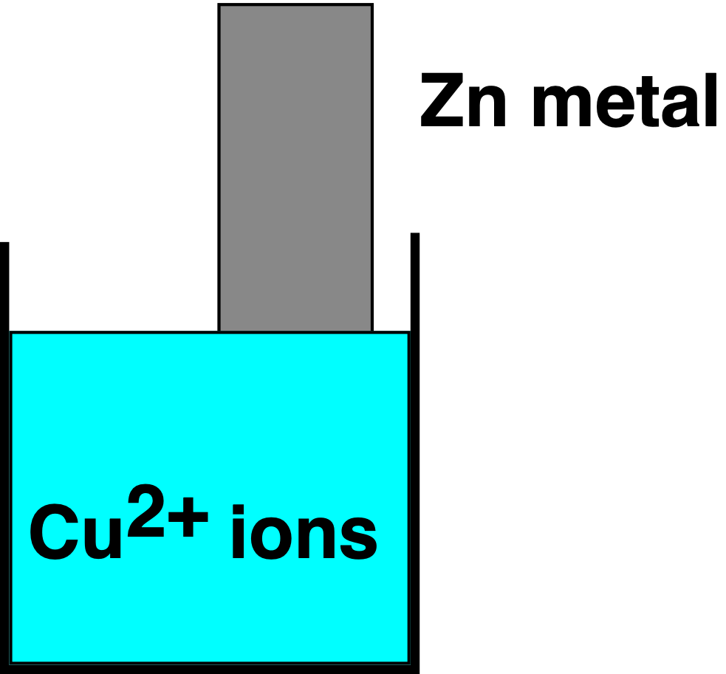
CHEMICAL CHANGE --> ELECTRIC CURRENT
Electrons are transferred from Zn to Cu²⁺, but there is no useful electric current.
Oxidation: Zn(s) → Zn²⁺(aq) + 2e-
Reduction: Cu²⁺(aq) + 2e- → Cu(s)
--------------------------------------------------------
Cu²⁺(aq) + Zn(s) → Zn²⁺(aq) + Cu(s)
MAR

Slide 33
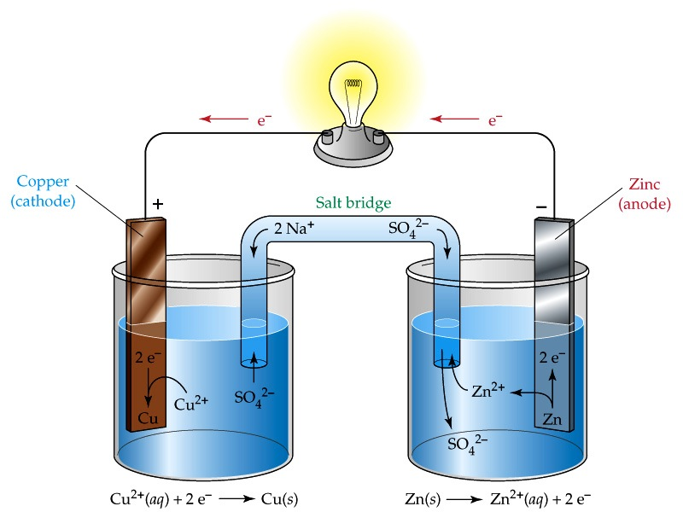
CHEMICAL CHANGE --> ELECTRIC CURRENT
To obtain a useful current, we separate the oxidizing and reducing agents so that electron transfer occurs through an external wire.
This is accomplished in a GALVANIC or VOLTAIC cell.
A group of such cells is called a battery.
MAR

Slide 34
Salt Bridge
Cu²⁺ + 2e- → Cu
Zn → Zn²⁺ + 2e-
Reduction
Cathode
Positive
Oxidation
Anode
Negative
Anions-->
<--Cations
Electrons travel through external wire.
Salt bridge allows anions and cations to move between electrode compartments, maintaining electrical neutrality.
MAR

Slide 35
A Red Cat and An Ox
Red Cat = REDuction
at the CAThode
Cu²⁺ + 2e- → Cu
An Ox = OXidation
at the ANode
Zn → Zn²⁺ + 2e-
also remember:
oxidation = reducing agent
reduction = oxidizing agent
MAR

Slide 36
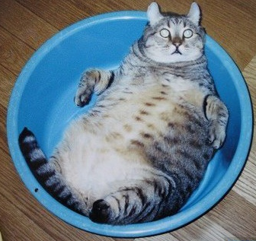
SHORTHAND NOTATION for GALVANIC CELLS
Cu²⁺(aq) + Zn(s) → Zn²⁺(aq) + Cu(s)
can also be written as:
anode half cell
cathode half cell
Zn(s) | Zn²⁺_{(aq)} || Cu²⁺_{(aq)} | Cu(s)
phase boundary
phase boundary
salt bridge
Electrons flow this way
oxidation
reduction
MAR
FAT CAT = electrons flow From Anode To CAThode

Slide 37
SHORTHAND NOTATION for GALVANIC CELLS
Example: Describe the following galvanic cell:
Cu(s) | Cu²⁺(1.0 M) || Cl₂(1.0 atm) | Cl⁻(1.0 M) | Pt(s)
Solution:
The anode (oxidation) is: Cu(s) → Cu²⁺_{(aq)} + 2 e⁻
and [Cu²⁺] = 1.0 M
The cathode (reduction) is: Cl₂(g) + 2 e⁻ → 2 Cl⁻_{(aq)}
and [Cl⁻] = 1.0 M and P(Cl₂) = 1.0 atm
The cathode uses a Platinum electrode to transfer electrons to the Cl_{2(g)}. The Pt does not react chemically with the electrons
MAR

Slide 38
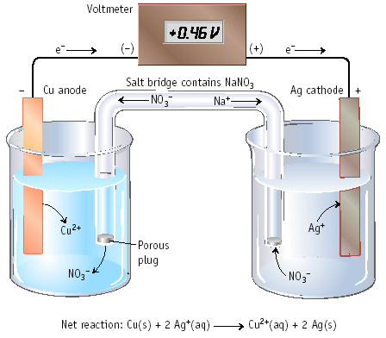
Cu | Cu²⁺ || Ag⁺ | Ag
Electrons move from anode to cathode in the wire.
Anions (mostly) move through the salt bridge.
MAR
Which species is being oxidized in the following reaction:
Zn(s) | Zn²⁺(aq) || Au⁺(aq) | Au(s)
Zn(s)
Zn²⁺(aq)
Au⁺(aq)
Au(s)
not a redox reaction
Enter your response on
your i>Clicker now!
Answer = A,
Zn(s)
left side shows anode (oxidation)
Zn(s) → Zn²⁺(aq) + 2 e⁻

Slide 39
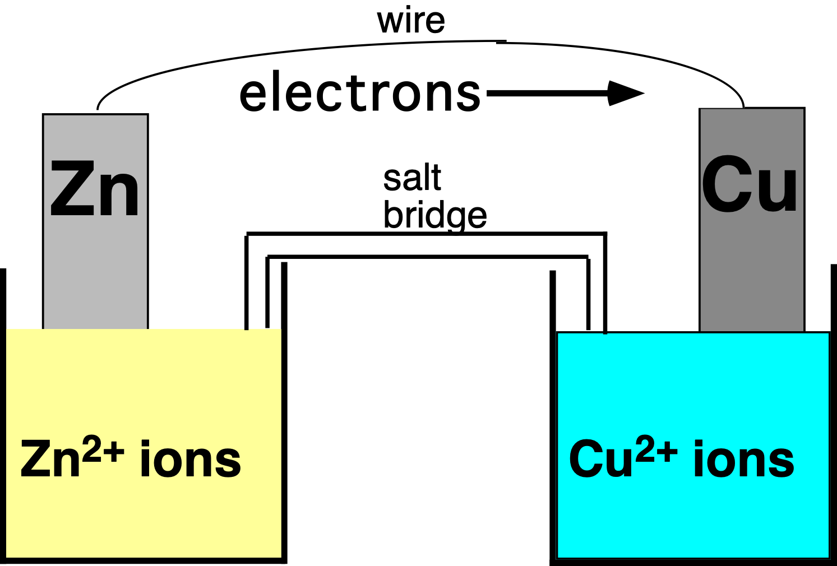
Sign of Battery Terminals (Galvanic Cells Only)
Anode,
site of oxidation,
negative
+
Cathode, site of reduction, positive
Electrons flow away from the "negative" terminal (anode) and to the "positive" terminal (cathode) in Galvanic cells
Electrolytic cells use opposite signs
MAR

Slide 40
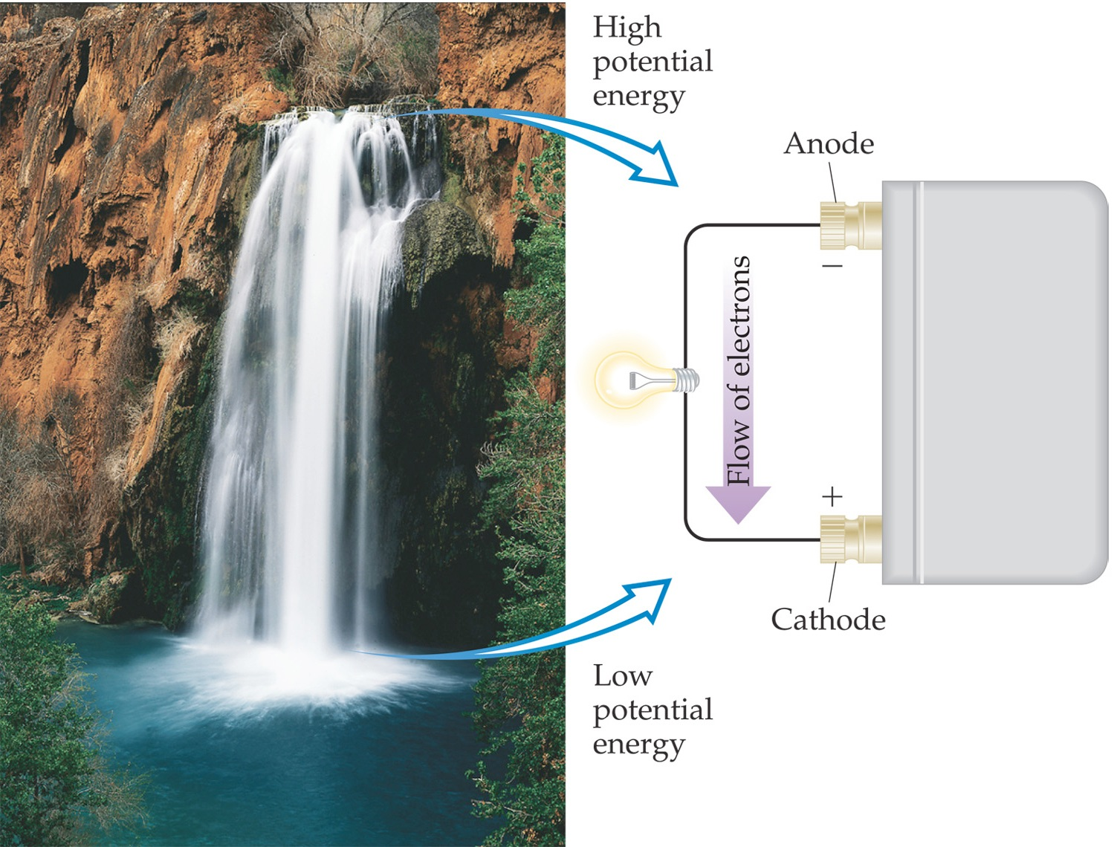
Electromotive Force (emf)
Water only spontaneously flows one way in a waterfall.
Likewise, electrons only spontaneously flow one way in a redox reaction—from higher to lower potential energy.
MAR

Slide 41
CELL POTENTIAL, E
1.10 V
1.0 M
1.0 M
Electrons are "driven" from anode to cathode by an electromotive force or emf.
For Zn/Cu cell, this is indicated by a voltage of 1.10 V at 25 ˚C and when [Zn²⁺] and [Cu²⁺] = 1.0 M.
Note that 1 V = 1 J/C, more on this later
MAR

Slide 42
CELL POTENTIAL, E
1.10 V
1.0 M
1.0 M
For Zn/Cu cell, voltage is 1.10 V at 25 ˚C and when [Zn²⁺] and [Cu²⁺] = 1.0 M.
This is the STANDARD CELL POTENTIAL, E˚
E˚ (measured in Volts, V) is a quantitative measure of the tendency for reactants to proceed to products when all are in their standard states at 1.0 M and 25 ˚C.
MAR

Slide 43
Calculating Cell Voltage
Balanced half-reactions can be added together to get overall, balanced equation.
Zn(s) → Zn²⁺(aq) + 2e-
Cu²⁺(aq) + 2e- → Cu(s)
--------------------------------------------
Cu²⁺(aq) + Zn(s) → Zn²⁺(aq) + Cu(s)
If we know Eº for each half-reaction, we can calculate Eº for net reaction.
MAR

Slide 44
CELL POTENTIALS, Eº
Cannot measure 1/2 reaction Eº directly. Therefore, measure it relative to a STANDARD HYDROGEN CELL, SHE.
(SHE = Standard Hydrogen Electrode)
2 H⁺(aq, 1 M) + 2e- ⇄ H₂(g, 1 atm)
Eº = 0.00 V
MAR

Slide 45
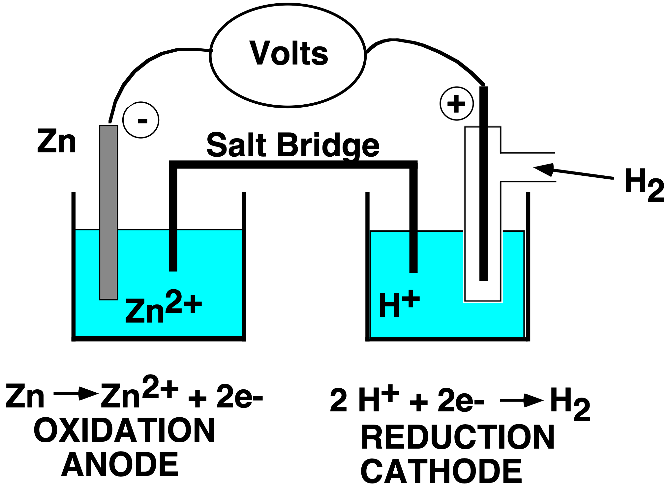
Zn and SHE
Zn/SHE half cell
Negative electrode
Positive electrode
Supplier of electrons
Acceptor of electrons
Zn → Zn²⁺ + 2e-
Oxidation
Anode
2 H⁺ + 2e-→ H₂
Reduction
Cathode
MAR
Eº for the cell = +0.76 V (measured)

Slide 46
Zn/SHE half cell
How to find the zinc half cell potential, E_{Zn}º:
Zn(s) → Zn²⁺(aq) + 2e- E_{Zn}º = ?
2 H⁺(aq) + 2e- → H₂(g) E_{H+}º = 0.00 V
---------------------------------------------------------------
Zn(s) + 2 H⁺ (aq) → Zn²⁺ + H₂(g) E_{net}º = +0.76 V
so E_{zn}º = E_{net}º - E_{H+}º = 0.76 - 0.00 = +0.76 V
Therefore, Eº for Zn → Zn²⁺(aq) + 2e- is +0.76 V
Zn is a better reducing agent than H₂.
MAR

Slide 47
Cu/Cu²⁺ and H₂/H⁺ Cell
Eº = +0.34 V
Positive
Negative
Acceptor of electrons
Supplier of electrons
Cu²⁺ + 2e- → Cu
Reduction
Cathode
H₂ → 2 H⁺ + 2e-
Oxidation
Anode
MAR

Slide 48
Cu/Cu²⁺ and H₂/H⁺ Cell
Overall reaction is reduction of Cu²⁺ by H₂ gas.
Cu²⁺ (aq) + H₂(g) → Cu(s) + 2 H⁺(aq)
Measured Eº = +0.34 V
Therefore, Eº for Cu²⁺ + 2e- → Cu is
+0.34 V
MAR

Slide 49
Zn/Cu Electrochemical Cell
+
Anode, negative, source of electrons
Cathode, positive, sink for electrons
Zn(s) → Zn²⁺(aq) + 2e- Eº = +0.76 V
Cu²⁺(aq) + 2e- → Cu(s) Eº = +0.34 V
---------------------------------------------------------------
Cu²⁺(aq) + Zn(s) → Zn²⁺(aq) + Cu(s)
Eº (calc'd) = +1.10 V
MAR
Determine the cell potential for the following reaction:
Ni(s) + Hg2²⁺(aq) → Ni²⁺(aq) + 2 Hg(l)
using the following:
Ni(s) → Ni²⁺(aq) + 2 e⁻ E° = 0.25 V
Hg2²⁺(aq) + 2 e⁻ → 2 Hg(l) E° = 0.79 V
-1.04 V
-0.54 V
0.54 V
1.04 V
0.00 V
Enter your response on
your i>Clicker now!
Answer = D,
1.04 V
Add 2 half reactions,
electrons cancel,
0.25 V + 0.79 V = 1.04 V

Slide 50
Uses of E° Values
Half-reactions organized by relative ability to act as oxidizing agents
Use tables of reduction potentials in your textbook or problem set to predict the direction of redox reactions.
MAR

Slide 51
Reversing Half Reactions
Reversing half reactions changes the sign but not the magnitude of E˚ values
Example:
Zn(s) → Zn²⁺(aq) + 2e- Eº = +0.76 V
would become
Zn²⁺(aq) + 2e- → Zn(s) Eº = -0.76 V
Because E˚ tables listed as reductions, many negative E˚ values will appear
Negative E˚ values imply great oxidizers / reducing agents
Positive E˚ values imply great reducers / oxidizing agents
MAR

Slide 52
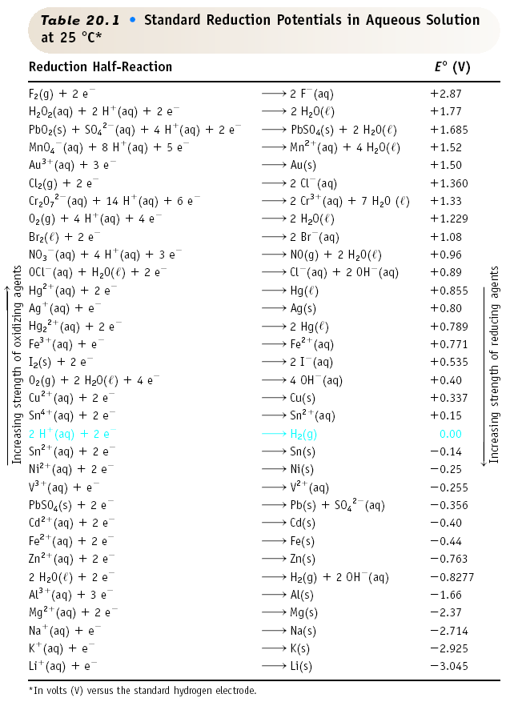
Table of Standard Reduction Potentials
reducing ability increases or oxidizing agent capacity increases
oxidizing
ability
increases
or reducing
agent
capacity
increases
MAR

Slide 53
Standard Redox Potentials, E°
Cu²⁺ + 2 e⁻ Cu
+0.34
2 H⁺ + 2 e- H₂
0.00
Zn²⁺ + 2e- Zn
-0.76
Any substance on the right will reduce any substance higher than it on the left.
Northwest-southeast rule: product-favored reactions occur between reducing agent at southeast corner (anode) and oxidizing agent at northwest corner (cathode).
MAR

Slide 54
Calculating Eº (Michael's Method)
Flip one half-reaction from table (and E˚ value), then add oxidation and reduction values
Example: Determine E˚ for the following:
2 Al + 3 Ni²⁺ → 2 Al³⁺ + 3 Ni
Solution: From redox tables we find:
Al³⁺ + 3 e⁻ → Al E˚ = -1.66 V
Ni²⁺ + 2 e⁻ → Ni E˚ = -0.25 V
Ni²⁺ ok as written; need to flip Al³⁺ reaction to:
Al → Al³⁺ + 3 e⁻ E˚ = +1.66 V
So: E˚ = 1.66 - 0.25 = 1.41 V
MAR

Slide 55
Calculating Eº
Calculate E˚_{net} for reaction between Cu and Ag⁺ ions
Ag⁺ + e⁻ → Ag E˚ = 0.80 V
Cu²⁺ + 2 e⁻ → Cu E˚ = 0.337 V
Ag⁺ ok as written; need to flip Cu²⁺ reaction to:
Cu → Cu²⁺ + 2 e⁻ E˚ = -0.337 V
Eº_{net} for Cu/Ag+ reaction = 0.80 - 0.337 = +0.46 V
balanced reaction: Cu + 2 Ag⁺ → 2 Ag + Cu²⁺
MAR

Slide 56
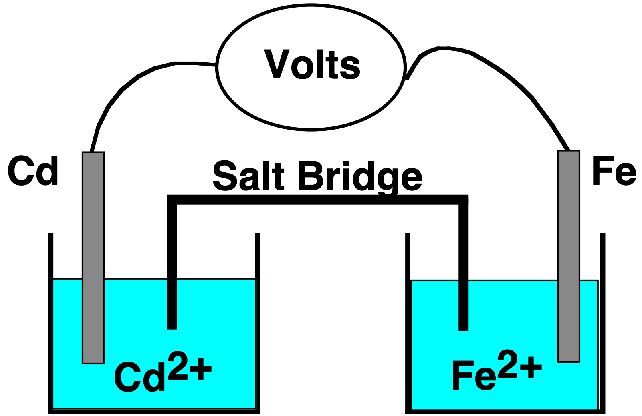
Eº for a Voltaic Cell
Cd → Cd²⁺ + 2e-
or
Cd²⁺ + 2e- → Cd
and
Fe²⁺ + 2e- → Fe
or
Fe → Fe²⁺ + 2e-
and
All ingredients are present.
Which way does the reaction proceed?
MAR

Slide 57
Eº for a Voltaic Cell
From tables, you see:
Fe²⁺ + 2 e⁻ → Fe E˚ = -.40
Cd²⁺ + 2 e⁻ → Cd E˚ = -.44
Reaction occurs spontaneously when E° values are positive
Overall reaction:
Fe²⁺ + Cd → Cd²⁺ + Fe
Eº = E˚_{cathode} - E˚_{anode}
= (-0.40 V) - (-0.44 V)
= +0.04 V
MAR

Slide 58
More About Calculating Cell Voltage
Can I⁻ ion reduce water? From tables:
2 H₂O + 2e- → H₂ + 2 OH⁻ E˚ = -.828 V
2 I⁻ → I₂ + 2e- E˚ = -.535 V
2 I⁻ + 2 H₂O → I₂ + 2 OH⁻ + H₂
Assuming reaction occurs as written,
E˚_{net} = E˚_{red} + E˚_{ox} = -0.828 V - 0.535 V = -1.363 V
Minus E˚ means rxn occurs in opposite direction!
I₂ + 2OH⁻ + H₂ → 2I⁻ + 2H₂O E˚ = +1.363 V
I⁻ ion does not reduce water spontaneously!
MAR
Will Hg(l) reduce Sn²⁺(aq) to Sn(s)?
Hg2²⁺(aq) + 2 e⁻ → 2 Hg(l) E° = 0.79 V
Sn²⁺(aq) + 2 e⁻ → Sn(s) E° = -0.14 V
yes
no
more info needed
Enter your response on
your i>Clicker now!
Answer = B,
no
Want to find E° for:
Sn²⁺(aq) + 2 Hg(l) → Sn(s) + Hg2²⁺(aq)
-0.79 V + -0.14 V = -0.93 V,
negative E° not spontaneous

Slide 59
More About Calculating Cell Voltage
Can we make the I⁻ ion reduce water?
2 I⁻ + 2 H₂O → I₂ + 2 OH⁻ + H₂ E° = -1.363 V
Non-spontaneous (negative E°) reactions can be "forced" to occur with external voltage
Voltage can be applied through battery, other voltaic cells, etc.
Applying 1.363 V to the above electrolytic cell will cause the I⁻ reduce water - electrolysis
Are we cheating the second law of thermodynamics?
MAR

Slide 60
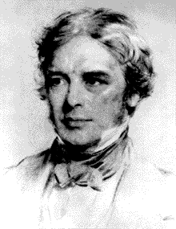
E° and ∆G°
E° is related to ∆G°, the free energy change for the reaction.
∆G° = - n F E°
where F = Faraday constant = 9.6485 x 10⁴ C/mol e⁻
and n is the number of moles of electrons transferred
Memorize the value of F!
Always use 96485 for F!
Michael Faraday
1791-1867
MAR
Notes:
Charge on 1 mol of e- (Chapter 2) = (1.6022 x 10⁻¹⁹ C/e-)(6.0221 x 10²³ e-/mol) = 96,485 C/mol e- = 1 Faraday

Slide 61
E° and ∆G°
∆G° = - n F E°
For a product-favored reaction
Reactants → Products
∆G° < 0 and so E° > 0
E° is positive
For a reactant-favored reaction
Reactants ⃪ Products
∆G° > 0 and so E° < 0
E° is negative
X
MAR
Determine ∆G° for the following reaction:
Sn²⁺(aq) + V(s) → Sn(s) + V²⁺(aq) E° = +1.07 V
206 kJ
103 kJ
0 kJ
-103 kJ
-206 kJ
Enter your response on
your i>Clicker now!
Answer = E,
-206 kJ
∆G° = - nFE°,
2 mol e⁻ transferred,
∆G° = - (2)(96485)(1.07 V)
∆G° = -206 kJ

Slide 62
Quantitative Aspects of Electrochemistry
Consider electrolysis of aqueous silver ion.
Ag⁺ (aq) + e- → Ag(s)
1 mol e- → 1 mol Ag
If we could measure the moles of e-, we could know the quantity of Ag formed.
But how to measure moles of e-?
MAR

Slide 63
Quantitative Aspects of Electrochemistry
A current of 1.50 amps (1.50 C/s) flows through a Ag⁺(aq) solution for 15.0 min. What mass of Ag metal is deposited?
Solution
(a) Calculate charge in Coulombs (C)
1.50 amps = 1.50 C/s
= (1.50 C/s)(60 s/min)(15.0 min) = 1350 C
MAR

Slide 64
Quantitative Aspects of Electrochemistry
A current of 1.50 amps (1.50 C/s) flows through a Ag⁺(aq) solution for 15.0 min. What mass of Ag metal is deposited?
Solution
(a) Charge = 1350 C
(b) Calculate moles of e- used (F = 96,485 C/mol e⁻)
(c) Calc. quantity of Ag
MAR

Slide 65
Quantitative Aspects of Electrochemistry
The anode reaction in a lead storage battery is
Pb(s) + HSO₄⁻(aq) → PbSO₄(s) + H⁺(aq) + 2e-
If a battery delivers 1.50 amp, and you have 454 g of Pb, how long will the battery last?
Solution
a) 454 g Pb = 2.19 mol Pb
b) Calculate moles of e-
c) Calculate charge
4.38 mol e- • 96,485 C/mol e- = 423,000 C
MAR

Slide 66
Quantitative Aspects of Electrochemistry
The anode reaction in a lead storage battery is
Pb(s) + HSO₄⁻(aq) → PbSO₄(s) + H⁺(aq) + 2e-
If a battery delivers 1.50 amp, and you have 454 g of Pb, how long will the battery last?
Solution
a) 454 g Pb = 2.19 mol Pb
b) Mol of e- = 4.38 mol
c) Charge = 423,000 C
d) Calculate time
About 78.3 hours
MAR
A gold plating process converts Au³⁺(aq) into Au(s). How long will it take to electrolyze a 0.0100 mol Au³⁺(aq) solution using a 2.00 Amp current?
483 s
4.83 x 10⁴ s
965 s
1450 s
all the time in the world...
Enter your response on
your i>Clicker now!
Answer = D, 1450 s
2.00 Amp = 2.00 Coulombs / sec
0.0100 mol Au³⁺ * (3 mol e⁻ / 1 mol Au³⁺) = 0.0300 mol e⁻
0.0300 mol e⁻ * (96485 C/mol e⁻) * (s / 2.00 C)
= 1450 s

Slide 67
The Nernst Equation
Q, the reaction quotient, can be related to non standard cell potentials, E
E is related to Q, the reaction quotient, by:
E = E° - (RT/nF) ln Q
where R = Gas constant (8.3145 J/K mol)
T = Temperature (K)
F = Faraday constant
E° = standard cell potential
and n = the number of moles of electrons transferred
MAR
This is the Nernst Equation (Handout)

Slide 68
The Nernst Equation
Cu²⁺(aq) + Zn(s) → Zn²⁺(aq) + Cu(s)
For Zn/Cu cell, voltage is 1.10 V at 25 ˚C when [Zn²⁺] and [Cu²⁺] = 1.0 M
Adding Cu²⁺_{(aq)} shifts reaction right (Le Chatelier's Principle), making reaction more spontaneous (∆G) and E° more positive
MAR

Slide 69
The Nernst Equation
Example: Find E when [Zn²⁺] = 0.0010 M, P(H₂) = 0.10 atm and pH = 0 at 290. K.
Solution: Find E° for reaction under standard conditions first
Zn(s) → Zn²⁺(aq) + 2e- E° = 0.76 V
2 H⁺(aq) + 2e- → H₂(g) E° = 0.00 V
--------------------------------------------------------
2 H⁺(aq) + Zn(s) → Zn²⁺(aq) + H₂(g)
E°_{net} = 0.76 V
Note that n = 2
MAR

Slide 70
The Nernst Equation
Example: Find E when [Zn²⁺] = 0.0010 M, P(H₂) = 0.10 atm and pH = 0 at 290. K. [H⁺] = 1.0 M
2 H⁺(aq) + Zn(s) → Zn²⁺(aq) + H₂(g) E°_{net} = 0.76 V
Solution
Use Nernst Equation:
E = E° - (RT/nF) ln Q
E = 0.76 V - (8.3145 * 290. K / 2 * 96485) ln Q
[H⁺] = 10^{-pH} M = 10⁻⁰ M = 1.0 M
Q = [Zn²⁺] * P_{H2} / [H⁺]² = [0.0010 * 0.10 / (1.0)²]
E = 0.76 V + 0.12 V = 0.88 V
MAR

Slide 71
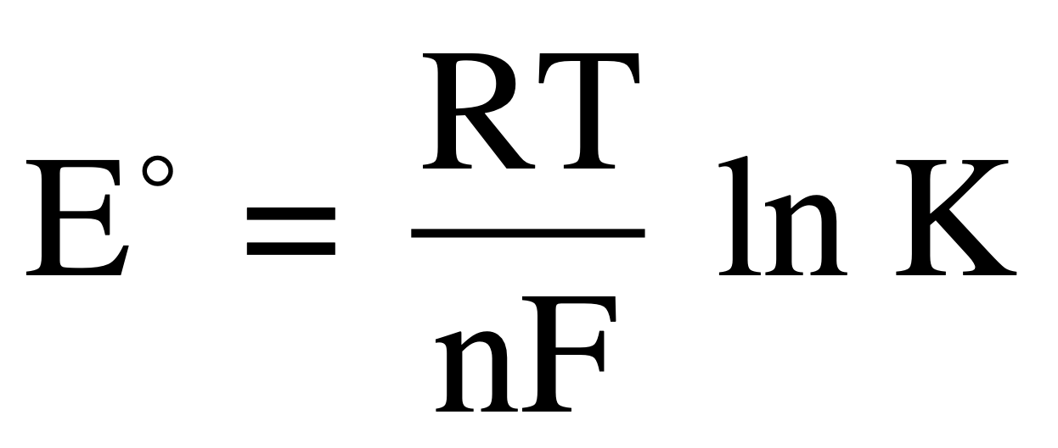
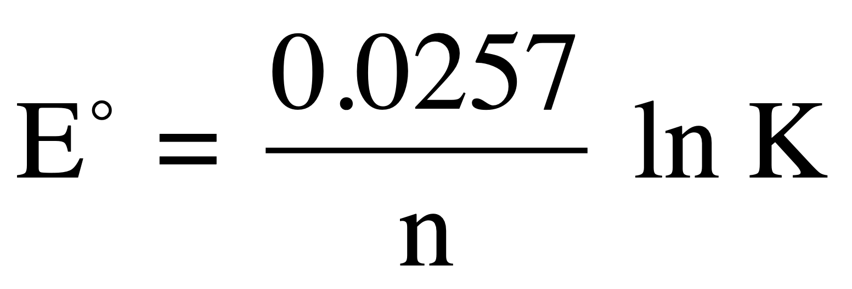
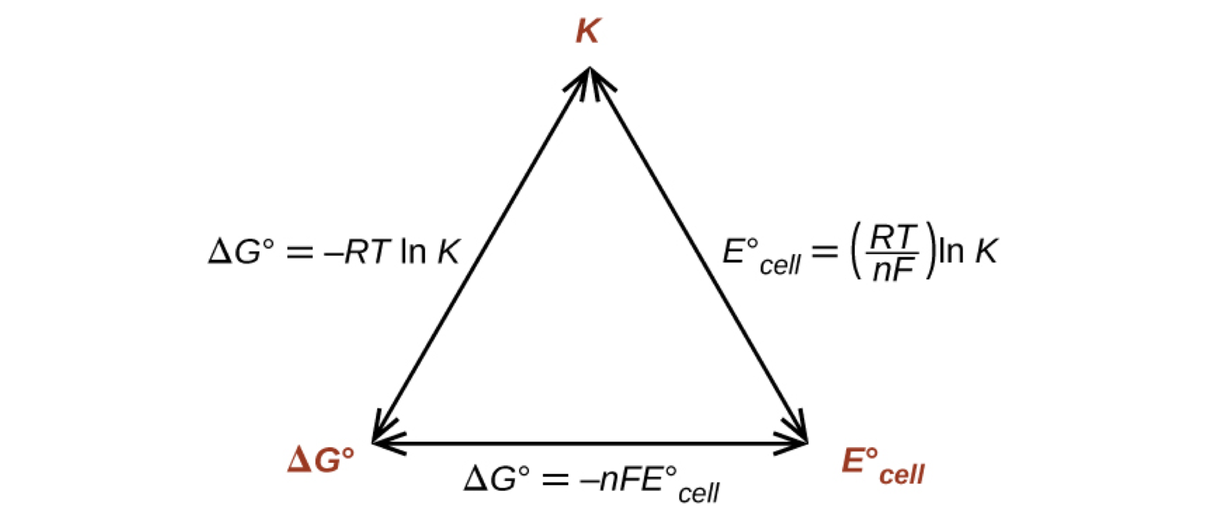
E° and K
At Equilibrium (K), combine ∆G expressions for E° and K to get:
If at 298 K, can use:
Only valid at 298 K!
Find equilibrium constants from E˚ data!
MAR

Slide 72
Electrochemical Processes in Batteries
A battery consists of self-contained voltaic cells arranged in series, so their individual voltages are added.
A primary battery cannot be recharged. The battery is “dead” when the cell reaction has reached equilibrium.
A secondary battery is rechargeable. Once it has run down, electrical energy is supplied to reverse the cell reaction and form more reactant.
MAR

Slide 73
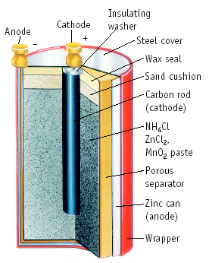
Dry Cell Battery
A primary battery - uses reactions that cannot be recharged
Anode (-)
Zn → Zn²⁺ + 2e-
Cathode (+)
2 NH₄⁺ + 2e- → 2 NH₃ + H₂
MAR

Slide 74
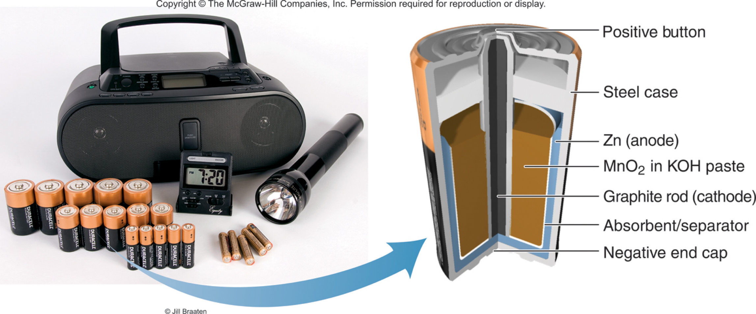
Alkaline Battery
Nearly same reactions as in common dry cell, but under basic conditions.
Anode (-): Zn + 2 OH⁻ ---> ZnO + H₂O + 2e-
Cathode (+): 2 MnO₂ + H₂O + 2e- ---> Mn₂O₃ + 2 OH⁻
Zn(s) + MnO2(s) + H2O(l) → ZnO(s) + Mn(OH)2(s)
Ecell = 1.5 V
MAR

Slide 75
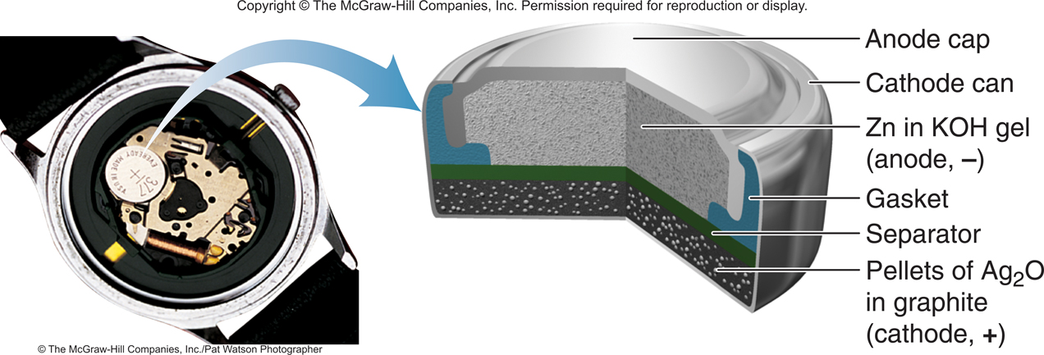
Silver Button Battery
Anode (oxidation): Zn(s) + 2OH⁻(aq) → ZnO(s) + H₂O(l) + 2e⁻
Cathode (reduction): Ag₂O(s) + H₂O(l) + 2e⁻ → 2Ag(s) + 2OH⁻(aq)
Overall (cell) reaction: Zn(s) + Ag₂O(s) → ZnO(s) + 2Ag(s)
E_{cell} = 1.6 V

Slide 76
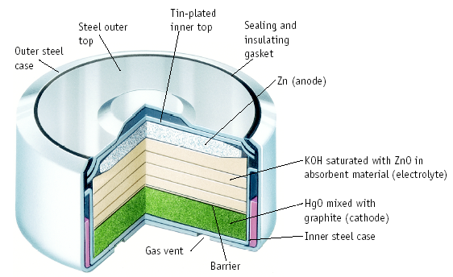
Mercury Button Battery
Anode:
Zn is reducing agent under basic conditions
Cathode:
HgO + H₂O + 2e- → Hg + 2 OH⁻
MAR

Slide 77
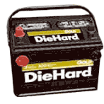
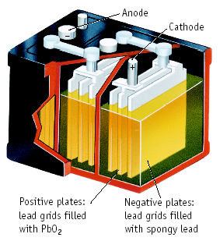
Lead-Acid Storage Battery
Anode (0.36 V): Pb(s) + HSO₄⁻(aq) → PbSO₄(s) + H⁺(aq) + 2e⁻
Cathode (1.68 V):
PbO₂(s) + 3H⁺(aq) + HSO₄⁻(aq) + 2e⁻ → PbSO₄(s) + 2H₂O(l)
Overall (cell) reaction (discharge):
PbO₂(s) + Pb(s) + H₂SO₄(aq) → 2PbSO₄(s) + 2H₂O(l) E_{cell} = 2.04 V
Overall (cell) reaction (recharge):
2PbSO₄(s) + 2H₂O(l) → PbO₂(s) + Pb(s) + H₂SO₄(aq)
A secondary battery - can be recharged, reversible redox reactions
MAR

Slide 78
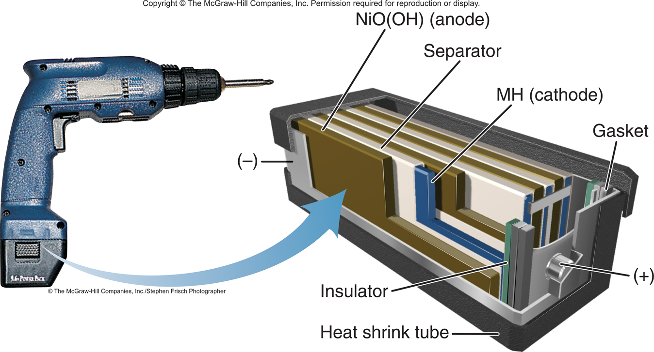
Nickel-Cadmium Battery
Anode (-):
Cd + 2 OH⁻ → Cd(OH)₂ + 2e-
Cathode (+):
NiO(OH) + H₂O + e- → Ni(OH)₂ + OH⁻
Overall cell:
2 NiO(OH) + 2 H₂O + Cd → 2 Ni(OH)₂ + Cd(OH)₂ Ecell = 1.4 V
MAR

Slide 79
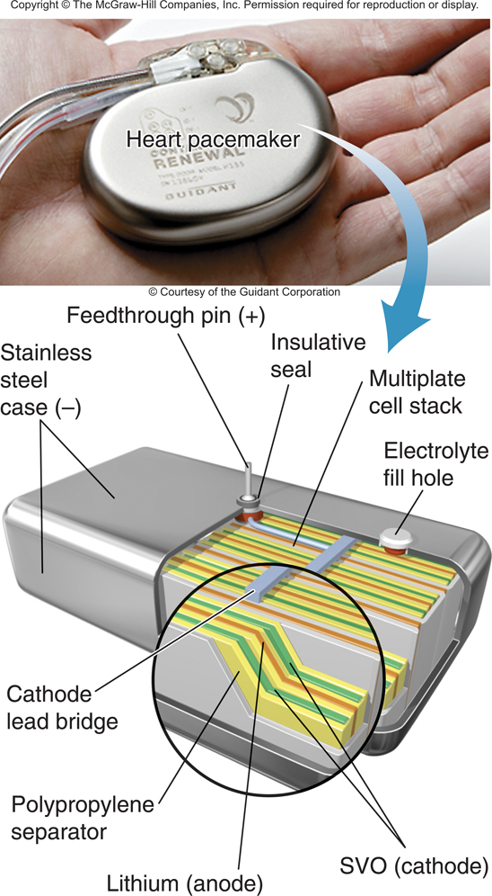
Lithium Battery
The primary lithium battery is widely used in watches, implanted medical devices, and remote-control devices.
Anode (oxidation):
3.5Li(s) → 3.5Li⁺ + 3.5e⁻
Cathode (reduction):
AgV₂O_{5.5} + 3.5Li⁻ + 3.5e⁻ → Li_{3.5}V₂O_{5.5}
Overall (cell) reaction:
AgV₂O_{5.5} + 3.5Li(s) → Li_{3.5}V₂O_{5.5}

Slide 80
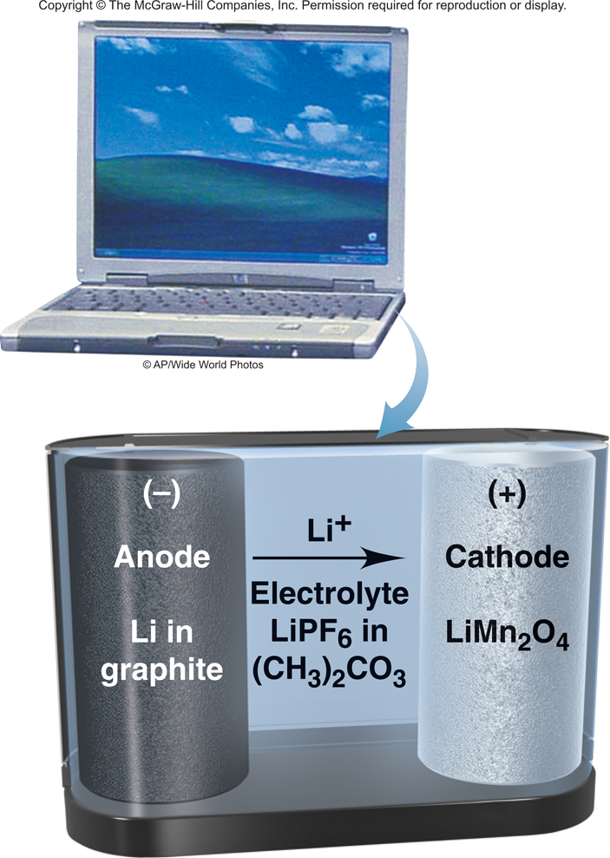
Lithium-Ion Battery
Anode (oxidation):
Li_{x}C₆(s) → xLi⁺ + xe⁻ + C₆(s)
Cathode (reduction):
Li_{1-x}Mn₂O₄(s) + xLi⁺ + xe⁻ → LiMn₂O₄(s)
Overall (cell) reaction:
Li_{x}C₆(s) + Li_{1-x}Mn₂O₄(s) → LiMn₂O₄(s)
E_{cell} = 3.7 V
The secondary (rechargeable) lithium-ion battery is used to power laptop computers, cell phones, and camcorders.

Slide 81
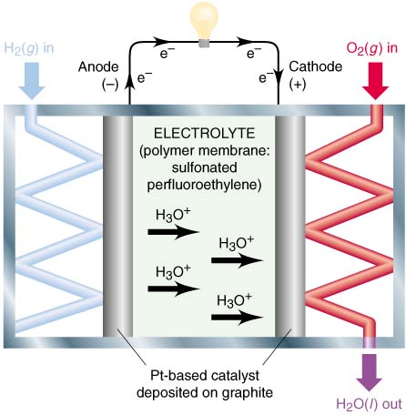
Hydrogen Fuel Cell
In a fuel cell reactants enter the cell and products leave, generating electricity through controlled combustion.
Reaction rates are lower in fuel cells than in other batteries, so an electrocatalyst is used to decrease the activation energy.
Anode (oxidation): 2H₂(g) → 4H⁺(aq) + 4e⁻
Cathode (reduction): O₂(g) + 4H⁺(aq) + 4e⁻ → 2H₂O(g)
Overall (cell) reaction: 2H₂(g) + O₂(g) → 2H₂O(g) E_{cell} = 1.2 V

Slide 82
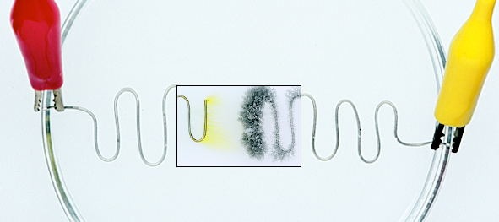
Electrolysis
Using external electrical energy to produce chemical change in a nonspontaneous reaction
Sn²⁺(aq) + 2 Cl⁻(aq) → Sn(s) + Cl₂(g)
SnCl₂(aq)
Cl₂
Sn
MAR

Slide 83
A tin-copper reaction as a voltaic and electrolytic cell
Sn(s) → Sn²⁺(aq) + 2e⁻
Cu²⁺(aq) + 2e⁻ → Cu(s)
Cu(s) → Cu²⁺(aq) + 2e⁻
Sn²⁺(aq) + 2e⁻ → Sn(s)
Cu²⁺(aq) + Sn(s) → Cu(s) + Sn²⁺(aq)
Sn²⁺(aq) + Cu(s) → Sn(s) + Cu²⁺(aq)
voltaic cell, Ecell = 0.48 V
electrolytic cell, Ecell = -0.48 V

Slide 84
Electrolysis of Aqueous NaOH
Electric Energy ----> Chemical Change
Anode (+) Eº = -0.40 V
4 OH⁻ → O₂(g) + 2 H₂O + 2e-
Cathode (-) Eº = -0.83 V
4 H₂O + 4e- → 2 H₂ + 4 OH⁻
Eº for cell = -1.23 V
MAR

Slide 85
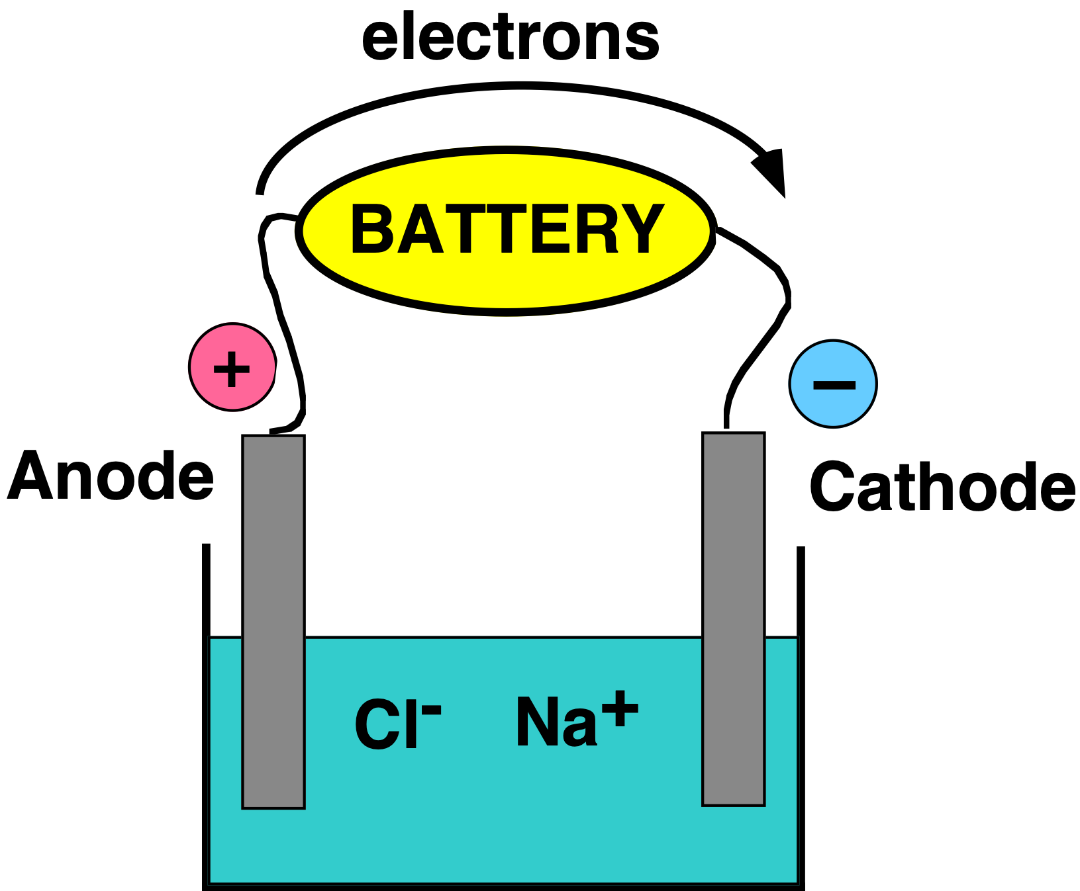
Electrolysis Electric Energy ---> Chemical Change
Electrolysis of molten NaCl.
Here a battery "pumps" electrons from Cl⁻ to Na⁺.
Polarity of electrodes is reversed from batteries.
MAR

Slide 86
Electrolysis of Molten NaCl
Anode (+) Eº = -1.36 V
2 Cl⁻ → Cl₂(g) + 2e-
Cathode (-) Eº = -2.71 V
Na⁺ + e- → Na
Eº for cell = -4.07 V
External energy needed because Eº is (-).
MAR

Slide 87
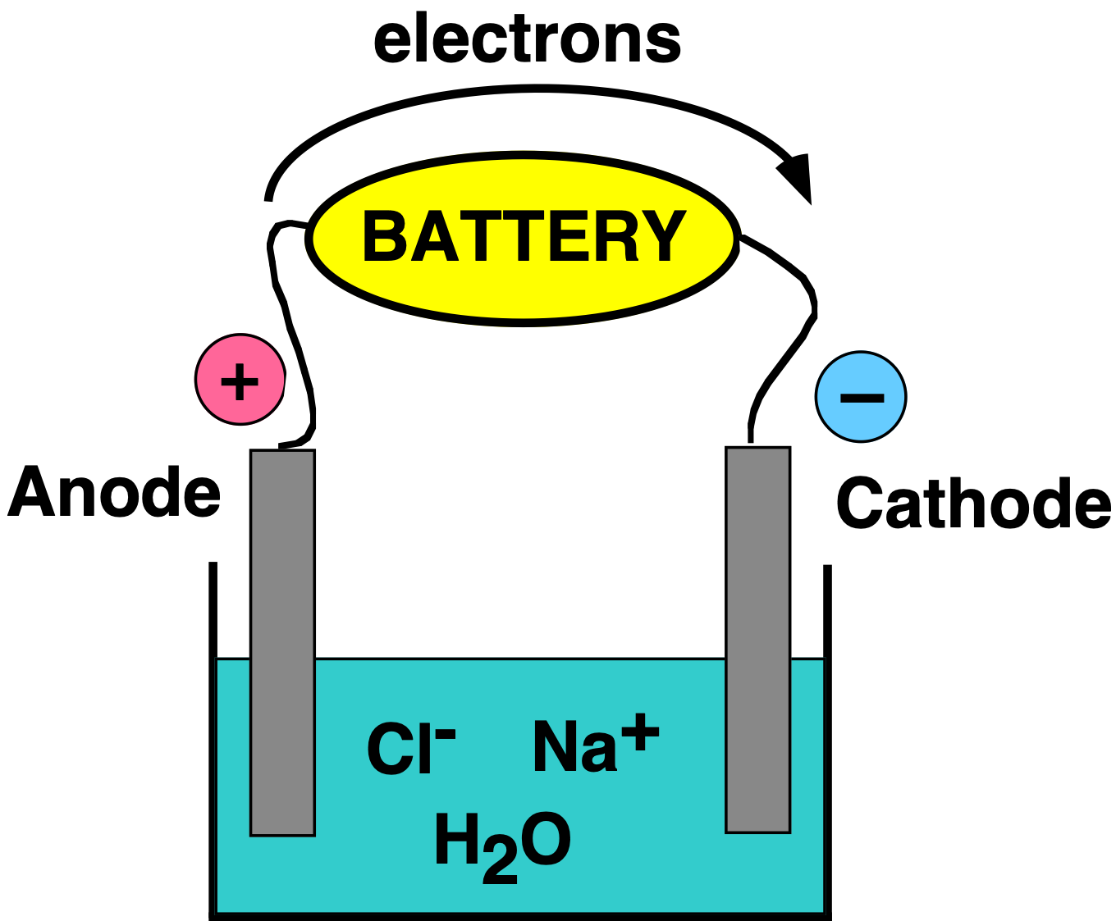
Electrolysis of Aqueous NaCl
Anode (+) Eº = -1.36 V
2 Cl⁻ → Cl₂(g) + 2e-
Cathode (-) Eº = -0.83 V
2 H₂O + 2e- → H₂ + 2 OH⁻
Eº for cell = -2.19 V
Note that H₂O is more
easily reduced than Na⁺.
Also, Cl⁻ is oxidized in preference to H₂O because of kinetics.
MAR

Slide 88
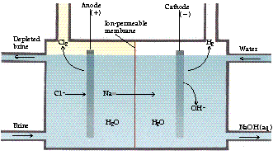
Electrolysis of Aqueous NaCl
Cells like these are the source of NaOH and Cl₂.
In 2006
65 million tons Cl₂
81 million tons NaOH
Also the source of NaOCl for use in bleach.
MAR

Slide 89
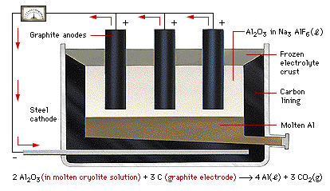
Producing Aluminum
2 Al₂O₃ + 3 C → 4 Al + 3 CO₂
Charles Hall (1863-1914) developed electrolysis process, founded Alcoa (alcoa.com)
MAR

Slide 90
End of
Chapter 17
See:
Chapter Seventeen Study Guide
Chapter Seventeen Concept Guide
Types of Equilibrium Constants
Important Equations (following this slide)
End of Chapter Problems (following this slide)
MAR

Slide 91
Important Equations, Constants, and Handouts
from this Chapter:
Redox Reactions: oxidation, reduction, LEO, GER, oxidizing agent, reducing agent, anode, cathode, galvanic/voltaic cells, electrolysis (electrolytic cells), shorthand notation for galvanic cells, SHE electrode
∆G° = - n F E°
E = E° - (RT/nF) ln Q
R = 8.3145 J mol⁻¹ K⁻¹
F = 9.6485 x 10⁴ C/mol e⁻
know how to balance redox reactions in acid or base conditions
be able to calculate Eº and E for cells
Handouts:
Thermodynamic Values and Electrochemical Cell Values (Problem Set #5)

Slide 92
End of Chapter Problems: Test Yourself
You will need the table of reduction potentials found in problem set #5
Write a balanced equation for the following half-reaction: VO3⁻¹(aq) → V²⁺(aq) (in acid)
Write a balanced equation for the following half-reaction: Ag(s) → Ag2O(s) (in base)
Balance the following redox equation in acid: Zn(s) + NO3⁻¹(aq) → Zn²⁺(aq) + N2O(g)
Balance the following redox equation in base: CrO4²⁻(aq) + SO3²⁻(aq) → Cr(OH)3(s) + SO4²⁻(aq)
Balance the following unbalanced equation in acid, then calculate the standard redox potential, E°: Cu(s) + NO3⁻¹(aq) → Cu²⁺(aq) + NO(g)
Calculate E°, ∆G° and the equilibrium constant for the following reaction: 2 Fe³⁺(aq) + 2 I⁻¹(aq) → 2 Fe²⁺(aq) + I2(aq)

Slide 93
End of Chapter Problems: Answers
VO3–(aq) + 6 H⁺(aq) + 3 e– → V²⁺(aq) + 3 H2O(l)
2 Ag(s) + 2 OH–(aq) → Ag2O(s) + H2O(l) + 2 e–
4 Zn(s) + 2 NO3–(aq) + 10 H⁺(aq) → 5 H2O(l) + 4 Zn²⁺(aq) + N2O(g)
2 CrO4²⁻(aq) + 5 H2O(l) + 3 SO3²⁻(aq) → 2 Cr(OH)3(s) + 4 OH⁻(aq) + 3 SO4²⁻(aq)
3 Cu(s) + 2 NO3⁻¹(aq) + 8 H⁺(aq) → 2 NO(g) + 3 Cu²⁺(aq) + 4 H2O(l), E° = 0.62 V
E° = 0.236 V, ∆G° = -45.5 kJ, K = 9 x 10⁷
You will need the table of reduction potentials found in problem set #5

