Slide 1
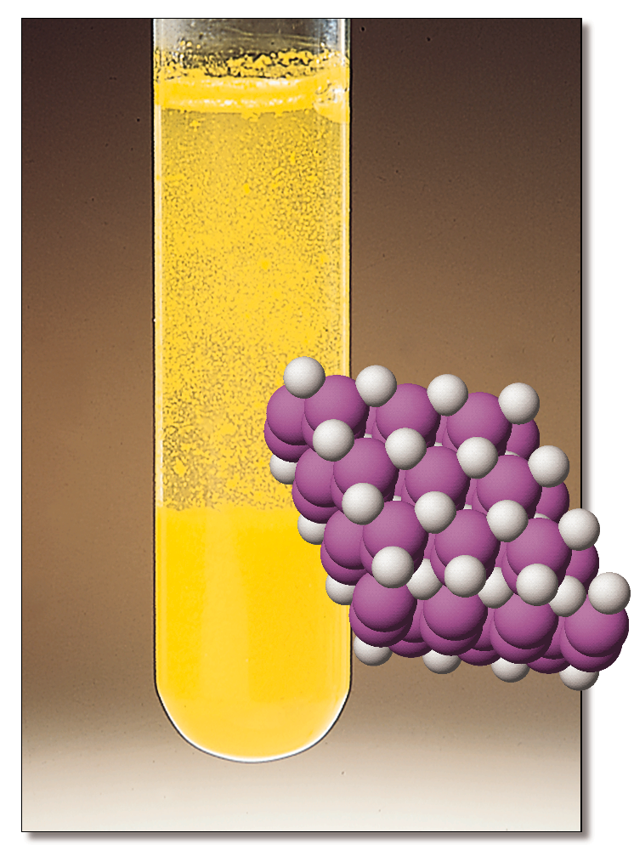
PRECIPITATION REACTIONS Chapter 15
Chemistry 223
Professor Michael Russell
MAR
Last update:
4/29/24

Slide 2
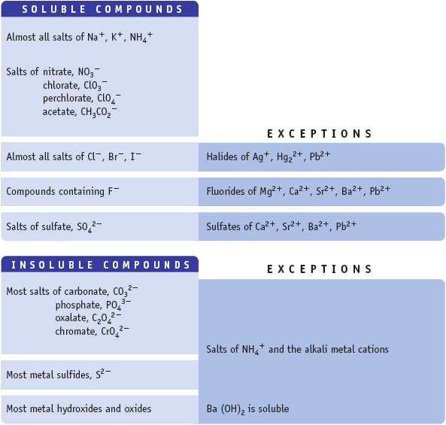
Flashback - Aqueous Salts!
If one ion from the “Soluble Compd.” list is present in a compound, the compound is water soluble.
Ba(NO3)2(aq)?
soluble
BaCl2(aq)?
soluble
BaSO4(aq)?
insoluble, BaSO4(s)
MAR

Slide 3
Solubility of a Salt
Consider NaCl dissolving in water:
NaCl(s) qe Na⁺(aq) + Cl⁻(aq)
Solubility of NaCl exceeded when solid precipitate does not dissolve
MAR

Slide 4
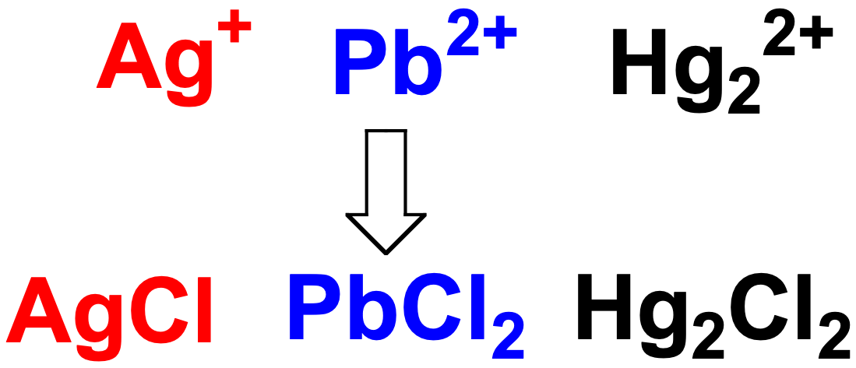
Analysis of Silver Group
All salts formed in this experiment are said to be INSOLUBLE
They form when mixing moderately concentrated solutions of the metal ion with chloride ions.
MAR
Notes:
AgCl precipitation video from “Beautiful chemistry” (http://beautifulchemistry.net) accessed 10/13/2014

Slide 5
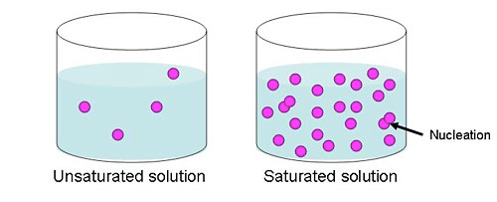
Analysis of Silver Group
Although all salts formed in this experiment are said to be insoluble, they do dissolve to some SLIGHT extent.
AgCl(s) qe Ag⁺(aq) + Cl⁻(aq)
When equilibrium has been established, no more AgCl dissolves and the solution is SATURATED.
MAR

Slide 6
Analysis of Silver Group
AgCl(s) qe Ag⁺(aq) + Cl⁻(aq)
When solution is SATURATED, expt. shows that [Ag⁺] = 1.67 x 10⁻⁵ M.
This is equivalent to the SOLUBILITY of AgCl.
What is [Cl⁻]?
This is also equivalent to the AgCl solubility, so [Cl⁻] = 1.67 x 10⁻⁵ M
MAR

Slide 7
Analysis of Silver Group
This type of K_{c} is the product of "solubilities", we call it
K_{sp} = solubility product constant
See: Solubility Guide
AgCl(s) qe Ag⁺(aq) + Cl⁻(aq)
Saturated solution has
[Ag⁺] = [Cl⁻] = 1.67 x 10⁻⁵ M
Use this to calculate K_{c}
K_{c} = [Ag⁺] [Cl⁻]
= (1.67 x 10⁻⁵)(1.67 x 10⁻⁵)
= 2.79 x 10⁻¹⁰
MAR

Slide 8
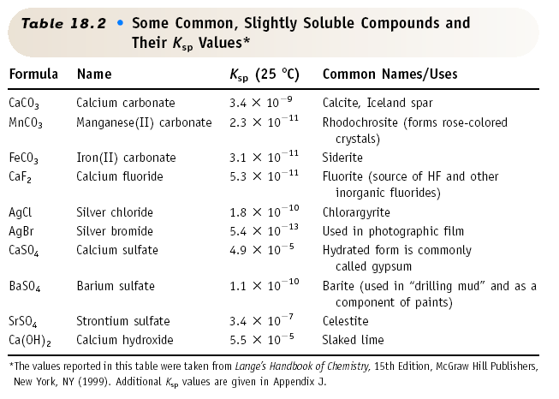
Soluble Compounds
MAR

Slide 9
Lead(II) Chloride
PbCl₂(s) qe Pb²⁺(aq) + 2 Cl⁻(aq)
K_{sp} = 1.9 x 10⁻⁵
MAR
Which of the following correctly displays the equation used to describe the Ksp for barium fluoride dissolving in water?
BaF₂(s) ⇌ BaF2(aq)
BaF₂(s) ⇌ Ba²⁺(aq) + F2²⁻(aq)
BaF₂(s) ⇌ Ba²⁺(aq) + 2 F–(aq)
BaF(s) ⇌ Ba²⁺(aq) + F–(aq)
Ba²⁺(aq) + 2 F–(aq) ⇌ BaF₂(s)
Enter your response on
your i>Clicker now!
Answer = C,
BaF₂(s) ⇌ Ba²⁺(aq) + 2 F–(aq)
solid as reactant,
ions as products

Slide 10
Solubility of Lead(II) Iodide
Consider PbI₂ dissolving in water
PbI₂(s) qe Pb²⁺(aq) + 2 I⁻(aq)
Calculate K_{sp} if solubility = 0.00130 M
Solution
Solubility refers to how many moles of solid dissolve per L
1. Solubility = [Pb²⁺] = 1.30 x 10⁻³ M
[I⁻] = 2 x [Pb²⁺] = 2.60 x 10⁻³ M
MAR

Slide 11
Solubility of Lead(II) Iodide
Consider PbI₂ dissolving in water
PbI₂(s) qe Pb²⁺(aq) + 2 I⁻(aq)
Calculate K_{sp} if solubility = 0.00130 M
Solution
1. Solubility = [Pb²⁺] = 1.30 x 10⁻³ M
[I⁻] = 2 x [Pb²⁺] = 2.60 x 10⁻³ M
2. K_{sp} = [Pb²⁺] [I⁻]²
= [Pb²⁺] {2 • [Pb²⁺]}²
= 4 [Pb²⁺]³
MAR

Slide 12
Solubility of Lead(II) Iodide
Consider PbI₂ dissolving in water
PbI₂(s) qe Pb²⁺(aq) + 2 I⁻(aq)
Calculate K_{sp} if solubility = 0.00130 M
Solution
2. K_{sp} = 4[Pb²⁺]³ = 4(solubility)³
K_{sp} = 4 (1.30 x 10⁻³)³ = 8.79 x 10⁻⁹
Notice that solubility of PbI₂ (x) and K_{sp} related here by: K_{sp} = 4x³
MAR

Slide 13
Solubility and K_{sp} Relations
# cations | # anions | K_{sp} and solubility (x) | Examples
1 | 1 | K_{sp} = x² x = (Ksp)^{1/2} | NaCl, SrO, KClO₃
1 | 2 | K_{sp} = 4x³ x = (Ksp/4)^{1/3} | PbI₂, Mg(OH)₂
2 | 1 | K_{sp} = 4x³ x = (Ksp/4)^{1/3} | Na₂O, (NH₄)₂SO₃
3 | 1 | K_{sp} = 27x⁴ x = (Ksp/27)^{1/4} | Li₃P, (NH₄)₃PO₄
1 | 3 | K_{sp} = 27x⁴ x = (Ksp/27)^{1/4} | AlBr₃, Cr(NO₃)₃
2 | 3 | K_{sp} = 108x⁵ x = (Ksp/108)^{1/5} | Fe₂O₃, Al₂(SO₄)₃
3 | 2 | K_{sp} = 108x⁵ x = (Ksp/108)^{1/5} | Ti₃As₂, Mg₃(PO₄)₂
See: Solubility Guide
MAR

Slide 14
Solubility and K_{sp} Relations
Example: What is the solubility of copper(II) phosphate if K_{sp} = 1.4*10⁻³⁷?
Answer: Formula = Cu₃(PO₄)₂
3 cations & 2 anions, so K_{sp} = 108x⁵
x = (1.4*10⁻³⁷/108)^{(1/5)} = 1.7*10⁻⁸ M
Example: What is K_{sp} for magnesium carbonate if the solubility at 25 ˚C is 2.6*10⁻³ M?
Answer: Formula = MgCO₃,
1 cation & 1 anion, so K_{sp} = x²
K_{sp} = (2.6*10⁻³)² = 6.8*10⁻⁶
MAR
The solubility of barium sulfate is found to be 1.05 x 10⁻⁵. The Ksp value is:
3.24 x 10⁻³
1.05 x 10⁻⁵
2.10 x 10⁻⁵
1.10 x 10⁻¹⁰
1.20 x 10⁻¹⁵
Enter your response on
your i>Clicker now!
Answer = D,
1.10 x 10⁻¹⁰
BaSO4: 1:1 ion
Ksp = x²
= (1.05 x 10⁻⁵)²

Slide 15
Precipitating an Insoluble Salt
Hg₂Cl₂(s) qe Hg₂²⁺(aq) + 2 Cl⁻(aq)
K_{sp} = 1.1 x 10⁻¹⁸ = [Hg₂²⁺] [Cl⁻]²
If [Hg₂²⁺] = 0.010 M, what [Cl⁻] is req'd to just begin the precipitation of Hg₂Cl₂?
That is, what is the maximum [Cl⁻] that can be in solution with 0.010 M Hg₂²⁺ without forming Hg₂Cl₂?
MAR

Slide 16
Precipitating an Insoluble Salt
Hg₂Cl₂(s) qe Hg₂²⁺(aq) + 2 Cl⁻(aq)
K_{sp} = 1.1 x 10⁻¹⁸ = [Hg₂²⁺] [Cl⁻]²
Solution
[Cl⁻] that can exist when [Hg₂²⁺] = 0.010 M:
If this conc. of Cl⁻ is just exceeded, Hg₂Cl₂ begins to precipitate.
MAR

Slide 17
Precipitating an Insoluble Salt
Hg₂Cl₂(s) qe Hg₂²⁺(aq) + 2 Cl⁻(aq)
K_{sp} = 1.1 x 10⁻¹⁸
Now raise [Cl⁻] to 1.0 M when [Hg₂²⁺] = 0.010 M. What is the value of [Hg₂²⁺] at this point?
Solution
[Hg₂²⁺] = K_{sp} / [Cl⁻]²
= K_{sp} / (1.0)² = 1.1 x 10⁻¹⁸ M
The concentration of Hg₂²⁺ has been reduced by 10¹⁶!
MAR
What concentration of CO₃²⁻ is required to begin the precipitation of insoluble SrCO₃ from a solution containing 0.050 M Sr²⁺? (K_{sp} for SrCO₃ = 5.6 x 10⁻¹⁰)
0.050 M
5.6 x 10⁻¹⁰ M
2.8 x 10⁻¹⁰ M
1.1 x 10⁻⁸ M
7.7 x 10⁻¹⁵ M
Enter your response on
your i>Clicker now!
Answer = D,
1.1 x 10⁻⁸ M
Ksp = [Sr²⁺][CO3²⁻], so
[CO3²⁻] = 5.6 x 10⁻¹⁰ / 0.050

Slide 18
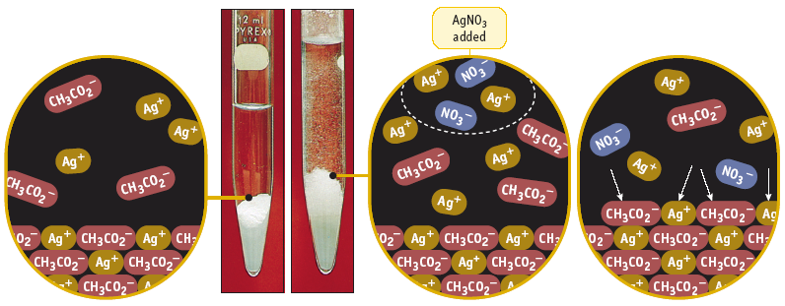
The Common Ion Effect
Adding an ion "common" to an equilibrium causes the equilibrium to shift back to reactant.
MAR

Slide 19
Common Ion Effect Adding an Ion "Common" to an Equilibrium
MAR

Slide 20
The Common Ion Effect
Calculate the solubility of BaSO₄ in (a) pure water and (b) in 0.010 M Ba(NO₃)₂.
K_{sp} for BaSO₄ = 1.1 x 10⁻¹⁰ = [Ba²⁺] [SO₄²⁻]
BaSO₄(s) qe Ba²⁺(aq) + SO₄²⁻(aq)
Solution: (part a)
Solubility in pure water = [Ba²⁺] = [SO₄²⁻] = x
K_{sp} = [Ba²⁺] [SO₄²⁻] = x²
x = (K_{sp})^{1/2} = 1.0 x 10⁻⁵ M
Note 1:1 ratio of cation to anion: K_{sp} = x²
MAR

Slide 21
The Common Ion Effect
Calculate the solubility of BaSO₄ in (a) pure water and (b) in 0.010 M Ba(NO₃)₂.
K_{sp} for BaSO₄ = 1.1 x 10⁻¹⁰ = [Ba²⁺] [SO₄²⁻]
BaSO₄(s) qe Ba²⁺(aq) + SO₄²⁻(aq)
Solution: (part b)
So... Solubility in pure water = 1.0 x 10⁻⁵ mol/L.
Now dissolve BaSO₄ in water already containing 0.010 M Ba²⁺.
Which way will the "common ion" shift the equilibrium? ___ Will solubility of BaSO₄ be less than or greater than in pure water?___
MAR

Slide 22
The Common Ion Effect
Calculate the solubility of BaSO₄ in (a) pure water and (b) in 0.010 M Ba(NO₃)₂.
K_{sp} for BaSO₄ = 1.1 x 10⁻¹⁰ = [Ba²⁺] [SO₄²⁻]
BaSO₄(s) qe Ba²⁺(aq) + SO₄²⁻(aq)
Solution: (part b)
[Ba²⁺] [SO₄²⁻]
initial 0.010 0
change + y + y
equilib. 0.010 + y y
MAR

Slide 23
The Common Ion Effect
Calculate the solubility of BaSO₄ in (a) pure water and (b) in 0.010 M Ba(NO₃)₂.
K_{sp} for BaSO₄ = 1.1 x 10⁻¹⁰ = [Ba²⁺] [SO₄²⁻]
BaSO₄(s) qe Ba²⁺(aq) + SO₄²⁻(aq)
Solution: (part b)
K_{sp} = [Ba²⁺] [SO₄²⁻] = (0.010 + y) (y)
Because y < 1.0 x 10⁻⁵ M (= x, the solubility in pure water), this means 0.010 + y is about equal to 0.010. Therefore,
K_{sp} = 1.1 x 10⁻¹⁰ = (0.010)(y)
y = 1.1 x 10⁻⁸ M = solubility in presence of added Ba²⁺ ion.
MAR

Slide 24
The Common Ion Effect
Calculate the solubility of BaSO₄ in (a) pure water and (b) in 0.010 M Ba(NO₃)₂.
K_{sp} for BaSO₄ = 1.1 x 10⁻¹⁰ = [Ba²⁺] [SO₄²⁻]
BaSO₄(s) qe Ba²⁺(aq) + SO₄²⁻(aq)
Solution:
Solubility in pure water = x = 1.0 x 10⁻⁵ M
Solubility in presence of added Ba²⁺
= 1.1 x 10⁻⁸ M
Le Chatelier's Principle is followed!
See: Solubility Guide
MAR
Notes:
BaSO4 video from “Beautiful chemistry” (http://beautifulchemistry.net) accessed 10/13/2014

Slide 25
DISTRACTIONS!!!
MAR

Slide 26
Separating Metal Ions Cu²⁺, Ag⁺, Pb²⁺
K_{sp} Values
AgCl 1.8 x 10⁻¹⁰
PbCl₂ 1.7 x 10⁻⁵
PbCrO₄ 1.8 x 10⁻¹⁴
MAR

Slide 27
Separating Salts by Differences in K_{sp}
A solution contains 0.020 M Ag⁺ and 0.020 M Pb²⁺. Add CrO₄²⁻ to precipitate red Ag₂CrO₄ and yellow PbCrO₄. Which precipitates first?
K_{sp} for Ag₂CrO₄ = 9.0 x 10⁻¹² = [Ag⁺]² [CrO₄²⁻]
K_{sp} for PbCrO₄ = 1.8 x 10⁻¹⁴ = [Pb²⁺] [CrO₄²⁻]
Solution
The substance whose K_{sp} is first exceeded precipitates first.
The ion requiring the lesser amount of CrO₄²⁻ ppts. first.
MAR

Slide 28
Separating Salts by Differences in K_{sp}
A solution contains 0.020 M Ag⁺ and 0.020 M Pb²⁺. Add CrO₄²⁻ to precipitate red Ag₂CrO₄ and yellow PbCrO₄. Which precipitates first?
K_{sp} for Ag₂CrO₄ = 9.0 x 10⁻¹² = [Ag⁺]² [CrO₄²⁻]
K_{sp} for PbCrO₄ = 1.8 x 10⁻¹⁴ = [Pb²⁺] [CrO₄²⁻]
Solution - Calculate [CrO₄²⁻] required by each ion
[CrO₄²⁻] to ppt. Ag₂CrO₄ = K_{sp} / [Ag⁺]²
= 9.0 x 10⁻¹² / (0.020)² = 2.3 x 10⁻⁸ M
[CrO₄²⁻] to ppt. PbCrO₄ = K_{sp} / [Pb²⁺]
= 1.8 x 10⁻¹⁴ / 0.020 = 9.0 x 10⁻¹³ M
PbCrO₄ precipitates first.
Answer = A,
CaSO3
solve for [Ca²⁺]:
CaSO3: 1.3 x 10⁻⁸ / 0.10 = 1.3 x 10⁻⁷
CaSO4: 2.4 x 10⁻⁵ / 0.30 = 8.0 x 10⁻⁵
smaller Ksp,
same cation:anion ratio (1:1),
less Ca²⁺ to precipitate salt,
smaller Ksp crashes out first
MAR
A solution contains 0.10 M potassium sulfite and 0.30 M sodium sulfate. Solid Ca(NO₃)₂ is added slowly.
Which precipitates first, CaSO₃ or CaSO₄? K_{sp} for CaSO₃ = 1.3 x 10⁻⁸ K_{sp} for CaSO₄ = 2.4 x 10⁻⁵
CaSO3
CaSO4
they precipitate at the same time
none of the above
Enter your response on
your i>Clicker now!

Slide 29
Separating Salts by Differences in K_{sp}
A solution contains 0.020 M Ag⁺ and 0.020 M Pb²⁺. Add CrO₄²⁻ to precipitate red Ag₂CrO₄ and yellow PbCrO₄. PbCrO₄ ppts. first.
K_{sp} (Ag₂CrO₄)= 9.0 x 10⁻¹² = [Ag⁺]² [CrO₄²⁻]
K_{sp} (PbCrO₄) = 1.8 x 10⁻¹⁴ = [Pb²⁺] [CrO₄²⁻]
How much Pb²⁺ remains in solution when Ag⁺ begins to precipitate (at 2.3 x 10⁻⁸ M)?
Solution
We know that [CrO₄²⁻] = 2.3 x 10⁻⁸ M to begin to precipitate Ag₂CrO₄.
What is the Pb²⁺ conc. at this point?
MAR

Slide 30
Separating Salts by Differences in K_{sp}
A solution contains 0.020 M Ag⁺ and 0.020 M Pb²⁺. Add CrO₄²⁻ to precipitate red Ag₂CrO₄ and yellow PbCrO₄.
K_{sp} (Ag₂CrO₄)= 9.0 x 10⁻¹² = [Ag⁺]² [CrO₄²⁻]
K_{sp} (PbCrO₄) = 1.8 x 10⁻¹⁴ = [Pb²⁺] [CrO₄²⁻]
How much Pb²⁺ remains in solution when Ag⁺ begins to precipitate (at 2.3 x 10⁻⁸ M)?
Solution
[Pb²⁺] = K_{sp} / [CrO₄²⁻] = 1.8 x 10⁻¹⁴ / 2.3 x 10⁻⁸ M
= 7.8 x 10⁻⁷ M
Lead ion has dropped from 0.020 M to < 10⁻⁶ M
MAR

Slide 31
Formation Constants
Complex Ions are systems with Lewis bases connected around the (Lewis) acidic metal center.
Examples: Zn(NH₃)₄²⁺, Ag(CN)₂⁻¹
Can write a Formation Constant, K_{f}
Ag⁺(aq) + 2 CN⁻¹(aq) qe Ag(CN)₂⁻¹(aq), and
K_{f} values usually quite large (product-favored)
and product is always the complex ion
MAR

Slide 32
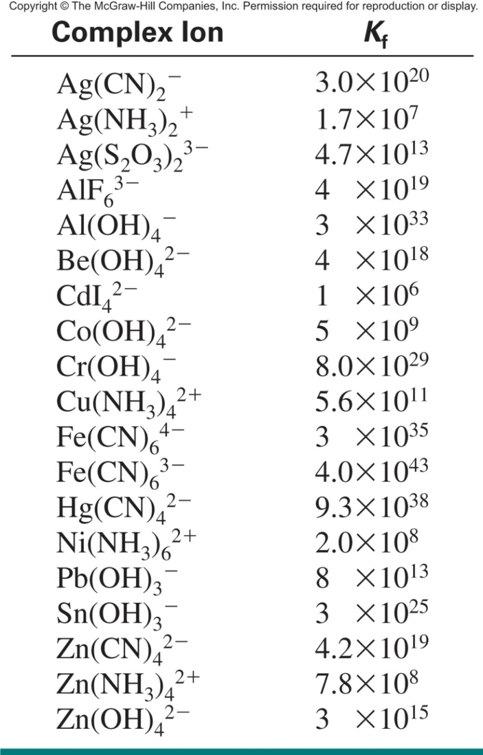
Formation Constants (Kf) at 25 °C
Example:
Ag⁺(aq) + 2 CN⁻¹(aq) qe Ag(CN)₂⁻¹(aq)
ions are reactants
complex ion is product
usually written as net ionic reactions

Slide 33
Formation Constants
Complex Ions can be helpful when dissolving solids. Ex: AgCl(s) and Ag(NH₃)₂⁺(aq)
AgCl(s) qe Ag⁺(aq) + Cl⁻(aq) Ksp
Ag⁺(aq) + 2 NH₃(aq) qe Ag(NH₃)₂⁺(aq) Kf
--------------------------------------
AgCl_{(s)}+ 2 NH₃ qe Ag(NH₃)₂⁺ + Cl⁻
Knet = Ksp * Kf
MAR

Slide 34
End of Chapter 15
See:
Chapter Fifteen Study Guide
Chapter Fifteen Concept Guide
Types of Equilibrium Constants
Solubility Guide
Important Equations (following this slide)
End of Chapter Problems (following this slide)
MAR

Slide 35
Important Equations, Constants, and Handouts
from this Chapter:
know how to predict solubility using CH 221 solubility guide
Ag⁺(aq) + 2 CN⁻¹(aq) qe Ag(CN)₂⁻¹(aq)
Solubility: Common ion effect, separating salts by differences in solubility
Handouts:
Types of Equilibrium Constants
Solubility Guide

Slide 36
End of Chapter Problems: Test Yourself
Predict whether each of the following is insoluble or soluble in water: (NH4)2CO3, ZnSO4, NiS, BaSO4
When 1.55 g of solid thallium(I) bromide is added to 1.00 L of water, the salt dissolves to a small extent: TlBr(s) Æ Tl⁺(aq) + Br⁻¹(aq) The thallium(I) and bromide ions in equilibrium with TlBr each have a concentration of 1.9 x 10⁻³ M. What is the value of Ksp for TlBr?
You add 0.979 g of Pb(OH)2 to 1.00 L of pure water at 25 °C. The pH is 9.15. Estimate the value of Ksp for Pb(OH)2.
Estimate the solubility of calcium fluoride, CaF2, (a) in moles per liter and (b) in grams per liter of pure water. CaF2(s) Æ Ca²⁺(aq) + 2 F⁻¹(aq) Ksp = 5.3 x 10⁻¹¹
The Ksp value for radium sulfate, RaSO4, is 3.7 x 10⁻¹¹. If 0.25 mg of radium sulfate is placed in 1.00 x 10² mL of water, does all of it dissolve? If not, how much dissolves? RaSO4(s) Æ Ra²⁺(aq) + SO4⁻²(aq)
Which compound is more soluble: PbCl2 (Ksp = 1.7 x 10⁻⁵) or PbBr2 (Ksp = 6.6 x 10⁻⁶)?

Slide 37
End of Chapter Problems: Answers
(NH4)2CO3 & ZnSO4 (soluble), NiS & BaSO4 (insoluble)
Ksp = 3.6 x 10⁻⁶
Ksp = 1.4 x 10⁻¹⁵
a) 2.4 x 10⁻⁴ M b) 0.018 g/L
0.05 mg does not dissolve
PbCl2

