Slide 1
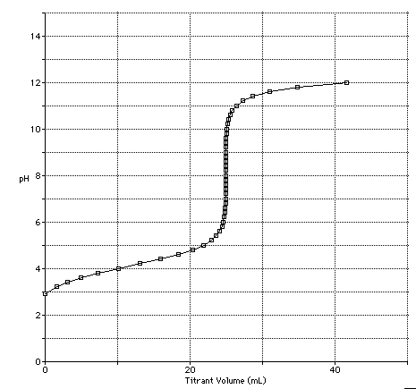
ACID-BASE REACTIONS Chapter 14
("Part II")
A Weak Acid + Strong Base
Titration
Last update:
4/29/24
Chemistry 223
Professor Michael Russell
MAR

Slide 2
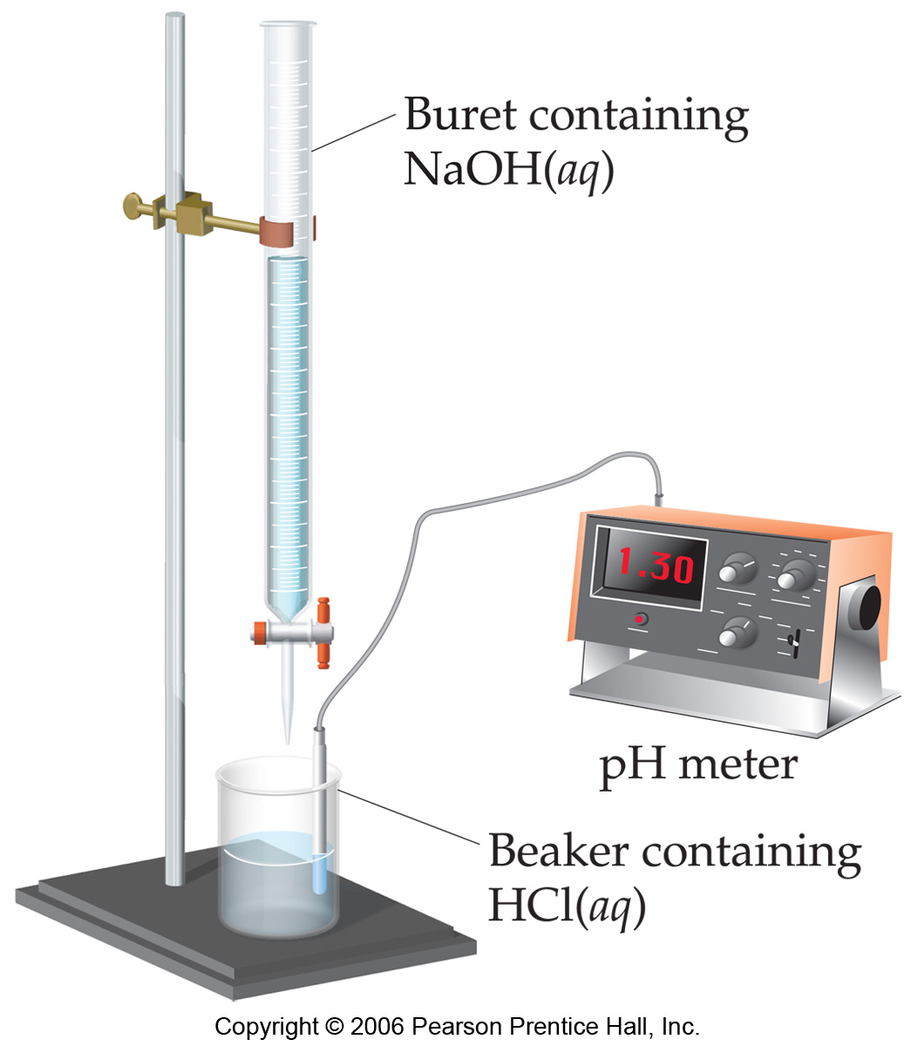
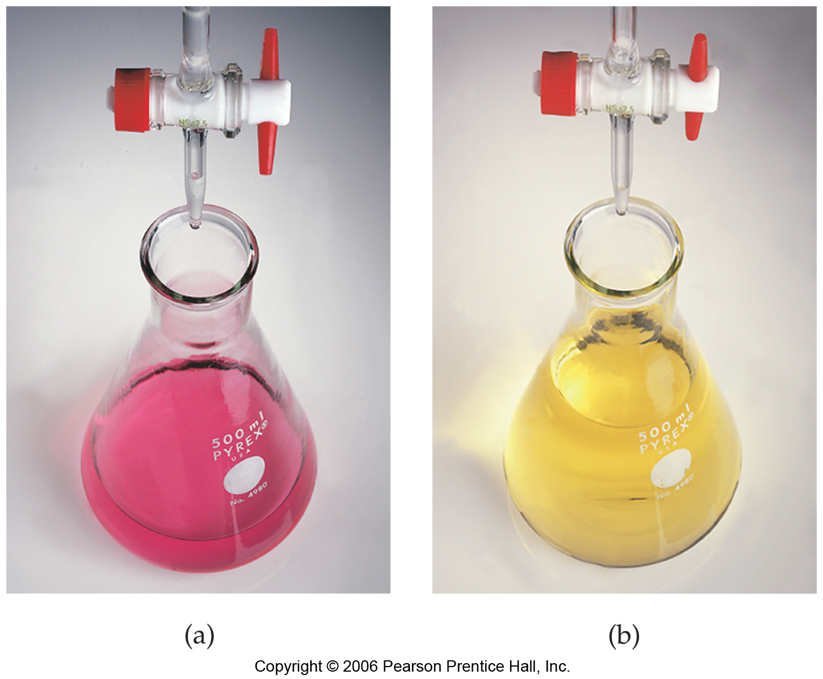
Titrations
In a titration a known concentration of base (or acid) is slowly added to a solution of acid (or base)
A pH meter or indicators are used to determine when the solution has reached the equivalence point (where moles of acid = moles of base)
Goal: to determine experimentally or calculate the pH at any point in a titration
MAR

Slide 3
Titrations
Adding NaOH from the buret to acetic acid:
Initially the pH increases very slowly, then rises dramatically at equivalence point
pH rises, then levels off as equivalence point passed
MAR

Slide 4
Acid-Base Titrations
Notice how [HOAc] diminishes with NaOH, but [OAc⁻] increases with NaOH
Important to consider conjugates in titrations where weak acids or bases dominate
But first, buffers and the common ion effect
MAR

Slide 5
The Common Ion Effect
A special form of Le Chatelier's Principle...
QUESTION: What is the effect on the pH of adding NH₄Cl to 0.25 M NH₃(aq)?
NH₃(aq) + H₂O qe NH₄⁺(aq) + OH⁻(aq)
Here we are adding an ion COMMON to the equilibrium with NH3 (i.e. NH4⁺)
Le Chatelier predicts that the equilibrium will shift to the ____________.
The pH will go _____________.
After all, NH₄⁺ is an acid!
MAR
Sodium acetate is added to an acetic acid solution. The pH of the solution will
increase
decrease
stay the same
equal 7
more info needed
Enter your response on
your i>Clicker now!
Answer = A,
increase
The acetate ion is a weak base,
pH will increase

Slide 6
The Common Ion Effect
A special form of Le Chatelier's Principle...
QUESTION: What is the effect on the pH of adding NH₄Cl to 0.25 M NH₃(aq)?
NH₃(aq) + H₂O qe NH₄⁺(aq) + OH⁻(aq)
Let us first calculate the pH of a 0.25 M NH₃ solution.
[NH₃] [NH₄⁺] [OH⁻]
initial 0.25 0 0
change -x +x +x
equilib 0.25 - x x x
MAR

Slide 7
The Common Ion Effect
A special form of Le Chatelier's Principle...
QUESTION: What is the effect on the pH of adding NH₄Cl to 0.25 M NH₃(aq)?
NH₃(aq) + H₂O qe NH₄⁺(aq) + OH⁻(aq)
Assuming x is << 0.25, we have
[OH⁻] = x = [K_{b}(0.25)]^{1/2} = 0.0021 M
This gives pOH = 2.67
and so pH = 14.00 - 2.67 = 11.33
or: pH = 14 + log [K_{b}•C_{b}]^{1/2} = 11.33
MAR

Slide 8
The Common Ion Effect
A special form of Le Chatelier's Principle...
Problem: What is the pH of a solution with 0.10 M NH₄Cl and 0.25 M NH₃(aq)?
NH₃(aq) + H₂O qe NH₄⁺(aq) + OH⁻(aq)
We expect that the pH will decline on adding NH₄Cl. Let's test that!
[NH₃] [NH₄⁺] [OH⁻]
initial 0.25 0.10 0
change -x +x +x
equilib 0.25 - x 0.10 + x x
MAR

Slide 9
The Common Ion Effect
A special form of Le Chatelier's Principle...
Problem: What is the pH of a solution with 0.10 M NH₄Cl and 0.25 M NH₃(aq)?
NH₃(aq) + H₂O qe NH₄⁺(aq) + OH⁻(aq)
Because equilibrium shifts left, x is MUCH less than 0.0021 M, the value without NH₄Cl.
MAR

Slide 10
The Common Ion Effect
A special form of Le Chatelier's Principle...
Problem: What is the pH of a solution with 0.10 M NH₄Cl and 0.25 M NH₃(aq)?
NH₃(aq) + H₂O qe NH₄⁺(aq) + OH⁻(aq)
[OH⁻] = x = (0.25 / 0.10)K_{b} = 4.5 x 10⁻⁵ M
This gives pOH = 4.35 and pH = 9.65
pH drops from 11.33 to 9.65 on adding a common ion (NH₄⁺).
MAR

Slide 11
Buffer Solutions
The function of a buffer is to resist changes in the pH of a solution.
Buffers invoke a special case of the common ion effect.
Buffer Composition:
Weak Acid + Conj. Base
HOAc + OAc⁻
H₂PO₄⁻ + HPO₄²⁻
Weak Base + Conj. Acid
NH₃ + NH₄⁺
MAR
Buffers and Henderson-Hasselbalch Guide
Which combination would be an ideal buffer solution?
0.20 HNO3 and 0.10 M NaNO3
0.20 M HCl and 0.10 M KOH
0.15 M CH3CO2H and 0.12 M NaCH3CO2
0.22 M NH3 and 0.25 M CH3NH3Cl
none of the above
Enter your response on
your i>Clicker now!
Answer = C,
0.15 M CH3CO2H and 0.12 M NaCH3CO2
Buffers must contain a weak acid and its
conjugate weak base
No strong acids or bases!

Slide 12
Buffer Solutions
HCl is added to pure water.
HCl is added to a solution of a weak acid H₂PO₄⁻ and its conjugate base HPO₄²⁻.
MAR

Slide 13
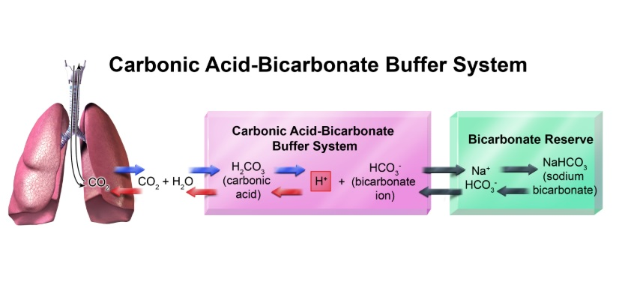
Buffers in Our Bodies
The blood pH in our bodies is regulated by a carbonic acid / hydrogen carbonate (“bicarbonate”) buffer system:
CO2 + H2O qe H2CO3 qe H⁺ + HCO3⁻¹
MAR
Exhaling CO2 raises the pH of our blood!

Slide 14
Buffer Solutions
Consider HOAc/OAc⁻ to see how buffers work
The weak acid in buffers consumes strong base!
We know:
OAc⁻ + H₂O qe HOAc + OH⁻
K_{b} = 5.6 x 10⁻¹⁰
Therefore, the reverse reaction of the weak acid with added OH⁻ (strong base) would be:
HOAc + OH⁻ qe OAc⁻ + H₂O
and: K_{reverse} = 1/ K_{b} = 1.8 x 10⁹
K_{reverse} is VERY large, so HOAc completely consumes the OH⁻!
MAR

Slide 15
Buffer Solutions
Consider HOAc/OAc⁻ to see how buffers work
Conjugate base in buffers consumes strong acid!
HOAc + H₂O qe OAc⁻ + H₃O⁺
K_{a} = 1.8 x 10⁻⁵
Therefore, the reverse reaction of the weak base with added H₃O⁺ (strong acid) would be:
OAc⁻ + H₃O⁺ qe HOAc + H₂O
K_{reverse} = 1/ K_{a} = 5.6 x 10⁴
K_{reverse} is VERY LARGE, so OAc⁻ completely consumes the H₃O⁺!
MAR

Slide 16
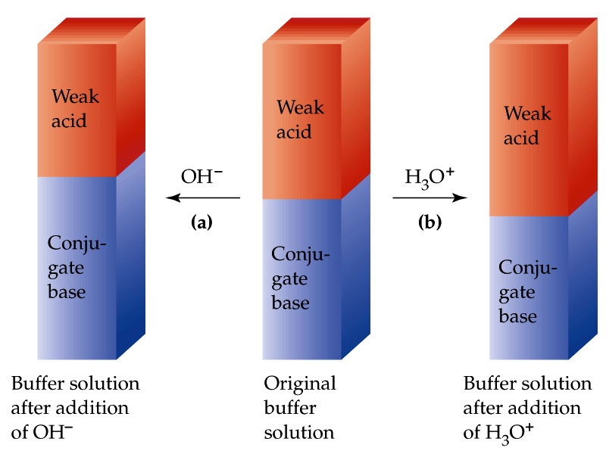
Buffer Solutions
MAR

Slide 17
Buffer Solutions
Problem: What is the pH of a buffer that has [HOAc] = 0.700 M and [OAc⁻] = 0.600 M?
HOAc + H₂O qe OAc⁻ + H₃O⁺
K_{a} = 1.8 x 10⁻⁵
[HOAc] [OAc⁻] [H₃O⁺]
initial 0.700 0.600 0
change -x +x +x
equilib 0.700 - x 0.600 + x x
MAR

Slide 18
Buffer Solutions
Problem: What is the pH of a buffer that has [HOAc] = 0.700 M and [OAc⁻] = 0.600 M?
HOAc + H₂O qe OAc⁻ + H₃O⁺
K_{a} = 1.8 x 10⁻⁵
[HOAc] [OAc⁻] [H₃O⁺]
equilib 0.700 - x 0.600 + x x
Assuming that x << 0.700 and 0.600, we have
[H₃O⁺] = 1.8 x 10⁻⁵ * (0.700 / 0.600) = 2.1 x 10⁻⁵ and pH = 4.68
MAR

Slide 19
Buffer Solutions
Notice that the expression for calculating the H⁺ conc. of the buffer is:
or
Notice that [H₃O⁺] or [OH⁻] depend on K and the ratio of acid and base concentrations
MAR

Slide 20
Henderson-Hasselbalch Equation
Take the negative log of both sides of this equation:
The Henderson - Hasselbalch Eq!
The pH is determined largely by the pK_{a} of the acid and then adjusted by the ratio of acid and conjugate base. Important equation!
MAR

Slide 21
Henderson-Hasselbalch Equation
Note that the CONCENTRATIONS of the acid and conjugate base are not important.
It is the RATIO of the NUMBER OF MOLES that affects pH
Result: diluting a buffer solution does not change its pH
Result: You can use moles or molarity when using Henderson-Hasselbalch!
See: Buffers and Henderson-Hasselbalch Guide
MAR
Acetic acid has K_{a} = 1.8 x 10⁻⁵ (pK_{a} = 4.74). To prepare a buffer containing CH₃CO₂H and NaCH₃CO₂ and having a pH of 5, the ratio of [NaCH₃CO₂] to [CH₃CO₂H] should be about
1:1
1.8:1
1:1.8
5.0:1
not enough info
Answer = B
1.8:1
Desired pH (5) more basic than pKa (4.74),
need more base than acid,
5 = 4.74 + log (base/acid)
10^{0.26} = 1.8 = base/acid,
1.8x more base than acid
Enter your response on
your i>Clicker now!

Slide 22
Adding an Acid to a Buffer
Problem: What is the pH when 1.00 mL of 1.00 M HCl is added to
a) 1.00 L of pure water (before HCl, pH = 7.00)
b) 1.00 L of buffer that has [HOAc] = 0.700 M and [OAc-] = 0.600 M (pH = 4.68)
Solution to Part (a)
pH of strong acid = - log [H₃O⁺] = - log [HCl]
M₁ • V₁ = M₂ • V₂
1.00 M * 1.00 mL = M₂ • 1001 mL
M₂ = 9.99 x 10⁻⁴ M = [H₃O⁺]
pH = 3.00
MAR

Slide 23
Adding an Acid to a Buffer
What is the pH when 1.00 mL of 1.00 M HCl is added to
a) 1.00 L of pure water (after HCl, pH = 3.00)
b) 1.00 L of buffer that has [HOAc] = 0.700 M and [OAc-] = 0.600 M (pH = 4.68)
Solution to Part (b)
Step 1 - do the stoichiometry
H₃O⁺ (from HCl) + OAc⁻ (from buffer) ---> HOAc (from buffer)
The reaction occurs completely because K is very large.
MAR

Slide 24
Adding an Acid to a Buffer
What is the pH when 1.00 mL of 1.00 M HCl is added to
a) 1.00 L of pure water (after HCl, pH = 3.00)
b) 1.00 L of buffer that has [HOAc] = 0.700 M and [OAc-] = 0.600 M (pH = 4.68)
Solution to Part (b): Step 1-Stoichiometry
[H₃O⁺] [OAc⁻] [HOAc]
Initial 0.000999 0.600 0.700
Change -0.000999 -0.000999 +0.000999
After rxn 0 0.599 0.701
Now we need to calculate pH using our new buffer solution
MAR

Slide 25
Adding an Acid to a Buffer
What is the pH when 1.00 mL of 1.00 M HCl is added to
a) 1.00 L of pure water (after HCl, pH = 3.00)
b) 1.00 L of buffer that has [HOAc] = 0.700 M and [OAc-] = 0.600 M (pH = 4.68)
Solution to Part (b): Step 2 - Equilibrium
HOAc + H₂O qe H₃O⁺ + OAc⁻
[HOAc] [OAc⁻] [H₃O⁺]
Initial 0.701 0.599 0
Change -x +x +x
Equilibrium 0.701-x 0.599+x x
MAR

Slide 26
Adding an Acid to a Buffer
What is the pH when 1.00 mL of 1.00 M HCl is added to
a) 1.00 L of pure water (after HCl, pH = 3.00)
b) 1.00 L of buffer that has [HOAc] = 0.700 M and [OAc-] = 0.600 M (pH = 4.68)
Solution to Part (b): Step 2 - Equilibrium
HOAc + H₂O qe H₃O⁺ + OAc⁻
[HOAc] [OAc⁻] [H₃O⁺]
Equilibrium 0.701-x 0.599+x x
Because [H₃O⁺] = 2.1 x 10⁻⁵ M BEFORE adding HCl, we again neglect x relative to 0.701 and 0.599.
MAR

Slide 27
Adding an Acid to a Buffer
What is the pH when 1.00 mL of 1.00 M HCl is added to
a) 1.00 L of pure water (after HCl, pH = 3.00)
b) 1.00 L of buffer that has [HOAc] = 0.700 M and [OAc-] = 0.600 M (pH = 4.68)
Solution to Part (b): Step 2 - Equilibrium
HOAc + H₂O qe H₃O⁺ + OAc⁻
[H₃O⁺] = 2.1 x 10⁻⁵ M ------> pH = 4.68
The pH has not changed on adding HCl to the buffer!
MAR

Slide 28
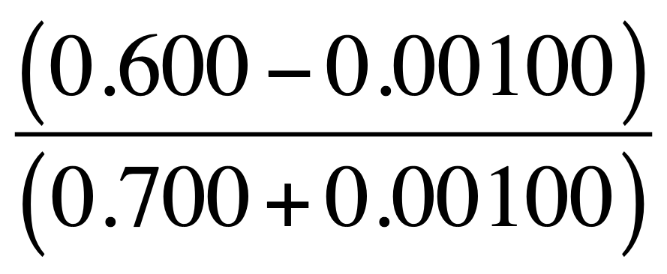
Adding an Acid to a Buffer
Use the Henderson-Hasselbalch equation to calculate the pH when 1.00 mL of 1.00 M HCl is added to 1.00 L of buffer that has [HOAc] = 0.700 M and [OAc-] = 0.600 M
We can use an alternate form of the H-H equation:
pH = pK_{a} + log
pK_{a} = - log (1.80 * 10⁻⁵) = 4.74
pH = 4.74 + log = 4.67
Answer in good agreement with “double ice" method (4.68)
See: Buffers and Henderson-Hasselbalch Guide
MAR

Slide 29
Adding Acids and Bases to Buffers
For adding strong acids to buffers:
pH = pK_{a} + log
For adding strong bases to buffers:
pH = pK_{a} + log
Very useful for calculating pH changes in buffers!
See: Buffers and Henderson-Hasselbalch Guide
MAR
Adding a small amount of strong base to a buffer results in:
an increased pH due to the strong base
an increased pH due to the weak base of the buffer
a decreased pH due to the weak base of the buffer
a decreased pH due to the strong base
a decreased pH due to the weak acid of the buffer
Answer = B
an increased pH due to the
weak base of the buffer
strong base neutralized by weak acid in buffer,
neutralized weak acid converts into more weak base
More weak base, more [OH⁻¹], pH increases
Enter your response on
your i>Clicker now!

Slide 30
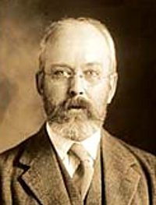
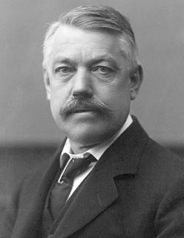
Preparing a Buffer
You want to create a buffer solution with a pH = 4.30.
This means [H₃O⁺] = 10^{-pH} = 5.0 x 10⁻⁵ M
It is best to choose an acid such that:
* [H₃O⁺] ≈ K_{a}, or
* pH ≈ pK_{a}
You get the exact [H₃O⁺] (or pH) by adjusting the ratio of weak acid to conjugate base.
For a pH = 4.30 buffer, we will look for a value of K_{a} ≈ 5.0 x 10⁻⁵ or a pK_{a} ≈ 4.30
Henderson
Hasselbalch
MAR

Slide 31
Preparing a Buffer
You wish to create a buffer solution at pH = 4.30 (or [H₃O⁺] = 5.0 x 10⁻⁵ M.) Which of these buffer combinations should you select?
POSSIBLE BUFFERS K_{a} pK_{a}
HSO₄⁻ / SO₄²⁻ 1.2 x 10⁻² 1.92
HOAc / OAc⁻ 1.8 x 10⁻⁵ 4.74
HCN / CN⁻ 4.0 x 10⁻¹⁰ 9.40
Best choice is acetic acid / acetate - closest in [H₃O⁺] to K_{a} or pH to pK_{a}!
MAR

Slide 32
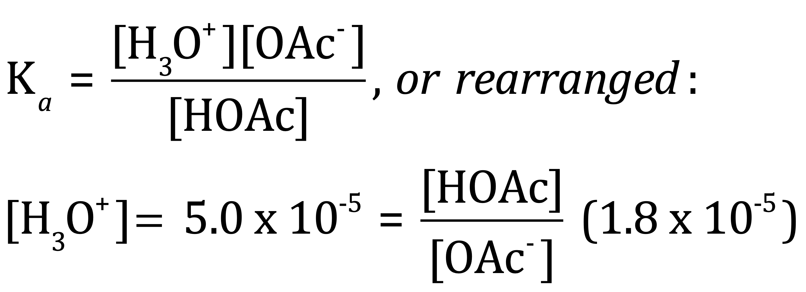
Preparing a Buffer
You want to create a buffer solution at pH = 4.30 (or [H₃O⁺] = 5.0 x 10⁻⁵ M) using HOAc and OAc⁻¹.
Equal moles of acid (HOAc) and base (OAc⁻¹) create pH = 4.74 (= pKa). Find the ratio of acid to base needed to get the buffer to 4.30.
Solve for [HOAc] / [OAc⁻] ratio:
= [H₃O⁺] / K_{a} = 2.8 / 1
MAR

Slide 33
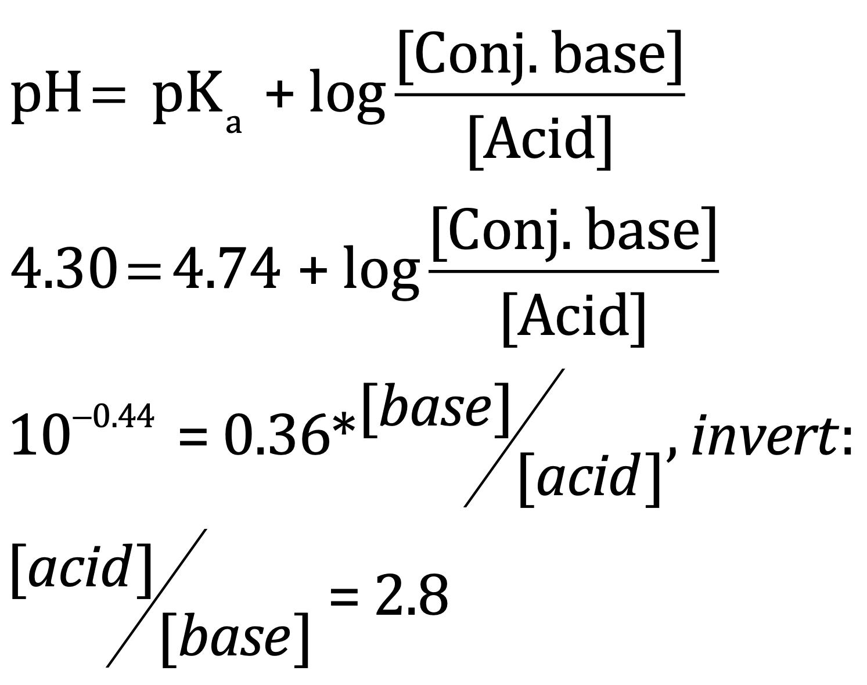
Preparing a Buffer
You want to create a buffer solution at pH = 4.30 (or [H₃O⁺] = 5.0 x 10⁻⁵ M). Find the ratio of acid to base needed to get the buffer to 4.30.
[HOAc] / [OAc⁻] ratio = 2.8 / 1 (previous slide)
Therefore, if you use 0.10 mol of NaOAc and 0.28 mol of HOAc, you will have pH = 4.30.
Could have also used
Henderson Hasselbalch:
MAR

Slide 34
Preparing a Buffer Solution
Buffer prepared from
8.4 g NaHCO₃
weak acid
16.0 g Na₂CO₃
conjugate base
HCO₃⁻ + H₂O qe H₃O⁺ + CO₃²⁻
What is the pH?
Check yourself! Answer: 10.50
MAR
Notes:
8.4 g NaHCO3 * (mol / 84.01 g) = 0.10 mol ...... 16.0 g Na2CO3 * (mol / 106.0 g) = 0.151 mol ...... Ka (HCO3-) = 4.8E-11, pKa = 10.32 ...... pH = 10.32 + log (0.151 / 0.10) = 10.50

Slide 35
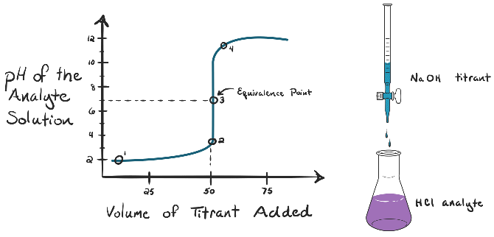
Titration Calculations
Allow us to calculate pH at any point in a titration
We will study four types of titrations:
SA + SB (equivalence pH = 7)
SB + SA (equivalence pH = 7)
WA + SB (equivalence pH > 7)
WB + SA (equivalence pH < 7)
Titrations separated into regions each with their own pH formula
Buffers used in WA + SB and WB + SA
We will do examples of all four as practice in lab.
See Titration Guide
MAR

Slide 36
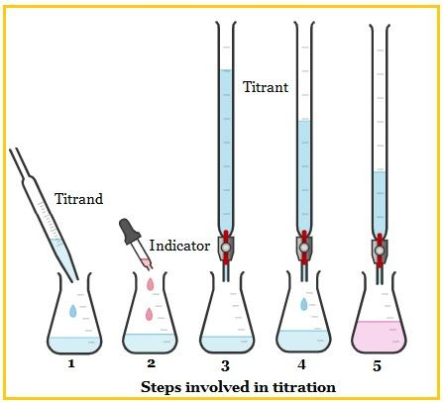
Titration Calculation Hints
Strong acids and strong bases annihilate their opposites
Weak acids and bases produce their conjugates
K_{a} and K_{b} may be determined through titrations or half-equivalence pH values
Remember: K_{a}*K_{b} = K_{w} = 1.00*10⁻¹⁴ (25 ˚C)
Often helpful to find pK_{a} or pK_{b}
Remember: pK_{a} + pK_{b} = 14
Need to know initial concentration and volume of titrant
MAR

Slide 37
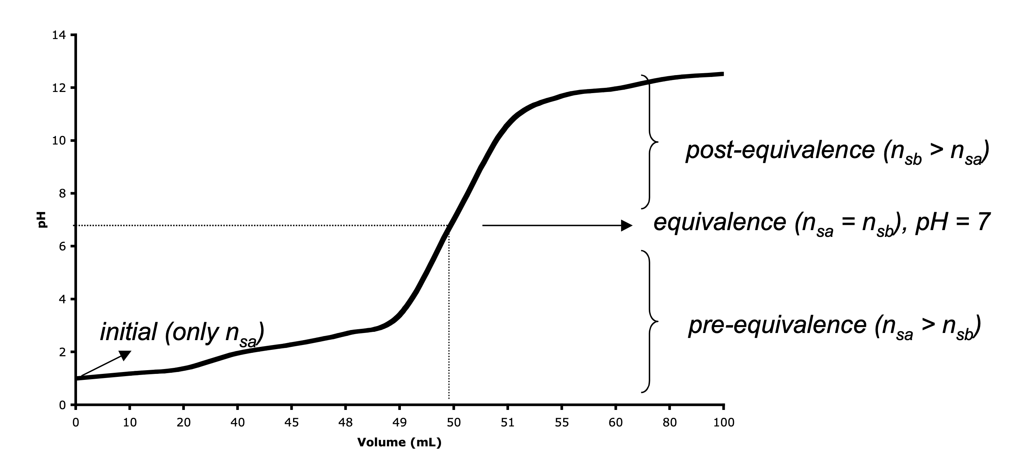
Strong Acid + Strong Base
A strong acid + strong base titration
MAR
At equivalence, the pH of a strong acid + strong base titration should be
pH < 7
pH > 7
pH = 7
dependant on the concentration of the strong acid and/or strong base
Answer = C
pH = 7 for the equivalence point between
strong acids and strong bases
Enter your response on
your i>Clicker now!

Slide 38
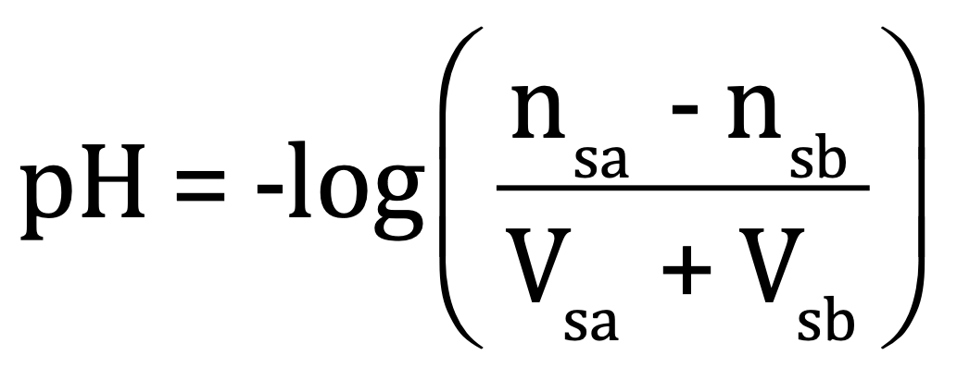
Strong Acid + Strong Base
Initial:
pH = - log [nsa / Vsa]
Pre-equivalence:
Equivalence:
pH = 7 (neutral salt + water)
Post-equivalence:
MAR

Slide 39
Acid-Base Reactions
QUESTION: You titrate 50. mL of a 0.100 M solution of HCl with 0.100 M NaOH. What is the pH of the initial solution?
HCl + H₂O ---> Cl⁻ + H₃O⁺
SOLUTION:
HCl is a strong acid
NaOH is a strong base
Hence, this is a strong acid + strong base titration
Other common strong acids: HNO₃, HBr, HI, HClO₄
Other common strong bases: KOH, LiOH
MAR

Slide 40
Acid-Base Reactions
QUESTION: You titrate 50. mL of a 0.100 M solution of HCl with 0.100 M NaOH. What is the pH of the initial solution?
HCl + H₂O ---> Cl⁻ + H₃O⁺
SOLUTION:
For strong acids,
pH = 1.000
MAR

Slide 41
Acid-Base Reactions
QUESTION: You titrate 50. mL of a 0.100 M solution of HCl with 0.100 M NaOH. What is the pH after 45 mL of NaOH have been added?
HCl + H₂O ---> Cl⁻ + H₃O⁺
SOLUTION:
First, determine which region of a strong acid and strong base titration to use by comparing mol HCl to mol NaOH
n_{sa} = 0.050 L * 0.100 M = 0.0050 mol HCl
n_{sb} = 0.045 L * 0.100 M = 0.0045 mol NaOH
Since n_{sa} > n_{sb}, this pH will fall in the pre-equivalence region
MAR

Slide 42
Acid-Base Reactions
QUESTION: You titrate 50. mL of a 0.100 M solution of HCl with 0.100 M NaOH. What is the pH after 45 mL of NaOH have been added?
HCl + H₂O ---> Cl⁻ + H₃O⁺
From before: n_{sa} = 0.0050 mol, n_{sb} = 0.0045 mol
pH = 2.3
MAR

Slide 43
Acid-Base Reactions
QUESTION: You titrate 50. mL of a 0.100 M solution of HCl with 0.100 M NaOH. What is the pH at the equivalence point?
At equivalence, HCl + NaOH ---> Na⁺ + Cl⁻ + H₂O
Only species present at equivalence are Na⁺, Cl⁻ and water.
Na⁺ and Cl⁻ are conjugates of strong bases and acids; hence, they have no effect on the pH
pH at equivalence point will be equal to 7 (neutral) due to presence of water
The volume required to get to equivalence:
0.0050 mol HCl * (mol NaOH / mol HCl) * (L/0.100 mol NaOH) = 0.050 L or 50. mL
MAR

Slide 44
Acid-Base Reactions
QUESTION: You titrate 50. mL of a 0.100 M solution of HCl with 0.100 M NaOH. What is the pH after 55 mL of NaOH have been added?
SOLUTION: (from before, n_{sa} = 0.0050 mol)
It took 50. mL of NaOH to reach equivalence; hence, we are now in the post-equivalence region
n_{sb} = 0.100 M * 0.055 L = 0.0055 mol
pH = 14 + (-2.3) = 11.7
MAR

Slide 45
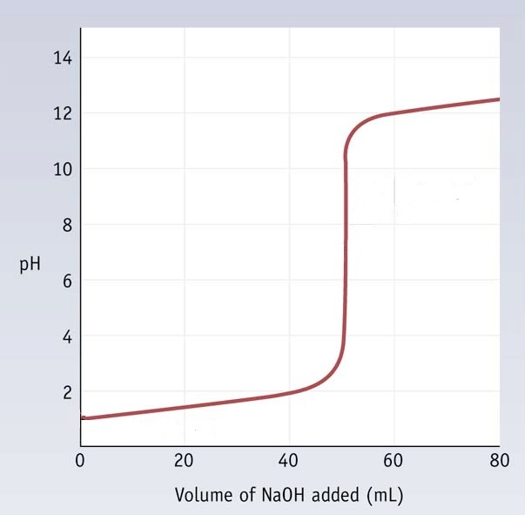
Acid-Base Reaction
HCl + NaOH Titration Graph
pH at 55 mL = 11.7
pH at 45 mL = 2.3
Equivalence point (50 mL)
pH = 7
initial pH
= 1.00
MAR

Slide 46
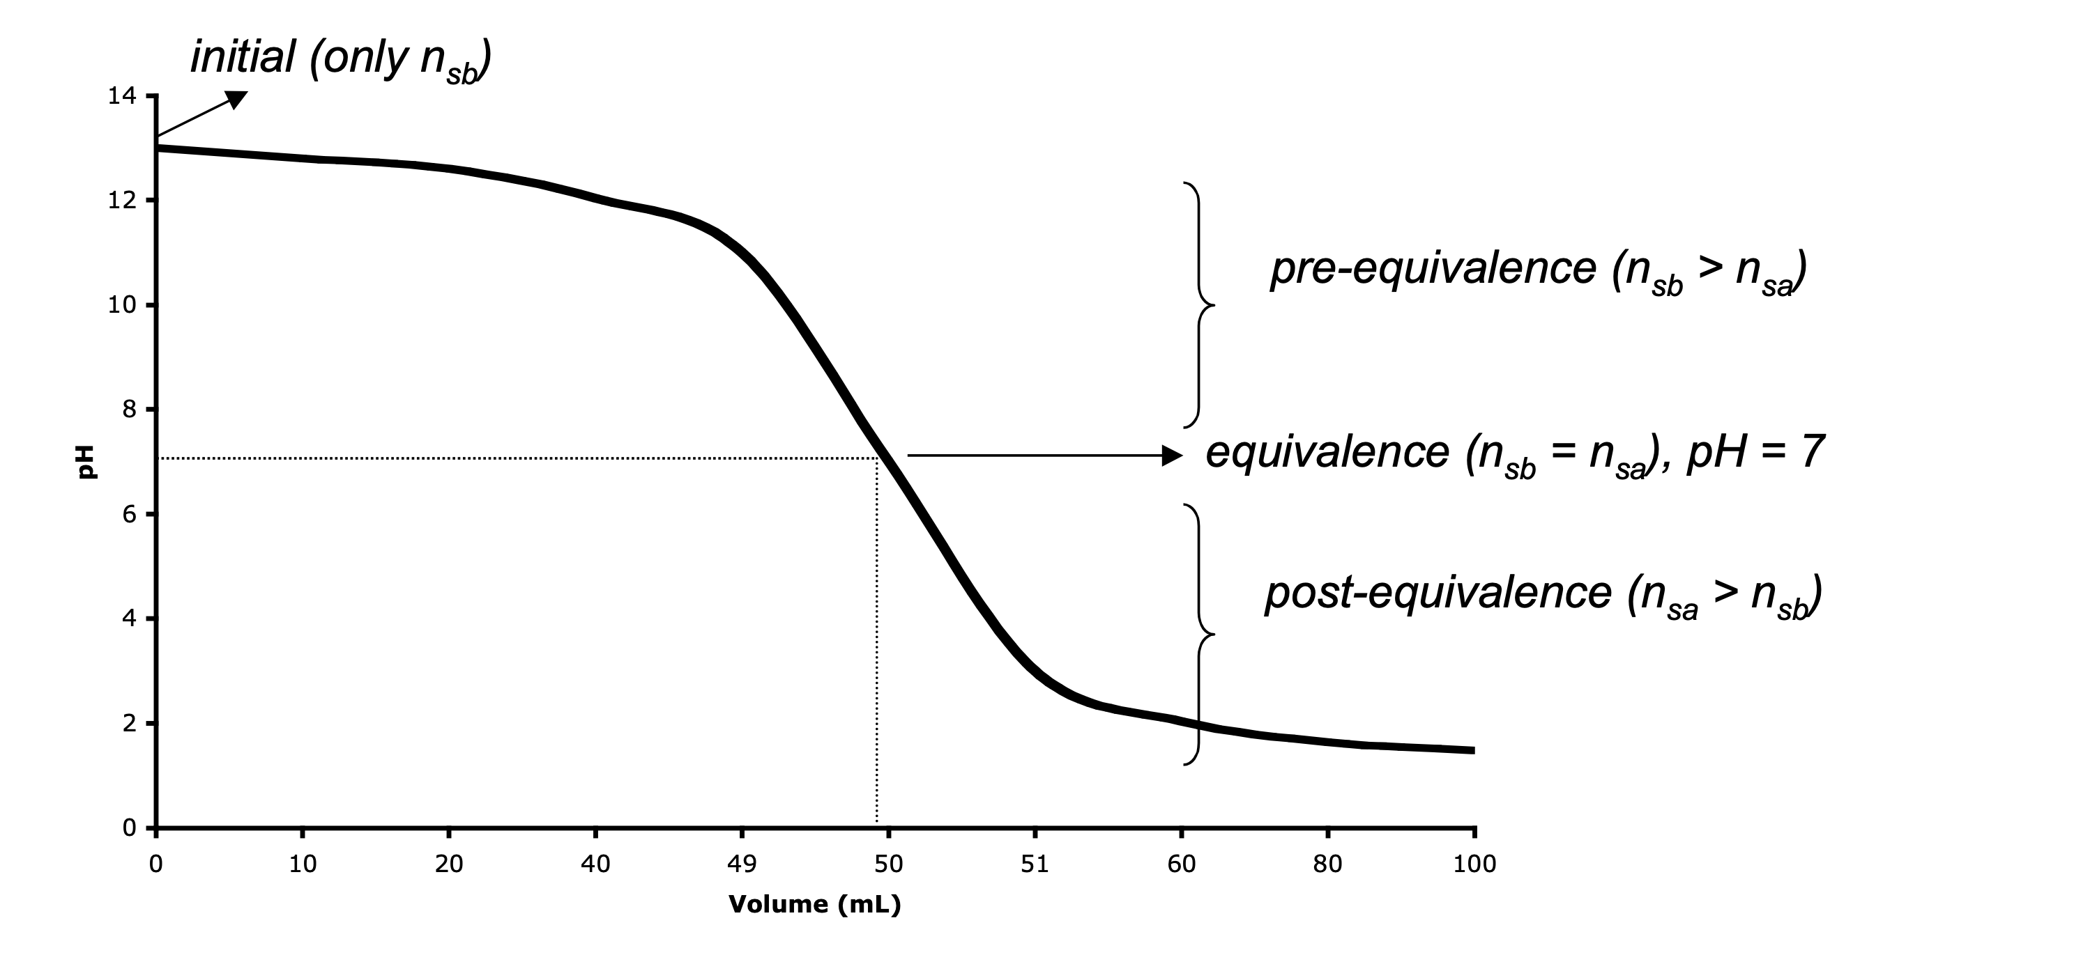
Strong Base + Strong Acid
Notice similarities between SA + SB and SB + SA titrations!
A strong base + strong acid titration
MAR

Slide 47
Strong Base + Strong Acid
Initial:
pH = 14 + log [nsb / Vsb]
Pre-equivalence:
Equivalence:
pH = 7 (neutral salt + water)
Post-equivalence:
MAR

Slide 48
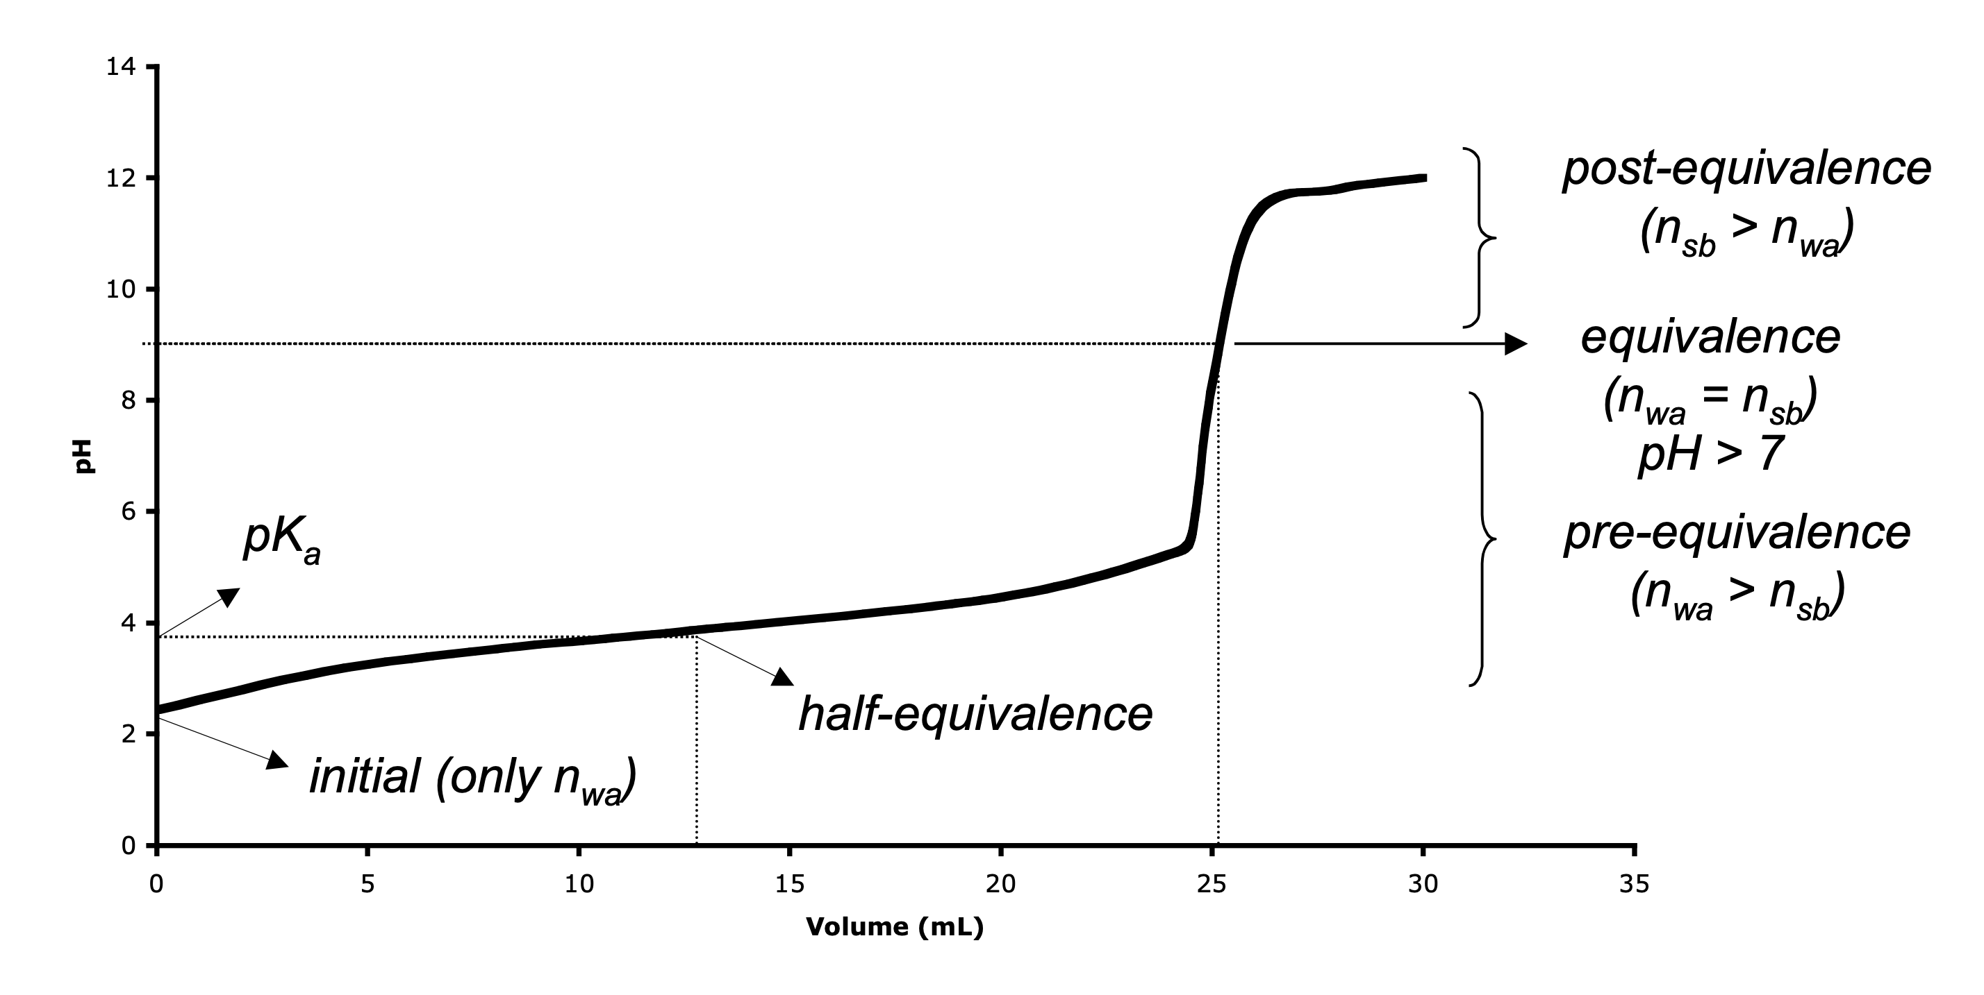
Weak Acid + Strong Base
Equivalence point dominated by conjugate base of weak acid
A weak acid + strong base titration
Pre-equivalence has weak acid and its conjugate base, acts like a "buffer"
At half-equivalence, pH = pK_{a}
MAR
At equivalence, the pH of a weak acid + strong base titration should be
pH < 7
pH > 7
pH = 7
dependant on the concentration of the weak acid and/or strong base
Answer = B
pH > 7 for the equivalence point between
weak acids and strong bases
At equivalence, mol weak acid = mol strong base,
annihilation!,
all weak acid converted to conjugate (weak) base,
pH > 7
Enter your response on
your i>Clicker now!

Slide 49
Weak Acid + Strong Base
Initial:
Pre-equivalence:
Equivalence:
Post-equivalence:
MAR

Slide 50
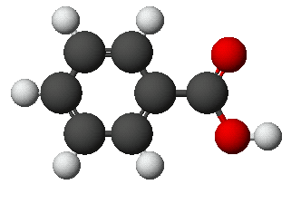
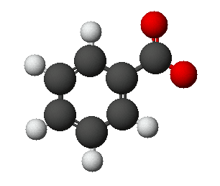
Acid-Base Reactions
QUESTION: You titrate 100. mL of a 0.025 M solution of benzoic acid with 0.100 M NaOH. What is the pH of the initial solution? K_{a} = 6.3 x 10⁻⁵
HBz + H₂O qe Bz⁻ + H₃O⁺
C₆H₅CO₂H = HBz
Benzoic acid
Benzoate ion = Bz⁻
MAR

Slide 51
Acid-Base Reactions
QUESTION: You titrate 100. mL of a 0.025 M solution of benzoic acid with 0.100 M NaOH. What is the pH of the initial solution? K_{a} = 6.3 x 10⁻⁵
HBz + H₂O qe Bz⁻ + H₃O⁺
SOLUTION:
For weak acids,
pH = 2.90
MAR

Slide 52
Acid-Base Reactions
QUESTION: You titrate 100. mL of a 0.025 M solution of benzoic acid with 0.100 M NaOH. What is the pH after 10. mL of NaOH have been added? K_{a} = 6.3 x 10⁻⁵
HBz + H₂O qe Bz⁻ + H₃O⁺
SOLUTION:
First, determine which region of a weak acid (benzoic acid) and strong base (NaOH) titration to use by comparing mol HBz to mol NaOH
n_{wa} = 0.100 L * 0.025 M = 0.0025 mol HBz
n_{sb} = 0.010 L * 0.100 M = 0.0010 mol NaOH
Since n_{wa} > n_{sb}, this pH will fall in the pre-equivalence region
Note that because n_{sb} is converted to mol Bz⁻ (the conjugate base), this region acts like a buffer
MAR

Slide 53
Acid-Base Reactions
QUESTION: You titrate 100. mL of a 0.025 M solution of benzoic acid with 0.100 M NaOH. What is the pH after 10. mL of NaOH have been added? K_{a} = 6.3 x 10⁻⁵
From before: n_{wa} = 0.0025 mol, n_{sb} = 0.0010 mol
pK_{a} = -log K_{a} = - log (6.3*10⁻⁵) = 4.20
A version of the Henderson-Hasselbalch equation!
pH = 4.20 - 0.176 = 4.02
MAR

Slide 54
Acid-Base Reactions
QUESTION: You titrate 100. mL of a 0.025 M solution of benzoic acid with 0.100 M NaOH. What is the pH after 12.5 mL of NaOH have been added? K_{a} = 6.3 x 10⁻⁵
From before: n_{wa} = 0.0025 mol, pK_{a} = 4.20
n_{sb} = 0.0125 L * 0.100 M = 0.00125 mol NaOH
Since n_{wa} > n_{sb}, this is the pre-equivalence region
pH = 4.20 + 0 = 4.20
MAR

Slide 55
Acid-Base Reactions
QUESTION: You titrate 100. mL of a 0.025 M solution of benzoic acid with 0.100 M NaOH. What is the pH after 12.5 mL of NaOH have been added? K_{a} = 6.3 x 10⁻⁵
Before: n_{wa} = 0.0025 mol, pK_{a} = 4.20, n_{sb} = 0.00125 mol
When n_{sb} = ¹/₂n_{wa}, this is called the half-equivalence region
pH = pK_{a} at the half-equivalence point
Useful method of finding K_{a} (and K_{b}) values
Also, the volume of titrant (NaOH) at half equivalence is exactly half the volume necessary to reach equivalence
We will need (2*12.5) = 25 mL of NaOH to reach equivalence!
MAR

Slide 56
Acid-Base Reactions
QUESTION: You titrate 100. mL of a 0.025 M solution of benzoic acid with 0.100 M NaOH to the equivalence point. What is the pH at the equivalence point? K_{a} = 6.3 x 10⁻⁵
At equivalence, HBz + NaOH ---> Na⁺ + Bz⁻ + H₂O
mol NaOH = mol HBz, or NaOH annihilates HBz
mol HBz = mol Bz⁻ at equivalence, and pH dominated by conjugate base of weak acid
pH at equivalence point will be basic when titrating a weak acid with a strong base!
qe
+
+
MAR

Slide 57
Acid-Base Reactions
QUESTION: You titrate 100. mL of a 0.025 M solution of benzoic acid with 0.100 M NaOH to the equivalence point. What is the pH at the equivalence point? K_{a} = 6.3 x 10⁻⁵
n_{wa} = 0.100 L * 0.025 M = 0.0025 mol HBz
0.0025 mol HBz = 0.0025 mol NaOH at equivalence
0.0025 mol NaOH * (L / 0.100 mol) = 0.025 L = V_{sb}
MAR
pH = 14 + (-5.75) = 8.25

Slide 58
Acid-Base Reactions
QUESTION: You titrate 100. mL of a 0.025 M solution of benzoic acid with 0.100 M NaOH. What is the pH after 26.0 mL of NaOH have been added?
SOLUTION: (from before, n_{wa} = 0.0025 mol)
It took 25 mL of NaOH to reach equivalence; hence, we are now in the post-equivalence region
n_{sb} = 0.100 M * 0.026 L = 0.0026 mol
pH = 14 + (-3.10) = 10.9
MAR

Slide 59
Acid-Base Reaction
Benzoic acid + NaOH Titration Graph
pH at 26.0 mL = 10.9
pH at half-equiv (12.5 mL) = 4.20
Equivalence point (25 mL)
pH = 8.25
initial pH
= 2.90
pH at 10. mL = 4.02
MAR

Slide 60
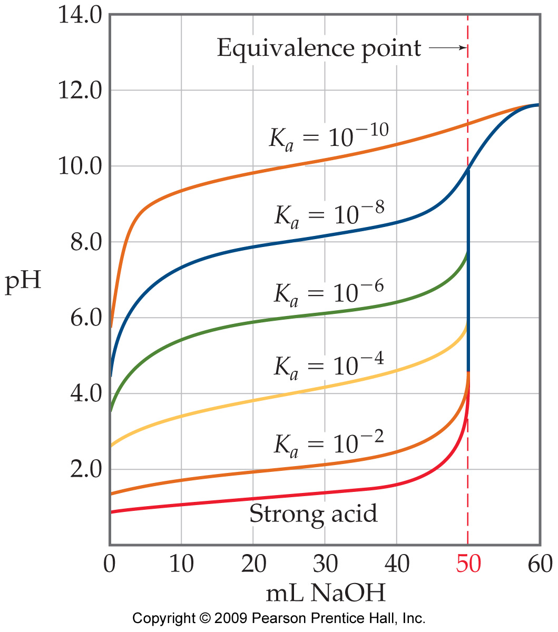
Acid-Base Reactions
With weaker acids, the initial pH is higher and pH changes near the equivalence point are more subtle.
MAR

Slide 61
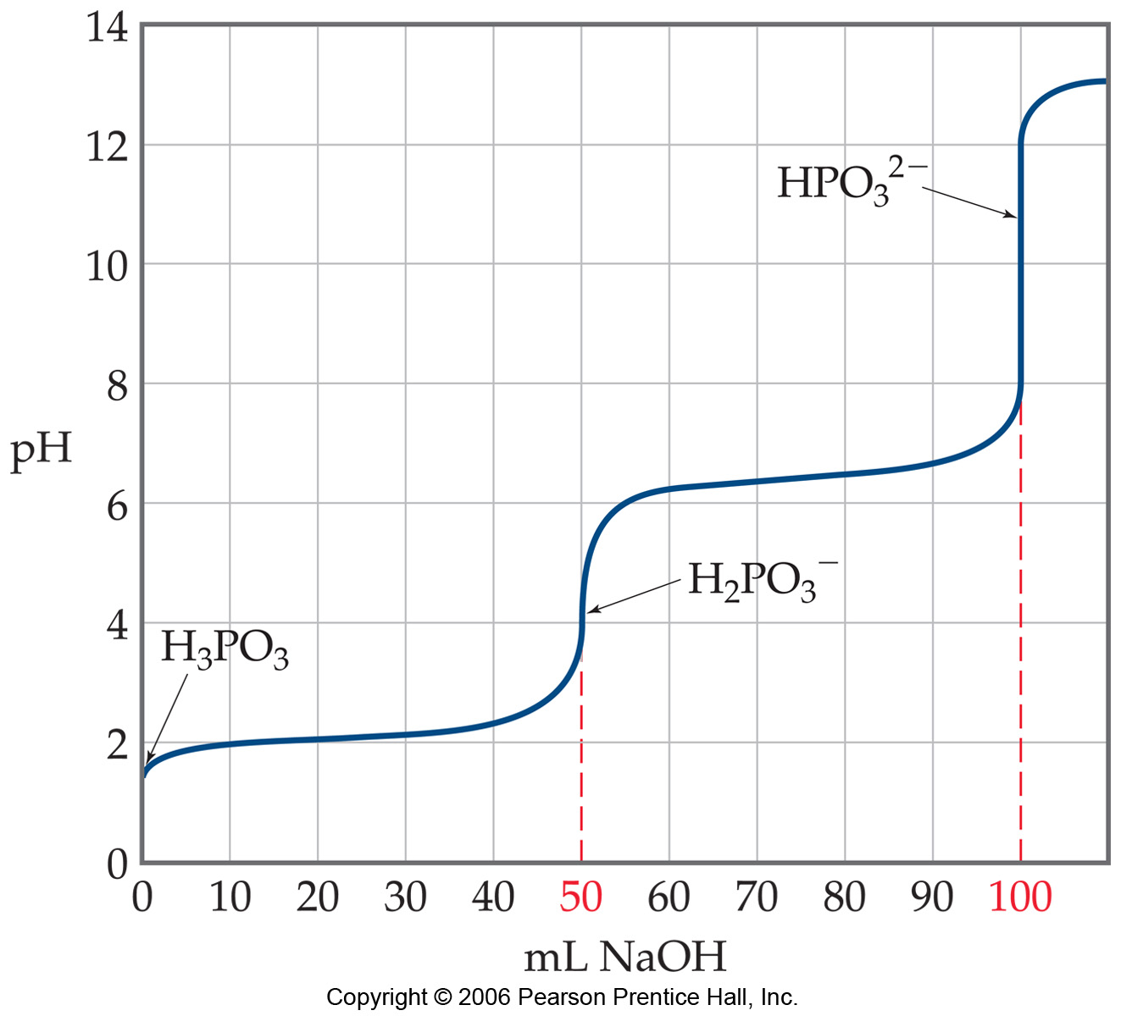
Polyprotic Acids
Titrations of polyprotic acids with bases have multiple equivalence points (and half equivalence points) for each dissociation.
x
x
second half equivalence (pH = pKa for H₂PO₃⁻¹)
first half equivalence (pH = pKa for H₃PO₃)
MAR

Slide 62
Weak Base + Strong Acid
Equivalence point dominated by conjugate acid of weak base
A weak base + strong acid titration
Pre-equivalence has weak base and its conjugate acid, acts like a "buffer"
pre-equivalence
(n_{wb} > n_{sa})
initial (only n_{wb})
equivalence
(n_{wb} = n_{sa})
pH < 7
pK_{a}
half-equivalence
At half-equivalence, pH = pK_{a}
post-equivalence
(n_{sa} > n_{wb})
MAR
At equivalence, the pH of a weak base + strong acid titration should be
pH < 7
pH > 7
pH = 7
dependant on the concentration of the weak acid and/or strong base
Answer = A
pH < 7 for the equivalence point between
weak bases and strong acids
At equivalence, mol weak base = mol strong acid,
annihilation!,
all weak base converted to conjugate (weak) acid,
pH < 7
Enter your response on
your i>Clicker now!

Slide 63
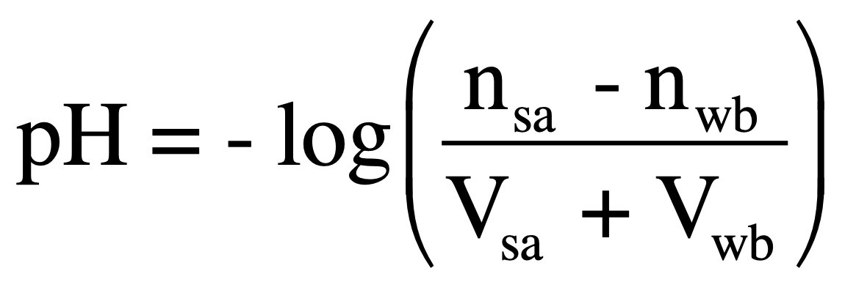
Weak Base + Strong Acid
initial (only n_{wb})
pre-equivalence
(n_{wb} > n_{sa})
pK_{a}
half-equivalence
equivalence
post-equivalence
(n_{sa} > n_{wb})
Initial:
Pre-equivalence:
Equivalence:
Post-equivalence:
MAR

Slide 64
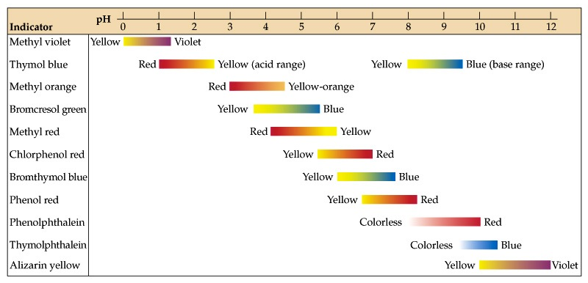
pH Indicators
Equivalence point important in titration, can use an indicator to signify equivalence point
Indicator color change must reflect equivalence point to be useful!
MAR
Focus on bromthymol blue for next slide

Slide 65
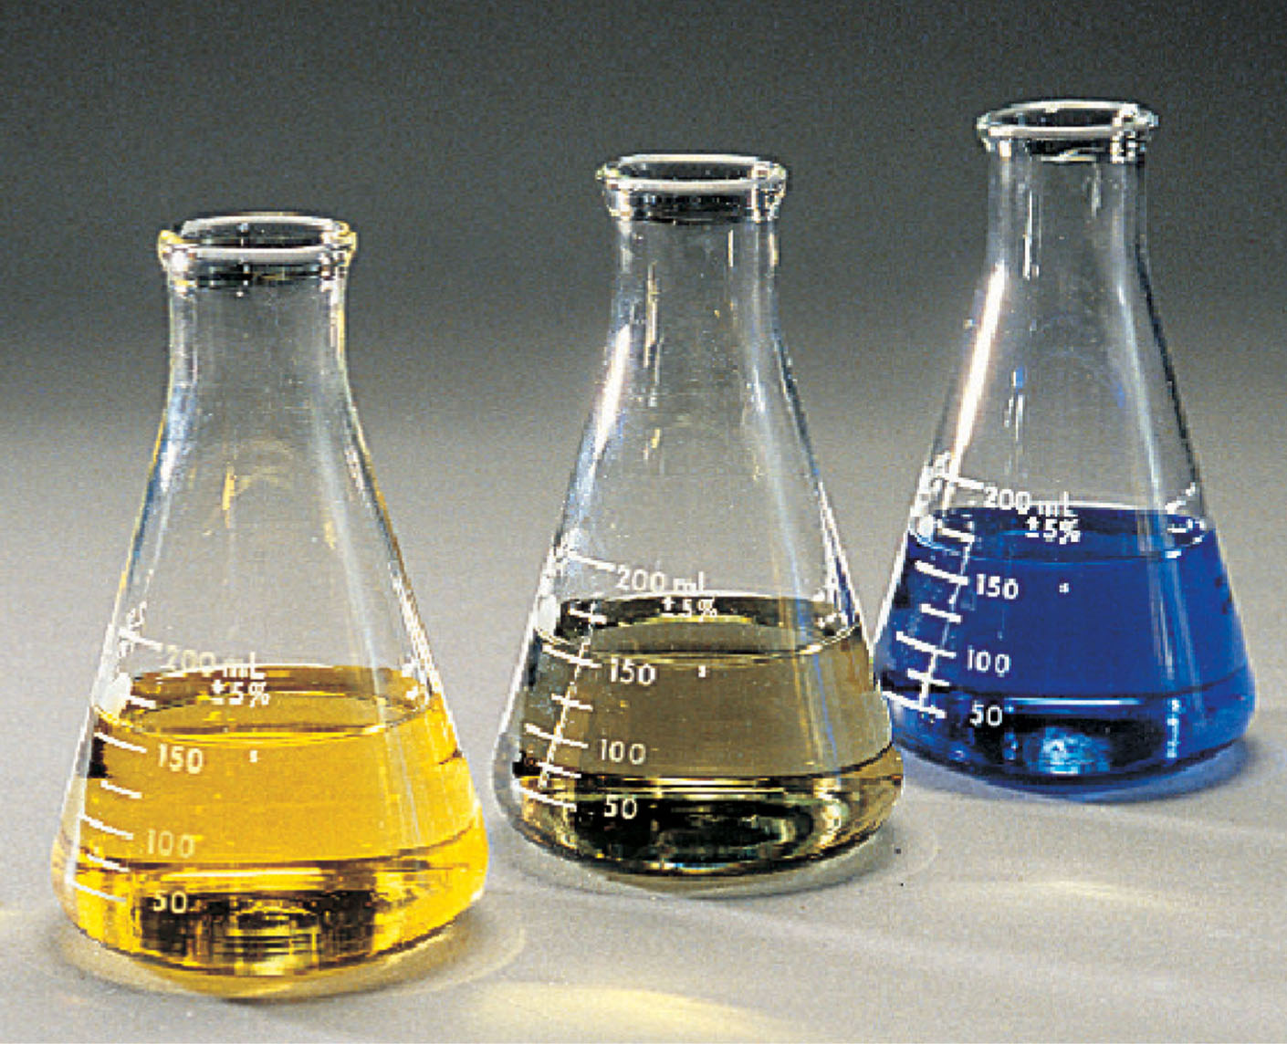
Color Changes for Bromthymol Blue
pH < 6.0
pH = 6.0-7.5
pH > 7.5

Slide 66
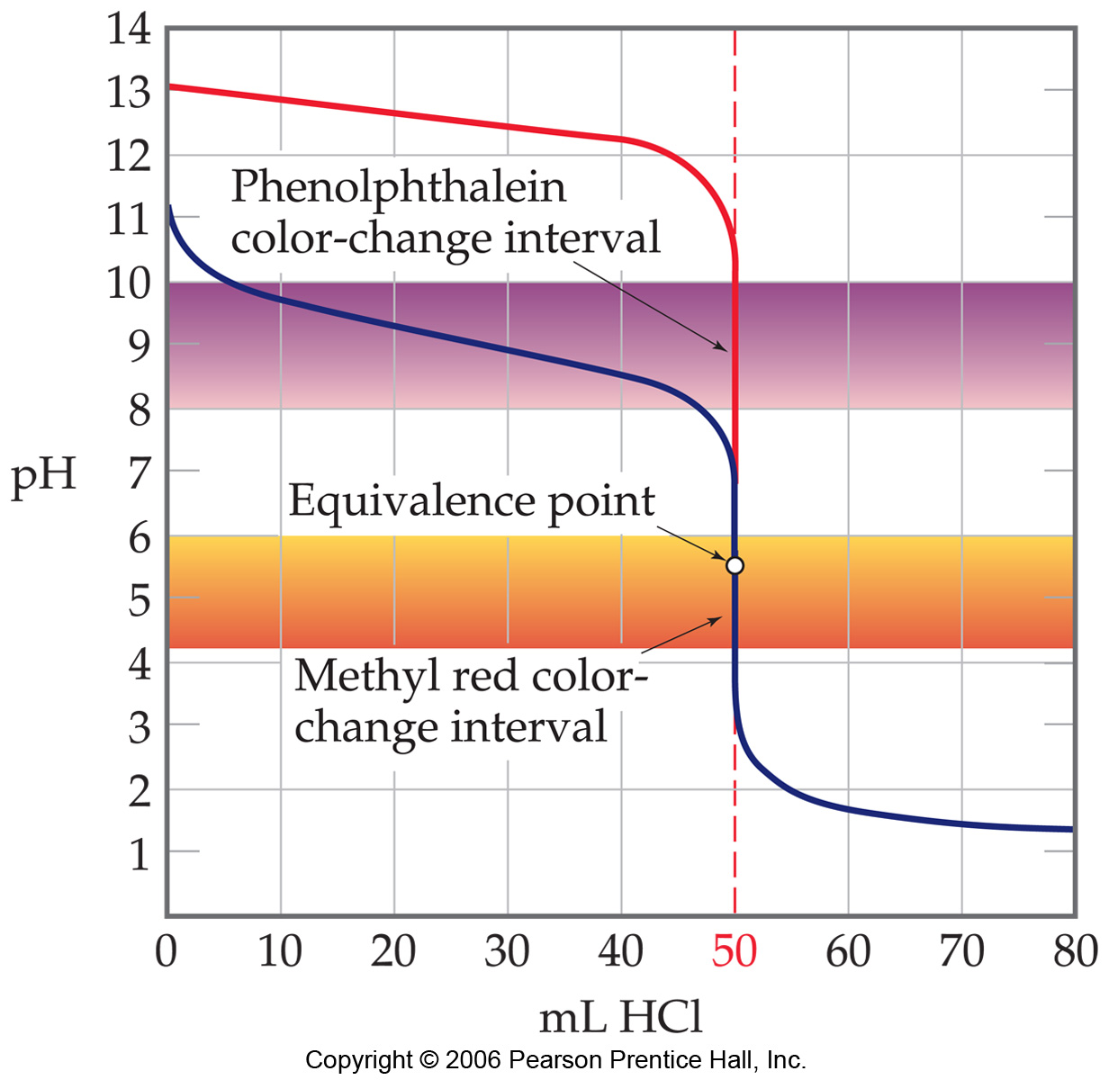
pH Indicators
Which indicator to use? Phenolphthalein or Methyl Red?
The pH at the equivalence point in this titration is < 7.
Methyl red is the indicator of choice here.
MAR

Slide 67
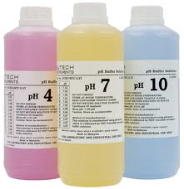
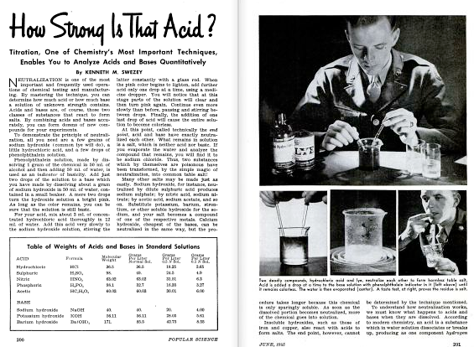
End of Chapter 14
Part II
See:
Chapter Fourteen Part II Study Guide
Chapter Fourteen Part II Concept Guide
Types of Equilibrium Constants
Titration Guide
Buffers and Henderson-Hasselbalch Guide
Important Equations (following this slide)
End of Chapter Problems (following this slide)
MAR

Slide 68
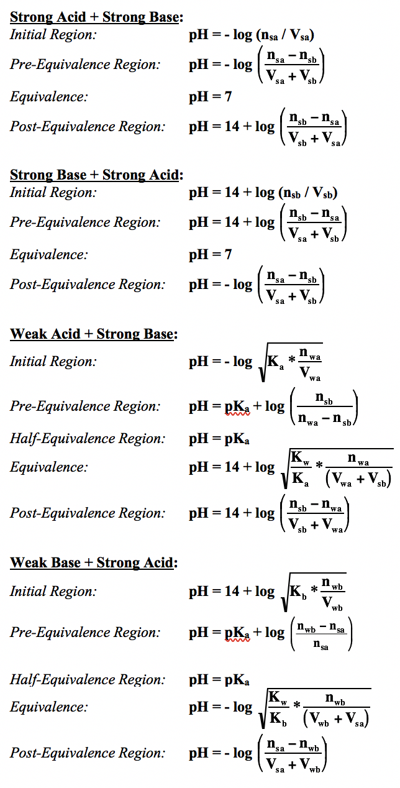
Important Equations, Constants, and
Handouts from this Chapter:
Titrations (SA+SB, SB+SA, WA+SB, WB+SA) and Buffers chapter
pH = pK_{a} + log
pH = pK_{a} + log
Handouts:
Manipulating Equilibrium Constant Expressions
Types of Equilibrium Constants
Table of Ka and Kb values in Problem Set #2
Titration Guide
Buffers and Henderson-Hasselbalch Guide

Slide 69
End of Chapter Problems: Test Yourself
See practice problem set #3 for additional titration and buffer examples
Does the pH of the solution increase, decrease, or stay the same when you: a) Add solid ammonium chloride to a dilute aqueous solution of NH3; b) Add solid sodium acetate to a dilute aqueous solution of acetic acid; c) Add solid NaCl to a dilute aqueous solution of NaOH?
For each of the following cases, decide whether the pH is less than 7, equal to 7, or greater than 7: a) equal volumes of 0.10 M acetic acid, CH3CO2H, and 0.10 M KOH are mixed; b) 25 mL of 0.015 M NH3 is mixed with 25 mL of 0.015 M HCl; c) 150 mL of 0.20 M HNO3 is mixed with 75 mL of 0.40 M NaOH
What is the pH of a solution that consists of 0.20 M ammonia, NH3, and 0.20 M ammonium chloride, NH4Cl? (Ka = 5.6 x 10⁻¹⁰)
What mass of sodium acetate, NaCH3CO2, must be added to 1.00 L of 0.10 M acetic acid to give a solution with a pH of 4.50? (Ka = 1.8 x 10⁻⁵)
Phenol, C6H5OH, is a weak organic acid. Suppose 0.515 g of the compound is dissolved in exactly 125 mL of water. The resulting solution is titrated with 0.123 M NaOH: C6H5OH(aq) + OH⁻¹(aq) Æ C6H5O⁻¹(aq) + H2O(l) a) What is the pH of the original solution of phenol? b) What are the concentrations of all of the following ions at the equivalence point: Na⁺¹, H3O⁺¹, OH⁻¹, and C6H5O⁻¹? c) What is the pH of the solution at the equivalence point?

Slide 70
End of Chapter Problems: Answers
a) pH decreases; b) pH increases; c) no change to pH
a. pH > 7 b. pH < 7 c. pH = 7
pH = 9.25
4.7 g
a) pH = 5.62 b) [Na⁺¹] = 3.23 x 10⁻² mol/L, [H3O⁺¹] = 6.5 x 10⁻¹² mol/L, [OH⁻¹] = 1.5 x 10⁻³ mol/L, and [C6H5O⁻¹] = 3.07 x 10⁻² mol/L c) pH = 11.19
See practice problem set #3 for additional titration and buffer examples

