Slide 1
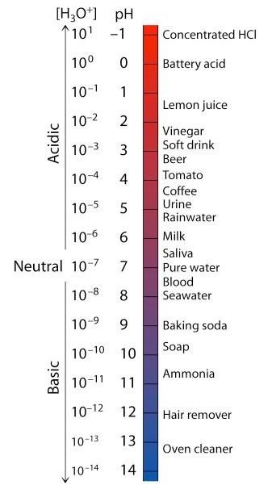
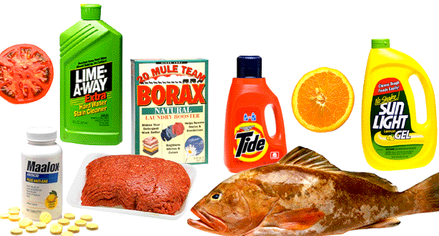
The Chemistry of Acids and Bases Separately
Chapter 14 Part I
Chemistry 223
Professor Michael Russell
MAR
Last update:
4/29/24

Slide 2
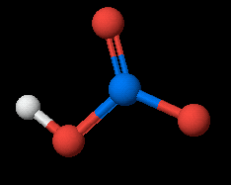
Strong and Weak Acids/Bases
Generally divide acids and bases into STRONG or WEAK categories.
STRONG ACID: HNO₃(aq) + H₂O(liq) →
H₃O⁺(aq) + NO₃⁻(aq)
HNO₃ is about 100% dissociated in water. Acids create hydronium when they react with water.
MAR

Slide 3
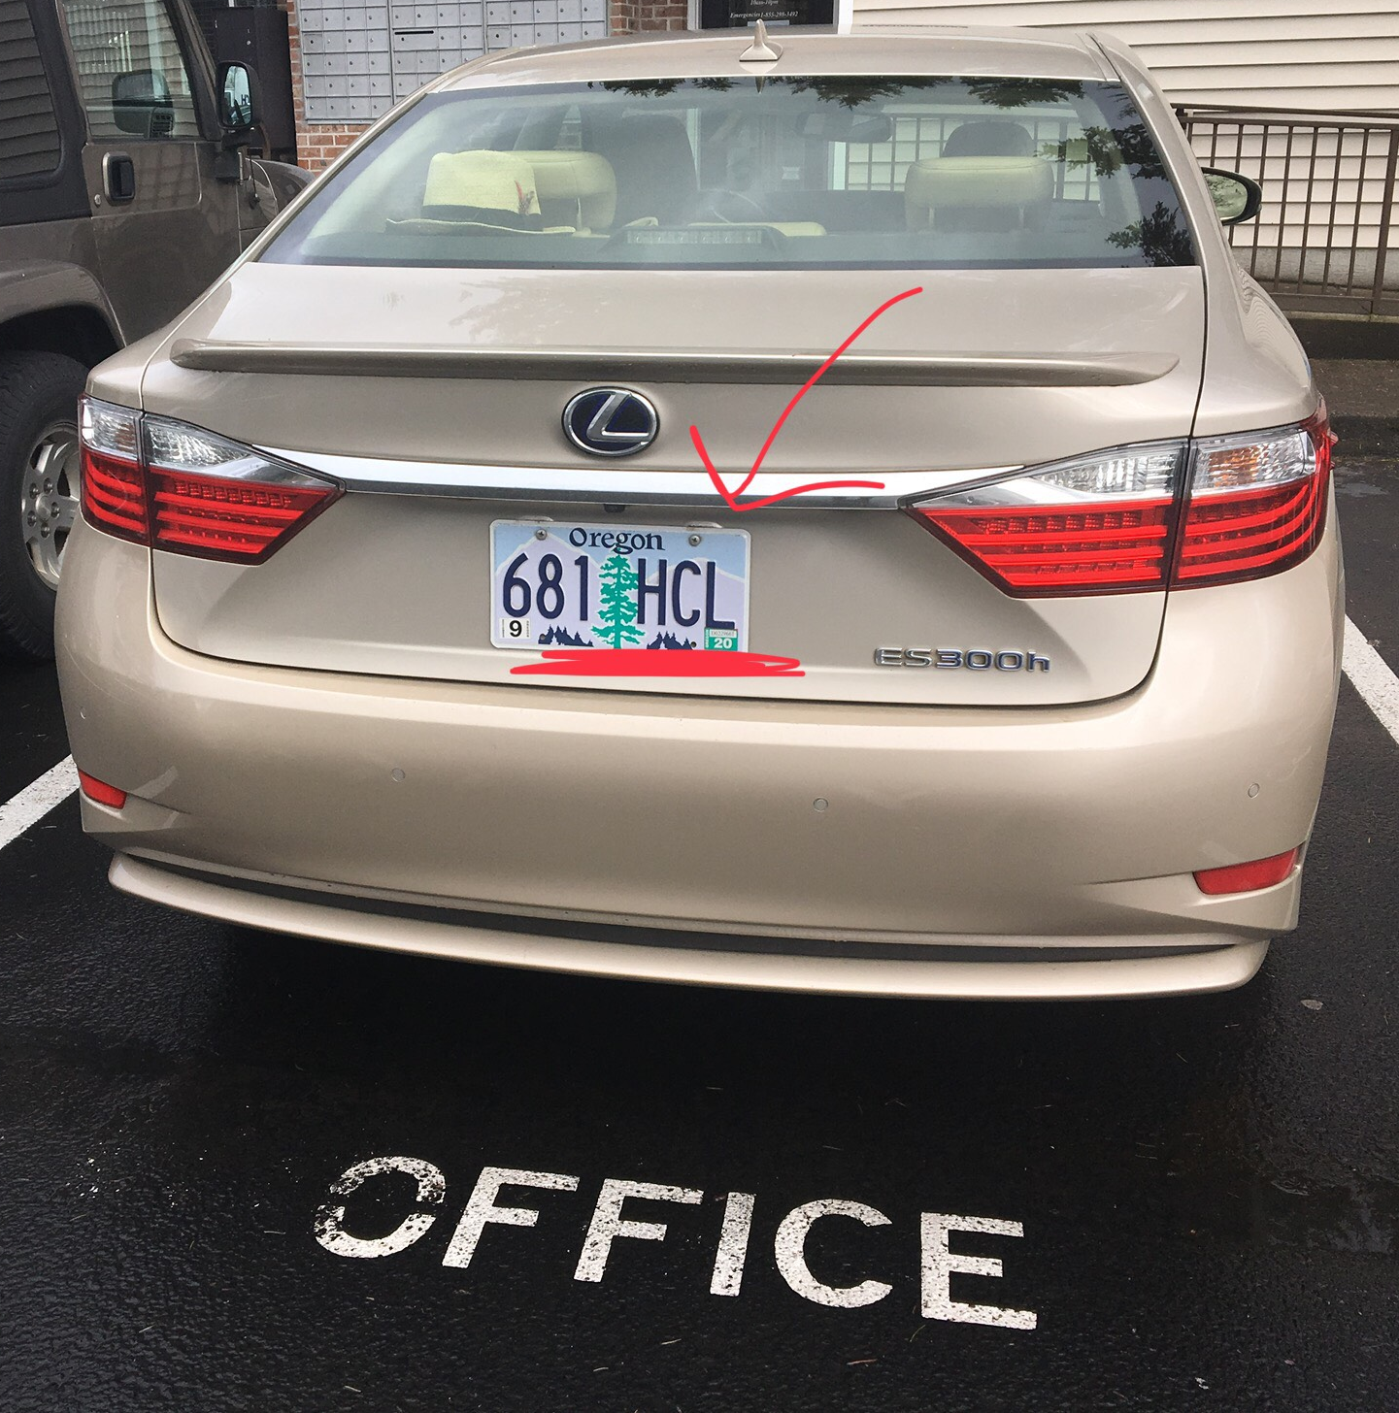
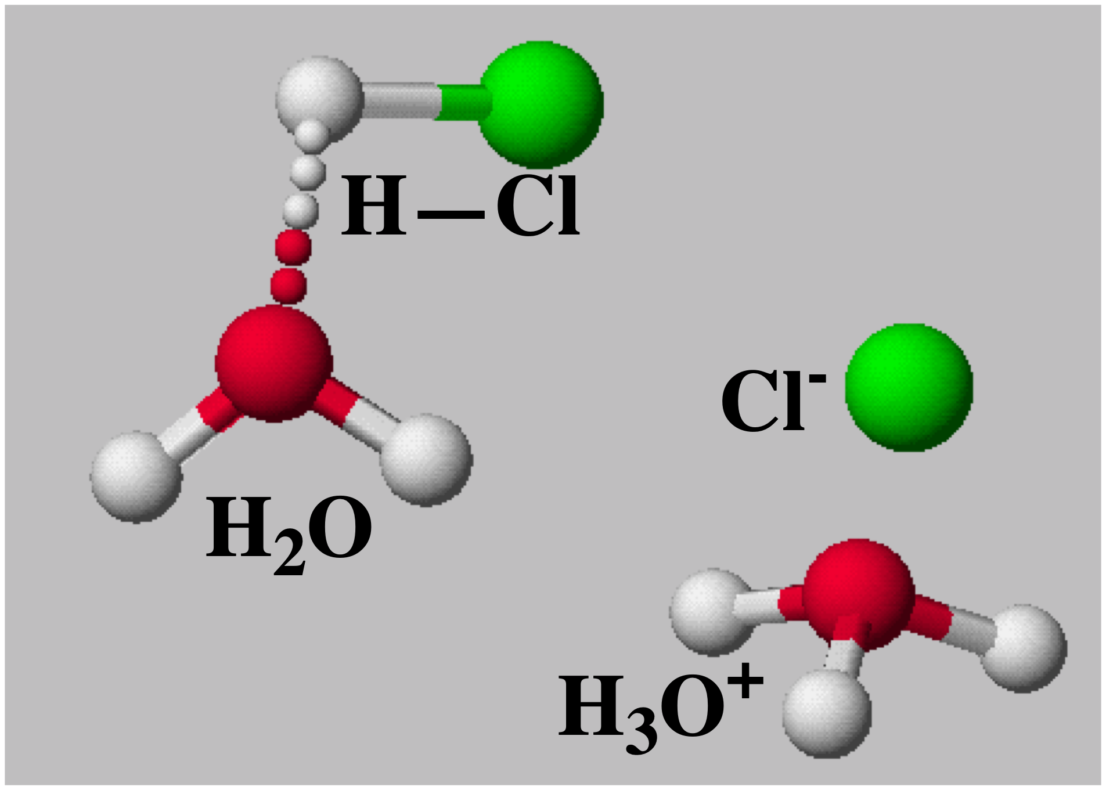
Strong and Weak Acids/Bases
HNO₃, HCl, HBr, HI and HClO₄ are among the few known strong monoprotic acids.
Coolest Oregon
License plate ever?
MAR
Memorize these five strong acids!

Slide 4
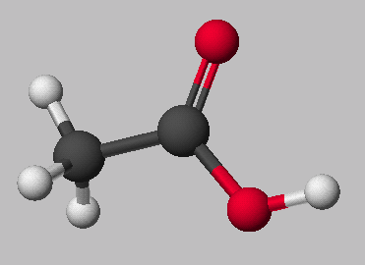
Strong and Weak Acids/Bases
Weak acids are much less than 100% ionized in water.
One of the best known is acetic acid = CH₃CO₂H = HOAc
HOAc(aq) + H₂O(liq) qe OAc⁻(aq) + H₃O⁺(aq)
OAc⁻ = CH₃CO₂⁻ = acetate ion
MAR

Slide 5
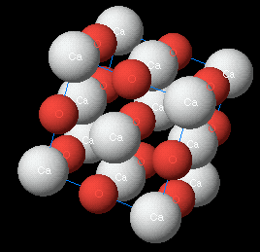
Strong and Weak Acids/Bases
Strong Base: 100% dissociated in water.
NaOH(aq) → Na⁺(aq) + OH⁻(aq)
Other strong monobasic bases: KOH, LiOH
Ca(OH)₂ is a strong dibasic system:
CaO (lime) + H₂O -->
Ca(OH)₂ (slaked lime)
CaO
Memorize the three strong monobasic bases!
MAR

Slide 6
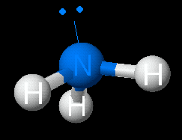
Strong and Weak Acids/Bases
Weak base: less than 100% ionized in water
One of the best known weak bases is ammonia, NH3
NH₃(aq) + H₂O(liq) qe NH₄⁺(aq) + OH⁻(aq)
MAR

Slide 7
ACID-BASE THEORIES
The most general theory for common aqueous acids and bases is the BRØNSTED - LOWRY theory
ACIDS DONATE H⁺ IONS
BASES ACCEPT H⁺ IONS
See Brønsted Acids and Bases Handout
MAR
Notes:
Older Arrhenius definition used acids donating H⁺ and bases donating OH⁻ ions.

Slide 8
ACID-BASE THEORIES
The Brønsted definition means NH₃ is a BASE in water - and water is itself an ACID
MAR

Slide 9
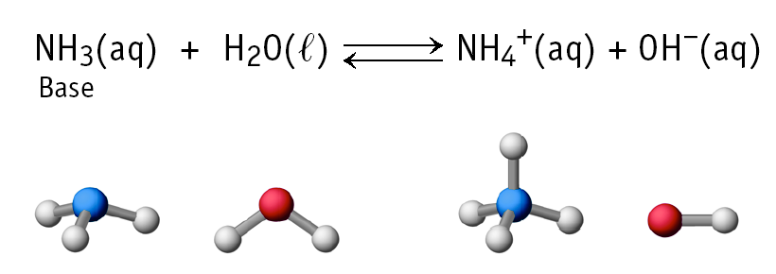
ACID-BASE THEORIES
NH₃ is a BASE in water - and water is itself an ACID
NH₃ / NH₄⁺ is a conjugate pair - related by the gain or loss of H⁺
Every acid has a conjugate base - and vice-versa.
MAR

Slide 10
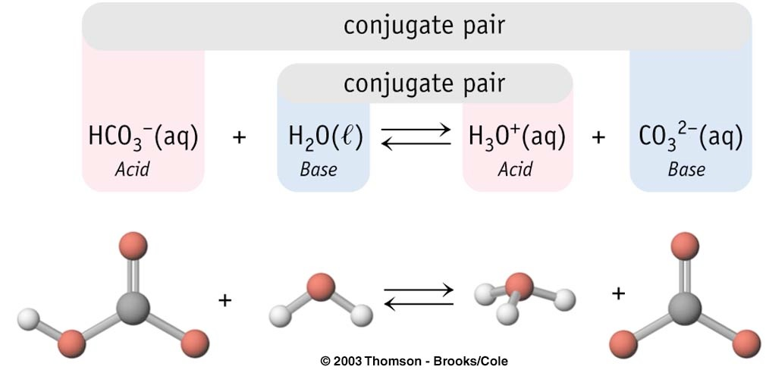
Conjugate Pairs
MAR
Which of the following is NOT an acid-base conjugate pair?
HClO and Cl⁻
HF and F⁻
HNO2 and NO2⁻
H2CO3 and HCO3⁻
HNO3 and NO3⁻
Enter your response on
your i>Clicker now!
Answer = A,
HClO and Cl⁻
not related by H⁺

Slide 11
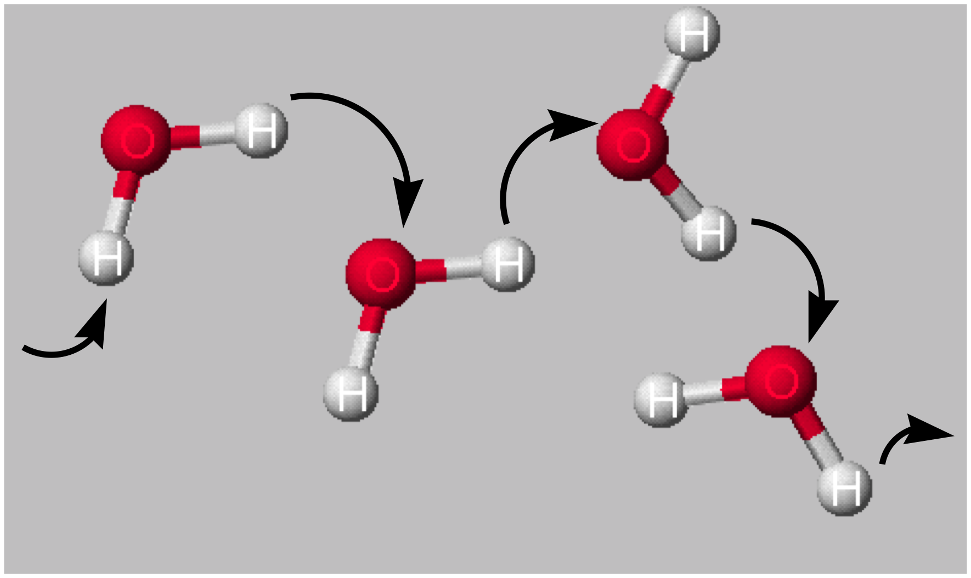
MORE ABOUT WATER
H₂O can function as both an ACID and a BASE.
Pure water undergoes AUTOIONIZATION
MAR

Slide 12
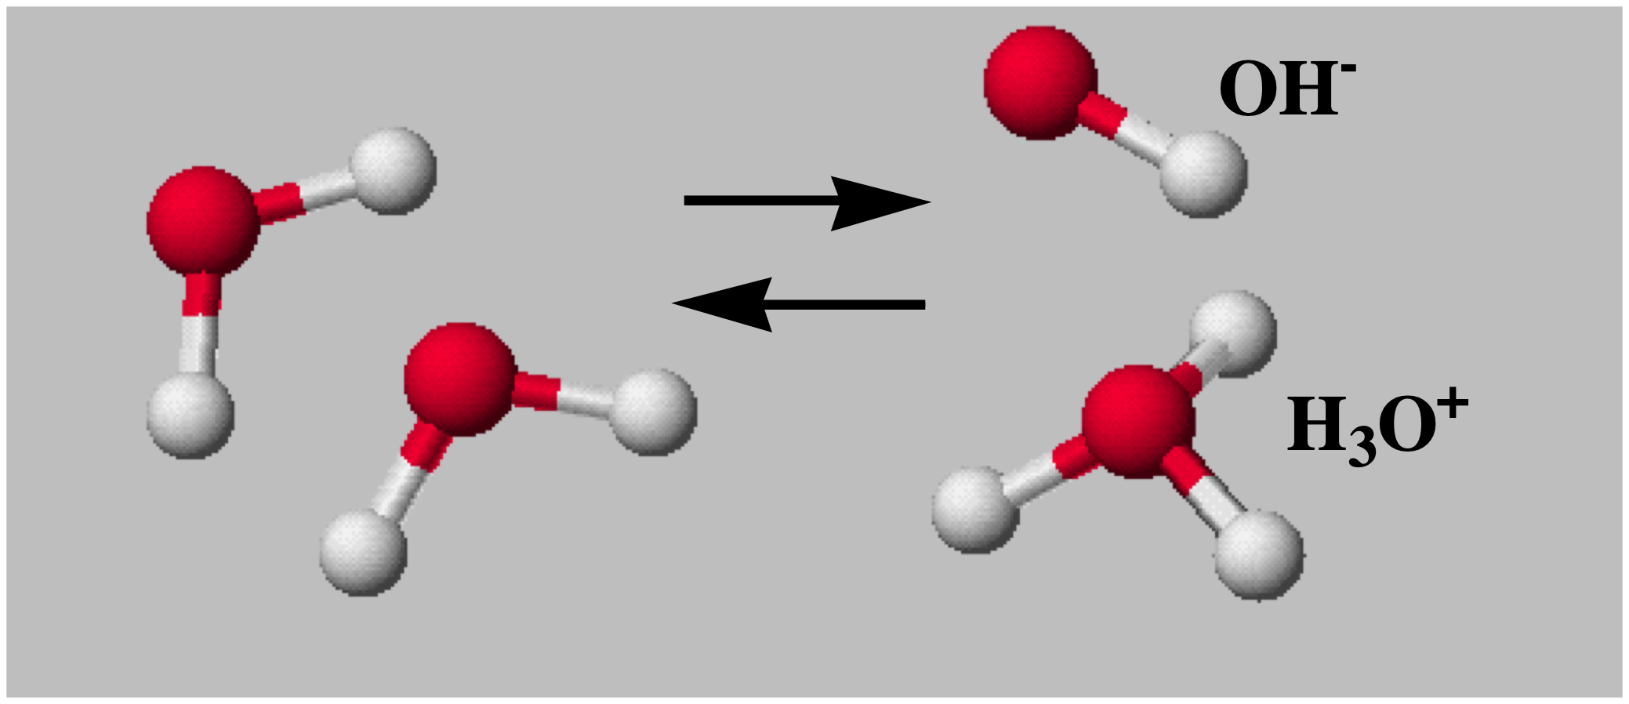
MORE ABOUT WATER
Autoionization
K_{w} = [H₃O⁺] [OH⁻] = 1.00 x 10⁻¹⁴ at 25 ºC
In a neutral solution [H₃O⁺] = [OH⁻]
so K_{w} = [H₃O⁺]² = [OH⁻]²
and so [H₃O⁺] = [OH⁻] = √K_{w} = 1.00 x 10⁻⁷ M
Memorize KW = 1.00 x 10⁻¹⁴!
MAR
A solution has [H3O⁺] = 1.0 x 10⁻⁸ M. [OH⁻] = ______
1.0 x 10⁻⁸ M
1.0 x 10⁻⁷ M
1.0 x 10⁻⁶ M
1.0 x 10⁻¹⁴ M
1.0 x 10⁻³ M
Enter your response on
your i>Clicker now!
Answer = C,
1.0 x 10⁻⁶ M
= Kw / [H3O⁺]
= 1.0 x 10⁻¹⁴ / 1.0 x 10⁻⁸

Slide 13
Calculating [H₃O⁺] & [OH⁻]
You add 0.0010 mol of NaOH to 1.0 L of pure water. Calculate [H₃O⁺] and [OH⁻].
Solution
2 H₂O(liq) qe H₃O⁺(aq) + OH⁻(aq)
Le Chatelier predicts equilibrium shifts to the ____________.
[H₃O⁺] < 10⁻⁷ at equilibrium.
Set up an ICE concentration table.
MAR

Slide 14
Calculating [H₃O⁺] & [OH⁻]
You add 0.0010 mol of NaOH to 1.0 L of pure water. Calculate [H₃O⁺] and [OH⁻].
Solution
2 H₂O(liq) qe H₃O⁺(aq) + OH⁻(aq)
initial 0 0.0010
change +x +x
equilib x 0.0010 + x
K_{w} = (x)(0.0010 + x)
Because x << 0.0010 M, assume [OH⁻] = 0.0010 M
K_{w} = (x)(0.0010 + x) ≈ (x)(0.0010) = [H₃O⁺](0.0010)
[H₃O⁺] = K_{w} / 0.0010 = 1.0 x 10⁻¹¹ M
MAR

Slide 15
Calculating [H₃O⁺] & [OH⁻]
You add 0.0010 mol of NaOH to 1.0 L of pure water. Calculate [H₃O⁺] and [OH⁻].
Solution
2 H₂O(liq) qe H₃O⁺(aq) + OH⁻(aq)
[H₃O⁺] = K_{w} / 0.0010 = 1.0 x 10⁻¹¹ M
[OH⁻] = 1.0 x 10⁻³ M
This solution is _________
because
[OH⁻] > [H₃O⁺]
MAR

Slide 16
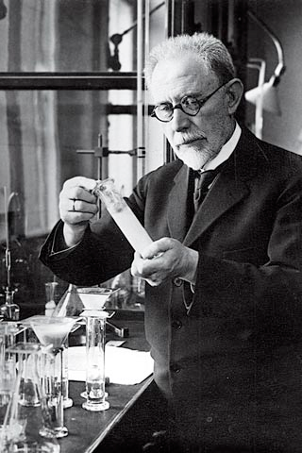
[H₃O⁺], [OH⁻] and pH
A common way to express acidity and basicity is with pH
pH = - log [H₃O⁺]
In a neutral solution, [H₃O⁺] = [OH⁻] =
1.0 x 10⁻⁷ at 25 ºC
pH = -log (1.00 x 10⁻⁷)
= - (-7.00) = 7.00
pH = 7.00 for neutral solutions!
MAR
Søren Sørensen, creator
of the pH scale

Slide 17
[H₃O⁺], [OH⁻] and pH
What is the pH of the 0.0010 M NaOH solution?
[H₃O⁺] = 1.0 x 10⁻¹¹ M
pH = - log (1.0 x 10⁻¹¹) = 11.00
General conclusion -
Basic solution pH > 7
Neutral pH = 7
Acidic solution pH < 7
Public Enemy are not scientists!
MAR
A solution which has a pH of 10.5 is ____________ .
acidic
basic
neutral
lame
Enter your response on
your i>Clicker now!
Answer = B,
basic
pH > 7 basic
pH < 7 acidc
pH = 7 neutral

Slide 18
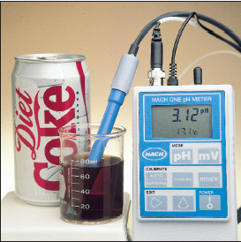
[H₃O⁺], [OH⁻] and pH
If the pH of Diet Coke is 3.12, it is ____________.
Because pH = - log [H₃O⁺] then
log [H₃O⁺] = - pH
Take antilog and get
[H₃O⁺] = 10^{-pH}
[H₃O⁺] = 10^{-3.12}
= 7.6 x 10⁻⁴ M
MAR
A solution has a pH of 4.50. The hydronium concentration is:
4.5 M
3.2 x 10⁻⁵
3.2 x 10⁻⁴
3.2 x 10⁻⁷
3.2 x 10⁻⁹
Enter your response on
your i>Clicker now!
Answer = B,
3.2 x 10⁻⁵
= 10^{-4.50}

Slide 19
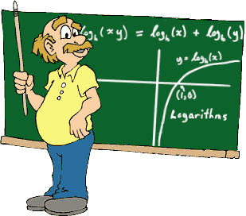
logarithms and sig figs
Logarithms are exponents with special sig figs rules. General rule:
log of experimentally measured number with N sig figs give numbers with N decimal places after the decimal (digit before decimal only indicates magnitude)
Examples:
log 3.07*10⁻³ = -2.513 (3 sigs, 3 places after decimal)
- log 1.1*10⁻⁸ = 7.96 (2 sigs, 2 places after decimal)
10^{-3.12} = 7.6 * 10⁻⁴ (2 places after decimal, 2 sigs)
MAR
Notes:
Movie clip from "The Atom A Love Story" (2019)

Slide 20
pH of Common Substances
MAR

Slide 21
Other pX Scales
In general pX = -log X
and: pK_{a} = - log K_{a}
and so: pOH = - log [OH⁻]
K_{w} = [H₃O⁺] [OH⁻] = 1.00 x 10⁻¹⁴ at 25 ºC
Take the negative log of both sides
-log (10⁻¹⁴) = - log [H₃O⁺] + (-log [OH⁻])
14 = pH + pOH
also: 14 = pK_{a} + pK_{b}
Answer = B,
9.51
pOH = - log [OH⁻]
pOH = - log [Kw/H3O⁺]
pOH = - log [10⁻¹⁴ / 3.2 x 10⁻⁵]
MAR
A solution has a hydronium ion concentration of 3.2 x 10⁻⁵ M. The pOH is:
18.02
9.51
7.00
4.49
3.31
Enter your response on
your i>Clicker now!
Notes:
pKa also refers to "Professional Kickboxing Association" (http://www.pkakickboxing.tv/) :)

Slide 22
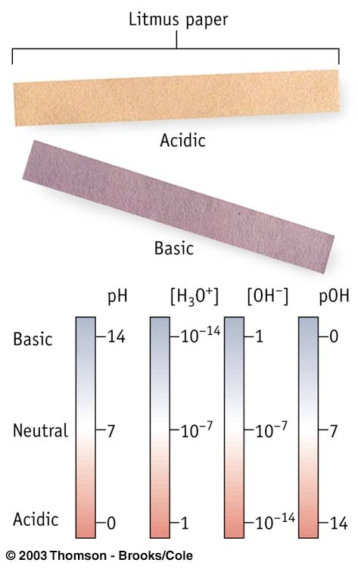
pH Scales
acidic solutions:
pH ↓,
[H₃O⁺] ↑,
[OH⁻] ↓,
pOH ↑
basic solutions: pH ↑,
[H₃O⁺] ↓,
[OH⁻] ↑,
pOH ↓
K_{w} = [H₃O⁺] [OH⁻] = 1.00 x 10⁻¹⁴ at 25 °C
pH + pOH = 14
MAR

Slide 23
Equilibria Considerations Involving Weak Acids and Bases
Acid Conjugate Base
acetic, CH₃CO₂H CH₃CO₂⁻, acetate
ammonium, NH₄⁺ NH₃, ammonia
bicarbonate, HCO₃⁻ CO₃²⁻, carbonate
A weak acid (or base) is one that ionizes to a VERY small extent (< 5%).
MAR

Slide 24
Equilibria Involving Weak Acids and Bases
Consider acetic acid, CH₃CO₂H (HOAc)
HOAc + H₂O qe H₃O⁺ + OAc⁻
Acid Conj. base
(K is designated K_{a} for ACID)
Because [H₃O⁺] and [OAc⁻] are SMALL, K_{a} << 1.
MAR

Slide 25
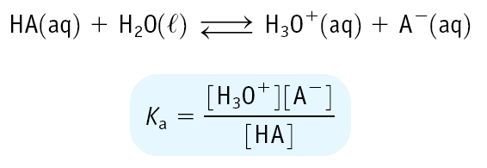
Equilibrium Constants for Weak Acids (K_{a})
Weak acids have K_{a} < 1
Leads to small [H₃O⁺] and a pH of 2 - 7
MAR

Slide 26
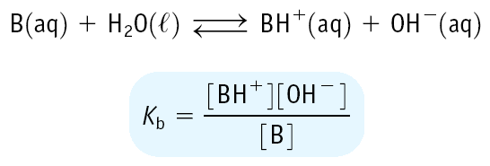
Equilibrium Constants for Weak Bases (K_{b})
Weak bases have K_{b} < 1
Leads to small [OH⁻] and a pH of 12 - 7
MAR

Slide 27
Equilibrium Constants for Weak Acids and Bases
HA + H₂O qe H₃O⁺ + A⁻ K_{a}
A⁻ + H₂O qe HA + OH⁻ K_{b}
-------------------------------------
2 H₂O qe H₃O⁺ + OH⁻ K_{a}*K_{b} = K_{w}
Important relations: K_{a}*K_{b} = K_{w} and pK_{a} + pK_{b} = 14
MAR

Slide 28
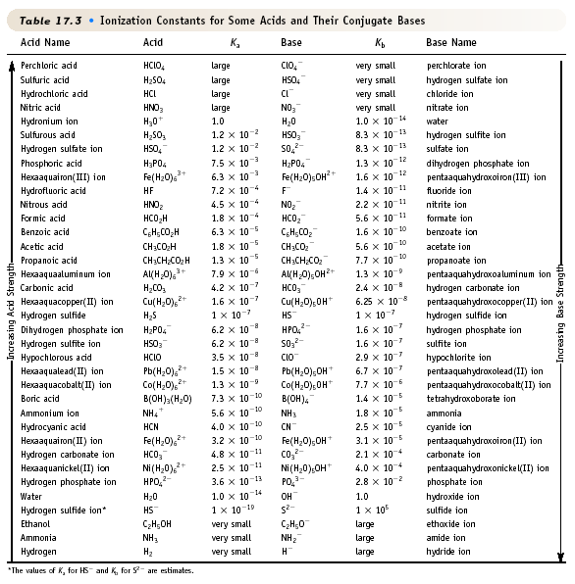
Ionization Constants for Acids/Bases
Acids
Conjugate
Bases
Increase strength
Answer = B,
CO3⁻², carbonate (Kb = 2.1 x 10⁻⁴)
Largest Kb = most hydroxide
Largest Kb = strongest base
Increase strength
MAR
Which is the strongest base?
CH3CO2⁻¹, acetate (Kb = 5.6 x 10⁻¹⁰)
CO3⁻², carbonate (Kb = 2.1 x 10⁻⁴)
HS⁻¹, hydrogen sulfide (Kb = 1.0 x 10⁻⁷)
NH3, ammonia (Kb = 1.8 x 10⁻⁵)
F⁻¹, fluoride (Kb = 1.4 x 10⁻¹¹)
Enter your response on
your i>Clicker now!

Slide 29
K and Acid-Base Reactions
ACIDS CONJUGATE BASES
STRONG
weak
weak
STRONG
In general, Reactions always go from the stronger A-B pair (larger K) to the weaker A-B pair (smaller K).
MAR

Slide 30
K and Acid-Base Reactions
A strong acid is 100% dissociated.
Therefore, a STRONG ACID - a good H⁺ donor-must have a WEAK CONJUGATE BASE - a poor H⁺ acceptor.
HNO₃(aq) + H₂O(liq) qe H₃O⁺(aq) + NO₃⁻(aq)
STRONG A base acid weak B
Every A-B reaction has two acids and two bases.
Equilibrium always lies toward the weaker pair.
Here K is very large... should write:
HNO₃(aq) + H₂O(liq) → H₃O⁺(aq) + NO₃⁻(aq)
MAR

Slide 31
K and Acid-Base Reactions
Acetic acid is only 0.42% ionized when [HOAc] = 1.0 M. It is a WEAK ACID
HOAc + H₂O qe H₃O⁺ + OAc⁻
WEAK A base acid STRONG B
Because [H₃O⁺] is small, this must mean
1. H₃O⁺ is a stronger acid than HOAc
2. OAc⁻ is a stronger base than H₂O
3. K for this reaction is small
MAR

Slide 32
Types of Acid/Base Reactions
1. Strong acid + Strong base (SA + SB) reactions:
HCl(aq) + NaOH(aq) qe H₂O(l) + NaCl(aq)
H⁺ + Cl⁻ + Na⁺ + OH⁻ qe H₂O + Na⁺ + Cl⁻
Net ionic equation:
H⁺(aq) + OH⁻(aq) qe H₂O(liq)
K = 1/K_{w} = 1 x 10¹⁴
very product favored K!
Mixing equal molar quantities of a strong acid and strong base produces a neutral solution.
should write:
HCl(aq) + NaOH(aq) → H₂O(l) + NaCl(aq)
MAR

Slide 33
Types of Acid/Base Reactions
2. Weak acid + Strong base (WA + SB) reactions:
CH₃CO₂H + OH⁻ qe H₂O + CH₃CO₂⁻
This is the reverse of the reaction of CH₃CO₂⁻ (conjugate base) with H₂O.
OH⁻ stronger base than CH₃CO₂⁻
K = 1/K_{b} = 1.8 x 10⁹
very product favored K!
Mixing equal molar quantities of a weak acid and strong base produces the acid's conjugate base. The solution is basic.
MAR
Notes:
OAc(-) Kb = 5.6E-10

Slide 34
Types of Acid/Base Reactions
3. Weak base + Strong acid (WB + SA) reactions:
H₃O⁺ + NH₃ qe H₂O + NH₄⁺
This is the reverse of the reaction of NH₄⁺ (conjugate acid of NH₃) with H₂O.
H₃O⁺ stronger acid than NH₄⁺
K = 1/K_{a} = 1.8 x 10⁹
very product favored K!
Mixing equal molar quantities of a strong acid and weak base produces the base's conjugate acid. The solution is acidic.
Answer = A,
right
strong acids (HCl) and bases push
reactions to the opposite side
MAR
For the reaction below, decide if the equilbrium lies predominantly to the right or to the left.
HCl(aq) + CO₃²⁻(aq) ⇌ Cl⁻(aq) + HCO₃–(aq)
right
left
exactly in the middle
none of the above
Enter your response on
your i>Clicker now!
Notes:
NH4(+) Ka = 5.6E-10

Slide 35
Types of Acid/Base Reactions
4. Weak acid + weak base (WA + WB) reactions:
Product cation = conjugate acid of weak base.
Product anion = conjugate base of weak acid.
pH of solution depends on relative strengths of cation and anion (larger K → smaller K).
MAR
We will not be studying WA + WB reactions in CH 223

Slide 36
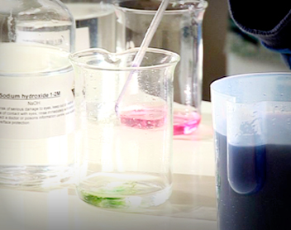
Types of Acid/Base Reactions: Summary
MAR
Notes:
Video from The Simpsons S01 E02 "Bart The Genius"

Slide 37
Equilibria Involving A Weak Acid
0.0001 M
0.003 M
Determining the pH of an acetic acid solution
0.06 M
2.0 M
a pH meter
MAR

Slide 38
Equilibria Involving A Weak Acid
You have 1.00 M HOAc. Calc. the equilibrium concs. of HOAc, H₃O⁺, OAc⁻, and the pH.
Step 1. Define ICE equilibrium using Ka.
HOAc + H₂O qe H₃O⁺ + OAc⁻
[HOAc] [H₃O⁺] [OAc⁻]
initial 1.00 0 0
change -x +x +x
equilib 1.00-x x x
Note that we neglect [H₃O⁺] from H₂O.
HOAc = acetic acid, OAc⁻ = acetate ion
MAR

Slide 39
Equilibria Involving A Weak Acid
You have 1.00 M HOAc. Calc. the equilibrium concs. of HOAc, H₃O⁺, OAc⁻, and the pH.
HOAc + H₂O qe H₃O⁺ + OAc⁻
Step 2. Write K_{a} expression
This is a quadratic equation; solve using the quadratic formula.
... but there's a better way, sometimes!
MAR

Slide 40
Equilibria Involving A Weak Acid
You have 1.00 M HOAc. Calc. the equilibrium concs. of HOAc, H₃O⁺, OAc⁻, and the pH.
Step 3. Solve K_{a} expression
First assume x is very small because K_{a} is so small. If so:
Therefore,
x = [H₃O⁺] = [OAc⁻] = [1.8x10⁻⁵ • 1.00]^{1/2} = [K_{a} • C_{a}]^{1/2}
MAR
Ca = concentration (M) of acid

Slide 41
Equilibria Involving A Weak Acid
You have 1.00 M HOAc. Calc. the equilibrium concs. of HOAc, H₃O⁺, OAc⁻, and the pH.
Step 3. Solve K_{a} approximate expression:
x = [H₃O⁺] = [OAc⁻] = [1.8x10⁻⁵ • 1.00]^{1/2}
x = [H₃O⁺] = [OAc⁻] = 4.2 x 10⁻³ M
pH = - log [H₃O⁺] = -log (4.2 x 10⁻³) = 2.37
MAR
Exact solution with quadratic: x = 0.0042, x = -0.0043

Slide 42
Equilibria Involving A Weak Acid
Consider the approximate expression:
For many weak acids
[H₃O⁺] = [conj. base] = [K_{a} • C_{a}]^{1/2}
where C_{a} = initial conc. of acid
Useful Rule of Thumb:
If 100•K_{a} < C_{a}, then [H₃O⁺] = [K_{a}•C_{a}]^{1/2}
or pH = - log [K_{a}•C_{a}]^{1/2}
MAR

Slide 43
Equilibria Involving A Weak Acid
Calculate the pH of a 0.0010 M solution of formic acid, HCO₂H.
HCO₂H + H₂O qe HCO₂⁻ + H₃O⁺
K_{a} = 1.8 x 10⁻⁴
100 * K_{a} is not less than C_{a}!
Approximate solution
[H₃O⁺] = [K_{a} • C_{a}]^{1/2} = 4.2 x 10⁻⁴ M, pH = 3.37
Exact Solution
[H₃O⁺] = [HCO₂⁻] = 3.4 x 10⁻⁴ M
[HCO₂H] = 0.0010 - 3.4 x 10⁻⁴ = 0.0007 M
pH = 3.47
MAR
Best answer because 100*Ka not less than Ca

Slide 44
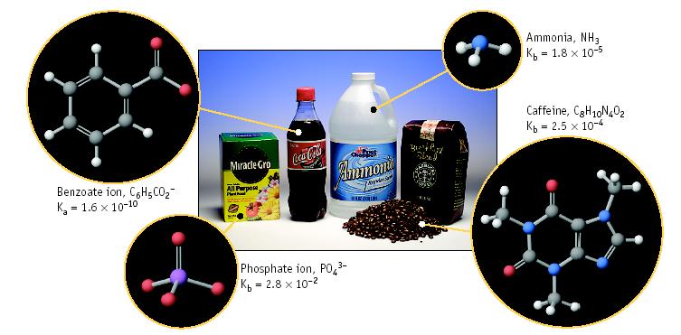
Weak Bases
MAR

Slide 45
Equilibria Involving A Weak Base
You have 0.010 M NH₃. Calculate the pH.
NH₃ + H₂O qe NH₄⁺ + OH⁻
K_{b} = 1.8 x 10⁻⁵
Step 1. Define equilibrium concs.
[NH₃] [NH₄⁺] [OH⁻]
initial 0.010 0 0
change -x +x +x
equilib 0.010 - x x x
MAR

Slide 46
Equilibria Involving A Weak Base
You have 0.010 M NH₃. Calculate the pH.
NH₃ + H₂O qe NH₄⁺ + OH⁻
K_{b} = 1.8 x 10⁻⁵
Step 2. Solve the equilibrium expression
Assume x is small (100•K_{b} < C_{b}), so
x = [OH⁻] = [NH₄⁺] = [K_{b} • C_{b}]^{1/2} = 4.2 x 10⁻⁴ M
check: [NH₃] = 0.010 - 4.2 x 10⁻⁴ ≈ 0.010 M
Valid approximation!
MAR
Exact solution with quadratic: x = 0.00042, x = -0.00043

Slide 47
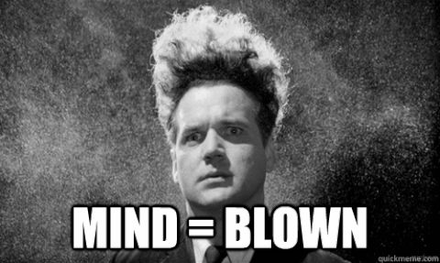
Equilibria Involving A Weak Base
You have 0.010 M NH₃. Calculate the pH.
NH₃ + H₂O qe NH₄⁺ + OH⁻
K_{b} = 1.8 x 10⁻⁵
Step 3. Calculate pH
[OH⁻] = 4.2 x 10⁻⁴ M
so pOH = - log [OH⁻] = 3.37
Because pH + pOH = 14,
pH = 10.63
or pH = 14 + log [K_{b}•C_{b}]^{1/2} = 10.63
MAR

Slide 48
Overview: Calculating pH of Acids & Bases
Strong acid: pH = - log C_{a} = - log [H₃O⁺]
Strong base:
pH = 14 + log C_{b} = 14 + log [OH⁻¹]
Weak acid:
pH = - log [K_{a}•C_{a}]^{1/2} (100 * Ka < Ca)
Weak base:
pH = 14 + log [K_{b}•C_{b}]^{1/2} (100 * Kb < Cb)
MAR
Memorize!

Slide 49
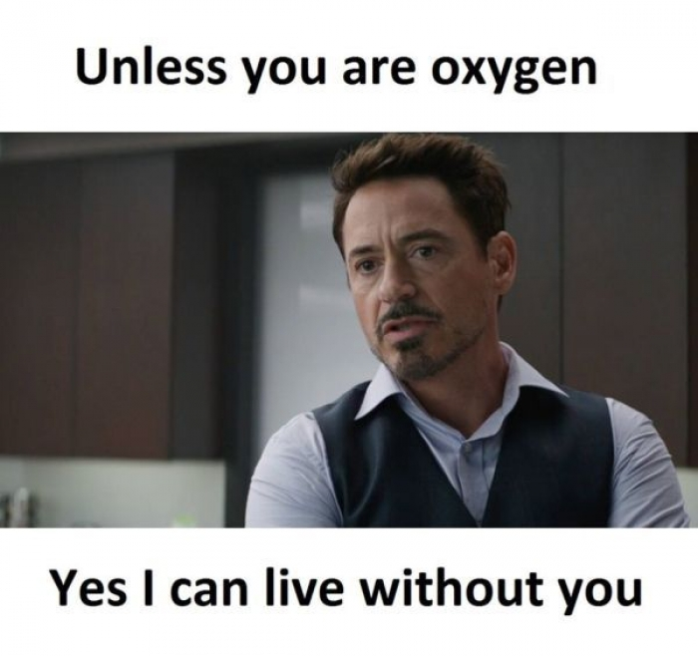
Acid-Base Properties of Salts
MX + H₂O ----> acidic or basic solution?
Consider NH₄Cl
NH₄Cl(aq) ----> NH₄⁺(aq) + Cl⁻(aq)
(a) Reaction of Cl⁻ with H₂O
Cl⁻ + H₂O ----> HCl + OH⁻
base acid acid base
Cl⁻ ion is a VERY weak base because its conjugate acid is strong.
Therefore, Cl⁻ ----> neutral solution
MAR

Slide 50
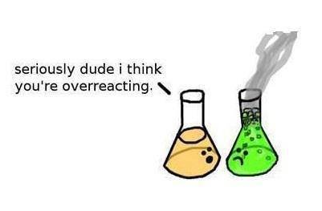
Acid-Base Properties of Salts
MX + H₂O ----> acidic or basic solution?
NH₄Cl(aq) ----> NH₄⁺(aq) + Cl⁻(aq)
(b) Reaction of NH₄⁺ with H₂O
NH₄⁺ + H₂O ----> NH₃ + H₃O⁺
acid base base acid
NH₄⁺ ion is a moderate acid (Ka = 5.6 x 10⁻¹⁰) because its conjugate base is weak.
Therefore, NH₄⁺ ----> acidic solution
MAR

Slide 51
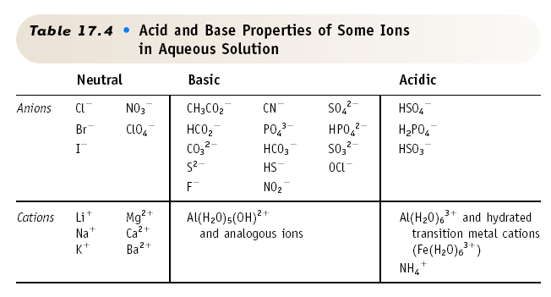
Acid-Base Properties of Salts
Answer = B,
greater than 7
CO3⁻², carbonate (Kb = 2.1 x 10⁻⁴),
weak base,
pH > 7
Na⁺ does not affect pH
MAR
Will a 0.1 M Na2CO3(aq) solution have a pH which is:
less than 7
greater than 7
equal to 7
Enter your response on
your i>Clicker now!

Slide 52
Acid-Base Properties of Salts
Calculate the pH of a 0.10 M solution of Na₂CO₃.
Na⁺ + H₂O ---> neutral
CO₃²⁻ + H₂O qe HCO₃⁻ + OH⁻
base acid acid base
K_{b} = 2.1 x 10⁻⁴
Step 1. Set up ICE concentration table
[CO₃²⁻] [HCO₃⁻] [OH⁻]
initial 0.10 0 0
change -x +x +x
equilib 0.10 - x x x
MAR

Slide 53
Acid-Base Properties of Salts
Calculate the pH of a 0.10 M solution of Na₂CO₃.
Na⁺ + H₂O ---> neutral
CO₃²⁻ + H₂O qe HCO₃⁻ + OH⁻
base acid acid base
K_{b} = 2.1 x 10⁻⁴
Step 2. Solve the equilibrium expression
Assume 0.10 - x ≈ 0.10, because 100•K_{b} < C_{b}
x = [HCO₃⁻] = [OH⁻] = [K_{b} • C_{b}]^{1/2} = 0.0046 M
MAR
Exact solution with quadratic: x = 0.0045, x = -0.0047

Slide 54
Acid-Base Properties of Salts
Calculate the pH of a 0.10 M solution of Na₂CO₃.
Na⁺ + H₂O ---> neutral
CO₃²⁻ + H₂O qe HCO₃⁻ + OH⁻
base acid acid base
K_{b} = 2.1 x 10⁻⁴
Step 3. Calculate the pH
[OH⁻] = 0.0046 M
pOH = - log [OH⁻] = 2.34
pH + pOH = 14,
so pH = 11.66, and the solution is ________.
or pH = 14 + log [K_{b}•C_{b}]^{1/2} = 11.66
MAR

Slide 55
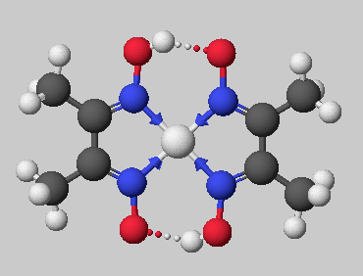
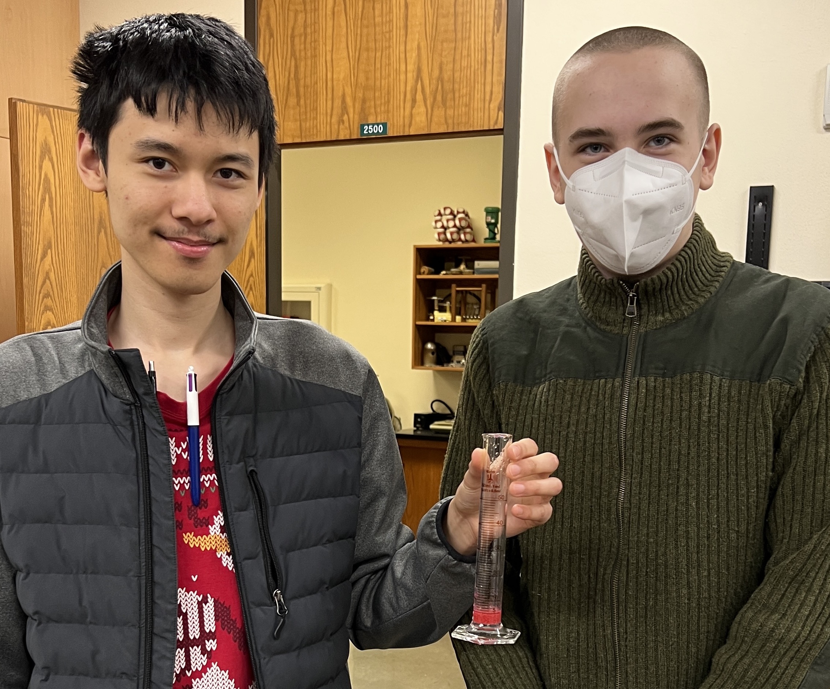
Lewis Acids & Bases
Clifford and Aiden with red
Nickel bis(dimethylglyoximate)
solution (April 2023)
Nickel bis(dimethylglyoximate)
MAR

Slide 56
Lewis Acids & Bases
Lewis acid = electron pair acceptor (BF₃)
Lewis base =
electron pair
donor (NH₃)
MAR

Slide 57
Lewis Acids & Bases
New bond formed using electron pair from the Lewis base.
Coordinate covalent bond
Notice geometry change on reaction.
MAR

Slide 58
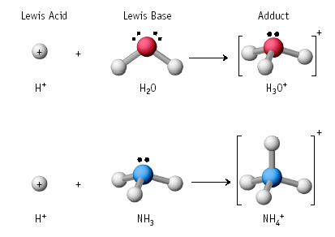
Lewis Acids & Bases
Lewis Acids & Bases
Answer = B,
Ag⁺ in Ag(NH3)2⁺
Transition metals often
great Lewis acids due to
unused d-orbitals
MAR
Which of the following is a Lewis acid?
CH3NH2
Ag⁺ in Ag(NH3)2⁺
CO
ClO⁻¹
Enter your response on
your i>Clicker now!

Slide 59
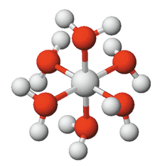
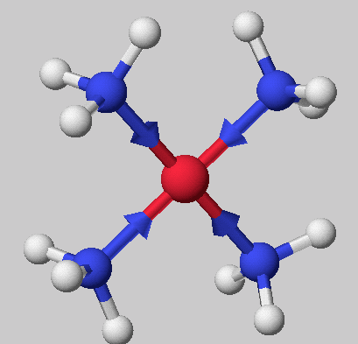
Lewis Acids & Bases
The combination of metal ions (Lewis acids) with Lewis bases such as H₂O and NH₃ ------> COMPLEX IONS
All metal ions form complex ions with water and are of the type [M(H₂O)_{x}]^{n+} where x = 4 and 6.
[Co(H₂O)₆]³⁺
[Cu(NH₃)₄]²⁺
MAR

Slide 60
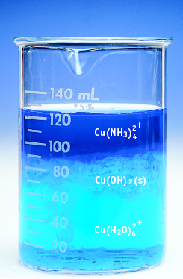
Lewis Acids & Bases
Add NH₃ to light blue [Cu(H₂O)₄]²⁺ ------>
light blue Cu(OH)₂ and then deep blue [Cu(NH₃)₄]²⁺
MAR

Slide 61
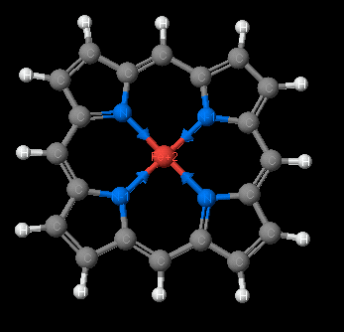
Lewis Acids & Bases
The Fe²⁺ in heme can interact with O₂ or CO in a Lewis acid-base reaction.
MAR

Slide 62
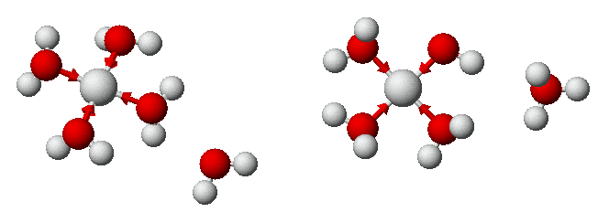
Lewis Acids & Bases
Many complex ions containing water undergo HYDROLYSIS to give acidic solutions.
[Cu(H₂O)₄]²⁺ + H₂O ---> [Cu(H₂O)₃(OH)]⁺ + H₃O⁺
This is a Ka expression
Answer = A,
less than 7
Transition metal solutions acidic
due to hydrolysis
Cl⁻¹ does not affect pH
This explains why water solutions of transition metals are acidic.
MAR
Will a 0.1 M FeCl3(aq) solution have a pH which is:
less than 7
greater than 7
equal to 7
Enter your response on
your i>Clicker now!

Slide 63
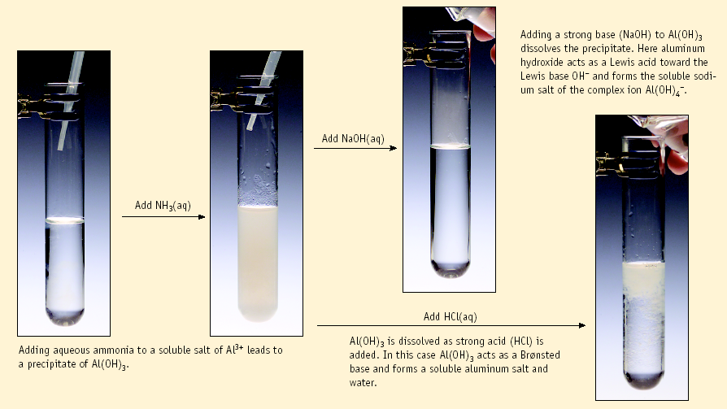
Lewis Acids & Bases
Lewis acid & base theory explains AMPHOTERIC nature of some metal hydroxides.
Al(OH)₃(s) + 3 H⁺ --> Al³⁺ + 3 H₂O
Here Al(OH)₃ is a Brønsted base.
Al(OH)₃(s) + OH⁻ --> Al(OH)₄⁻
Here Al(OH)₃ is a Lewis acid.
MAR

Slide 64
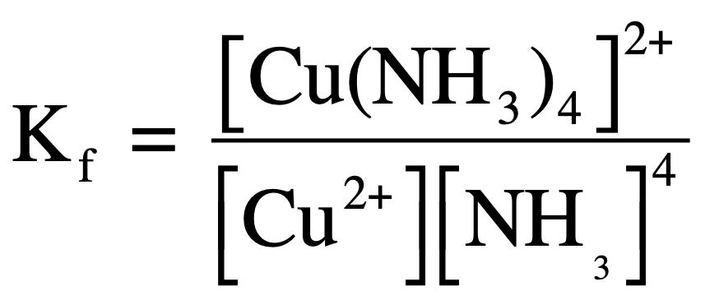
Lewis Acids & Bases
Many complex ions are very stable.
Cu²⁺ + 4 NH₃ qe [Cu(NH₃)₄]²⁺
K for the reaction is called K_{formation}
or a "formation constant"
Here K_{f} = 6.8 x 10¹². Reaction is strongly product-favored.
MAR

Slide 65
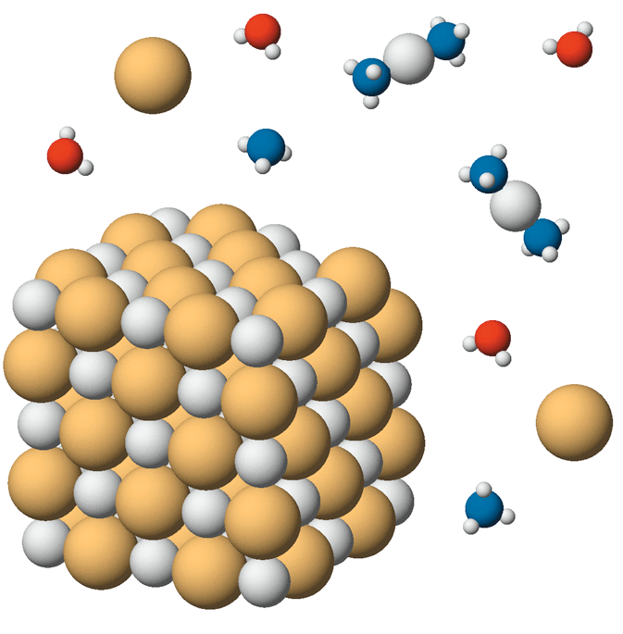
Lewis Acids & Bases
Formation of complex ions explains why you can dissolve a precipitate by forming a complex ion.
AgCl(s) + 2 NH₃ qe
Ag(NH₃)₂⁺ + Cl⁻
MAR
AgCl(s)

Slide 66
Lewis Acids & Bases
Formation of complex ions explains why you can dissolve a precipitate by forming a complex ion.
AgCl(s) qe Ag⁺ + Cl⁻ K_{sp} = 1.8 x 10⁻¹⁰
Ag⁺ + 2 NH₃ qe Ag(NH₃)₂⁺ K_{form} = 1.6 x 10⁷
-------------------------------------
AgCl(s) + 2 NH₃ qe Ag(NH₃)₂⁺ + Cl⁻
K_{net} = K_{sp} • K_{form} = 2.9 x 10⁻³
MAR

Slide 67
Hints for This Chapter
pH_{(strong acid)} = - log C_{a}
pH_{(strong base)} = 14 + log C_{b}
pH_{(weak acid)} = - log [K_{a}*C_{a}]^{1/2}
pH_{(weak base)} = 14 + log [K_{b}*C_{b}]^{1/2}
14 = pH + pOH = pK_{a} + pK_{b}
K_{w} = 1.00 * 10⁻¹⁴ = [H₃O⁺][OH⁻] = K_{a}*K_{b} (25 °C)
Know equivalence point pH values for different titrations
Know how to use formation constants
Understand Lewis acid/base theory
MAR

Slide 68
End of Chapter 14 Part I
See:
Chapter Fourteen Part I Study Guide
Chapter Fourteen Part I Concept Guide
Types of Equilibrium Constants
Important Equations (following this slide)
End of Chapter Problems (following this slide)
MAR

Slide 69
Important Equations, Constants, and Handouts
from this Chapter:
pH_{(strong acid)} = - log C_{a}
pH_{(strong base)} = 14 + log C_{b}
pH_{(weak acid)} = - log [K_{a}*C_{a}]^{1/2}
pH_{(weak base)} = 14 + log [K_{b}*C_{b}]^{1/2}
14 = pH + pOH = pK_{a} + pK_{b}
K_{w} = 1.00 * 10⁻¹⁴ = [H₃O⁺][OH⁻] = K_{a}*K_{b} (25 °C)
HOAc + H₂O qe H₃O⁺ + OAc⁻
Acid-Base Theory: Brønsted theory, conjugate acid and base, strong and weak acids and bases, know the 8 strong acids and bases!, autoionization, Lewis theory, electron pair acceptor and donator, salt acidity/basicity, formation constants (Kf)
Handouts:
Manipulating Equilibrium Constant Expressions
Types of Equilibrium Constants
Table of Ka and Kb values in Problem Set #2

Slide 70
End of Chapter Problems: Test Yourself
An aqueous solution has a pH of 3.75. What is the hydronium ion concentration of the solution? What is the hydroxide ion concentration of the solution? Is it acidic or basic?
What is the pH of a 0.0015 M solution of Ba(OH)2?
Epinephrine hydrochloride has a pKa value of 9.53. What is the value of Ka?
A weak base has Kb = 4.7 x 10⁻¹¹. What is the value of Ka for the conjugate acid?
A 0.015 M solution of hydrogen cyanate, HOCN, has a pH of 2.67. What is the hydronium ion concentration in the solution? What is the ionization constant, Ka, for the acid?
A 0.015 M solution of a base has a pH of 10.09. What are the hydronium and hydroxide ion concentrations of this solution? What is the value of Kb for this base?
Which of the following substances should be classified as a Lewis acid and a Lewis base: Fe²⁺(aq), CH3NH2

Slide 71
End of Chapter Problems: Answers
[H3O⁺] = 1.8 × 10^{–4} M, [OH⁻] = 5.6 × 10^{–11} M, acidic
11.48
3.0 x 10^{–10}
2.1 x 10^{–4}
0.0021 M, 3.6 x 10^{–4} (Ka = 3.0 x 10⁻⁴ using short method)
[H3O⁺] = 8.1 × 10^{–11} M, [OH⁻] = 1.2 × 10^{–4} M, Kb = 9.7 x 10⁻⁷
Fe²⁺(aq) would be a Lewis acid, CH3NH2 would be a Lewis base

