Slide 1
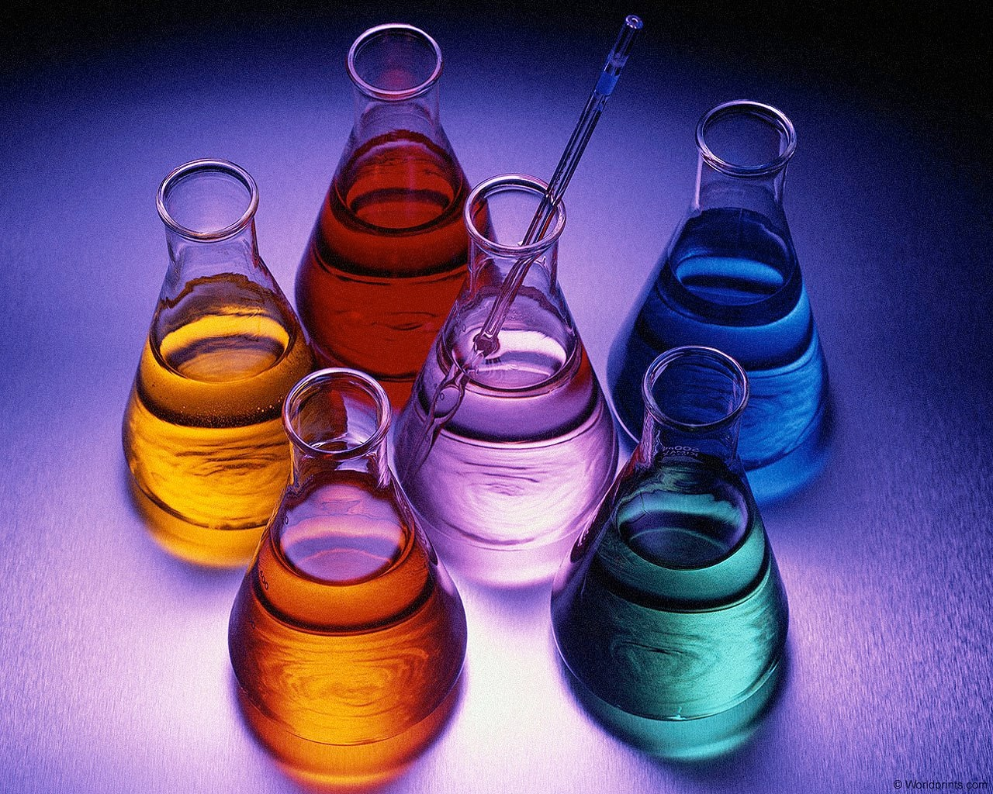
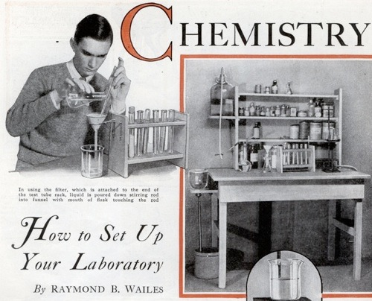
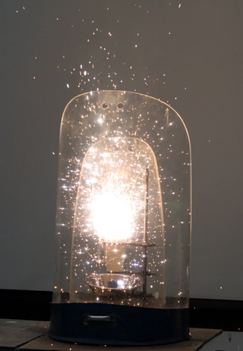
Principles of Chemical Reactivity: Equilibria Chapter 13
Get the CH 223 Companion
before lab!
Chemistry 223
Professor Michael Russell
http://mhchem.org/223
MAR
Last update:
4/29/24

Slide 2
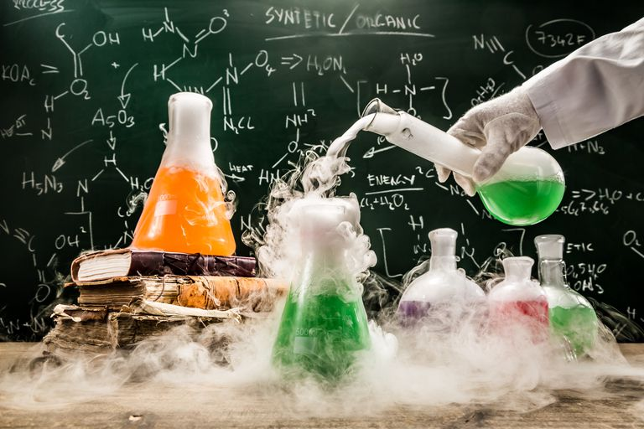
CH 223: Lectures and Labs
Lectures: MWF from 9 - 9:50 AM in AC 1303 (this room)
Lectures recorded, available soon afterwards
Lecture notes to print available (under "Problem Sets and Handouts", mhchem.org/223), get CH 223 Companion as soon as possible
Labs (Section 01): Mondays from 1:10 - 5 PM
Start in room AC 2501 ("the recitation")
Move to AC 2507 ("the lab") around 3 PM
For first day, bring a printed copy of the "Determination of an Equilibrium Constant (in class)" Lab (mhchem.org/223), a pair of safety glasses (Dollar store ok) and your calculator
MAR
...more on Monday afternoon

Slide 3
CHEMICAL EQUILIBRIUM
qe = Bi-directional
arrow
MAR

Slide 4
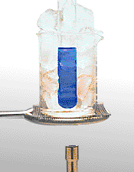
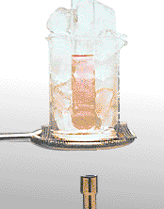
Properties of an Equilibrium
Equilibrium systems are
DYNAMIC (in constant motion)
REVERSIBLE
can be approached from either direction
Pink to blue
Co(H₂O)₆Cl₂ + 2 Cl⁻¹ ---> Co(H₂O)₂Cl₄²⁻ + 4 H₂O
Blue to pink
Co(H₂O)₂Cl₄²⁻ + 4 H₂O ---> Co(H₂O)₆Cl₂ + 2 Cl⁻¹
MAR

Slide 5
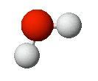
Chemical Equilibrium Fe³⁺ + SCN⁻ qe FeSCN²⁺
+
Fe(H₂O)₆³⁺ + SCN⁻ qe Fe(SCN)(H₂O)₅²⁺ + H₂O
MAR

Slide 6
Chemical Equilibrium Fe³⁺ + SCN⁻ qe FeSCN²⁺
After a period of time, the concentrations of reactants and products are constant.
The forward and reverse reactions continue after equilibrium is attained.
MAR

Slide 7
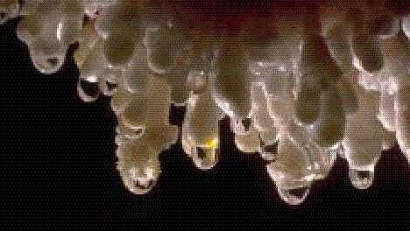
Examples of Chemical Equilibria
Phase changes:
H₂O(s) qe H₂O(liq)
Formation of stalactites
and stalagmites:
CaCO₃(s) + H₂O(liq) + CO₂(g)qe
Ca²⁺(aq) + 2 HCO₃⁻(aq)
MAR

Slide 8
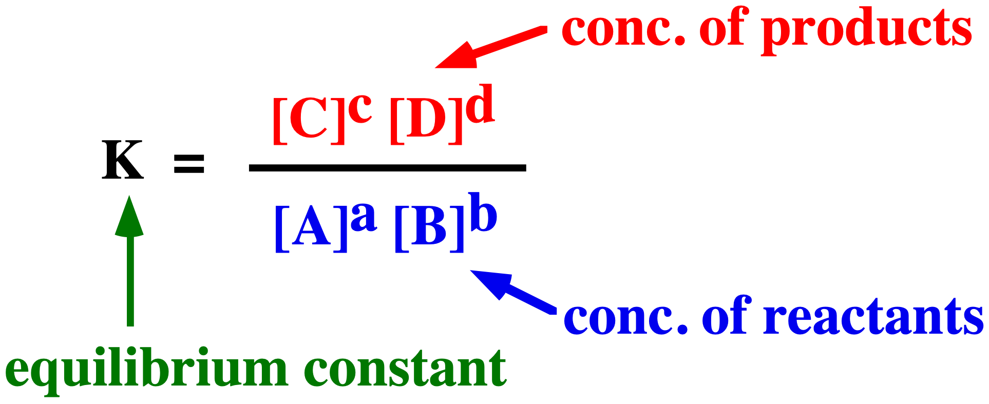
The Equilibrium Constant
First Clicker Question!
Participating in Clicker questions
is optional and ungraded
requires an i>clicker 2 (bookstore, Amazon)
is worth extra credit (must register at iclicker.com and participate in 10 lectures - see extra credit guide)
Let's go!
For any type of chemical equilibrium of the type
a A + b B qe c C + d D
the following is a CONSTANT (at a given T)
If K is known, we can predict
concentrations of products or reactants.
MAR
Enter your response on
your i>Clicker now!
Which of the following is the correct form of the equilibrium constant expression for the reaction below?
2 SO₃(g) ⇌ 2 SO₂(g) + O₂(g)
K = [SO₂][O₂] / [SO₃]
K = [SO₂]²[O₂] / [SO₃]²
K = [SO₃]² / [SO₂]²[O₂]
K = [SO₂][O₂]²
none of the above
Answer = B,
K = [SO₂]²[O₂] / [SO₃]²
K = [products] / [reactants]

Slide 9
The Equilibrium Constant: Example
Equilibrium constants, K, come from kinetic rate constants, k
Example: For 2 NO_{2(g)} qe N₂O_{4(g)},
rate_{f} = k_{f}[NO₂]²
rate_{r} = k_{r}[N₂O₄]
When rates equal, rate_{f} = rate_{r}, and
k_{f}[NO₂]² = k_{r}[N₂O₄]
[N₂O₄]/[NO₂]² = k_{f}/k_{r} = K (equilibrium)
Product of two constants (k_{f} & k_{r}) is itself a constant (K)!
MAR

Slide 10
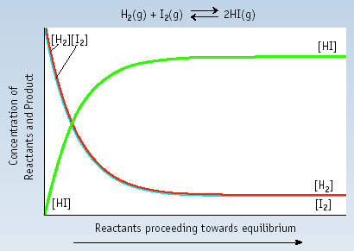
The Equilibrium Constant: Example
Equilibrium achieved
Product conc. increases and then becomes constant at equilibrium
Reactant conc. declines and then becomes constant at equilibrium
MAR

Slide 11
The Equilibrium Constant: Example
Equilibrium achieved
In the equilibrium region
[HI]
2
=
55.3
=
K
[H
][I
]
2
2
K
=
equilibrium constant
MAR

Slide 12
Determining K
2 NOCl(g) qe 2 NO(g) + Cl₂(g)
Place 2.00 mol of NOCl is a 1.00 L flask. At equilibrium you find 0.66 mol/L of NO. Calculate K.
Solution
Set of a table of concentrations (ICE)
[NOCl] [NO] [Cl₂]
Initial 2.00 0 0
Change
Equilibrium 0.66
MAR

Slide 13
Determining K
2 NOCl(g) qe 2 NO(g) + Cl₂(g)
Place 2.00 mol of NOCl is a 1.00 L flask. At equilibrium you find 0.66 mol/L of NO. Calculate K.
Solution
Set of a table of concentrations (ICE)
[NOCl] [NO] [Cl₂]
Initial 2.00 0 0
Change -0.66 +0.66 +0.33
Equilibrium 1.34 0.66 0.33
How to remember ICE:
MAR

Slide 14
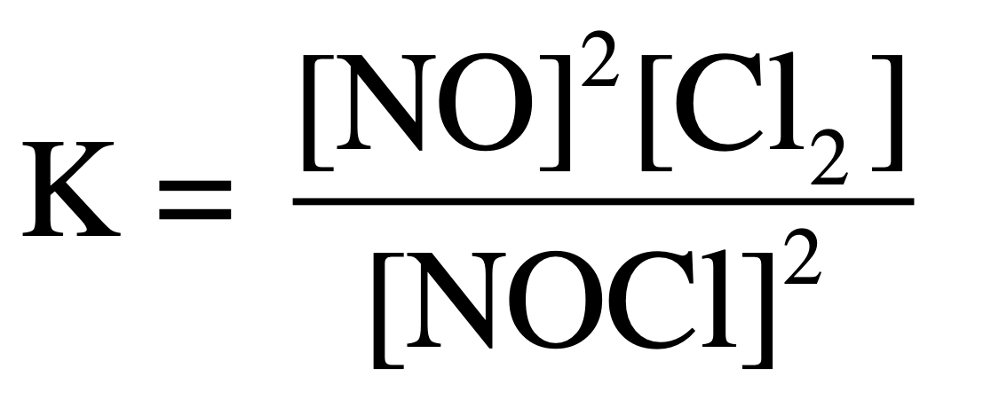
Determining K
2 NOCl(g) qe 2 NO(g) + Cl₂(g)
[NOCl] [NO] [Cl₂]
Initial 2.00 0 0
Change -0.66 +0.66 +0.33
Equilibrium 1.34 0.66 0.33
MAR

Slide 15
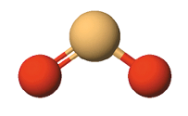
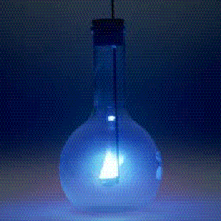
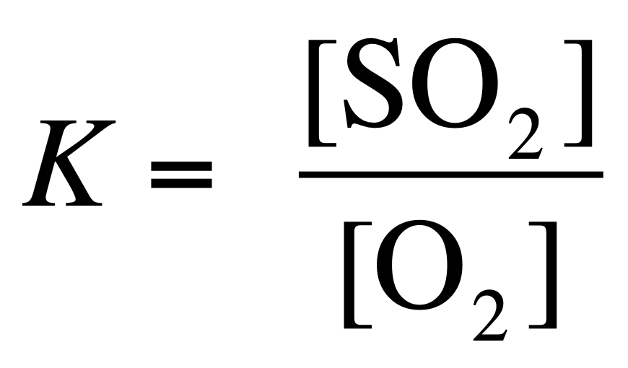
Writing and Manipulating K Expressions
Solids and liquids NEVER appear in equilibrium expressions.
S(s) + O₂(g) qe SO₂(g)
MAR

Slide 16
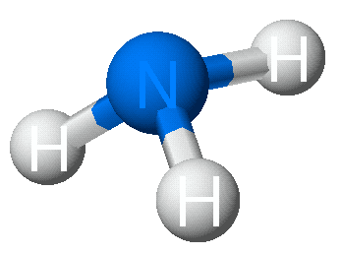
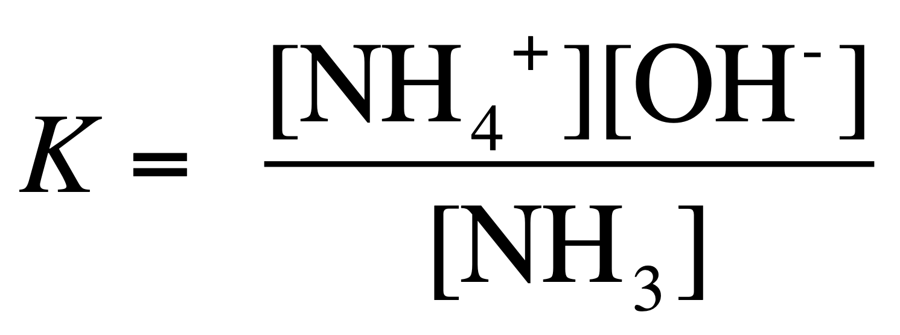
Writing and Manipulating K Expressions
Solids and liquids NEVER appear in equilibrium expressions.
NH₃(aq) + H₂O(liq) qe NH₄⁺(aq) + OH⁻(aq)
MAR
Which of the following is the correct form of the equilibrium constant expression for the reaction below?
2 K(s) + 2 H2O(l) ⇌ 2 KOH(aq) + H₂(g)
K = [H2] / [K]²[H₂O]²
K = [KOH]²[H2] / [H₂O]²
K = [KOH]²[H2] / [K]²
K = [KOH][H2]^{1/2} / [K][H₂O]
K = [KOH]²[H2]
Enter your response on
your i>Clicker now!
Answer = E,
K = [KOH]²[H2]
do not include
solids and liquids

Slide 17
Writing and Manipulating K Expressions
Adding equations for reactions
S(s) + O₂(g) qe SO₂(g) K₁ = [SO₂] / [O₂]
SO₂(g) + 1/2 O₂(g) qe SO₃(g)
K₂ = [SO₃] / [SO₂][O₂]^{1/2}
NET EQUATION
S(s) + 3/2 O₂(g) qe SO₃(g)
MAR

Slide 18
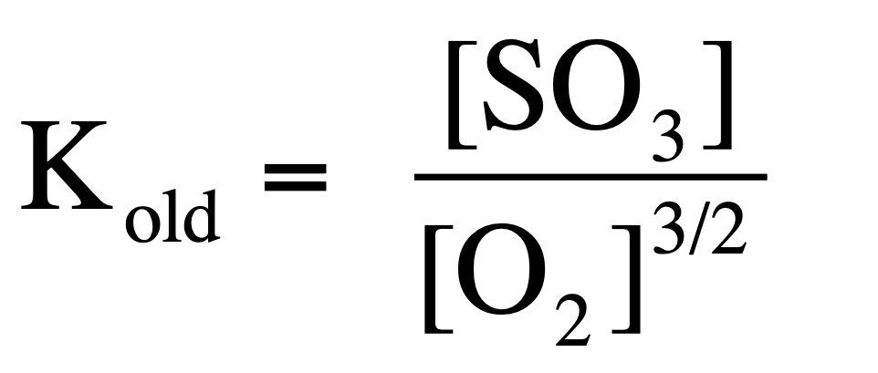
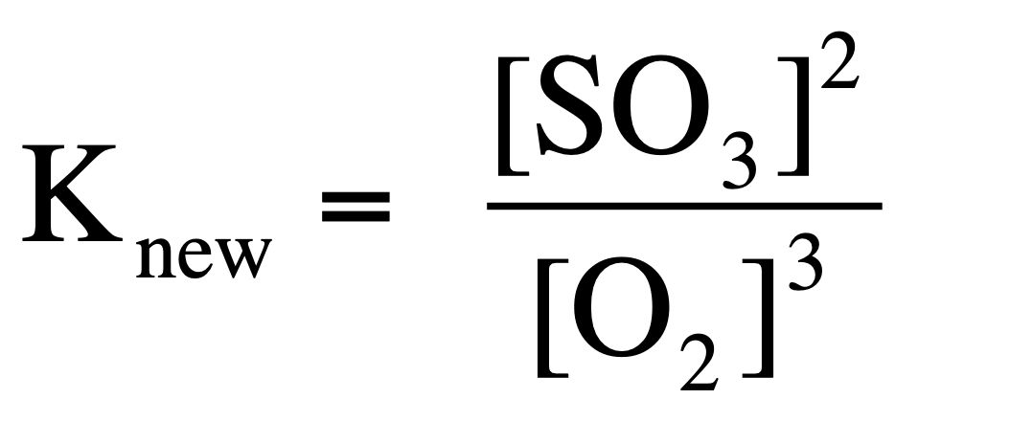
Writing and Manipulating K Expressions
Changing coefficients
S(s) + 3/2 O₂(g) qe SO₃(g)
2 S(s) + 3 O₂(g) qe 2 SO₃(g)
MAR

Slide 19
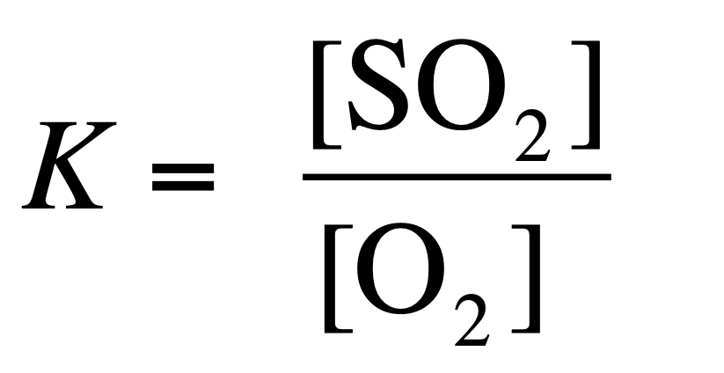
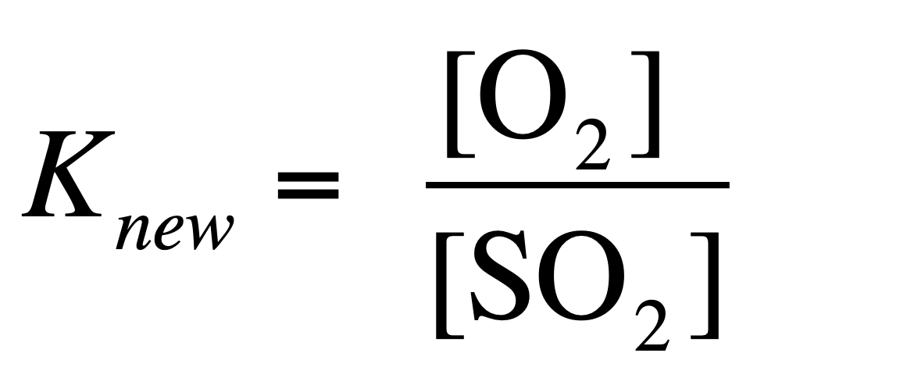
Writing and Manipulating K Expressions
Changing direction
S(s) + O₂(g) qe SO₂(g)
SO₂(g) qe S(s) + O₂(g)
and:
See Manipulating Equilibrium Constant Expressions
MAR
Given that:
n-butane ⇌ iso-butane K = 2.5
What is the value of K for the reverse reaction:
iso-butane ⇌ n-butane?
2.5
1.58
-2.5
0.40
1.7 x 10⁻⁵
Enter your response on
your i>Clicker now!
Answer = D,
0.40
K = 1/2.5 = 0.40

Slide 20
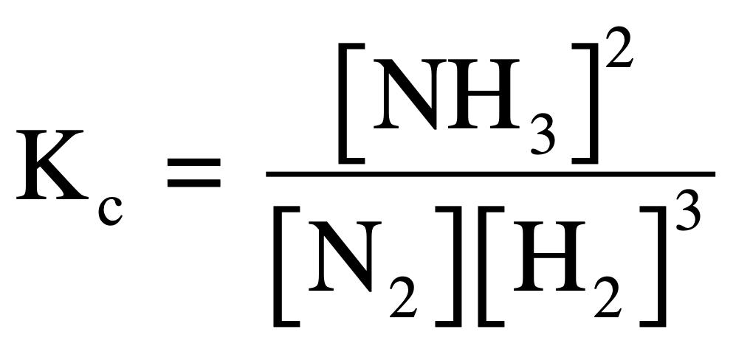
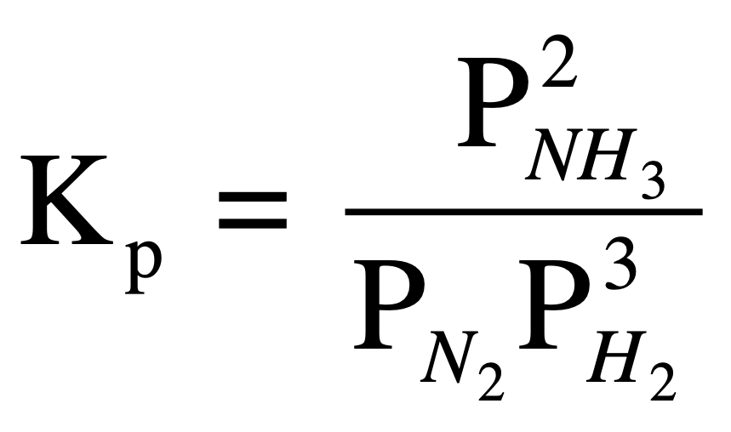
Kp Expressions
We have been writing K in terms of M (mol/L), designated by K_{c}
Equilibrium constants expressed in terms of gases designated K_{p} where all pressures in atm (760 mm Hg = 1 atm)
For: N₂(g) + 3 H₂(g) qe 2 NH₃(g)
MAR

Slide 21
Converting Kc Into Kp
K_{p} = K_{c}(RT)^{∆n}
T = Temperature (K)
R = 0.082057 L atm mol⁻¹ K⁻¹
∆n = change in moles of gas
Example:
N₂(g) + 3 H₂(g) qe 2 NH₃(g)
∆n = 2 - 4 = -2
see: Types of Equilibrium Constants
MAR

Slide 22
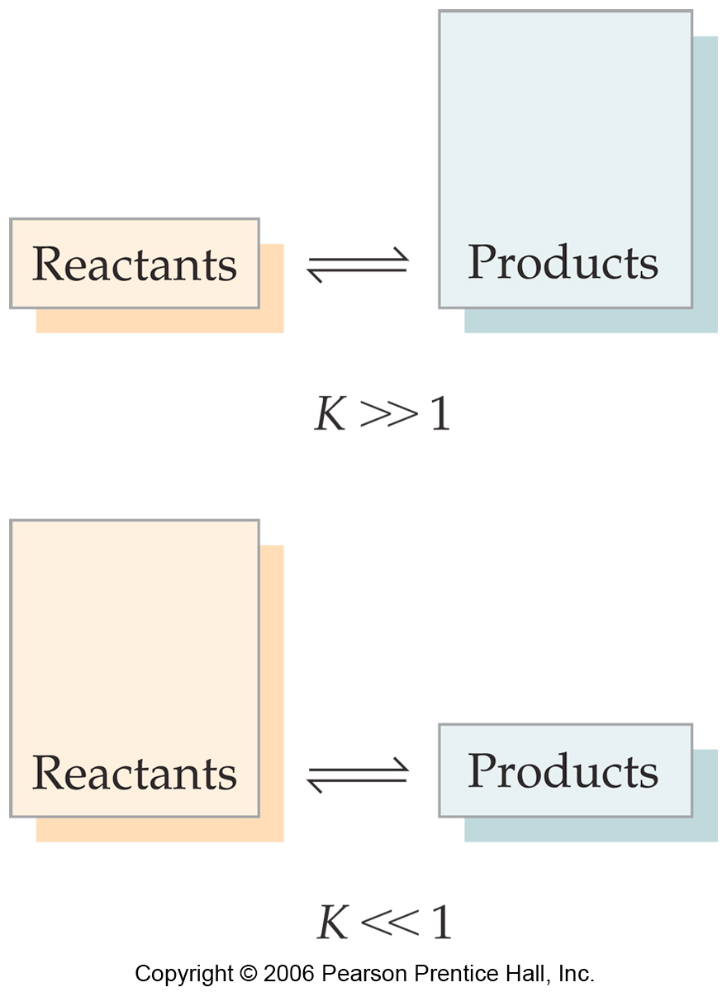
The Meaning of K
If K>>1, the reaction is product-favored; product predominates at equilibrium.
If K<<1, the reaction is reactant-favored; reactant predominates at equilibrium.
MAR

Slide 23
The Meaning of K
Can tell if a reaction is product-favored or reactant-favored.
For: N₂(g) + 3 H₂(g) qe 2 NH₃(g)
Conc. of products is much greater than that of reactants at equilibrium.
The reaction is strongly product-favored.
MAR

Slide 24
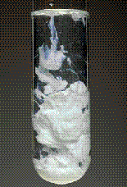
The Meaning of K
For: AgCl(s)qeAg⁺(aq) + Cl⁻(aq)
K_{c} = [Ag⁺] [Cl⁻] = 1.8 x 10⁻⁵
Conc. of products is much less than that of reactants at equilibrium.
The reaction is strongly reactant-favored.
The reverse reaction
Ag⁺(aq) + Cl⁻(aq) qe AgCl(s)
is product-favored,
K_{rev} = 1/1.8 x 10⁻⁵ = 5.6 x 10⁴
MAR

Slide 25
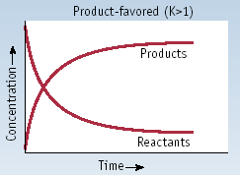
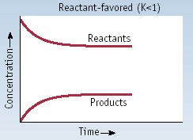
Product- or Reactant Favored
Product-favored
K > 1
Reactant-favored
K < 1
MAR
Given the following reactions: (a) 2 NO₂(g) ⇌ N₂O₄(g) K = 180 (b) Fe(OH)₂(s) ⇌ Fe²⁺(aq) + 2 OH–(aq) K = 7.9 x 10⁻¹⁵
Which statement is true?
Both reactions are product-favored.
Both reactions are reactant-favored.
Reaction (a) is product-favored and reaction (b) is reactant-favored.
Reaction (a) is reactant-favored and reaction (b) is product-favored.
Enter your response on
your i>Clicker now!
Answer = C,
Reaction (a) is product-favored and
reaction (b) is reactant favored

Slide 26
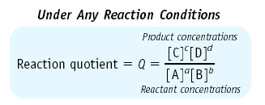
The Reaction Quotient, Q
All reacting chemical systems can be characterized by their REACTION QUOTIENT, Q.
For: a A + b B qe c C + d D
If Q = K, then system is at equilibrium.
If Q ≠ K, then system is not at equilibrium
MAR

Slide 27
The Reaction Quotient, Q
At any point in the reaction
H₂ + I₂ qe 2 HI
[HI]
2
Q
reaction
quotient
=
=
[H
][I
]
2
2
MAR

Slide 28
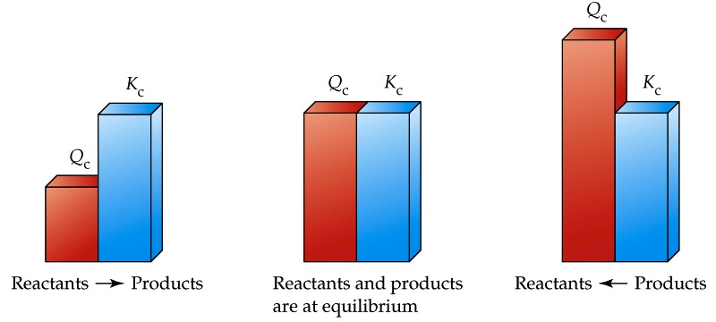
The Reaction Quotient, Q
Comparing Q and K:
Q < K, reaction shifts to the products (right)
Q > K, reaction shifts to the reactants (left)
Q = K, reaction is at equilibrium
MAR

Slide 29
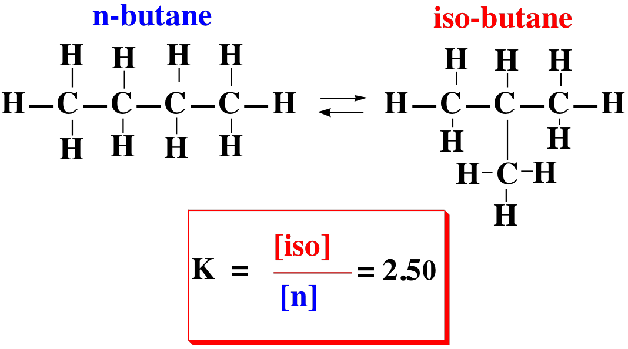
The Reaction Quotient, Q
We can use Q to tell if a reaction is at equilibrium. If not at equilibrium, we can predict which way the reaction will move to approach equilibrium.
MAR
see Understanding K and Q Handout

Slide 30
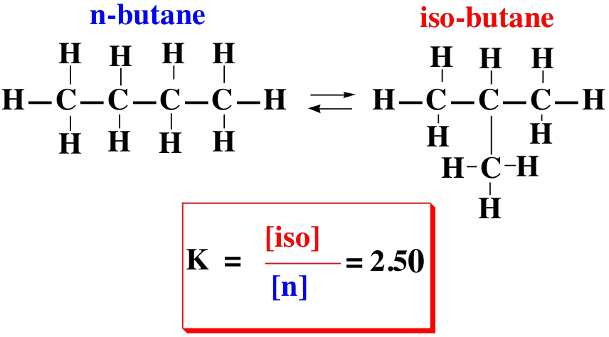
The Reaction Quotient, Q
If [iso] = 0.35 M and [n] = 0.15 M, are you at equilibrium?
Which way does the reaction "shift" to approach equilibrium?
To [iso]! Q = 2.3, Q < K, reaction will shift to "right" (product side, or [iso])
MAR
Given that:
n-butane ⇌ iso-butane K = 2.5
and if:
[n-butane] = 0.020 M and [iso-butane] = 0.030 M
Is this reaction at eqiulibrium?
yes, it is at equilibrium (Q = K)
no, more reactants than products (Q < K)
no, more products than reactants (Q > K)
more information is needed
Enter your response on
your i>Clicker now!
Answer = B,
no, more reactants than products (Q < K)
Q = 0.030 / 0.020 = 1.5
Q (1.5) < K (2.5), move to right (product) side

Slide 31
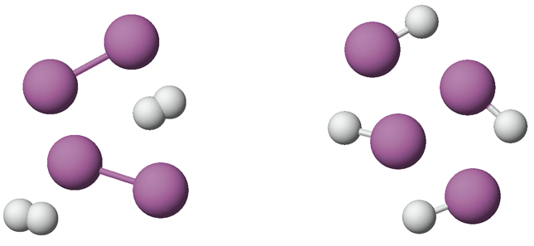
Typical Calculations
H₂(g) + I₂(g) qe 2 HI(g)
Place 1.00 mol each of H₂ and I₂ in a 1.00 L flask. Calc. equilibrium concentrations.
qe
MAR

Slide 32
H₂(g) + I₂(g) qe 2 HI(g), K_{c} = 55.3
Step 1. Set up ICE table to define EQUILIBRIUM concentrations.
[H₂] [I₂] [HI]
Initial 1.00 1.00 0
Change -x -x +2x
Equilib 1.00-x 1.00-x 2x
where x is defined as am't of H₂ and I₂ consumed on approaching equilibrium.
MAR

Slide 33
H₂(g) + I₂(g) qe 2 HI(g), K_{c} = 55.3
Step 2. Put equilibrium concentrations into K_{c} expression.
MAR

Slide 34
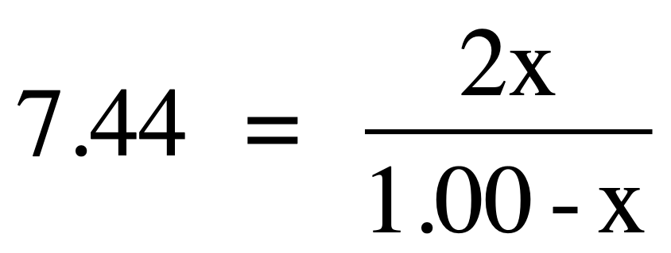
H₂(g) + I₂(g) qe 2 HI(g), K_{c} = 55.3
Step 3. Solve K_{c} expression - take square root of both sides.
7.44 (1.00 - x) = 2x
7.44 - 7.44x = 2x
x = 7.44 / 9.44 = 0.788
Therefore, at equilibrium
[H₂] = [I₂] = 1.00 - x = 0.21 M
[HI] = 2x = 1.58 M
MAR

Slide 35
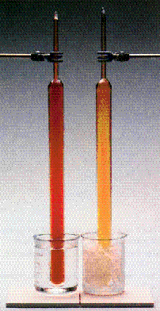
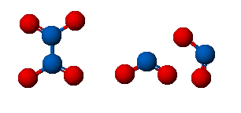
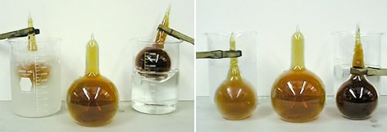
Nitrogen Dioxide Equilibrium N₂O₄(g) qe 2 NO₂(g)
qe
MAR

Slide 36
Nitrogen Dioxide Equilibrium N₂O₄(g) qe 2 NO₂(g)
If initial concentration of N₂O₄ is 0.50 M, what are the equilibrium concentrations?
Step 1. Set up an equilibrium table
[N₂O₄] [NO₂]
Initial 0.50 0
Change
Equilib
MAR

Slide 37
Nitrogen Dioxide Equilibrium N₂O₄(g) qe 2 NO₂(g)
If initial concentration of N₂O₄ is 0.50 M, what are the equilibrium concentrations?
Step 1. Set up an equilibrium table
[N₂O₄] [NO₂]
Initial 0.50 0
Change -x +2x
Equilib 0.50 - x 2x
MAR

Slide 38
Nitrogen Dioxide Equilibrium N₂O₄(g) qe 2 NO₂(g)
Step 2. Substitute into K_{c} expression and solve.
Rearrange: 0.0059 (0.50 - x) = 4x²
0.0029 - 0.0059x = 4x²
4x² + 0.0059x - 0.0029 = 0
This is a QUADRATIC EQUATION
ax² + bx + c = 0
a = 4 b = 0.0059 c = -0.0029
CH 223: report both values of x when
performing quadratic calculations
MAR

Slide 39
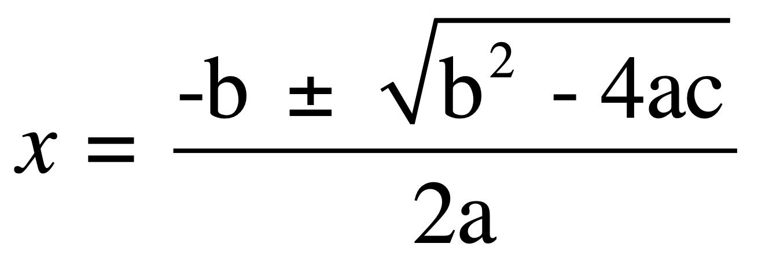
Nitrogen Dioxide Equilibrium N₂O₄(g) qe 2 NO₂(g)
Solve the quadratic equation for x.
ax² + bx + c = 0
a = 4 b = 0.0059 c = -0.0029
x = -0.00074 ± 1/8(0.046)^{1/2} = -0.00074 ± 0.027
MAR

Slide 40
Nitrogen Dioxide Equilibrium N₂O₄(g) qe 2 NO₂(g)
x = -0.00074 ± 1/8(0.046)^{1/2} = -0.00074 ± 0.027
x = 0.026 or -0.028
But a negative value is not reasonable.
Conclusion: x = 0.026
[N₂O₄] = 0.50 - x = 0.47 M
[NO₂] = 2x = 0.052 M
CH 223: report both values of x when
performing quadratic calculations
MAR

Slide 41
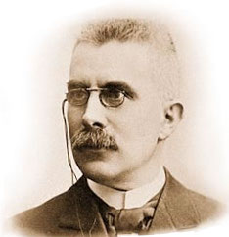
Le Chatelier's Principle
Temperature, changes in volume, changes in pressure and changes in concentration affect equilibria.
The outcome is governed by LE CHATELIER'S PRINCIPLE
"...if a system at equilibrium is disturbed, the system tends to shift its equilibrium position to counter the effect of the disturbance."
Henri Le Chatelier,
1850 - 1936
MAR

Slide 42
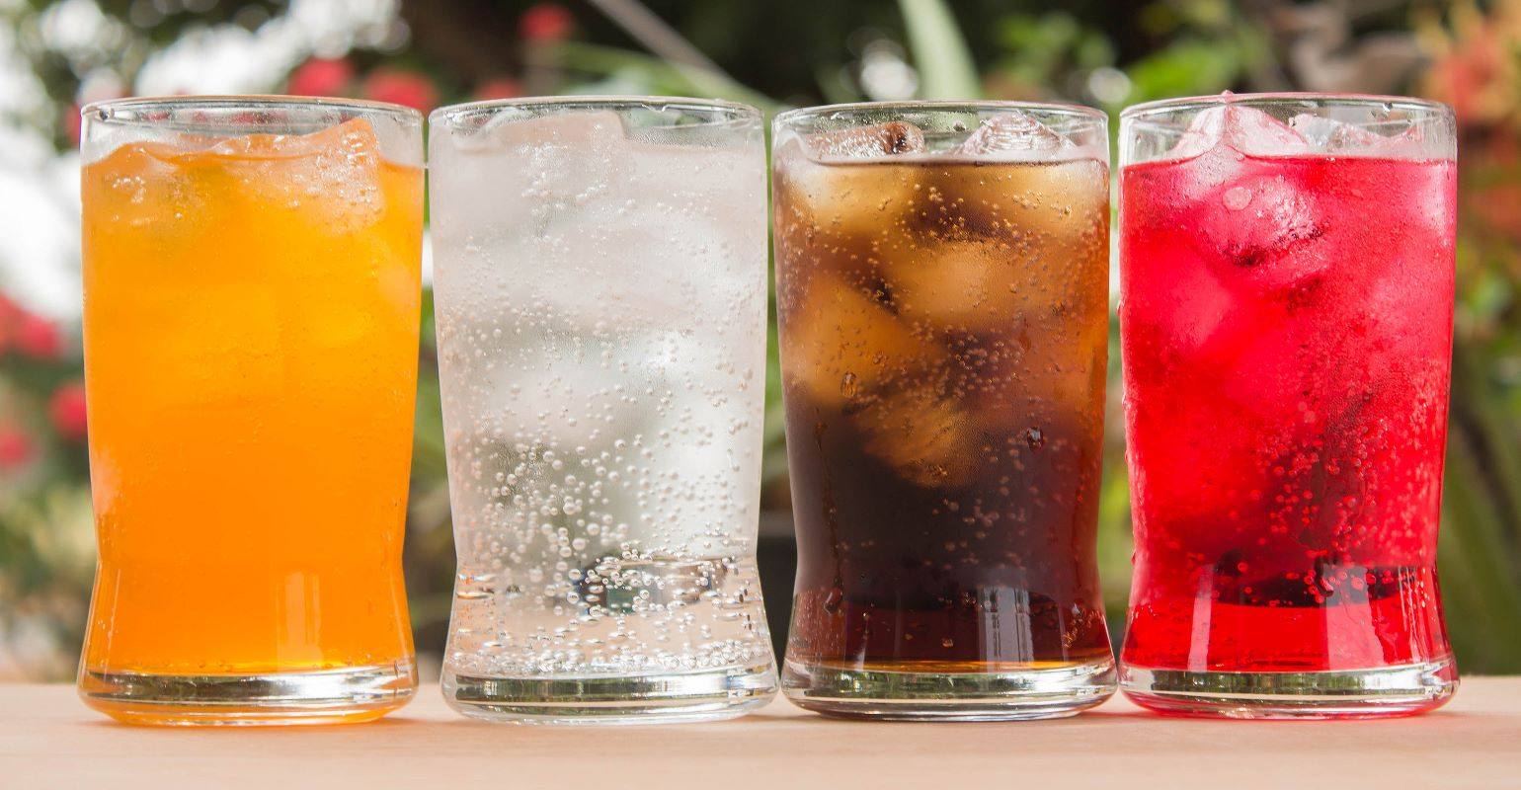
Temperature effects change the numeric value of K
Consider the fizz in a soft drink CO₂(g) + H₂O(liq) qe CO₂(aq) + heat
Decrease T. What happens to equilibrium position? To value of K?
K = [CO₂] / P (CO₂)
K increases as T goes down because [CO₂] increases and P(CO₂) decreases.
Increase T. Now what?
Equilibrium shifts left and K decreases.
see: Le Chatelier's Guide
MAR

Slide 43
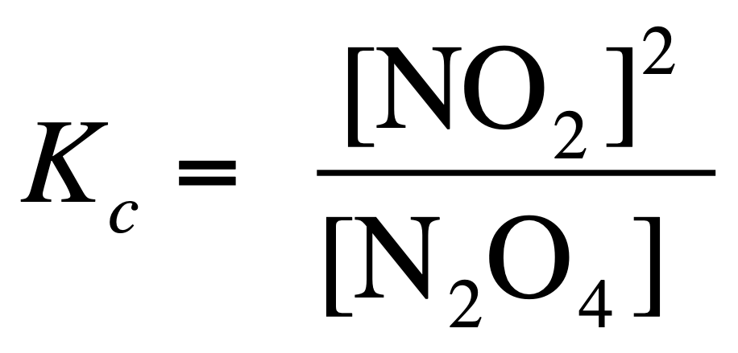
Temperature Effects on Equilibrium
N₂O₄ (colorless) + heat qe 2 NO₂ (brown)
∆Hº = + 57.2 kJ (endothermic)
K_{c} = 0.00077 at 273 K
K_{c} = 0.0059 at 298 K
K changes with temperature
MAR
The formation of ClF₃(g) is exothermic: Cl₂(g) + 3 F₂(g) ⇌ 2 ClF₃(g) + heat Predict the effect on the equilibrium by raising the temperature.
no change
shifts left (reactant side)
shifts right (product side)
Enter your response on
your i>Clicker now!
Answer = B,
shifts left (reactant side)

Slide 44
Volume & Pressure Effects on Equilibrium
N₂O₄(g) + heat qe 2 NO₂(g)
colorless gas brown gas
endothermic
Volume and Pressure changes affect equilibrium
Larger volume / Less Pressure = more molecules
Smaller volume / Higher Pressure = fewer molecules
MAR
The formation of ClF₃(g) is exothermic: Cl₂(g) + 3 F₂(g) ⇌ 2 ClF₃(g) + heat Predict the effect on the equilibrium by decreasing the volume of the flask containing the reaction.
no change
shifts left (reactant side)
shifts right (product side)
Enter your response on
your i>Clicker now!
Answer = C,
shifts right (product side)

Slide 45
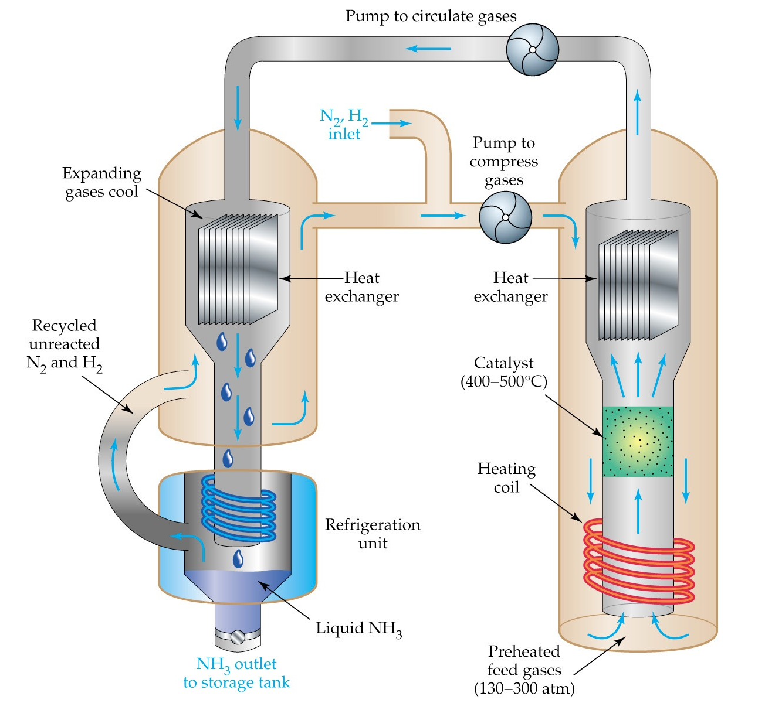
NH₃ Production
Catalyst for the Haber-Frisch reaction is mostly Fe with some KOH
N₂(g) + 3 H₂(g) qe 2 NH₃(g)
K = 3.5 x 10⁸ at 298 K
MAR
Notes:
exothermic reaction (can't get T too high, high pressure (pushes molecules together), http://www.chemguide.co.uk/physical/equilibria/haber.html

Slide 46
EQUILIBRIUM AND EXTERNAL EFFECTS
Concentration changes ---> no change in K - only the position of equilibrium changes.
We can use the "water U-tube" to demonstrate this phenomena (and connect to Haber-Frisch)
Haber-Frisch reaction:
N₂(g) + 3 H₂(g) qe 2 NH₃(g)
MAR
Water U-tube

Slide 47
Le Chatelier's Principle
Adding a "reactant" to a chemical system.
Haber-Frisch reaction: adding N2 or H2,
reaction moves to right
N₂(g) + 3 H₂(g) qe 2 NH₃(g)
MAR
The formation of ClF₃(g) is exothermic: Cl₂(g) + 3 F₂(g) ⇌ 2 ClF₃(g) + heat Predict the effect on the equilibrium of adding Cl₂.
no change
shifts left (reactant side)
shifts right (product side)
Enter your response on
your i>Clicker now!
Answer = C,
shifts right (product side)

Slide 48
Le Chatelier's Principle
Removing a "reactant" from a chemical system.
Haber-Frisch reaction: removing N2 or H2,
reaction moves to left
N₂(g) + 3 H₂(g) qe 2 NH₃(g)
MAR
The formation of ClF₃(g) is exothermic: Cl₂(g) + 3 F₂(g) ⇌ 2 ClF₃(g) + heat Predict the effect on the equilibrium of removing F₂.
no change
shifts left (reactant side)
shifts right (product side)
Enter your response on
your i>Clicker now!
Answer = B,
shifts left (reactant side)

Slide 49
Le Chatelier's Principle
Adding a "product" to a chemical system.
Haber-Frisch reaction: adding NH3,
reaction moves to left
N₂(g) + 3 H₂(g) qe 2 NH₃(g)
MAR
The formation of ClF₃(g) is exothermic: Cl₂(g) + 3 F₂(g) ⇌ 2 ClF₃(g) + heat Predict the effect on the equilibrium of adding ClF₃.
no change
shifts left (reactant side)
shifts right (product side)
Enter your response on
your i>Clicker now!
Answer = B,
shifts left (reactant side)

Slide 50
Le Chatelier's Principle
Removing a "product" from a chemical system.
Haber-Frisch reaction: removing NH3,
reaction moves to right
N₂(g) + 3 H₂(g) qe 2 NH₃(g)
MAR

Slide 51
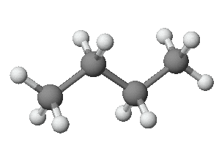
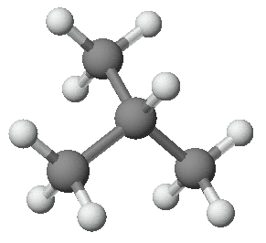
Butane-Isobutane Equilibrium
butane
isobutane
MAR

Slide 52
Butane qe Isobutane
Assume you are at equilibrium with [iso] = 1.25 M and [butane] = 0.50 M. Now add 1.50 M butane. When the system comes to equilibrium again, what are [iso] and [butane]? K = 2.50
butane
isobutane
MAR

Slide 53
Butane qe Isobutane
Assume you are at equilibrium with [iso] = 1.25 M and [butane] = 0.50 M. Now add 1.50 M butane. When the system comes to equilibrium again, what are [iso] and [butane]? K = 2.50
Solution
Calculate Q immediately after adding more butane and compare with K.
Q is LESS THAN K. Therefore, the reaction will shift to the ____________.
MAR

Slide 54
Butane qe Isobutane
You are at equilibrium with [iso] = 1.25 M and [butane] = 0.50 M. Now add 1.50 M butane.
Solution
Q is less than K, so equilibrium shifts right - away from butane and toward isobutane.
Set up concentration (ICE) table
[butane] [isobutane]
Initial 0.50 + 1.50 1.25
Change - x + x
Equilibrium 2.00 - x 1.25 + x
MAR

Slide 55
Butane qe Isobutane
You are at equilibrium with [iso] = 1.25 M and [butane] = 0.50 M. Now add 1.50 M butane.
Solution
x = 1.07 M
At the new equilibrium position,
[butane] = 0.93 M and [isobutane] = 2.32 M
Equilibrium has shifted toward isobutane.
MAR

Slide 56
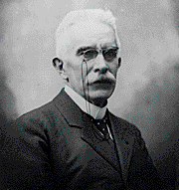
Le Chatelier's Principle - Overview
Change T
changes the value of K
changes observed in P, V or concentrations at equilibrium
Add or take away reactant or product
K does not change
Reaction adjusts to new equilibrium "position"
Use a catalyst
reaction comes more quickly to equilibrium. K not changed.
MAR

Slide 57
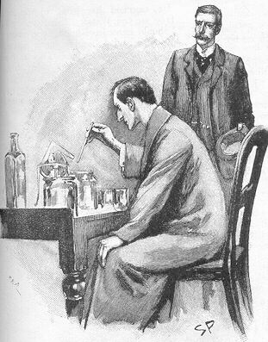
End of Chapter 13
See:
Chapter Thirteen Study Guide
Chapter Thirteen Concept Guide
Types of Equilibrium Constants
Important Equations (following this slide)
End of Chapter Problems (following this slide)
MAR

Slide 58
Important Equations, Constants, and Handouts
from this Chapter:
for: a A + b B qe c C + d D
K_{p} = K_{c}(RT)^{∆n}
R = 0.082057 L atm mol⁻¹ K⁻¹
Handouts:
Manipulating Equilibrium Constant Expressions
Types of Equilibrium Constants
Le Chatelier’s Principle

Slide 59
Write an equilibrium constant expression for the following reaction: C(s) + CO2(g) ⇄ 2 CO(g)
K = 5.6 x 10⁻¹² at 500 K for the dissociation of iodine molecules to iodine atoms: I2(g) ⇄ 2 I(g) A mixture has [I2] = 0.020 mol/L and [I] = 2.0 x 10⁻⁸ mol/L. Is the reaction at equilibrium (at 500 K)? If not, which way must the reaction proceed to reach equilibrium?
The reaction: PCl5(g) ⇄ PCl3(g) + Cl2(g) was examined at 250 °C. At equilibrium, [PCl5] = 4.2 x 10⁻⁵ mol/L, [PCl3] = 1.3 x 10⁻² mol/L, and [Cl2] = 3.9 x 10⁻³ mol/L. Calculate K for the reaction.
The equilibrium constant for the dissociation of iodine molecules to iodine atoms: I2(g) ⇄ 2 I(g) is 3.76 x 10⁻³ at 1000 K. Suppose 0.105 mol of I2 is placed in a 12.3 L flask at 1000 K. What are the concentrations of I2 and I when the system comes to equilibrium?
Dinitrogen trioxide decomposes to NO and NO2 in an endothermic process (ΔH = 40.5 kJ/mol): N2O3(g) ⇄ NO(g) + NO2(g) Predict the effect of the following changes on the position of the equilibrium (left, right, or no change):
a. adding more N2O3(g) b. adding more NO2(g) c. increasing the volume of the reaction flask
d. lowering the temperature
End of Chapter Problems: Test Yourself

Slide 60
End of Chapter Problems: Answers
Kc = [CO]² / [CO2] or Kp = PCO² / PCO2
No, Q < K, reaction will proceed to the right (more products)
K = 1.2
[I2] = 0.00614 M, [I] = 0.00480 M
a. right b. left c. right d. left

