Slide 1
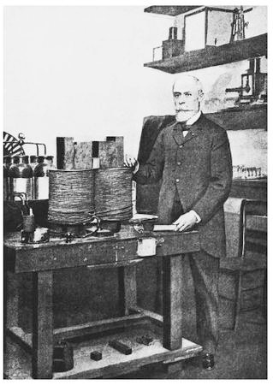
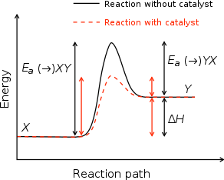
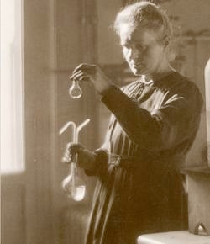
Chemistry 222 Final Exam Review Chapters 12 and 21
Chemistry 222
Professor Michael Russell
Last update:
4/29/24
MAR
Clockwise from top: Lewis, Curie, Rutherford

Slide 2
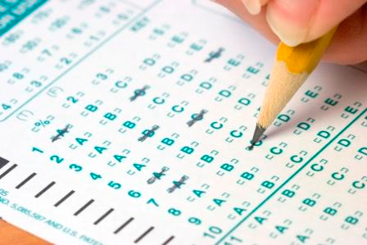
Lecture Final
Chapters 7 - 12 & 20, 21
Bring: calculator, pencil, scantron (50 questions / side, 100 questions total), Take Home Final, Kinetics II lab, Final Exam Prep Worksheet
32 multiple choice questions, four short answer questions, ~2 hours in length; meet at 8:45 AM, AC 1303, Wednesday
Final Grades posted by Thursday 5 PM
Good luck with your studying!
Let's start the review!
MAR

Slide 3
Lecture Final
Chapters 7 - 12 & 20, 21
Bring: calculator, pencil, page of notes, Take Home Lab Final, Kinetics II lab, Final Exam Prep Worksheet
32 multiple choice questions, five short answer questions, ~2 hours in length; meet at 8:45 AM, AC 1303, Wednesday
Final Grades posted by Thursday 5 PM
Good luck with your studying!
Let's start the review!
MAR

Slide 4
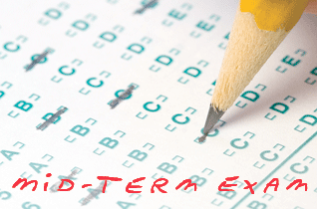
Lecture Final
Chapters 7-12, 20, 21
If this is an online class:
32 multiple choice questions
Due Friday at 9 AM via email
Final grades available by Sunday at noon. Final exams not returned.
Good luck with your studying!
Let's start the review!
MAR

Slide 5
Lecture Final
Chapters 7-12, 20, 21
If this is an online class:
32 multiple choice questions
Due Friday at 9 AM via email
Final grades available by Sunday at noon. Final exams not returned.
Good luck with your studying!
Let's start the review!
MAR

Slide 6
Lecture & Lab Final Exams
Lecture Final:
32 multiple choice questions and nine short answer questions over Chapters 7-12, 20, 21
Lab Final:
6 short answer questions over labs from this term
Both exams released early March 18 and due Wednesday March 16 by 11:59 PM via email (along with Final Exam Prep worksheet) No lecture or lab next week
Final grades available by Friday night. Final exams not returned.
Good luck with your studying! Let's start the review!
MAR

Slide 7
For the reaction below, what is ∆[CH₂O]/∆t with respect to ∆[O₂]/∆t?
C₂H₄(g) + O₃(g) → 2 CH₂O(g) + ½ O₂(g)
∆[CH₂O]/∆t = 2 • ∆[O₂]/∆t
∆[CH₂O]/∆t = ¼ • ∆[O₂]/∆t
∆[CH₂O]/∆t = – 4 • ∆[O₂]/∆t
∆[CH₂O]/∆t = 4 • ∆[O₂]/∆t
∆[CH₂O]/∆t = ∆[O₂]/∆t
MAR
Enter your response on
your i>Clicker now!
Answer = D,
∆[CH₂O]/∆t = 4 • ∆[O₂]/∆t
For this reaction,
rate =
-∆[C2H4]/∆t = -∆[O3]/∆t
= +¹/2 ∆[CH2O]/∆t
= +1/(¹/2) ∆[O2]/∆t, or
= 2 ∆[O2]/∆t
Combine:
+¹/2 ∆[CH2O]/∆t = 2∆[O2]/∆t
∆[CH2O]/∆t = 4∆[O2]/∆t

Slide 8
The reduction of NO with hydrogen produces nitrogen and water.
2 NO + 2 H₂ → N₂ + 2 H₂O
The reaction is second order in NO and third order overall. The rate law for the reaction is
Rate = k [NO][H₂]
Rate = k [NO][H₂]²
Rate = k [NO]²[H₂]
Rate = k [NO]²[H₂]²
Rate = k [NO2][H⁺]³
MAR
Enter your response on
your i>Clicker now!
Answer = C,
rate = k[NO]²[H2]
second order [NO],
third order overall means
first order in H2
(2 + 1 = 3)

Slide 9
The reduction of NO with hydrogen produces nitrogen and water.
2 NO + 2 H₂ → N₂ + 2 H₂O
The reaction is second order in NO and third order overall. The [NO] is increased by a factor of 5, the rate will increase by a factor of
0
1
5
10
25
MAR
Enter your response on
your i>Clicker now!
Answer = E, 25
rate = k[NO]²[H2]
NO is second order, so:
[5]² = 25
rate goes up by a factor of 25!

Slide 10
Given the initial rate data for the reaction A + B → C, determine the rate expression for the reaction.
[A] (M) [B] (M) ∆[C]/∆t (M/s)
0.10 0.20 40.
0.20 0.20 80.
0.10 0.10 40.
∆[C]/∆t = 2000[A][B]
∆[C]/∆t = 40.[A]²
∆[C]/∆t = 4.0[B]
∆[C]/∆t = 400[A]
∆[C]/∆t = #1[AC/DC]
MAR
Enter your response on
your i>Clicker now!
Answer = D, ∆[C]/∆t = 400[A]
rate = ∆[C]/∆t,
find orders, then k value
trial 1 vs. trial 2: [A] doubles, [B] constant, rate doubles;
∴ [A] first order
trial 3 vs. trial 1: [B] doubles, [A] constant, rate constant;
∴ [B] zero order
rate = ∆[C]/∆t = k[A]
now find k; use trial 1,
k = rate / [A] = 40./0.10 = 400, so
rate = ∆[C]/∆t = 400[A]

Slide 11
For the reaction A → B, the disappearance of A is found to be second-order. Which of the following will produce a straight line graph?
log [A] vs. time
ln [A] vs. time
[A] vs. time
1/[A] vs. time
[A]² vs. time
MAR
Enter your response on
your i>Clicker now!
Answer = D, 1/[A] vs. time
Second order reactants obey
1/[A] vs. time
First order: ln [A] vs. time
Zero order: [A] vs. time

Slide 12
For the reaction A → B, the disappearance of A is found to be first-order. A linear regression analysis of the data yields the equation:
y = -0.00106x + -3.91
What is the value of the rate constant, k?
-0.00106
0.00106
-3.91
3.91
42
MAR
Enter your response on
your i>Clicker now!
Answer = B, 0.00106
For first order graphs:
ln [A] vs. time gives straight line
slope = -k
y-intercept = ln A0
k = -slope = -(-0.00106) = 0.00106
ln Ao = -3.91
Ao = e^{-3.91} = 0.020 M

Slide 13
For the reaction A → B the disappearance of A is first-order where k = 0.030/min. If we begin with [A] = 0.36 M, what will [A] be after 46 min?
0.091 M
0.18 M
0.31 M
0.25 M
0.50 M
MAR
Enter your response on
your i>Clicker now!
Answer = A, 0.091 M
Use: ln (A/A0) = -kt
solve for A
ln (A/0.36 M) = -0.030 min⁻¹ *46 min
ln (A/0.36 M) = -1.38
(A/0.36 M) = 0.251579
A = 0.36 M * 0.251579
A = 0.091 M

Slide 14
Radioactive gold-198 is used in the diagnosis of liver problems. The half-life of the isotope is 2.7 days. If you begin with 5.6 mg of the isotope, how many days does it take 5.6 mg of gold to become 0.70 mg?
2.0 days
2.7 days
5.4 days
8.1 days
10.8 days
MAR
Enter your response on
your i>Clicker now!
Answer = D, 8.1 days
Use: ln (A/A0) = -kt
and
t1/2 = 0.693/k
k = 0.693 / t1/2, so:
ln (A/A0) = -(0.693/t1/2)t
ln (0.70mg/5.6mg) = -(0.693/2.7d)t
solve for t:
-2.0794 = -0.25667*t
t = 8.1 days

Slide 15
The reaction of NO₂(g) and CO(g) is thought to occur in two steps:
Step 1 Slow NO₂(g) + NO₂(g) → NO(g) + NO₃(g)
Step 2 Fast NO₃(g) + CO(g) → NO₂(g) + CO₂(g)
Which of the following rate laws would correspond to this mechanism?
Rate = k[NO₂][CO]
Rate = k[NO₂]
Rate = k[NO₂]²
Rate = k[CO]
Rate = k[CO]²
MAR
Enter your response on
your i>Clicker now!
Answer = C, Rate = k[NO₂]²
Slow step (the rate determining step, or rds) determines the speed (or rate) of reaction
rds has 2 NO2 as reactants, they determine how fast reaction goes
Rate = k[NO2][NO2] or
Rate = k[NO2]²

Slide 16
Use the rate laws below to determine which reaction is most likely to occur in a single step:
2 NO2(g) + F2(g) → 2 NO2F(g) Rate = k[NO2][F2]
H2(g) + Br2(g) → 2 HBr(g) Rate = k[H2][Br2]^{1/2}
NO(g) + O2(g) → NO2(g) + O(g) Rate = k[NO][O2]
NO2(g) + CO(g) → NO(g) + CO2(g) Rate = k[NO2]
MAR
Enter your response on
your i>Clicker now!
Answer = C,
NO(g) + O2(g) → NO2(g) + O(g) Rate = k[NO][O2]
All reactants present in rate law, probably a
single elementary step in this mechanism

Slide 17
Which statement is incorrect?
A catalyst provides an alternative mechanism for a reaction
A catalyst is regenerated in a reaction
A reaction involving a catalyst yields more product
A catalyst speeds up the forward and reverse reactions
Catalysts are cool! :)
MAR
Enter your response on
your i>Clicker now!
Answer = C, A reaction involving a catalyst yields more product

Slide 18
How many neutrons and protons are there in the radioisotope ⁶⁰Co that is used in cancer therapy?
60 neutrons and 27 protons
27 neutrons and 60 protons
33 neutrons and 27 protons
27 neutrons and 33 protons
0 neutrons and 0 protons
MAR
Enter your response on
your i>Clicker now!
Answer = C, 33 neutrons and 27 protons
cobalt: Z = 27 = protons
cobalt-60: A = 60 = neutrons + protons
neutrons = 60 - 27 = 33 neutrons

Slide 19
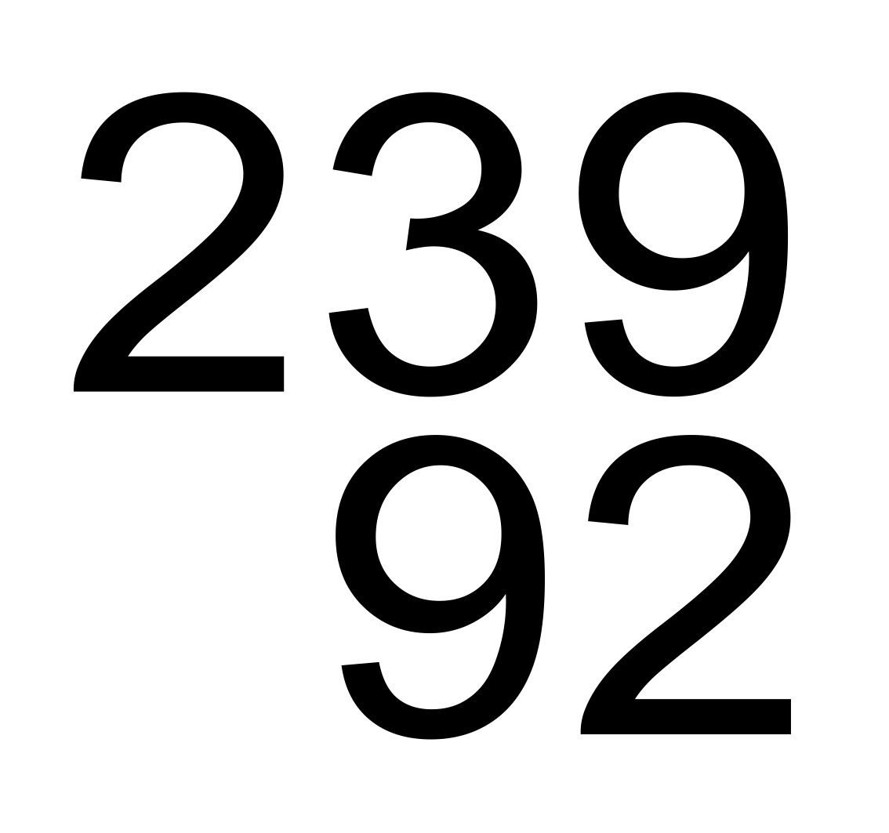
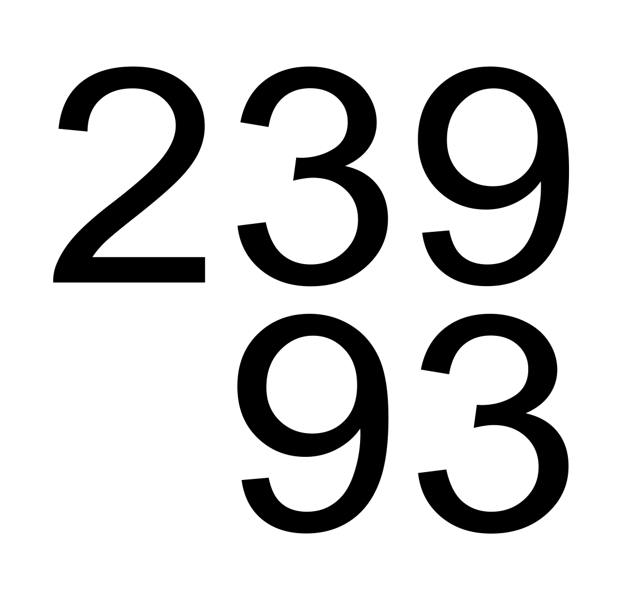
What is the unknown particle in the following nuclear reaction?
U → particle + Np
alpha
beta
gamma
neutron
positron
MAR
Enter your response on
your i>Clicker now!
Answer = B, beta
Sum of atomic numbers (Z) must match on both sides; same for mass numbers (A)
Atomic numbers:
92 = Z + 93
Z = -1
Mass numbers:
239 = A = 239
A = 0
particle is: -1⁰β, a beta particle

Slide 20
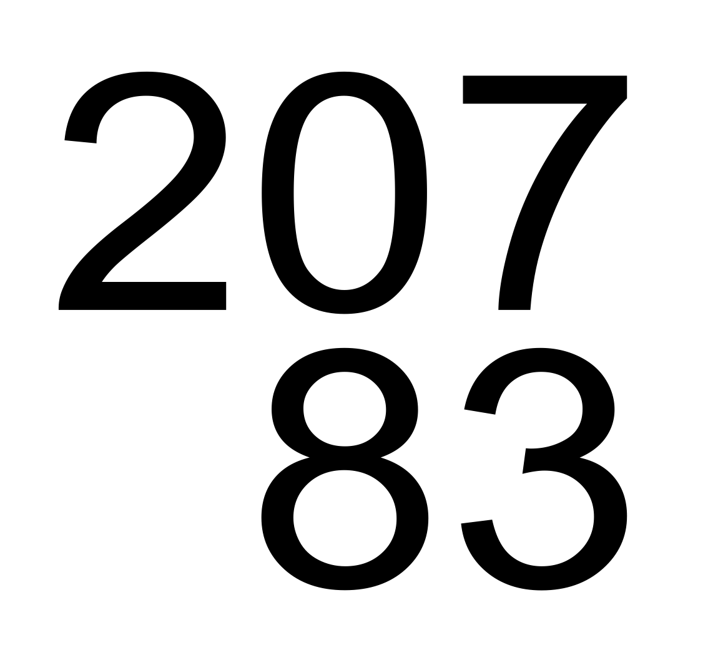
What is the unknown particle in the following nuclear reaction?
Po → particle + Bi
alpha
beta
gamma
neutron
positron
MAR
Enter your response on
your i>Clicker now!
Answer = E, positron
Sum of atomic numbers (Z) must match on both sides; same for mass numbers (A)
Atomic numbers:
84 = Z + 83
Z = +1
Mass numbers:
207 = A = 207
A = 0
particle is: +1⁰β, a positron
(anti-electron)

Slide 21
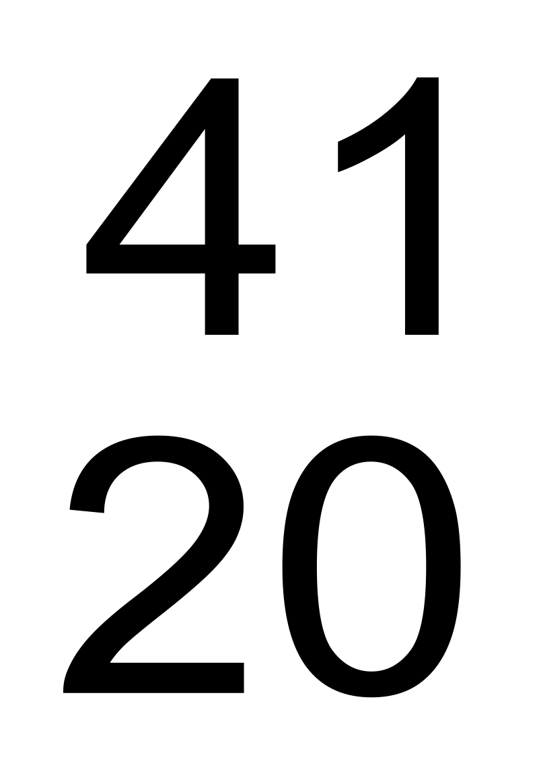
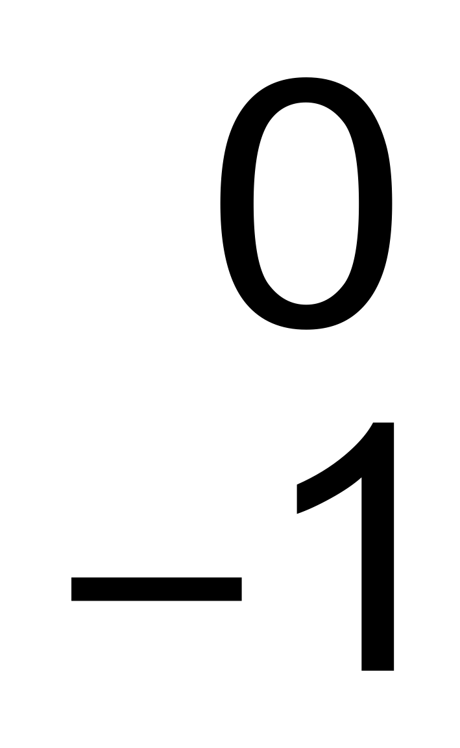
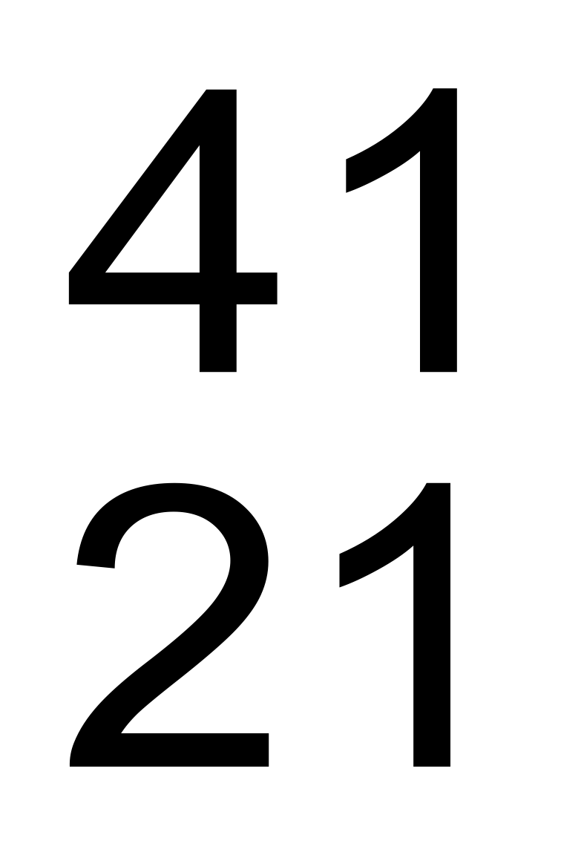
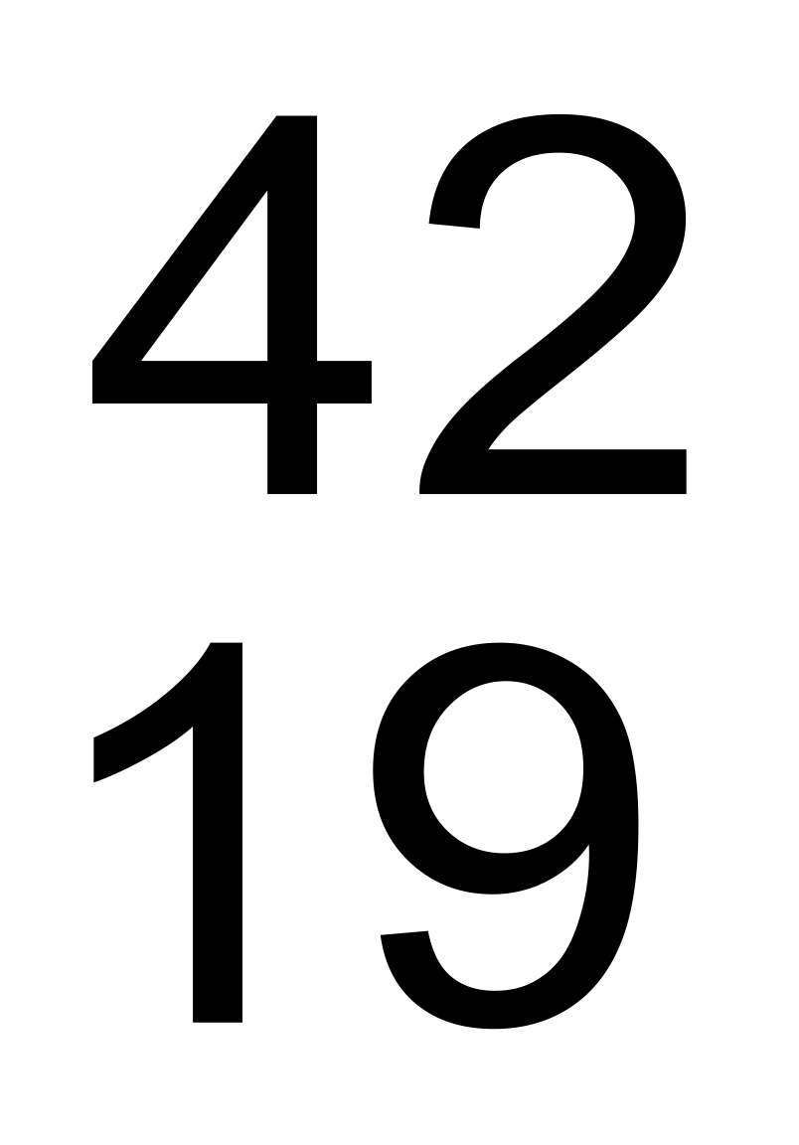
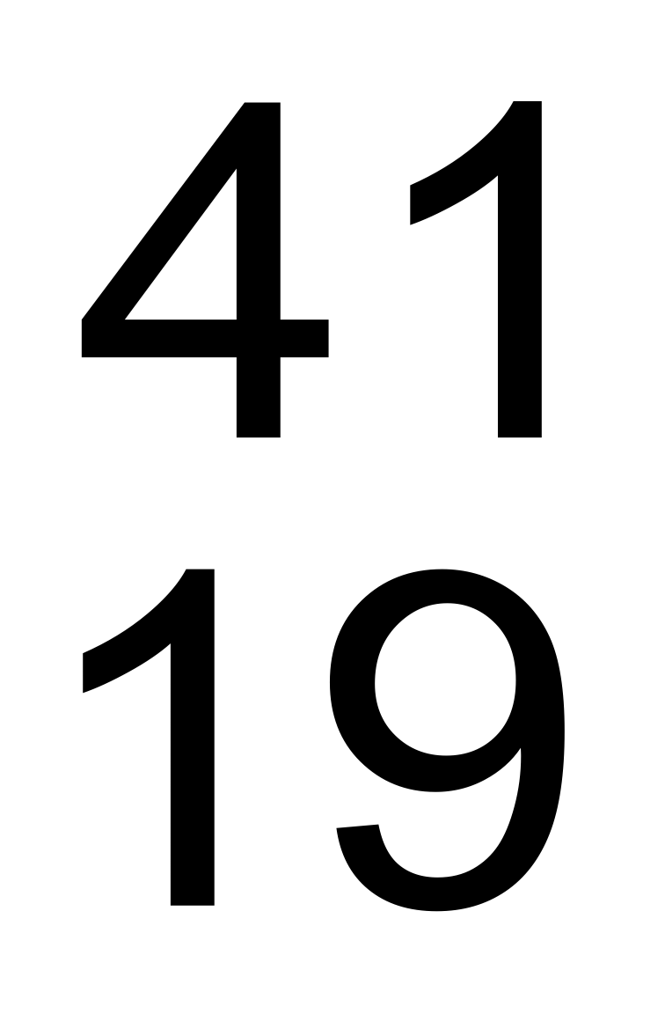
What new nucleus is produced in the following nuclear reaction? Ca + e → ?
Sc
K
K
MAR
Enter your response on
your i>Clicker now!
Answer = C, 19⁴¹K
Sum of atomic numbers (Z) must match on both sides; same for mass numbers (A)
Atomic numbers:
20 - 1 = Z
Z = 19
Mass numbers:
41 + 0 = A
A = 41
particle is: 19⁴¹K

Slide 22
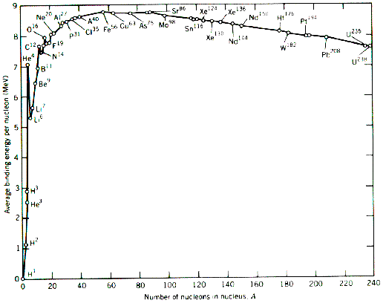
Which of the following nuclei has the highest binding energy per nucleon?
⁷Li
⁵⁹Ni
⁴He
²³²Th
⁰Jq
MAR
Enter your response on
your i>Clicker now!
Answer = B, ⁵⁹Ni
Highest binding energy per nucleon: ⁵⁶Fe
Elements closer to ⁵⁶Fe will be higher, hence ⁵⁹Ni
Actual binding energies
per nucleon (Eb):
⁷Li: 4.88 MeV
⁵⁹Ni: 8.69 MeV
⁴He: 5.49 MeV
²³²Th: 7.63 MeV
(1 MeV = 1.60 x 10¹³ J)

Slide 23
Calculate the binding energy per mol of nucleons (Eb) for carbon-12. Helpful values:
1 proton = 1.007825 g/mol
1 neutron = 1.008665 g/mol
carbon-12 = 12.000000 g/mol
2.998 x 10⁸ m/s = c
7.411 x 10⁸ kJ
8.893 x 10⁹ kJ
1.482 x 10⁹ kJ
-0.098940 kJ
0.0001 x 10⁸ kJ
Answer = A, 7.411 x 10⁸ kJ
Find ∆m, then ∆E, then Eb
∆m = ¹²C - [6¹p + 6^{1n}]
= 12.000000 - (6*1.007825 + 6*1.008665]
∆m = -0.098940 g/mol
∆E = ∆m(kg)*c²
∆E = -0.098940*10⁻³ kg/mol*(2.998x10⁸)²*10⁻³ kJ/J
∆E = -8.893 * 10⁹ kJ/mol
Eb = -∆E/12 nucleons
= -(-8.893E9 kJ/mol)/12
Eb = 7.411 x 10⁸ kJ/mol nucleons
MAR
Enter your response on
your i>Clicker now!

Slide 24
Radioactive iodine-131 is used to treat hyperthyroidism. It has a half-life of 8.04 days. If you begin with 8.8 micrograms, what mass remains after 32.3 days?
4.4 micrograms
2.2 micrograms
1.1 micrograms
0.54 micrograms
0.23 micrograms
MAR
Enter your response on
your i>Clicker now!
Answer = D, 0.54 micrograms
Use: ln (A/A0) = -kt
and
t1/2 = 0.693/k
k = 0.693 / t1/2, so:
ln (A/A0) = -(0.693/t1/2)t
ln (A/8.8μg) = -(0.693/8.04d)32.3d
solve for A:
ln (A / 8.8 μg) = -2.7841
(A / 8.8 μg) = 0.061785
A= 0.061785*8.8 μg
A = 0.54 μg

Slide 25
Gallium citrate, containing radioactive ⁶⁷Ga, is used as a tumor-seeking agent. It has a half-life of 78.2 hours. How long will it take for a sample of gallium citrate to decay to 15% of its original activity?
86.5 hours
157 hours
214 hours
235 hours
150 seconds
MAR
Enter your response on
your i>Clicker now!
Answer = C, 214 hours
Use: ln (A/A0) = -kt
and
t1/2 = 0.693/k
k = 0.693 / t1/2, so:
ln (A/A0) = -(0.693/t1/2)t
ln (15%/100%) = -(0.693/78.2h)t
solve for t:
-1.8971 = -0.0088619*t
t = 214 hours

Slide 26
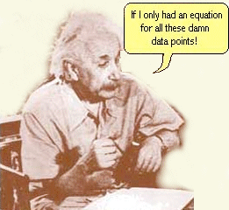
End of
Review -
good luck
with your
studying!
Need more practice?
Practice Problem Sets (online)
Concept Guides (Companion and online)
Chapter Guides (online)
End of Chapter Problems in Textbook (every other question has answer at end)
Good luck with your studying!
MAR

