Slide 1
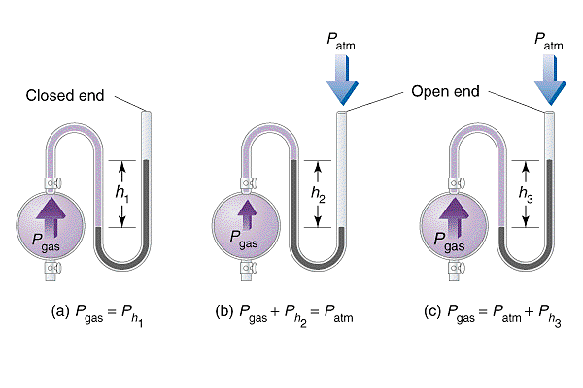
Chemistry 222 Exam II Review Chapters 9, 10 and 11
Chemistry 222
Professor Michael Russell
Last update:
4/29/24
MAR

Slide 2
Midterm II
Chapters 9, 10, 11
For this "face to face" class (01 & H1):
Bring: calculator, pencil, "notes sheet" "Freezing Point Depression" lab, Exam Prep Worksheet II, Take Home Quiz 5, "Kinetics I (in class)" printed lab
20 multiple choice questions, 5 short answer questions, ~2 hours in length
Returned following lab period with "summary sheet" Good luck with your studying!
Let's start the review!
MAR

Slide 3
Midterm II
Chapters 9, 10 and 11
Bring: calculator, pencil, scantron (50 questions / side, 100 questions total), "Freezing Point Depression" lab, Exam Prep II
20 multiple choice questions, four short answer questions, ~2 hours in length
Returned Friday with "summary sheet"
Good luck with your studying!
Let's start the review!
MAR

Slide 4
Midterm II
Chapters 9, 10 and 11
For this online exam:
20 multiple choice questions, 3-4 short answer questions
Released Wednesday night, due Friday at 9 AM via email
Returned with "summary sheet" at end
Good luck with your studying!
Let's start the review!
MAR

Slide 5
Midterm II
Chapters 9, 10 and 11
If this is an online class:
20 multiple choice questions, 3-4 short answer questions
Due Friday at 9 AM via email
Returned with "summary sheet" at end
Good luck with your studying!
Let's start the review!
MAR

Slide 6
A sample of gas has a volume of 222 mL at 695 mm Hg and 0 °C. What would be the volume of this same sample of gas if it were measured at 333 mm Hg and 0 °C?
894 mL
463 mL
657 mL
359 mL
-155 mL
MAR
Answer = B, 463 mL
Can use "combined gas law",
P1V1/T1 = P2V2/T2
convert T to Kelvin (or just cancel! :), solve for V2:
V2 = P1V1T2/P2T1
V2 =695 mm Hg*222 mL * 273 K / 333 mm Hg * 273 K
V2 = 463 mL
Enter your response on
your i>Clicker now!

Slide 7
Gas density: Which has the greatest density at 25 °C and 1.00 atm pressure?
O₂ 32 g/mol
N₂ 28 g/mol
H₂ 2 g/mol
CO₂ 44 g/mol
Xe 131 g/mol
MAR
Answer = E, Xe
PM = dRT, or
Molar mass (M) proportional
to density (d),
largest M, largest d (at same T and P)
Largest M = Xe,
Xe has greatest density!
Enter your response on
your i>Clicker now!

Slide 8
Diborane reacts with O₂ to give boric oxide and water vapor:
B₂H₆(g) + 3 O₂(g) → B₂O₃(s) + 3 H₂O(g)
If 1.5 L of B₂H₆ is mixed with O₂, what volume of O₂ is required for reaction? Assume constant T and P.
1.5 L
4.5 L
0.50 L
6.0 L
0.0 L
MAR
Answer = B, 4.5 L
Use stoichiometry to convert L of B2H6 into L of O2:
3 mol O2 / 1 mol B2H6
Volume proportional to mol (ideal gas law), so:
1.5 L B2H6 * (3 L O2 / 1 L B2H6) = 4.5 L O2
This works for Pressure as well!
Enter your response on
your i>Clicker now!

Slide 9
Diborane, B₂H₆, burns in air according to the equation:
B₂H₆(g) + 3 O₂(g) → B₂O₃(s) + 3 H₂O(g)
There are three gases involved in the reaction above. Place them in order of increasing velocity.
B₂H₆ < O₂ < H₂O
O₂ < B₂H₆ < H₂O
H₂O < B₂H₆ < O₂
O₂ < H₂O < B₂H₆
MAR
Answer = B, O₂ < B₂H₆ < H₂O
Velocity ↑ as molar mass ↓,
O2: 32 g/mol
B2H6: 28 g/mol
H2O: 18 g/mol
O₂ (slowest) < B₂H₆ < H₂O (fastest)
Enter your response on
your i>Clicker now!

Slide 10
Equal masses of helium and neon are placed in separate containers of equal V at the same T. Compare the pressures of the gases.
P(He) > P(Ne)
P(Ne) > P(He)
P(He) = P(Ne)
Too much pressure!
MAR
Answer = A, P(He) > P(Ne)
Equal masses, unequal molar masses
moles proportional to pressure
Assume a given mass (4 g) for each:
4 g He * (mol He / 4 g) = 1 mol He
4 g Ne * (mol Ne / 20 g Ne) = 0.2 mol Ne
Fewer mol Ne, less P of Ne, P(He) > P(Ne)
Enter your response on
your i>Clicker now!

Slide 11
Using intermolecular forces, the predicted order of decreasing boiling points for the following substances is
CH₃OH > CH₄ > H₂
CH₃OH > H₂ > CH₄
CH₄ > CH₃OH > H₂
CH₄ > H₂ > CH₃OH
H₂ > CH₄ > CH₃OH
MAR
Answer = A, CH₃OH > CH₄ > H₂
CH3OH: polar, hydrogen bonds
CH4: nonpolar, induced dipole-induced dipole (ID-ID) bonds
H2: nonpolar, ID-ID bonds
Between CH4 and H2, lower molar mass boils at lower temperature, so:
CH₃OH > CH₄ > H₂
Enter your response on
your i>Clicker now!

Slide 12
Rank the following molecules in order of increasing intermolecular forces:
SO₂, NaCl, CH₃OH, He
NaCl < He < SO₂ < CH₃OH
He < CH₃OH < SO₂ < NaCl
He < SO₂ < CH₃OH < NaCl
He < SO₂ < NaCl < CH₃OH
MAR
Answer = C, He < SO₂ < CH₃OH < NaCl
He: nonpolar, ID-ID force
SO2: polar, dipole-dipole force
CH3OH: polar, O-H bond, hydrogen bonds
NaCl: ionic, ion-ion force
IM "Order of Strength": ID-ID < dipole-ID < dipole-dipole < hydrogen bonds < ion-dipole < ion-ion/metallic
Enter your response on
your i>Clicker now!

Slide 13
When KCl dissolves in water, what types of intermolecular bonds are formed?
ion-ion
ion-dipole
hydrogen bonds
ion-ion forces and H-bonds
matrimony bonds
MAR
Answer = B, ion-dipole bonds
KCl(s) has ion-ion bonds
H2O(l) has hydrogen bonds
KCl(aq) implies (CH 221):
K⁺(aq) and Cl⁻(aq),
ion-dipole bonds
once ionic compound dissolves
Enter your response on
your i>Clicker now!

Slide 14
Which of the following should have the highest ∆Hvap?
F₂
CH₃OH
H₂O
NH₃
all have the same ∆Hvap value
MAR
Answer = C, H2O
Strongest IM forces lead to strongest ∆Hvap
NH3, CH3OH and NH3 all have hydrogen bonds, but water makes "network" of H-bonds, very strong!
Actual values:
∆Hvap for F2: 6.62 kJ/mol
∆Hvap for CH3OH: 35.3 kJ/mol
∆Hvap for H2O: 40.7 kJ/mol
∆Hvap for NH3: 23.4 kJ/mol
Enter your response on
your i>Clicker now!

Slide 15
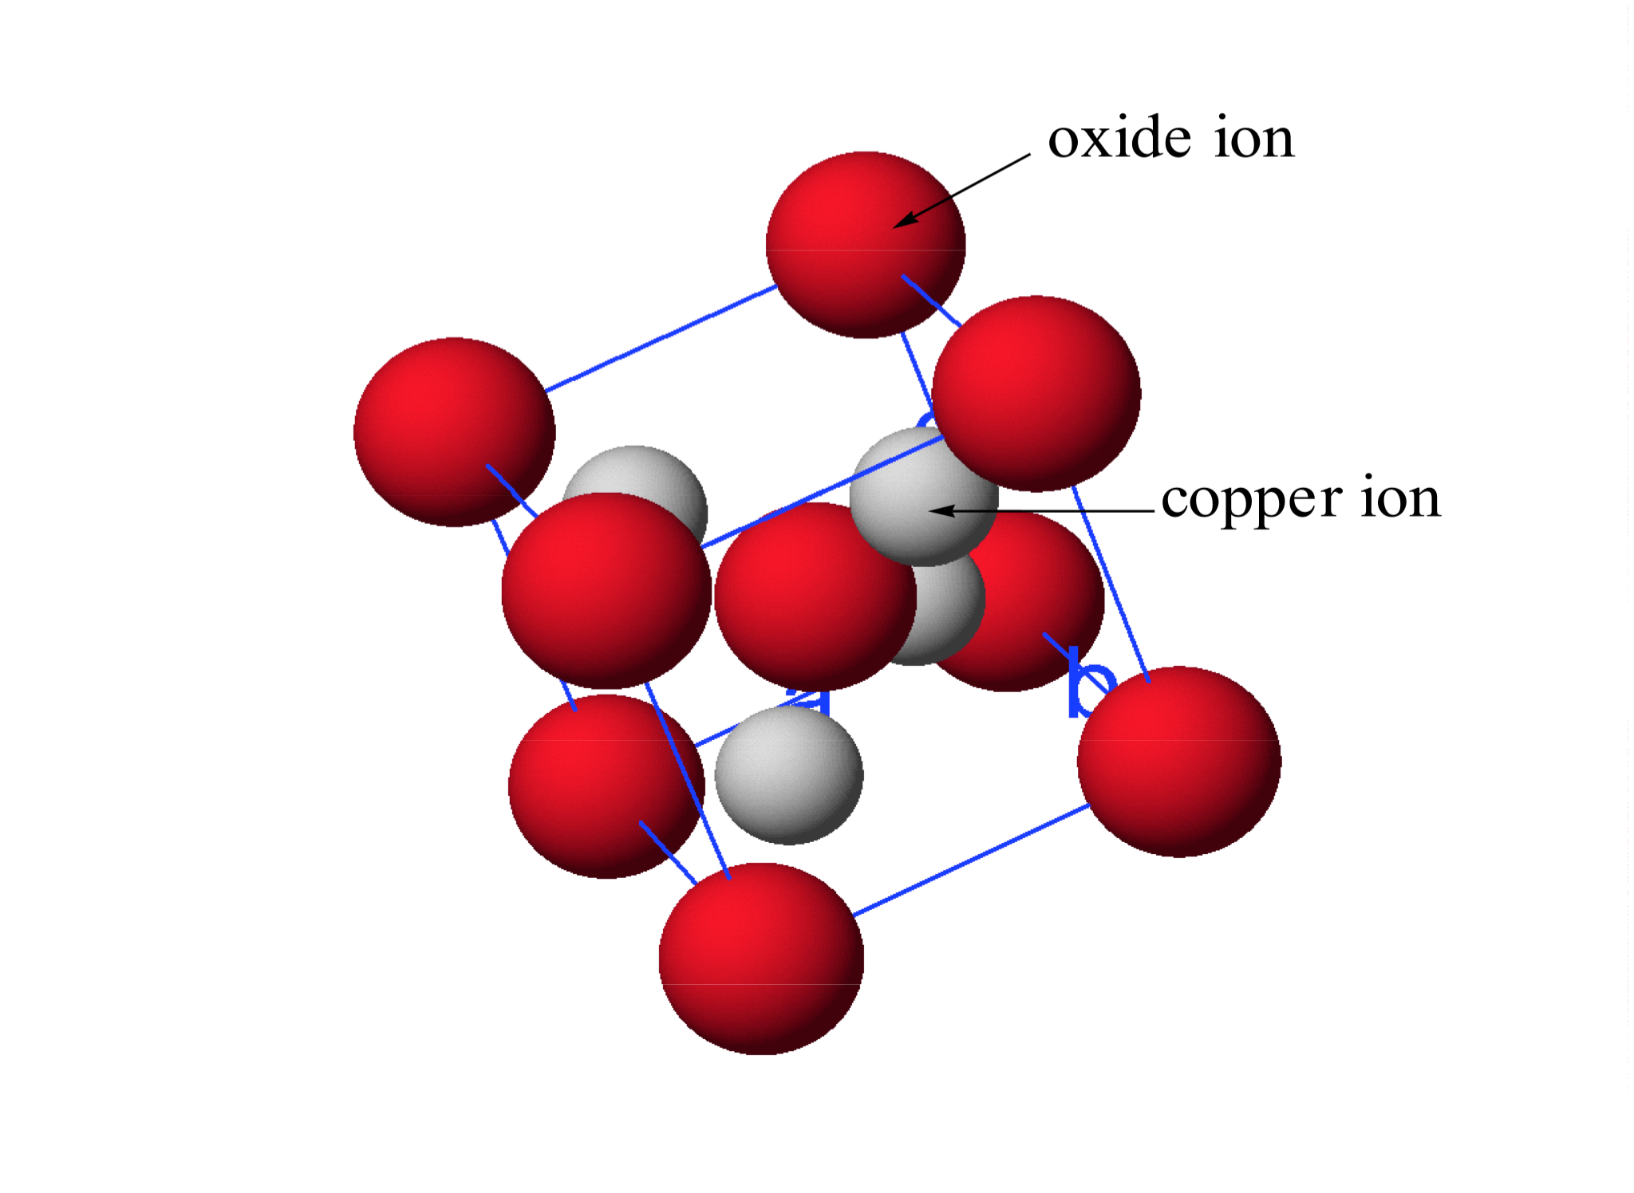
The unit cell for a compound of copper and oxygen is illustrated here. All the grey copper atoms are within the unit cell. Determine the formula of the compound.
CuO
Cu₂O
CuO₂
Cu₂O₃
Cu₄O₉
MAR
Answer = B, Cu2O
O atoms in corners, one in middle, so:
8*(1/8) + 1 = 2 net O atoms
Cu atoms in center of cell:
4 net Cu atoms
Use smallest whole number, so:
Cu4O2 = Cu2O,
copper(I) oxide
Enter your response on
your i>Clicker now!

Slide 16
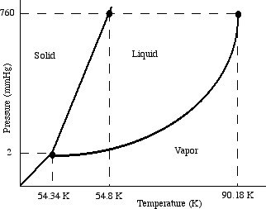
Below is a phase diagram for O₂. What is the name of the point at P = 2 mm Hg and T = 54.34 K?
normal freezing point
triple point
normal boiling point
critical point
freak out point
MAR
Enter your response on
your i>Clicker now!
Answer = B, triple point
All three phases of O2 exist simultaneously at the triple point

Slide 17
At right is a phase diagram for O₂. Which statement is correct regarding the densities of solid and liquid O₂ at the same temperature?
The density of liquid O₂ is 1.426 g/cm³ whereas the density of solid O₂ is 1.149 g/cm³.
The density of solid O₂ is 1.426 g/cm³ whereas the density of liquid O₂ is 1.149 g/cm³.
The densities of solid and liquid O₂ are the same.
MAR
Answer = B, The density of solid O₂ is 1.426 g/cm³ whereas the density of liquid O₂ is 1.149 g/cm³.
If solid-liquid line has a positive slope, d(solid) > d(liquid)
Enter your response on
your i>Clicker now!

Slide 18
Below is a phase diagram for O₂. In what phase is oxygen found at a pressure of 1 mmHg and a temperature of 55 K?
solid
liquid
vapor
plasma
MAR
Answer = C, vapor
Enter your response on
your i>Clicker now!

Slide 19
Calculate the energy required to convert 1.00 L of liquid ethanol at 25.0 °C to a gas at 78.3 °C. Constants for ethanol:
density = 0.7849 g/mL
molar mass = 46.08 g/mol
boiling point = 78.3 °C
heat capacity = 2.44 J/g∙K
heat of vaporization = 38.56 kJ/mol
-329 kJ
329 kJ
-759 kJ
759 kJ
0 KJ
MAR
Answer = D, 759 kJ
q(total) = mC∆T + “mass*heat”
1.00 L * 10³ mL/L * 0.7849 g/mL = 785 g
mC∆T = 785 g * 2.44 * (78.3-25.0)*(kJ/10³ J) = 102 kJ
“mass*heat” = 785 g*(mol/46.08 g)*38.56 kJ/mol = 657 kJ
q(total) = 102 + 657 = 759 kJ
endothermic reaction!
Enter your response on
your i>Clicker now!

Slide 20
You dissolve 92.0 grams of CH₃CH₂OH, ethanol, in 270 g of water. What is the mole fraction of ethanol in the solution?
2.0
0.12
0.067
0.0083
0
MAR
Answer = B, 0.12
Χ = (mol ethanol) / (mol ethanol + mol H2O)
92.0 g ethanol * (mol / 46.1 g) = 2.00 mol
270 g H2O * (mol / 18.02 g) = 15 mol
Χ = (2.00) / (2.00 + 15) = 0.12
Enter your response on
your i>Clicker now!

Slide 21
You dissolve 92.0 grams of CH₃CH₂OH, ethanol, in 270. g of water. What is the weight percent of ethanol in the solution?
34.1 %
17.0 %
25.4 %
74.8 %
100. %
MAR
Answer = C, 25.4%
wt% = (g ethanol) / (g ethanol + g H2O) *100%
wt% = (92.0) / (92.0 + 270.)*100% = 25.4%
Enter your response on
your i>Clicker now!

Slide 22
You dissolve 92.0 grams of CH₃CH₂OH, ethanol, in 270. g of water. What is the molality of ethanol in the solution?
341 m
170. m
0.341 m
7.41 m
18.0 m
MAR
Answer = D, 7.41 m
m = mol ethanol / kg H2O
92.0 g ethanol * (mol / 46.1 g) = 2.00 mol
270. g H2O * (kg / 1000 g) = 0.270 kg
m = 2.00 mol / 0.270 kg = 7.41 m
Enter your response on
your i>Clicker now!

Slide 23
You dissolve 92.0 grams of CH₃CH₂OH, ethanol, in 270. g of water, and the density of the solution is 0.9780 g/mL. What is the molarity of ethanol in the solution?
0.370 M
2.00 M
7.42 M
3.05 M
5.41 M
MAR
Answer = E, 5.41 M
M = mol ethanol / L solution
Find mass of solution, turn to V using density
92.0 g ethanol * (mol / 46.1 g) = 2.00 mol
270. + 92.0 = 362 g solution
362 g solution * (mL / 0.9780 g) = 370. mL
370. mL * (L / 1000 mL) = 0.370 L
M = 2.00 mol / 0.370 L = 5.41 M
Enter your response on
your i>Clicker now!

Slide 24
An aqueous solution of ethanol (CH₃CH₂OH) has a solution density of 0.9163 g/mL and a concentration of 0.801 M. What is the mole fraction of ethanol in the solution?
0.911
1.1111
0.9839
0.0161
4.03
MAR
Answer = D, 0.0161
M = mol ethanol / L solution
Assume exactly 1 L solution = 1000 mL
1 L solution = 0.801 mol ethanol
1000 mL * (0.9163 g / mL) = 916.3 g solution
0.801 mol * (46.1 g/mol) = 36.9 g ethanol
916.3 g solution - 36.9 g solute = 879.4 g H2O
879.4 g * (mol / 18.02 g) = 48.80 mol H2O
Χ = (mol ethanol) / (mol ethanol + mol H2O)
Χ = (0.801) / (0.801 + 48.80) = 0.0161
Enter your response on
your i>Clicker now!

Slide 25
The Henry's Law constant for N2 in water at 53 °C is 8.4 x 10⁻⁷ M/mm Hg, and the vapor pressure of water at 53 °C is 107 torr. Find the equilibrium concentration of N2 in water if the total pressure equals 1 atm.
5.5 x 10⁻⁴ M
9.0 x 10⁻⁵ M
6.4 x 10⁻⁴ M
3.2 x 10⁻⁵ M
42 M
MAR
Answer = A, 5.5 x 10 ⁻⁴ M
Henry's Law: Sg = kH*Pg
Find partial pressure of N2 from 1 atm
760 mm Hg - 107 mm Hg = 653 mm Hg
Now find concentration of N2:
Sg = kH*Pg
Sg = 8.4 x 10⁻⁷ M/mm Hg * 653 mm Hg
Sg = 5.5 x 10 ⁻⁴ M
Enter your response on
your i>Clicker now!

Slide 26
0.0400 mol of I₂ (10.1 g) is dissolved in 1.96 mol of CCl₄ (300 g) at 65 °C. Given that the vapor pressure of pure CCl₄ is 504 mm Hg at this temperature, what is the vapor pressure of the CCl₄ over this solution?
504 mm Hg
514 mm Hg
494 mm Hg
10.1 mm Hg
Too much pressure!
MAR
Answer = C, 494 mm Hg
Use Raoult's Law
VPsolution = Xsolvent*VP°solvent
Xsolvent = (1.96)/(1.96+0.0400) = 0.980
VPsolution = 0.980 * 504 mm Hg
VPsolution = 494 mm Hg
Enter your response on
your i>Clicker now!

Slide 27
What mass of ethylene glycol (HOC₂H₄OH, molar mass = 62.0 g/mol) must be added to 125 g of water to raise the boiling point by 1.00 °C? (k_{bp}(H2O) = +0.512 °C/m)
1.95 g
0.244 g
15.1 g
31.0 g
0 g
MAR
Answer = C, 15.1 g
solution = ethylene glycol (solute) + water (solvent)
Use: ∆T = kbp m i, solve for m (i = 1)
m = ∆T/kbp = 1.00°C/0.512 °C/m = 1.95 m
(1.95 mol / kg H2O) * 0.125 kg H2O = 0.244 mol
0.244 mol ethylene glycol * 62.0 g/mol = 15.1 g
Enter your response on
your i>Clicker now!

Slide 28
Which water-based solution is expected to have the higher boiling point?
0.10 molal NaCl
0.15 molal sugar
both the same
not enough information
MAR
Enter your response on
your i>Clicker now!
Answer = A, 0.10 m NaCl
∆T = kbp m i
i = 1 (sugar), i = 2 (NaCl, theoretical value)
Both have same k (H2O), so
∆T α m*i
∆T α 0.10 m*2 = 0.20 (NaCl)
∆T α 0.15 m*1 = 0.15 (sugar)
NaCl larger, higher boiling point

Slide 29
29.3 g of NaCl (molar mass = 58.5 g/mol) is dissolved in 500. grams water. What is the boiling point of this solution? (k_{bp}(H2O) = +0.512 °C/m)
100.512 °C
98.976 °C
101.02 °C
1.024 °C
10⁴ °K
MAR
Answer = C, 101.02 °C
solution = NaCl (solute) + water (solvent)
Note: for NaCl, i = 2 (theoretical i value)
Use: ∆T = kbp m i, solve for ∆T
m = {29.3g NaCl * mol/58.5 g}/0.500 kg = 1.00 m
∆T = 0.512* 1.00 m*2 = 1.02 °C
Tsolution = 100.00 + 1.02 = 101.02 °C
Enter your response on
your i>Clicker now!

Slide 30
Erythritol occurs naturally in algae and fungi. A solution of 2.50 g of erythritol in 50.0 g of water freezes at -0.762 °C. What is the molar mass of the compound? (k_{fp}(H2O) = -1.86 °C/m)
26.9 g/mol
35.5 g/mol
122 g/mol
224 g/mol
0.0100 g/mol
MAR
Answer = C, 122 g/mol
solution = erythritol (solute) + water (solvent)
Use: ∆T = kfp m i, solve for m (i = 1)
m = ∆T/kfp = -0.762°C/-1.86 °C/m = 0.410 m
(0.410 mol / kg H2O) * 0.0500 kg H2O = 0.0205 mol
2.50 g / 0.0205 mol erythritol= 122 g/mol
Enter your response on
your i>Clicker now!

Slide 31
Insulin (20.0 mg) dissolved in 5.00 mL of water at 300. K provides an osmotic pressure of 12.5 mm Hg. What is the molar mass of insulin?
18.0 g/mol
42.0 g/mol
3980 g/mol
6010 g/mol
12,100 g/mol
MAR
Answer = D, 6010 g/mol
Use: π = icRT (i = 1),
solve for c, then MM
π = (12.5 mm Hg * 1atm/760 mm Hg) = 0.0164 atm
c = π/iRT = 0.0164 / (1*0.082057*300.) = 6.66 x 10⁻⁴ M
6.66 x 10⁻⁴ M * 0.00500 L = 3.33 x 10⁻⁶ mol
0.0200 g / 3.33 x 10⁻⁶ mol = 6010 g/mol
Enter your response on
your i>Clicker now!

Slide 32
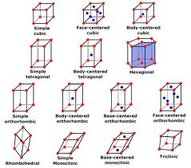
End of
Review -
good luck
with your
studying!
Need more practice?
Practice Problem Sets (online)
Concept Guides (Companion and online)
Chapter Guides (online)
End of Chapter Problems in Textbook (every other question has answer at end)
Good luck with your studying!
MAR

