Slide 1
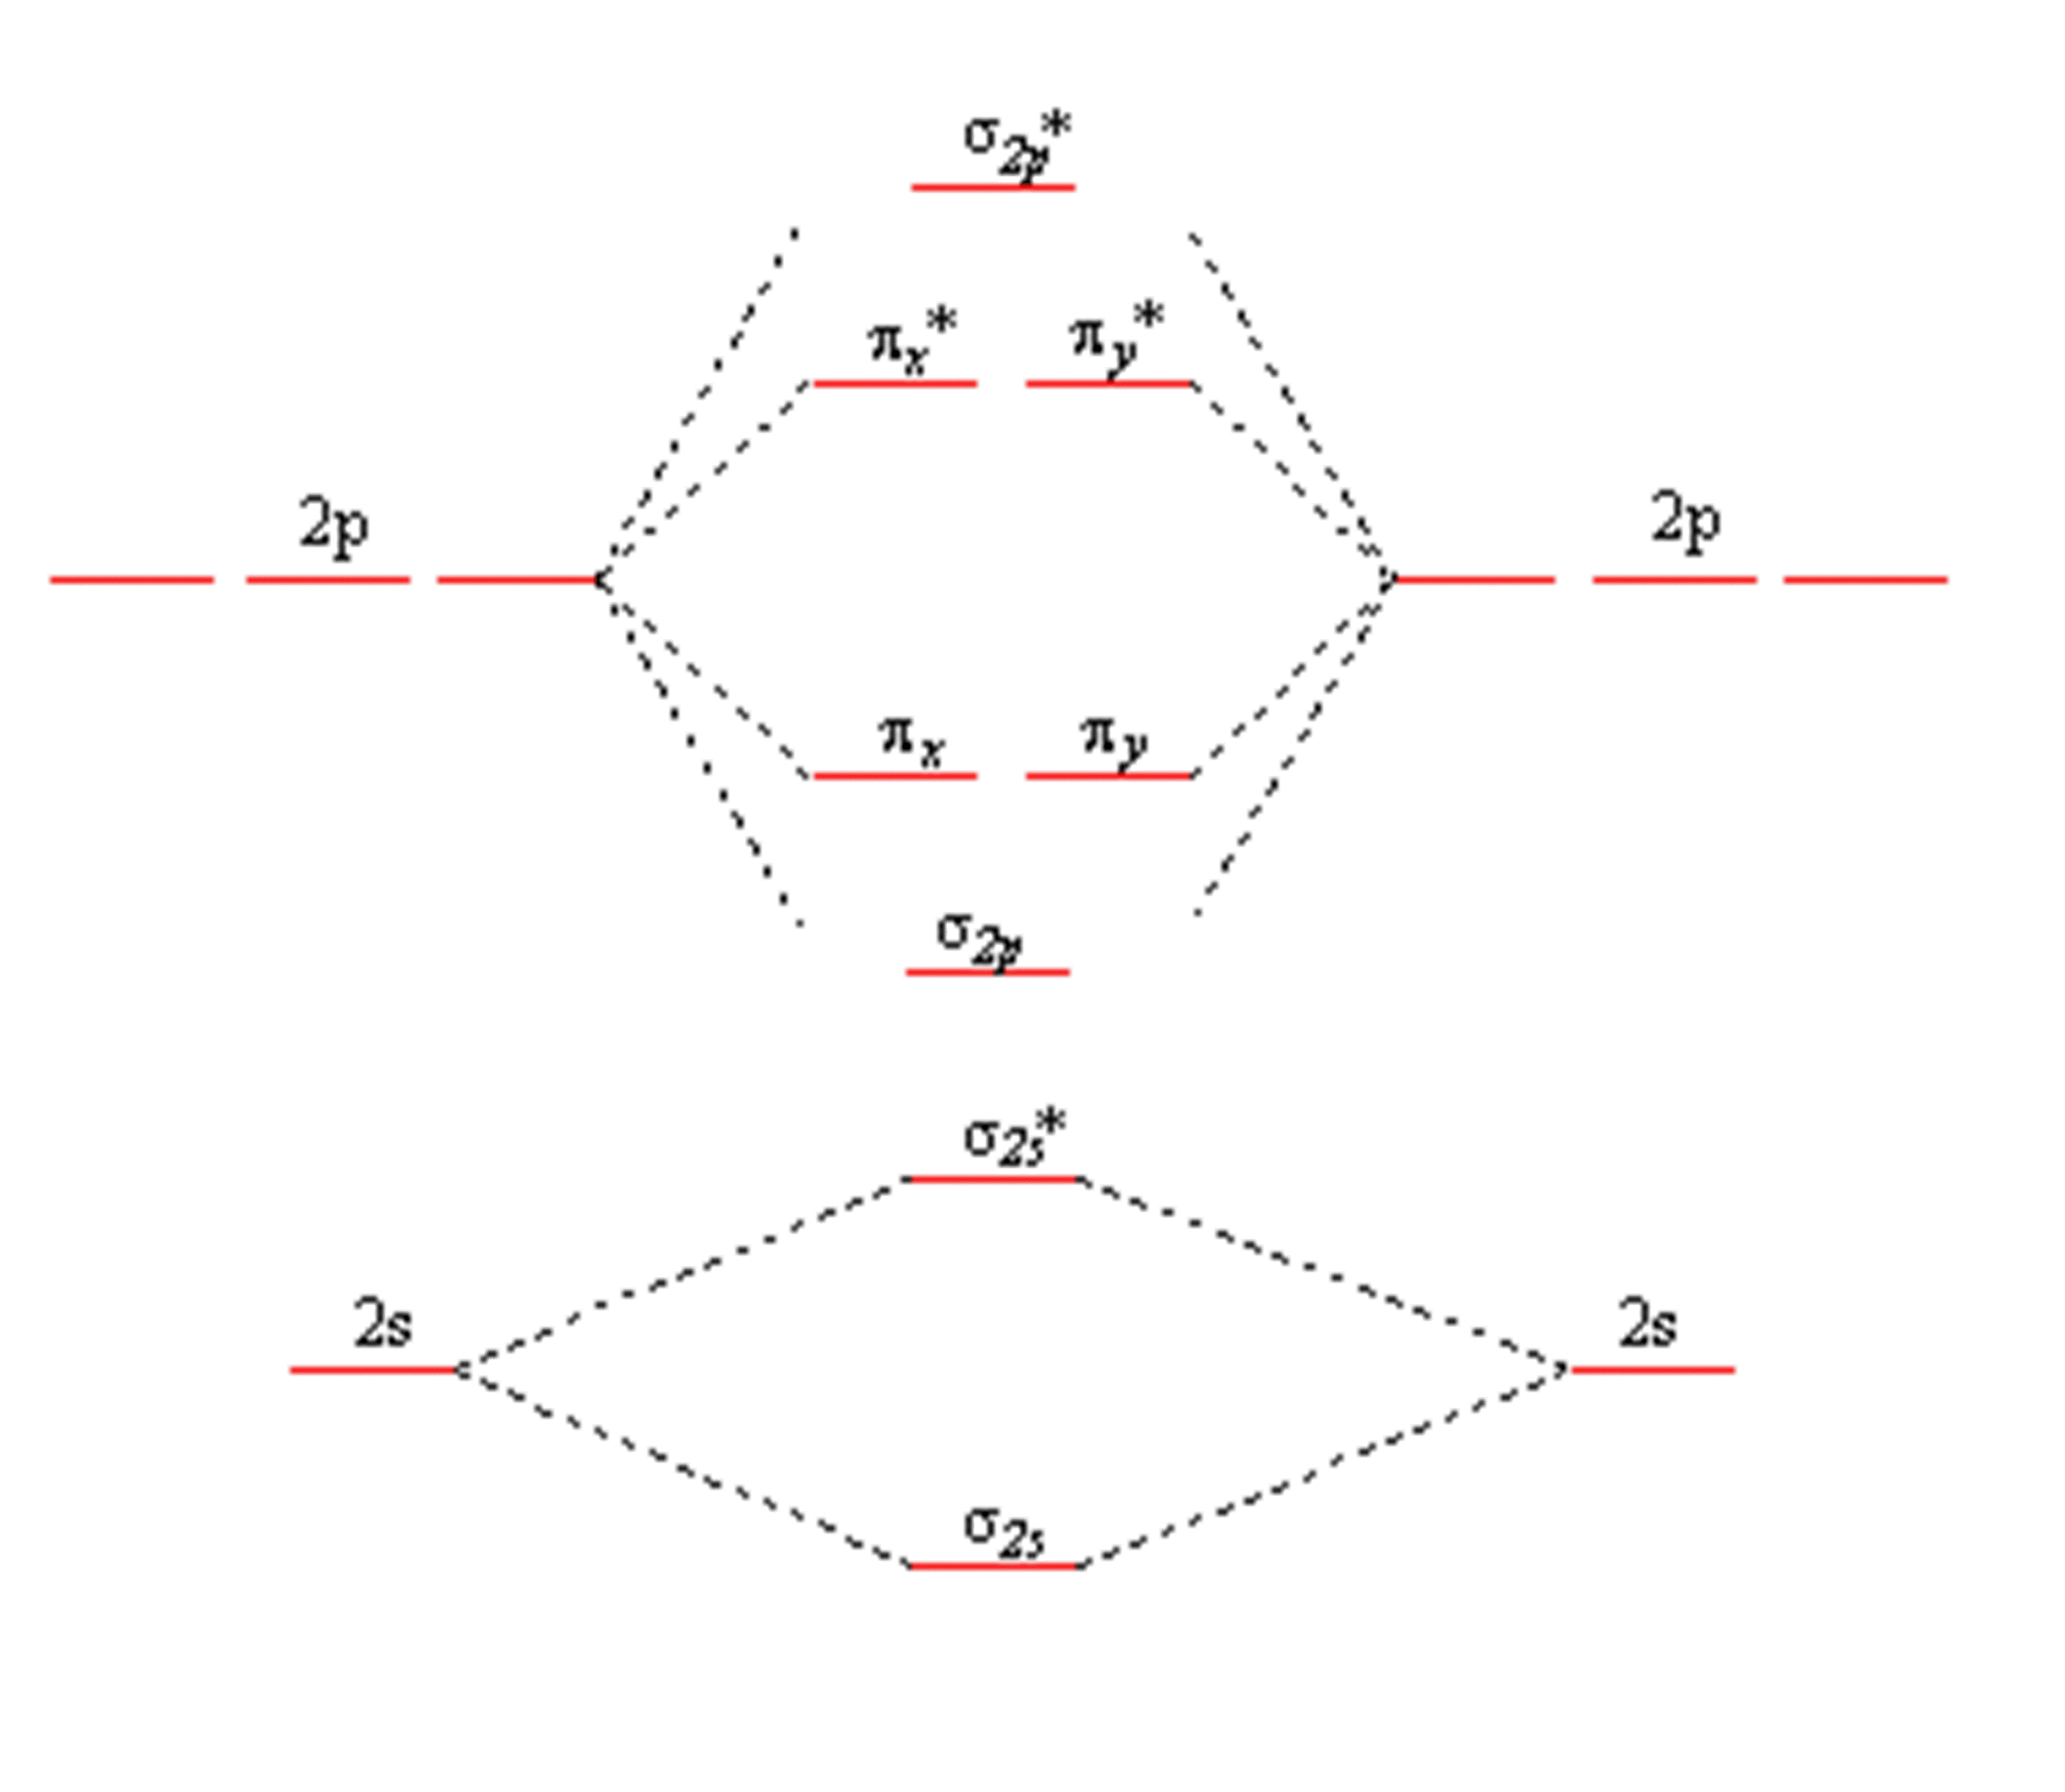
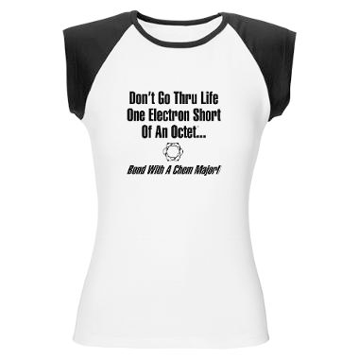
Chemistry 222 Exam I Review Chapters 7, 8 and 20
Chemistry 222
Professor Michael Russell
[Core electrons]
Last update:
4/29/24
MAR

Slide 2
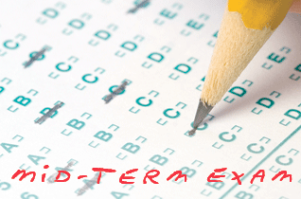
Midterm I
Chapters 7, 8, 20
For this "face to face" class (01 & H1):
Bring: calculator, pencil, "notes sheet", "Organic Chemistry" lab, Exam Prep Worksheet I, "Molar Mass of a Volatile Liquid (in class)" printed lab, safety goggles
20 multiple choice questions, 5 short answer questions, ~2 hours in length
Returned following lab period with "summary sheet" Good luck with your studying!
Let's start the review!
MAR

Slide 3
Midterm I
Chapters 7, 8, 20; For section 01:
Bring: calculator, pencil, "notes sheet", two labs ("Organic Chemistry" & "VB and MO"), two problem sets (Problem Set #2 and #3), two Take Home Quizzes (Quiz 2 and 3), Exam Prep Worksheet I
Also bring printed "Molar Mass of a Volatile Liquid (in class)" lab, safety goggles
20 multiple choice questions, 5 short answer questions, ~2 hours in length
Returned following lab period with "summary sheet" Good luck with your studying!
Let's start the review!
MAR

Slide 4
Midterm I
Chapters 7, 8 and 20
Bring: calculator, pencil, scantron (50 questions / side, 100 questions total), "Organic Chemistry" lab, Exam Prep Worksheet I, safety goggles
20 multiple choice questions, four short answer questions, ~2 hours in length
Returned Friday with "summary sheet"
Good luck with your studying!
Let's start the review!
MAR

Slide 5
Midterm I
Chapters 7, 8, 20
If this is an online class:
20 multiple choice questions, 3-4 short answer questions
Due Friday at 9 AM via email
Returned with "summary sheet" at end
Good luck with your studying!
Let's start the review!
MAR

Slide 6
Midterm I
Chapters 7, 8, 20
For this online exam:
20 multiple choice questions, 3-4 short answer questions
Released Wednesday night, due Friday at 9 AM via email
Returned with "summary sheet" at end
Good luck with your studying!
Let's start the review!
MAR

Slide 7
Which of the following is NOT a correct Lewis dot structure?
1
.
3
.
A.
N
N
C.
H
C
N
2
.
4
.
B.
N
O
D.
C
O
MAR
Enter your response on
your i>Clicker now!
Answer = B,
Structure is actually NO⁺
Five electron pairs shown or
10 valence electrons (ve⁻s)
NO (neutral): 5 + 6 = 11 ve⁻s
Take away electron to get NO⁺
with 10 ve⁻s total

Slide 8
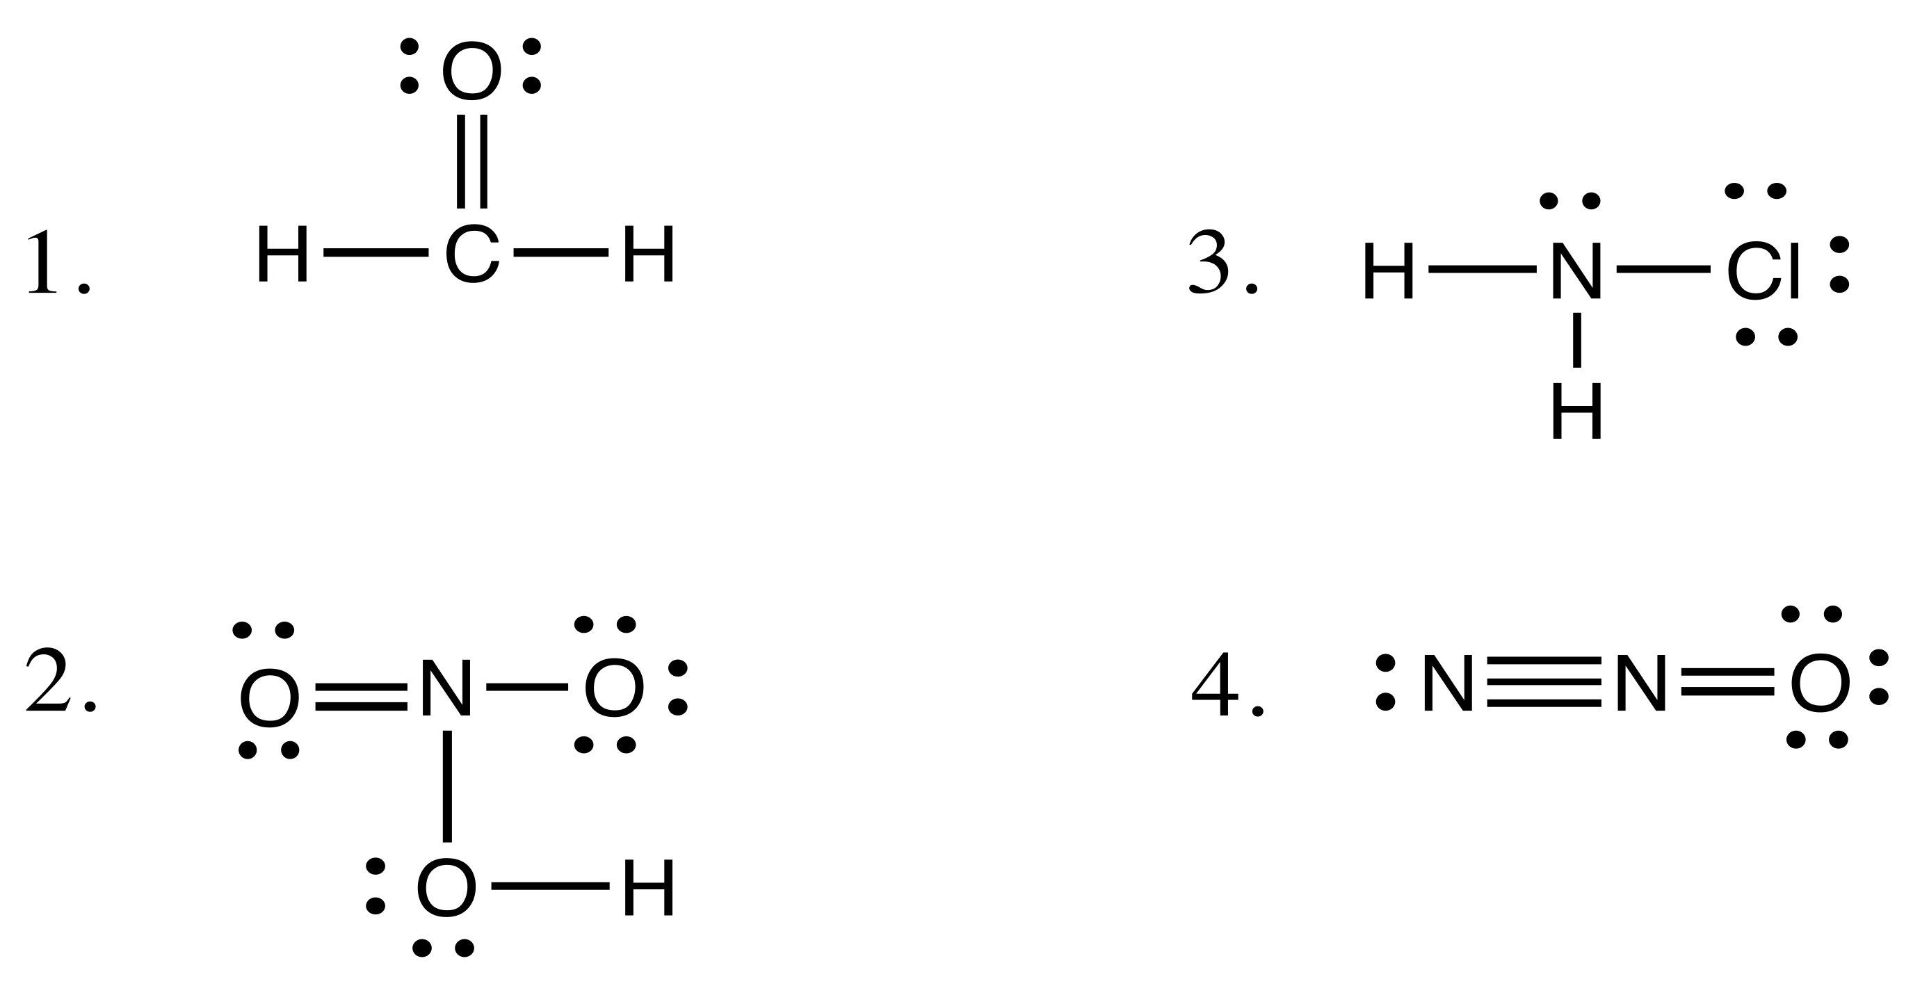
Which of the following is NOT a correct Lewis dot structure?
A.
C.
B.
D.
MAR
Enter your response on
your i>Clicker now!
Answer = D,
Too many bonds around middle N; 2nd period can only have four bonds total

Slide 9
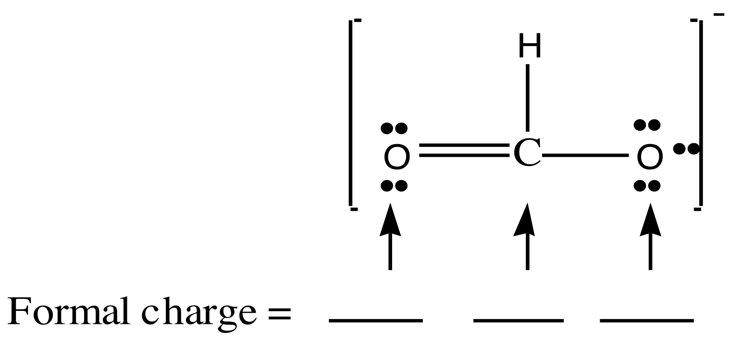
Determine the formal charges for the formate ion:
0 0 0
+1 –1 –1
+1 0 –1
0 0 –1
MAR
Enter your response on
your i>Clicker now!
Answer = D, 0, 0, -1
formal charge = GN - lpe - 0.5*bpe
GN = group number
lpe = lone pair electrons
bpe = bonding pair electrons
O on left:
fc = 6 - 4 - 0.5(4) = 0
C in middle:
fc = 4 - 0 - 0.5(8) = 0
O on right:
fc = 6 - 6 - 0.5(2) = -1

Slide 10
Using VSEPR, which of the following corresponds to the molecular shape of SCl₂?
linear
bent
“T-shaped"
trigonal pyramid
orthorhombic
MAR
Enter your response on
your i>Clicker now!
Answer = B, bent
VSEPR = Valence Shell Electron Pair Repulsion Theory (VSEPR)
Draw Lewis structure
Central S in tetrahedral EPG
2 lone pairs and 2 bonding pairs:
bent molecular geometry
bond angle 109°

Slide 11
Based on VSEPR, which of the following corresponds to the molecular shape of the IF₂─ ion?
linear
bent (bond angle 120˚)
“T-shaped”
bent (bond angle 109.5˚)
trigonal pyramid
MAR
Enter your response on
your i>Clicker now!
Answer = A, linear
VSEPR = Valence Shell Electron Pair Repulsion Theory (VSEPR)
Draw Lewis structure
Central I in trigonal bipyramid EPG
3 lone pairs and 2 bonding pairs:
linear molecular geometry
bond angle 180°

Slide 12
What is the approximate C-C-H angle in the acetylene, C₂H₂, molecule?
90˚
120˚
109.5˚
180˚
-30˚
MAR
Enter your response on
your i>Clicker now!
Answer = D, 180°
Two "clouds" (a triple bond and a single bond), 180°

Slide 13
Which of the following groups of elements is arranged correctly in order of increasing electronegativity?
Mg < P < N < F
Mg < N < P < F
N < Mg < P < F
F < P < Mg < N
S < U < Pr < I < Se
MAR
Enter your response on
your i>Clicker now!
Answer = A, Mg < P < N < F
Electronegativity increases up and to the right
F most "up and to the right" on periodic table

Slide 14
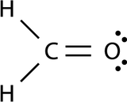
What is the carbon-oxygen bond order in formaldehyde, CH₂O?
1
2
1 ½
2 ½
0
MAR
Enter your response on
your i>Clicker now!
Answer = B, 2
Double bonds: bond order = 2

Slide 15
What is the average carbon-oxygen bond order in the formate ion, HCO₂–?
1
2
1 ½
2 ½
-1
MAR
Enter your response on
your i>Clicker now!
Answer = C, 1 ¹/2
More than a single bond,
less than a double bond
Resonance!
3 bonds in 2 spaces,
bond order = 1.5

Slide 16
Given the bond dissociation enthalpies below, calculate the standard molar enthalpy of formation of NF₃: ½ N₂(g) + ³∕₂ F₂(g) → NF₃(g)
Bond | Dissociation Enthalpy (kJ/mol)
N≡N | 946
F—F | 159
N—F | 272
833 kJ/mol
-105 kJ/mol
440. kJ/mol
-578 kJ/mol
-220. kJ/mol
MAR
Enter your response on
your i>Clicker now!
Answer = B, -105 kJ/mol
∆H = Σ∆H(bonds broken) - Σ∆H(bonds formed)
∆H = {0.5(N≡N) + 1.5(F-F)} - {3(N-F)}
∆H = {0.5*946 + 1.5*159) - {3*272}
∆H = -105 kJ/mol

Slide 17
Which of the bonds below is least polar?
B—O
B—N
B—F
B—C
AC-DC
MAR
Enter your response on
your i>Clicker now!
Answer = D, B-C
The closer the elements are to each other on periodic table, the smaller the difference in electronegativity... hence, the less polar

Slide 18
Which of the following molecules is polar?
BCl₃
CO₂
N₂
ClF
Ne
MAR
Enter your response on
your i>Clicker now!
Answer = D, ClF
All other molecules are symmetrical and nonpolar

Slide 19
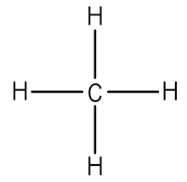
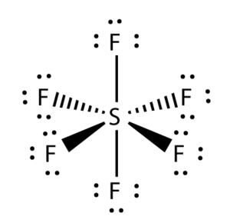
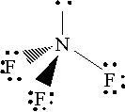
Which of the following molecules is most likely to have a dipole moment?
CH₄
SF₆
BeF₂
NF₃
Rn
MAR
Enter your response on
your i>Clicker now!
Answer = D, NF3
Dipole moment = polar
All molecules other than NF3 are symmetrical and nonpolar with no dipole moment

Slide 20
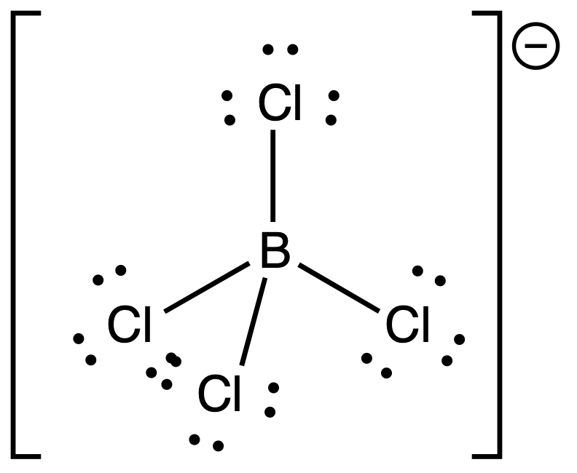
What hybrid orbital set is used by the boron atom in the BCl₄⁻ ion?
sp
sp³
sp²
sp³d²
sp³d
MAR
Enter your response on
your i>Clicker now!
Answer = B, sp³
tetrahedral EPG = sp³

Slide 21
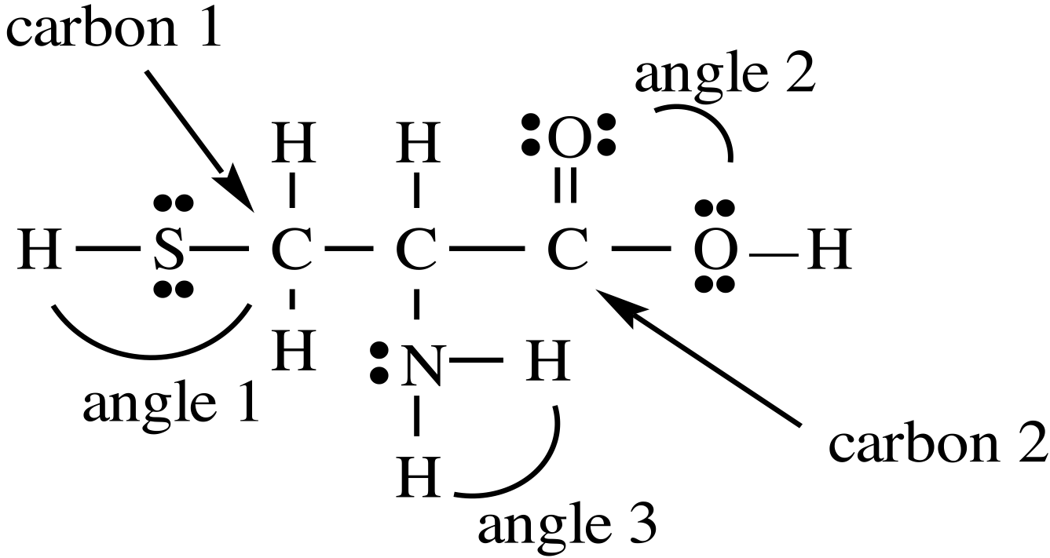
Cysteine is one of the natural amino acids.
The molecule has
13 sigma (σ) bonds and 1 pi (π) bond
14 sigma (σ) bonds and 1 pi (π) bond
20 sigma (σ) bonds and 1 pi (π) bond
12 sigma (σ) bonds and 1 pi (π) bond
MAR
Enter your response on
your i>Clicker now!
Answer = A, 13 σ bonds and 1 π bond
Each single bond is a σ bond
Each double bond contains 1 σ bond and 1 π bond

Slide 22
Cysteine is one of the natural amino acids.
Estimate the values of the indicated angles:
Angle 1 = 180˚ Angle 2 = 120˚ Angle 3 = 109˚
Angle 1 = 109˚ Angle 2 = 120˚ Angle 3 = 109˚
Angle 1 = 109˚ Angle 2 = 109˚ Angle 3 = 109˚
Angle 1 = 180˚ Angle 2 = 90˚ Angle 3 = 90˚
MAR
Enter your response on
your i>Clicker now!
Answer = B, Angle 1 = 109˚ Angle 2 = 120˚ Angle 3 = 109°
Angle 1 and 3: tetrahedral, 109°
Angle 2: trigonal planar, 120°

Slide 23
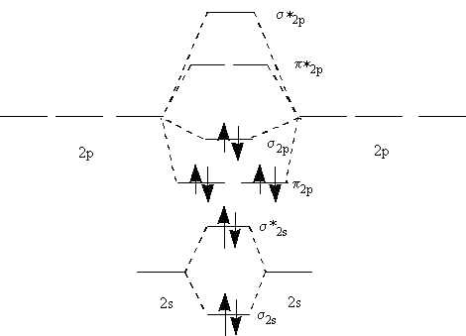
Nitrogen can lose an electron to form N₂⁺. What is the bond order of N₂⁺?
1
1.5
2
2.5
3
MAR
Enter your response on
your i>Clicker now!
Answer = D, 2.5
Determine MO for N2:
[core] (σ_{2s})²(σ*_{2s})²(π_{2p})⁴(σ_{2p})²
Remove e⁻ from highest occupied molecular orbital (HOMO), get:
[core] (σ_{2s})²(σ*_{2s})²(π_{2p})⁴(σ_{2p})¹
bond order = 0.5(5 - 0) = 2.5
[Core electrons]

Slide 24
Is N₂⁺ diamagnetic or paramagnetic?
diamagnetic
paramagnetic
42
MAR
Enter your response on
your i>Clicker now!
Answer = B, paramagnetic
Determine MO for N2⁺:
[core] (σ_{2s})²(σ*_{2s})²(π_{2p})⁴(σ_{2p})¹
one unpaired e⁻ in σ2p orbital,
paramagnetic

Slide 25
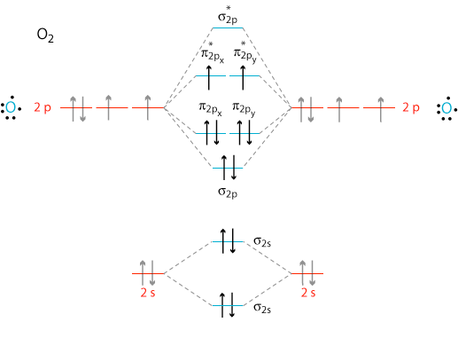
What is the bond order of the superoxide ion, O₂–?
1
1.5
2
2.5
3
MAR
Enter your response on
your i>Clicker now!
Answer = B, 1.5
Determine MO for O2:
[core] (σ_{2s})²(σ*_{2s})²(σ_{2p})²(π_{2p})⁴(π*_{2p})²
Add e⁻ to lowest unoccupied molecular orbital (LUMO), get:
[core] (σ_{2s})²(σ*_{2s})²(σ_{2p})²(π_{2p})⁴(π*_{2p})³
bond order = 0.5(6 - 3) = 1.5
[Core electrons]

Slide 26
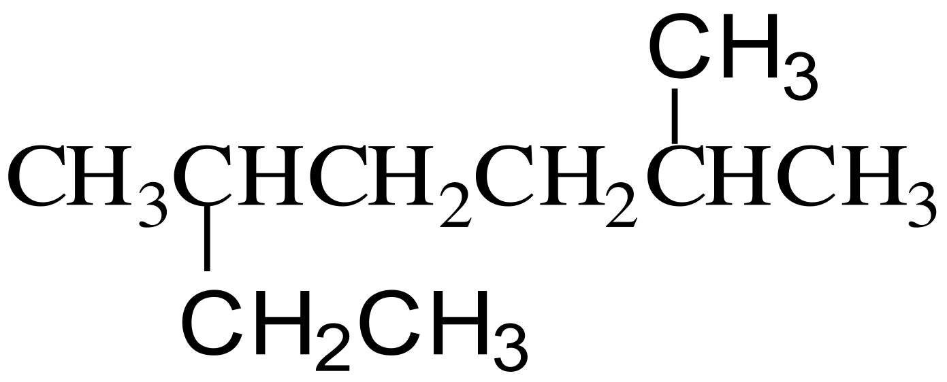
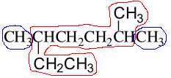
What is the systematic name for this alkane?
nonane
2-ethyl-5-methylhexane
2,5-dimethylheptane
2,3-dimethyloctane
3,6-dimethylheptane
MAR
Enter your response on
your i>Clicker now!
Answer = C, 2,5-dimethylheptane
red atoms = heptane (7-carbon chain)
blue atoms = dimethyl
lowest numbers: 2,5 (and not 3,6)

Slide 27
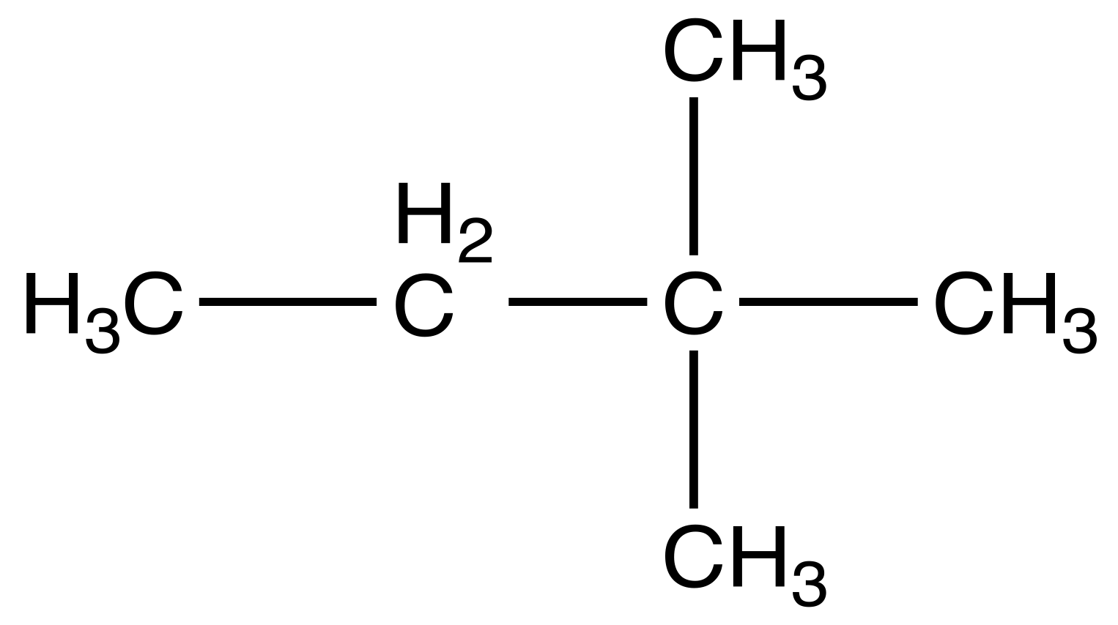
This compound:
The compound is an isomer of pentane and is named 2,3-dimethylbutane.
The compound is an isomer of octane and is named 2,2-dimethylbutane.
The compound is an isomer of hexane and is named 2,2-dimethylbutane.
The compound is an isomer of hexane and is named 3,3-dimethylbutane.
MAR
Enter your response on
your i>Clicker now!
Answer = C, The compound is an isomer of hexane and is named 2,2-dimethylbutane
6 carbons total = isomer of hexane
longest chain = 4 carbons (butane)
dimethyls better at 2,2 (smaller numbers) than 3,3

Slide 28
Given the following compounds:
1. C₃H₆ 2. C₇H₁₄ 3. C₁₁H₂₄ 4. C₇H₈
Which one(s) could be an alkane?
only 1
only 2
only 3
3 and 4
none of the above
MAR
Enter your response on
your i>Clicker now!
Answer = C, only 3
Alkanes: CnH2n+2
Only 3 follows this formula (n = 11)

Slide 29
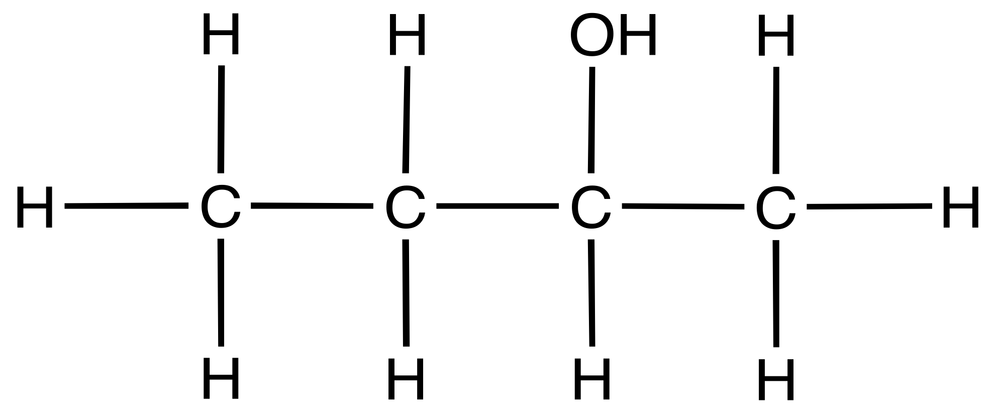
What is the name of the molecule?
butanoic acid
butanal
butanol
butan-2-ol
butane
MAR
Enter your response on
your i>Clicker now!
Answer = D, butan-2-ol
4 carbons (butane) with an OH alcohol (butanol), OH on second C, so butan-2-ol

Slide 30
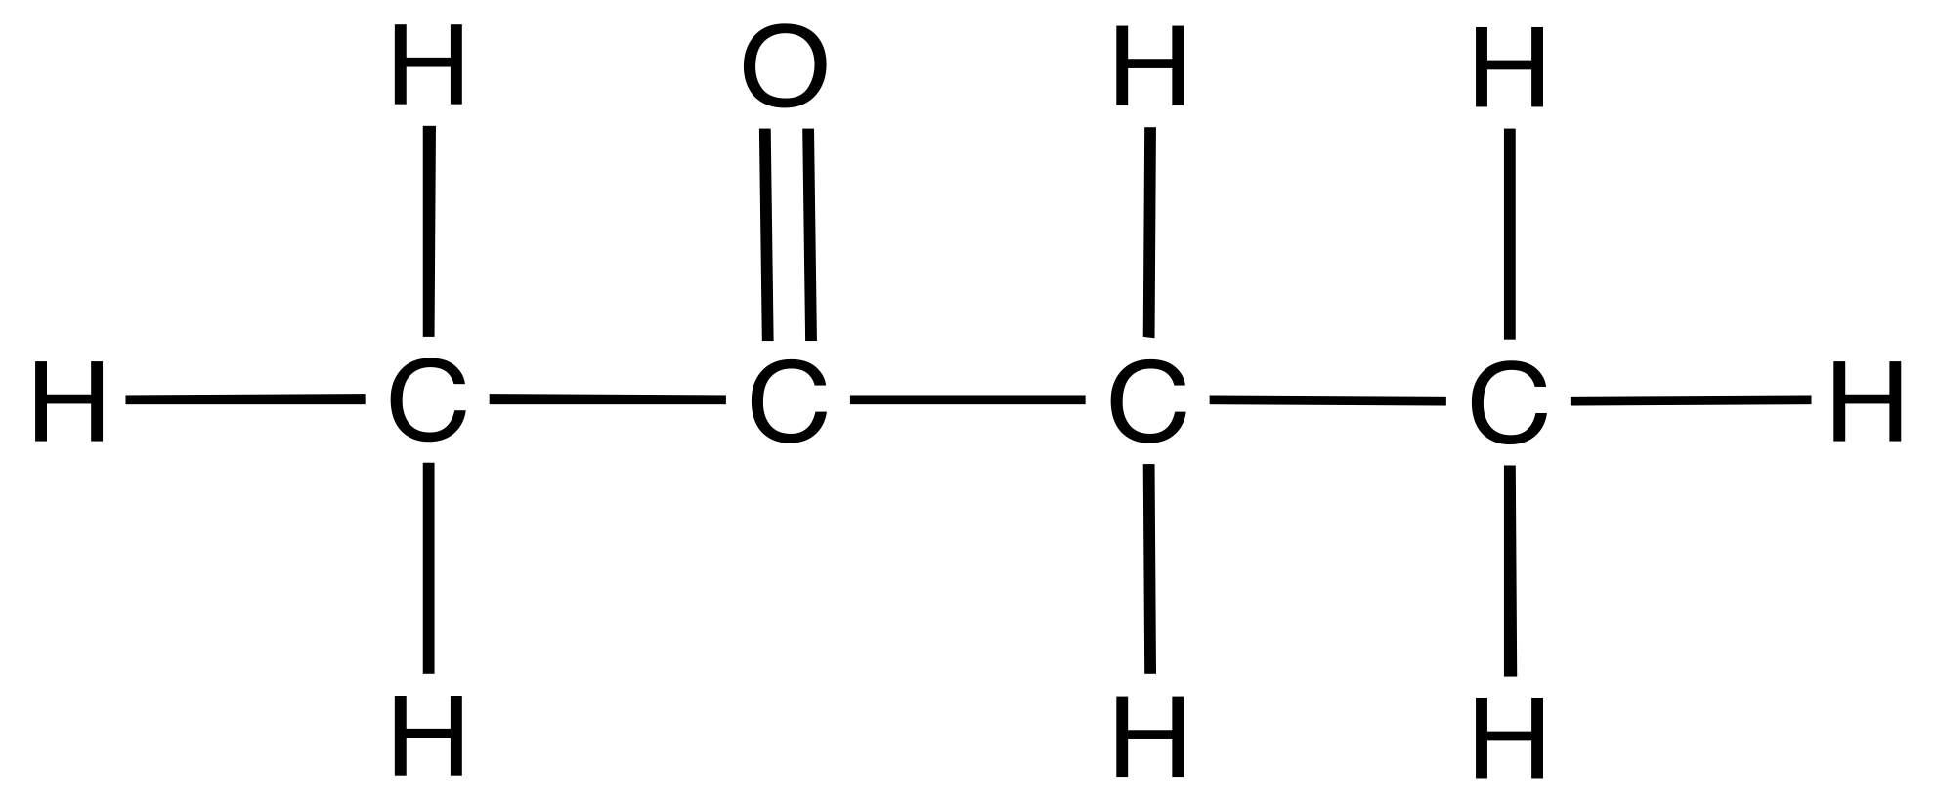
What is the name of the molecule?
butanoic acid
butanal
2-butylamine
butan-2-ol
butanone
MAR
Enter your response on
your i>Clicker now!
Answer = E, butanone
4 carbons (butane), carbonyl in middle of C atoms (ketone), so butanone

Slide 31
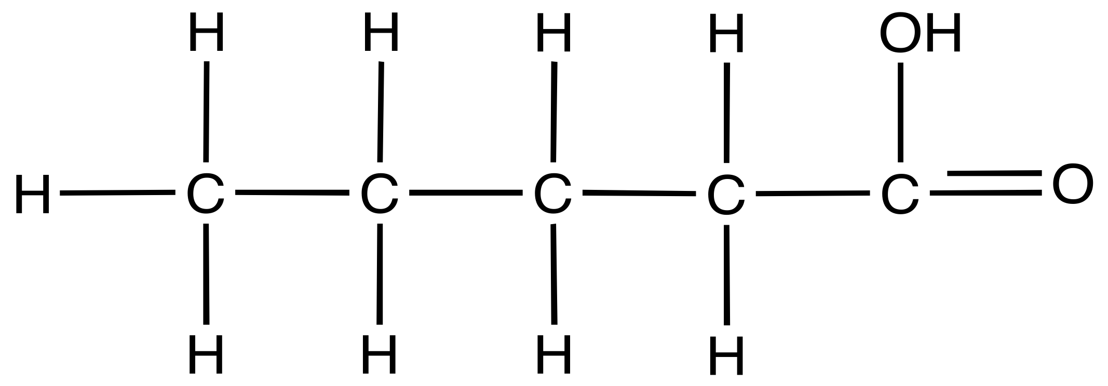
What is the name of the molecule?
butanoic acid
pentanal
pentanoic acid
pentanone
pentan-1-ol
MAR
Enter your response on
your i>Clicker now!
Answer = C, pentanoic acid
5 carbons (pentane),
acid on end C (carboxylic acid),
so pentanoic acid

Slide 32
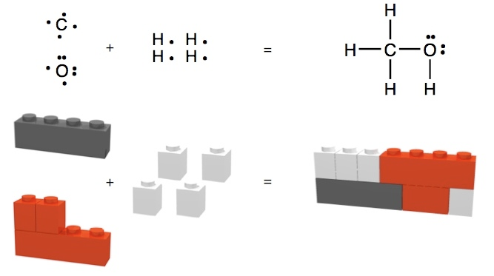
End of
Review -
good luck
with your
studying!
Need more practice?
Practice Problem Sets (online)
Concept Guides (Companion and online)
Chapter Guides (online)
End of Chapter Problems in Textbook (every other question has answer at end)
Good luck with your studying!
MAR

