Slide 1
Carbon: Not Just Another Element Chapter 20:
The Organic Chemistry chapter!
Chemistry 222
Professor Michael Russell
MAR
Last update:
4/29/24

Slide 2
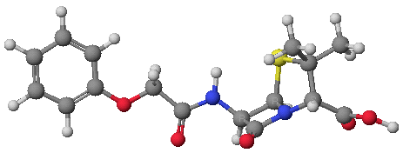
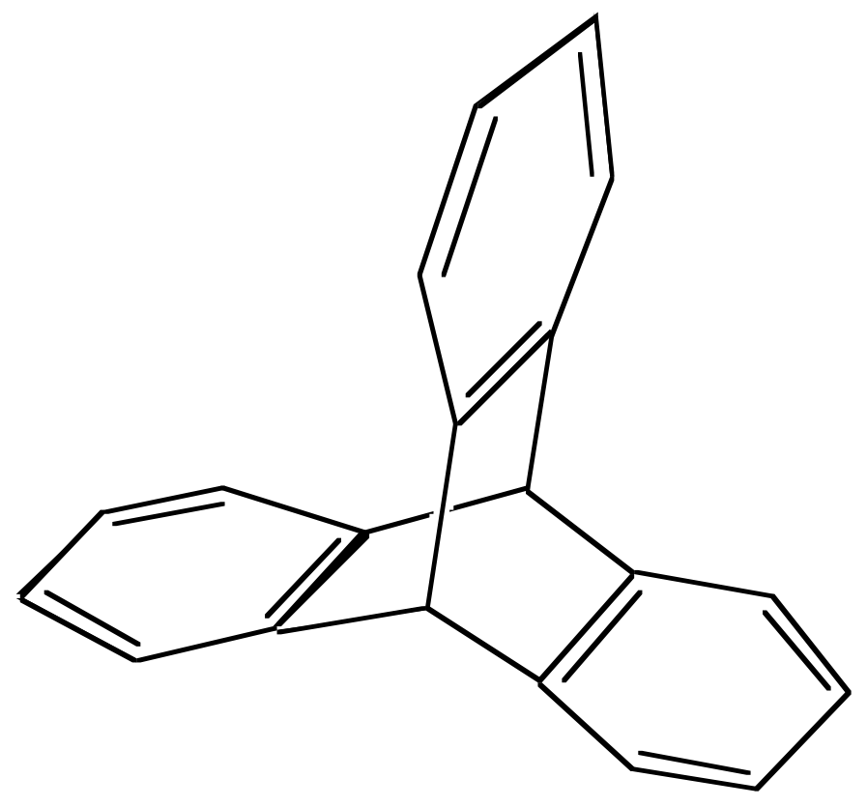
Organic Chemistry
Vast majority of over 20 million known compounds are based on Carbon: organic compounds.
Generally contain C, H + other elements
Great variety of compounds
MAR

Slide 3
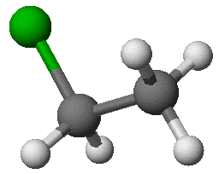
Two Major Concepts
NOMENCLATURE - Naming the molecules correctly and knowing the general classes of organic compounds
REACTIVITY - Studying patterns of reactivity within classes of compounds
We will focus primarily on nomenclature but also show examples of reactivity
MAR

Slide 4
Nomenclature
Need to know Alkyl Groups -
methyl = CH₃
ethyl = CH₃CH₂
propyl = CH₃CH₂CH₂
butyl = CH₃CH₂CH₂CH₂
Also pentyl, hexyl, heptyl, octyl, etc.
R is "generic" alkyl group
Alkyl groups may be combined with other elements or alkyl groups to give classes of compounds
MAR
See the Organic Chemistry Nomenclature Guide

Slide 5
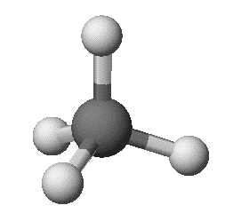
ALKANES
Generic Alkane Representation: R-H
Generic Alkane Formula: C_{n}H_{2n+2}
-yl +ane
Ex: methane = CH₄
(methyl group + H)
CH₃-H
MAR

Slide 6
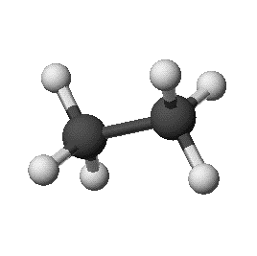
ALKANES
Generic Alkane Representation: R-H
Generic Alkane Formula: C_{n}H_{2n+2}
-yl +ane
Ex: ethane = CH₃CH₃
(ethyl group + H)
CH₃CH₂-H
MAR

Slide 7
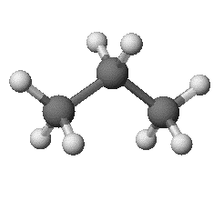
ALKANES
Generic Alkane Representation: R-H
Generic Alkane Formula: C_{n}H_{2n+2}
-yl +ane
Ex: propane = CH₃CH₂CH₃
(propyl group + H)
CH₃CH₂CH₂-H
MAR

Slide 8
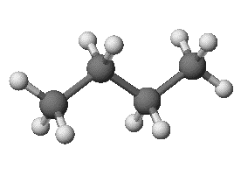
ALKANES
Generic Alkane Representation: R-H
Generic Alkane Formula: C_{n}H_{2n+2}
-yl +ane
Ex: butane = CH₃CH₂CH₂CH₃
(butyl group + H)
CH₃CH₂CH₂CH₂-H
Alkanes often called "saturated hydrocarbons" – all carbons "saturated" with H
MAR
Which of the following could be an alkane?
1. C2H4 2. C5H10 3. C14H30 4. C7H8 5. C2H6O
only 1
only 2
only 3
3 and 4
all five
Enter your response on
your i>Clicker now!
Answer = C,
only 3 (C14H30)
Only one structure follows
CnH2n+2 formula

Slide 9
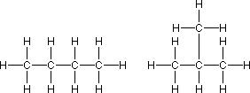
ALKANES - Isomers
But we can write butane in two ways:
These are isomers (same formula, structurally different). Name using "longest chain" alkane preceded by numbered alkyl groups
n-butane
2-methylpropane
MAR

Slide 10
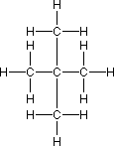
Isomers of Pentane
n-pentane
2-methylbutane
“3-methylbutane” would be incorrect - use smallest number possible
2,2-dimethylpropane
MAR

Slide 11
Isomers of Hexane
Number of isomers grows as number of carbons increases
MAR

Slide 12
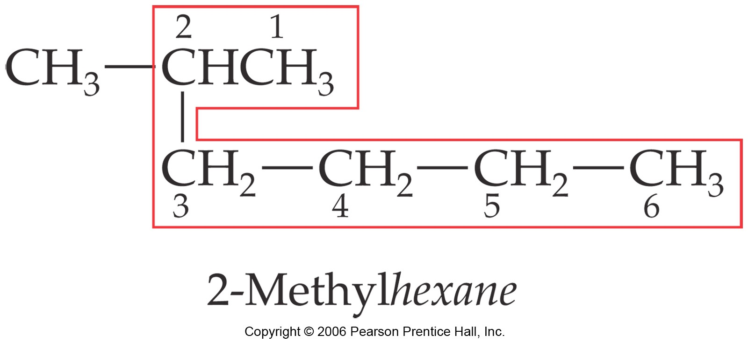
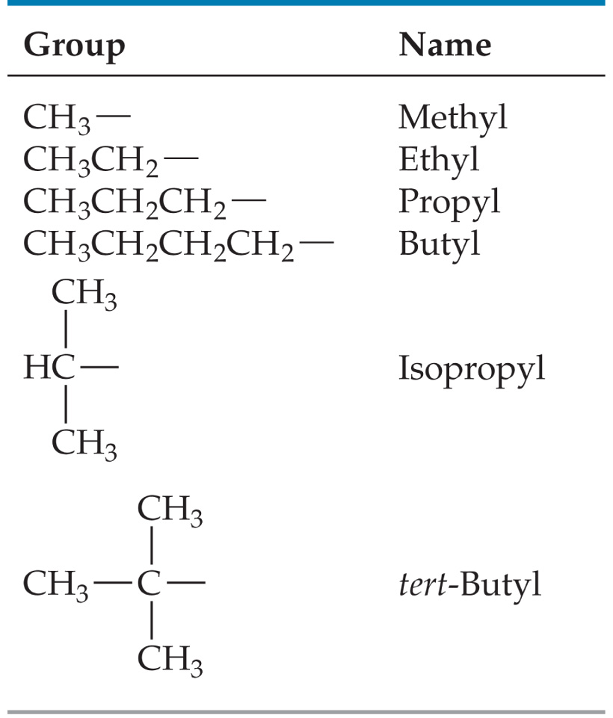
How to Name a Compound
Find the longest chain in the molecule.
Number the chain from the end nearest the first substituent encountered.
List the substituents as a prefix along with the number(s) of the carbon(s) to which they are attached.
MAR
"Longest chain, smallest number"

Slide 13
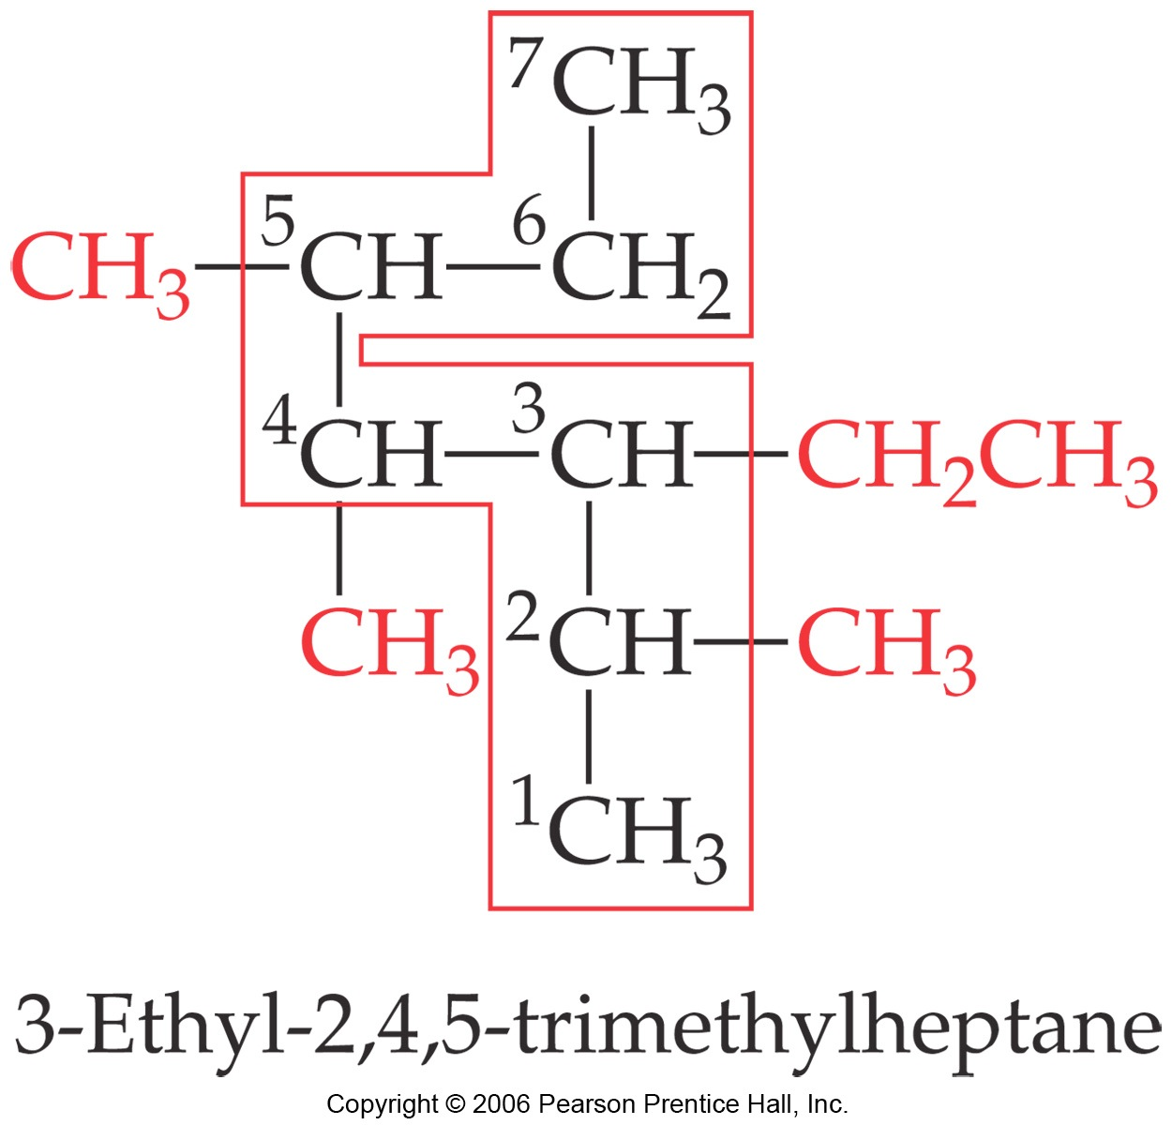
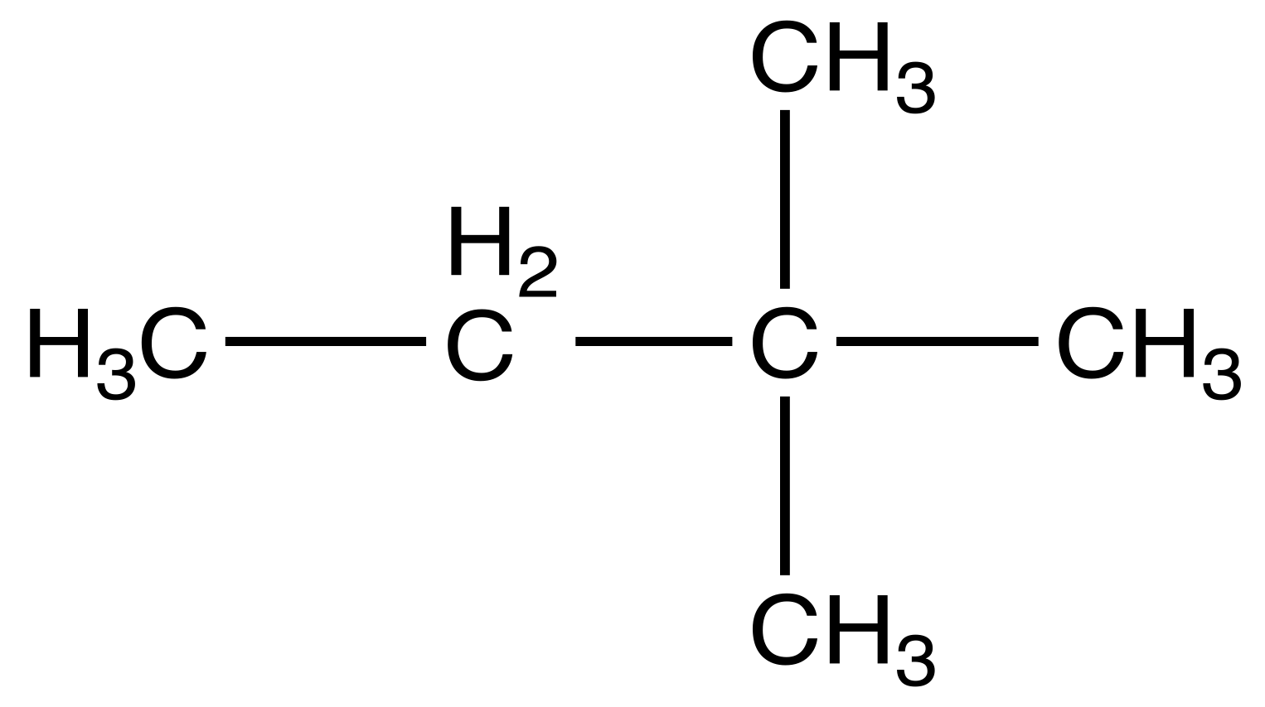
How to Name a Compound
If there is more than one type of substituent in the molecule, list them alphabetically.
MAR
"Longest chain, smallest number"
Name the following organic compound.
2,3-dimethylbutane
2,2-dimethylbutane
3,3-dimethylbutane
methylpentane
1,2,3-trimethylpropane
Enter your response on
your i>Clicker now!
Answer = B,
2,2-dimethylbutane
longest chain = 4 carbons, butane
2 methyl groups not part of chain, dimethyl
smallest numbers = 2,2 (both off second C)

Slide 14
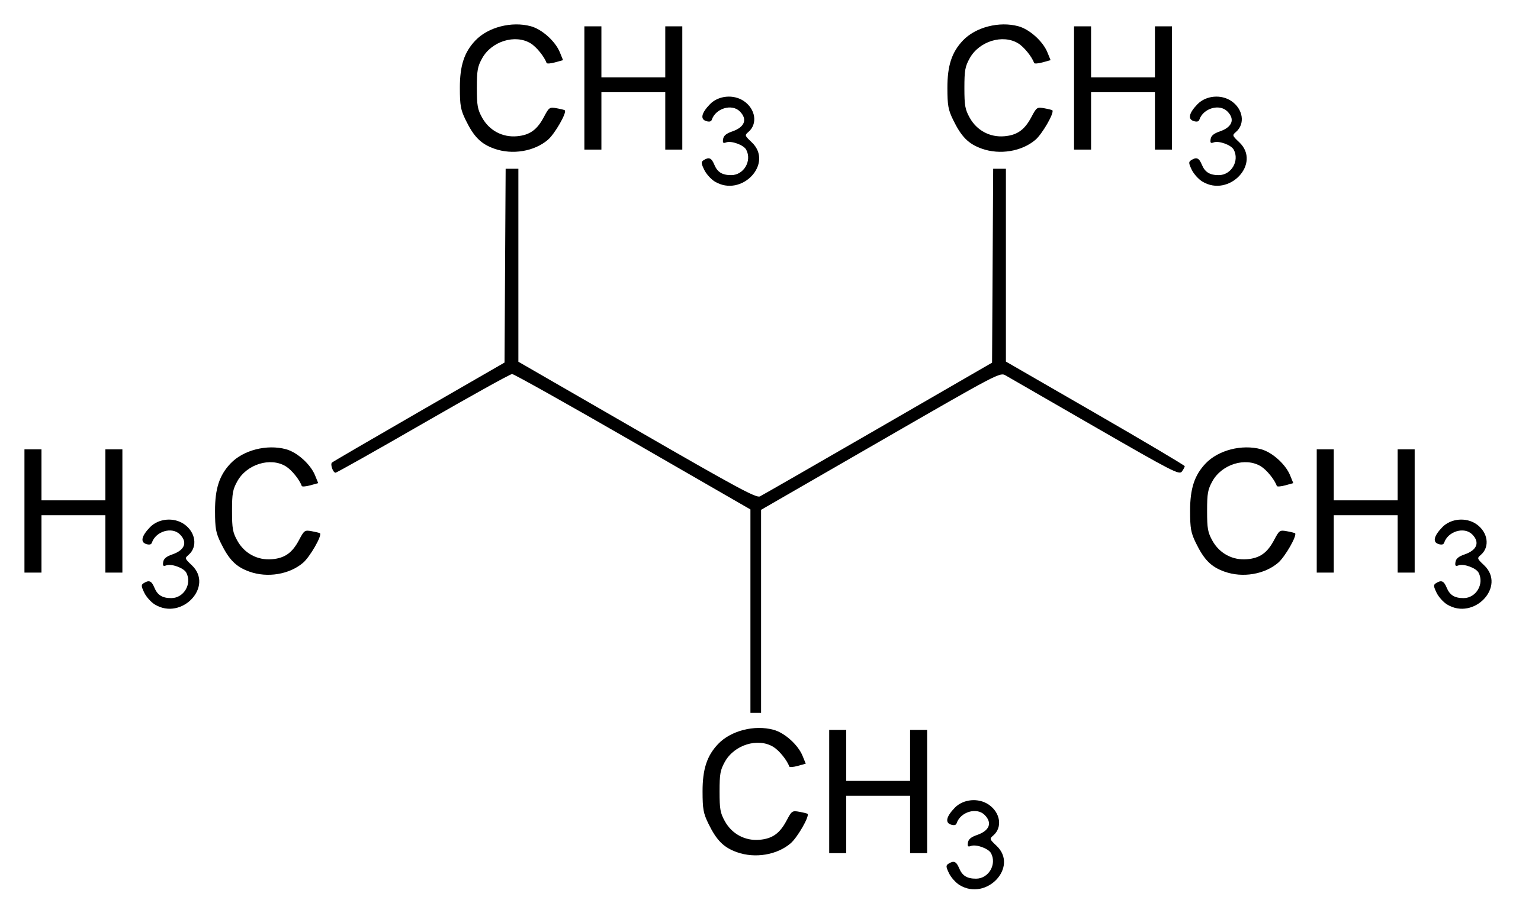
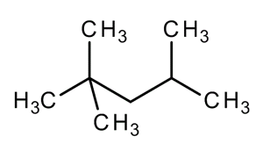
How to Create a Structure from a Name
Example: provide the structure for the following name: 2,2,4-trimethylpentane
C-C-C-C-C
Start at the end of the name to find the chain of carbons; write them "in a row" and number them
Groups not in the chain will be listed at the beginning of the name (methyl = CH3, etc.)
Fill in hydrogen atoms at the end if necessary
1
2
3
4
5
C
C
|
|
C-C-C-C-C
1
2
3
4
5
|
C
MAR
"Longest chain, smallest number"
Draw 2,3,4-trimethylpentane.
I drew it
I'm working on it
I'm thinking about it
Inorganic is better than organic!
What are we studying? :)
Enter your response on
your i>Clicker now!
Answer = A,
2,3,4-trimethylpentane.
longest chain = 5 carbons, trimethyl
numbers = 2,3,4

Slide 15
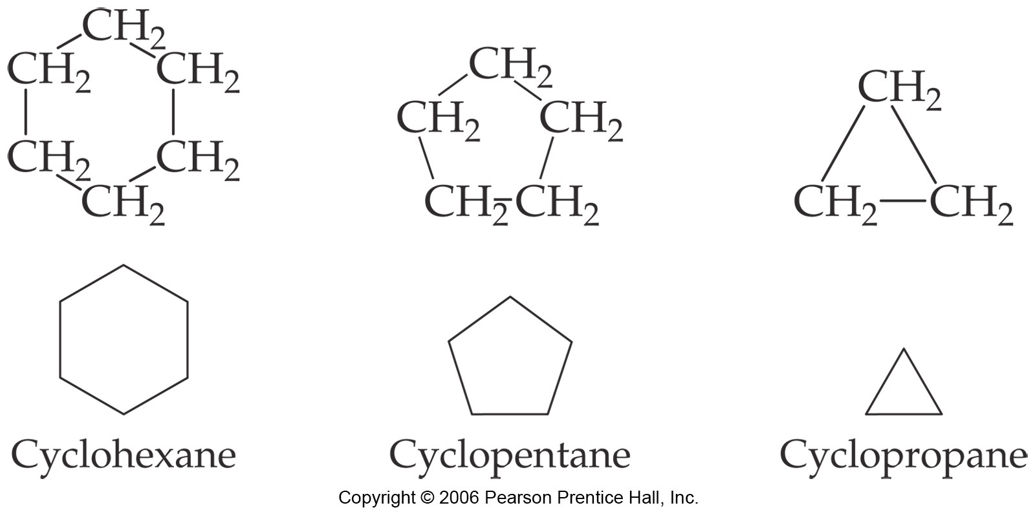
CYCLOALKANES (C_{n}H_{2n})
+cyclo -yl +ane
Ex: cyclohexane = C₆H₁₂
Generic Cycloalkane Formula: C_{n}H_{2n}
(cyclohexyl group + H)
Also cyclobutane, etc.
MAR
Which of the following could be a cycloalkane?
1. C2H4 2. C5H10 3. C14H30 4. C7H8 5. C2H6O
only 1
only 2
only 3
3 and 4
all five
Enter your response on
your i>Clicker now!
Answer = B, only 2 (C5H10)
Only structure which follows
CnH2n formula and has enough
C atoms to make a "loop"

Slide 16
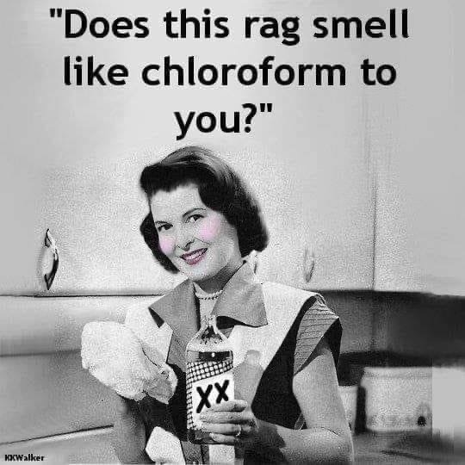
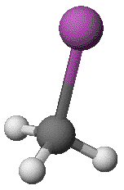
Alkyl Halides
Generic Alkyl Halide Representation: R-X
X = halogen (F, Cl, Br or I)
Ex: methyl iodide = CH₃-I
(methyl + iodide)
also known as iodomethane
Ex: 2-iodopropane = CH₃-CHI-CH₃
(2-propyl + iodide)
also known as 2-propyl iodide
Many other possibilities
MAR
Chloroform:
trichloromethane,
CHCl3

Slide 17
ALCOHOLS
Generic Alcohol Representation: R-OH
-yl +anol
Generic Alcohol Formula: C_{n}H_{2n+2}O
Ex: ethanol = CH₃CH₂OH
(ethyl group + OH)
CH₃CH₂-OH
MAR

Slide 18
ALCOHOLS
Generic Alcohol Representation: R-OH
-yl +anol
Generic Alcohol Formula: C_{n}H_{2n+2}O
Ex: 1-propanol = CH₃CH₂CH₂OH
(propyl group + OH)
CH₃CH₂CH₂-OH
new: propan-1-ol
MAR

Slide 19
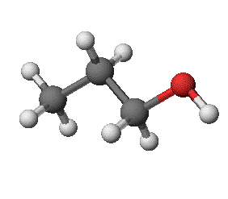
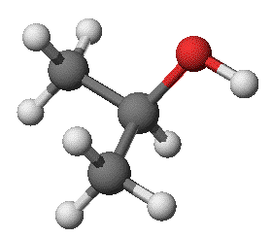
ALCOHOLS
Generic Alcohol Representation: R-OH
Note that both 1-propanol and 2-propanol exist
1-propanol
CH₃-CH₂-CH₂OH
propan-1-ol
2-propanol
CH₃-CH(OH)-CH₃
propan-2-ol
MAR

Slide 20
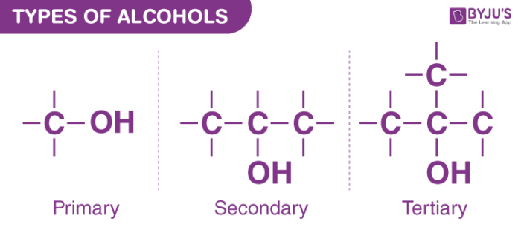
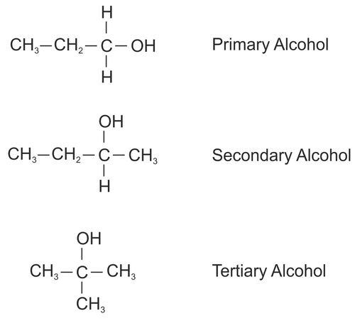
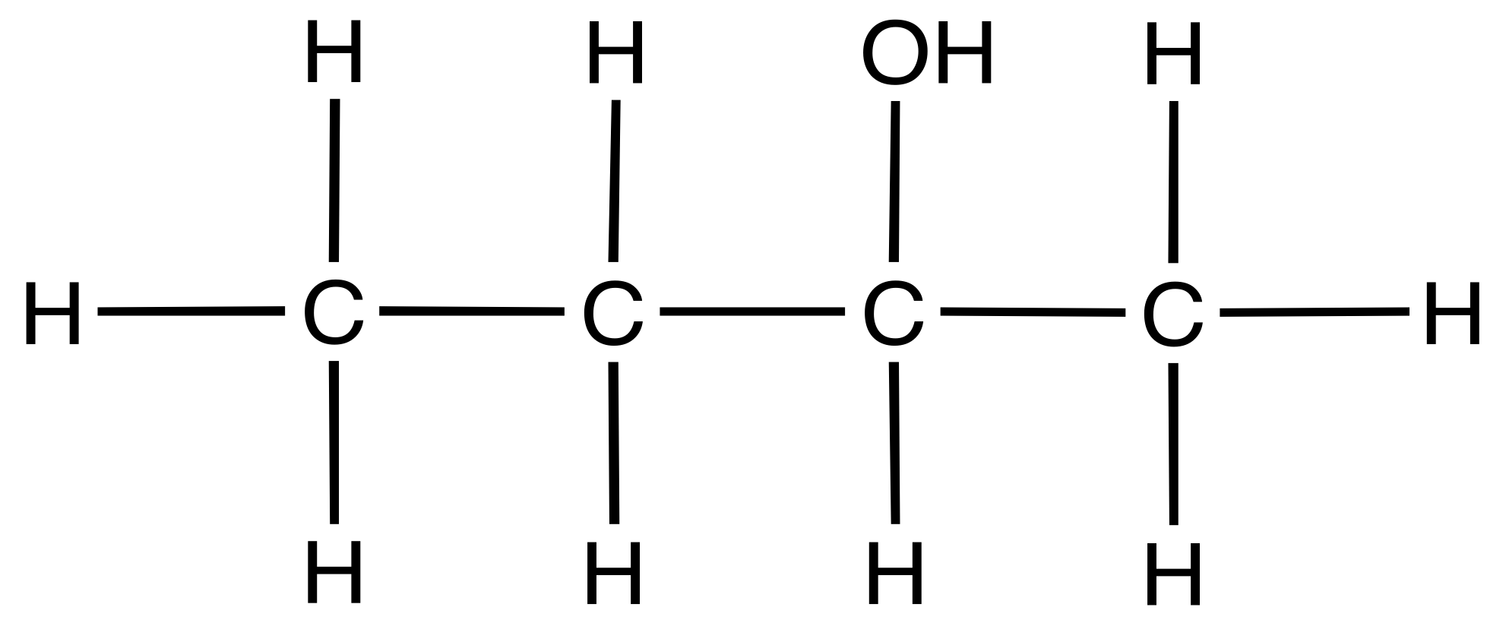
TYPES OF ALCOHOLS
propan-1-ol
butan-2-ol
2-methyl-propan-2-ol
ethanol
propan-2-ol
2-methyl-propan-2-ol
MAR
What is the name of the following molecule?
butanol
butan-1-ol
butan-2-ol
butan-3-ol
none of the above
Enter your response on
your i>Clicker now!
Answer = C,
butan-2-ol
This is a secondary
alcohol

Slide 21
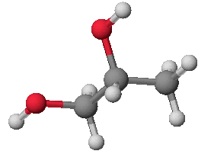
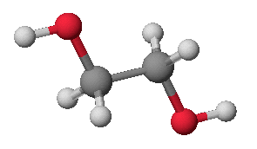
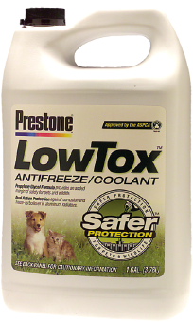
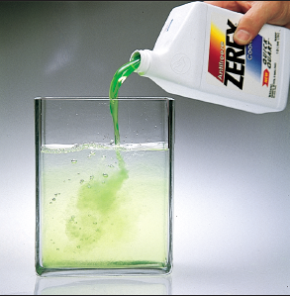
GLYCOLS Alcohols (diols) with Two OH Groups
Ethylene glycol (ethane-1,2-diol)
Propylene glycol (propane-1,2-diol)
MAR

Slide 22
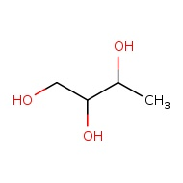
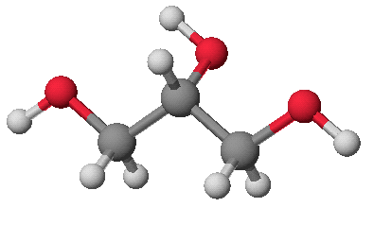
Glycerol (propane-1,2,3-triol) Alcohol with 3 OH Groups
butane-1,2-3-triol
MAR
octane-2,3-4-triol

Slide 23
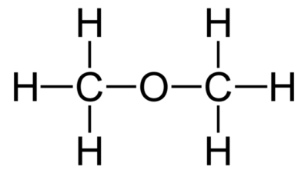
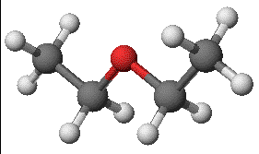
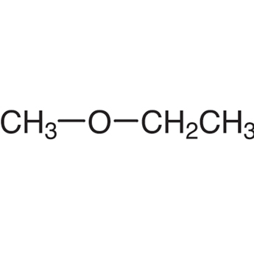
ETHERS - "old school"
Generic Ether Representation: R-O-R
Generic Ether Formula: C_{n}H_{2n+2}O
Ex: diethyl ether = CH₃CH₂-O-CH₂CH₃
(ethyl + O + ethyl)
dimethyl ether
ethyl methyl ether
Many other possibilities
MAR

Slide 24
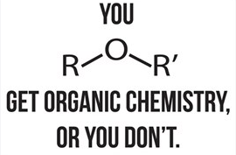
ETHERS - "IUPAC"
Two nomenclatures for ethers!
Ethers also use "IUPAC" Nomenclature
(shorter alkyl group -yl +oxy) (longer group -yl +ane)
Ex: 1-ethoxypropane = CH₃CH₂-O-CH₂CH₂CH₃
(ethyl -yl + oxy)(propyl -yl +ane)
old school: ethyl 1-propyl ether
Ex: 2-methoxypropane = CH₃CH(OCH₃)-CH₃
2-(methyl -yl + oxy)(propyl -yl +ane)
old school: methyl 2-propyl ether
methoxy ethane
MAR

Slide 25
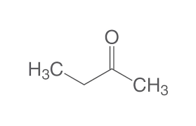
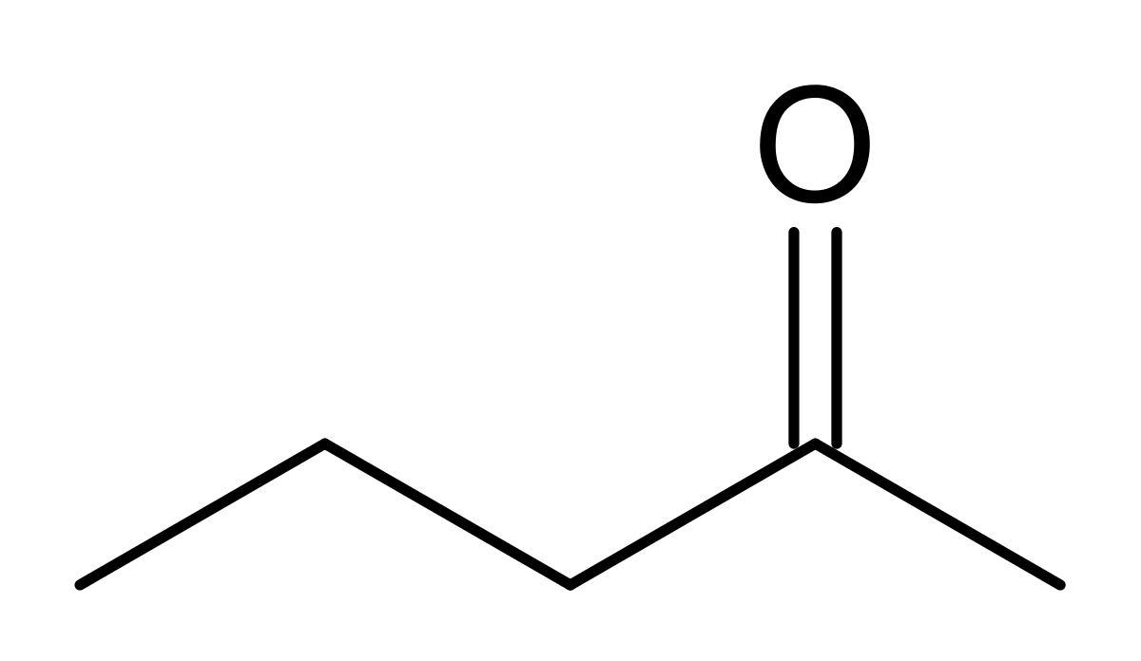
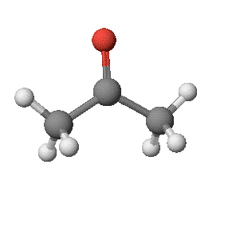
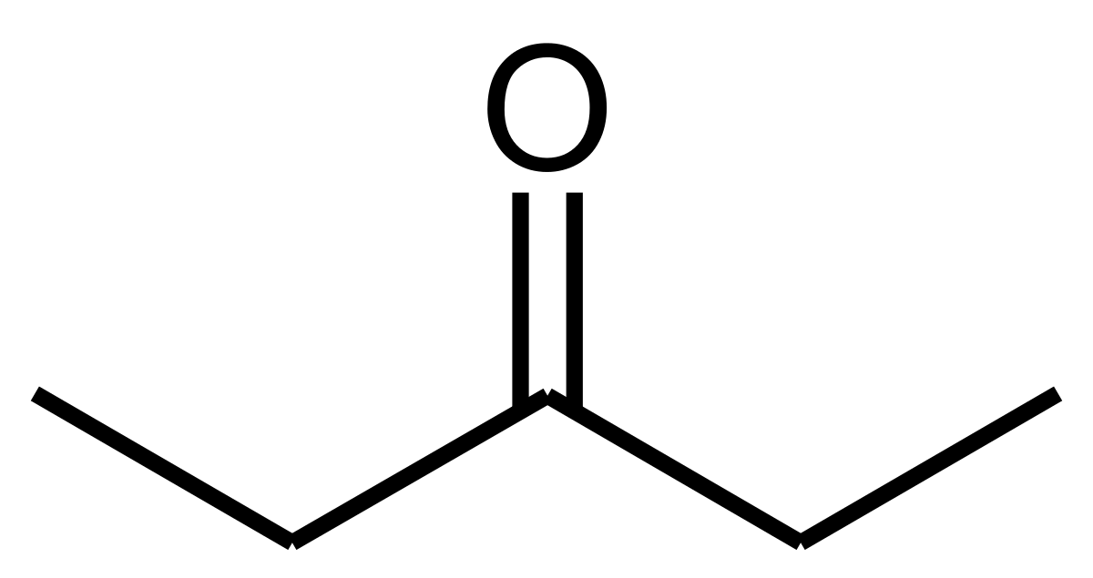
KETONES
Generic Ketone Representation: R-CO-R
R = alkyl group, CO = carbonyl (C=O)
Generic Ketone Formula: C_{n}H_{2n}O
Two carbons connected to carbonyl
Ex: propanone = CH₃-C(=O)-CH₃
(methyl + C=O + methyl)
3 carbon atoms like propane
butanone
2-pentanone
Propanone
is also known as
Acetone
MAR
3-pentanone

Slide 26
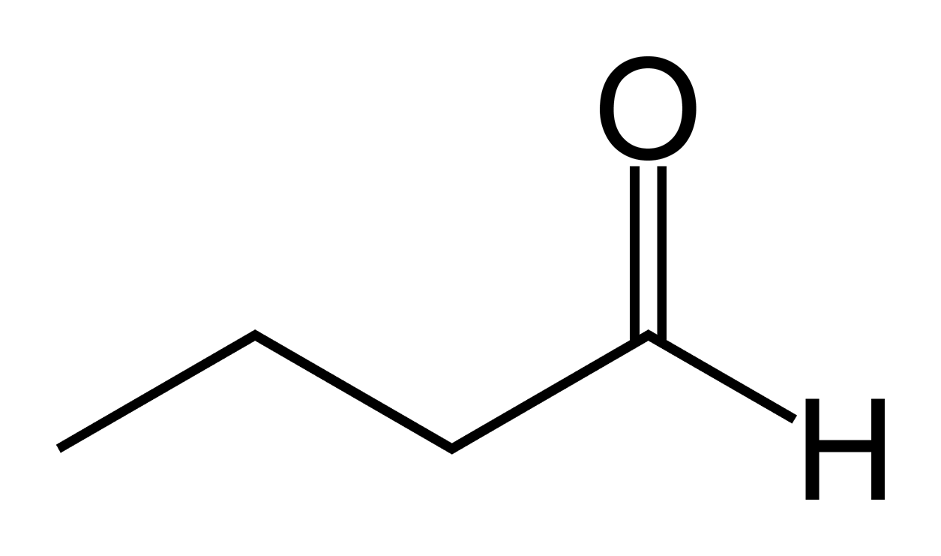
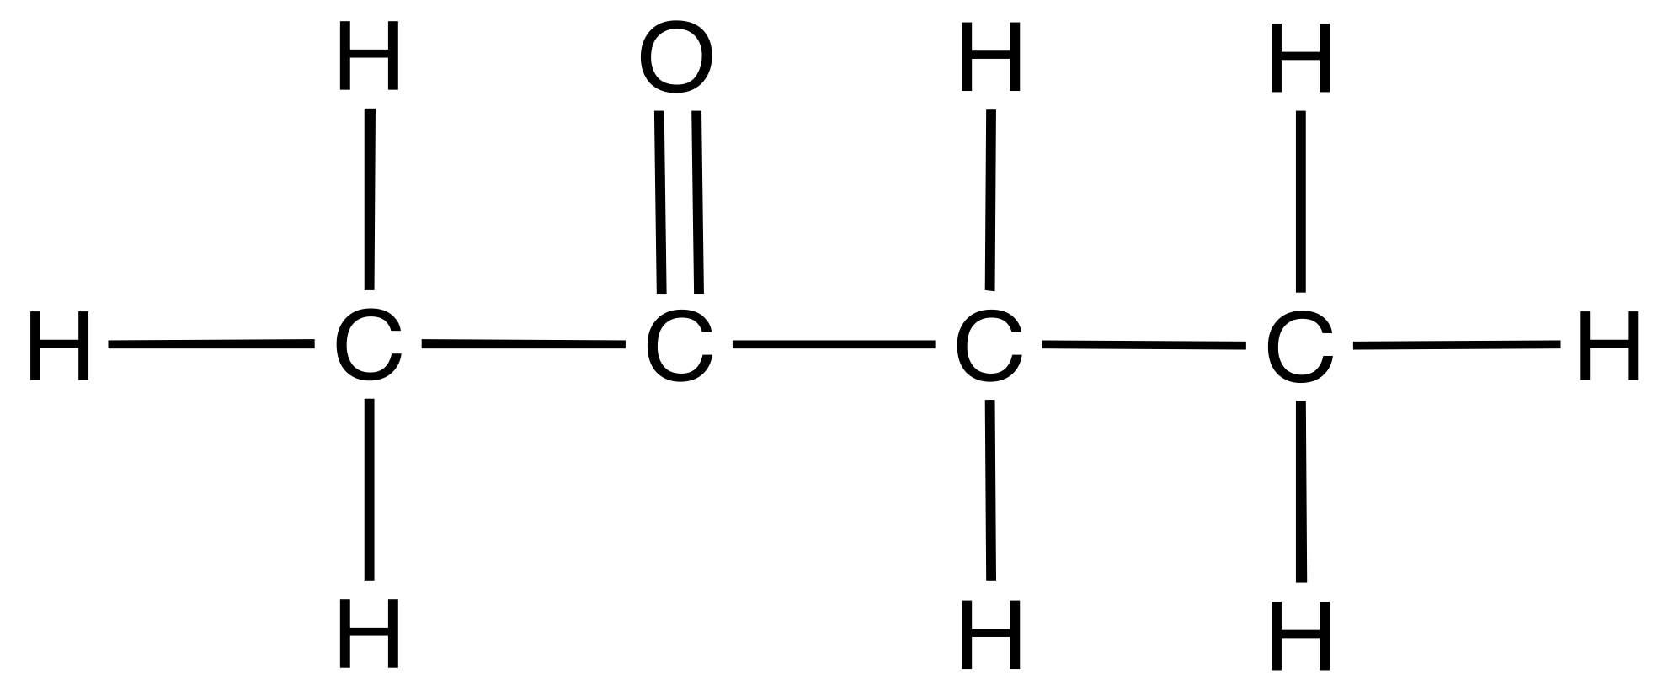
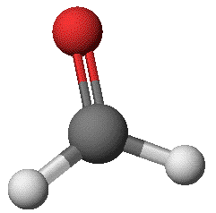
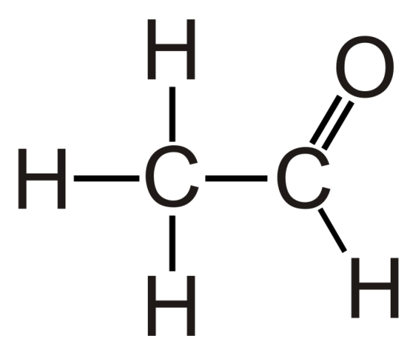
ALDEHYDES
Generic Aldehyde Representation: R-CO-H
R = alkyl group or H, CO = carbonyl (C=O)
Generic Aldehyde Formula: C_{n}H_{2n}O
At least one H connected to carbonyl
Ex: methanal = H₂-C=O
1 carbon atom like methane
butanal
Methanal
is also known as
Formaldehyde
ethanal
(acetaldehyde)
MAR
What is the name of the following molecule?
butanoic acid
butanal
butan-2-ol
1-butanol
butanone
Enter your response on
your i>Clicker now!
Answer = E, butanone
ketone (carbonyl in middle of C atoms)

Slide 27
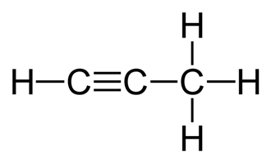
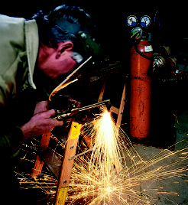
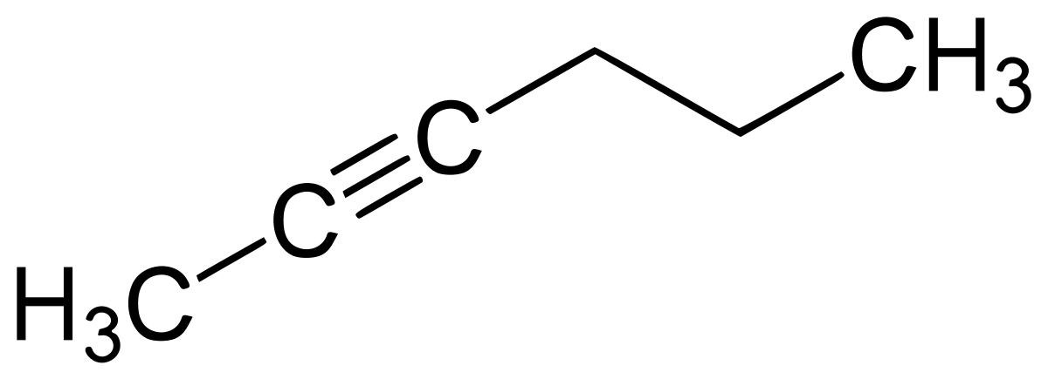
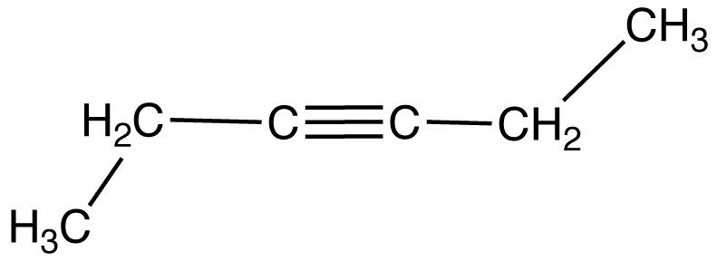
ALKYNES
Generic Alkyne Representation: R-C≡C-R
R = alkyl group or H
Generic Alkyne Formula: C_{n}H_{2n-2}
Ex: 2-pentyne = H₃C-C≡C-CH₂CH₃
5 carbon atoms like pentane
propyne
Ethyne
is also known as
Acetylene
2-hexyne
MAR
3-hexyne

Slide 28
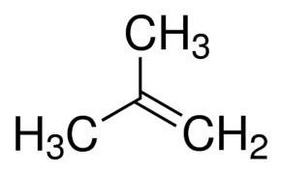
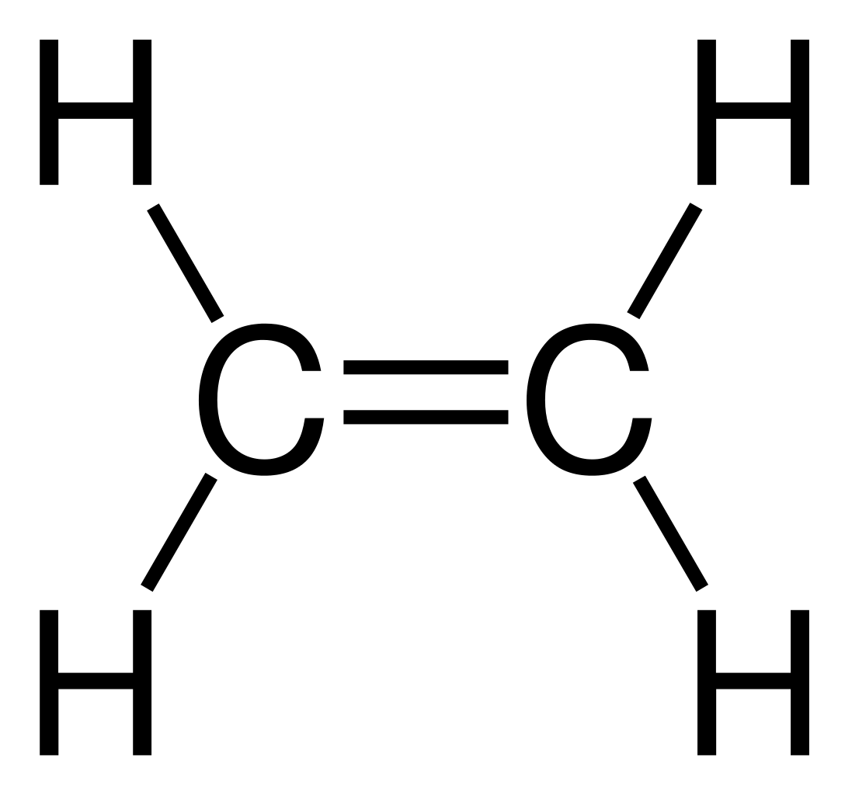
ALKENES
Generic Alkene Representation: R-HC=CH-R
R = alkyl group or H
Generic Alkene Formula: C_{n}H_{2n}
Ex: trans-pent-2-ene = H₃C-HC=CH-CH₂CH₃
5 carbon atoms like pentane
but-1-ene
2-methyl propene
ethene or
ethylene
MAR
Which of the following could be a alkene?
1. C2H4 2. C5H10 3. C14H30 4. C7H8 5. C2H6O
only 1
only 2
only 3
1 and 2
all five
Enter your response on
your i>Clicker now!
Answer = D, 1 and 2
Both structures follow
CnH2n formula

Slide 29
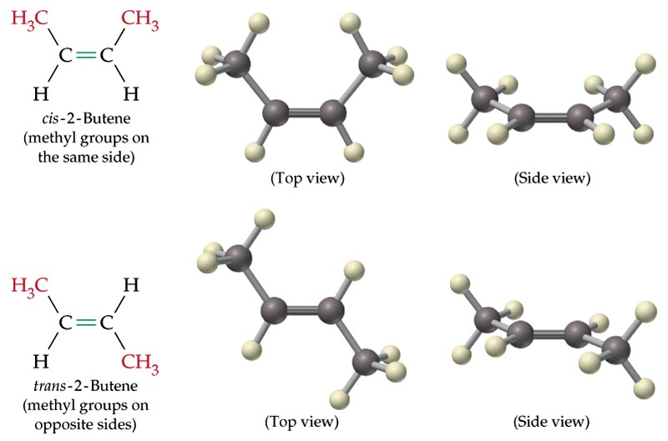
ALKENES - cis and trans
cis
(same side)
cis-but-2-ene
trans
(opposite)
trans-but-2-ene
Important!
Differing reactivity in cis and trans isomers
MAR

Slide 30
ALKENES - cis and trans
Cis - trans isomerism occurs because the electronic structure of the carbon–carbon double bond makes rotation energetically unfavorable.
MAR

Slide 31
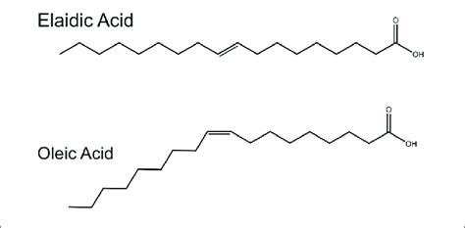
ALKENE ISOMERS - cis and trans fats
Oleic acid is a monosaturated fat with a cis double bond found naturally in olive oil, nuts, avocados, etc. Healthier!
Elaidic acid is a trans fat with a trans double bond which is difficult to digest and causes multiple health issues. Dangerous!
Both structures: C18H34O2
MAR

Slide 32
AROMATIC HYDROCARBONS
Aromatic compounds use conjugated double bonds for increased stability.
Flat, stable organic functional group
Simplest aromatic compound is Benzene, C₆H₆
MAR

Slide 33
AROMATIC HYDROCARBONS
Notice: aromatic compounds are flat rings with delocalized π electrons
σ bonds
σ and π bonds
π bonds
MAR

Slide 34
AROMATIC HYDROCARBONS
More on The Ring
MAR

Slide 35
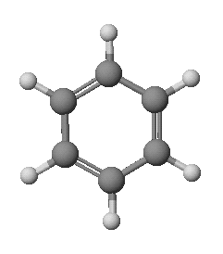
Resonance in Benzene
C–C single bond: 154 pm C=C bond: 134 pm
CC bonds in benzene: 139 pm
CC bond order is _______________
π electrons delocalized
MAR

Slide 36
AROMATICS - Examples
methylbenzene
Naphthalene
See Handout
MAR

Slide 37
AROMATICS - Examples
ortho position
meta position
para position
1,2-dichlorobenzene
or
o-dichlorobenzene
1,3-dichlorobenzene
or
m-dichlorobenzene
1,4-dichlorobenzene
or
p-dichlorobenzene
See Handout
MAR

Slide 38
CARBOXYLIC ACIDS
Generic Carboxylic Acid Representation:
R-COOH
Generic Carboxylic Acid Formula: C_{n}H_{2n}O₂
Ex: propanoic acid = CH₃CH₂-CO-OH
(propyl -2H + =O + OH)
methanoic acid or
formic acid
hexanoic acid
MAR
Many other possibilities!
2-methyl-butanoic acid

Slide 39
Carboxylic Acids
Benzoic acid
Acetic acid
Acids are found in many natural substances: bread, fruits, milk, wine
Carboxylic acid group with acidic H⁺
All are WEAK acids
MAR
Vinegar is essentially acetic acid!

Slide 40
Carboxylic Acids
Formic acid, HCO₂H, gives the sting to ants.
Aspirin, acetylsalicylic acid
MAR
What is the name of the following molecule?
butanoic acid
pentanal
pentanoic acid
1-pentanone
1-pentanol
Enter your response on
your i>Clicker now!
Answer = C, pentanoic acid

Slide 41
AMINES
Generic Amine Representation: R_{(3-x)}-NH_{x}
Ex: ethylamine = CH₃CH₂-NH₂
(ethyl + NH₂)
Also diethylamine and triethylamine
MAR
Provide a name: (CH3)2NH
dimethylnitro
dinitrane
dimethylamine
methylated nitrane
Drano
Enter your response on
your i>Clicker now!
Answer = C,
dimethylamine

Slide 42
AMINES
Methylamine
Dimethylamine
Trimethylamine
Amines generally have terrible odors!
Cadaverine
Pyridine
MAR

Slide 43
ESTERS
Generic Ester Representation: R₁-COO-R₂
Generic Ester Formula: C_{n}H_{2n}O₂
Ex: ethyl propanate = CH₃CH₂-COO-CH₂CH₃
(propyl -2H + =O + O + ethyl)
Similar to carboxylic acids
Name R₂ first, then R₁
MAR

Slide 44
AMIDES
Generic Amide Representation:
R_{x}-CO-NH_{y}R_{(2-y)}
Ex: N-methylpropanamide
CH₃NH-CO-CH₂CH₃
N-groups off of nitrogen atom
MAR

Slide 45
Nomenclature and Models
MAR

Slide 46
REACTIVITY
Huge Topic, too vast for CH 222
We will look at a few general
patterns of reactivity;
many more exist!
Important to know how each chemical reacts!
MAR
Notes:
From "Police Squad!: The Complete Series", episode 4, "Revenge and Remorse (The Guilty Alibi)".
Background picture from G. Russell, University of Oregon, March 2024 Organic Chemistry class :)

Slide 47
Reactions of Alkenes: ADDITION REACTIONS
Alkenes are unsaturated — more bonds can form to the C atoms
Molecules such as Br₂, H₂, HCl, HBr, and H₂O add to the double bond
MAR

Slide 48
REACTIVITY
C₂H₄ + Br₂ →
CH₂Br-CH₂Br
Example #1: Addition Reactions
Diatomics adding across double bond
MAR

Slide 49
REACTIVITY
Example #2: Addition Reactions Diatomics adding across double bond
H₂C=CH-CH₃ + H₂ →
CH₃-CH₂-CH₃
Fats can be “hydrogenated” with H₂.
Many foods have hydrogenated fats
MAR

Slide 50
REACTIVITY
Example #3: Substitution Reactions
Functional groups switch places
MAR
-OH +NO₃

Slide 51
REACTIVITY
Example #4: Elimination Reactions
sp or sp² bond formation
CH₃CH₂-CH₂OH + H⁺ →
CH₃-CH=CH₂ + H₂O + H⁺
MAR

Slide 52
Polymers
Giant molecules made by joining many small molecules called monomers
Average production is 150 kg per person annually in the U.S. (!)
MAR

Slide 53
Polymers
A Polymer literally means "many parts"
Many mer (or monomer) units combined to make a polymer
Polymers have high molar masses (10⁷ g mol⁻¹ or more!) and are used for plastic, fabric, Teflon, much more
Synthesized by addition and condensation reactions
MAR
polyethylene

Slide 54
REACTIVITY
Example #5: Addition Polymerization Reactions
Polymers built from sp² carbons (pi bonds)
A polymer with a molar mass of 1e⁶ has about 360,000 units.
MAR

Slide 55
Polyethylene Synthesis
Chain initiator: benzoyl peroxide
.
Initiation Step: Reaction of benzoyl radical
MAR

Slide 56
Polyethylene Synthesis
Chain Propagation: Addition of further ethylene
Chain Termination: Reaction of two radicals
MAR

Slide 57
Types of Polyethylene
Linear, high density PE (HDPE)
Branched, low density PE, LDPE
Cross-linked PE, CLPE
MAR

Slide 58
Polystyrene
Polystyrene (PS) is a nonpolar material and dissolves in organic solvents.
PS foam is mostly air, and when it dissolves it collapses to a much smaller volume.
MAR

Slide 59
REACTIVITY
Example #6: Condensation Polymerization Reactions
Condensation reactions combine different functional groups to make polymers with different properties
Very powerful reaction mechanism; used in contact lenses, nylon, much more
MAR

Slide 60
REACTIVITY
Example #6: Condensation Polymerization Reactions
Polyester
MAR

Slide 61
Condensation
Polymerization
Reactions
Formation of polyester
Formation of Kevlar
MAR

Slide 62
Polyesters (PET)
Jackets made from recycled PET soda bottles
Soda bottles, mylar film.
MAR

Slide 63
REACTIVITY
Example #6: Condensation Polymerization Reactions
Nylon-6,6
MAR

Slide 64
Polyamides: Nylon
Each monomer has 6 C atoms in its chain.
A polyamide link forms on elimination of HCl
Result = nylon-6,6
MAR

Slide 65
USES FOR POLYMERS
Examples of Polymers:
Teflon - polytetrafluoroethylene
Fabric - polyester, polyacrylonitrile
Milk & soda bottles - (High Density) Polyethylene
Styrofoam - polystyrene
plastic wrap (Saran) - poly(vinylidene chloride)
contact lenses - poly(methyl methacrylate)
Other uses:
MAR

Slide 66
Bubble Gum! A copolymer
Styrene + butadiene
MAR

Slide 67
Slime!
Slime is polyvinylalcohol cross-linked with boric acid
MAR

Slide 68
Polymer Recycling Symbols
PETE = Polyethylene terephthalate, 1.35-1.38
HDPE = High density PE, 0.941-0.965 g/cm³
V = PVC (polyvinyl chloride), 1.30-1.58
LDPE = Low density PE, 0.910-0.925 g/cm³
PP = Polypropylene, 0.90-0.92 g/cm³
PS = Polystyrene, 1.03-1.06 g/cm³
Other = Other plastics (varies)
MAR
Notes:
See: http://www.earthodyssey.com/symbols.html

Slide 69
End of Chapter 20
See:
Chapter Twenty Study Guide
Chapter Twenty Concept Guide
Important Equations (following this slide)
End of Chapter Problems (following this slide)
MAR

Slide 70
Important Equations, Constants, and Handouts
from this Chapter:
be able to name organic compounds using the functional group along with the “longest chain, shortest number” concept
recognize some common organic chemistry reactions
see the Organic Chemistry Nomenclature Guide (handout)
Organic Chemistry: alkyl group, alkane, cycloalkane, alkyl halide, alcohol, ether, ketones, aldehydes, alkynes, alkenes, aromatic compounds, carboxylic acids, amines, isomers

Slide 71
End of Chapter Problems: Test Yourself
Be sure to view practice problem set #3 and self quizzes for
organic chemistry nomenclature examples and practice
Name a straight chain alkane with six carbon atoms.
Name this compound: CH3CH2CH2OH Provide two isomers of this compound and name them.
Draw structural formulas for all four compounds with the formula C4H10Br. Give the systematic name of each.
Provide IUPAC numbered names for the following three compounds: m-dibromobenzene, o-dibromobenzene, p-dibromobenzene
Which of the following would exhibit cis, trans isomerization? 1-pentene, propene, 2-butene

Slide 72
End of Chapter Problems: Answers
n-hexane
1-propanol. 2-propanol and 1-methoxy propane would be isomers.
1-bromobutane, 2-bromobutane, 2-bromo-2-methylpropane, 1-bromo-2-methylpropane
m-dibromobenzene = 1,3-dibromobenzene, o-dibromobenzene = 1,2-dibromobenzene, p-dibromobenzene = 1,4-dibromobenzene
only 2-butene would exhibit cis, trans isomerization.
Be sure to view practice problem set #3 and self quizzes for
organic chemistry nomenclature examples and practice

