Slide 1
Chemical Kinetics: The Rates of Chemical Reactions Chapter 12
Chemistry 222
Professor Michael Russell
An automotive catalytic muffler.
Last update:
4/29/24
MAR

Slide 2
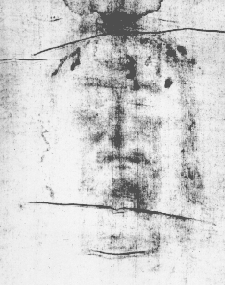
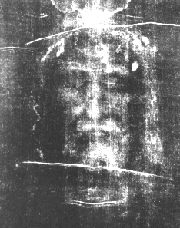
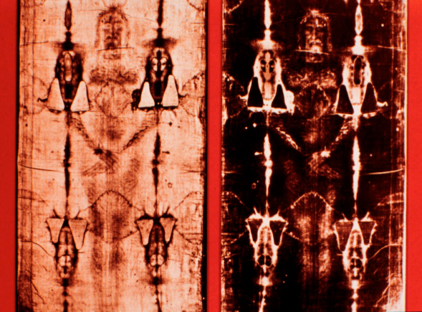
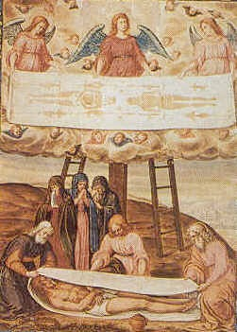
Shroud of Turin
Shroud of Jesus?!?
Fake or Real?
Explored with Kinetics
MAR
Notes:
Late 1890s Italian photographer developed photos of shroud (black and white image upper middle), "reversed" image (upper right) shows head of Jesus? C14 analysis in 1980s showed shroud only about 700 years old (a prank of local knights?), but 2005 arguments suggest that C14 cloth sample was only a "patch" on the shroud, and the "real" shroud is between 1300 and 3000 years old through "preliminary" half life analysis of the pigments. Controversy continues!

Slide 3
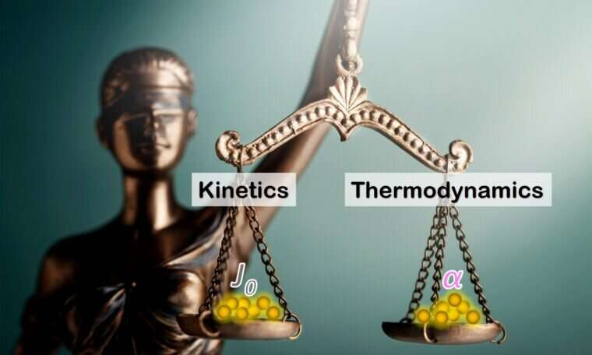
Chemical Kinetics
We can use thermodynamics to tell if a reaction is product or reactant favored.
But this gives us no info on HOW FAST reaction goes from reactants to products.
KINETICS - the study of REACTION RATES and their relation to the way the reaction proceeds, i.e., its MECHANISM.
MAR

Slide 4
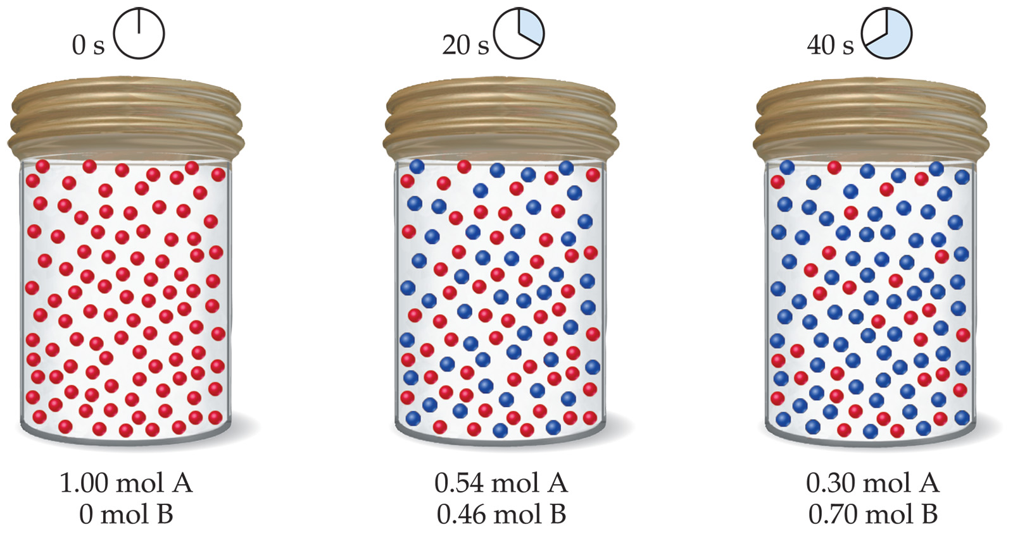
Reaction Rates
Reaction rate is the change in concentration of a reactant or product with time
Ex: for A → B
MAR

Slide 5
Reaction Rates
Reaction rate is the change in concentration of a reactant or product with time
Reactants disappear with time (hence, negative sign), and products appear with time (hence, positive sign)
Ex: for N₂O_{4(g)} → 2 NO_{2(g)}
MAR
Rates in chemistry are usually "amount per unit time", i.e. M/s, etc.

Slide 6
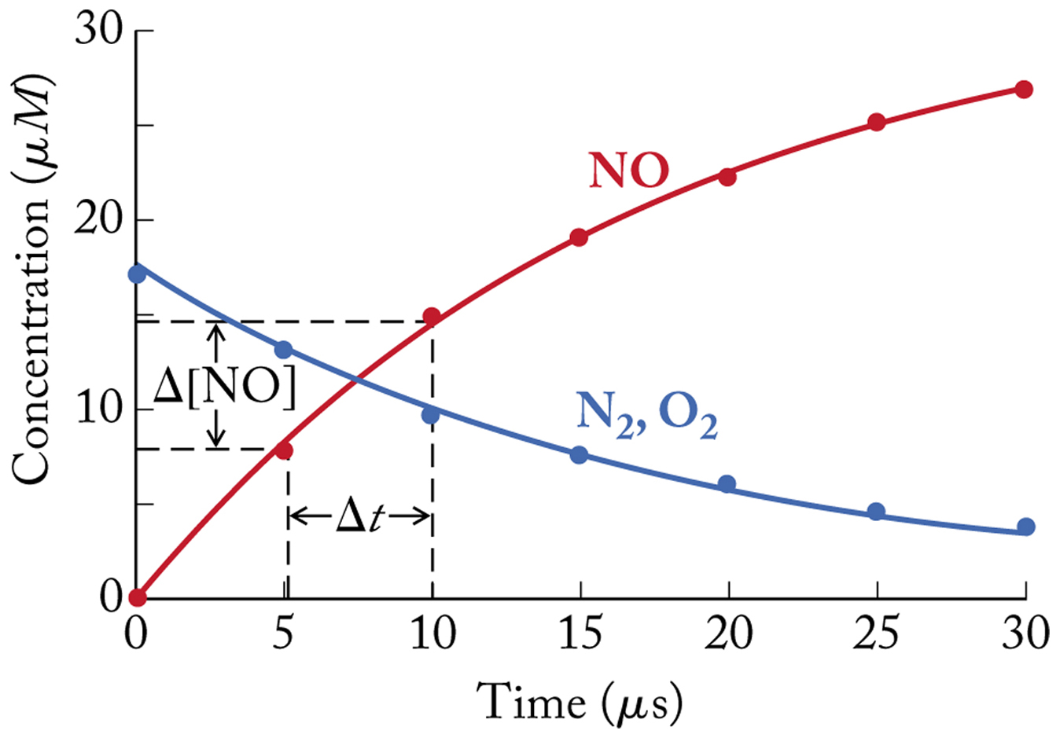
Reaction Rates
Ex: N_{2(g)} + O_{2(g)} → 2 NO_{(g)}
Reaction Rate =
MAR

Slide 7
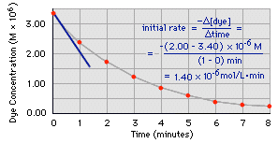
Determining a Reaction Rate
Blue dye is oxidized with bleach.
Its concentration decreases with time.
The rate - the change in dye conc with time - can be determined from a plot of [Dye] vs. time
MAR

Slide 8
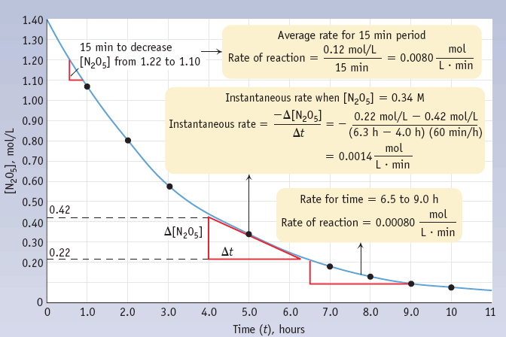
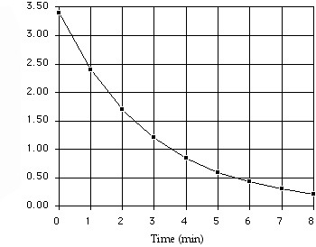
Average, Instantaneous, Reaction Rates
MAR
We will use “average rate” in CH 222
What is the average rate of this reaction over the first 2 minutes?
-1.7 mol/L.min
-2.4 mol/L.min
+0.85 mol/L.min
-0.35 mol/L.min
+2.4 mol/L.min
Enter your response on
your i>Clicker now!
Answer = C,
+0.85 mol/L.min
= -(1.70 - 3.40) M / (2 - 0) min
reactant, so put negative sign
in front of calculation

Slide 9
Factors Affecting Rates
Concentration
Greater concentration of reactants means more collisions and faster rates
Temperature
Higher temperatures means particles collide with greater kinetic energy, increasing the rates
Surface Area
Increased surface area means greater chances for collisions and faster rates
Catalysts
Catalysts speed up reactions without being used up. They lower the activation energy and increase the rates
MAR

Slide 10
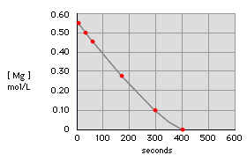
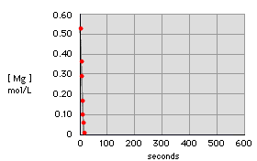
Factors Affecting Rates
Concentrations
Rate with 0.3 M HCl
Rate with 6.0 M HCl
Mg(s) + 2 HCl(aq) —>
MgCl₂(aq) + H₂(g)
MAR

Slide 11
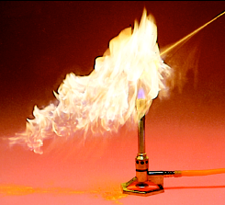
Factors Affecting Rates
Surface area of reactants
Lycopodium powder is a yellow-tan dust-like powder consisting of the dry spores of clubmoss plants or ferns
MAR

Slide 12
Factors Affecting Rates
Catalysts: catalyzed decomposition of H₂O₂ with MnO2
2 H₂O₂(l) —> 2 H₂O(l) + O₂(g)
MAR

Slide 13
Factors Affecting Rates
Temperature
MAR

Slide 14
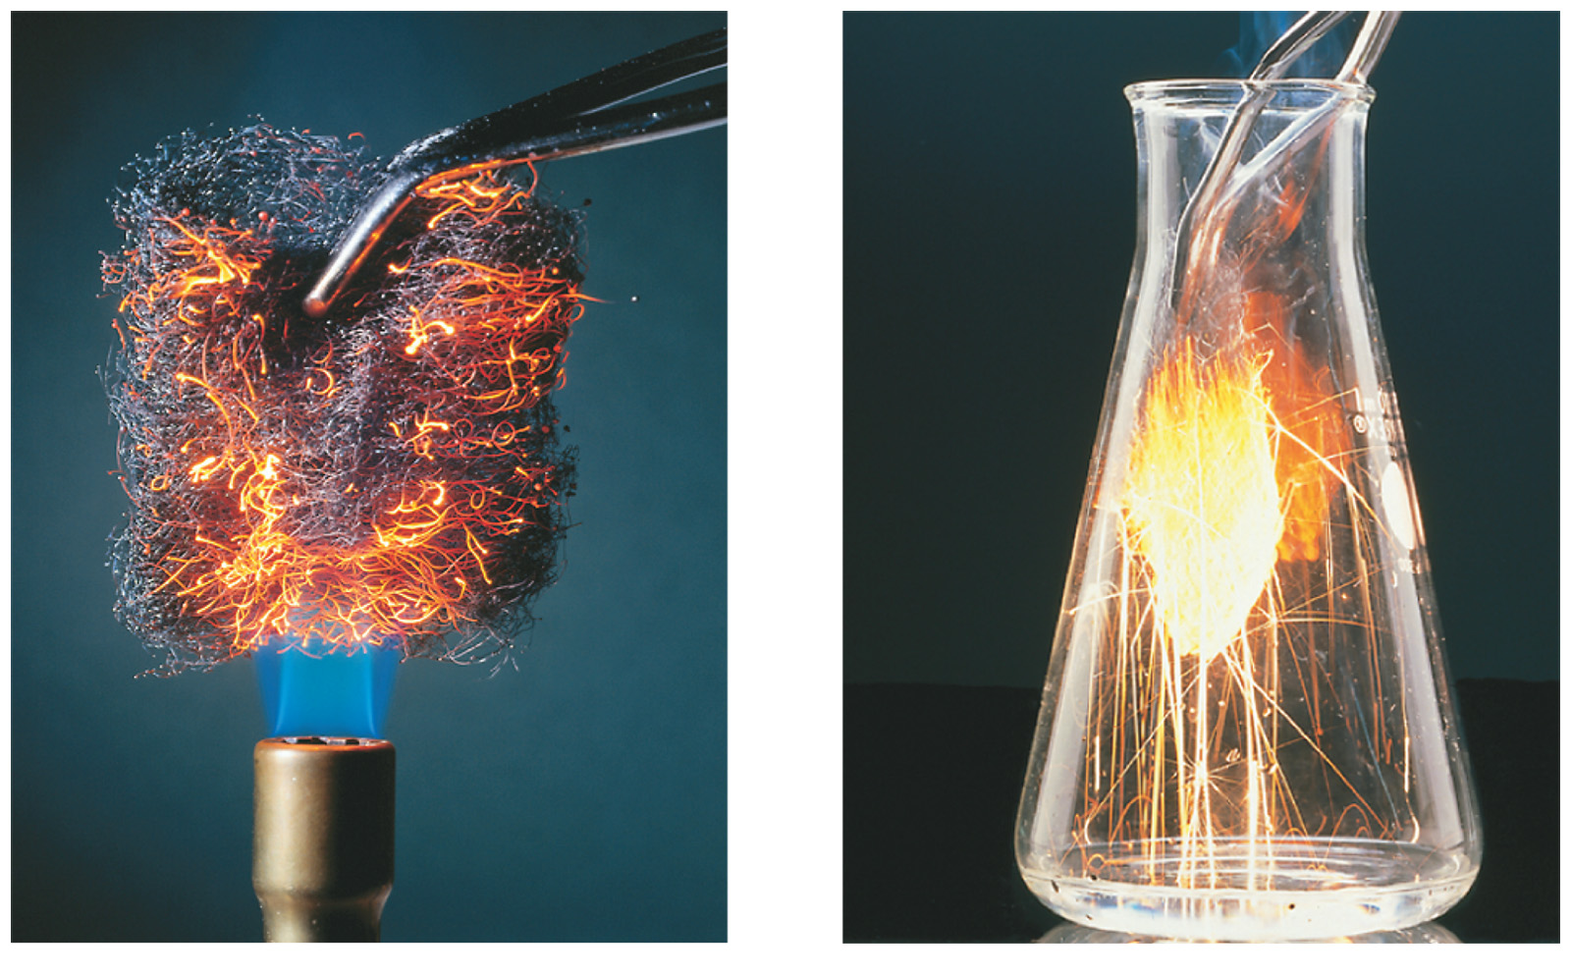
Concentrations and Rates
To postulate a reaction mechanism, we study its
reaction rate and
concentration dependence
MAR

Slide 15
Concentrations and Rates
Take reaction where Cl⁻ in cisplatin [Pt(NH₃)₂Cl₂] is replaced by H₂O
MAR

Slide 16
Concentrations and Rates
If calculated rate = 4.3 x 10⁻⁶ M s⁻¹ and [cisplatin] = 0.00250 M, then approximate time for cisplatin to react:
rate = [cisplatin] / time, and
time = [cisplatin] / rate
time = 0.00250 M / 4.3 x 10⁻⁶ M s⁻¹
time = 580 s
MAR

Slide 17
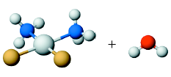
Concentrations and Rates
Rate of reaction is proportional to [Pt(NH₃)₂Cl₂]
We express this as a RATE LAW
Rate of reaction = k [Pt(NH₃)₂Cl₂]
where k = rate constant
k is independent of conc. but increases with T
MAR

Slide 18
Concentrations, Rates, and Rate Laws
In general, for
a A + b B ---> x X with a catalyst C
Rate = k [A]^{m}[B]^{n}[C]^{p}
The exponents m, n, and p
• are the reaction order
• can be 0, 1, or 2 (in CH 222 - CH 223!)
• must be determined by experiment!
• overall order = m + n + p
MAR

Slide 19
Interpreting Rate Laws
Example: Rate = k [A]^{m}
If m = 1, rxn. is 1st order in A
Rate = k [A]¹
If [A] doubles, then rate goes up by factor of ?
If m = 2, rxn. is 2nd order in A.
Rate = k [A]²
Doubling [A] increases rate by ?
If m = 0, rxn. is zero order.
Rate = k [A]⁰
If [A] doubles, rate ?
MAR

Slide 20
Deriving Rate Laws
Example: Derive rate law and k for
CH₃CHO(g) ---> CH₄(g) + CO(g)
from experimental data for rate of disappearance of CH₃CHO
Expt. [CH₃CHO] Disappear of CH₃CHO (mol/L) (mol/L•sec)
1 0.10 0.020
2 0.20 0.081
3 0.30 0.182
4 0.40 0.318
The rate law: rate = k[CH3CHO]^{x}
MAR

Slide 21
Deriving Rate Laws
Expt. [CH₃CHO] (mol/L) Rate of CH₃CHO (mol/L•sec)
1 0.10 0.020
2 0.20 0.081
3 0.30 0.182
4 0.40 0.318
Let’s find the order (x) with respect to CH3CHO
Use two trials where [CH3CHO] changes - any change in rate is caused by CH3CHO
Apply the rate law to these two trials:
4.1 = 2.0^{x}
2 = x
So the order of reaction for CH3CHO is “2”. We say the reaction is second order with respect to CH3CHO
{
Could also:
log 4.1 = log 2.0^{x} = x log 2.0
x = (log 4.1)/(log 2.0)
x = 2
MAR
2 NO + 2 H₂ → N₂ + 2 H₂O
The reaction above is second order in NO and third order overall. The rate law for the reaction is:
Rate = k [NO][H₂]
Rate = k [NO][H₂]²
Rate = k [NO]²[H₂]
Rate = k [NO]²[H₂]²
Enter your response on
your i>Clicker now!
Answer = C,
Rate = k [NO]²[H2]

Slide 22
Deriving Rate Laws
Rate of rxn = k [CH₃CHO]²
Here the rate goes up by ______ when initial conc. doubles. Therefore, we say this reaction is _________________ order.
Now determine the value of k. Use expt. #3 data on earlier slide,
0.182 mol/L•s = k (0.30 mol/L)²
k = 2.0 (L / mol•s)
Using k you can calc. rate at other values of [CH₃CHO] at same T.
MAR

Slide 23
Concentration/Time Relations
Chemists need to know what the concentration of reactant is as function of time.
Most reactions are first order (radioactive, biological, etc.)
Let's consider FIRST ORDER REACTIONS
For 1st order reactions (1), the rate law is:
- (∆ [R] / ∆ time) = k [R]¹
Integration (calculus):
MAR

Slide 24
Concentration/Time Relations
Integrating - (∆ [R] / ∆ time) = k [R] we get:
[
R
]t
=
-
k
t
l
n
[
R
]
0
natural
logarithm
[R] at time = 0
[R]_{t} / [R]₀ = fraction remaining after
time t has elapsed.
This is the integrated first-order rate law.
MAR

Slide 25
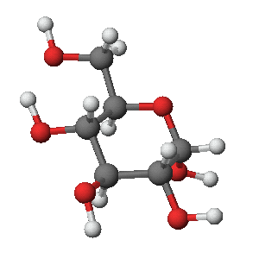
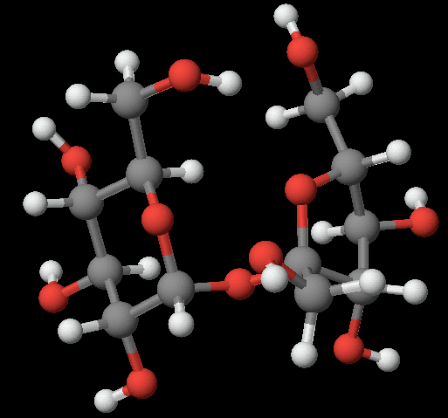
Concentration/Time Relations
Sucrose decomposes to simpler sugars
Rate of disappearance of sucrose = k [sucrose]
k = 0.21 hr⁻¹
Initial [sucrose] = 0.010 M
How long to drop 90% (to 0.0010 M)?
Sucrose
MAR

Slide 26
Rate of disappear of sucrose = k [sucrose], k = 0.21 hr⁻¹. If initial [sucrose] = 0.010 M, how long to drop 90% or to 0.0010 M?
Concentration/Time Relations
Use the first order integrated rate law
ln (0.10) = - 2.30 = - (0.21 hr⁻¹) • time
time = 11 hours
sig figs and logarithms
covered in CH 223
MAR
For the reaction A → B, the disappearance of A is first order where k = 0.030 min⁻¹. If we begin with [A] = 0.36 M, what will [A] be after 46 min?
0.090 M
0.18 M
0.31 M
0.25 M
0 M
Enter your response on
your i>Clicker now!
Answer = A,
0.090 M
ln (R/.36) = -0.030 * 46
e^(ln (R/.36)) = e^(-0.030 * 46)
R/.36 = 0.25
R = 0.36*0.25
R = 0.090 M

Slide 27
Using the Integrated Rate Law
The integrated rate law suggests a way to tell if a reaction is first order based on experiment.
2 N₂O₅(g) ---> 4 NO₂(g) + O₂(g)
Rate = k[N₂O₅]
Time (min) [N₂O₅] (M) ln [N₂O₅]
0 1.00 0
1.0 0.705 -0.35
2.0 0.497 -0.70
5.0 0.173 -1.75
MAR

Slide 28
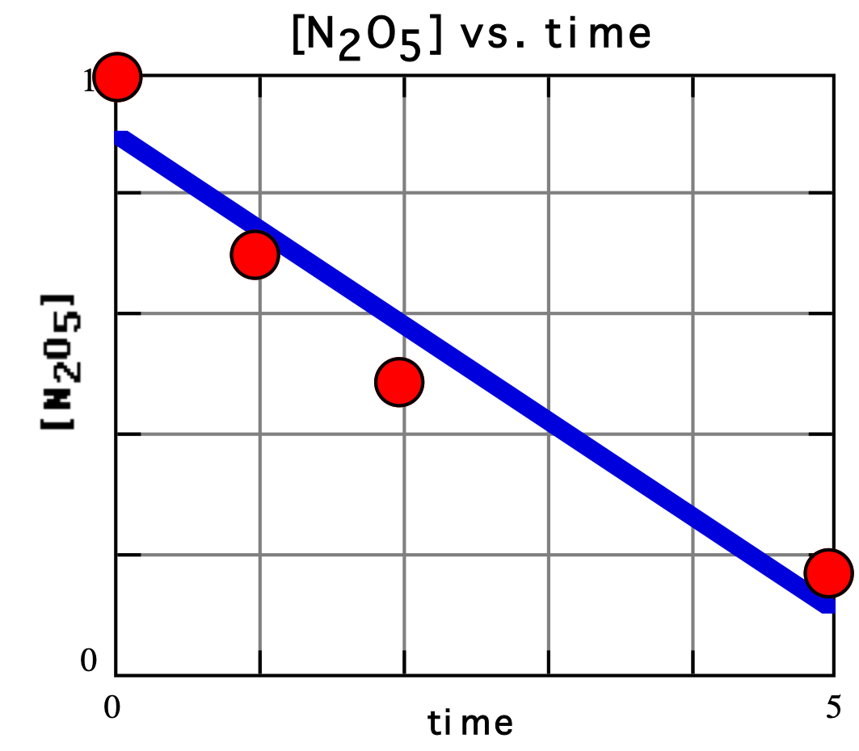
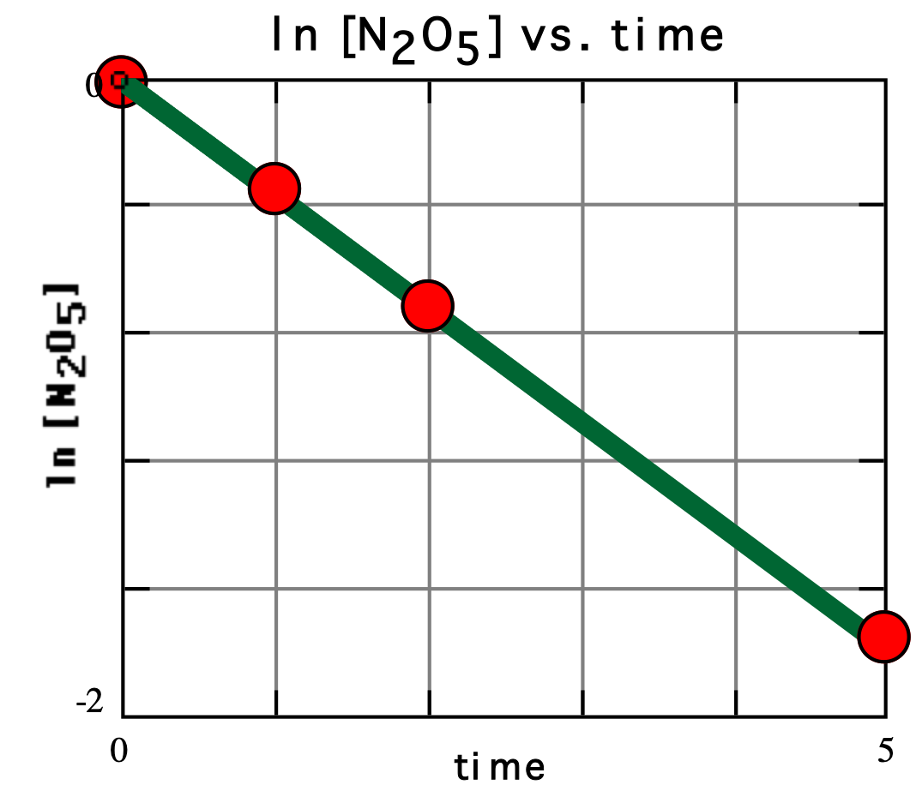
Using the Integrated Rate Law
2 N₂O₅(g) ---> 4 NO₂(g) + O₂(g) Rate = k[N₂O₅]
Data of conc. vs. time plot do not fit straight line.
Plot of ln [N₂O₅] vs. time is a straight line!
MAR

Slide 29
Using the Integrated Rate Law
Plot of ln [N₂O₅] vs. time is a straight line!
Eqn. for straight line:
y = ax + b
All 1st order reactions have straight line plot for ln [R] vs. time.
(2nd order gives straight line for plot of 1/[R] vs. time; zero order [R] vs. time) - see Handout
MAR

Slide 30
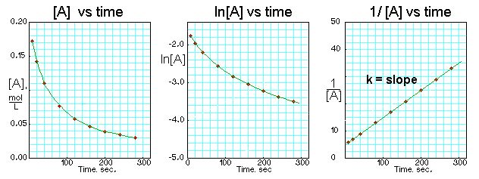
Using the Rate Laws
Also see the "Kinetics Cheat Sheet" Handout
MAR
The graphs below were obtained for a chemical reaction. What is the order with respect to the rate law for this reaction?
zero
first
second
not enough information
Enter your response on
your i>Clicker now!
Answer = C,
second order
1/[A] vs. time is a straight line

Slide 31
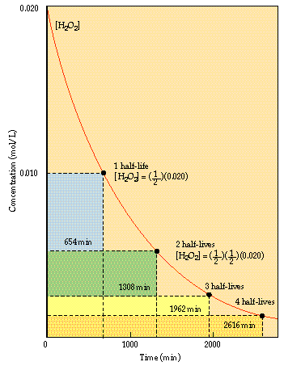
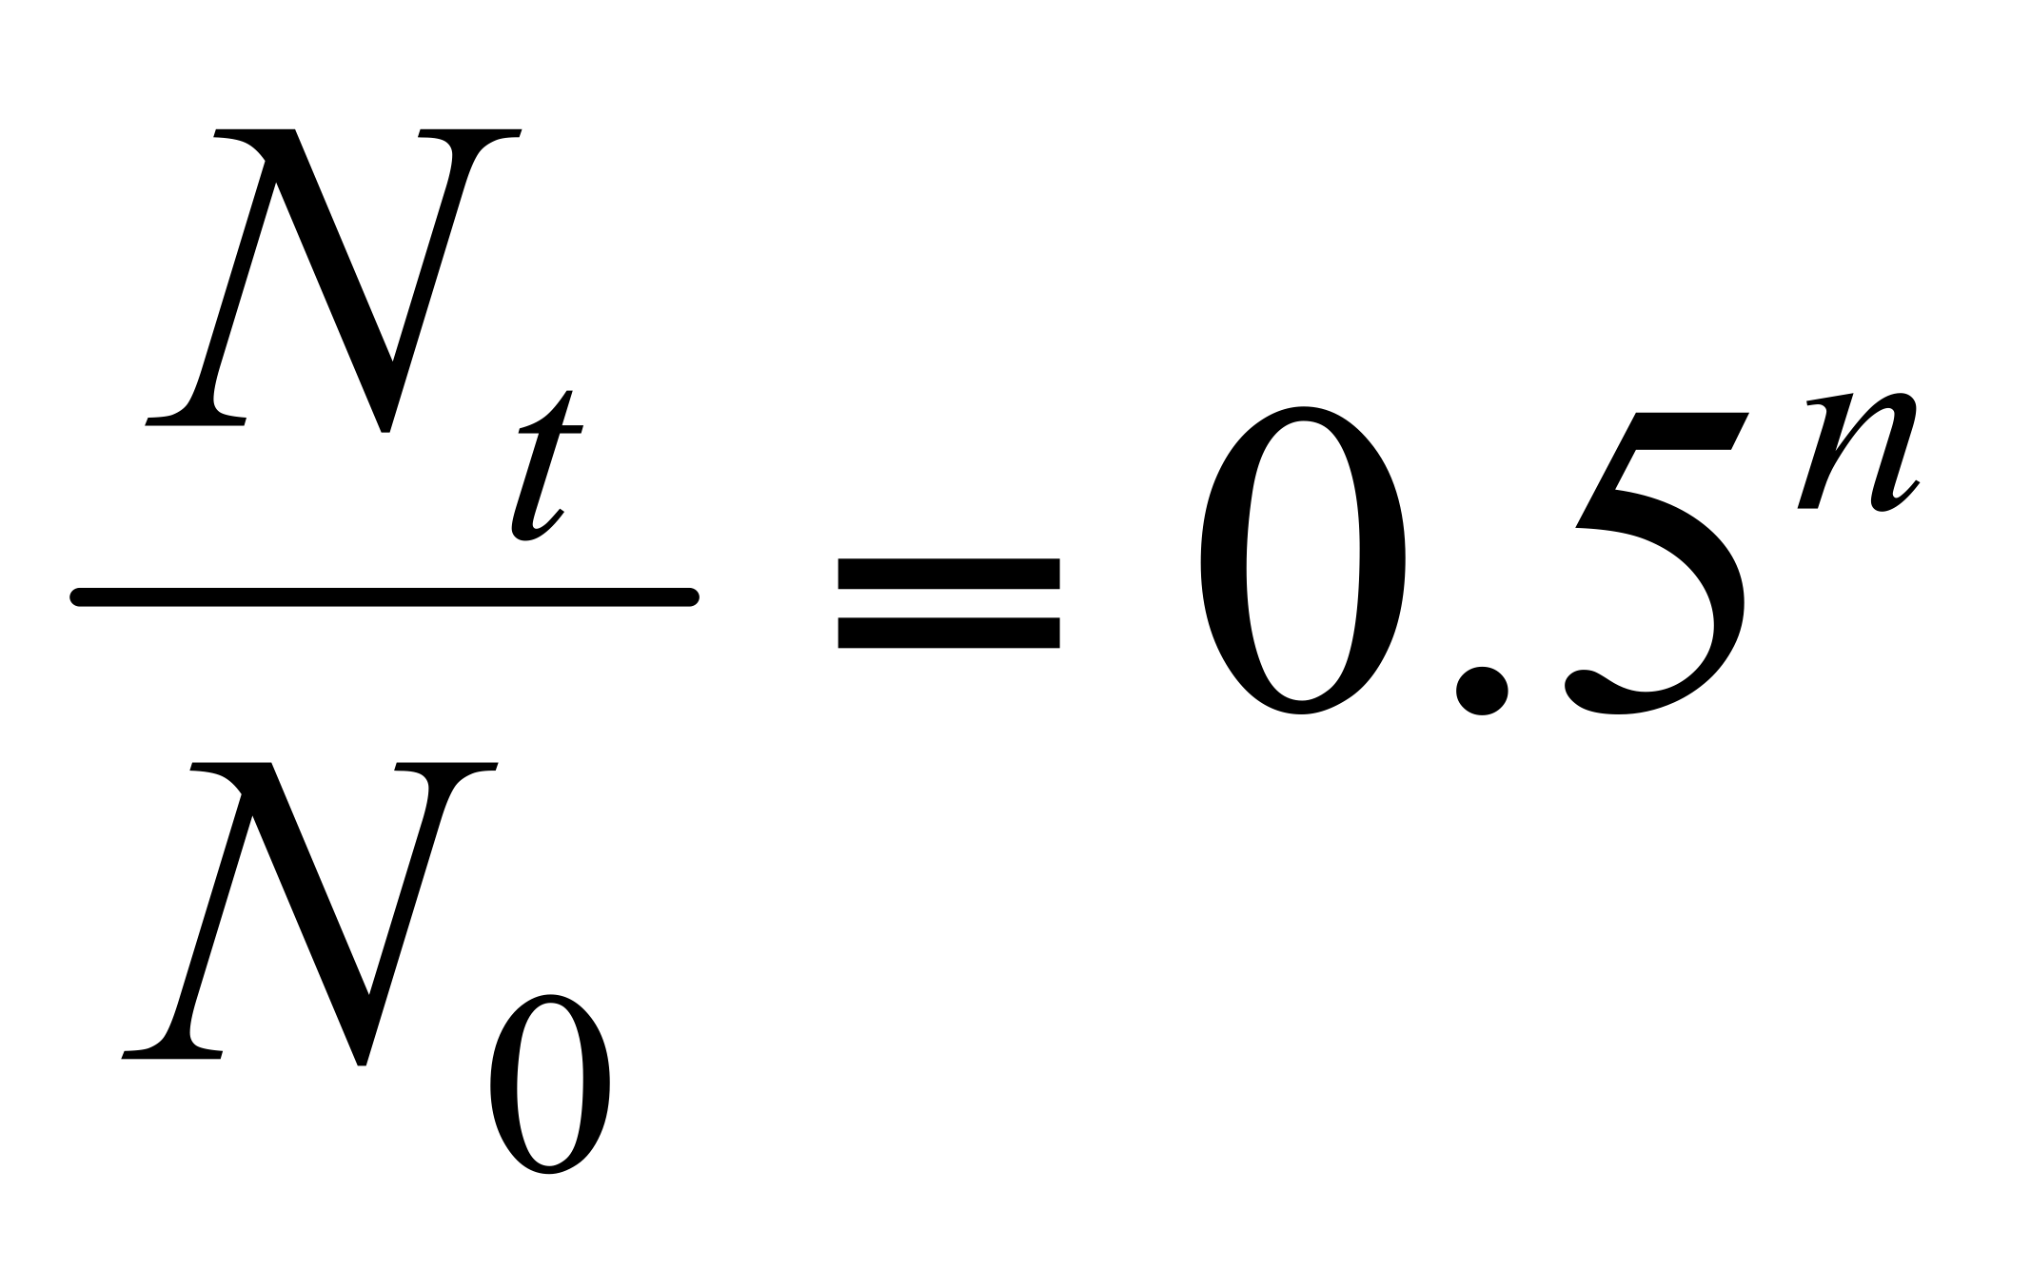
Half-Life
HALF-LIFE is the time it takes for 1/2 a sample is disappear.
For 1st order reactions, the concept of HALF-LIFE is especially useful.
n = the number of half-lives
MAR

Slide 32
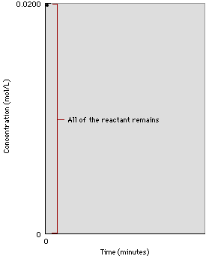
Half-Life
Reaction is 1st order decomposition of H₂O₂.
MAR

Slide 33
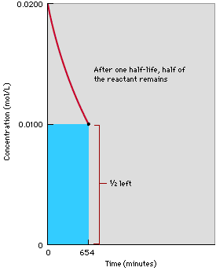
Half-Life
Reaction after 654 min, 1 half-life.
1/2 of the reactant remains.
MAR

Slide 34
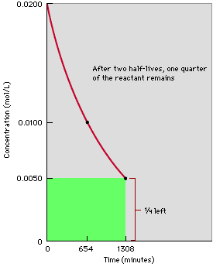
Half-Life
Reaction after 1308 min, or 2 half-lives.
1/4 of the reactant remains.
MAR

Slide 35
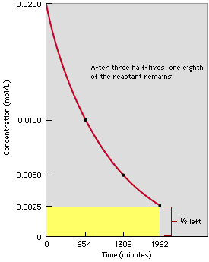
Half-Life
Reaction after 3 half-lives, or 1962 min.
1/8 of the reactant remains.
MAR

Slide 36
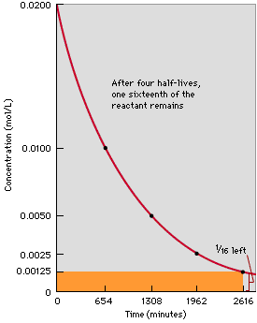
Half-Life
Reaction after 4 half-lives, or 2616 min.
1/16 of the reactant remains.
MAR

Slide 37
Half-Life
Sugar is fermented in a 1st order process (using an enzyme as a catalyst).
sugar + enzyme --> products
Rate of disappear of sugar = k[sugar]
k = 3.3 x 10⁻⁴ sec⁻¹
What is the half-life of this reaction?
MAR

Slide 38
Half-Life
Rate = k[sugar] and k = 3.3 x 10⁻⁴ sec⁻¹. What is the half-life of this reaction?
Solution
[R] / [R]₀ = 1/2 when t = t_{1/2}
Therefore, ln (1/2) = - k • t_{1/2}
- 0.693 = - k • t_{1/2}
t_{1/2} = 0.693 / k
So, for sugar,
t_{1/2} = 0.693 / k = 2100 sec = 35 min
see Handout
MAR
For a given first order reaction, k = 0.347 hr⁻¹. What is the half-life of this reaction?
2.00 min
20.8 min
120. min
240. min
Where's Dr. Gordon Freeman when you need him?
Enter your response on
your i>Clicker now!
Answer = C,
120. min
0.693/0.347 = 2.00 hr
= 120. min

Slide 39
Half-Life
Rate = k[sugar] and k = 3.3 x 10⁻⁴ sec⁻¹. Half-life is 35 min. Start with 10.00 g sugar. How much is left after 2 hr and 20 min? (t_{1/2} = 0.693 / k)
Two Solution pathways - The "CH 104" method:
2 hr and 20 min = 4 half-lives
Half-life Time Elapsed Mass Left
1st 35 min 5.00 g
2nd 70 2.50 g
3rd 105 1.25 g
4th 140 0.625 g answer
MAR

Slide 40
Half-Life
Rate = k[sugar] and k = 3.3 x 10⁻⁴ sec⁻¹. Half-life is 35 min. Start with 10.00 g sugar. How much is left after 2 hr and 20 min? (t_{1/2} = 0.693 / k)
Two Solution Pathways - The "CH 222" Method:
Convert 2 hrs 20 min to 8400 seconds
ln (R / 10.00 g) = - (3.3 x 10⁻⁴ sec⁻¹)(8400 s)
ln (R / 10.00 g) = - 2.772
Take antilog: (R / 10.00 g) = e^{-2.772} = 0.0625
R = 10.00 g * 0.0625 = 0.625 g
CH 222 Method recommended,
not limited to whole number of half-lives, etc.
e = "Euler's number" in math = 2.71828...
MAR

Slide 41
Half-Life
Radioactive decay is a first order process.
Tritium ---> electron + helium
³₁H ⁰₋₁e ³₂He
If you have 1.50 mg of tritium, how much is left after 49.2 years? t_{1/2} = 12.3 years
MAR

Slide 42
Half-Life
Start with 1.50 mg of tritium, how much is left after 49.2 years? t_{1/2} = 12.3 years
ln [R] / [R]₀ = -kt
[R] = ? [R]₀ = 1.50 mg t = 49.2 yrs
Need k, so we calc k from: k = 0.693 / t_{1/2}
Obtain k = 0.0564 y⁻¹
Now ln [R] / [R]₀ = -kt = - (0.0564 y⁻¹) • (49.2 y)
= - 2.77
Take antilog: [R] / [R]₀ = e^{-2.77} = 0.0627
0.0627 is the fraction remaining
[R]₀ = 1.50 mg, so [R] = 1.50*0.0627 = 0.0941 mg
MAR
The radioactive isotope copper-64 (⁶⁴Cu) is used in the form of copper(II) acetate to study Wilson’s disease. The isotope has a half-life of 12.70 hours. What fraction of copper(II) acetate remains after 2.0 days?
0.50
0.21
0.073
0.0
more information is needed
Enter your response on
your i>Clicker now!
Answer = C,
0.073
ln (R/R0) = -(0.693/12.70 h) * 48 hours
R/R0 = 0.073

Slide 43
Half-Life
Half-Life for first order reactions:
t_{1/2} = 0.693 / k
All biological, radioactive processes first order, most useful
Half-Life for second order reactions:
t_{1/2} = 1 / (k[A]0)
Half-Life for zero order reactions:
t_{1/2} = [A]0 / 2k
[A]0 is the initial concentration of the reactant
MAR
Notes:
Example of zero order reaction: Reversed Haber process: 2 NH3 -> N2 + 3H2
Example of second order reaction: 2 NO2 -> 2 NO + O2

Slide 44
Half-Lives of Radioactive Elements
Rate of decay of radioactive isotopes given in terms of half-life (t_{1/2}).
²³⁸U --> ²³⁴Th + He 4.5 x 10⁹ y
¹⁴C --> ¹⁴N + beta 5730 y
¹³¹I --> ¹³¹Xe + beta 8.05 d
Element 106 - seaborgium ²⁶³Sg --> ²⁵⁹Rf + He 0.8 s
Element 111 - roentgenium ²⁷²Rg --> ²⁶⁸Mt + He 0.0015 s
Half-life also used in medicine;
t_{1/2} caffeine = 3.5 hours in the body
MAR

Slide 45
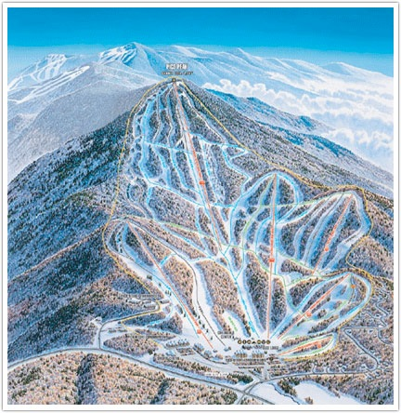
MECHANISMS A Microscopic View of Reactions
How are reactants converted to products at the molecular level?
We want to connect the
RATE LAW to the MECHANISM
the experiment to the
theory
MAR
Notes:
Pico Mountain Vermont ski map! ☺

Slide 46
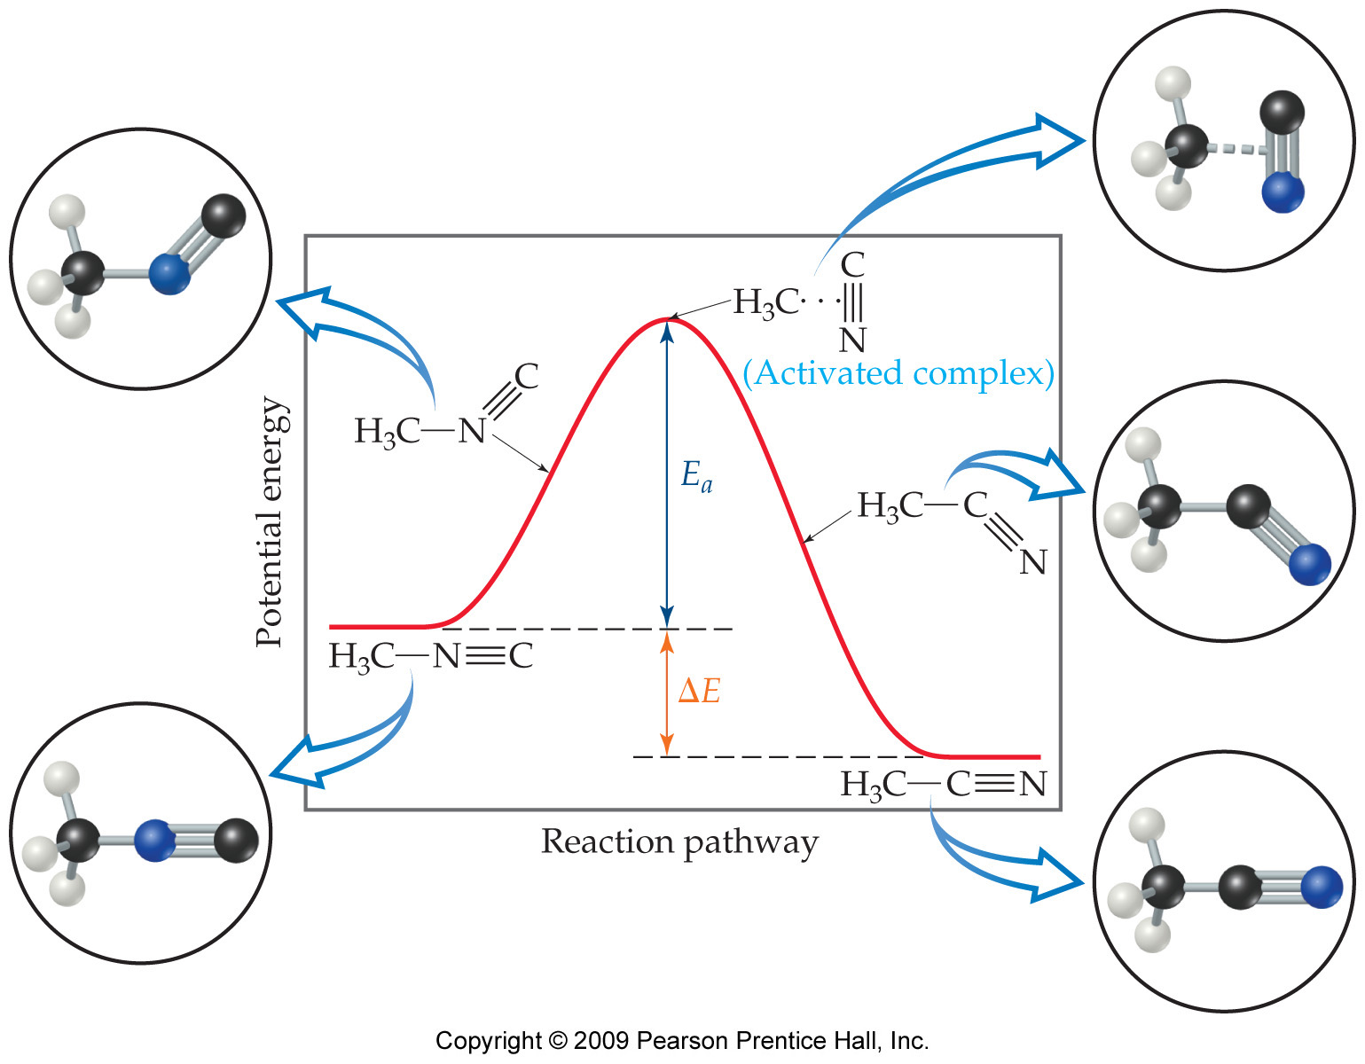
Reaction Coordinate Diagrams
It is helpful to visualize energy changes throughout a process on a reaction coordinate diagram.
This diagrams shows the rearrangement of methyl isocyanide to methyl cyanide (acetonitrile).
MAR

Slide 47
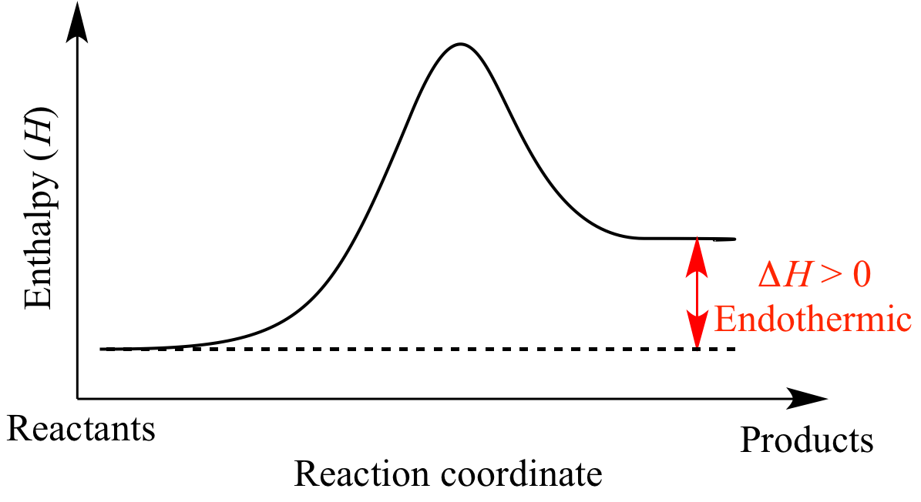
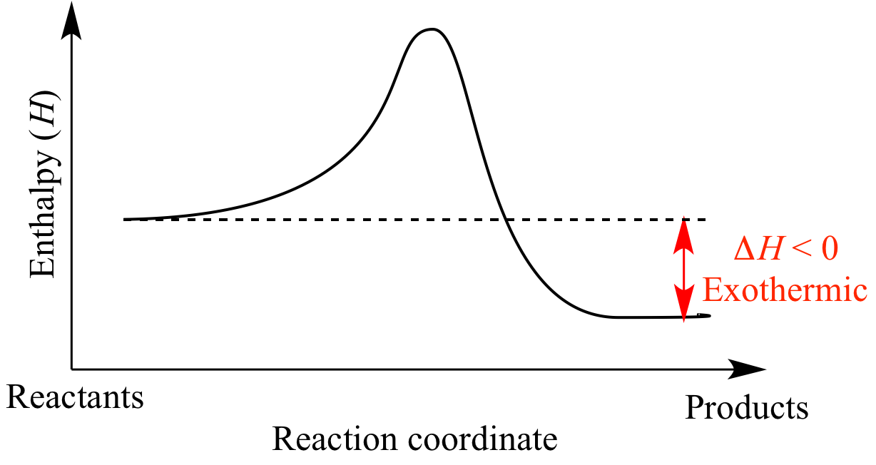
Reaction Coordinate Diagrams
The diagram shows the energy of the reactants and products (and, therefore, ΔE); exo- or endo-thermic!
The high point on the diagram is the transition state.
The species present at the transition state is called the activated complex.
The energy gap, Ea between the reactants and the activated complex is the activation energy barrier.
MAR

Slide 48
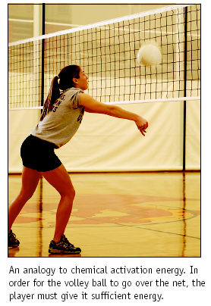
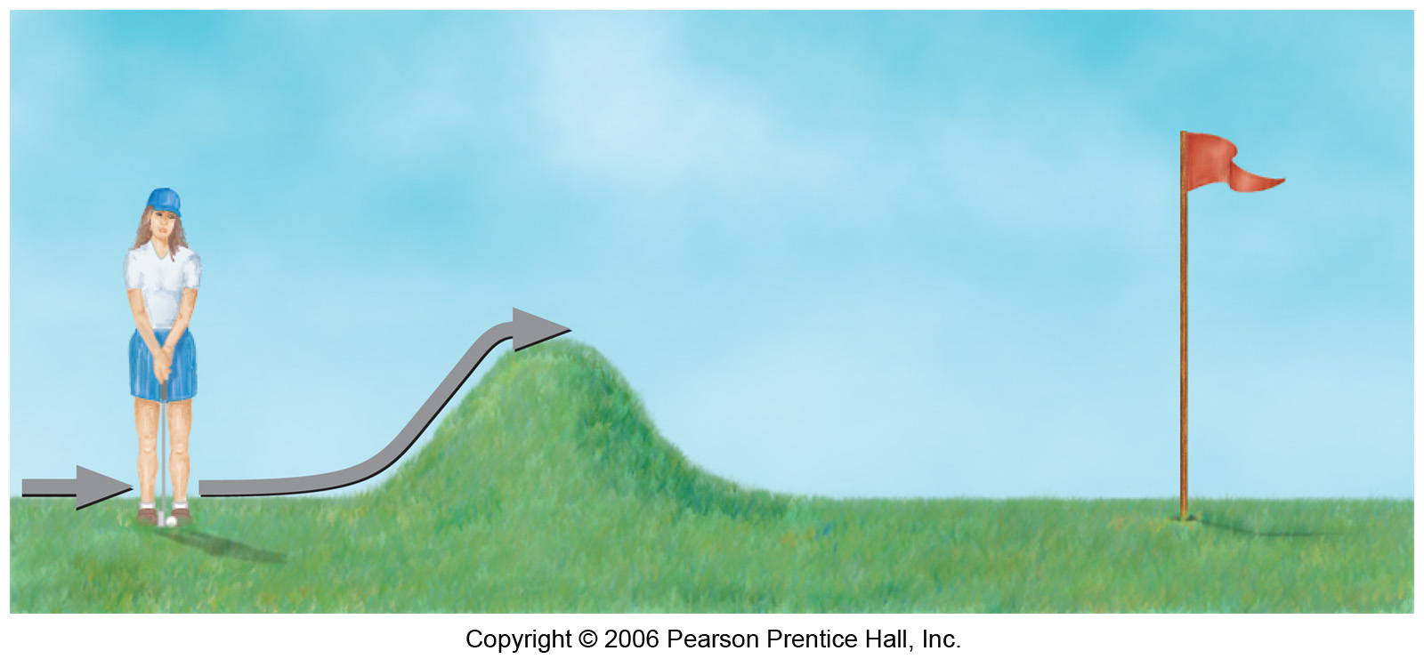
Activation Energy
There is a minimum amount of energy required for a reaction: the activation energy, Ea.
In general, differences in activation energy are the reason reactions vary from fast to slow.
MAR

Slide 49
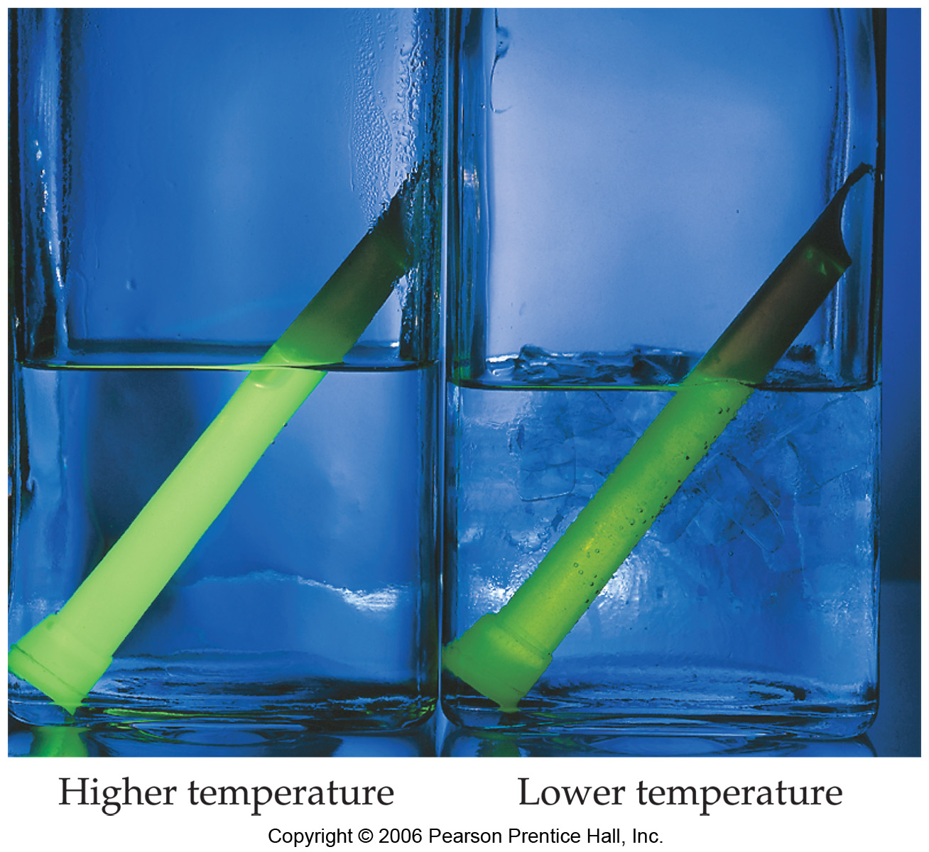
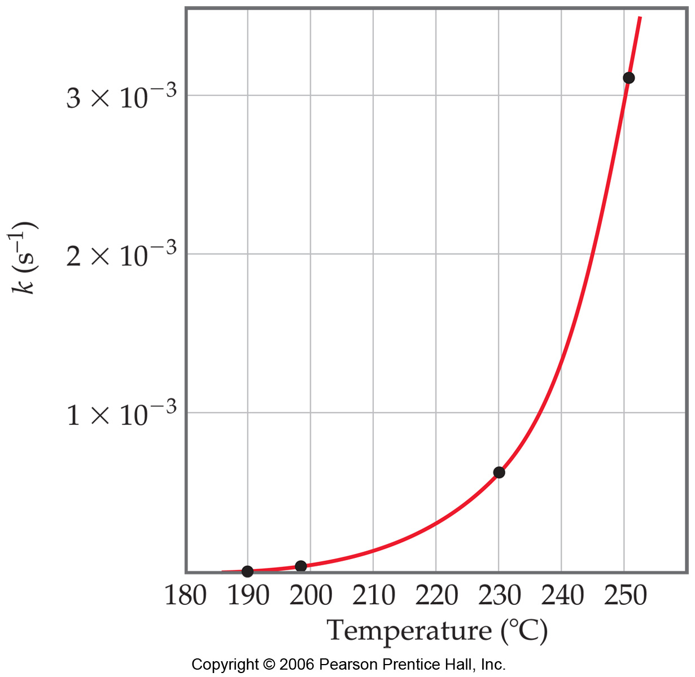
Temperature and Rate
Generally, as temperature increases, so does the reaction rate.
This is because k is temperature dependent.
Find activation energy through changes in temperature.
MAR

Slide 50
Effect of Temperature
Reactions generally occur slower at lower T.
Iodine clock reaction
H₂O₂ + 2 I⁻ + 2 H⁺ -->
2 H₂O + I₂
MAR

Slide 51
Collision Theory
To break and make bonds, reactions require
(a) activation energy and
(b) correct geometry.
O₃(g) + NO(g) ---> O₂(g) + NO₂(g)
Insufficient
activation energy
Incorrect geometry
MAR

Slide 52
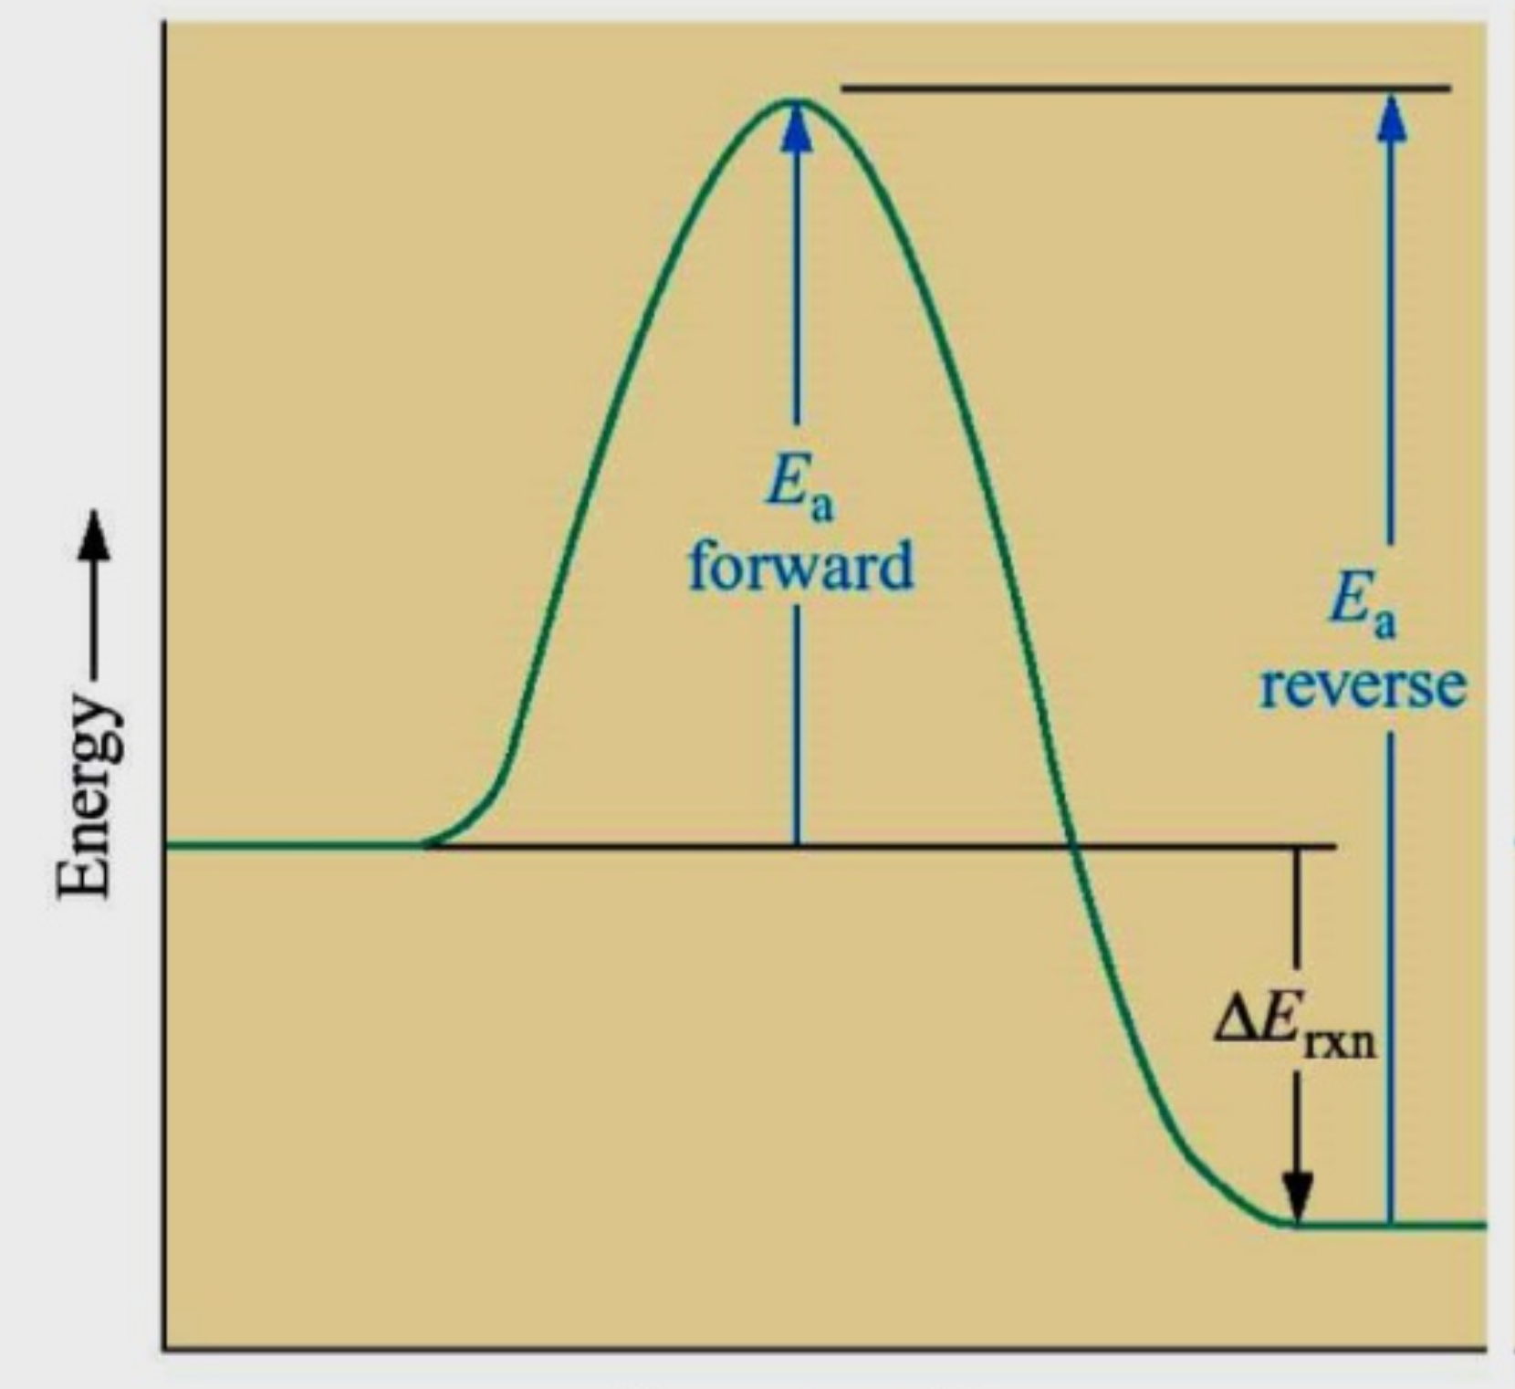
Collision Theory
To break and make bonds, reactions require
(a) activation energy and
(b) correct geometry.
O₃(g) + NO(g) ---> O₂(g) + NO₂(g)
Correct activation energy and geometry
MAR

Slide 53
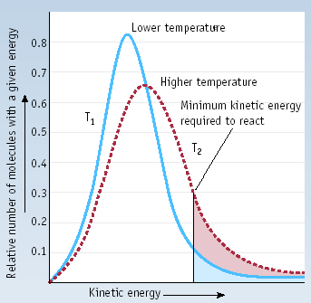
Activation Energy and Temperature
Reactions are slower at lower T because a smaller fraction of reactant molecules have enough energy to convert to product molecules.
In general, differences in activation energy cause reactions to vary from fast to slow.
MAR

Slide 54
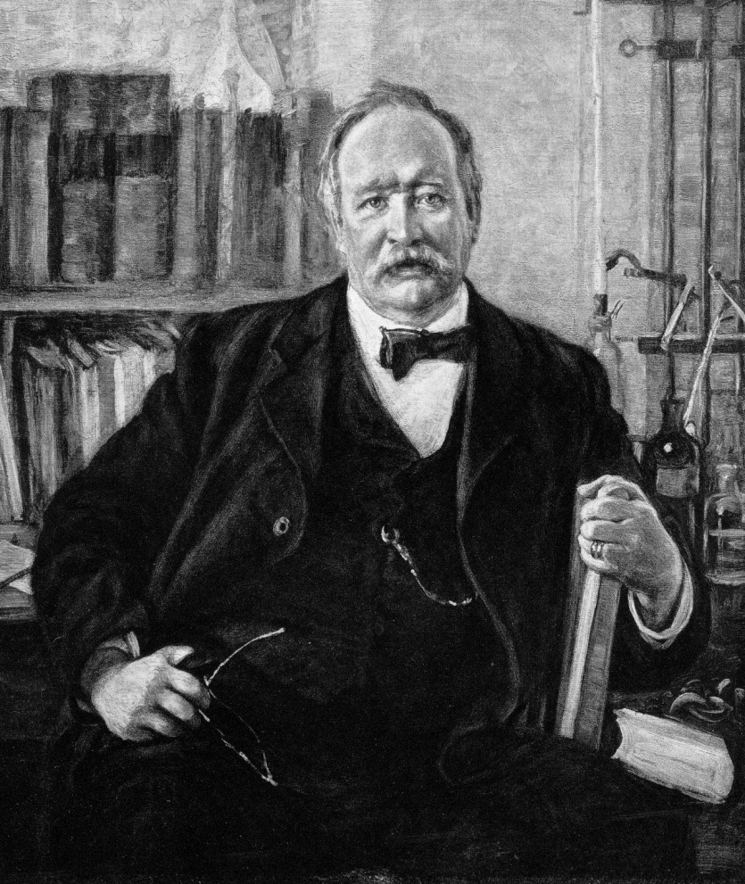
The Arrhenius Equation
Arrhenius equation -
Temp (K)
Rate constant
Svante Arrhenius
Activation energy
8.3145 J/K•mol
Frequency factor
Frequency factor = frequency of collisions with correct geometry.
Plot ln k vs. 1/T ---> straight line.
slope = -E_{a}/R,
best way to find E_{a}
MAR
Always use 8.3145 for "energy" R!

Slide 55
More About the Frequency Factor, A
Frequency Factor often expressed as:
Boltzmann constant,
1.381 x 10⁻²³ J/K
Temp (K)
Frequency Factor
Planck constant,
6.626 x 10⁻³⁴ J s
Entropy of activation
8.3145 J/K•mol
We will be seeing entropy (∆S) again in CH 223.
MAR
Notes:
Via Eyring's equation: H. Eyring, J. Chem. Phys., 1935, 3, 107; also J. Chem. Phys, 1935, 3, 492.
From my P-chem book, page 378-382.

Slide 56
REACTION MECHANISMS
A reaction mechanism is the sequence of events that describes the actual process by which reactants become products.
Reactions may occur all at once ("single step") or through several discrete steps.
Each of these steps known as an elementary step
A bimolecular reaction
Exo- or endothermic?
MAR

Slide 57
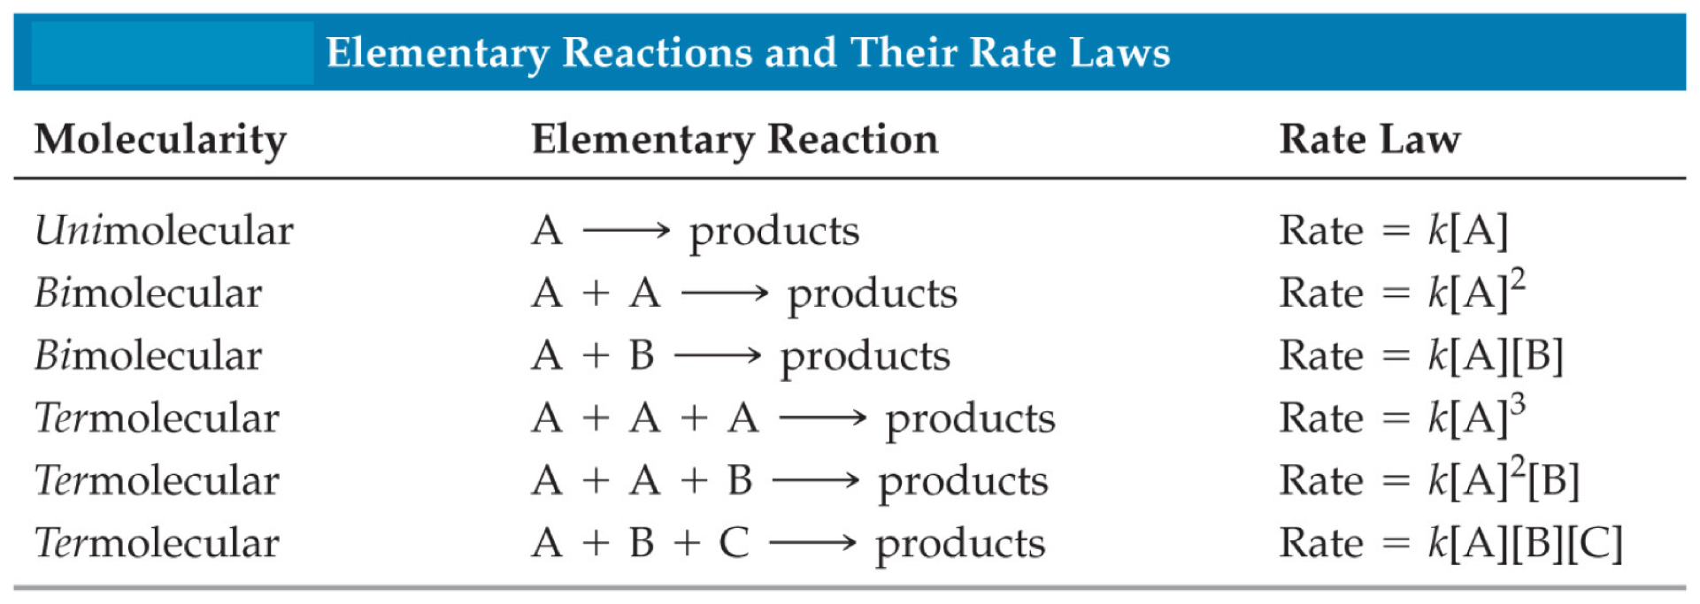
MOLECULARITY
The molecularity of a process tells how many molecules are involved in the elementary step.
UNIMOLECULAR - only one reactant is involved.
BIMOLECULAR - two different molecules must collide
TERMOLECULAR - three different molecules collide
MAR

Slide 58
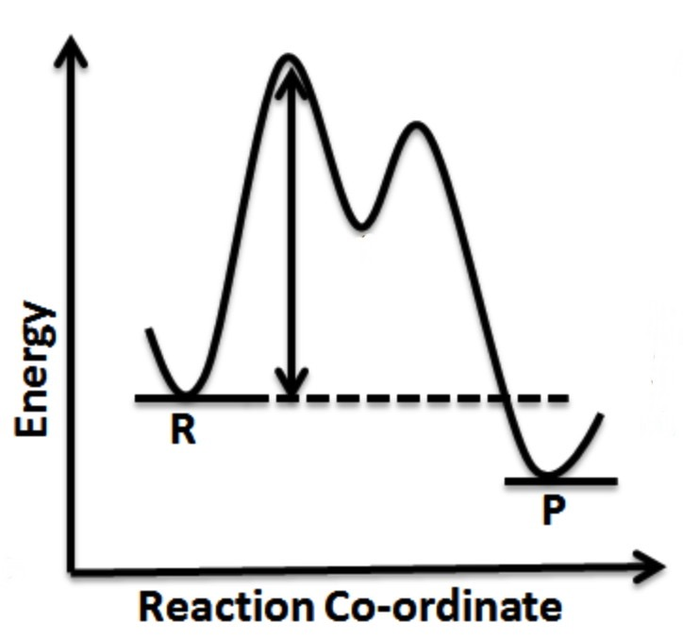
MECHANISMS
Some reactions occur in a single elementary step. Most reactions involve a sequence of elementary steps.
Adding elementary steps gives NET reaction.
Every elementary step gets a “hump” in the diagram
MAR

Slide 59
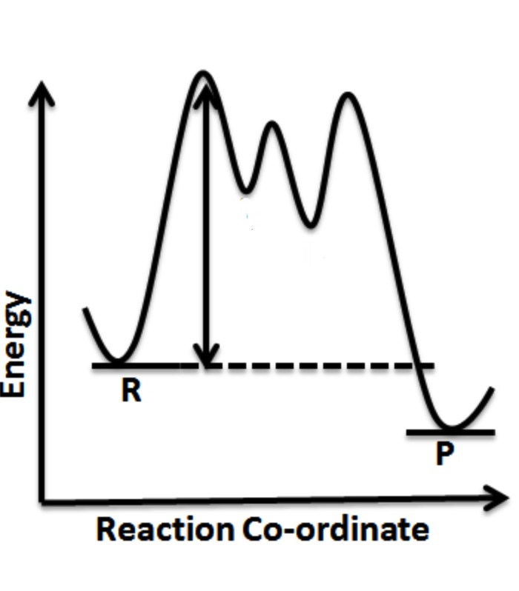
MECHANISMS
Most reactions involve a sequence of elementary steps.
Adding elementary steps gives NET reaction.
Every elementary step gets a “hump” in the diagram
MAR

Slide 60
Mechanisms
In multistep mechanisms, one step will be slower than all others - this is the rate determining step (rds).
Most reactions involve a sequence of elementary steps. Example:
2 I⁻ + HOOH + 2 H⁺ ---> I₂ + 2 H₂O
Rate = k [I⁻] [H₂O₂]
Note that the rate law comes from experiment.
Also note that order of reactants in rate law not necessarily the same as stoichiometric coefficients!
MAR
Notes:
Use idea of "ordering pizza from Little Caesar's":
1) drive to Little Caesars (slow)
2) pay for pizza (fast)
3) eat pizza (fast)

Slide 61
MECHANISMS
2 I⁻ + HOOH + 2 H⁺ ---> I₂ + 2 H₂O
Rate = k [I⁻] [HOOH]
A scientist proposes the following mechanism for this reaction:
Step 1 - slow HOOH + I⁻ --> HOI + OH⁻
Step 2 - fast HOI + I⁻ --> I₂ + OH⁻
Step 3 - fast 2 OH⁻ + 2 H⁺ --> 2 H₂O
Note that H⁺ not involved in slow step, so [H⁺] is not in the rate law (a zero order reactant.)
Bimolecular slow step reflected in the rate law; this is a legitimate mechanism.
MAR
The reaction of NO₂(g) and CO(g) is thought to occur in two steps.
Step 1 Slow NO₂(g) + NO₂(g) → NO(g) + NO₃(g)
Step 2 Fast NO₃(g) + CO(g) → NO₂(g) + CO₂(g)
Which of the following rate laws would correspond to this mechanism?
Rate = k[NO₂][CO]
Rate = k[NO₂]
Rate = k[NO₂]²
more information is needed
Enter your response on
your i>Clicker now!
Answer = C,
rate = k[NO2]²
slow step is rds,
reflected in rate

Slide 62
MECHANISMS
2 I⁻ + HOOH + 2 H⁺ ---> I₂ + 2 H₂O
Rate = k [I⁻] [HOOH]
Step 1 - slow HOOH + I⁻ --> HOI + OH⁻
Step 2 - fast HOI + I⁻ --> I₂ + OH⁻
Step 3 - fast 2 OH⁻ + 2 H⁺ --> 2 H₂O
Step 1 is bimolecular and involves I⁻ and HOOH. Therefore, this predicts the rate law should be
Rate α [I⁻] [HOOH] - as observed!!
The species HOI and OH⁻ are reaction intermediates; critical for providing evidence for or against a proposed mechanism.
See: Reaction Mechanisms Guide
MAR
The substitution of an I⁻ by a Cl⁻ on CH₃I can occur by two possible mechanisms:
Mechanism 1: step 1. CH₃I → CH₃⁺ + I⁻ slow step
step 2. CH₃⁺ + Cl⁻ → CH₃Cl fast step
Mechanism 2: step 1. CH₃I + Cl⁻ → CH₃ICl⁻ slow step
step 2. CH₃ICl⁻ → CH₃Cl + I⁻ fast step
The rate law was experimentally determined to be:
rate = k[CH3I]
Which mechanism is consistent with this rate law?
Mechanism 1
Mechanism 2
more information is needed
Enter your response on
your i>Clicker now!
Answer = A,
Mechanism 1
Cl⁻¹ is a zero order reactant

Slide 63
Mechanisms - Uses
Mechanisms help predict the products of a reaction
Very useful in organic chemistry: the S_{N}1 and S_{N}2 mechanisms
S_{N} = substitution nucleophilic
S_{N}1
S_{N}2
MAR

Slide 64
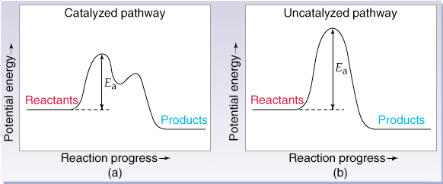
CATALYSIS
Catalysts speed up reactions by altering the mechanism to lower the activation energy barrier.
MAR

Slide 65
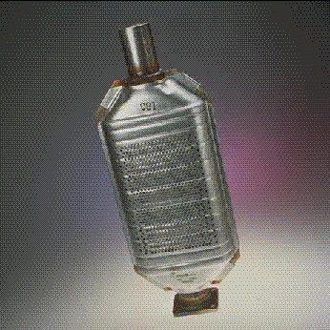
CATALYSIS - Uses
1. In auto exhaust systems - Pt, NiO, PtO
2 CO + O₂ ---> 2 CO₂
2 NO ---> N₂ + O₂
MAR

Slide 66
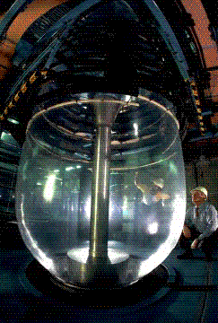
CATALYSIS - Uses
2. Polymers: H₂C=CH₂ ---> polyethylene
3. Acetic acid: CH₃OH + CO --> CH₃CO₂H
4. Enzymes - biological catalysts
Making
polyethylene
film
MAR

Slide 67
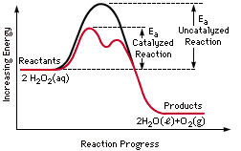
CATALYSIS
Catalysis and activation energy
MnO₂ catalyzes decomposition of H₂O₂
2 H₂O₂ ---> 2 H₂O + O₂
Uncatalyzed reaction
Catalyzed reaction
MAR

Slide 68
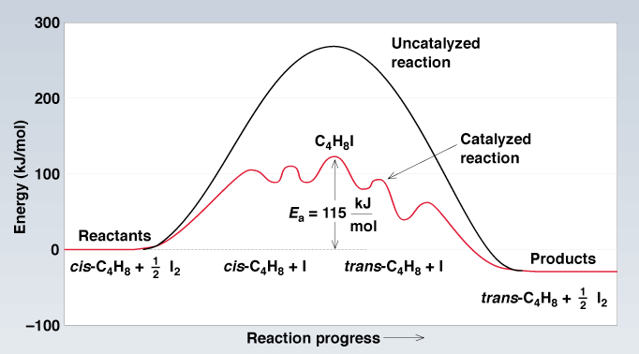
Iodine-Catalyzed Isomerization of cis-2-Butene
MAR

Slide 69
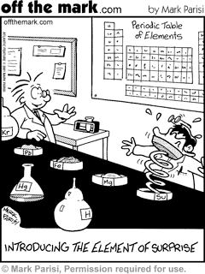
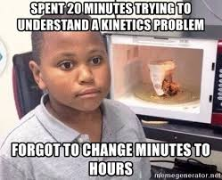
End of Chapter 12
See:
Chapter Twelve Study Guide
Chapter Twelve Concept Guide
Important Equations (following this slide)
End of Chapter Problems (following this slide)
MAR

Slide 70
Important Equations, Constants, and Handouts
from this Chapter:
R = 8.3145 J/mol∙K
“Kinetics Cheat Sheet” handout
“Reactions Mechanisms” handout
The Rate Law:
$$Rate=k[A]^{p}[B]^{m}[C]^{n}...$$
m, n, p = 0, 1 or 2 only (in our classes)
1st Order Integrated Rate Law;
Kinetics: rate, rate law, orders of reaction, the rate constant (k), 1st vs. 2nd. vs. zero order, half life, mechanism, elementary reaction, bimolecular (and uni- and ter-molecular), Arrhenius equation, activation energy, frequency factor, mechanism, intermediate, catalyst, rds (rate determining step)
$$ln\frac{[R]}{[R_{0}]}=-kt$$
$$t_{\frac{1}{2}}=\frac{0.693}{k}$$
The Arrhenius Equation:
$$ln(k)=-(\frac{E_{a}}{R})(\frac{1}{T})+ln(A)$$

Slide 71
End of Chapter Problems: Test Yourself
The reaction between ozone and nitrogen dioxide at 231 K is first order in both NO2 and O3: 2 NO2(g) + O3(g) → N2O5(s) + O2(g) Write the rate equation for the reaction. If the concentration of NO2 is tripled, what is the change in the reaction rate?
After 2.57 h at 27 °C, a first order sucrose concentration decreased from 0.0146 M to 0.0132 M. Find the rate constant, k.
The compound Xe(CF3)2 decomposes in a first-order reaction to elemental Xe with a half-life of 30. min. If you place 7.50 mg of Xe(CF3)2 in a flask, how long must you wait until only 0.25 mg of Xe(CF3)2 remains?
Gaseous NO2 decomposes at 573 K: 2 NO2(g) → 2 NO(g) + O2(g) The concentration of NO2 was measured as a function of time. A graph of 1/[NO2] versus time gives a straight line with a slope of 1.1 L/mol.s. What is the rate law for this reaction? What is the rate constant k?
What is the rate law for the following elementary reaction: NO(g) + NO3(g) → 2 NO2(g)
For a reaction, ln k versus 1/T(K) is plotted, and the linear regression line is: y = -6373.3x + 18.19, r = -0.997 What is the activation energy for this reaction?

Slide 72
End of Chapter Problems: Answers
Rate = k[NO2][O3]; tripling NO triples the rate.
0.0392 h⁻¹
150 min
Rate = k[NO2]², k = 1.1 L/mol∙s
Rate = k[NO][NO3]
53.0 kJ/mol

