Slide 1
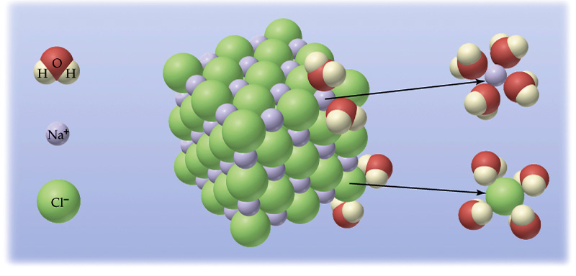
Solutions and Their Behavior Chapter 11
Chemistry 222
Professor Michael Russell
Last update:
4/29/24
MAR

Slide 2
Solution Behavior
Why does a raw egg swell or shrink when placed in different solutions?
MAR

Slide 3
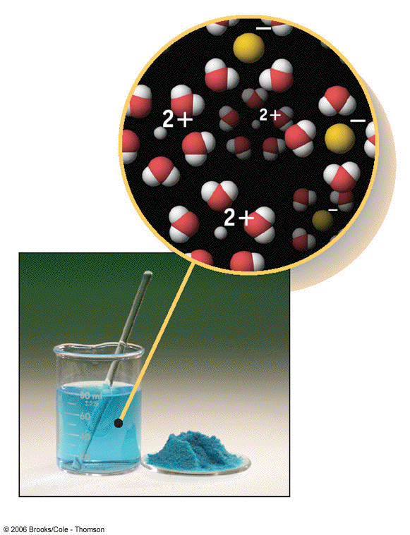
Some Definitions
A solution is a HOMOGENEOUS mixture of 2 or more substances in a single phase.
Solutions, Colloids and Suspensions are all examples of homogenous mixtures
Solutions most important to chemists
MAR

Slide 4
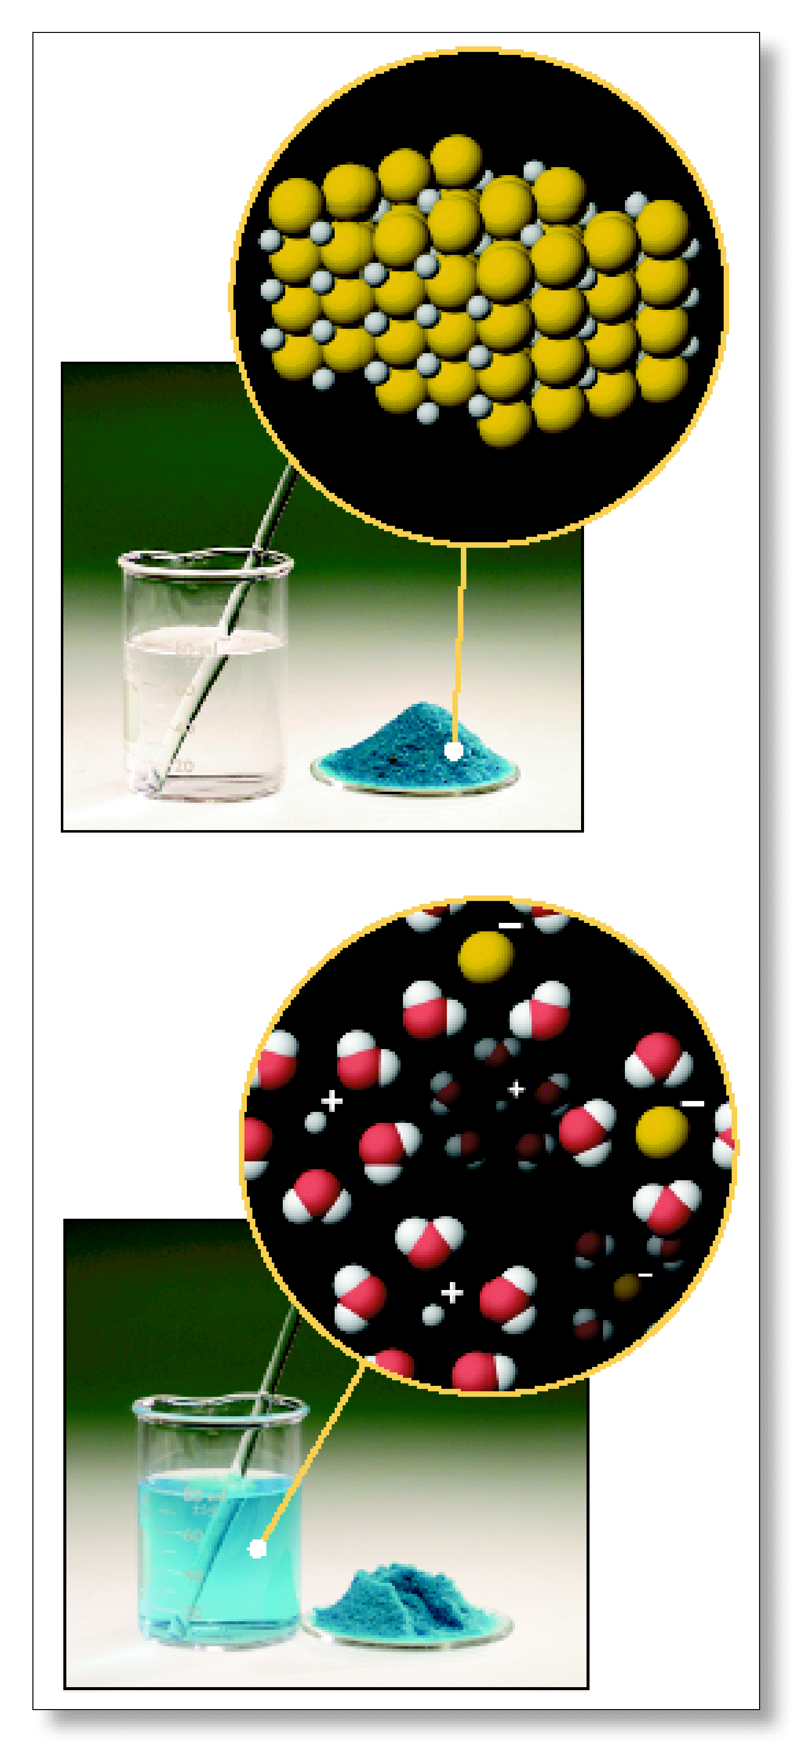
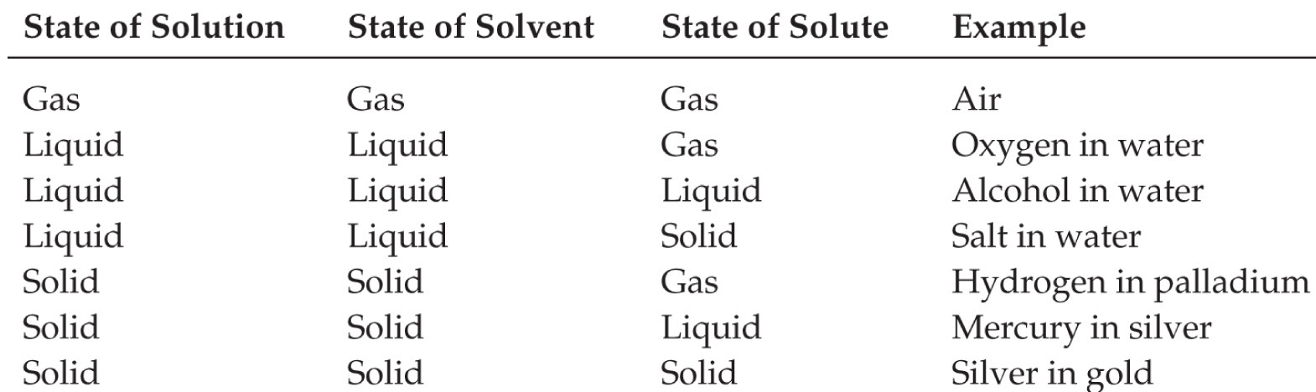
Some Definitions
A SOLUTION has at least two constituents
One constituent is usually regarded as the SOLVENT and the others as SOLUTES
So a SOLUTION = SOLUTE + SOLVENT
MAR

Slide 5
Definitions
Solutions can be classified as unsaturated or saturated.
A saturated solution contains the maximum quantity of solute that dissolves at that temperature.
MAR

Slide 6
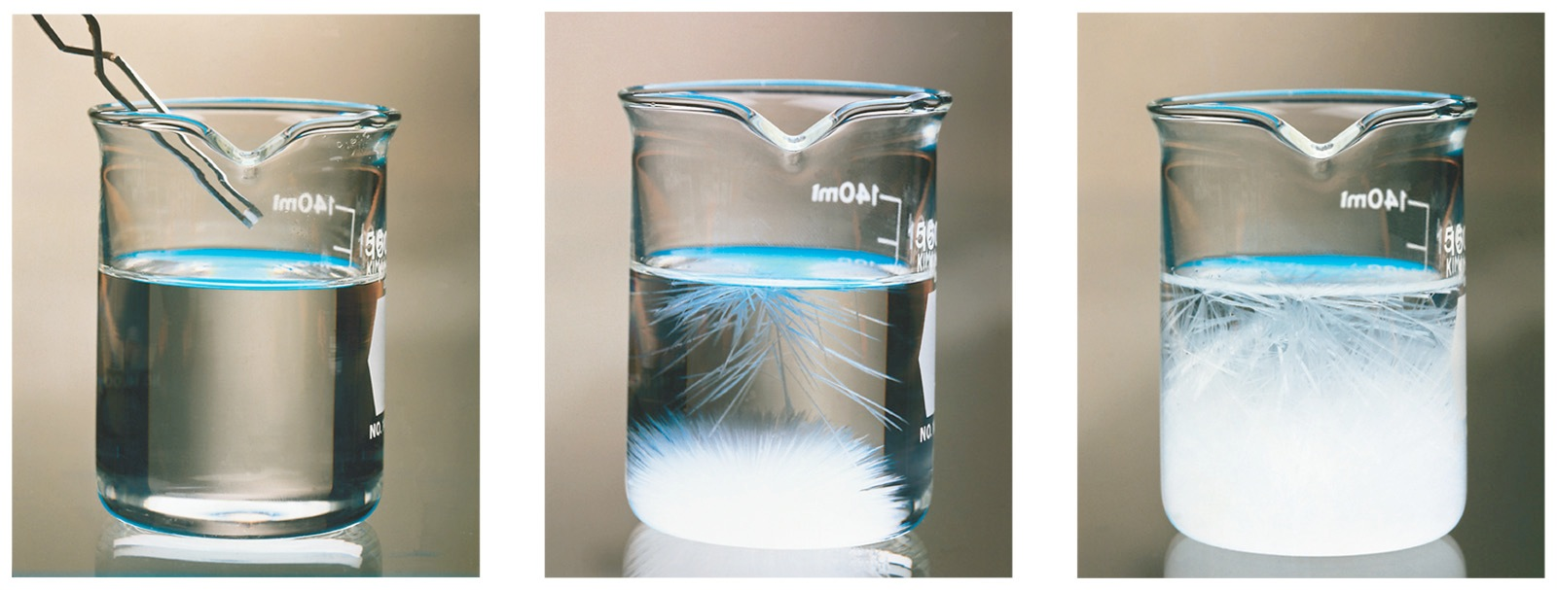
Definitions
SUPERSATURATED SOLUTIONS contain more than is possible and are unstable.
Unstable solutions; crystallization can usually be stimulated by adding a “seed crystal” or scratching the side of the flask.
MAR
Notes:
Also see: http://www.youtube.com/watch?v=aC-KOYQsIvU Cool video with supersaturated sodium acetate!

Slide 7
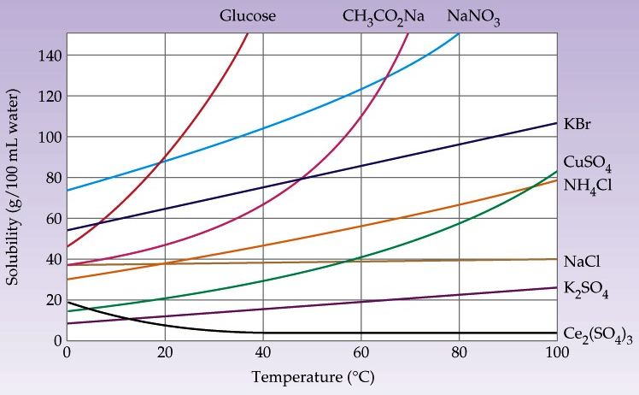
Solution Definitions
Miscible: Two (or more) liquids that are completely soluble in each other
Solubility: A measure of how much solute will dissolve in a solvent at a specific temperature
MAR

Slide 8
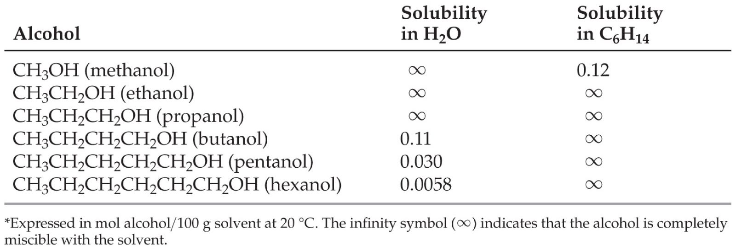
Factors Affecting Solubility
Chemists use the axiom “like dissolves like"
The closer the intermolecular forces of two phases of matter, the more likely they will dissolve to make a solution
Polar substances tend to dissolve in polar solvents.
Nonpolar substances tend to dissolve in nonpolar solvents.
MAR

Slide 9
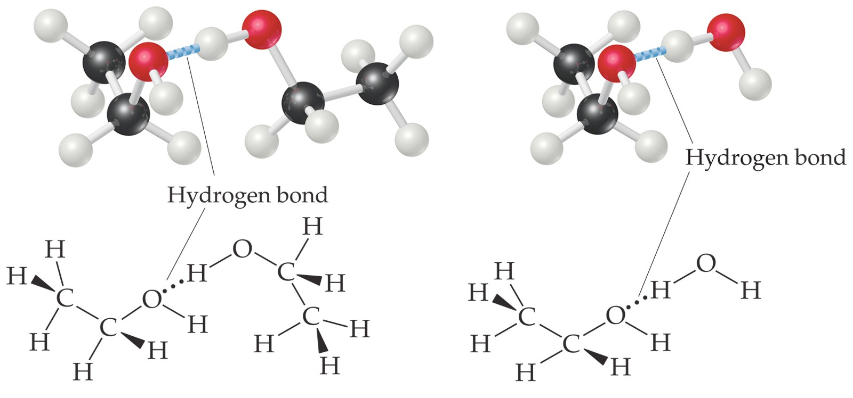
Factors Affecting Solubility
"Like dissolves like"
Example: water (polar, H-bonds) dissolves in acetone (polar)
Example: benzene (ID-ID) dissolves in toluene (ID-ID)
Example: benzene (ID-ID) does not dissolve very well in water (polar, H-bonds)
See Solubility Handout
We will discuss solubility more in CH 223
MAR
In which of the following solvents would you expect LiCl to be highly soluble?
H2O(l)
CCl4(l)
CS2(l)
CH3CH2CH2CH3(l)
C6H6(l)
Enter your response on
your i>Clicker now!
Answer = A,
water

Slide 10
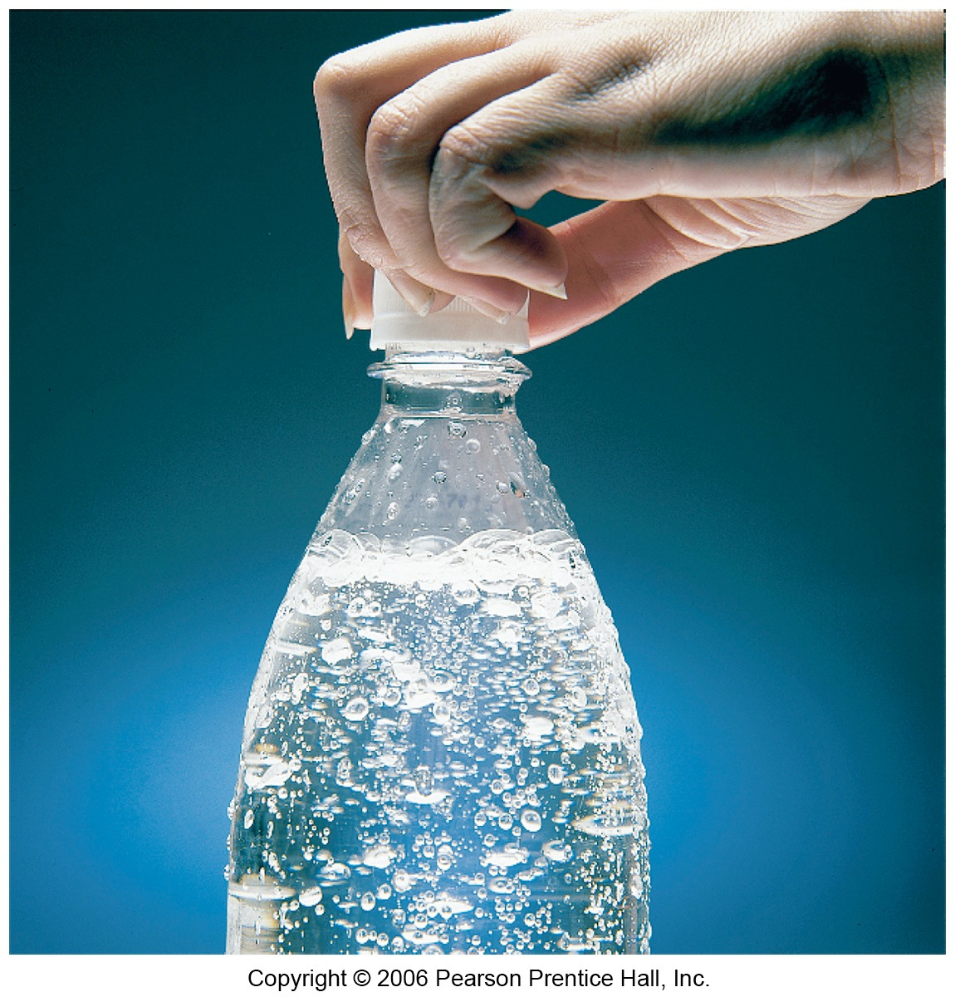
Henry's Law
The solubility of liquids and solids does not change appreciably with pressure.
The solubility of a gas in a liquid is directly proportional to its pressure.
Henry's Law: S_{g} = kP_{g}
S_{g} is the solubility of the gas (M)
k is the Henry’s Law constant for that gas in that solvent, and
P_{g} is the partial pressure of the gas above the liquid.
MAR

Slide 11
Dissolving Gases & Henry’s Law
Gas solubility (M) = S_{g} = k • P_{g}
k for O₂ = 1.66 x 10⁻⁶ M/mm Hg
When P_{g} drops, solubility drops.
MAR
After a can of Diet Coke is removed from the refrigerator, opened and left to stand awhile, which of the following best describes the changes that cause the soda to “go flat” (i.e. lose its CO₂ content)?
lowering the CO₂(g) pressure over the solution and raising of temperature
lowering the CO₂(g) pressure over the solution
lowering the temperature
change (increase) in salt content
Enter your response on
your i>Clicker now!
Answer = A,
lowering CO2(g) pressure over the solution and
raising the temperature

Slide 12
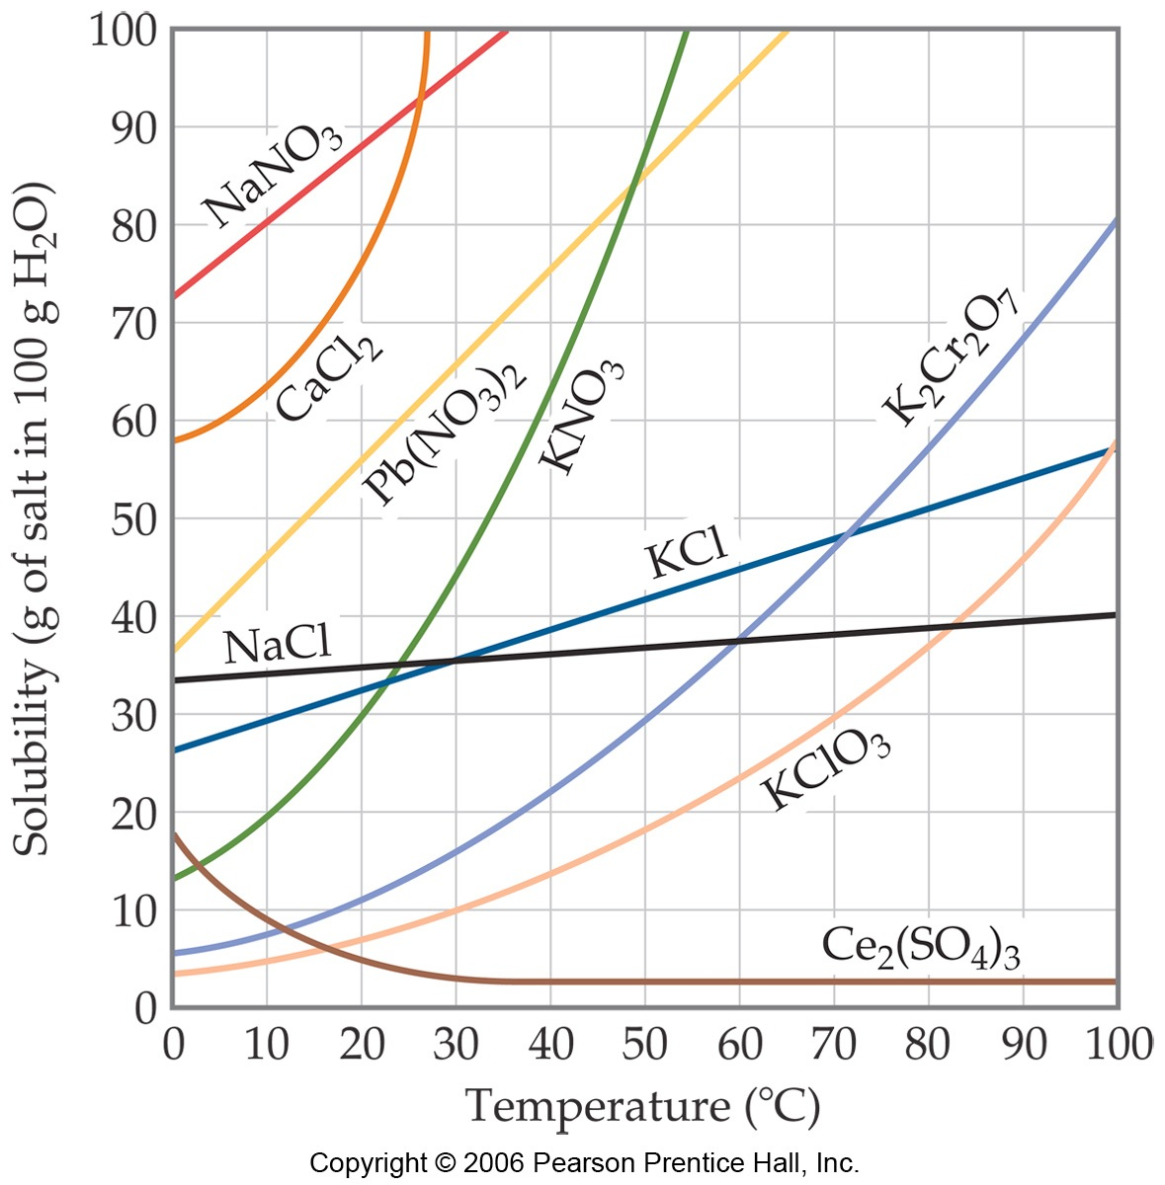
Temperature and Solubility
Generally, the solubility of solid solutes in liquid solvents increases with increasing temperature.
MAR

Slide 13
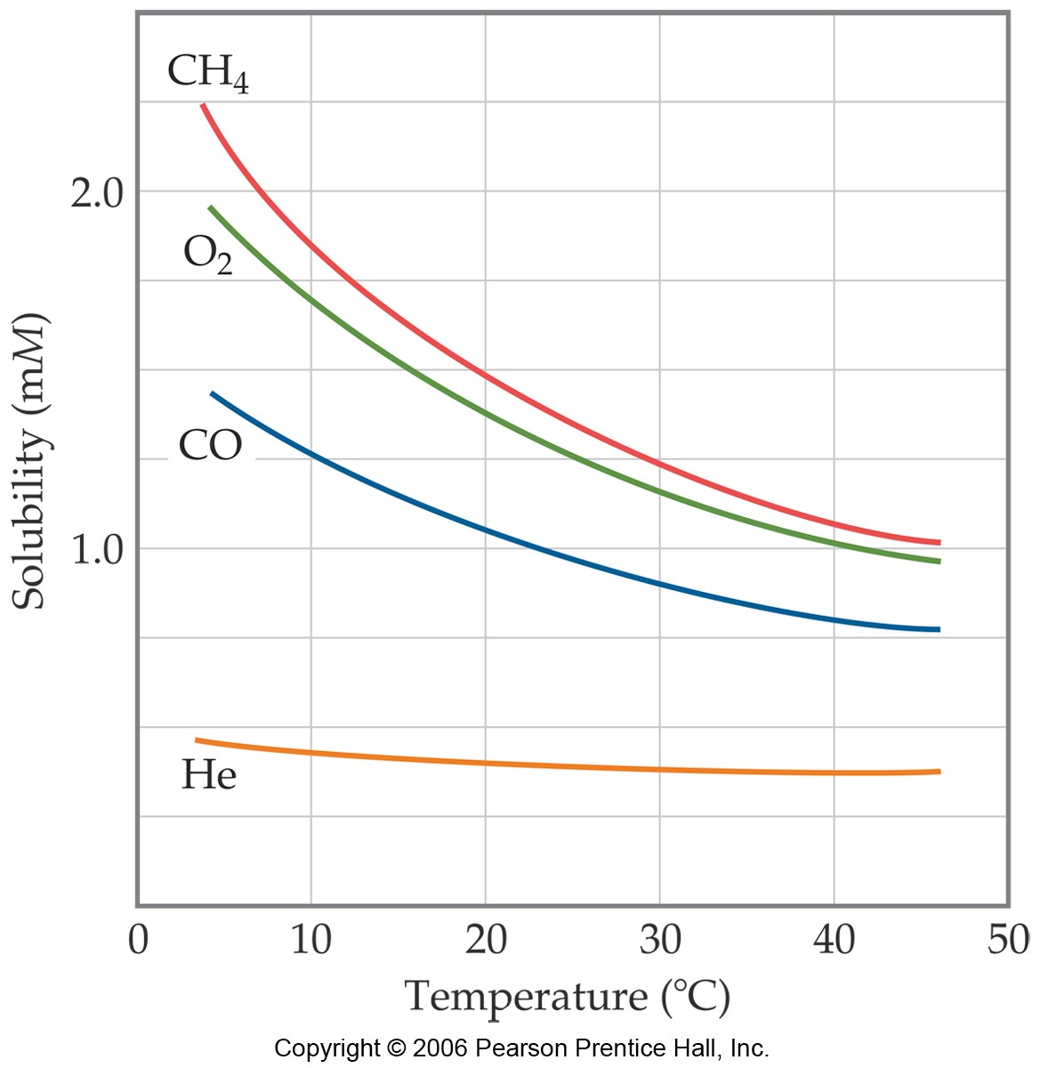
Temperature and Solubility
The opposite is true for gases.
Carbonated soft drinks are more “bubbly” if stored in the refrigerator.
Warm lakes have less O₂ dissolved in them than cool lakes.
MAR

Slide 14
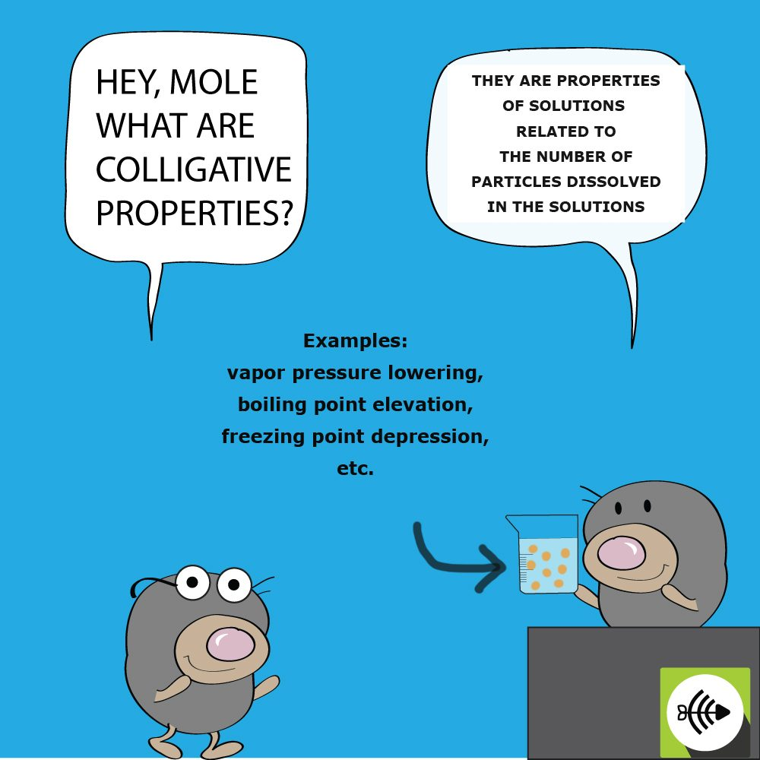
Colligative Properties
On adding a solute to a solvent, the solvent properties are modified.
Vapor pressure decreases
Melting point decreases
Boiling point increases
Osmosis is possible (osmotic pressure)
These changes are called COLLIGATIVE PROPERTIES.
They depend only on the NUMBER of solute particles relative to solvent particles, not on the KIND of solute particles. We need new concentration units! (more than molarity, M)
MAR

Slide 15
Concentration Units
MOLE FRACTION, X
For a mixture of A, B, and C
MOLALITY, m
WEIGHT % = grams solute per total g in solution
see Concentration Units Handout
MAR
You dissolve 1.0 mol (60. g) of urea (CO(NH2)2) in 15 mol (270 g) of water. What is the mole fraction of urea?
1.0
0.063
15
16
60.
Enter your response on
your i>Clicker now!
Answer = B,
0.063
= 1.0 / (15 + 1.0)
= 0.063

Slide 16
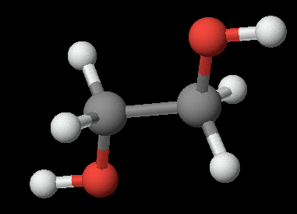
Calculating Concentrations
Dissolve 62.1 g (1.00 mol) of ethylene glycol in 250. g of H₂O. Calculate mol fraction, molality, and weight % of glycol.
MAR

Slide 17
Calculating Concentrations
Dissolve 62.1 g (1.00 mol) of ethylene glycol in 250. g of H₂O. Calculate X, m, and % of glycol.
250. g H₂O = 13.9 mol
X_{glycol} = 0.0672
X_{water} = 1 - 0.0672 = 0.9328
MAR

Slide 18
Calculating Concentrations
Dissolve 62.1 g (1.00 mol) of ethylene glycol in 250. g of H₂O. Calculate X, m, and % of glycol.
Calculate molality
Calculate weight %
%water = 100% - 19.9% = 80.1%
MAR
see Concentration Units Handout
You dissolve 92.0 grams of CH₃CH₂OH, ethanol, in 270. g of water. What is the mass percent ethanol in the solution?
92.0%
270.%
362%
16.0%
25.4%
Enter your response on
your i>Clicker now!
Answer = E,
25.4%
= {92 / (92 + 270)} * 100%

Slide 19
M vs m, χ and wt%
Converting between molality (m), mole fraction (χ) and weight percent (wt%) relatively straightforward
Molarity (M) = mol solute per Liter of solution
Converting from m, χ or wt% to molarity (M) requires solution density in units of g/mL or g/cm³
Recall: solution = solute + solvent
MAR

Slide 20
M vs m, χ and wt%
Example: Convert a 10.7 m aqueous NaOH solution to χ, wt% and M if the solution density = 1.33 g/cm³.
Solution:
Assume 1 kg solvent and 10.7 mol solute
1 kg water = 1000 g H₂O = 55.5 mol H₂O
10.7 mol NaOH * 40.0 g mol⁻¹ = 428 g NaOH
MAR

Slide 21
M vs m, χ and wt%
Example: Convert a 10.7 m aqueous NaOH solution to χ, wt% and M if the solution density = 1.33 g/cm³.
χ_{NaOH} = 10.7 / (10.7 + 55.5) = 0.162
wt%_{NaOH} = 428 / (1000 + 428) * 100%
wt%_{NaOH} = 30.0%
You do not need the density of the solution to calculate wt% and χ from molality!
MAR

Slide 22
M vs m, χ and wt%
Example: Convert a 10.7 m aqueous NaOH solution to χ, wt% and M if the solution density = 1.33 g/cm³.
If we have 1000 g of solvent (H₂O),
then we have 428 g of solute (NaOH) or
1428 g of solution (NaOH + H₂O)
Volume of solution = 1428 g * (cm³ / 1.33 g)
Volume of solution = 1070 mL = 1.07 L
Molarity = 10.7 mol NaOH / 1.07 L solution
Molarity NaOH = 10.0 M
MAR
see Concentration Units Handout

Slide 23
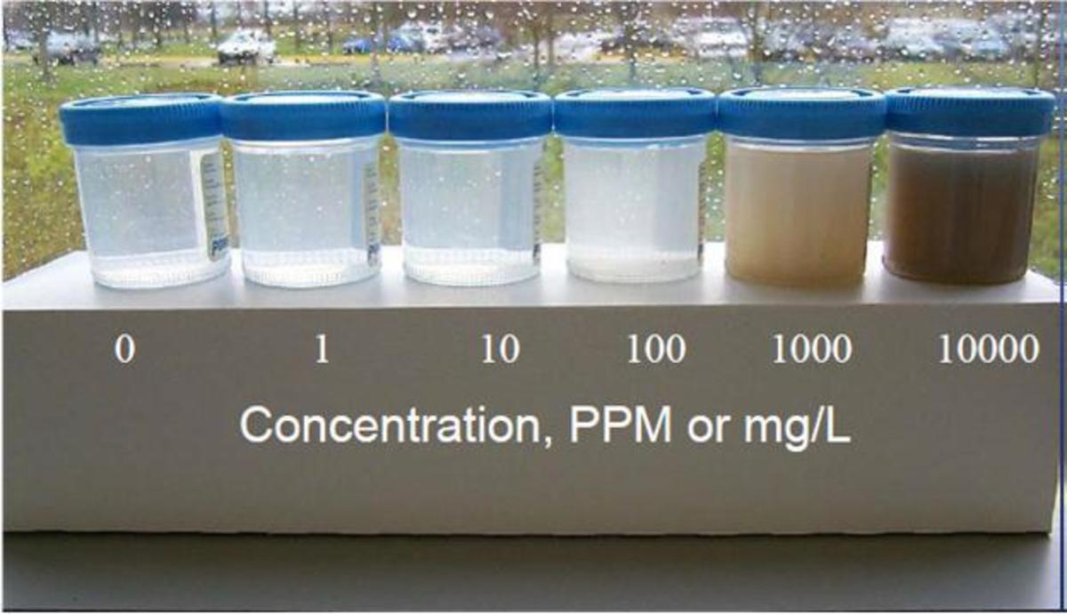
Parts Per Million (ppm)
Expresses very dilute concentrations; used by environmental chemists, biologists, geologists, etc.
1.0 ppm = 1.0 g of a substance in a sample with a total mass of 1.0 million (10⁶) g
Density of water about 1.0 g/mL, units often interconverted
Also parts per thousand (ppt), parts per billion (ppb), etc.
Different than the lab parts per thousand, which is a measure of precision
MAR

Slide 24
Understanding Colligative Properties
To understand colligative properties, study the LIQUID-VAPOR EQUILIBRIUM for a solution.
The right animation assumes a non-volatile solute
MAR

Slide 25
Understanding Colligative Properties
Vapor Pressure of H₂O over a solution depends on the number of H₂O molecules per solute molecule.
P_{solvent} proportional to X_{solvent}
or
P_{solvent} = X_{solvent} • Pº_{solvent}
Vapor Pressure of solvent over solution = (Mol frac solvent)•(VP pure solvent)
RAOULT’S LAW: The vapor pressure of solvent over a solution is always LOWER than the pure solvent!
MAR

Slide 26
Raoult’s Law
Non-volatile ethylene glycol (62.1 g) is placed in 250. g of water. What is the vapor pressure of water in the solution at 30 ºC? (The vapor pressure of pure H₂O is 31.8 mm Hg)
Solution
X_{glycol} = 0.0672 and so X_{water} = ?
Because X_{glycol} + X_{water} = 1
X_{water} = 1.000 - 0.0672 = 0.9328
P_{water} = X_{water} • Pº_{water} = (0.9328)(31.8 mm Hg)
P_{water} = 29.7 mm Hg
MAR
You dissolve 0.0400 mol of I₂ (10.1 g) in 1.96 mol of CCl₄ (300 g) at 65 °C. Given that the vapor pressure of pure CCl₄ is 504 mm Hg at 65 °C, what is the vapor pressure of the CCl₄ over this solution?
504 mm Hg
514 mm Hg
494 mm Hg
10.1 mm Hg
1.96 mm Hg
Enter your response on
your i>Clicker now!
Answer = C,
494 mm Hg
= (1.96/(1.96+0.0400)) * 504 mm Hg
= 0.980 * 504 mm Hg
= 494 mm Hg

Slide 27
Raoult’s Law
Previous examples assumed a non-volatile solute to calculate vapor pressure. If solute is volatile, then:
P_{total} = X_{A} • Pº_{A} + X_{B} • Pº_{B} + X_{C} • Pº_{C} +...
Example: At 25 ˚C, heptane (Pº = 31 torr) and octane (Pº = 11 torr) are mixed such that X_{heptane} = 0.15. Calculate the total vapor pressure of the system.
Solution: This is a two component system.
If X_{heptane} = 0.15, then
X_{octane} = 1 - 0.15 = 0.85
MAR

Slide 28
Raoult’s Law
Problem: At 25 ˚C, heptane (Pº = 31 torr) and octane (Pº = 11 torr) are mixed such that X_{heptane} = 0.15 and X_{octane} = 0.85. Calculate the total vapor pressure of the system.
Solution: In a two component system,
P_{total} = X_{hept} • Pº_{hept} + X_{oct} • Pº_{oct}
P_{total} = 0.15 • 31 torr + 0.85 • 11 torr
P_{total} = 4.7 + 9.4 = 14.1 torr
The total vapor pressure in the mixture is 14.1 torr
MAR

Slide 29
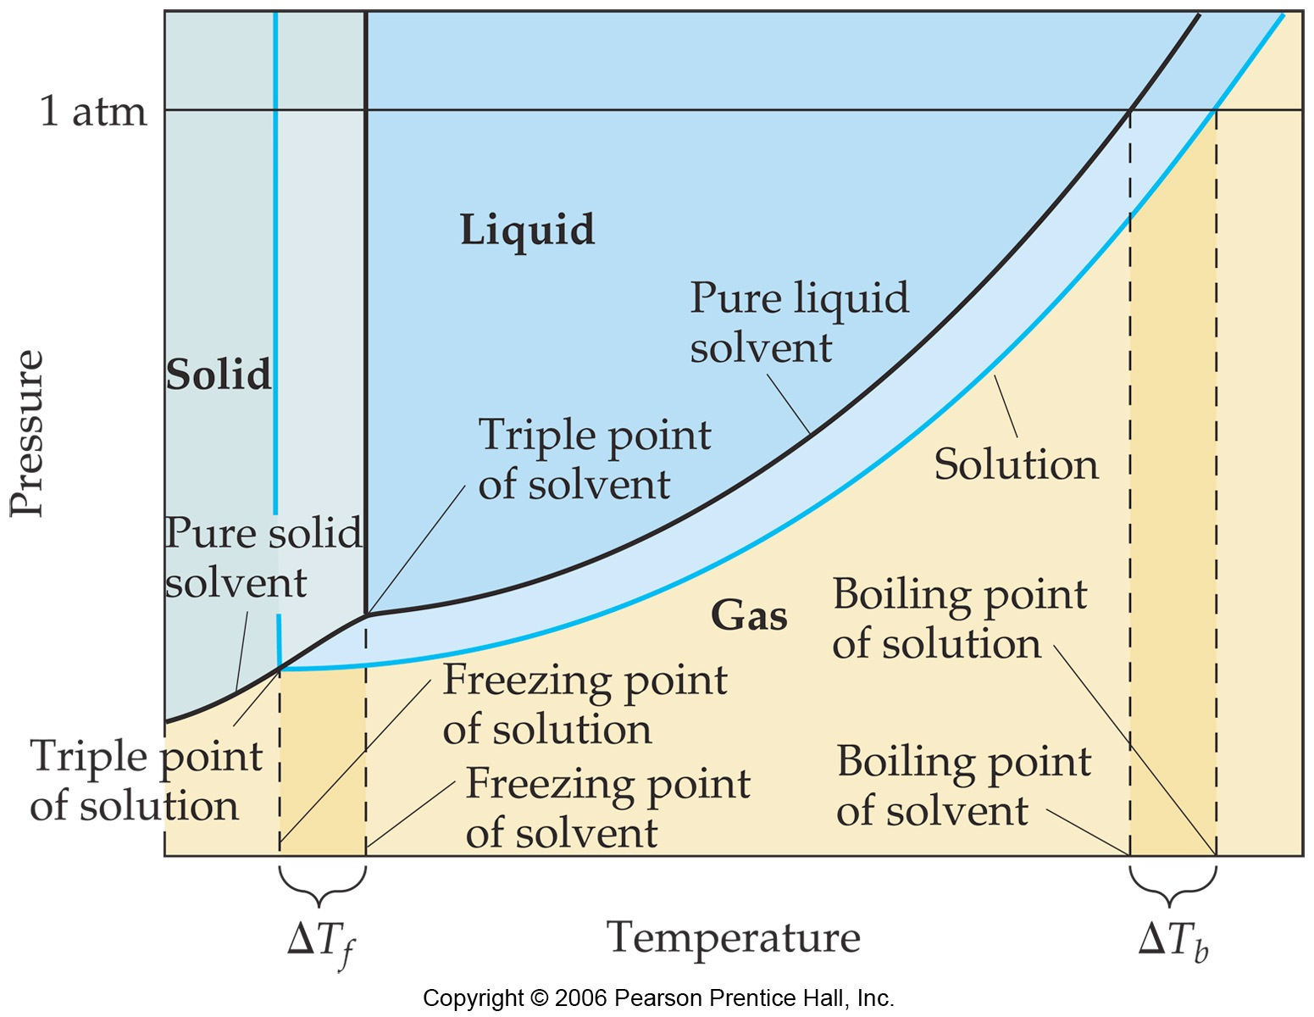
The boiling point of a solution is higher than that of the pure solvent.
MAR

Slide 30
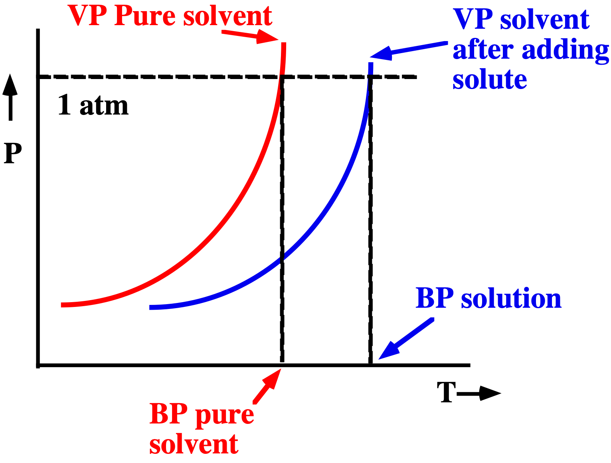
Elevation of Boiling Point
Elevation in BP = ∆T_{BP} = K_{BP} • m
(where K_{BP} is characteristic of solvent)
MAR

Slide 31
Change in Boiling Point
Dissolve 62.1 g of glycol (1.00 mol) in 250. g of water. What is the BP of the solution?
K_{BP} = 0.512 ºC/molal for water (see Textbook)
Solution
1. Calculate solution molality = 4.00 m
2. ∆T_{BP} = K_{BP} • m
∆T_{BP} = 0.512 ºC/molal (4.00 molal)
∆T_{BP} = 2.05 ºC
BP = 100.00 + 2.05 = 102.05 ºC
MAR

Slide 32
Change in Freezing Point
Pure water
Ethylene glycol/water
solution
The freezing point of a solution is LOWER than that of the pure solvent.
Notice how the animations incorrectly use "dense" ice!
MAR

Slide 33
The freezing point of a solution is lower than that of the pure solvent.
FP depression = ∆T_{FP} = K_{FP} • m
MAR

Slide 34
Freezing Point Depression
Calculate the FP of a 4.00 molal glycol/water solution.
K_{FP} = 1.86 ºC/molal (from Textbook)
Solution
∆T_{FP} = K_{FP} • m
= (1.86 ºC/molal)(4.00 m)
∆T_{FP} = 7.44 ºC
So the FP = 0 ˚C - 7.44 ˚C = -7.44 ˚C
Many textbooks use negative K_{FP} values
If using negative K_{FP}, ∆T_{FP} is also negative
Concentration (molality) must be positive!
MAR

Slide 35
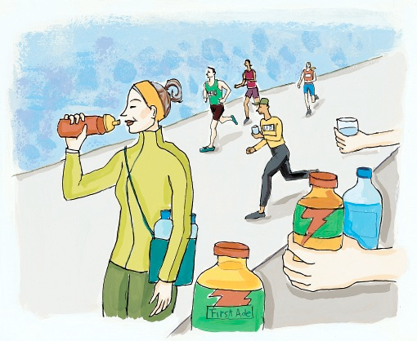
Freezing Point Depression of Electrolytes
How much NaCl must be dissolved in 4.00 kg of water to lower FP to -10.00 ºC?
Solution
Calculate required molality
∆T_{FP} = K_{FP} • m
(0 - -10.00 ºC) = (1.86 ºC/molal) • m
m = 5.38 molal
Use -10 ºC for ∆T if -1.86 ºC/m
MAR

Slide 36
Freezing Point Depression of Electrolytes
How much NaCl must be dissolved in 4.00 kg of water to lower FP to -10.00 ºC?
Solution
Concentration required = 5.38 molal
This means we need 5.38 mol of dissolved particles per kg of solvent.
Recognize that m represents the total concentration of all dissolved particles.
Recall that 1 mol NaCl(aq) --> 1 mol Na⁺(aq) + 1 mol Cl⁻(aq)... or: 2 mol of particles per 1 mol of ionic solute!
MAR

Slide 37
Freezing Point Depression of Electrolytes
How much NaCl must be dissolved in 4.00 kg of water to lower FP to -10.00 ºC?
Solution
Concentration required = 5.38 molal
We need 5.38 mol of dissolved particles per kg of solvent.
NaCl(aq) --> Na⁺(aq) + Cl⁻(aq)
2 particles per mol NaCl!
To get 5.38 mol/kg of particles we need
5.38 mol / 2 = 2.69 mol NaCl / kg
2.69 mol NaCl / kg ---> 157 g NaCl / kg
(157 g NaCl / kg)•(4.00 kg) = 629 g NaCl
MAR

Slide 38
Boiling Point Elevation and Freezing Point Depression
∆T = k • m • i
A generally useful equation
i = van’t Hoff factor = number of particles produced per formula unit.
Compound Theoretical Value of i
glycol 1
NaCl 2
CaCl₂ 3
MAR
We will use the theoretical value of i in CH 222
Which aqueous solution is expected to have the higher boiling point?
0.10 m NaCl
0.15 m sugar
pure water will have a higher boiling point than either solution
Enter your response on
your i>Clicker now!
Answer = A,
0.1 m NaCl
i = 2, twice the boiling point elevation
of i = 1 sugar
Notes:
Called "Limiting value" in the Brown text

Slide 39
Colligative Properties and Molar Mass
Can use colligative properties to find molar mass of solute
Molar mass = grams solute / moles solute
Example: Find the molar mass of azulene if 0.640 g are dissolved in 99.0 g of benzene (k_{b} = 2.53 ˚C/m), and the observed boiling point is 80.230 ˚C. (normal bp = 80.100 ˚C)
Solution:
∆T = (80.230 - 80.100) = 0.130 ˚C
m = ∆T/k_{b} = 0.130 ˚C/2.53 ˚C/m = 5.14*10⁻² mol / kg
0.0990 kg * 5.14*10⁻² mol / kg solvent = 5.05*10⁻³ mol
Molar mass = grams solute / moles solute
Molar mass = 0.640 g / 5.05*10⁻³ moles = 127 g mol⁻¹
MM = (grams solute * k)/(ΔT*kg solvent)
useful for both bp and fp calculations
MAR

Slide 40
Osmosis
Dissolving the shell in vinegar
Egg in pure water
Egg in corn syrup
MAR

Slide 41
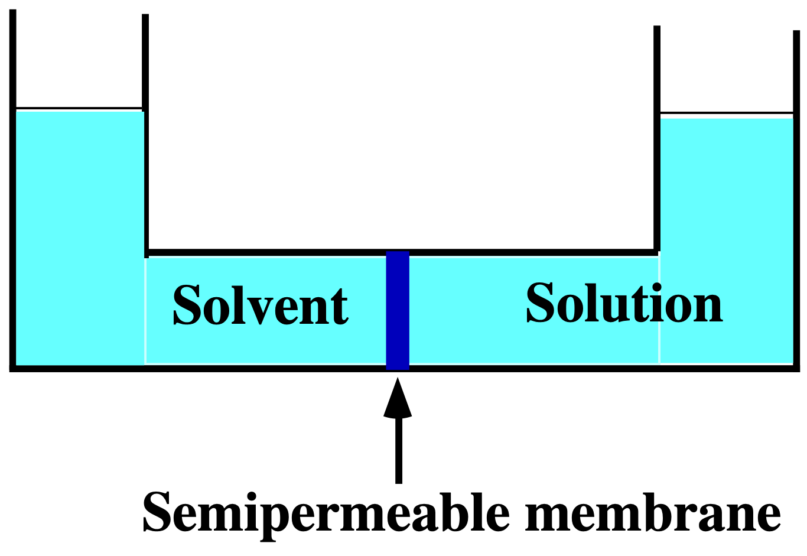
Osmosis
The semipermeable membrane allows only the movement of solvent molecules.
Solvent molecules move from pure solvent to solution in an attempt to make both have the same concentration of solute.
Driving force is entropy (CH 223)
MAR

Slide 42
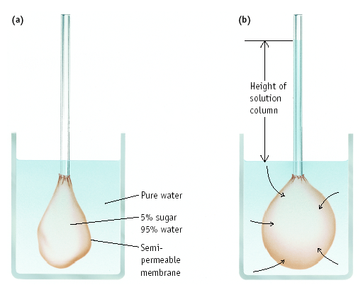
Process of Osmosis
MAR

Slide 43
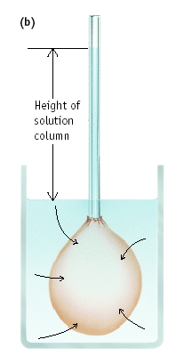
Osmotic Pressure, ∏
Equilibrium is reached when pressure - the OSMOTIC PRESSURE, ∏ - produced by extra solution counterbalances pressure of solvent molecules moving through the membrane.
∏ = icRT
c = conc. in mol/L
i = the van't Hoff factor
R = 0.082057 (L atm)/(mol K)
T = Kelvin Temp.
Osmotic pressure
MAR

Slide 44
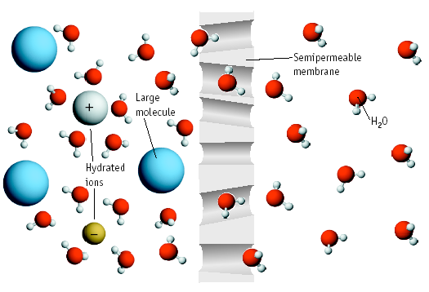
Osmosis
MAR

Slide 45
Osmosis Calculating a Molar Mass
Dissolve 35.0 g of hemoglobin in enough water to make 1.00 L of solution. π measured to be 10.0 mm Hg at 25 ˚C. Calc. molar mass of hemoglobin.
Solution
(a) Calc. π in atmospheres
π = 10.0 mm Hg • (1 atm / 760 mm Hg)
π = 0.0132 atm
MAR

Slide 46
Osmosis Calculating a Molar Mass
Dissolve 35.0 g of hemoglobin in enough water to make 1.00 L of solution. π measured to be 10.0 mm Hg at 25 ˚C. Calc. molar mass of hemoglobin.
Solution
(b) Calc. concentration from π = cRT
Conc = 5.40 x 10⁻⁴ mol/L (* 1 L)
(c) Calc. molar mass
Molar mass = 35.0 g / 5.40 x 10⁻⁴ mol
Molar mass = 64,800 g/mol
MAR

Slide 47
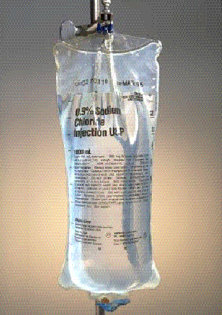
Osmosis
Osmosis of solvent from one solution to another can continue until the solutions are ISOTONIC - they have the same concentration.
Osmotic pressure important in living systems
MAR

Slide 48
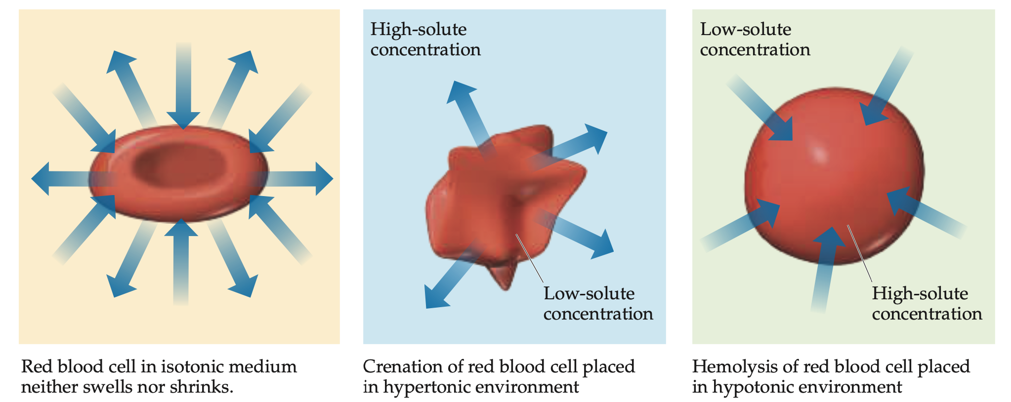
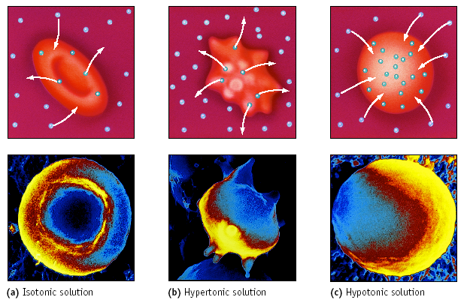
Osmosis & Living Cells
MAR

Slide 49
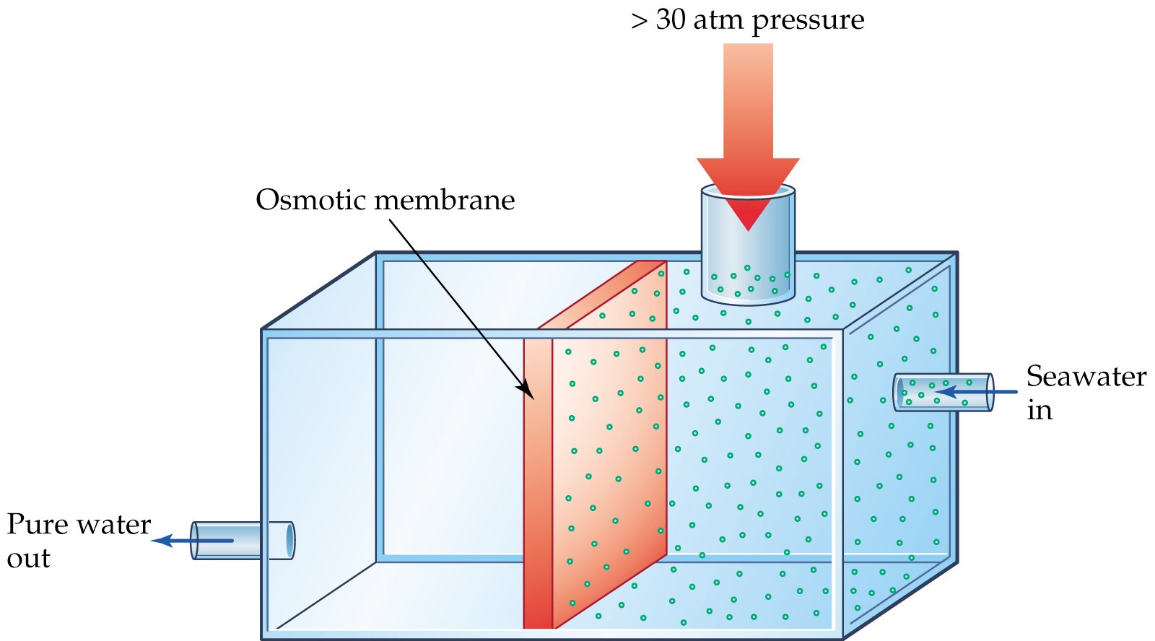
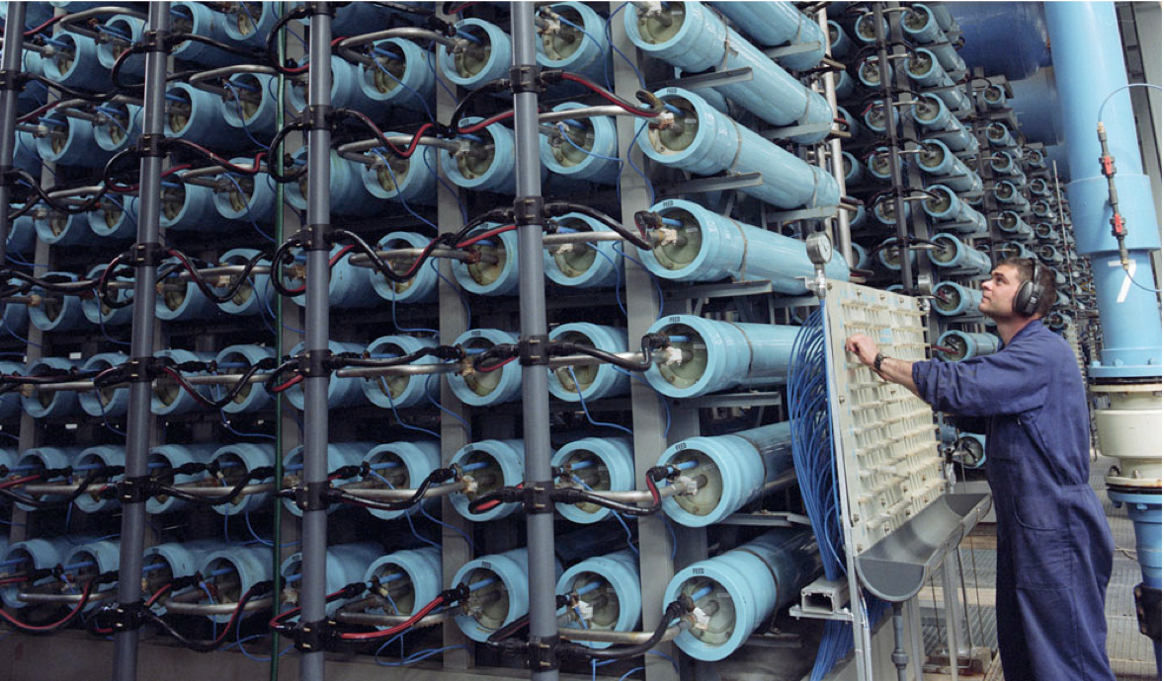
Reverse Osmosis Water Desalination
External pressure allows for reverse osmosis
MAR

Slide 50
Other Homogeneous Mixtures
Homogeneous mixtures: more than just solutions!
Solutions - most important, particles in the range 0.2 - 2 nm in diameter (salt water, acids, etc.)
Colloids - a "solution" with particles in the range 2 - 1000 nm (milk, fog, etc.)
Suspensions - contain particles greater than 1000 nm in diameter (blood, paint, aerosol sprays, etc.)
MAR

Slide 51
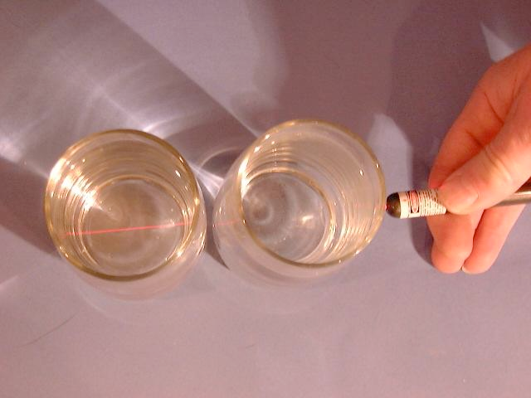
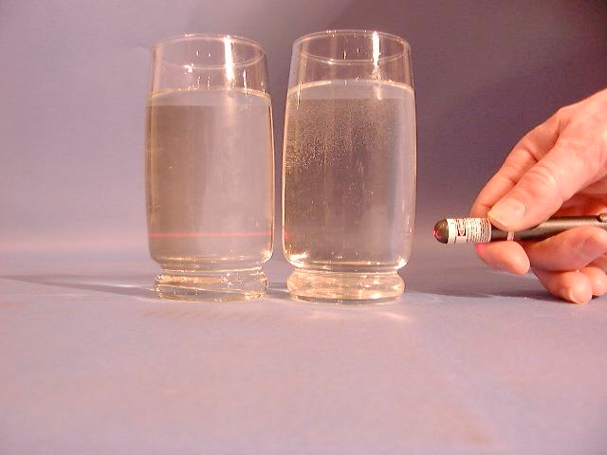
The Tyndall Effect
Colloids (and suspensions) have particles too small to settle out of solution - hence, the Tyndall effect
Right: Pure tap water
Left: 5 ppm colloidal silver
MAR
Notes:
Pictures from: http://silver-lightning.com/tyndall/

Slide 52
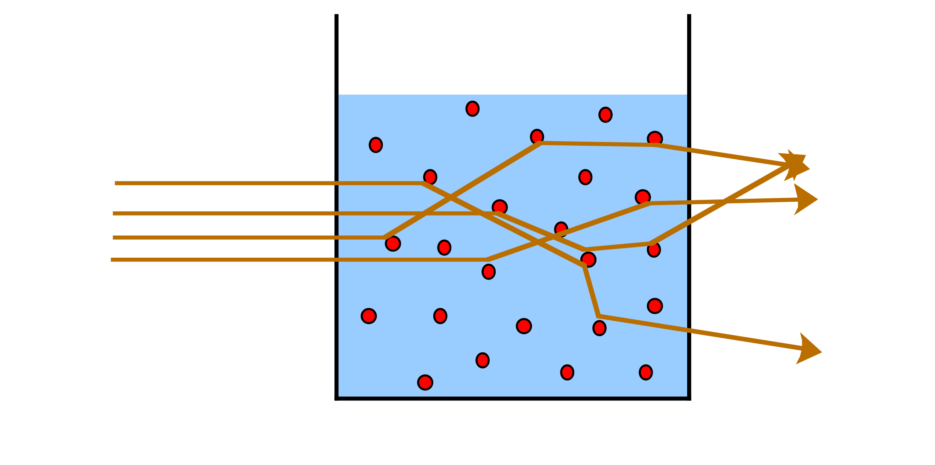
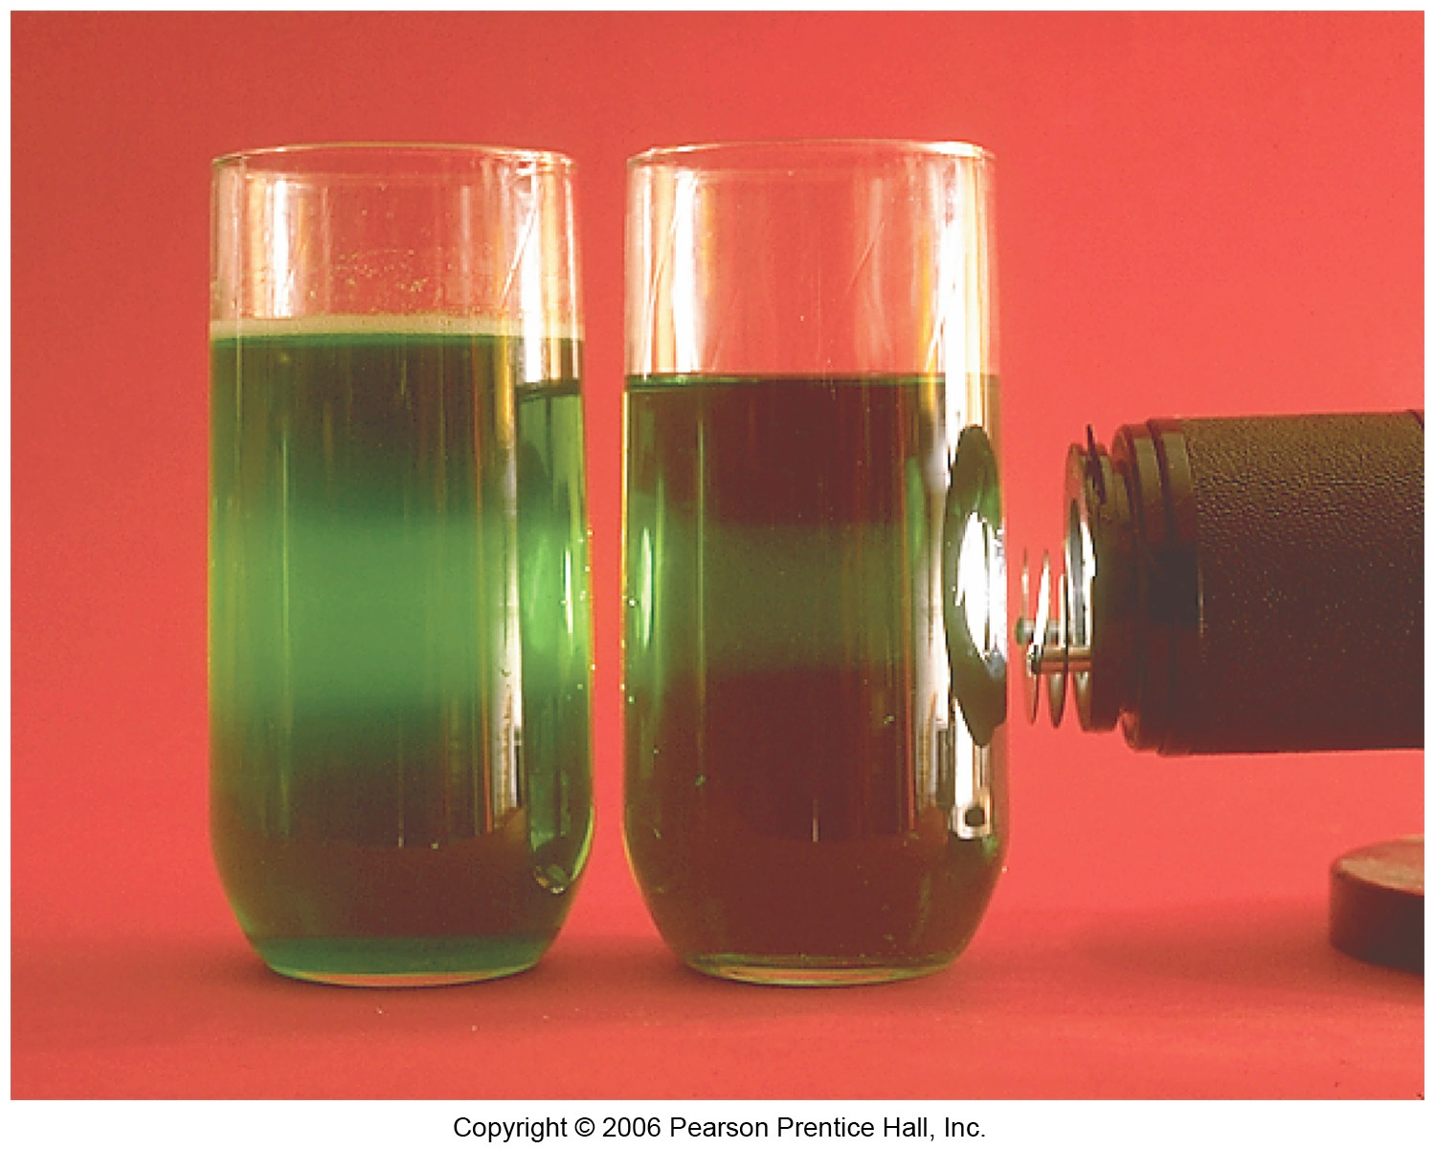
The Tyndall Effect
MAR

Slide 53
Colloids
Colloids have a dispersed phase ("solute") and a dispersing medium ("solvent"). Many types of colloids:
Type D Medium D Phase Examples
aerosol gas liquid fog, clouds
aerosol gas solid smoke, viruses
foam liquid gas shaving cream
emulsion liquid liquid milk, mayonnaise
sol liquid solid mud, paint, ink
foam solid gas foam rubber, sponge
gel solid liquid jelly, cheese, yogurt
solid sol solid solid steel, bronze, pearls
MAR

Slide 54
Surfactant Emulsifying Agents
Surfactants (or Surfactant Emulsifying Agents) promote the formation of colloids by coating dispersed phase, preventing the formation of large particles.
Surfactants used for cleaning called detergents.
MAR

Slide 55
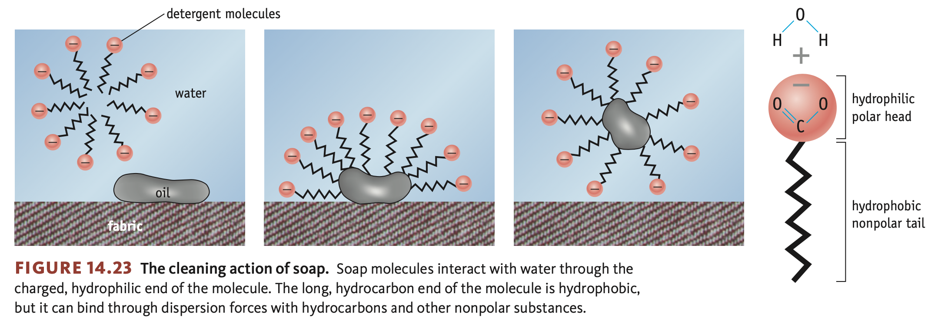
Surfactant Emulsifying Agents
Soaps and detergents: surfactants with both a hydrophobic (nonpolar) and a hydrophilic (polar) end. Can remove nonpolar oils and polar compounds.
Soaps often grouped in micelles with like-polarities grouped together.
MAR

Slide 56
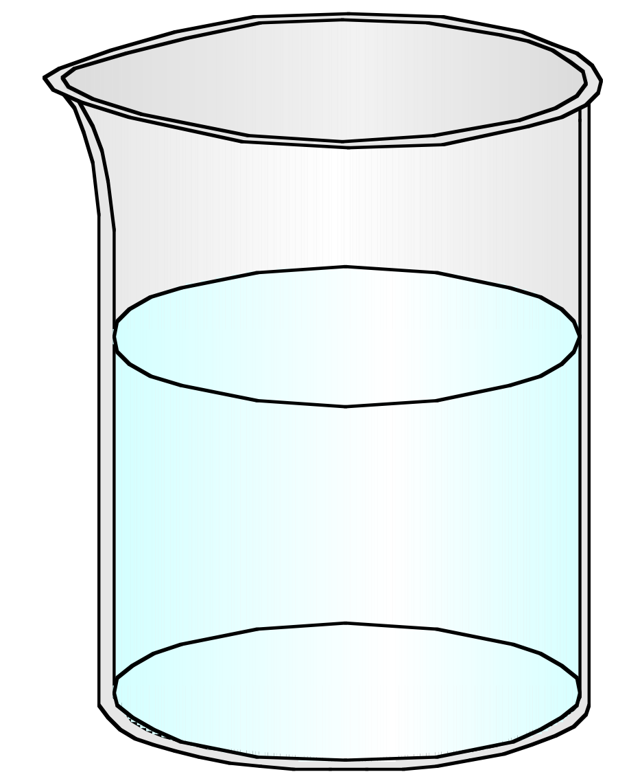
Oil and Water
Oil and water do not mix due to differences in polarity; water excludes oil due to stronger intermolecular forces
Soap removes oil readily using nonpolar end of micelle
⁻OOC
COO⁻
COO⁻
⁻OOC
MAR

Slide 57
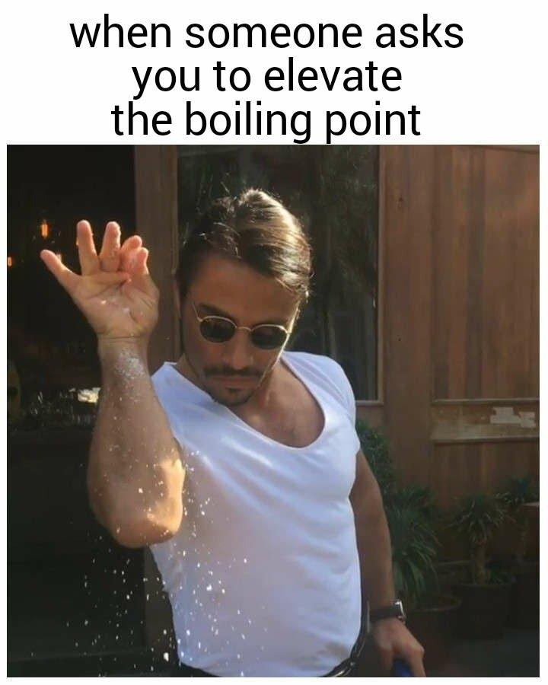
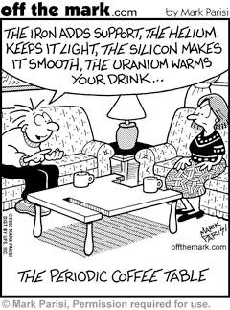
End of Chapter 11
See:
Chapter Eleven Study Guide
Chapter Eleven Concept Guide
Important Equations (following this slide)
End of Chapter Problems (following this slide)
MAR

Slide 58
Important Equations, Constants, and Handouts
from this Chapter:
Henry’s Law:
solution = solute + solvent
see Concentration Units Handout
$$S_{g}=k∙P_{g}$$
Raoult’s Law / Vapor Pressure Depression:
Solution Concentrations:
$$P_{solvent}=χ_{solvent}∙P_{solvent}^{o}$$
$$Molarity(M)=\frac{molSolute}{LSolution}$$
$$molality(m)=\frac{molSolute}{kgSolvent}$$
Boiling Point Elevation /
Freezing Point Depression:
$$ΔT_{BP/FP}=K_{BP/FP}∙(\frac{molSolute}{kgSolvent})∙i$$
$$weight\%=\frac{massSolute}{Totalmass}$$
Osmosis:
$$molefraction(χ)=\frac{molA}{totalmol}$$
$$π=i(\frac{molSolute}{LSolvent})RT$$
$$ppm=\frac{1.0gofsubstance}{1.0milliongsample}$$
R = 0.082057 L atm mol⁻¹ K⁻¹
i = van’t Hoff factor

Slide 59
End of Chapter Problems: Test Yourself
Fill in the blanks in the table. All solutions are aqueous.
Hydrochloric acid is sold as a concentrated aqueous solution. If the molarity of commercial HCl is 12.0 and its density is 1.18 g/cm3, calculate the molality and the weight percent of HCl in the solution.
A soda can has an aqueous CO2 concentration of 0.0506 M. What is the pressure of CO2 gas in the can? (kH = 4.48 x 10⁻⁵ M/mm Hg)
Pure nonvolatile iodine (105 g) is dissolved in 325 g of CCl4 at 65 °C. Given that the vapor pressure of CCl4 at this temperature is 531 mm Hg, what is the vapor pressure of the solution at 65 °C?
What is the boiling point of a solution composed of 15.0 g of CHCl3 (which boils at 61.70 °C) and 0.515 g of the nonvolatile solute acenaphthene, C12H10?
An aqueous solution containing 1.00 g of bovine insulin (a protein, not ionized) per liter has an osmotic pressure of 3.1 mm Hg at 25 °C. Calculate the molar mass of bovine insulin.
Compound | Molality | Weight Percent | Mole Fraction
NaI | 0.15 | _____ | _____
C2H5OH | _____ | 5 | _____
C12H22O11 | _____ | _____ | 0.0027

Slide 60
End of Chapter Problems: Answers
Completed table:
Compound Molality Weight percent Mole fraction
NaI 0.15 2.20 .0027 C2H5OH 1.1 5.00 .020 C12H22O11 0.15 4.90 .0027
16.2 m, 37.1%
1130 mm Hg
444 mm Hg
62.51 °C
6.0 x 10³ g/mol

