Slide 1
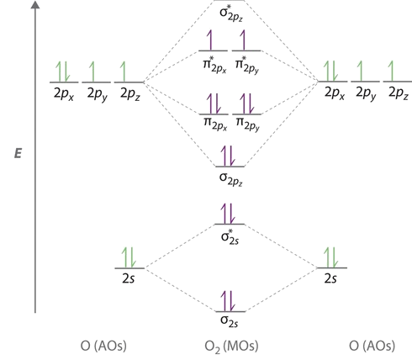
Bonding and Molecular Structure: Orbital Hybridization and Molecular Orbitals Chapter 8
Chemistry 222
Professor Michael Russell
[Core electrons]
Last update:
4/29/24
MAR

Slide 2
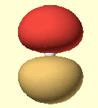
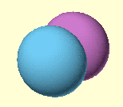
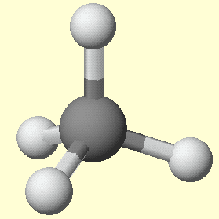
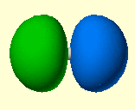
Advanced Theories of Chemical Bonding
Atomic Orbitals
Molecules
MAR

Slide 3
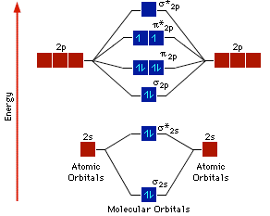
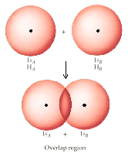
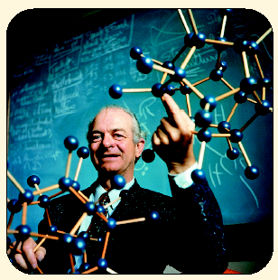
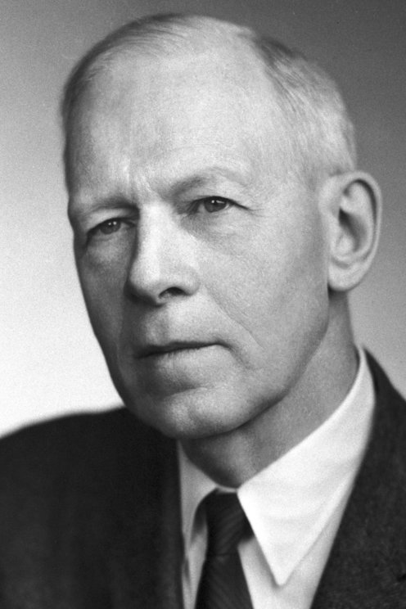
Two Theories of Bonding
VALENCE BOND (VB) THEORY - Linus Pauling
valence electrons are localized between atoms (or are lone pairs)
half-filled atomic orbitals overlap to form bonds.
electrons stabilized by 2 nuclei
MOLECULAR ORBITAL (MO) THEORY - Robert Mulliken
valence electrons are delocalized over entire molecule in molecular orbitals
MAR
Robert Mulliken

Slide 4
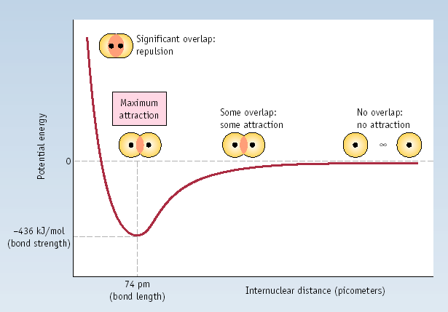
Sigma Bond Formation by Orbital Overlap
Two s orbitals overlap
MAR

Slide 5
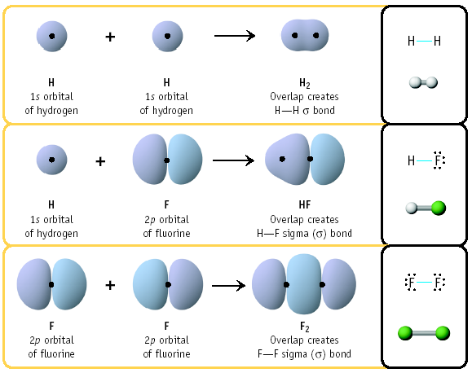
Sigma Bond Formation by Orbital Overlap
Two s orbitals overlap
One s & one p overlap
Two p orbitals overlap
MAR

Slide 6
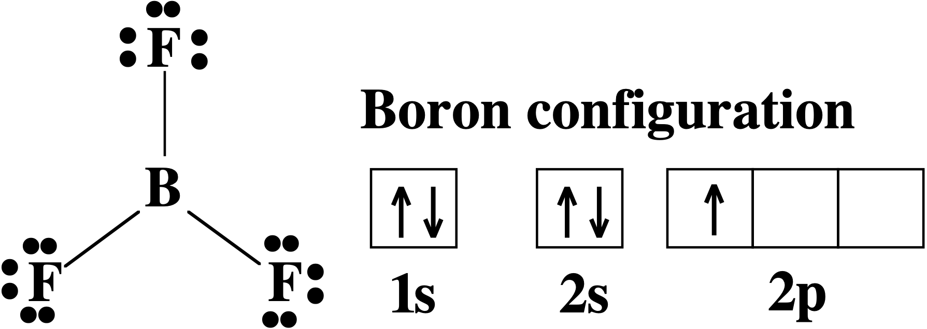
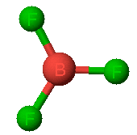
Using Valence Bond Theory
Bonding in BF₃
planar triangle
angle = 120º
MAR

Slide 7
Bonding in BF₃
How to account for 3 bonds 120º apart using a spherical s orbital and p orbitals that are 90º apart?
Pauling said to modify VB approach with ORBITAL HYBRIDIZATION
- mix available orbitals to form a new set of orbitals - HYBRID ORBITALS - that will give the maximum overlap in the correct geometry.
MAR

Slide 8
Bonding in BF₃
2s
2p
hybridize orbs.
rearrange electrons
three sp
2
unused p
orbital
hybrid orbitals
MAR

Slide 9
Bonding in BF₃
The three hybrid orbitals are made from 1 s orbital and 2 p orbitals create 3 sp² hybrids.
Now we have 3, half-filled HYBRID orbitals that can be used to form planar B-F sigma bonds.
MAR

Slide 10
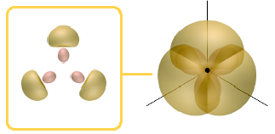
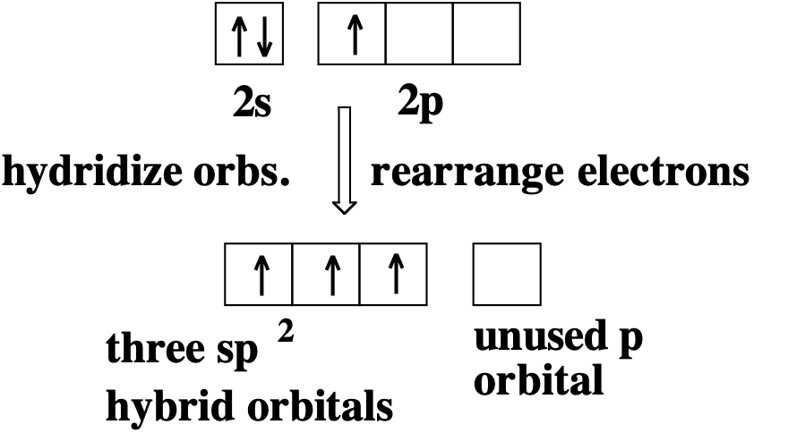
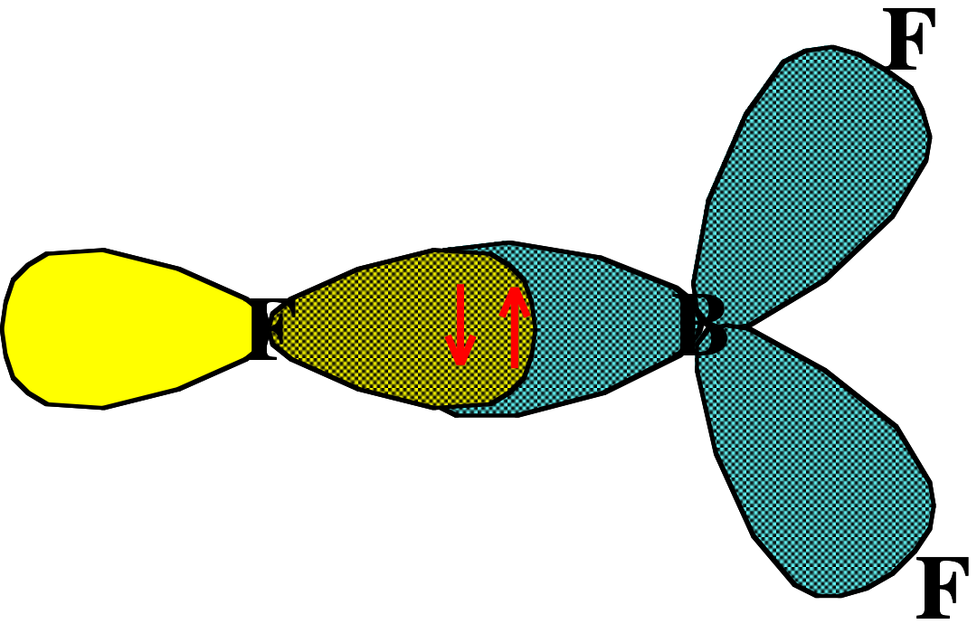
Bonding in BF₃
An orbital from each F overlaps one of the sp² hybrids to form a B-F σ bond.
MAR

Slide 11
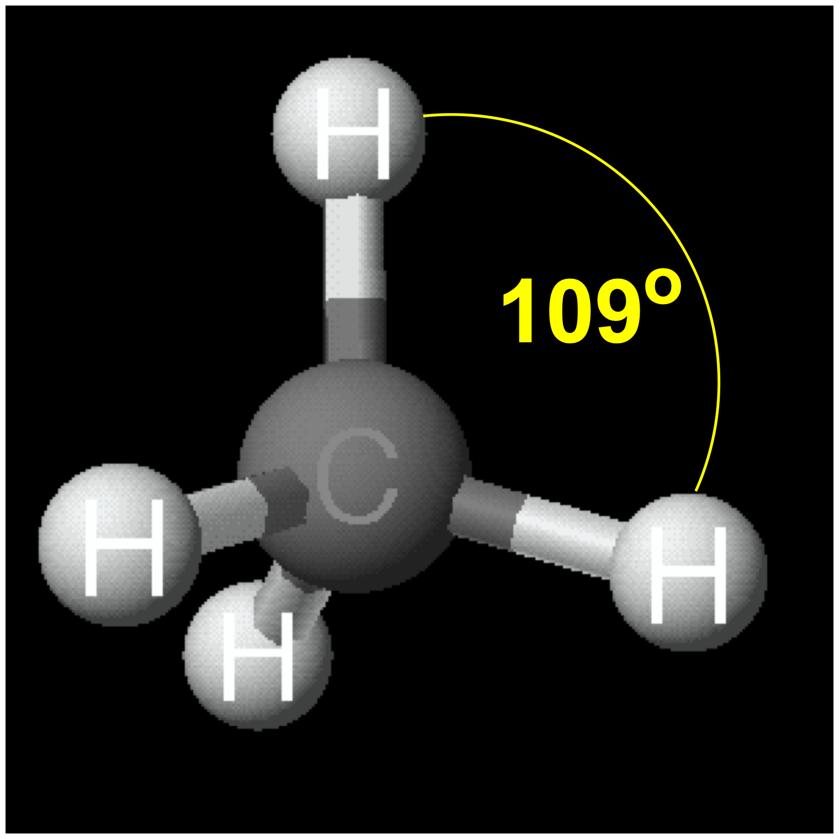
Bonding in CH₄
How do we account for 4 C-H sigma bonds 109º apart?
Need to use 4 atomic orbitals - s, p_{x}, p_{y}, and p_{z} - to form 4 new hybrid orbitals pointing in the correct direction.
MAR

Slide 12
Bonding in a Tetrahedron - Formation of Hybrid Atomic Orbitals
4 C atom orbitals hybridize to form four equivalent sp³ hybrid atomic orbitals.
MAR

Slide 13
Bonding in a Tetrahedron - Formation of Hybrid Atomic Orbitals
4 C atom orbitals hybridize to form four equivalent sp³ hybrid atomic orbitals.
MAR

Slide 14
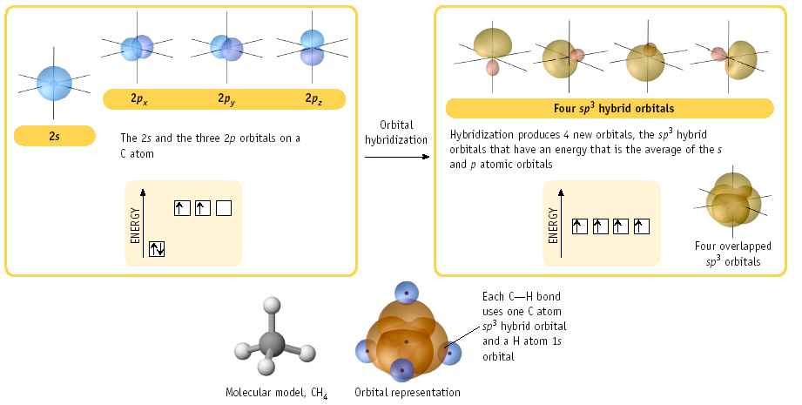
Bonding in CH₄
MAR

Slide 15
Orbital Hybridization
Bonds EPG Hybrid REMAINING p orbs?
2 linear sp 2 p
3 trigonal sp² 1 p planar
4 tetrahedral sp³ none
5 trigonal sp³d ---
bipyramid
6 octahedral sp³d² ---
see: VSEPR Guide
MAR
What hybrid orbital set is used by the N atom in ammonia, NH3?
sp
sp²
sp³
sp³d
sp³d²
Enter your response on
your i>Clicker now!
Answer = C, sp³

Slide 16
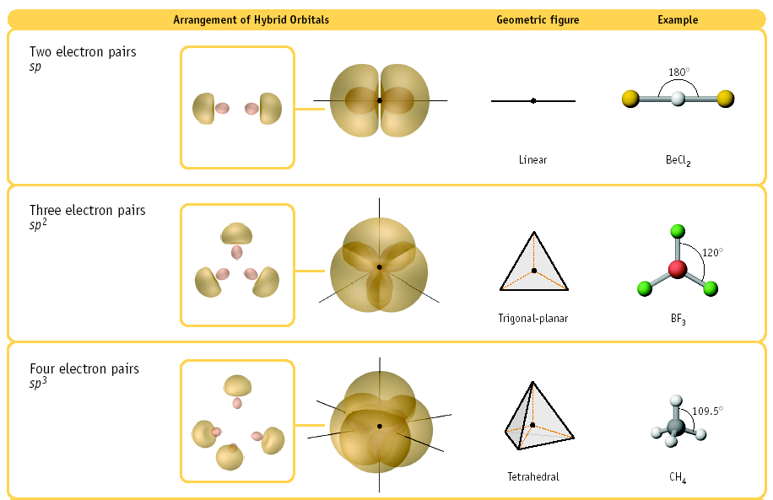
Hybrid Examples
MAR

Slide 17
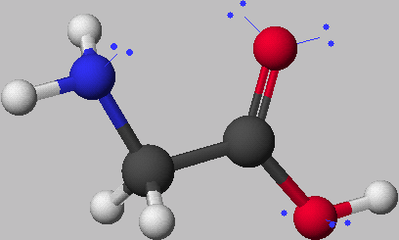
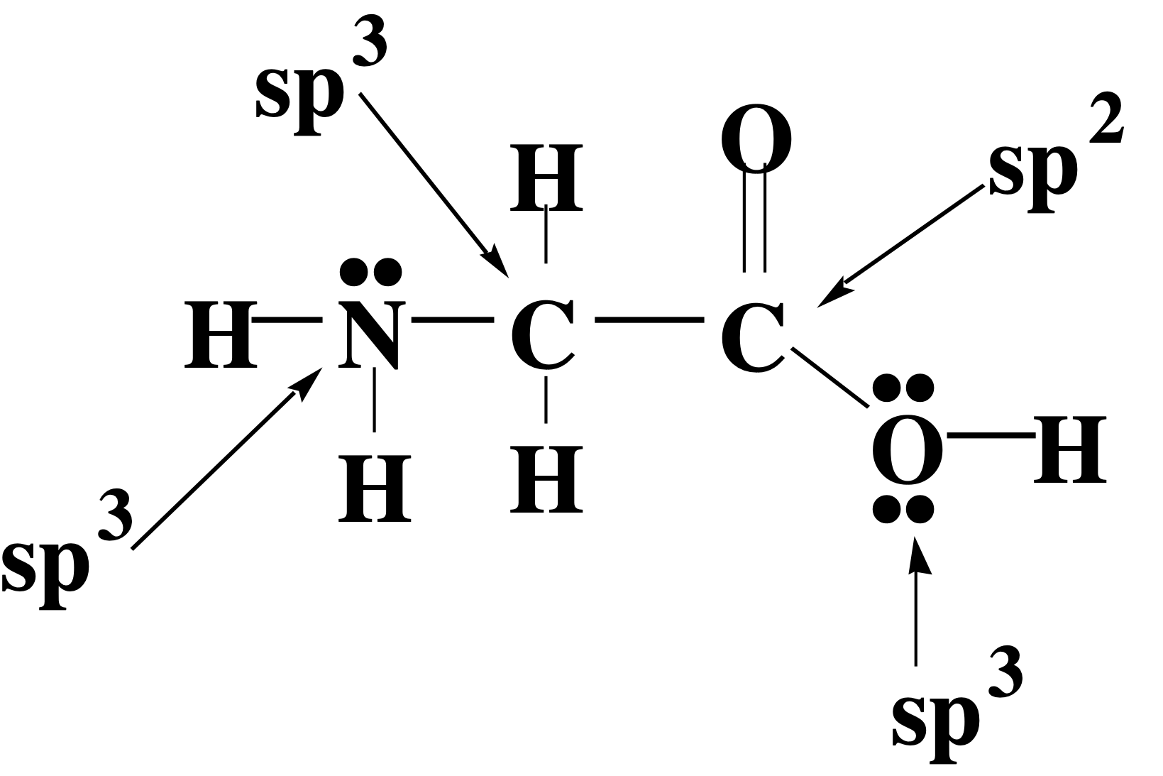
Bonding in Glycine
start
finish
MAR

Slide 18
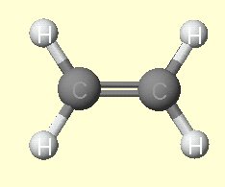
Multiple Bonds
Consider ethylene, C₂H₄
MAR

Slide 19
Sigma Bonds in C₂H₄
MAR

Slide 20
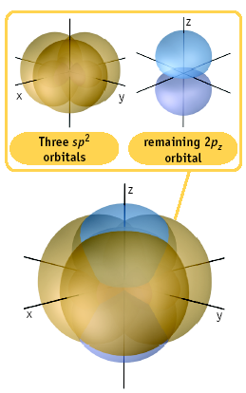
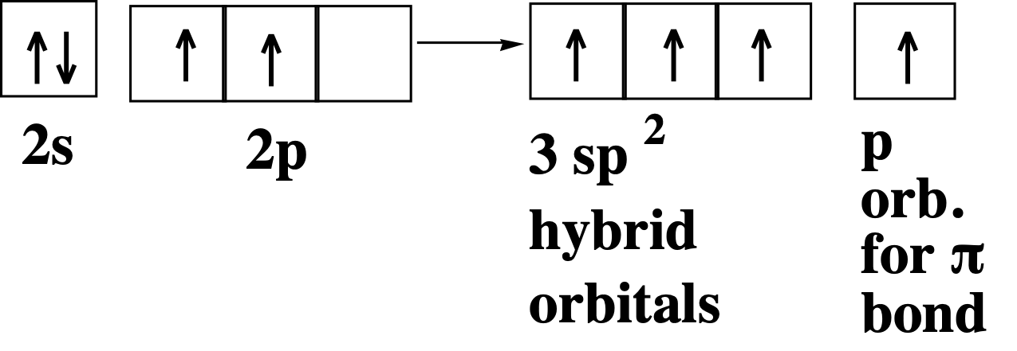
π Bonding in C₂H₄
The unused p orbital on each C atom contains an electron and this p orbital overlaps the p orbital on the neighboring atom to form the π bond.
MAR

Slide 21
π Bonding in C₂H₄
The unused p orbital on each C atom contains an electron, and this p orbital overlaps the p orbital on the neighboring atom to form the π bond.
MAR

Slide 22
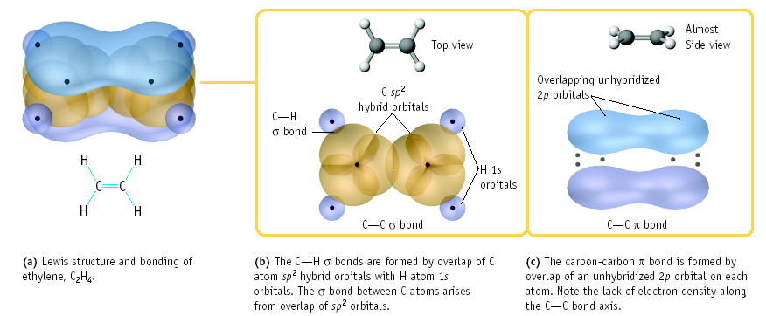
Multiple Bonding in C₂H₄
MAR

Slide 23
σ and π Bonding in C₂H₂
C₂H₂ has a triple bond
MAR
Enter your response on
your i>Clicker now!
How many total sigma and pi bonds in acetylene, C2H2?
1 σ, 1 π
1 σ, 2 π
2 σ, 2 π
3 σ, 2 π
3 σ, 3 π
Answer = D,
3 σ, 2 π,
2 C-H σ, 1 C-C σ, 2 C-C π

Slide 24
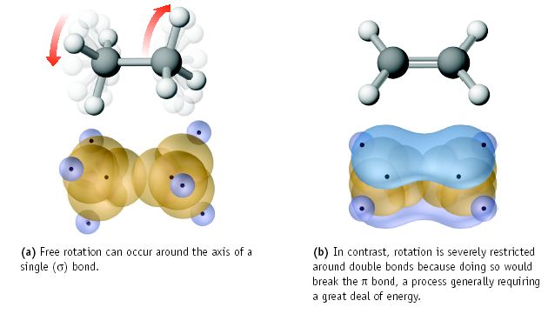
Consequences of Multiple Bonding
There is restricted rotation around C=C bond.
MAR

Slide 25
Consequences of Multiple Bonding
Restricted rotation around C=C bond.
trans-but-2-ene
MAR
n-butane

Slide 26
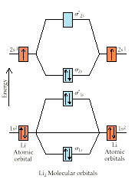
Molecular Orbital Theory
Accounts for paramagnetism, color, bonding
Atomic orbitals delocalize into molecular orbitals
Bonding, Antibonding and Nonbonding orbitals
Quite complicated, need computers; we will only look at diatomics (2 atom systems) from the first and second periods only
MAR

Slide 27
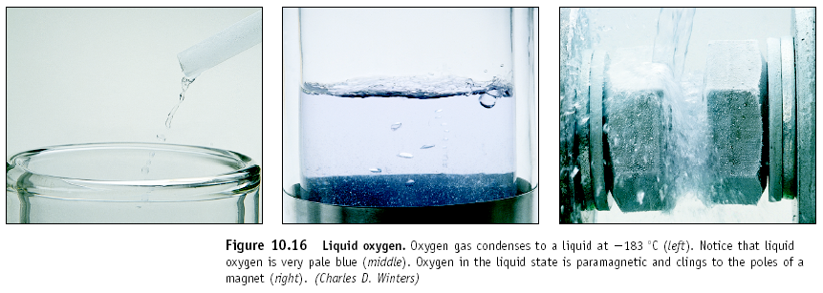
Advantages of MO Theory
Dioxygen should be electron paired (diamagnetic) by VB Theory, but dioxygen is actually paramagnetic.
MO Theory accounts for paramagnetism of O₂
MAR

Slide 28
Four Principles of MO Theory
Principle #1:
Number of Molecular Orbitals =
Number of Atomic Orbitals
Two 1s orbitals from two hydrogen atoms
create two molecular orbitals in H₂
Two 1s orbitals and two 2s orbitals from two lithium atoms create four molecular orbitals in Li₂
See Four Principles of MO Handout
MAR
If you combine two oxygen atoms (with a 1s² 2s² 2p⁴ configuration each) how many total molecular orbitals would you expect?
4
6
8
10
12
Enter your response on
your i>Clicker now!
Answer = D, 10
each oxygen has 1 1s orbital, 1 2s orbital and 3 2p orbitals…. 5 each means 10 molecular orbitals total

Slide 29
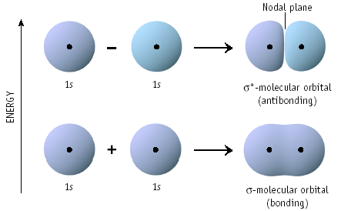
Molecular Orbital Type
When two atomic 1s H orbitals combine,
a bonding (σ) and antibonding (σ*)
molecular orbital forms
antibonding σ*
MAR
bonding σ

Slide 30
Four Principles of MO Theory
Principle #2:
Bonding MO lower in energy than the parent orbital
Antibonding MO higher in energy
than the parent orbital
Principle #3:
Electrons of molecule assigned to
successively higher MOs
Use Pauli Exclusion Principle and Hund's Rule when assigning electrons
MAR

Slide 31
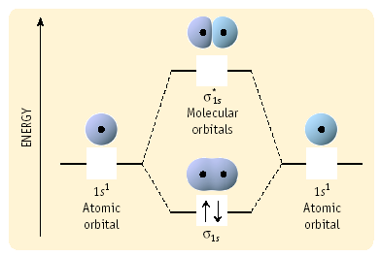
MO Diagram for H₂
Antibonding MO
Atomic Orbitals
Bonding MO
Two 1s electrons from two H atoms
occupy the σ orbital in H₂
MAR

Slide 32
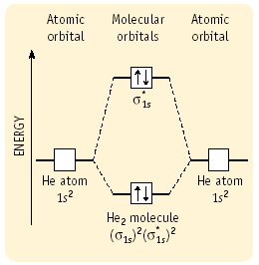
MO Diagram for He₂
Antibonding MO
Atomic Orbitals
Bonding MO
Two 1s electrons in σ,
Two 1s electrons in σ*
MAR

Slide 33
Bond Order in MO Theory
Bond Order = ¹/₂ (# bonding e⁻ - # antibonding e⁻)
Bond Order > 0,
stable molecule
Bond Order = 0 or < 0,
unstable molecule
In H₂,
Bond Order =
¹/₂ (2 - 0) = 1;
stable
MAR

Slide 34
Bond Order in MO Theory
Bond Order = ¹/₂ (# bonding e⁻ - # antibonding e⁻)
Bond Order > 0,
stable molecule
Bond Order = 0 or < 0,
unstable molecule
In He₂,
Bond Order =
¹/₂ (2 - 2) = 0;
unstable
∴He₂ does not exist
MAR

Slide 35
Four Principles of MO Theory
Principle #4:
Atomic orbitals combine to give molecular orbitals only when the atomic orbitals are of similar energy
Similar energy = better overlap
1s + 1s = good MO
1s + 2s = poor MO
2s + 2s = good MO
2s + 2p = poor MO
3s + 2s = poor MO
... etc. ...
MAR
Which combination of atomic orbitals would you expect to create the best molecular orbitals?
1s + 2p
2p + 3p
3d + 3d
4d + 4f
5g, it needs no molecular orbitals
Enter your response on
your i>Clicker now!
Answer = C, 3d + 3d
similar energy atomic orbitals create good molecular orbitals

Slide 36
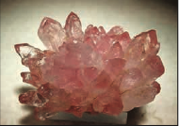
Example: Dilithium, Li₂
Note: no overlap between
1s and 2s
Bond Order = ¹/₂ (4 - 2) = 1
Stable molecule
Would you expect Be₂ to exist? Why?
MAR
Notes:
Real picture of dilithium crystals... supposedly. Journal of Chemical Education, 2009, Volume 86 page 1141

Slide 37
p orbitals and π bonds
Three possible p orbitals on each atom - six total p MO orbitals
Two p orbitals create 2 σ MO bonds
Four remaining p orbitals create 4 π MO bonds
Four p atomic orbitals create
four π molecular orbitals,
π = bonding (2)
π* = antibonding (2)
... but there's a catch!
MAR

Slide 38
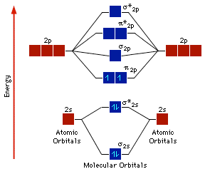
p orbitals and π bonds
For B, C and N,
π orbitals lower energy than σ orbital
π* orbitals lower energy than σ* orbital
Example: B₂
Bond Order = 1
[Core electrons]
MAR
See MO Diagram (B₂ - N₂) Handout

Slide 39
p orbitals and π bonds
For O, F and Ne,
σ orbital lower energy than π orbitals
π* orbitals lower energy than σ* orbital
σ*_{2pz}
π∗_{2px}
π∗_{2py}
2p_{x} 2p_{y} 2p_{z}
2p_{x} 2p_{y} 2p_{z}
π_{2px}
π_{2py}
σ_{2pz}
σ∗_{2s}
2s
2s
σ_{2s}
σ∗_{1s}
1s
σ_{1s}
1s
MAR

Slide 40
p orbitals and π bonds
For O, F and Ne,
σ orbital lower energy than π orbitals
π* orbitals lower energy than σ* orbital
Example: O₂
Bond Order = 2
[Core electrons]
MAR
See MO Diagram (B₂ - N₂) Handout

Slide 41
Paramagnetism
Paramagnetism exists when unpaired
electrons in MO diagram
O₂ is paramagnetic;
unpaired electrons
in two π* orbitals
MAR
[Core electrons]

Slide 42
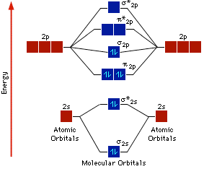
Paramagnetism
Paramagnetism exists when unpaired
electrons in MO diagram
N₂ is diamagnetic;
all electrons paired
[Core electrons]
MAR
Is N₂⁺ paramagnetic or diamagnetic?
paramagnetic
diamagnetic
Enter your response on
your i>Clicker now!
Answer = A, paramagnetic

Slide 43
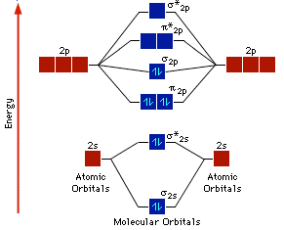
Molecular Orbital Notation
Used to abbreviate the MO diagrams
Ignore core electrons
Write in order of increasing energy
For N₂:
[Core electrons]
[core electrons](σ_{2s})²(σ*_{2s})²(π_{2p})⁴(σ_{2p})²
MAR
What is the bond order of N₂⁺?
1
1.5
2
2.5
3
Enter your response on
your i>Clicker now!
Answer = D, 2.5

Slide 44
Sigma and Pi Bonds
Determine sigma and pi bonds using:
# σ bonds = ¹/₂ (# σ bonding e⁻ - # σ antibonding e⁻)
# π bonds = ¹/₂ (# π bonding e⁻ - # π antibonding e⁻)
and
# σ bonds + # π bonds = bond order
For N₂:
[core electrons](σ_{2s})²(σ*_{2s})²(π_{2p})⁴(σ_{2p})²
# σ bonds = ¹/₂(4 - 2) = 1 σ bond
# π bonds = ¹/₂(4 - 0) = 2 π bonds
bond order = ¹/₂(8 - 2) = 3 = 1 σ + 2 π bonds
[Core electrons]
MAR

Slide 45
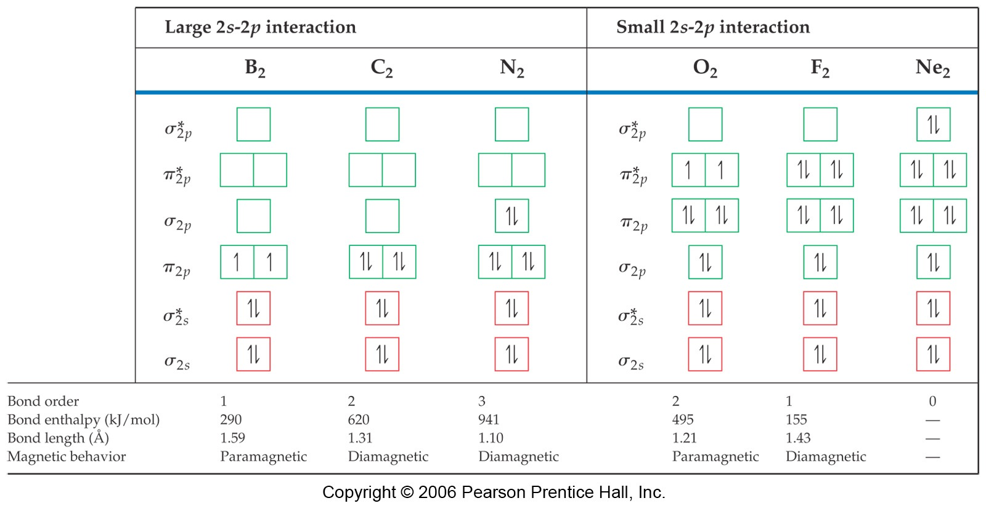
MO Diagram for Diatomics
Note: all should have [core electrons]
Changes in MO diagrams due to
s-p mixing and/or electron repulsion
MAR

Slide 46
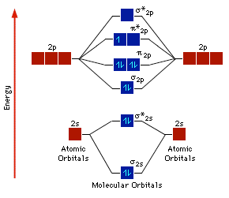
Ionic Diatomic Molecules
Predicting Ionic Diatomic MO diagrams simple
Use Hund and Pauli
Example: O₂⁺
Remove electron from
π*_{2p} orbital
Check bond order,
paramagnetism
[Core electrons]
MAR

Slide 47
Ionic Diatomic Molecules
Predicting Ionic Diatomic MO diagrams simple
Use Hund and Pauli
Example: O₂⁻
Using the O₂ diagram on
the right,
where would you place
the extra electron?
Is O₂⁻ more or less stable
than O₂? Why?
[Core electrons]
MAR

Slide 48
Application: Vision
Molecular Orbital Theory helps to describe the process of vision - photochemistry
MAR

Slide 49
Application: Band Theory
Two Re atoms bonding in carbon nanotubes - Jan. 2020
In metallic bonding, electrons delocalized over metallic lattice - a sea of electrons
MO energies identical, excellent overlap
Helps explain conductivity, malleability, more
MAR
Notes:
"Atoms bonding caught on camera" - from YouTube: https://youtu.be/byEqhd5Bpr4 (Jan. 2020) - explanation here: https://fstoppers.com/nature/scientists-record-incredible-footage-atoms-bonding-448963

Slide 50
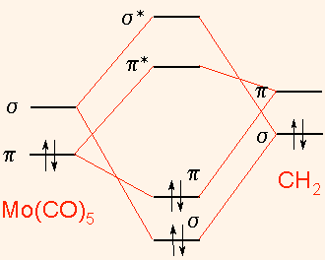
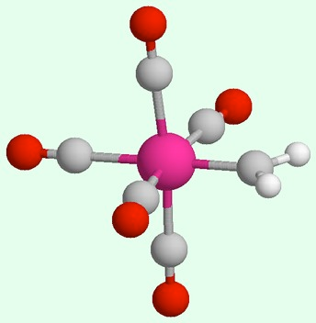
End of Chapter 8
See:
Chapter Eight Study Guide
Chapter Eight Concept Guide
Important Equations (following this slide)
End of Chapter Problems (following this slide)
MO Diagram for Mo(CO)5=CH2
MAR
Notes:
MO Diagram for Mo(CO)5=CH2 from http://www.chm.bris.ac.uk/pt/harvey/elstruct/lcao_mo.html

Slide 51
Important Equations, Constants, and Handouts
from this Chapter:
Valence Bond / Hybridization Theory: types of hybridization (sp, sp², etc.), sigma and pi bonds
the bond order, bond energy and bond length relationships still apply to both theories
know the advantages and disadvantages of the Valence Bond and Molecular Orbital theories
see the Geometry and Polarity Guide and the two Molecular Orbital Theory diagrams (NBC and FONe) (handouts)
Molecular Orbital Theory: bonding and antibonding orbitals, sigma bonds and pi bonds, paramagnetic and diamagnetic, the “NBC” vs. “FONe” diagrams
$$\frac{1}{2}(\#bondinge^{-}-\#antibondinge^{-})$$
bond order (MO theory) =

Slide 52
End of Chapter Problems: Test Yourself
Be sure to view practice problem set #2 and self quizzes for
MO theory and Valence Bond theory examples and practice
Specify the electron-pair and molecular geometry for each of the following. Describe the hybrid orbital set used by the central atom in each molecule or ion. a. BBr3 b. CO2 c. CH2Cl2 d. XeF4
Use MO theory to tell which has the largest bond order: C2 or F2. Are either species paramagnetic?
Use MO theory to speculate on the existence of dilithium.
Which compound is stronger by MO theory: Be2 or B2⁺¹.
Describe the hybridization change on carbon as methane (CH4) is burned to create carbon dioxide.

Slide 53
End of Chapter Problems: Answers
a. trigonal planar, trigonal planar, sp². b. linear, linear, sp. c. tetrahedral, tetrahedral, sp³. d. octahedral, square planar, sp³d²
BO(C2) = 2, diamagnetic. BO(F2) = 1, diamagnetic.
By MO theory, dilithium (Li2) should exist (BO = 1, diamagnetic.)
MO theory would predict that B2⁺¹(bond order = 0.5, paramagnetic) is stronger than Be2 (bond order = 0, this should not exist at all.)
sp³ to sp
Be sure to view practice problem set #2 and self quizzes for
MO theory and Valence Bond theory examples and practice

