Slide 1
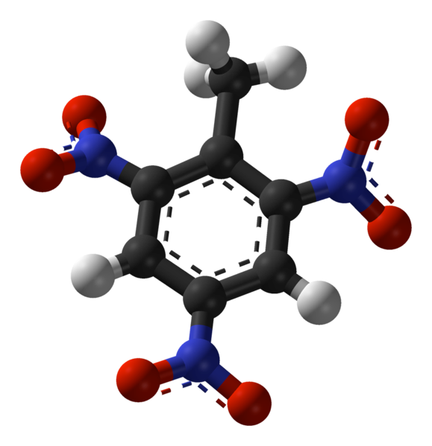
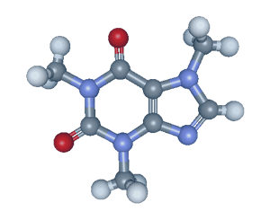
Bonding and
Molecular Structure Chapter 7
Get the CH 222 Companion
before lab!
Chemistry 222
Professor Michael Russell
http://mhchem.org/222
Last update:
4/29/24
MAR

Slide 2
CH 222: Lectures and Labs
Lectures: MWF from 9 - 9:50 AM in AC 1303 (this room)
Lectures recorded, available soon afterwards
Lecture notes to print available (under "Problem Sets and Handouts", mhchem.org/222), get CH 222 Companion as soon as possible
Labs (Section 01): Mondays from 1:10 - 5 PM
Start in room AC 2501 (not AC 1303)
Move to AC 2507 ("the lab") around 3 PM
For first day, bring a printed copy of the "Chromatography" Lab (mhchem.org/222), a pair of safety glasses (Dollar store ok) and your calculator
MAR
...more on Monday afternoon
Notes:
From "Lessons in Chemistry" Season 01 Episode 05 "CH3COOH"

Slide 3
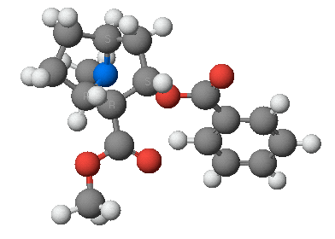
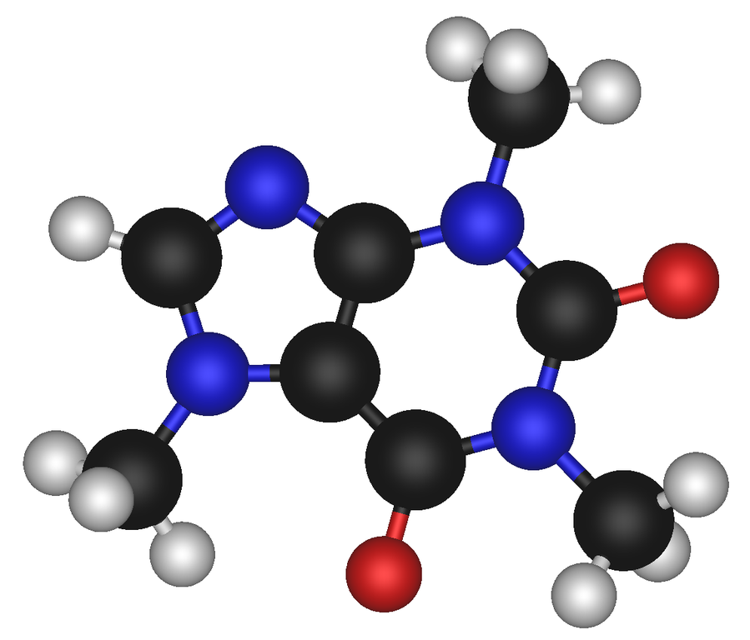
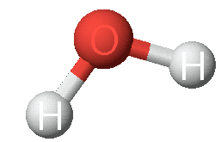
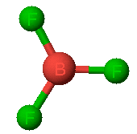
Chemical Bonding
caffeine
cocaine
water
MAR
boron trifluoride
ammonia

Slide 4
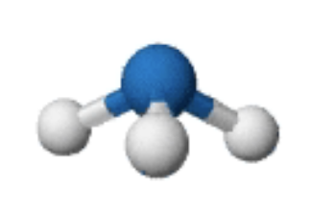
Chemical Bonding
Problems and questions:
How is a molecule or polyatomic ion held together?
Why are atoms distributed at strange angles?
Why are molecules not flat?
Can we predict the structure?
How is structure related to chemical and physical properties?
MAR

Slide 5
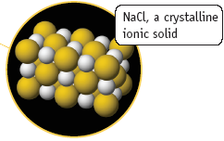
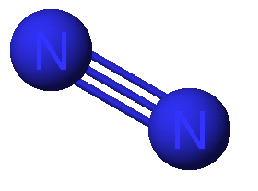
Two Extreme Forms of Chemical Bonds
Ionic - complete transfer of electrons from one atom to another, metals + nonmetals
Covalent - electrons shared between atoms, mostly nonmetals
Most bonds are somewhere in between
Also Metallic - for metals, studied later
MAR
December 2018: Metavalent bonding (for metalloids!)
Notes:
Metavalent bonding proposed: https://www.chemistryworld.com/news/bonding-rethink-called-for-as-new-metavalent-bond-proposed/3009908.article (December 2018)

Slide 6
Bonding Overview
Mostly just
for nonmetals
metals plus
nonmetals
metals and
alloys
MAR

Slide 7
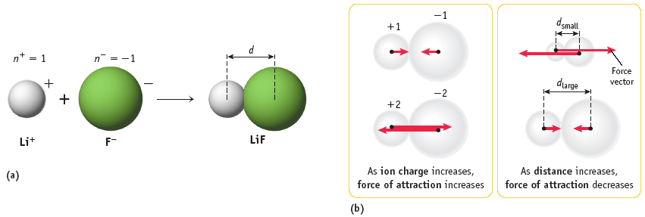
Ionic Forces - Coulomb's Law
CH 221
Flashback:
MAR
Higher ionic force, higher melting point, etc.

Slide 8
Covalent Bonding
Covalent bonds arise from the mutual attraction of 2 nuclei for the same electrons.
A covalent bond is a balance of attractive
and repulsive forces.
MAR

Slide 9
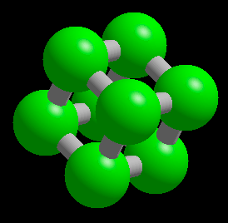
Covalent Bonding
Covalent bonding will be the focus of the first two chapters
We will re-visit Ionic bonding and Metallic bonding in a future chapter
Important to know when a compound is ionic, covalent or metallic!
MAR

Slide 10
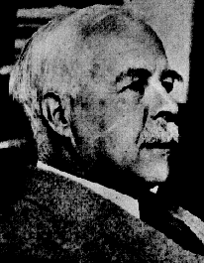
Electron Distribution in Molecules
Electron distribution is depicted with Lewis electron dot structures
Valence electrons are distributed as shared or BOND PAIRS and unshared or LONE PAIRS.
G. N. Lewis
1875 - 1946
MAR

Slide 11
Bond and Lone Pairs
Valence electrons are distributed as shared or BOND PAIRS and unshared or LONE PAIRS.
••
H
Cl
•
•
••
lone pair (LP)
shared or
bond pair
This is called a LEWIS ELECTRON DOT structure
3 lone pairs + 1 bond pair = 4 pairs total
MAR

Slide 12
Bond Formation
A bond can result from a "head-to-head" overlap of atomic orbitals on neighboring atoms, making a sigma (σ) bond.
••
••
H
+
Cl
•
H
Cl
•
•
•
••
••
Overlap of H (1s) and Cl (3p)
Note that each atom has a single, unpaired electron in their atomic orbital.
MAR

Slide 13
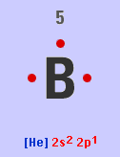
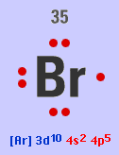
Valence Electrons
Electrons are divided between core and valence electrons
B 1s² 2s² 2p¹
Core = [He] , valence = 2s² 2p¹
2 core e⁻, 3 valence e⁻
Br [Ar] 3d¹⁰ 4s² 4p⁵
Core = [Ar] 3d¹⁰ , valence = 4s² 4p⁵
28 core e⁻, 7 valence e⁻
MAR

Slide 14
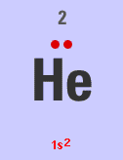
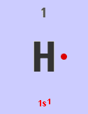
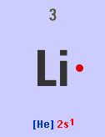
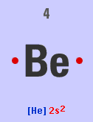
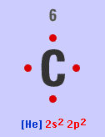
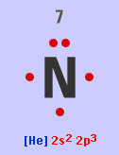
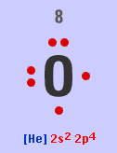
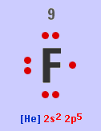
Valence Electrons
8A
1A
First Clicker Question!
Participating in Clicker questions
is optional and ungraded
requires an i>clicker 2 (bookstore, Amazon)
is worth extra credit (must register at iclicker.com and participate in 10 lectures - see extra credit guide)
Let's go!
2A
3A
4A
5A
6A
7A
∴ Number of valence electrons is equal to the Group number
MAR
Enter your response on
your i>Clicker now!
How many valence electrons in phosphorus (P)?
2
3
4
5
6
Answer = D, 5
P is in group VA

Slide 15
Building Lewis Structures
No. of valence electrons of a main group atom = Group number
For Groups 1A - 4A, no. of bond pairs = group number.
For Groups 5A - 7A, BPs = 8 - Grp. No.
MAR

Slide 16
Building a Lewis Dot Structure
No. of valence electrons of an atom = Group number
For Groups 1A - 4A (14), no. of bond pairs = group number
For Groups 5A (15) - 7A (17), BPs = 8 - Grp. No.
Except for H (and sometimes atoms of 3rd and higher periods),
BPs + LPs = 4
This observation is called the
OCTET RULE
MAR

Slide 17
Building a Lewis Dot Structure
Ammonia, NH₃
1. Count valence electrons
H = 1 and N = 5
Total = (3 x 1) + 5
= 8 electrons or
4 pairs of electrons
2. Decide on the central atom; never H.
Central atom is atom of lowest affinity for electrons.
Therefore, N is central
MAR

Slide 18
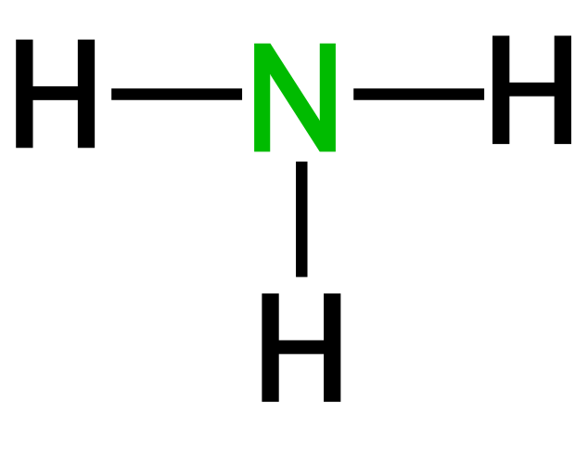
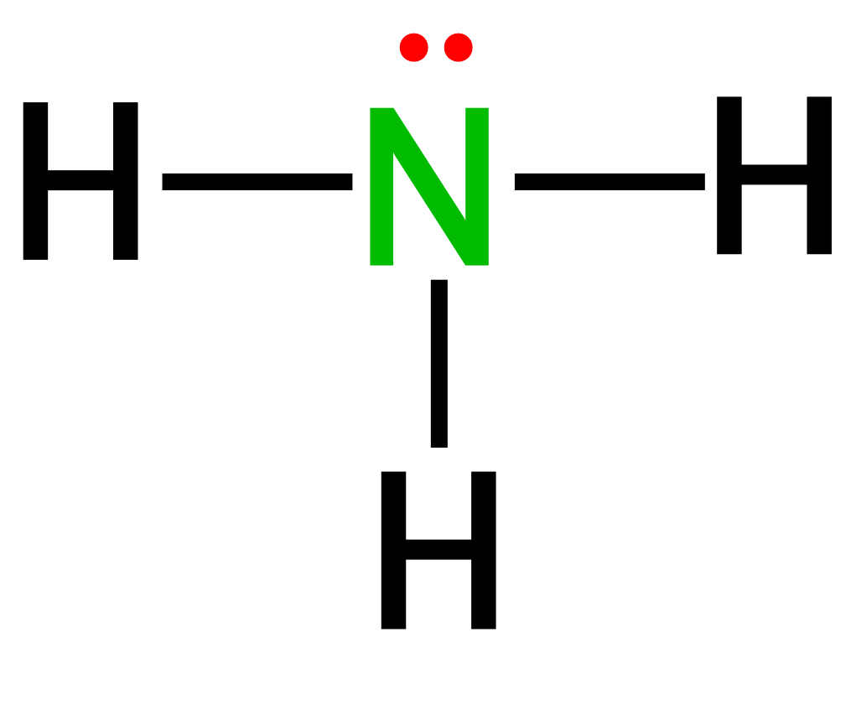
Building a Lewis Dot Structure
3. Form a sigma bond (single bond) between the central atom and surrounding atoms.
1
.
H
N
3
H
.
H
P
H
H
H
Remaining electrons form LONE PAIRS to complete octet as needed.
2
.
4
H
O
H
.
H
F
3 BOND PAIRS and 1 LONE PAIR. Note that N has a share in 4 pairs (8 electrons), while H shares 1 pair.
Unshared electron pairs ("lone pairs")
take up more volume than
shared electron pairs ("bonding pairs")
See Building Lewis Structures handout
MAR
Which of the following Lewis structures are correct?
structure 1
structure 2
structure 3
structure 4
all four are correct
Enter your response on
your i>Clicker now!
Answer = C, 3

Slide 19
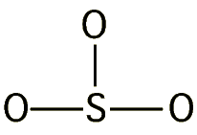
Sulfite ion, SO₃²⁻
Step 1. Central atom = S
Step 2. Count valence electrons
S = 6
3 x O = 3 x 6 = 18
Negative charge = 2
TOTAL = 26 e- or 13 pairs
Step 3. Form sigma bonds
10 pairs of electrons are
now left.
MAR

Slide 20
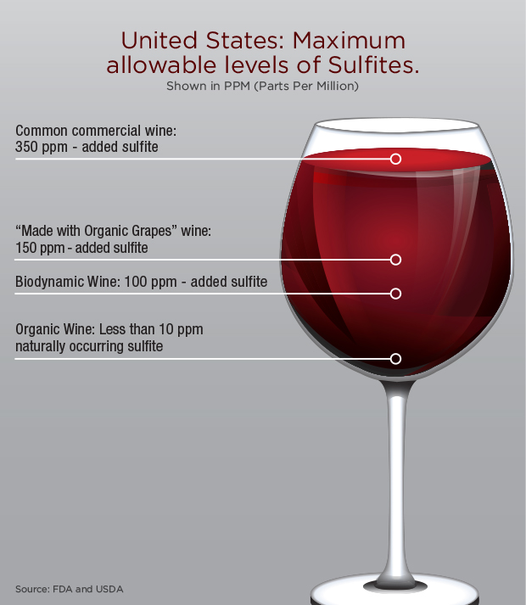
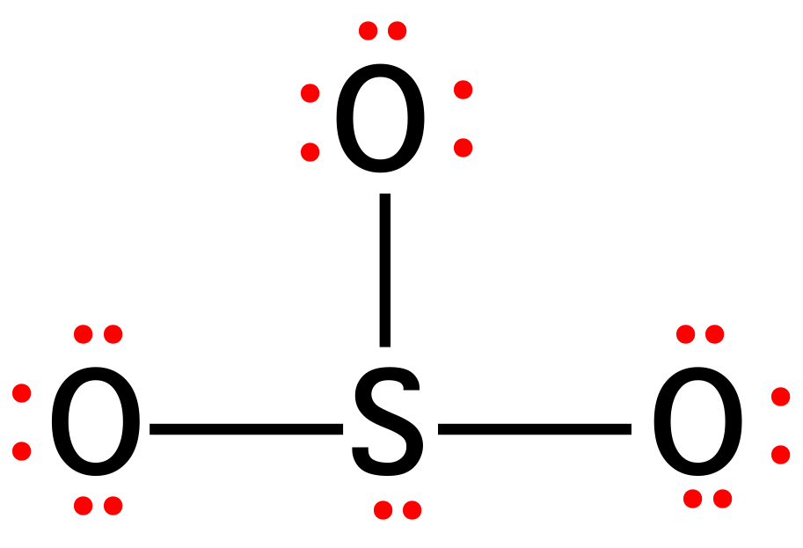
Sulfite ion, SO₃²⁻
Remaining pairs become lone pairs, first on outside atoms and then on central atom.
Each atom is surrounded by an octet of electrons.
MAR

Slide 21
Carbon Dioxide, CO₂
1. Central atom = _______
2. Valence electrons = __ or __ pairs
3. Form sigma bonds.
This leaves 6 pairs.
4. Place lone pairs on outer atoms.
MAR

Slide 22
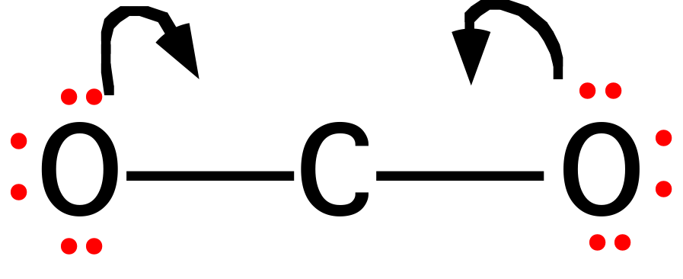
Carbon Dioxide, CO₂
4. Place lone pairs on outer atoms.
5. So that C has an octet, we shall form DOUBLE BONDS between C and O.
The second bonding pair forms a pi (π) bond.
MAR

Slide 23
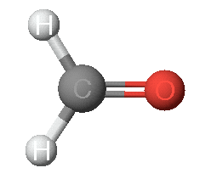
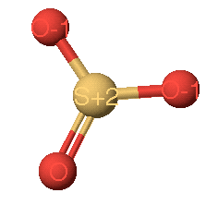
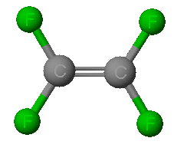
Double and even triple bonds are commonly observed for C, N, P, O, and S
H₂CO
SO₃
C₂F₄
MAR

Slide 24
Sulfur Dioxide, SO₂
1. Central atom = S
2. Valence electrons = 18 or 9 pairs
3. Form pi (π) bond so that S has an octet - but note that there are two ways of doing this.
MAR

Slide 25
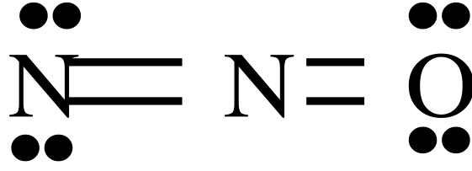
Sulfur Dioxide, SO₂
1.
2.
This leads to the following structures.
3.
4.
These equivalent structures are called
RESONANCE STRUCTURES. The true electronic structure is a HYBRID of the two.
MAR
Which of the following Lewis resonance structures is incorrect for N2O?
1
2
3
4
all are correct
Enter your response on
your i>Clicker now!
Answer = D, 4

Slide 26
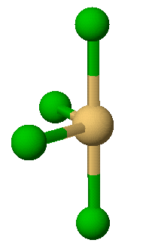
Violations of the Octet Rule
Usually occurs with B and elements of higher periods.
BF₃
SF₄
MAR

Slide 27
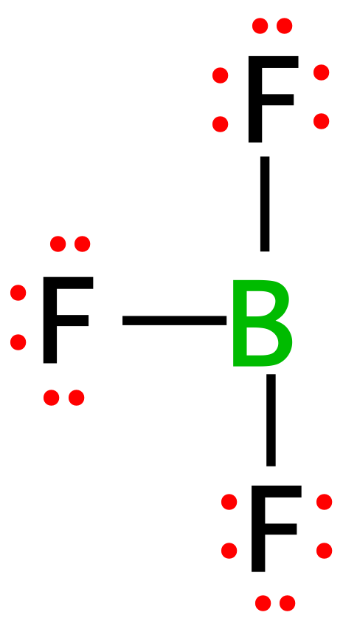
Boron Trifluoride
Central atom =
Valence electrons = or electron pairs =
Assemble dot structure
The B atom has a share in only 6 electrons (or 3 pairs). B atom in many molecules is electron deficient.
Also common for Al and Be
MAR

Slide 28
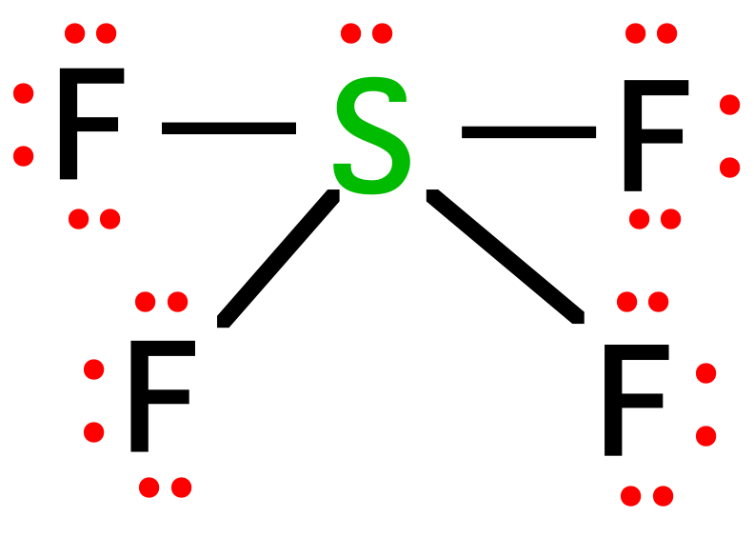
Sulfur Tetrafluoride, SF₄
Central atom =
Valence electrons = ___ or ___ pairs.
Form sigma bonds and distribute electron pairs.
5 pairs around the S atom. A common occurrence outside the 2nd period.
MAR

Slide 29
Odd # of electrons: NO₂ Paramagnetic compounds & free radicals
For NO₂, central atom = ___
Valence electrons = ___ or ___ pairs.
Odd e⁻ occupies its own "space"
Form sigma bonds and distribute electron pairs.
•
••
•
••
N
O
N
O
•
•
••
••
••
••
O
O
•
•
••
••
Paramagnetic substances often more reactive than diamagnetic substances
MAR

Slide 30
Formal Atom Charges
Atoms in molecules often bear a charge (+ or -).
The predominant resonance structure of a molecule is the one with charges as close to 0 as possible.
Formal charge = Group number - ¹/₂ (number bonding electrons) - (number lone pair electrons (lpe)),
or
FC = GN - bonds - lpe
Sum of all formal charges in a molecule must equal ionic charge
See Guide to Formal Charges
MAR

Slide 31
Formal Atom Charges
Formal charge = Group number - ¹/₂ (number bonding electrons) - (number lone pair electrons)
or
FC = GN - bonds - lpe
more stable structure
0
0
0
0
+1
-1
MAR

Slide 32
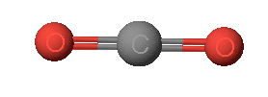
Carbon Dioxide, CO₂
FC = GN - bonds - lpe
6
-
(
1
/
2
)
(
4
)
-
4
=
0
•
Sum of formal charges =
= 0 + 0 + 0 = 0
which equals ionic charge on molecule
This is a good structure!
•
•
•
O
C
O
•
•
•
•
4
-
(
1
/
2
)
(
8
)
-
0
=
0
MAR

Slide 33
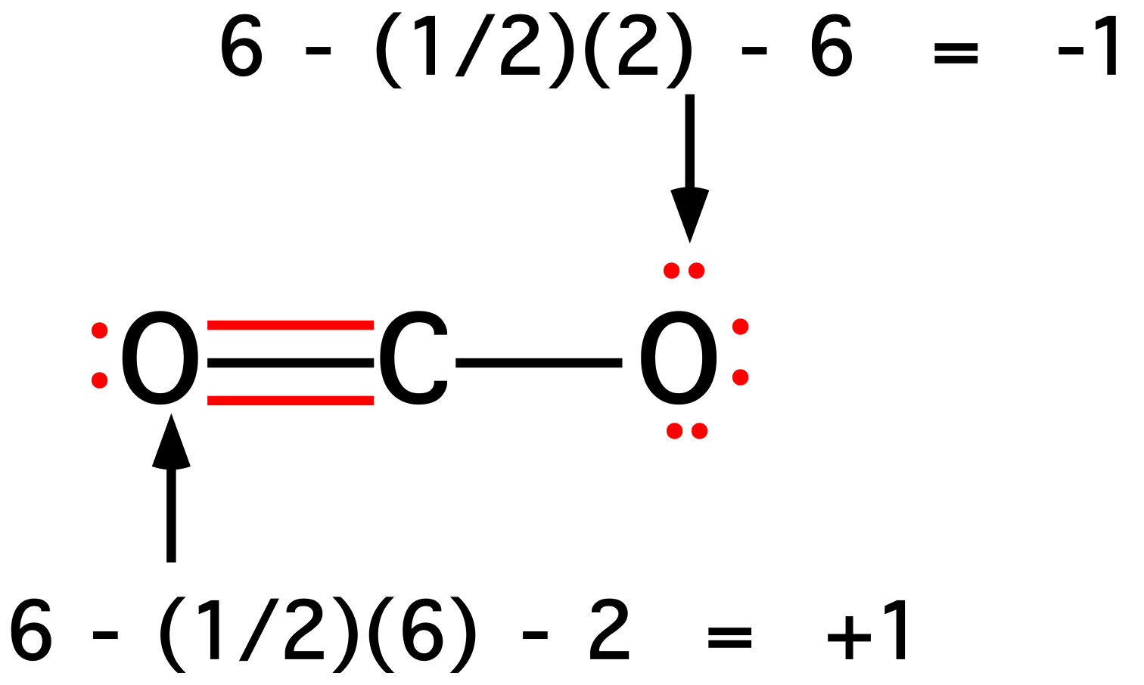
Formal Charge Comparison with CO₂
FC = GN - bonds - lpe
Sum of formal charges =
= -1 + 0 + 1 = 0
which equals ionic charge on molecule
This is a valid resonance form, but not as good as previous slide
C atom formal charge is still 0.
MAR

Slide 34
Formal Charge
MAR

Slide 35
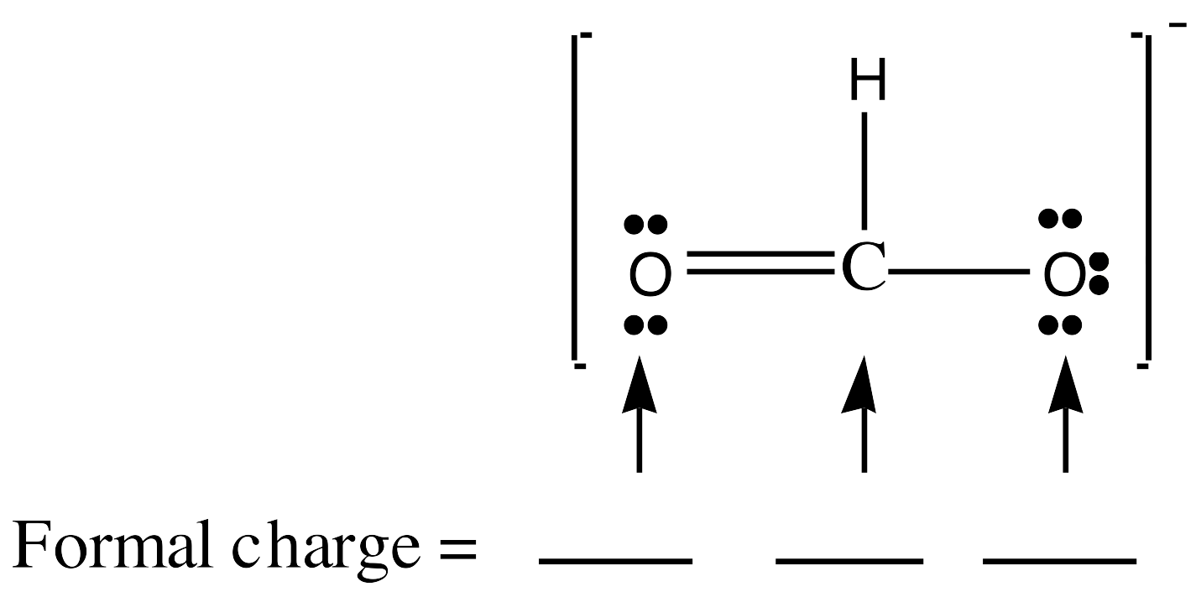
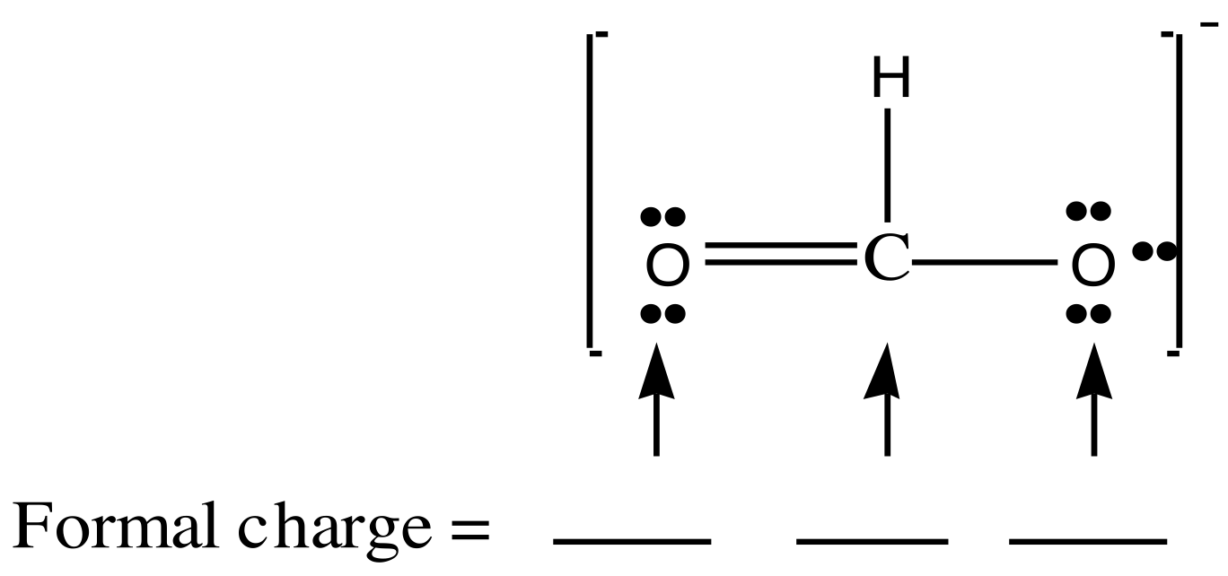
Boron Trifluoride, BF₃
+1
F
•
•
•
•
••
-1
F
B
•
•
••
F
•
•
•
•
••
What if we form a B-F double bond to satisfy the B atom octet?
F never makes double bonds!
MAR
Determine the formal charges for the formate ion:
0 0 0
+1 -1 -1
+1 0 -1
0 0 -1
none of the above
Enter your response on
your i>Clicker now!
Answer = D

Slide 36
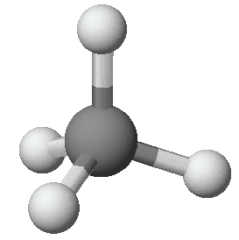
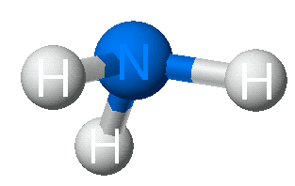
Molecular Geometry
MAR

Slide 37
MOLECULAR GEOMETRY
VSEPR
Valence Shell Electron Pair Repulsion theory.
Most important factor in determining geometry is relative repulsion between electron pairs.
Molecule adopts the shape that minimizes the electron pair repulsions.
See Geometry and Polarity Guide
MAR

Slide 38
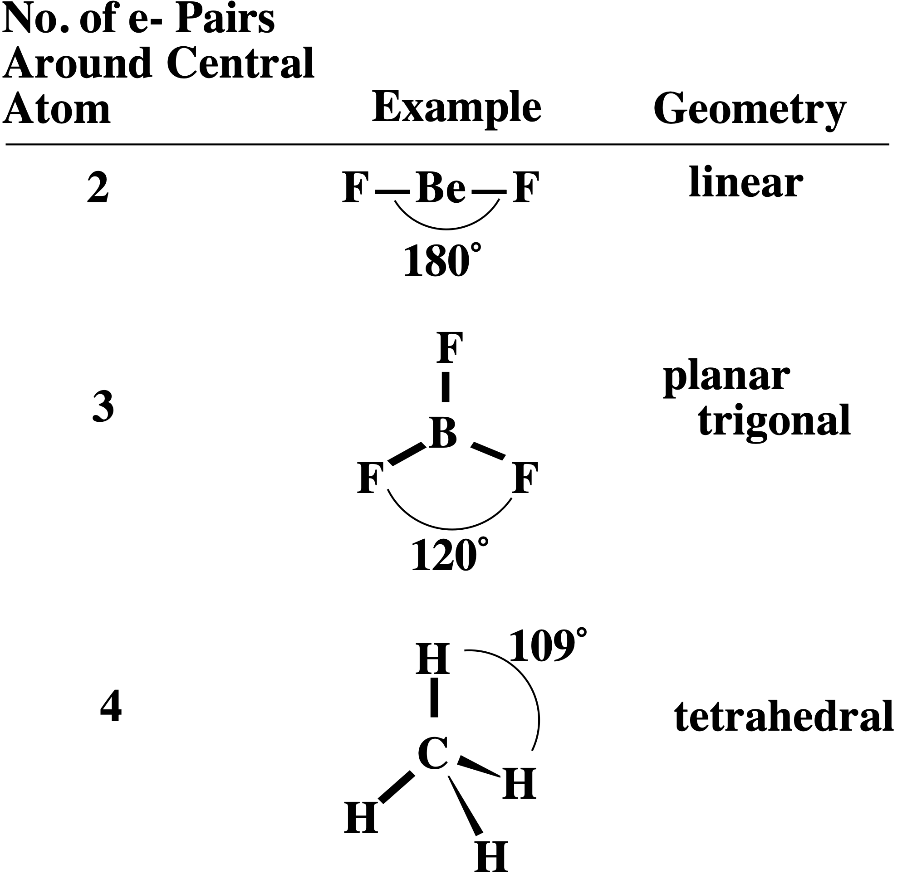
VSEPR
MAR
See Geometry and Polarity Guide

Slide 39
VSEPR
Electron Pair
Geometry
linear
trigonal
planar
MAR
See Geometry and Polarity Guide

Slide 40
VSEPR
Electron Pair
Geometry
linear
trigonal
planar
tetrahedral
MAR
See Geometry and Polarity Guide

Slide 41
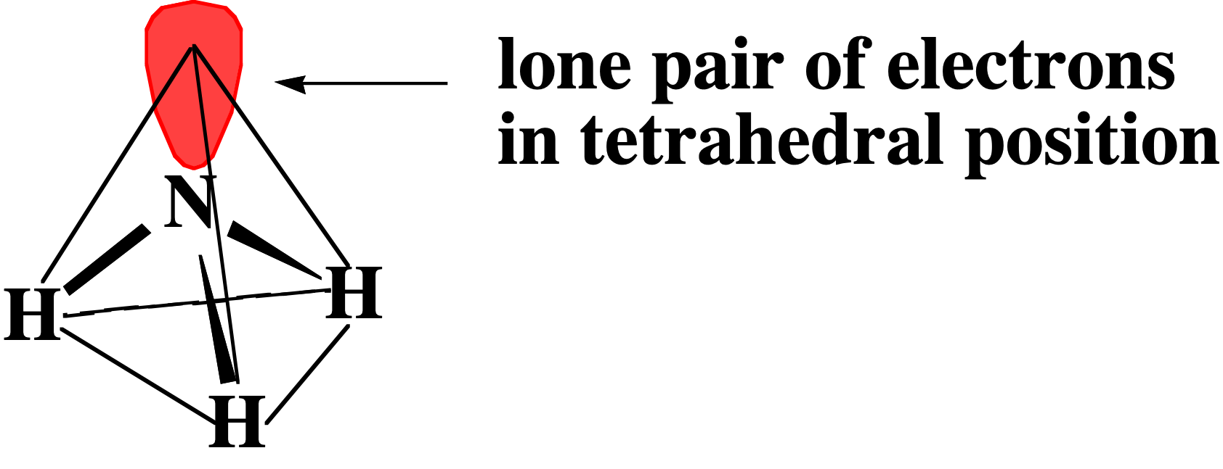
Structure Determination by VSEPR
Ammonia, NH₃
1. Draw electron dot structure
2. Count BPs and LPs = 4
3. The 4 electron pairs are at the corners of a tetrahedron.
The ELECTRON PAIR GEOMETRY is tetrahedral.
MAR

Slide 42
Structure Determination by VSEPR
Ammonia, NH₃
The electron pair geometry is tetrahedral.
The MOLECULAR GEOMETRY - the positions of the atoms - is TRIGONAL PYRAMID
See Geometry and Polarity Guide
MAR

Slide 43
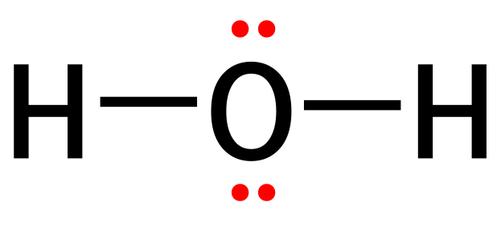
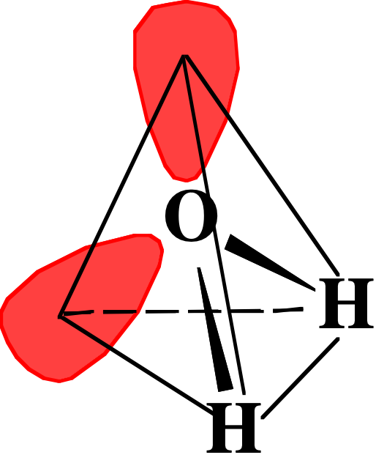
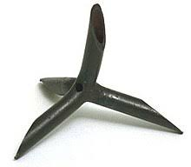
Structure Determination by VSEPR
Water, H₂O
1. Draw electron dot structure
2. Count BPs and LPs = 4
3. The 4 electron pairs are at the corners of a tetrahedron.
The electron pair geometry is TETRAHEDRAL
A caltrop
MAR

Slide 44
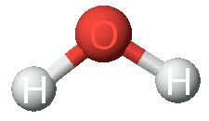
Structure Determination by VSEPR
Water, H₂O
The electron pair geometry is TETRAHEDRAL
The molecular geometry is bent
MAR
Based on the Valence Shell Electron Pair Repulsion Theory (VSEPR), which of the following corresponds most closely to the molecular shape of SCl₂?
linear
bent (bond angle 120°)
T-shaped
bent (bond angle 109.5°)
none of the above
Enter your response on
your i>Clicker now!
Answer = D (bent, 109.5° angle)

Slide 45
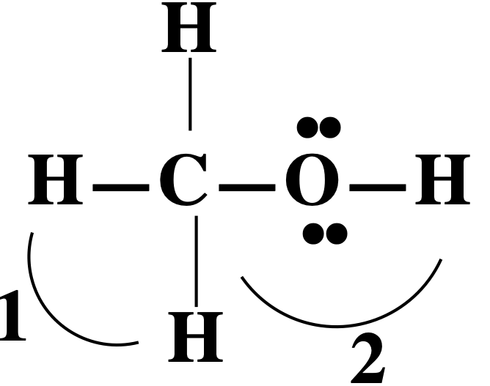
Structure Determination by VSEPR
Methanol, CH₃OH
1. Draw electron dot structure
2. Define bond angles 1 and 2
MAR

Slide 46
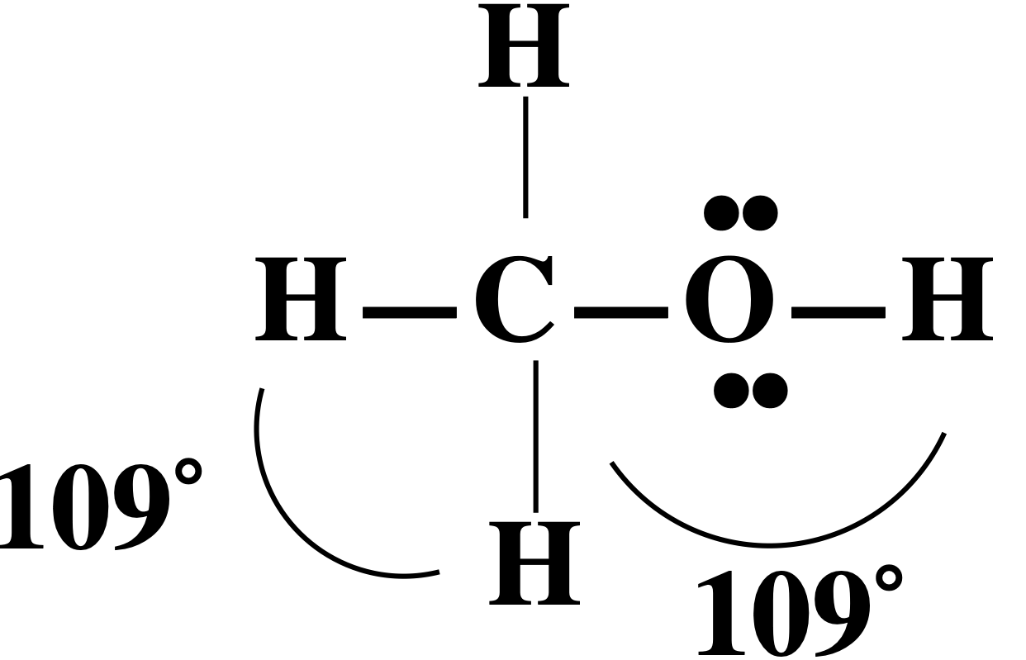
Structure Determination by VSEPR
Methanol, CH₃OH
Define bond angles 1 and 2
Angle 1 = 109º
Angle 2 = 109º
In both cases the atom is surrounded by 4 electron pairs.
MAR

Slide 47
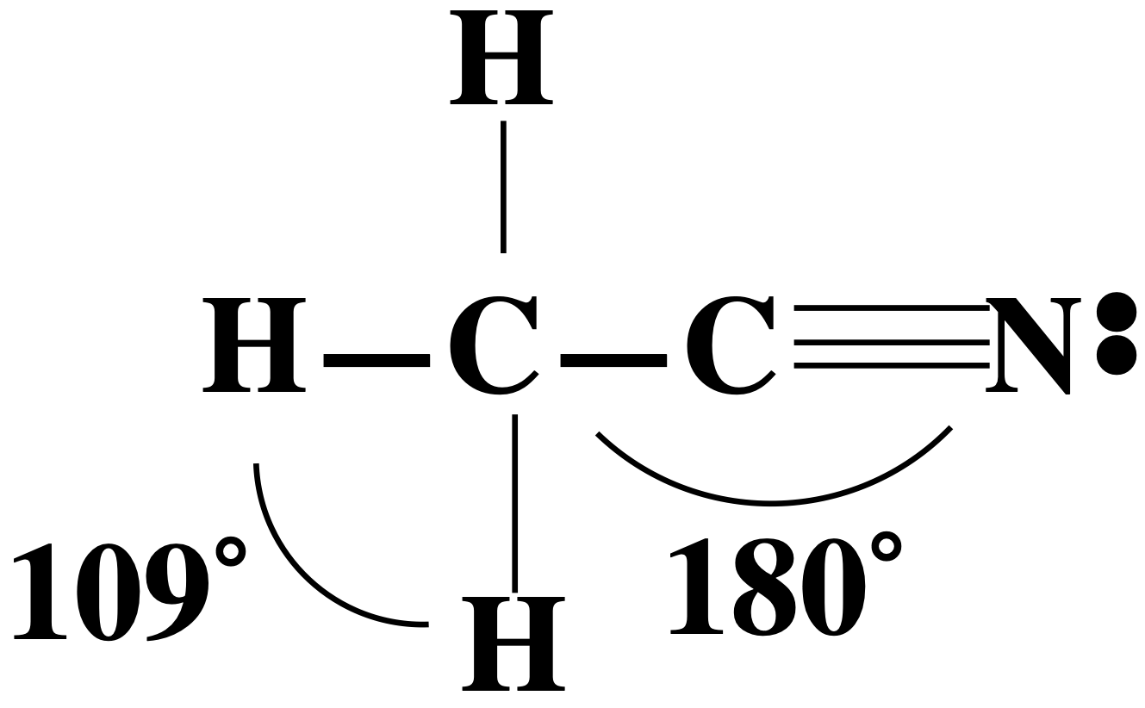
Structure Determination by VSEPR
Acetonitrile, CH₃CN
Define bond angles 1 and 2
Angle 1 = 109º
Angle 2 = 180º
One C is surrounded by 4 electron "clouds" and the other by 2 "clouds"
MAR

Slide 48
STRUCTURES WITH CENTRAL ATOMS THAT DO NOT OBEY THE OCTET RULE
Usually occurs with Group 3A elements and with those of 3rd period and higher.
MAR

Slide 49
Compounds with 3 Pairs Around the Central Atom
The B atom is surrounded by only 3 electron pairs.
Bond angles are 120º
Geometry described as planar trigonal or trigonal planar
MAR

Slide 50
Compounds with 5 or 6 Pairs Around the Central Atom
MAR

Slide 51
Compounds with 5 or 6 Pairs Around the Central Atom
5 electron pairs
MAR
See Geometry and Polarity Guide

Slide 52
Compounds with 5 or 6 Pairs Around the Central Atom
6 electron pairs
The game “Jacks”
MAR
See Geometry and Polarity Guide

Slide 53
Sulfur Tetrafluoride, SF₄
Number of valence electrons = 34
Central atom = S
Dot structure
Electron pair geometry
= trigonal bipyramid (because there are 5 pairs around the S)
MAR

Slide 54
Sulfur Tetrafluoride, SF₄
Molecular geometry
= seesaw
Lone pair is in the equator because it requires more room.
Unshared electron pairs ("lone pairs")
take up more volume than
shared electron pairs ("bonding pairs")
MAR
Notes:
"seesaw: sometimes referred to as "distorted tetrahedron"

Slide 55
Other Molecular Geometries
MAR
A molecule has five electron clouds (pairs and/or atoms) around a central atom and the molecular geometry is linear. How many lone pairs are present on the central atom of this molecule?
0
1
2
3
4
Enter your response on
your i>Clicker now!
Answer = D, 3
Notes:
Cool animated gifs here: http://chemmybear.com/shapes.html :)

Slide 56
Bond Order
Bond Order
# of bonds between a pair of atoms
Double bond (bo = 2)
Single bond (bo = 1)
Acrylonitrile
Triple bond
(bo = 3)
MAR
What is the carbon-oxygen bond order in formaldehyde, CH2O?
1
1.5
2
2.5
0
Enter your response on
your i>Clicker now!
Answer = C,
2 (double bond)

Slide 57
Bond Order
Fractional bond orders occur in molecules with resonance structures.
Consider NO₂⁻
MAR
The N-O bond order = 1.5

Slide 58
Bond Order
Bond order is related to two important bond properties:
(a) bond length
(b) bond energy
110 pm
745 kJ
Bond length is inversely proportional to bond order
Bond energy is proportional to bond order
123 pm
414 kJ
Bond lengths measured in pm (1 pm = 10⁻¹² m) or Angstroms (1 Å = 10⁻¹⁰ m)
Bond energies measured in kJ (1 kJ = 10³ J)
MAR

Slide 59
Bond Length
Bond length depends on bond order
As bond order increases, bond length decreases
Bond length is inversely proportional to bond order
Bond distances measured in Angstroms (1 Å = 10⁻¹⁰ m)
MAR

Slide 60
Bond Length
Bond length, the distance between two nuclei, also depends on the size of bonded atoms.
Bond length is inversely proportional to bond order
H-F
H-Cl
Bond distances measured in Angstroms (1 Å = 10⁻¹⁰ m)
MAR
H-I

Slide 61
Bond Energy
Bond Energy is measured by the energy required to break a bond
The GREATER the number of bonds (bond order) the LARGER the bond energy and the SHORTER the bond.
MAR

Slide 62
Bond Energy
Bond order = 1.5
bond energy = ?
Bond order =2
498 kJ/mol
Bond order = 1
210 kJ/mol
MAR

Slide 63
Using Bond Energies
Estimate the energy of the reaction:
H-H + Cl-Cl → 2 H-Cl
Net energy = ∆H_{rxn} = energy required to break bonds - energy evolved when bonds formed
H-H = 436 kJ/mol
Cl-Cl = 243 kJ/mol
H-Cl = 431 kJ/mol
∆H = bonds broken - bonds formed
MAR

Slide 64
Using Bond Energies
∆H = bonds broken - bonds formed
Estimate the energy of the reaction: H-H + Cl-Cl ----> 2 H-Cl
H-H = 436 kJ/mol
Cl-Cl = 243 kJ/mol
H-Cl = 431 kJ/mol
"Bonds broken" or "Reactant bonds":
H-H + Cl-Cl bond energies = 436 kJ + 243 kJ = 679 kJ
"Bonds formed" or "Product bonds":
2 mol H-Cl bond energies = 2 x 431 kJ = 862 kJ
∆H = bonds broken - bonds formed
∆H = 679 kJ - 862 kJ = -183 kJ
MAR
exothermic!

Slide 65
Molecular Polarity
Boiling point = 100 ˚C
Boiling point = -161 ˚C
Why do water and methane differ so much in their boiling points?
Why do ionic compounds dissolve in water?
MAR

Slide 66
Molecular Polarity
Water molecules are attracted to balloons that have a static electric charge
MAR

Slide 67
Bond Polarity
HCl is POLAR because it has a positive end and a negative end (dipoles).
Cl has a greater share in bonding electrons than does H.
Cl has slight negative charge (-δ) and H has slight positive charge (+δ)
MAR

Slide 68
Bond Polarity
Dipole moment, μ, can measure dipole strength by placing molecules in electrical field. Polar molecules will align when the field is on. Nonpolar molecules will not.
+
-
+
-
Polar molecules
Nonpolar molecules
MAR

Slide 69
Bond Polarity
Due to polarity, the H-Cl bond energy is GREATER than expected for a "pure" covalent bond.
BOND ENERGY
"pure" bond 339 kJ/mol calc'd
real bond 432 kJ/mol measured
Difference = 92 kJ. This difference is proportional to the difference in ELECTRONEGATIVITY, χ.
See Polarity Guide
MAR

Slide 70
Electronegativity, χ
χ is a measure of the ability of an atom in a molecule to attract electrons to itself.
Electronegativities tend to increase up and to the right on the periodic table
MAR

Slide 71
Linus Pauling, 1901-1994
The only person to receive two unshared Nobel prizes (for Peace and Chemistry)
Chemistry areas: bonding, electronegativity, protein structure
A great Oregonian and a great Scientist
MAR

Slide 72
Electronegativity, χ
F has maximum χ.
Atom with lowest χ is the center atom in most molecules.
Relative values of χ determine BOND POLARITY (and point of attack on a molecule).
MAR
We are using “traditional” electronegativity values,
but a new system has been introduced (January 2019)
Which of the following groups of elements is arranged correctly in order of increasing electronegativity?
B < O < Al < F
B < O < F < Al
Al < B < O < F
F < O < B < Al
Enter your response on
your i>Clicker now!
Answer = C,
Al < B < O < F
Notes:
Rahm, M; Zeng, T; Hoffman, R. J. Am. Chem. Soc., 2019, 141 (1), pp 342–351

Slide 73
Bond Polarity
Which bond is more polar (or DIPOLAR)?
O-H O-F
χ 3.5 - 2.1 3.5 - 4.0
∆χ 1.4 0.5
∴ OH is more polar than OF
and polarity is "reversed"
MAR
Which of the following pairs of bonded atoms would be expected to have the greatest bond polarity?
N - O
K - F
B - N
S - Cl
F - F
Enter your response on
your i>Clicker now!
Answer = B,
K - F

Slide 74
Molecular Polarity
Molecules will be polar if
a) bonds are polar
AND
b) the molecule is NOT "symmetric"
All above are symmetric and NOT polar (nonpolar)
MAR

Slide 75
Polar or Nonpolar?
Compare CO₂ and H₂O. Which one is polar?
Polar bonds,
nonpolar molecule
Polar bonds,
polar molecule
MAR

Slide 76
Polar or Nonpolar?
Consider AB₃ molecules: BF₃, Cl₂CO, and NH₃.
MAR
Which of the following molecules is polar?
BCl3
CO2
N2
ClF
all are nonpolar
Enter your response on
your i>Clicker now!
Answer = D,
ClF

Slide 77
CH₄ through CCl₄ Polarity
Methane (CH₄) and carbon tetrachloride (CCl₄) are symmetrical and NOT polar.
All other compounds asymmetrical and polar.
MAR

Slide 78
More on Molecular Polarity
acetylene (ethyne)
benzene
disilane
ethene
white
phosphorus
ferrocene
2,2-dimethylpropane
All of these molecules are nonpolar due to their symmetry.
MAR

Slide 79
End of
Chapter 7
See:
Chapter Seven Study Guide
Chapter Seven Concept Guide
Important Equations (following this slide)
End of Chapter Problems (following this slide)
MAR

Slide 80
Important Equations, Constants, and Handouts
from this Chapter:
know how to determine if ionic, covalent or metallic bonds are present
ionic bond strength determined by Coulomb’s Law
# valence electrons = group number (US periodic table!)
know the relationship between bond order, bond length and bond energy
see Geometry and Polarity Guide and Bond Enthalpies and Electronegativities (handouts)
Formal Charge = Group Number - bonds - lone pair electrons
FC = GN - bonds - lpe
∆Hrxn = bonds broken -
bonds formed
Lewis Structures / VSEPR: bonding pairs, lone pairs, valence electrons, core electrons, total electrons, sigma bond, pi bond, VSEPR names (EPG & MG), formal charge, bond angles, polar, nonpolar, paramagnetic, diamagnetic, resonance structures, isomers
$$\frac{\#ofe^{-}pairsusedforatypeofbond}{\#ofbondsofthattype}$$
bond order (resonance) =

Slide 81
End of Chapter Problems: Test Yourself
See practice problem set #1 and self quizzes for
Lewis Structure / VSEPR examples and practice
Which of the following elements are capable of forming compounds in which the indicated atom has more than four valence electron pairs? N, As, C, O, Br, Be, S, Se
Which compound in each of the following pairs should require the higher temperature to melt? a. KBr or CsBr b. SrS or CaS
c. LiF or BeO
Describe the EPG and MG around N in NH2Cl.
Describe the EPG and MG around Cl in ClF5.
Describe the EPG and MG around Te in TeF4.
Which molecules are polar and which are nonpolar? H2O, NH3, CO2, ClF, CCl4
Give the bond order for each bond in the following molecules or ions: CH2O, CO2, NO2⁺¹, CH4
Oxygen difluoride is quite reactive with water, giving oxygen and HF:
OF2(g) + H2O(g) → O2(g) + 2 HF(g) ∆H°rxn = -318 kJ Using bond energies, calculate the bond dissociation energy of the O-F bond in OF2.

Slide 82
End of Chapter Problems: Answers
As, Br, S and Se
a. KBr b. CaS c. BeO
tetrahedral and trigonal pyramid
octahedral and square pyramid
trigonal bipyramid and seesaw
polar: H2O, NH3, ClF nonpolar: CO2, CCl4
CH2O (2xBO=1 (C-H), 1xBO=2 (C=O)) , CO2 (2xBO=2 (C-O)), NO2⁺¹ (2xBO=2 (N-O)), CH4 (4xBO=1 (C-H))
D(O-F) = 195 kJ/mol
See practice problem set #1 and self quizzes for
Lewis Structure / VSEPR examples and practice

