Slide 1
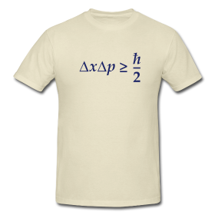
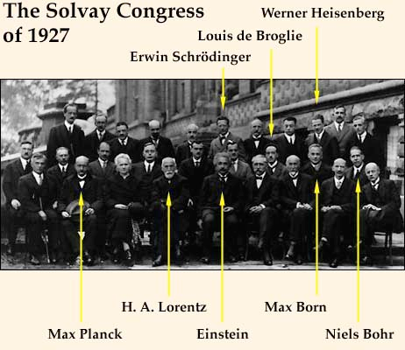
Chemistry 221 Final Exam Review Chapter 6
Chemistry 221
Professor Michael Russell
Last update:
4/29/24
MAR

Slide 2
CH 221 Lecture & Lab Final Exams
For section 01 and section H1
Lecture Final:
32 multiple choice questions and four short answer questions, Chapters 1 - 6,
Sec 01: Wednesday, 8:45 AM, AC 1303
Sec H1: Wednesday, 1:10 PM, AC 2501
Lab Final: Due at time of Lecture Final
6 short answer questions over labs from this term; released Monday morning, complete printed copy and turn in Wednesday with Final Exam Prep worksheet
Final grades available by Friday night. Final exams not returned.
Good luck with your studying!
Let's start the review!
MAR

Slide 3
Lecture Final
Chapters 1 - 6
If this class meets "face to face":
Bring: calculator, pencil, scantron (50 questions / side, 100 questions total), Final Exam Prep Worksheet, Take Home Final
32 multiple choice questions, ~2 hours in length; meet at 8:45 AM, AC 1303, Wednesday
Final Grades posted by Friday at 5 PM
Good luck with your studying!
Let's start the review!
MAR

Slide 4
Lecture Final
Chapters 1 - 6
If this is an online class:
32 multiple choice questions and nine short answer questions
Due Wednesday by 11:59 PM via email
Final grades available by Friday night. Final exams not returned.
Good luck with your studying!
Let's start the review!
MAR

Slide 5
How many emission lines are possible considering only the five quantum levels of hydrogen shown below?
3
4
7
8
10
MAR
Enter your response on
your i>Clicker now!
Answer = E, 10
Emission lines: high n → low n
5→4, 5→3, 5→2, 5→1 (4)
4→3, 4→2, 4→1 (3)
3→2, 3→1 (2)
2→1 (1)
Total = 4 + 3 + 2 + 1 = 10 emission lines

Slide 6
Photons of the highest frequency will be emitted in a transition from the level with n = ____ to the level with the n = _____.
from n = 1 to n = 2
from n = 2 to n = 1
from n = 3 to n = 1
from n = 4 to n = 1
from n = 5 to n = 1
MAR
Enter your response on
your i>Clicker now!
Answer = E, n = 5 to n = 1
highest frequency = highest energy
y-axis is energy, so 5 → 1 is:
highest energy, and
highest frequency; and also
smallest wavelength

Slide 7
The emission line having the longest wavelength corresponds to a transition from the level with n = ___ to the level with n = ___.
from n = 1 to n = 2
from n = 2 to n = 1
from n = 4 to n = 1
from n = 5 to n = 1
from n = 5 to n = 4
MAR
Enter your response on
your i>Clicker now!
Answer = E, n = 5 to n = 4
longest wavelength = smallest energy,
n levels get closer together as n increases, and since
y-axis is energy: 5 → 4 is:
smallest energy, and
smallest frequency; and also
longest wavelength

Slide 8
Excited H atoms emit visible light when electrons fall from higher levels to n = 2 (this is called the Balmer series of lines). If green light comes from the transition from n = 4 to n = 2, is the light from the n = 3 to n = 2 transition expected to be red or blue?
Red
Blue
ultramagnetic
MAR
Enter your response on
your i>Clicker now!
Answer = A, red
H transitions ending at n = 2 are Balmer (visible) lines
red is lower E than blue
4 →2 larger E than 3 →2,
3 →2 expected to be red
(Hydrogen Emission lab!)

Slide 9
Calculate the wavelength in nanometers associated with an energy change of 182.3 kJ/mol.
3.027 x 10⁻¹⁹
6.563 x 10⁻⁷
302.7
656.3
billions!
MAR
Enter your response on
your i>Clicker now!
Answer = D, 656.3
Convert kJ/mol to J/photon, then into λ in m, then nm
∆E = 182.3 kJ/mol * (mol/6.022E23) * (1000 J/kJ)
∆E = 3.027 x 10⁻¹⁹ J/photon
∆E = hν = hc/λ, so
λ = hc/∆E
λ = 6.626E-34 * 2.998E8 / 3.027E-19
λ = 6.563 x 10⁻⁷ m * (nm / 10⁻⁹ m)
λ = 656.3 nm

Slide 10
What is the observed wavelength for an electron (mass = 9.109 x 10⁻²⁸ g) traveling at a speed of 1.20 x 10⁸ m/s? (hint: use kg for mass!)
6.06 x 10⁻³ m
1.17 x 10⁻⁵ fm
3.00 x 10⁸ m
6.06 x 10⁻³ nm
none of the above
MAR
Enter your response on
your i>Clicker now!
Answer = D, 6.06 x 10⁻³ nm
λ = h / m v
convert mass to kg for de Broglie
λ = 6.626E-34 / 9.109E-31*1.20E8
λ = 6.06 x 10⁻¹² m (*10⁹ nm/m)
λ = 6.06 x 10⁻³ nm

Slide 11
Which of the following is NOT a valid set of quantum numbers?
n = 4, ℓ = 1, and m_{ℓ} = -1
n = 6, ℓ = 5, and m_{ℓ} = 0
n = 2, ℓ = 2, and m_{ℓ} = +1
n = 3, ℓ = 2, and m_{ℓ} = -2
n = 1, ℓ = 0, and m_{ℓ} = 0
MAR
Enter your response on
your i>Clicker now!
Answer = C,
n = 2, ℓ = 2, and m_{ℓ} = +1
max ℓ = n - 1, and ℓ ≠ n
(max mℓ = ℓ, and min mℓ = -ℓ)

Slide 12
For a certain orbital, n = 3, ℓ = 1, and m_{ℓ} = -1. What type of orbital is this?
3d
3s
3p
4d
1f
MAR
Enter your response on
your i>Clicker now!
Answer = C, 3p
use nℓ notation:
n = 3
ℓ = 1 is a p subshell
ℓ: 0(s) 1(p) 2(d) 3(f) 4(g)

Slide 13
If an electron subshell has 7 orbitals, what is the ℓ value for this subshell?
two
three
four
five
seven
MAR
Enter your response on
your i>Clicker now!
Answer = B, three
# orbitals = 2ℓ + 1
7 = 2ℓ + 1
solve for ℓ,
ℓ = 3 (f orbital)

Slide 14
What type of orbital has 2 nodal planes?
s
p
d
ƒ
g
MAR
Enter your response on
your i>Clicker now!
Answer = C, d
# of nodal planes = ℓ
(spherical nodes = n - ℓ - 1)
2 nodal planes: ℓ = 2
ℓ: 0(s) 1(p) 2(d) 3(f) 4(g)
a d orbital

Slide 15
Which of the following orbitals has 2 spherical nodes?
1s
2p
3d
3p
4p
MAR
Enter your response on
your i>Clicker now!
Answer = E, 4p
# of spherical nodes = n - ℓ - 1
ℓ: 0(s) 1(p) 2(d) 3(f) 4(g)
4p: 4 - 1 - 1 = 2 spherical nodes

Slide 16
The electron configuration for neutral chlorine is
1s² 2s²2p⁶ 3s⁵
1s² 2s²2p⁶ 3s²3p⁵
1s² 2s²2p⁵
1s² 2s²2p⁶ 3s²3p⁶
[Xe]
MAR
Enter your response on
your i>Clicker now!
Answer = B,
1s² 2s²2p⁶ 3s²3p⁵
Cl has 17 total electrons,
past [Ne],
one before [Ar]
or: [Ne] 3s²3p⁵

Slide 17
What neutral element has the electron configuration 1s² 2s²2p⁶ 3s²3p⁶ 3d¹⁰ 4s²?
Zn
Ca
Ge
Ni
H
MAR
Enter your response on
your i>Clicker now!
Answer = A, Zn
30 total electrons, all neutral atom choices,
must be Zn
also past [Ar],
filled 3d¹⁰ subshell

Slide 18
The electron configuration for neutral tin is:
[Ne] 4s² 3d¹⁰ 4p²
[Ar] 4s² 3d¹⁰ 4p²
[Kr] 5s² 4d¹⁰ 5p²
[Xe] 5s² 4d¹⁰ 5p²
[Uuo] or [Og] Z = 118! :)
MAR
Enter your response on
your i>Clicker now!
Answer = C, [Kr] 5s² 4d¹⁰ 5p²
Tin = Sn, Z = 50
past [Kr], before [Xe],
must be answer C!
also:
a [noble gas] ns² np² element,
n = 5 (5th period)

Slide 19
What neutral element has the following electron configuration?
Cl
S
Be
Ti
Jq
MAR
Enter your response on
your i>Clicker now!
Answer = B, S
[Ne] = 10 e⁻, plus 6 more = 16 e⁻
Z = 16, S, sulfur

Slide 20
What neutral element has the electron configuration [Xe] 4f¹⁴ 5d¹⁰ 6s² 6p²?
Hf
Lu
Pb
Sn
Jq
MAR
Enter your response on
your i>Clicker now!
Answer = C, Pb
Lead = Pb, Z = 82
past [Xe], before [Rn],
also a [noble gas] ns² np² element,
n = 6 (6th period)

Slide 21
What is the electronic configuration of P³⁻?
[Ne] 3s² 3p⁶
[Ne] 3s² 3p³
[Ne] 3s²
[Ne] 3p⁶
[Ne]
MAR
Enter your response on
your i>Clicker now!
Answer = A, [Ne] 3s² 3p⁶
neutral P: [Ne] 3s² 3p³
extra 3 e⁻ go in 3p orbital,
P³⁻: [Ne] 3s² 3p⁶ = [Ar]

Slide 22
What ion corresponds to the following electron configuration?
Fe³⁺
Rh³⁺
Co²⁺
Ni²⁺
Li¹⁺
MAR
Enter your response on
your i>Clicker now!
Answer = C, Co²⁺
Must be Fe³⁺, Co²⁺ or Ni²⁺ if [Ar]
1st e⁻ removed from 4s subshell
Fe³⁺: [Ar] 3d⁵
Ni²⁺: [Ar] 3d⁸
Co²⁺: [Ar] 3d⁷

Slide 23
Which of the following ions is diamagnetic?
Ti²⁺
V²⁺
Mg²⁺
Cr²⁺
none are diamagnetic
MAR
Enter your response on
your i>Clicker now!
Answer = C, Mg²⁺
All main group metal ions diamagnetic
(groups IA, IIA, IIIA)
Mg²⁺: [Ne] (no unpaired electrons)
Ti²⁺: [Ar] 3d² (2 unpaired e⁻)
V²⁺: [Ar] 3d³ (3 unpaired e⁻)
Cr²⁺: [Ar] 3d⁴ (4 unpaired e⁻)

Slide 24
Which of the following is the correct electronic configuration for the nickel(II) ion?
[Ar] 3d⁸
[Kr] 4s² 3d⁶
[Ar] 4s² 3d⁶
[Kr] 3d⁸
[He]
MAR
Enter your response on
your i>Clicker now!
Answer = A, [Ar] 3d⁸
Ni past Ar, before Kr,
answers A or C only
Ni: [Ar] 4s² 3d⁸
Ni²⁺: [Ar] 3d⁸
remove electrons from highest n (4s), then highest n + ℓ (3d)

Slide 25
Which of the following is the correct electronic configuration for the tin(II) ion?
[Kr] 5s² 5p² 4d¹⁰
[Kr] 5s² 4d¹⁰
[Kr] 5s² 5p² 4d⁸
[Kr] 5p² 4d¹⁰
[He] 2s² 2p²
MAR
Enter your response on
your i>Clicker now!
Answer = B, [Kr] 5s² 4d¹⁰
Sn (Z = 50) has filled 4d shell
Sn: [Kr] 5s² 4d¹⁰ 5p²
Sn²⁺: [Kr] 5s² 4d¹⁰
remove electrons from highest n (tie: 5s and 5p)
If tie, then highest n + ℓ (5p higher than 5s)

Slide 26
Compare the elements Na, B, Al, and C with regard to the following properties: Which has the largest atomic radius?
Na
B
Al
C
Jq
MAR
Enter your response on
your i>Clicker now!
Answer = A, Na (sodium)
Atomic radii increase down and to the left
Na most "down and to the left" on periodic table

Slide 27
Which of the following is expected to have the largest radius?
P^{3–}
Cl–
S^{2–}
Ar
need a table to determine
MAR
Enter your response on
your i>Clicker now!
Answer = A, P³⁻
All four have same number of electrons (18), but different number of protons
Fewest protons (parents) electrons will "wander" (children)

Slide 28
Compare the elements Na, B, Al, and C with regard to the following properties: Which has the largest (most negative) electron affinity?
Na
B
Al
C
Jq
MAR
Enter your response on
your i>Clicker now!
Answer = D, C (carbon)
Electron affinity increases up and to the right
C most "up and to the right" on periodic table

Slide 29
Which of the following groups of elements is arranged correctly in order of increasing first ionization energy?
Mg < C < N < F
N < Mg < C < F
Mg < N < C < F
F < C < Mg < N
I need Google to answer this question
MAR
Enter your response on
your i>Clicker now!
Answer = A,
Mg < C < N < F
(first) ionization energy increases up and to the right
follow periodic table "up and to the right" to get answer

Slide 30
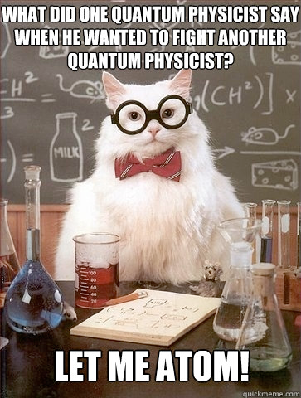
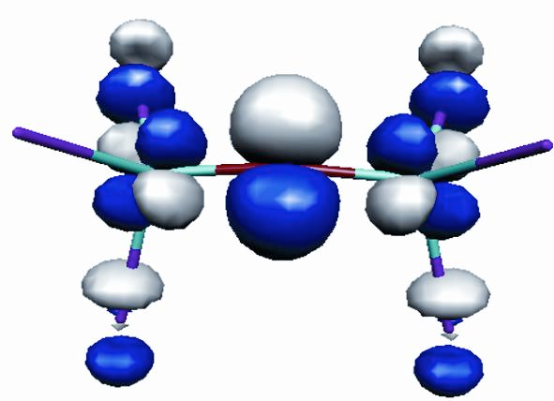
End of
Review -
Good luck
with your
final exams!
Need more practice?
Practice Problem Sets (online)
Concept Guides (Companion and online)
Chapter Guides (online)
End of Chapter Problems in Textbook (every other question has answer at end)
Good luck with your studying!
MAR

