Slide 1
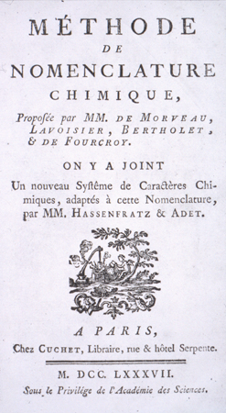
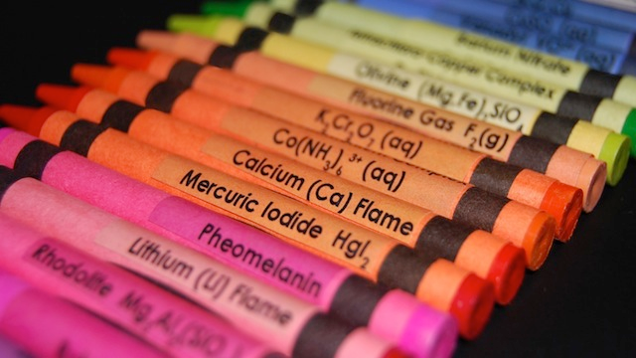
Chemistry 221 Exam I Review Chapters 1, 2 and 3.1 - 3.2
Last update:
4/29/24
Chemistry 221
Professor Michael Russell
1787 Nomenclature book by Lavoisier
MAR

Slide 2
Midterm I
Chapters 1, 2, up to 3.2
For this "face to face" class (01 & H1):
Bring: calculator, pencil, "notes sheet" "Determination of an Empirical Formula" lab, Exam Prep Worksheet I, "%KClO3 (in class)" printed lab, safety goggles
20 multiple choice questions, 4 short answer questions, ~2 hours in length
Returned following lab period with "summary sheet" Good luck with your studying!
Let's start the review!
MAR

Slide 3
Midterm I
Chapters 1, 2, up to 3.2
For this online exam:
20 multiple choice questions, 3-4 short answer questions
Released Wednesday night, Due Friday at 9 AM via email
Returned with "summary sheet" at end
Good luck with your studying!
Let's start the review!
MAR

Slide 4
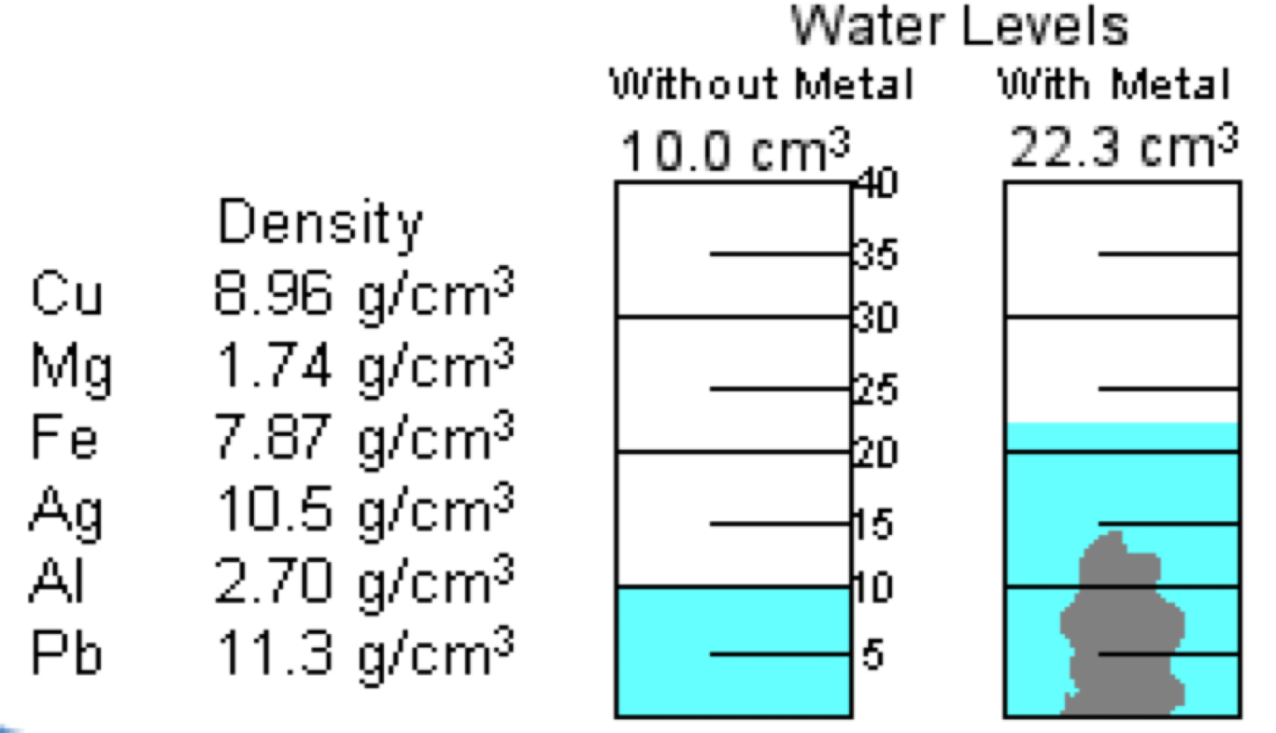
A piece of metal with a mass of 33.2 g is immersed in 10.0 mL of water in a graduated cylinder. Determine the identity of the metal.
Cu, 8.96 g/cm³
Mg, 1.74 g/cm³
Fe, 7.87 g/cm³
Ag, 10.5 g/cm³
Al, 2.70 g/cm³
MAR
Enter your response on
your i>Clicker now!
Answer = E, Al, 2.70 g/cm³
Read cylinder before and after
for volume,
density = mass / volume
density = 33.2 g / (22.3 - 10.0) cm³
density = 2.70 g/cm³,
closest to Al (2.70 g/cm³)

Slide 5
You are given temperature readings at three locations on Earth: 29 ˚C, 45 ˚F, and 256 K. What is the order of increasing temperature?
29 ˚C < 45 ˚F < 256 K
45 ˚F < 29 ˚C < 256 K
256 K < 29 ˚C < 45 ˚F
256 K < 45 ˚F < 29 ˚C
45 ˚F < 256 K < 29 ˚C
MAR
Enter your response on
your i>Clicker now!
Answer = D,
256 K < 45 ˚F < 29 ˚C
Convert to common scale (°C):
T(°C) = T(K) - 273.15
T(°C) = 256 - 273.15 = -17 °C
T(°C) = (T(°F) - 32)/1.8
T(°C) = (45 - 32)/1.8 = 7.2 °C
-17 °C < 7.2 °C < 29 °C, or
256 K < 45 °F < 29 °C

Slide 6
Place the following in order of increasing size: 215 mm, 9 cm, 2.3 m, and 0.125 m
215 mm < 9 cm < 2.3 m < 0.125 m
215 mm < 9 cm < 0.125 m < 2.3 m
9 cm < 215 mm < 0.125 m < 2.3 m
9 cm < 0.125 m < 215 mm < 2.3 m
0.125 m < 9 cm < 215 mm < 2.3 m
MAR
Enter your response on
your i>Clicker now!
Answer = D,
9 cm < 0.125 m < 215 mm < 2.3 m
Convert to common scale (m):
1000 mm = 1 m,
215 mm = 0.215 m
100 cm = 1 m,
9 cm = 0.09 m
0.09 m < 0.125 m < 0.215 m < 2.3 m, or
9 cm < 0.125 m < 215 mm < 2.3 m

Slide 7
Which of the following is NOT an isotope of element X (Z = 9)?
¹⁹₉X
²⁰₁₀X
¹⁸₉X
²¹₉X
²²₉X
MAR
Enter your response on
your i>Clicker now!
Answer = B, ²⁰10X
Isotopes have same atomic number (Z), different mass numbers (A)
Atomic number Z in lower left corner of symbol
X = F, fluorine :)

Slide 8
Which statement describes the composition of a neutral atom of iron-58?
26 neutrons, 32 protons, and 26 electrons
32 neutrons, 26 protons, and 26 electrons
26 neutrons, 26 protons, and 32 electrons
26 neutrons, 26 protons, and 26 electrons
Not enough information
MAR
Enter your response on
your i>Clicker now!
Answer = B, 32 neutrons, 26 protons, and 26 electrons
Fe: Z = 26, so 26 protons
Neutral atom, so 26 electrons
# neutrons = A - Z, or
# neutrons = 58 - 26 = 32

Slide 9
An element (E) has several naturally occurring isotopes, with the following abundances: ⁷²E, 54.5% ⁷³E, 15.6% ⁷⁴E, 29.9%
The most reasonable atomic weight for this element would be
72.1
72.8
73.4
73.8
74.0
MAR
Enter your response on
your i>Clicker now!
Answer = B, 72.8
quick answer:
Highest % ⁷²E, somewhat close to 72, but appreciable higher isotopes, so 72.8 "reasonable"
math answer:
atomic weight = Σ(abundance*mass)
= 0.545*72 + 0.156*73 + 0.299*74
= 72.754 ≈ 72.8

Slide 10
Which ion in the following list is NOT likely to form?
Na⁺
Mg³⁺
Al³⁺
Fe²⁺
Zn²⁺
MAR
Enter your response on
your i>Clicker now!
Answer = B, Mg³⁺
Mg (alkaline earth metal) in group IIA takes +2 charge
Mg²⁺ only reasonable charge for Mg

Slide 11
When the ion Sr²⁺ forms,
the Sr atom loses 1 electron and now has the same number of electrons as Kr
the Sr atom loses 1 electron and now has the same number of electrons as Xe
the Sr atom loses 2 electrons and now has the same number of electrons as Kr
the Sr atom gains 2 electrons and now has the same number of electrons as Kr
the Sr atom loses 3 electrons and now has the same number of electrons as Kr
MAR
Enter your response on
your i>Clicker now!
Answer = C, the Sr atom loses 2 electrons and now has the same number of electrons as Kr
Becoming positive means "losing electrons"
Becoming negative means "gaining electrons"

Slide 12
Which compound formula and name in the list is NOT correct?
CaSO₄, calcium sulfate
NaNO₃, sodium nitrate
MgI₂, magnesium iodide
NH₄PO₄, ammonium phosphate
Ca(ClO)2, calcium hypochlorite
MAR
Enter your response on
your i>Clicker now!
Answer = D, NH₄PO₄,
ammonium phosphate
NH4⁺ = ammonium
PO4³⁻ = phosphate
charges must balance, so:
(NH4)3PO4 = ammonium phosphate

Slide 13
Which compound in the list is NOT ionic?
LiCl, lithium chloride
SO₂, sulfur dioxide
AlF₃, aluminum fluoride
Ba(NO₃)₂, barium nitrate
NaHCO₃, sodium hydrogen carbonate
MAR
Enter your response on
your i>Clicker now!
Answer = B, SO2 sulfur dioxide
ionic = cation + anion (usually metal + nonmetal)
sulfur and oxygen both nonmetals (and covalent)

Slide 14
Sodium oxalate has the formula Na₂C₂O₄. Based on this information, the formula for iron(III) oxalate is
FeC₂O₄
Fe(C₂O₄)₂
Fe(C₂O₄)₃
Fe₂(C₂O₄)₃
Fe₃(C₂O₄)₂
MAR
Enter your response on
your i>Clicker now!
Answer = D, Fe2(C2O4)3
Sodium always Na⁺, so
C2O4²⁻ (oxalate anion)
Combine with Fe³⁺ to get
Fe2(C2O4)3

Slide 15
All of the following statements concerning ionic compounds are correct EXCEPT
as the ion charges increase, the attraction between the ions increases.
ionic compounds form extended 3-dimensional networks called crystal lattices.
ionic crystals tend to be rigid, and they cleave along planes.
positive and negative ions are attracted to each other by electrostatic forces.
the electrostatic forces are weaker in CaO than in NaCl.
MAR
Enter your response on
your i>Clicker now!
Answer = E, the electrostatic forces are weaker in CaO than in NaCl
Coulomb's Law: +2/-2 ions in CaO stronger than +1/-1 in NaCl

Slide 16
You have 0.25 mol of each of the following elements. Which one has the largest mass?
Fe → 55.8 g/mol * 0.25 mol = 14 g Fe
Al → 27.0 g/mol * 0.25 mol = 6.8 g Al
Zn → 65.4 g/mol * 0.25 mol = 16 g Zn
Ca → 40.1 g/mol * 0.25 mol = 10. g Ca
C → 12.0 g/mol * 0.25 mol = 3.0 g C
MAR
Enter your response on
your i>Clicker now!
Answer = C, Zn
Largest MM will give largest mass,

Slide 17
Calculate the average mass of one chromium atom.
8.634 x 10⁻²³ g
6.626 x 10⁻³⁴ g
6.022 x 10⁻²³ g
51.996 g
too small to calculate accurately
MAR
Enter your response on
your i>Clicker now!
Answer = A, 8.634 x 10⁻²³ g
Molar mass of Cr = 51.996 g/mol
Avogadro’s number:
6.022 x 10²³ atoms / mol
51.996 g/mol * (1 mol / 6.022E23 atoms) = 8.634 x 10⁻²³ g/atom

Slide 18
Which answer best represents the percent composition of the compound CO₂?
50.0% C & 50.0% O
12.0% C & 88.0% O
27.3% C & 72.7% O
12.0% C & 32.0% O
64.0% C & 36.0% O
MAR
Enter your response on
your i>Clicker now!
Answer = C, 27.3% C and 72.7%O
MM (CO2) = 44.01 g/mol
1 mol C = 12.0 g, so:
%C = (12.0/44.01)* 100%
%C = 27.3%
2 mol O = 32.0 g, so:
%O = (32.0/44.01)* 100%
%O = 72.7%
or: 100% - 27.3 %C = 72.7 %O

Slide 19
Nitrogen and oxygen form a series of oxides with the general formula N_{x}O_{y}. One of them has 46.67% N. The empirical formula for this oxide is
N₂O
NO
NO₂
N₂O₃
N₂O₅
MAR
Enter your response on
your i>Clicker now!
Answer = B, NO
Assume 100 g, turn into moles:
46.67 g N * (mol N / 14.01 g)
= 3.331 mol N
100% - 46.67% = 53.33% O
53.33 g O * (mol O / 16.00 g)
= 3.333 mol O
N3.331O3.333
divide both by smallest number:
N(3.331/3.331)O(3.333/3.331)
= N1.000O1.001 = NO

Slide 20
Combining 6.54 g of Zn with oxygen gives a white powder, Zn_{x}O_{y}, with a mass of 8.14 g (all of the Zn reacts.) The empirical formula is:
ZnO
Zn₂O
ZnO₂
Zn₂O₃
Zn3O4
MAR
Enter your response on
your i>Clicker now!
Answer = A, ZnO
Law of mass action:
g O = 8.14 g - 6.54 g Zn = 1.60 g
Turn g into mol, compare:
mol O = 1.60 g O * (mol O / 16.00 g)
mol O = 0.100 mol O
mol Zn = 6.54 g Zn * (mol Zn / 65.34 g)
mol Zn = 0.100 mol Zn
Zn0.100O0.100
divide both by smallest number:
Zn(0.100/0.100)O(0.100/0.100)
= Zn1.00O1.00 = ZnO

Slide 21
Glyceraldehyde has an empirical formula of CH₂O and a molar mass is 90.08 g/mol. The molecular formula is:
CH₂O
C₂H₄O₂
C₃H₆O₃
C₄H₈O₄
C₄H₄O₄
MAR
Enter your response on
your i>Clicker now!
Answer = C, C₃H₆O₃
CH2O MM = 12 + 2(1) + 16
CH2O MM = 30 g/mol
90.08 g/mol / 30 g/mol ≈ 3
this ratio always whole number
MF = (EF)ratio = (CH2O)3 = C₃H₆O₃

Slide 22
A compound with P and F is 75.41% F with a molar mass of 251.94 g/mol. What is the molecular formula?
P₂F2
P10F2
PF₅
P₂F₅
P₂F₁₀
MAR
Enter your response on
your i>Clicker now!
Answer = E, P2F10
Assume 100 g, turn into moles:
75.41 g F * (mol F / 19.00 g)
= 3.969 mol F
100% - 75.41% = 24.59% P
24.59 g P * (mol P / 30.97 g)
= 0.7940 mol P
P0.7940F3.969, or:
P(0.7940/0.7940)F(3.969/0.7940)
EF = P1.000F4.999 = PF5
MM of PF5 = 125.97 g/mol,
251.94 / 125.97 = 2,
MF = (EF)ratio = (PF5)2
MF = P2F10

Slide 23
Which compound below represents iodous acid?
HI hydroiodic acid
HIO hypoiodous acid
HIO2 iodous acid
HIO3 iodic acid
HIO4 periodic acid
MAR
Enter your response on
your i>Clicker now!
Answer = C, HIO2

Slide 24
What is the molar mass of nickel(II) nitrate hexahydrate?
139 g/mol
201 g/mol
228 g/mol
291 g/mol
539 g/mol
MAR
Enter your response on
your i>Clicker now!
Answer = D, 291 g/mol
Formula =
Ni(NO3)2 ․ 6 H2O

Slide 25
End of
Review -
good luck
with your
studying!
Need more practice?
Practice Problem Sets (online)
Concept Guides (Companion and online)
Chapter Guides (online)
End of Chapter Problems in Textbook (every other question has answer at end)
Good luck with your studying!
MAR

