Slide 1
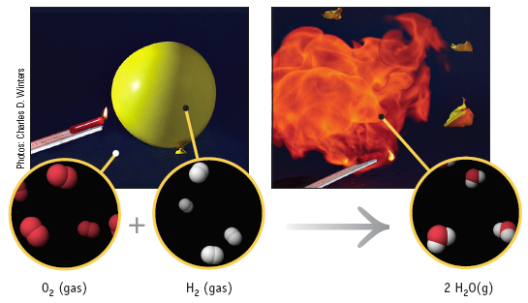
Chapter 7 Part I: Stoichiometry of Chemical Reactions (7.1 - 7.2 only)
Chemistry 221
Professor Michael Russell
http://mhchem.org/221
Last update:
7/7/25
MAR

Slide 2
7.1 - Writing and Balancing Chemical Equations
A balanced chemical equation (or reaction) uses symbolism to represent the identities and the relative quantities of substances undergoing a chemical (or physical) change.
Chemical equations depict the kind of reactants (left) and products (right) and their relative amounts in a reaction.
4 Al(s) + 3 O₂(g) → 2 Al₂O₃(s)
The numbers in the front are called stoichiometric coefficients
The letters (s), (g), (aq) and (l) are the physical states of compounds (solid, gas, liquid and 'dissolved in water' (aq))
MAR

Slide 3
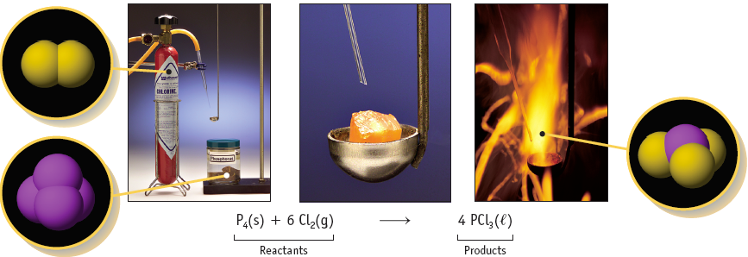
Reaction of Phosphorus with Cl2
Notice the stoichiometric coefficients and the physical states of the reactants and products.
MAR

Slide 4
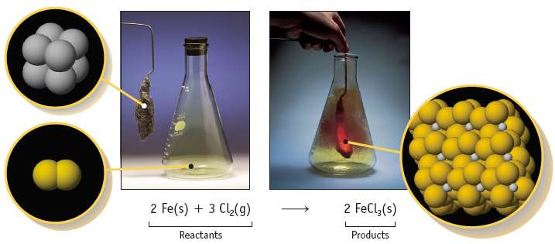
Reaction of Iron with Cl2
Evidence of a chemical reaction:
heat change, precipitate formation, gas evolution, color change
MAR

Slide 5
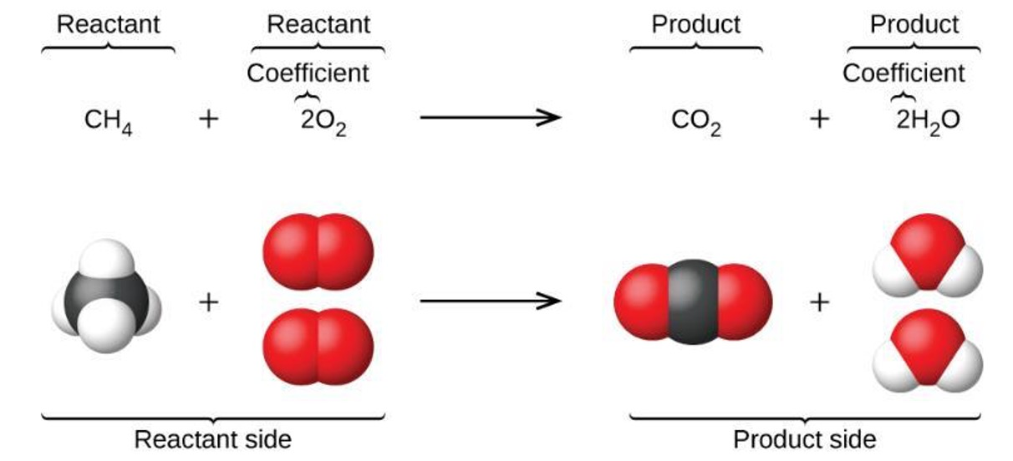
Reaction of Methane (CH4) with O2
Use smallest coefficients possible, i.e. 1:2:1:2 (above), not 2:4:2:4, etc.
MAR

Slide 6
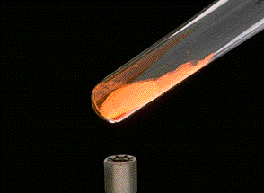
Chemical Equations
Because the same atoms are present in a reaction at the beginning and at the end, the amount of matter in a system does not change.
This is the Law of the Conservation of Matter
Also known as the Law of Mass Action
MAR

Slide 7
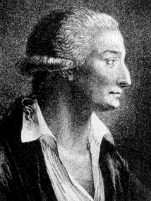
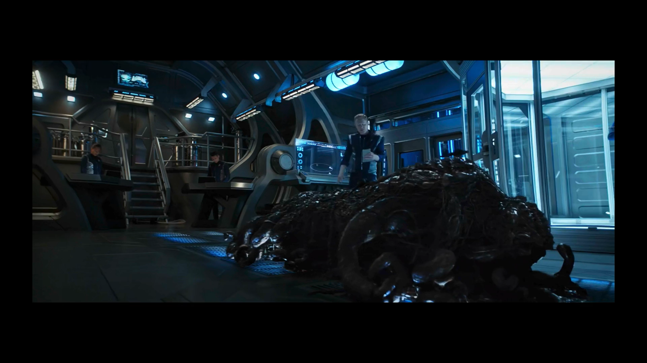
Lavoisier
"Mass is neither created nor destroyed"
Because of the principle of the conservation of matter,
an equation must be balanced.
It must have the same number of atoms of the same kind on both sides.
MAR
Lavoisier, 1788
Notes:
Scene from Star Trek: Discovery, Season 2 Episode 5, “Saints of Imperfection”

Slide 8
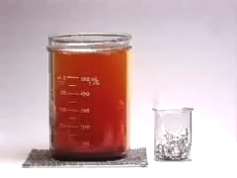
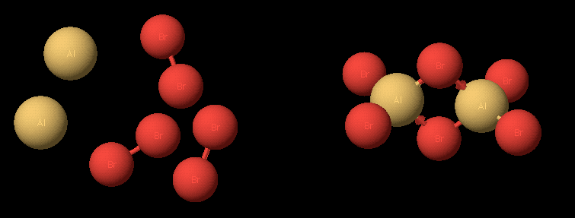
Balancing Equations
2 Al(s) + 3 Br₂(liq) ---> Al₂Br₆(s)
_ Al(s) + _ Br₂(liq) ---> _ Al₂Br₆(s)
MAR

Slide 9
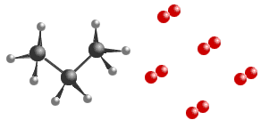
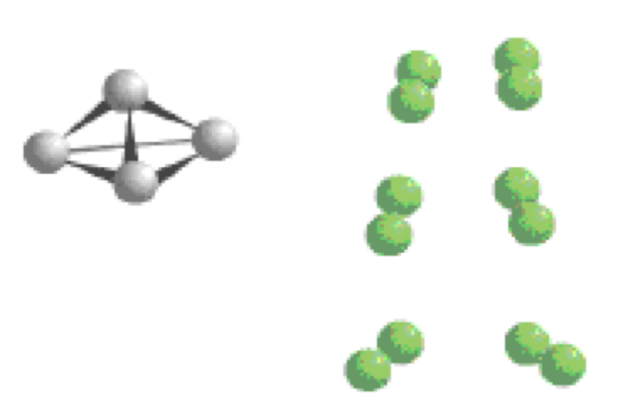
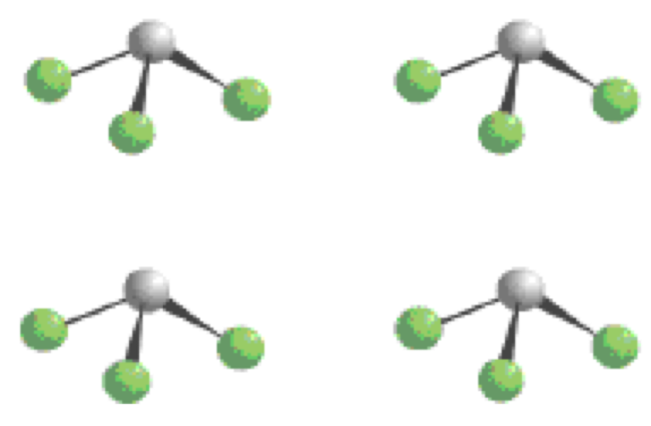
Balancing Equations
C₃H₈(g) + 5 O₂(g) → 3 CO₂(g) + 4 H₂O(g)
____C₃H₈(g) + _____ O₂(g) → _____CO₂(g) + _____ H₂O(g)
____B₄H₁₀(g) + _____ O₂(g) → ___ B₂O₃(g) + _____ H₂O(g)
Reactants
Products
MAR
The diagram below illustrates the reaction of phosphorus (P, gray) and chlorine (Cl, green) to produce phosphorus trichloride. Which statement is correct?
  The reaction involves 1 P atom and 6 Cl atoms to produce 1 PCl₃ molecule.
  The reaction involves 4 P atoms and 12 Cl atoms to produce 4 PCl₃ molecules.
  The reaction involves 1 P atom and 6 Cl atoms to produce 4 PCl₃ molecules.
2 B₄H₁₀(g) + 11 O₂(g) → 4 B₂O₃(g) + 10 H₂O(g)
Enter your response on
your i>Clicker now!
Answer = B,
The reaction involves 4 P atoms
and 12 Cl atoms to produce
4 PCl₃ molecules.

Slide 10

Balancing Equations - hints
A reaction which is heated may include an uppercase Greek letter delta (Δ) over the arrow:
CaCO3(s) ⟶ CaO(s) + CO2(g)
It is sometimes convenient to use fractions instead of integers as intermediate coefficients.
C2H6 + ⁷/2 O2 ⟶ 3 H2O + 2 CO2 (balanced)
Generally fractions are not used, so when balance is achieved, all the equation’s coefficients are multiplied by a whole number to convert to whole numbers.
2 C2H6 + 7 O2 ⟶ 6 H2O + 4 CO2 (balanced)
MAR

Slide 11

Balancing Equations - More Hints
Balance those atoms which occur in only one compound on each side last (i.e. O2 in previous examples)
Balance the remaining atoms first. Try not to use fractions as coefficients.
Never change the subscripts on a formula, only change the coefficients
Reduce coefficients to smallest whole integers
Check your answer if uncertain
Check that charges are balanced
Practice, practice, practice!
MAR

Slide 12
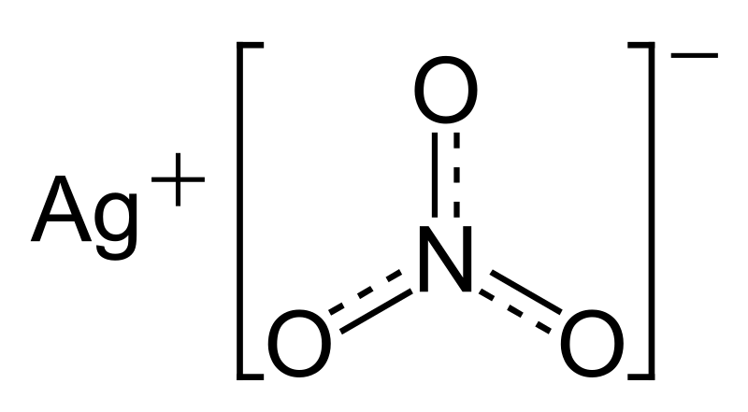
Aqueous Compounds
Consider: CaCl2(aq) + 2 AgNO3(aq) ⟶ Ca(NO3)2(aq) + 2 AgCl(s)
When ionic compounds dissolve in water, they dissociate into their constituent ions. Examples:
CaCl2(aq) ⟶ Ca²⁺(aq) + 2 Cl¹⁻(aq)
2 AgNO3(aq) ⟶ 2 Ag¹⁺(aq) + 2 NO3¹⁻(aq)
Ca(NO3)2(aq) ⟶ Ca²⁺(aq) + 2 NO3¹⁻(aq)
...but AgCl does not dissolve in water (it stays a solid).
MAR

Slide 13
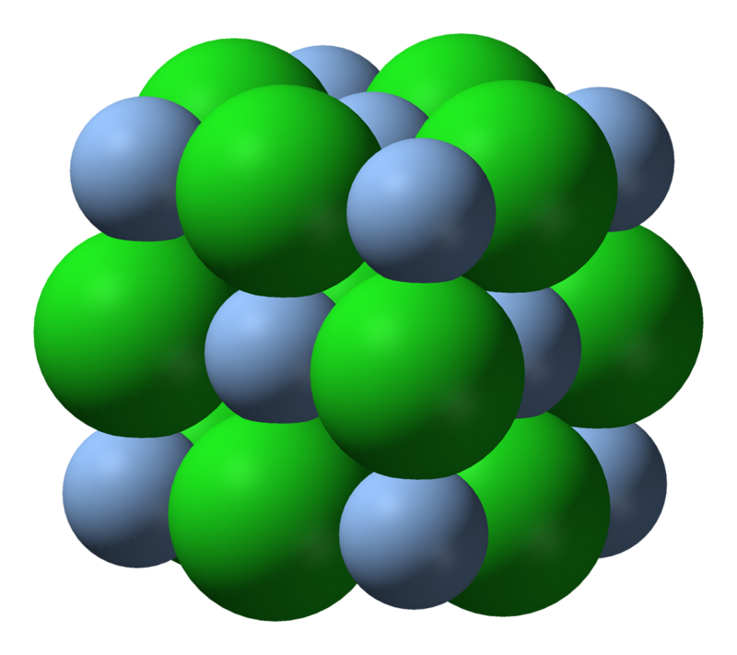
Aqueous Compounds
Consider: CaCl2(aq) + 2 AgNO3 (aq) ⟶ Ca(NO3)2(aq) + 2 AgCl(s)
We can re-write the equation as:
Ca²⁺(aq) + 2 Cl¹⁻(aq) + 2 Ag¹⁺(aq) + 2 NO3¹⁻(aq) ⟶ Ca²⁺(aq) + 2 NO3¹⁻(aq) + 2 AgCl(s)
Notice that Ca²⁺(aq) and 2 NO3¹⁻(aq) appear on both sides - they are spectator ions and can be removed from the reaction to get the net ionic reaction:
2 Cl¹⁻(aq) + 2 Ag¹⁺(aq) ⟶ 2 AgCl(s) or better yet:
Cl¹⁻(aq) + Ag¹⁺(aq) ⟶ AgCl(s)
AgCl
This is the net ionic reaction
No spectator ions in net ionic reactions
MAR

Slide 14
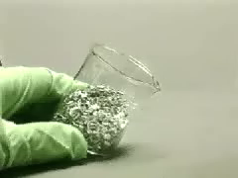
Net Ionic Equations
The two Cl⁻ ions are SPECTATOR IONS - they do not participate. Could have used NO₃⁻ (via HNO₃)
Mg(s) + 2 HCl(aq) → H₂(g) + MgCl₂(aq)
Break up (aq), leave gases, solids and liquids alone, to write:
Mg(s) + 2 H⁺(aq) + 2 Cl⁻(aq) → H₂(g) + Mg²⁺(aq) + 2 Cl⁻(aq)
Cl⁻ is a spectator - leave out - write the Net Ionic Equation:
Mg(s) + 2 H⁺(aq) → H₂(g) + Mg²⁺(aq)
MAR

Slide 15
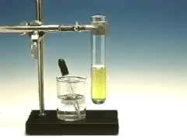
Net Ionic Equations
K₂CrO₄(aq) + Pb(NO₃)₂(aq) → PbCrO₄(s) + 2 KNO₃(aq)
Net Ionic Equation:
Pb²⁺(aq) + CrO₄²⁻(aq) → PbCrO₄(s)
K⁺ and NO₃⁻ are spectators
See Net Ionic Reactions Handout
MAR
What is/are the spectator ion(s) in the following reaction:
2 KOH(aq) + FeCl₂(aq) → Fe(OH)₂(s) + 2 KCl(aq)
  K⁺
  Cl⁻
  K^{+,} Fe²⁺
  Cl^{-,} OH⁻
  K^{+,} Cl⁻
Answer = E,
K⁺, Cl⁻
Enter your response on
your i>Clicker now!

Slide 16
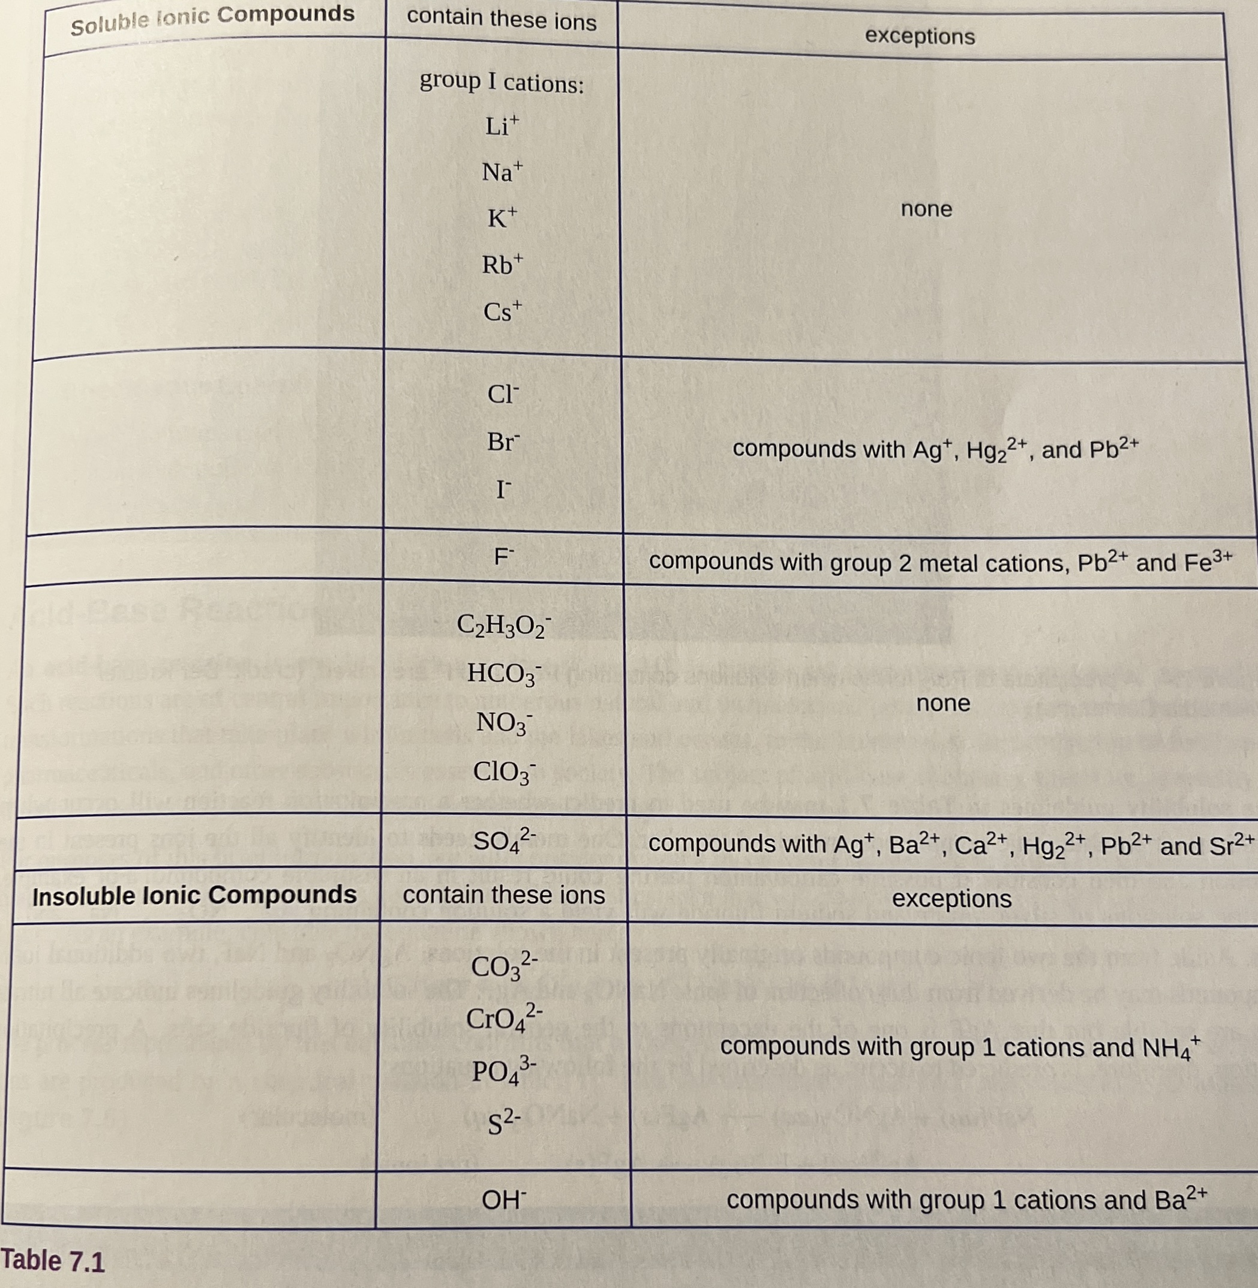
7.2 - Classifying Chemical Reactions - Precipitation
A precipitation reaction is a reaction where dissolved substances create solid products (a precipitate.) Chemists use a solubility table to know common combinations of chemicals which result in soluble (no solids) or insoluble (solids form) products.
Our solubility table is slightly different than the textbook's version, but similar.
Textbook's
Solubility
Guide
MAR

Slide 17
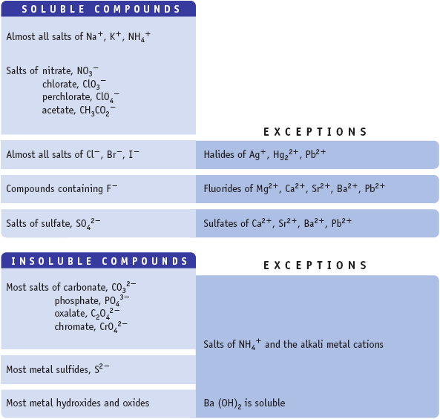
Water Solubility of Ionic Compounds
If one ion from the “Soluble Compd.” list is present in a compound, the compound is water soluble.
Ba(NO3)2(aq)?
soluble
BaCl2(aq)?
soluble
BaSO4(aq)?
insoluble
should write BaSO4(s)!
MAR
Use this solubility guide in CH 221-223!

Slide 18
Water Solubility Of Ionic Compounds
Many ionic compounds dissolve in water (soluble), but many are insoluble and do not dissolve.
Many ions make compounds soluble all of the time:
Solubility guide:
http://mhchem.org/sol/
Examples: Na⁺, K⁺, Li⁺, NH₄⁺, NO₃⁻, ClO₃⁻, ClO₄⁻, CH₃CO₂⁻, and most SO₄²⁻, Cl⁻, Br⁻ and I⁻ compounds.
MAR
Which of the following is the only INSOLUBLE salt in water?
  NH₄NO₃
  NaOH
  PbI₂
  K₂CO₃
  LiCl
Answer = C,
PbI2
Enter your response on
your i>Clicker now!

Slide 19
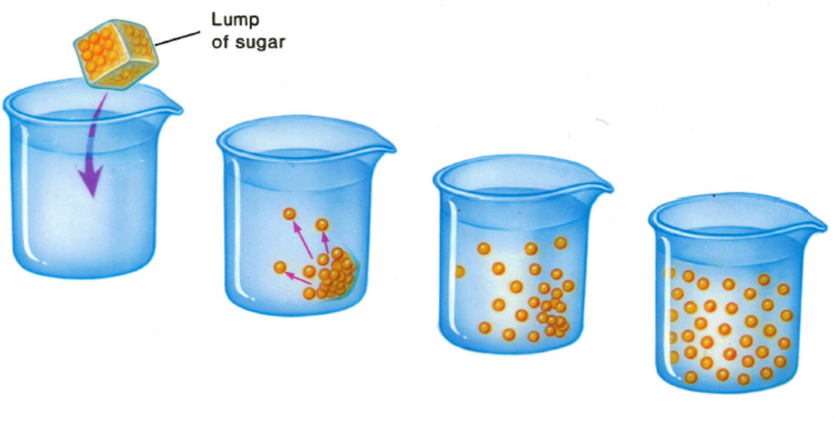
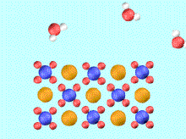
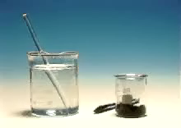

Ionic Compounds in
Aqueous Solution
Soluble ionic compounds dissolve in water to make aqueous solutions.
Insoluble ionic compounds stay undissolved in water.
MAR
KMnO₄ in water
K⁺(aq) + MnO₄⁻(aq)

Slide 20
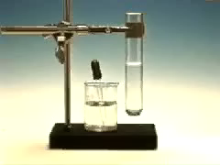
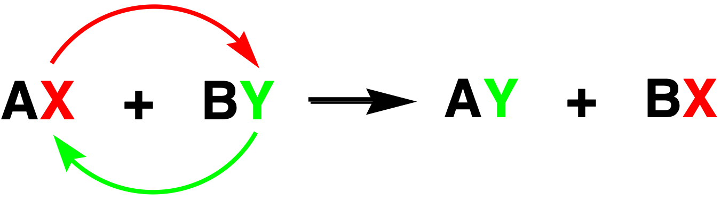
Chemical Reactions In Water
Many reaction types are Exchange Reactions
The anions exchange places between cations
Pb(NO₃)₂(aq) + 2 KI(aq)
→ PbI₂(s) + 2 KNO₃(aq)
Exchange reactions often called Double Displacement Reactions
MAR

Slide 21
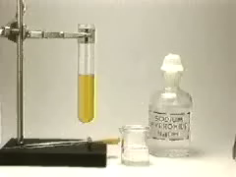
Precipitation Reactions
A precipitation reaction is an exchange reaction where a precipitate (i.e. solid) is formed as a product
The "driving force" is the formation of an insoluble compound - a precipitate.
Fe(NO₃)₃(aq) + 3 NaOH(aq) →
  3 NaNO₃(aq) + Fe(OH)₃(s)
Net ionic equation
Fe³⁺(aq) + 3 OH⁻(aq) → Fe(OH)₃(s)
MAR

Slide 22
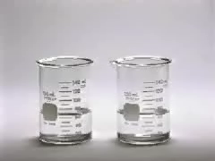
Acid-Base Reactions
An acid-base reaction is an exchange reaction where an acid and a base create water and a 'salt'
Acids react readily with bases. The "driving force" is the formation of water.
NaOH(aq) + HCl(aq) →
NaCl(aq) + H₂O(liq)
Net ionic equation:
OH⁻(aq) + H⁺(aq) → H₂O(liq)
This applies to ALL reactions of STRONG acids and bases.
Acid-base reactions often called "neutralizations", water and "salt" created
MAR

Slide 23
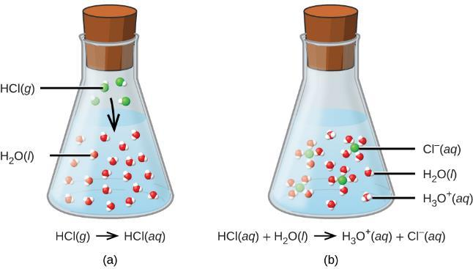
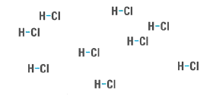
What is an Acid?
Hydronium often written as just H⁺
An acid is a substance which dissolves in water to create the hydronium ion, H3O⁺.
Acids that give the maximum amount of hydronium possible are called strong acids.
There are five strong acids (important):
HCl hydrochloric acid
HBr hydrobromic acid
HI hydroiodic acid
HNO₃ nitric acid
HClO₄ perchloric acid
MAR

Slide 24
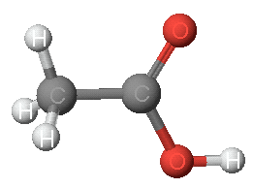
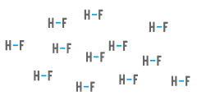
Weak Acids
Most acids do not create the maximum amount of hydronium possible; they are called weak acids.
Most foods are weak acids!
Assume an acid is weak unless you know it is strong
acetic acid
Examples:
CH₃CO₂H acetic acid
H₂CO₃ carbonic acid
H₃PO₄ phosphoric acid
HF hydrofluoric acid
MAR

Slide 25
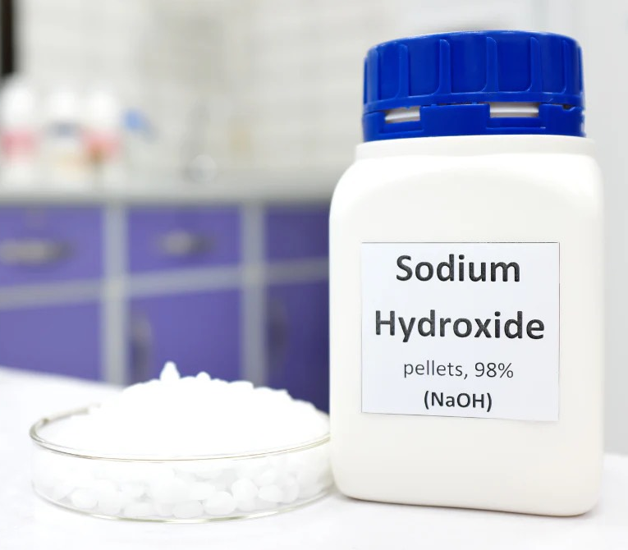
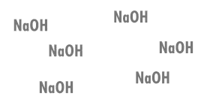
What is a Base?
A base is a metal hydroxide. Hydroxide ions react with hydronium ions to create water (and energy!)
Bases that give the maximum amount of hydroxide possible are called strong bases.
There are three strong bases (important):
NaOH sodium hydroxide
KOH potassium hydroxide
LiOH lithium hydroxide
MAR

Slide 26
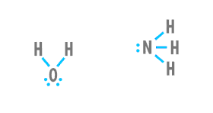
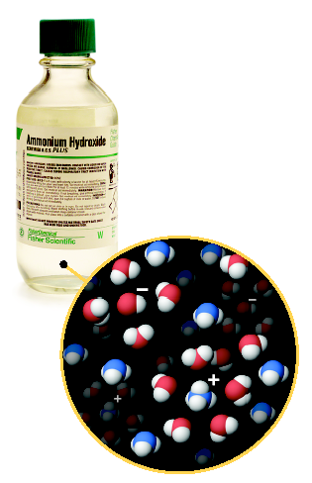
Weak Bases
Most bases do not create the maximum amount of hydroxide possible; they are called weak bases.
Most household cleaners are weak bases
Assume a base is weak unless you know it is strong
ammonia creates ammonium hydroxide in water
Examples:
NH₃ ammonia
Na₂CO₃ sodium carbonate
Na₃PO₄ sodium phosphate
N₂H₄ hydrazine
MAR

Slide 27
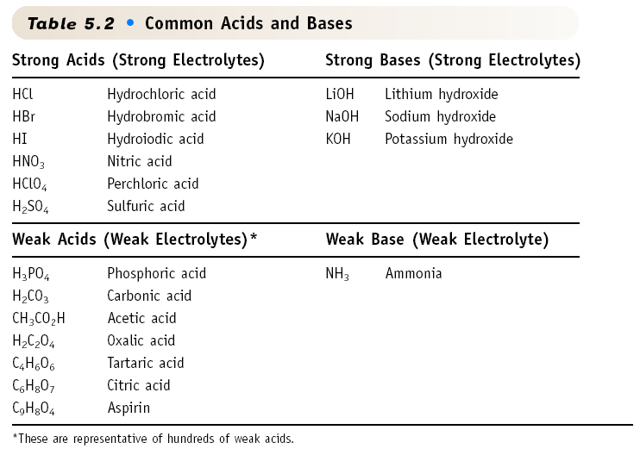
Common Acids and Bases
Know the strong acids & bases!
MAR
Which of the compounds below is not an acid in aqueous solution?
  CH₃CO₂H
  H₃PO₄
  NH₃
  HCl
  HIO
Answer = C,
NH3
Enter your response on
your i>Clicker now!

Slide 28
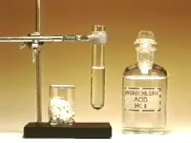

Gas-Forming Reactions
A gas forming reaction is an exchange reaction where one of the products is a gas. Gases often result from unstable products that break down into a gas immediately after the chemicals are mixed. Example:
CaCO₃(s) + 2 HCl(aq) → CaCl₂(aq) + H₂CO₃(aq)
Carbonic acid (H₂CO₃) is unstable and forms CO₂ & H₂O
H₂CO₃(aq) → CO₂(g) + H₂O(l)
so we should write:
CaCO₃(s) + 2 HCl(aq) → CaCl₂(aq) + CO₂(g) + H₂O(l)
Another gas forming species: ammonium hydroxide
NH₄OH(aq) → NH₃(g) + H₂O(l)
Be on the lookout for H₂CO₃ and NH₄OH as products! They will break down!
MAR
Which equation below best represents the balanced, net ionic equation for the reaction of magnesium carbonate with nitric acid?
  MgCO₃(s) + 2 HNO₃(aq) → Mg(NO₃)₂(aq) + CO₂(g) + H₂O(liq)
  MgCO₃(s) + 2 H⁺(aq) → Mg²⁺(aq) + CO₂(g) + H₂O(liq)
  Mg²⁺(aq) + 2 NO₃⁻(aq) → Mg(NO₃)₂(s)
  MgCO₃(s) + 2 HNO₃(aq) → Mg(NO₃)₂(aq) + H₂CO₃
Answer = B,
MgCO₃(s) + 2 H⁺(aq) → Mg²⁺(aq) + CO₂(g) + H₂O(liq)
Carbonic acid dissociates into water and CO2
Enter your response on
your i>Clicker now!
Notes:
Bubbling video from “Beautiful chemistry” (http://beautifulchemistry.net) accessed 10/13/2014

Slide 29
Combustion Reactions
A special example of a gas-forming reaction; not an exchange reaction. Used in quantitative chemistry; high temperatures
Reactants: (often) oxygen (O₂) and "something organic" (C, H, sometimes O or N)
Products: water and carbon dioxide (also NO₂ if N present)
Examples:
C₂H₄(g) + 3 O₂(g) → 2 H₂O(g) + 2 CO₂(g)
4 C₆H₅NO₂(g) + 29 O₂(g) → 10 H₂O(g) + 24 CO₂(g) + 4 NO₂(g)
MAR

Slide 30
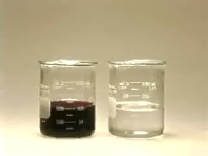
Oxidation-Reduction Reactions
An oxidation-reduction reaction (often called a redox reaction) is a reaction where electrons are transferred from one reactant (the reducing agent) to another reactant (the oxidizing agent). Knowing where electrons come from (and go to) important!
Very powerful and common reaction type (batteries, making chemicals, breathing!)
2 H₂(g) + O₂(g) → 2 H₂O(liq)
MAR

Slide 31

LEO says
GER
MAR

Slide 32
LEO says GER
Lose Gain
Electrons Electrons
Oxidized Reduced
  Zn(s) → Zn²⁺ + 2e- Oxidized (Zn is the reducing agent)
  Cu²⁺ + 2e- → Cu(s) Reduced (Cu²⁺ is the oxidizing agent)
Can also use "OIL RIG":
OIL = "Oxidation is Losing" (electrons)
RIG = "Reduction is Gaining" (electrons)
MAR

Slide 33
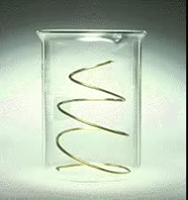
Redox Reactions
In all reactions: if something has been oxidized then something has also been reduced:
Cu(s) + 2 Ag⁺(aq) →
Cu²⁺(aq) + 2 Ag(s)
Oxidized species become more positive (lose electrons), reduced species become more negative (gain electrons)
Oxidation numbers help visualize electron transfer pathways
Lose Gain
Electrons Electrons
Oxidized Reduced
MAR
Iron can react with Cu²⁺ to make Cu metal:
Fe(s) + Cu²⁺(aq) → Cu(s) + Fe²⁺(aq)
Which of the following describes this reaction?
  Fe is reduced and Cu²⁺ is oxidized.
  Fe is oxidized and Cu²⁺ is reduced.
  Fe is reduced and Cu²⁺ is reduced.
  Fe is oxidized and Cu²⁺ is oxidized.
Answer = B,
Fe is oxidized and Cu²⁺ is reduced
Fe(s) → Fe²⁺(aq) + 2 e– (oxidized)
2 e– + Cu²⁺(aq) → Cu(s) (reduced)
Enter your response on
your i>Clicker now!

Slide 34
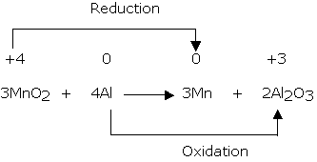
Oxidation Numbers
Use oxidation number rules to determine redox activity:
Atoms in free element have ox. no. = 0
Zn(s), O₂(g), Br₂(liq)
In simple ions, ox. no. = charge on ion
-1 for Cl⁻, +2 for Mg²⁺
In compounds, F is always -1, O is -2 (except peroxides (O = -1) and with F) and H is +1 (except hydrides (H = -1))
Sum of oxidation numbers = 0 for a compound or equals the overall charge for an ion
MAR

Slide 35
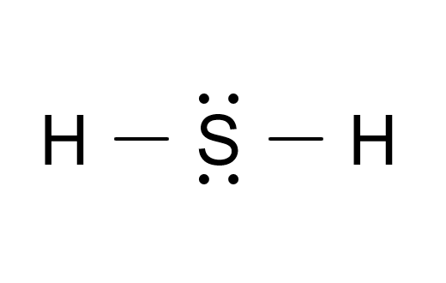
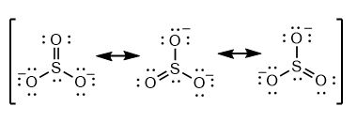
Oxidation Numbers
Example: Find the oxidation number for each element in H2S.
The oxidation number for H is +1, H2S is neutral, so:
Charge on H2S = 0 = (2 × 1) + 1x
x = −2 the oxidation number for S is -2!
Example: Find the oxidation number for each element in sulfite, SO3²⁻
The oxidation number for O is -2, sulfite has a -2 charge, so:
-2 = 1x + (3 × -2)
x = +4 the oxidation number for S is +4!
MAR

Slide 36
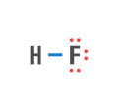
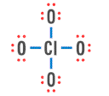
Oxidation Numbers
Determining oxidation numbers takes practice
HF
H: +1
F: -1
ClO₄⁻
Cl: +7
O: -2
MAR

Slide 37
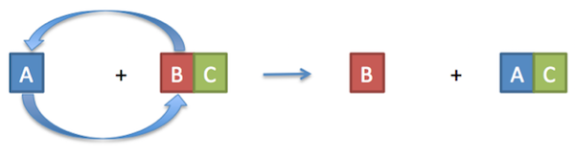
Single Replacement Reactions
Single Replacement reactions are always redox reactions
Examples:
Cu(s) + 2 AgNO3(aq) ⟶ Cu(NO3)2(aq) + 2Ag(s)
Mg(s) + 2 HCl(aq) ⟶ MgCl2(aq) + H2(g)
MAR

Slide 38
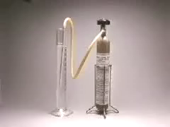
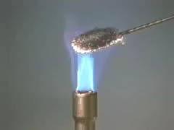
Redox Reaction Examples
NO = reducing agent
O₂ = oxidizing agent
2 NO + O₂ → 2 NO₂
Fe = reducing agent
Cl₂ = oxidizing agent
2 Fe + 3 Cl₂ → 2 FeCl₃
reducing agent = oxidized
oxidizing agent = reduced
MAR

Slide 39
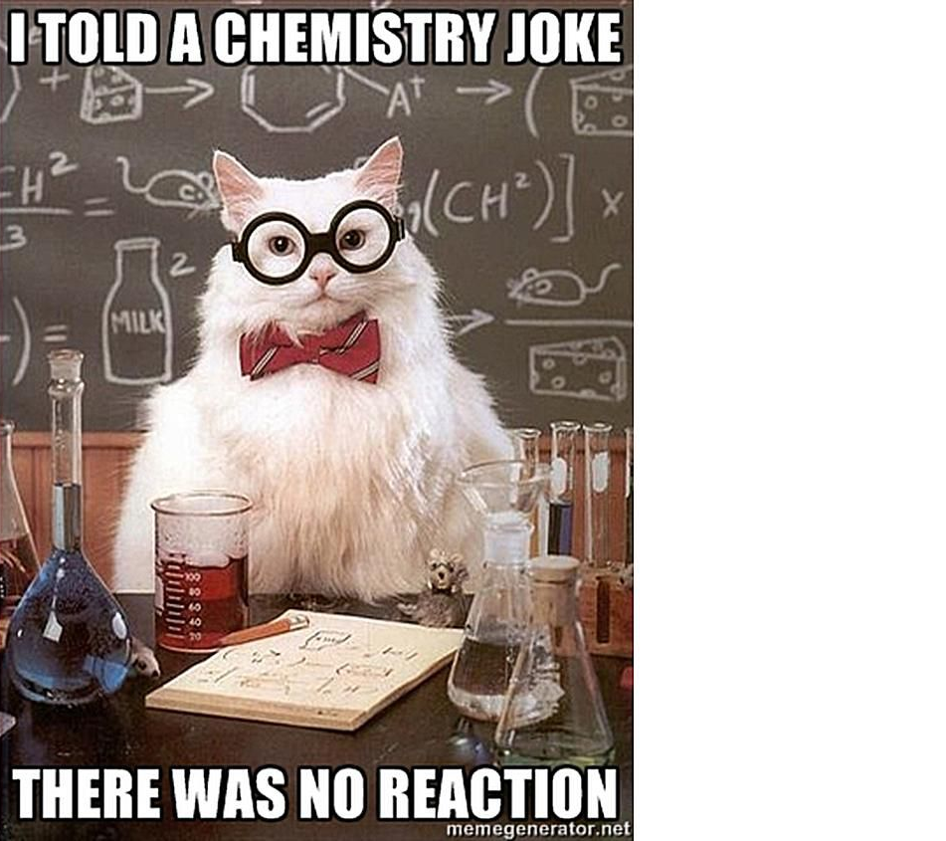
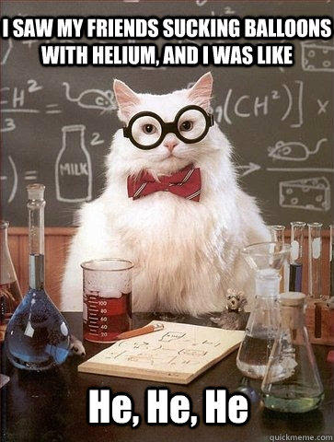
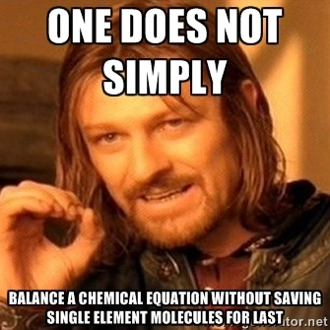
End of Chapter 7 Part 1
See also:
Chapter Seven Part 1 Study Guide
Chapter Seven Part 1 Concept Guide
Important Equations (following this slide)
End of Chapter Problems (following this slide)
MAR

Slide 40
Balancing Equations: Reactants, Products, states of matter (s, l, g, aq), stoichiometric coefficients, Law of Conservation of Matter (“mass action”)
Important Equations, Constants, and Handouts
from this Chapter:
Know how the solubility guide works
Know what makes an acid acidic (and bases basic) and strong or weak; know how to use the pH scale
Know how to write and determine net ionic equations and find spectator ions
Know how to use molarity with solution stoichiometry problems
Solutions: Solute, solvent, aqueous, solubility (use the Net Ionics solubility table), precipitation, types of reactions, molarity (M)
Know the five types of reactions: precipitation, acid-base, gas forming, combustion and redox. Know how to determine if something has been oxidized or reduced (and the oxidizing agent and reducing agent)

Slide 41
End of Chapter Problems: Test Yourself
Predict whether these compounds would be labeled as insoluble or soluble: HCl, NaCl, AgCl
Predict the products of this precipitation reaction and write the net ionic equation: NiCl2(aq) + (NH4)2S(aq) → ? List any spectator ions.
In the following reaction, decide which reactant is oxidized and which is reduced. Designate the oxidizing agent and the reducing agent. Si(s) + 2 Cl2(g) → SiCl4(l)
Identify the ions and their concentration that exist in this aqueous solution: 0.25 M (NH4)2SO4

Slide 42
End of Chapter Problems: Answers
Soluble: HCl(aq), NaCl(aq). Insoluble: AgCl(s)
NiCl2(aq) + (NH4)2S(aq) → NiS(s) + 2 NH4Cl(aq)
Ni²⁺(aq) + S^{2–}(aq) → NiS(s) Spectator ions: NH4⁺¹ and Cl⁻¹
Si is oxidized and is the reducing agent; Cl2 is reduced and is the oxidizing agent
0.50 M NH4⁺¹; 0.25 M SO4²⁻

