Slide 1
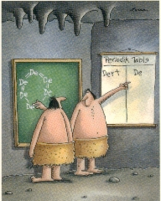
Chapter 6: The Composition of Substances and Solutions
Chemistry 221
Professor Michael Russell
http://mhchem.org/221
Early chemists describe the first dirt molecule
MAR
Last update:
7/7/25

Slide 2
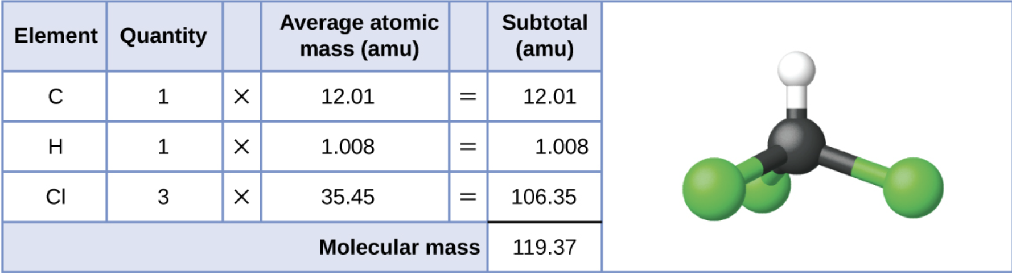
6.1 - Formula Mass (covalent molecules)
The formula mass of a substance is the sum of the average atomic masses of all the atoms in the substance’s formula (i.e. the molar mass)
For covalent molecules (i.e. nonmetal compounds), the formula mass is the mass of the molecule
Example:
Chloroform,
CHCl3
MAR
Recall: molecular mass in amu equals molar mass in g/mol

Slide 3
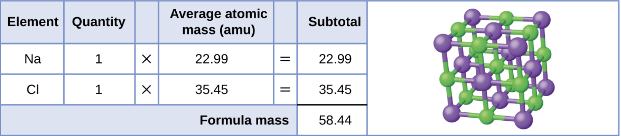
6.1 - Formula Mass (ionic compounds)
Ionic substances do not exist as molecules, so chemists calculate formula masses by the smallest whole number ratio of ions which result in a neutral charge (the empirical formula)
Example:
Sodium chloride,
NaCl
Recall: molecular mass in amu equals molar mass in g/mol
MAR

Slide 4
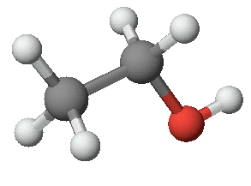
6.2 - Determining Empirical and Molecular Formulas
Finding the formula for a compound important to chemists!
A useful analysis tool can determine the percent composition of a compound. Percent composition provides percentages by mass (i.e. grams), and using molar mass values, these values can be converted to a formula (and vice-versa)
Example: Ethanol, C₂H₆O
52.13% C,
13.15% H,
34.72% O
Notice how all mass percentages for a compound equal 100%!
MAR

Slide 5
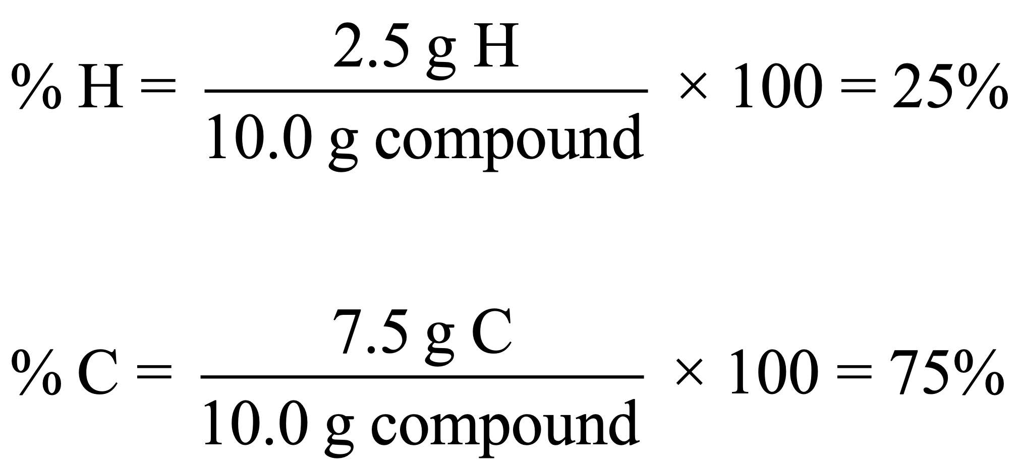
Percent Composition Calculations
Example: A 10.0 g sample of a compound is determined to contain 2.5 g hydrogen and 7.5 g carbon. Find the percentage by mass for H and C.
Need: total mass = 2.5 g + 7.5 g = 10.0 g
Note that %C could also have been calculated by 100% - 25%, alternative method
MAR

Slide 6
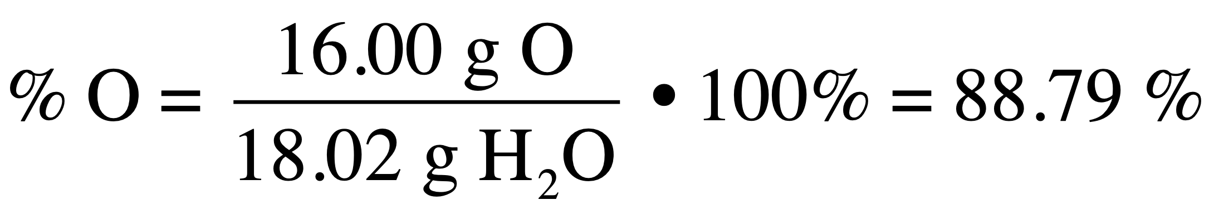
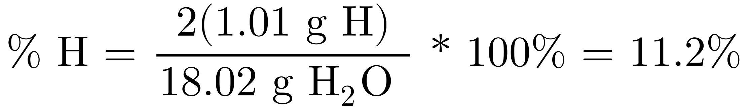
Percent Composition Calculations with Known Formula
For compounds of known formula, percent composition can be calculated from the formula mass and the atomic masses of the constituent elements.
Example: for water, H2O, with formula mass = 18.02 g/mol:
Note that %H could also have been calculated by 100% - 88.79%, alternative method, better sigs!
MAR
What is the percent nitrogen in NO? MM = 30.01 g/mol
  30.45 % N
  46.68 % N
  50.00 % N
  53.32 % N
  69.55% N
Answer = B,
  46.68%
  = (1*14.01/30.01) * 100%
  = 46.68% N
Enter your response on
your i>Clicker now!

Slide 7
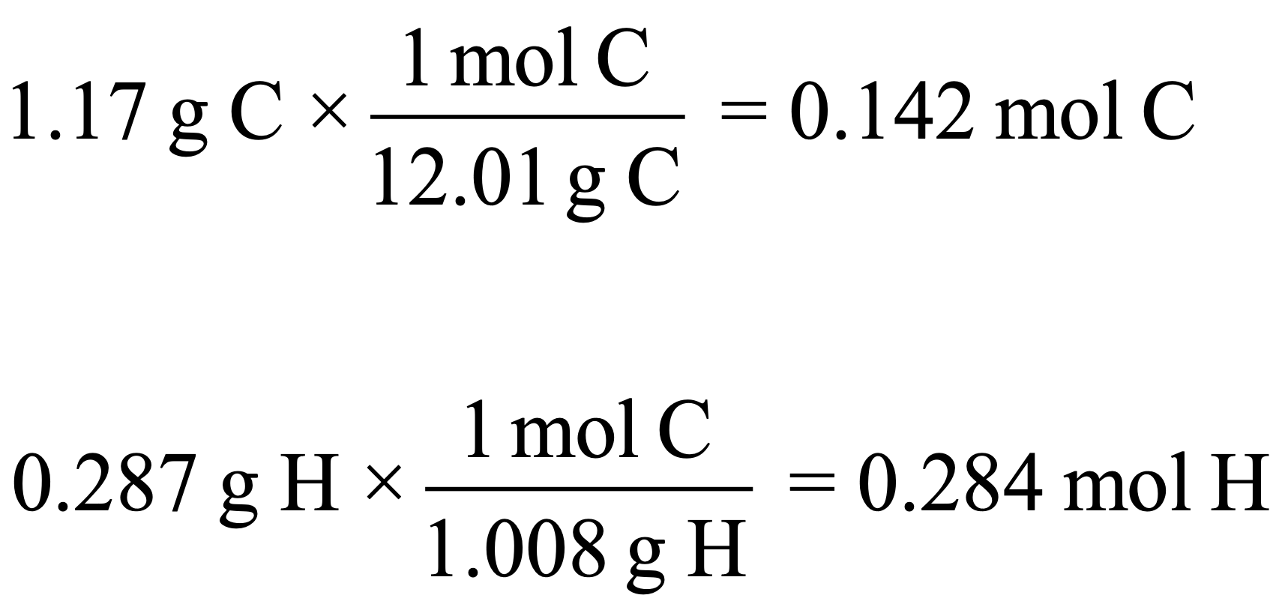
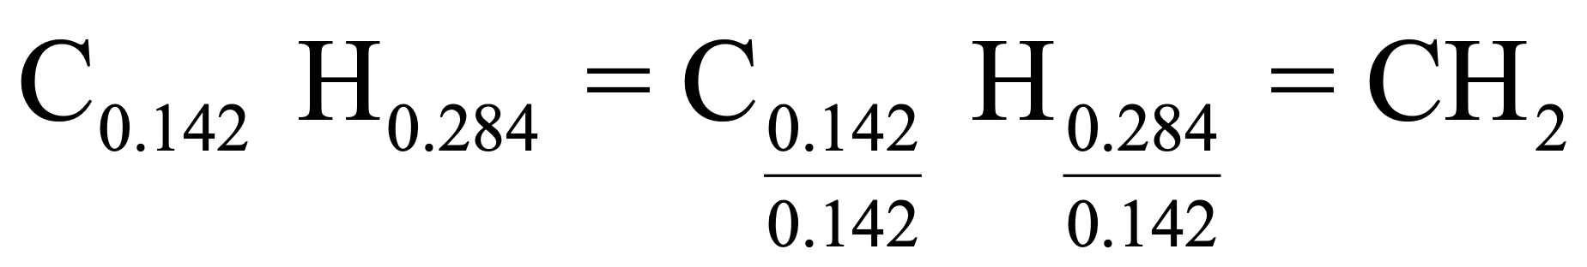
Empirical Formula From Masses
A compound’s empirical formula can be determined from mass values.
1 - Convert element masses to moles
2 - Divide mole values by the smallest number of moles
3 - If necessary, multiply by an integer to give the smallest whole number ratio of subscripts.
Example: A compound is determined to contain 1.71 g C and 0.287 g H. Find the Empirical Formula
Empirical formula = CH2
MAR

Slide 8
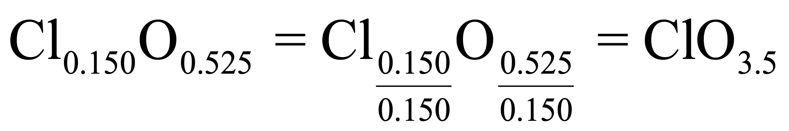
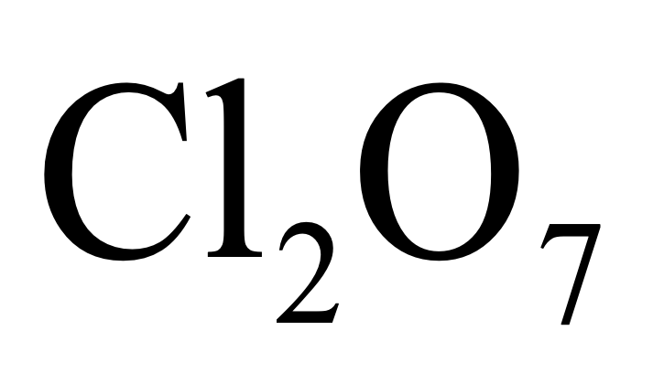
Empirical Formula From Masses
Example: A compound is determined to contain 5.31 g Cl and 8.40 g O. Find the Empirical Formula
First, convert to moles, get 0.150 mol Cl and 0.525 mol O
To convert into whole numbers, multiply each of the subscripts by two, giving the empirical formula:
Empirical formula = Cl2O7
MAR

Slide 9

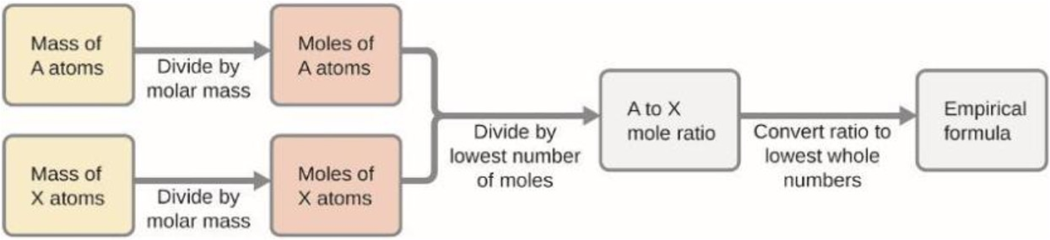
Empirical Formula From Masses
General plan:
5.31 g Cl
0.150 mol Cl
3.50 mol O to
1 mol Cl
7 mol O to
2 mol Cl
EF = Cl2O7
8.40 g O
0.525 mol O
MAR
Notes:
From Breaking Bad, Season 3, Episode 5, “Mas”

Slide 10
Empirical Formula From Percent Composition
A compound’s empirical formula can be determined from percent composition values
1 - Convert percent composition to masses by assuming a 100 g sample of compound.
2 - Convert element masses to moles
3 - Divide mole values by the smallest number of moles
4 - If necessary, multiply by an integer to give the smallest whole number ratio of subscripts.
Example: The bacterial fermentation of grain to produce ethanol forms a gas with a percent composition of 27.29% C and 72.71% O. What is the empirical formula for this gas?
MAR

Slide 11
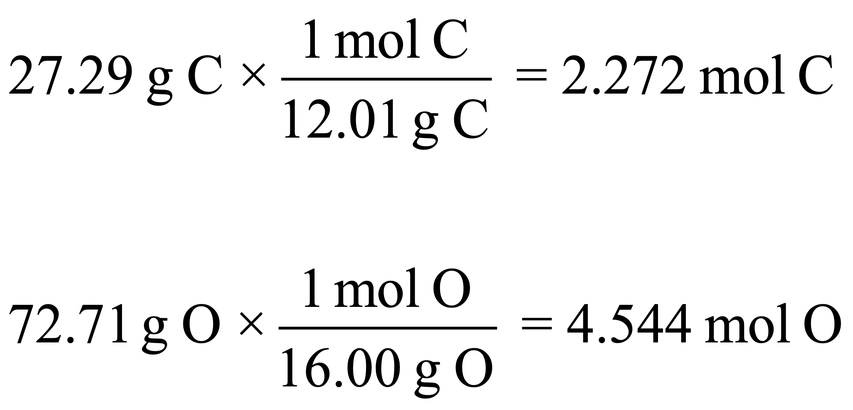
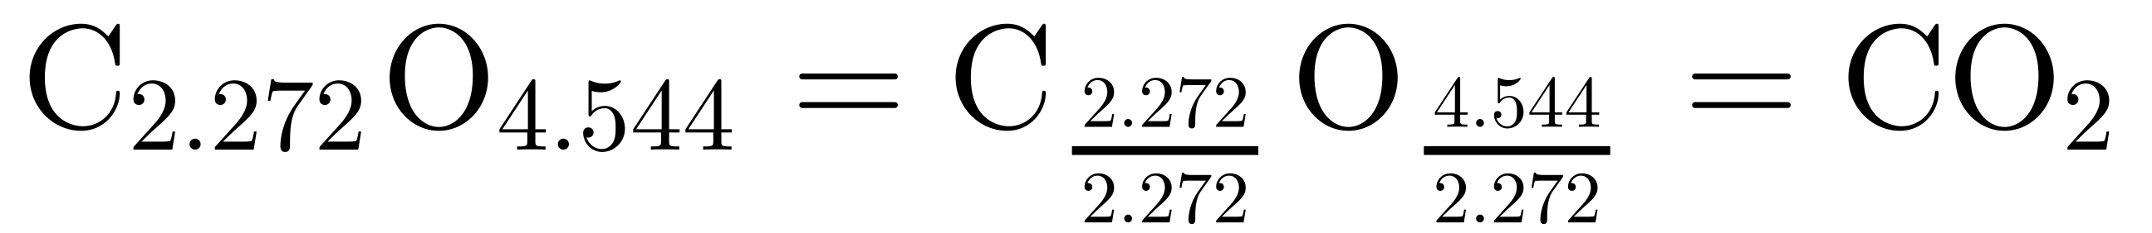
Empirical Formula From Percent Composition - Example
Example: The bacterial fermentation of grain to produce ethanol forms a gas with a percent composition of 27.29% C and 72.71% O. What is the empirical formula for this gas?
Assume 100 g total sample, which would give 27.29 g C and 72.71 g O
MAR
Empirical formula = CO2

Slide 12
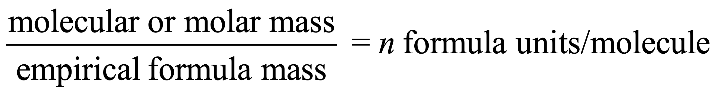
Molecular Formula From Empirical Formula
Some compounds have the same percent composition and empirical formula.
Example: nitrogen dioxide (NO2): 30.45% N, 69.55% O, EF = NO2
Example: dinitrogen tetraoxide (N2O4): 30.45% N, 69.55% O, EF = NO2
Chemists need a method to convert EF into a molecular formula (MF)!
The molecular formula is then obtained by multiplying each subscript in the empirical formula by n.
Molecular formula = (Empirical formula)n
MAR

Slide 13
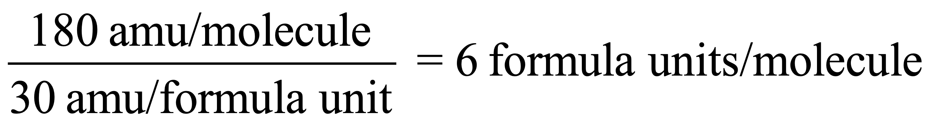
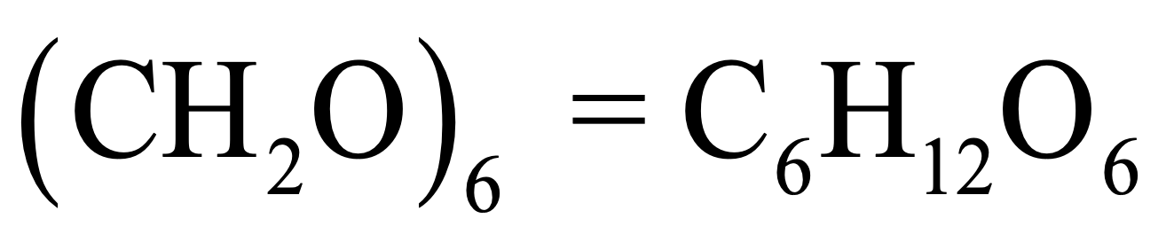
Molecular Formula From Empirical Formula - Example
Example: A compound has an empirical formula of CH2O (empirical formula mass = 30 amu) and a molecular mass of 180 amu. Find the molecular formula.
Molecular formula = C6H12O6
MAR
The simplest carbohydrate is glyceraldehyde. Its empirical formula is CH₂O and its molar mass is 90.08 g/mol. The molecular formula is
  CH₂O
  C₂H₄O₂
  C₃H₆O₃
  C₄H₈O₄
  CHO
Answer = C,
  C3H6O3
  CH2O = 12 + 2*1 + 16 = 30 g/mol,
  90.08 / 30 ≈ 3,
  MF = (CH2O)3 = C3H6O3
Enter your response on
your i>Clicker now!

Slide 14
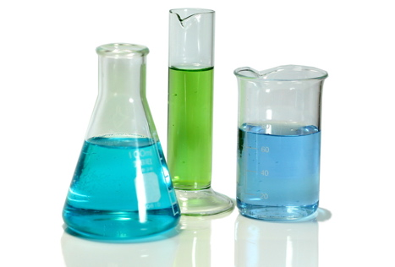
Molecular Formula From Empirical Formula - Combined
Example: A compound of B and H is 81.10% B. The molar mass of the compound is 53.3 g/mol. What is its empirical formula? What is the molecular formula? Try this yourself.
Steps:
Convert % to grams, and grams to moles: 7.502 mol B, 18.75 mol H
Compare moles to get empirical formula: EF = B2H5
molar mass of EF = 26.67 g/mol
molar mass of compound / molar mass of EF = n = 2, so
MF = (EF)2 = B4H10
MAR

Slide 15
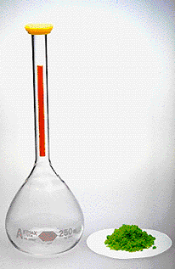
6.3 - Molarity
In previous sections, we have considered pure substances... but in the 'real world', mixtures are more common.
A solution is a homogeneous mixture (single phase) with uniform composition (i.e. 'mixed well') and the relative amount of a given solution component is known as its concentration
Solutions have two components:
* Solvent: the component whose physical state is preserved when solution forms (often water)
* Solute: component that is typically present at a much lower concentration than the solvent (the 'exciting' part)
A solution in which water is the solvent is called an aqueous solution and gets the symbol (aq)
MAR

Slide 16
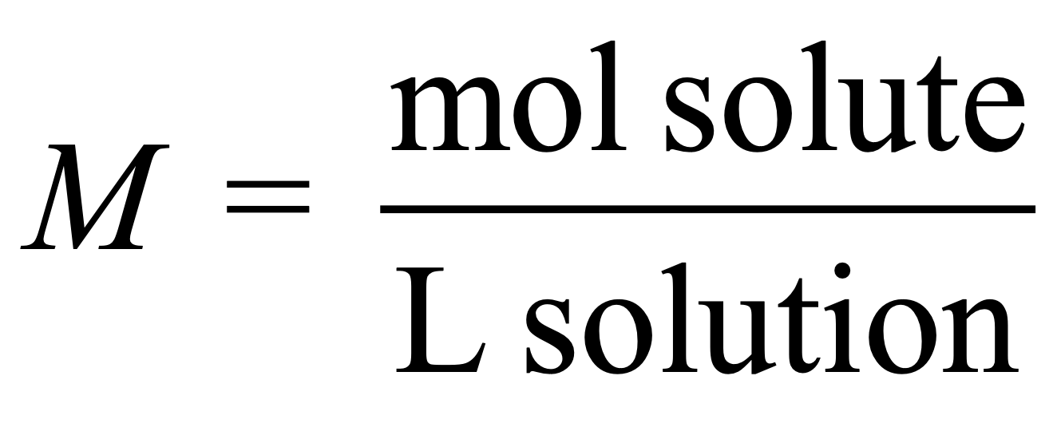
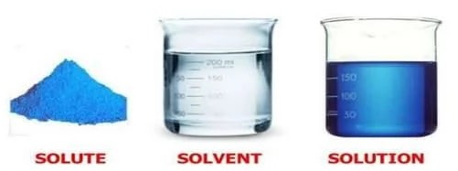
Molarity Definition
Molarity (M) represents the number of moles of solute in exactly 1 L of solution:
"3.6 M" means a concentration of 3.6 molarity, or 3.6 mol of solute per L of solution
Molarity is a very useful and common concentration in chemistry. Often"concentration" and molarity the same (but not always!)
MAR

Slide 17
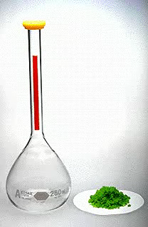
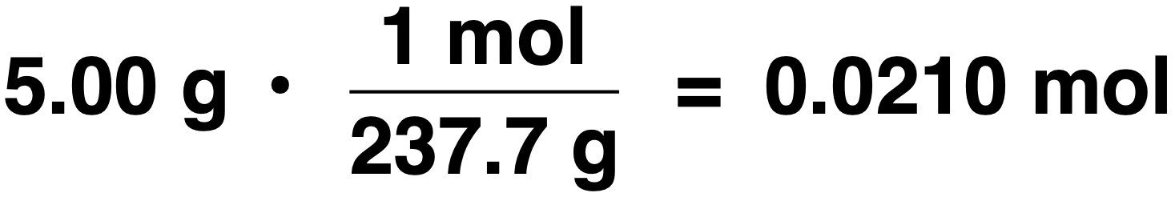
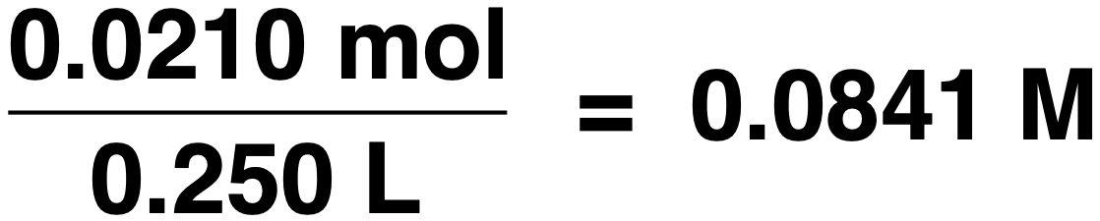
Example: Dissolve 5.00 g of NiCl₂•6 H₂O in enough water to make 250. mL of solution. Calculate molarity (M.)
6.3 - Molarity Example
Step 1: Calculate moles of NiCl₂•6H₂O
Step 2: Calculate molarity (1000 mL = 1L)
[NiCl₂•6 H₂O] = 0.0841 M
MAR

Slide 18
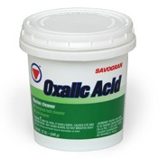
6.3 - Molarity Example II
What mass of oxalic acid, H₂C₂O₄, is
required to make 250. mL of a 0.0500 M
solution?
moles = M • V
Step 1: Calculate moles of acid required.
(0.0500 mol/L)(0.250 L) = 0.0125 mol
Step 2: Calculate mass of acid required.
(0.0125 mol )(90.00 g/mol) = 1.13 g
MAR

Slide 19
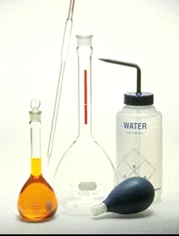
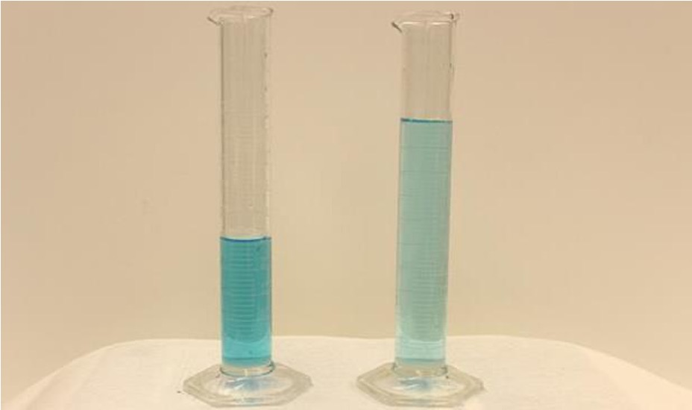
Preparing Solutions
Weigh out a solid solute and dissolve in a given quantity of solvent
or
Dilute a concentrated solution to give one that is less concentrated.
Same copper(II) nitrate,
left more concentrated (less solvent),
right more dilute (more solvent)
MAR

Slide 20
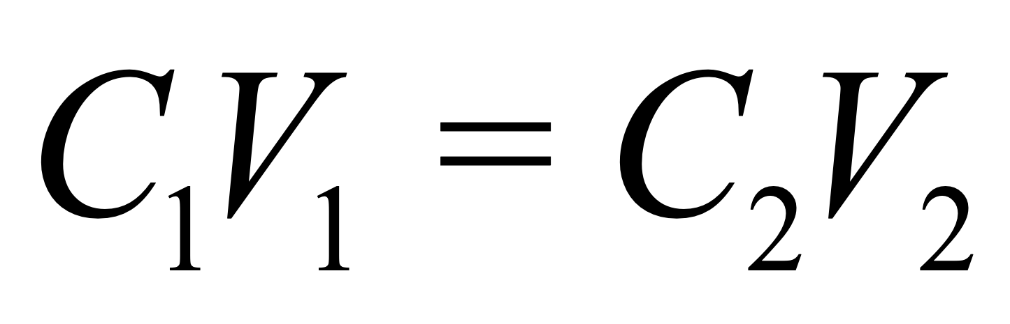
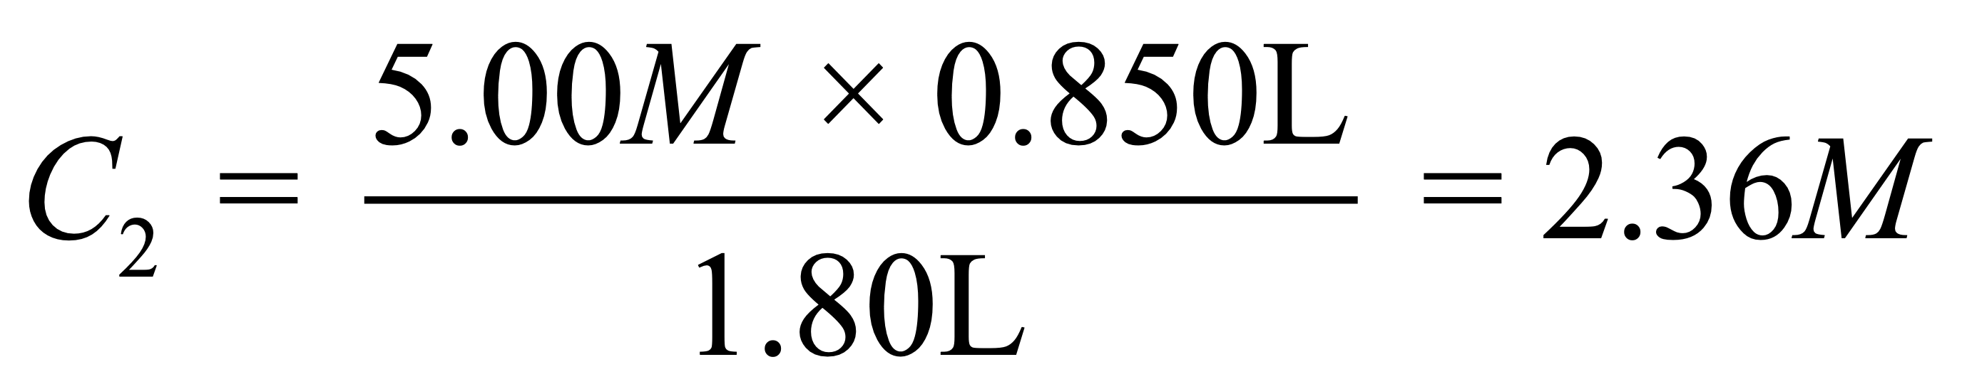
The Dilution Equation
When diluting a solution, the solute (moles) does not change. A useful equation:
C = concentration (molarity),
V = volume (Liters or mL)
Often abbreviated: MiVi = MfVf
Example: If 0.850 L of a 5.00 M solution of copper nitrate, Cu(NO3)2, is diluted to a volume of 1.80 L by the addition of water, what is the molarity of the diluted solution?
Notice that 0.950 L of water was added to the solution
MAR
A student takes 20.0 mL of 3.00 M HCl and accidentally adds it to 100.0 mL of water (for 120.0 mL total). What is the new concentration of the HCl?
  3.00 M
  1.50 M
  0.600 M
  0.500 M
  0.100 M
Answer = D,
  C2 = 3.00 M * 20.0 mL / 120.0 mL
  C2 = 0.500 M
Enter your response on
your i>Clicker now!

Slide 21
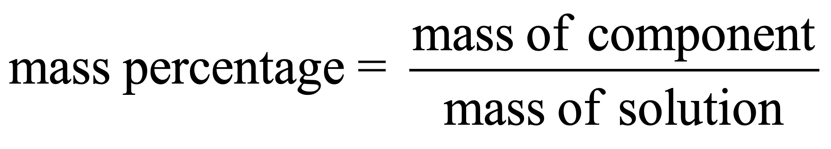

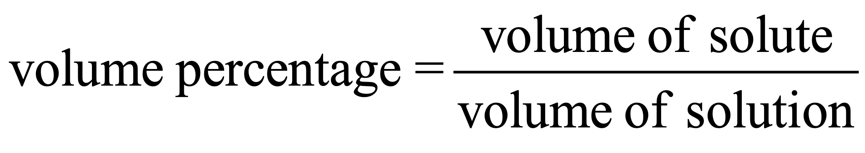
6.4 - Other Units for Solution Concentrations
Molarity used most often for concentration in chemistry, but mass percentage, volume percentage and parts per million used as well.
Mass percentage (of solute) defined as:
Volume percentage (of solute) can be used also:
MAR

Slide 22
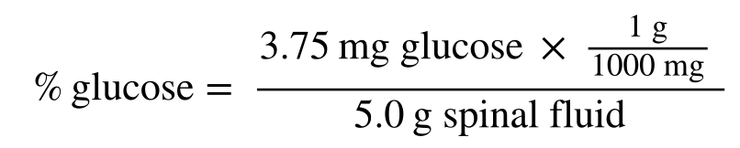
Mass Percentage Example
Example: A 5.0 g spinal fluid sample contains 3.75 mg of glucose. What is the mass percent of glucose?
Convert mg to g (1000 mg = 1 g), then:
Mass percent of glucose = 0.075%
MAR
A car enthusiast adds 50.0 mL of ethylene glycol to a radiator with 120.0 mL of water (170.0 mL total.) What is the volume percentage of the ethylene glycol?
  12.0%
  29.4%
  50.0%
  70.1%
  85.1%
Answer = B
  50.0 mL / 170.0 mL * 100%
  29.4%
Enter your response on
your i>Clicker now!

Slide 23
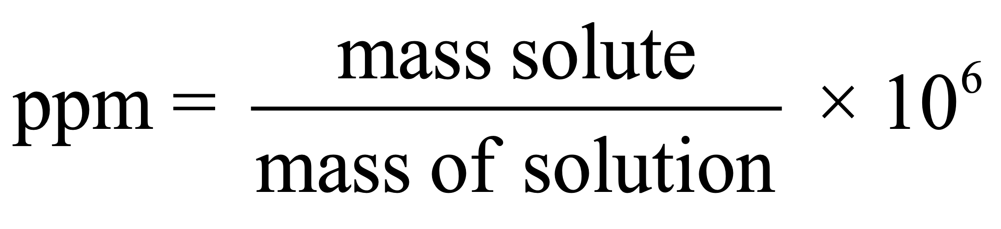
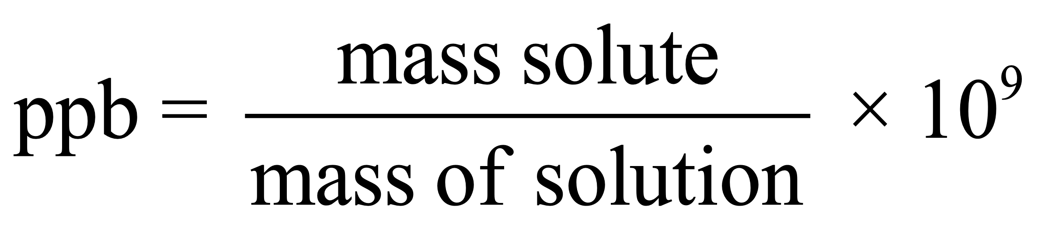
Parts Per Million (ppm)
Very low solute concentrations (the environment, etc.) often expressed in "parts per" units. (density = 1.00 g/mL for solution if water is the solvent)
Parts per million:
Parts per billion:
MAR

Slide 24
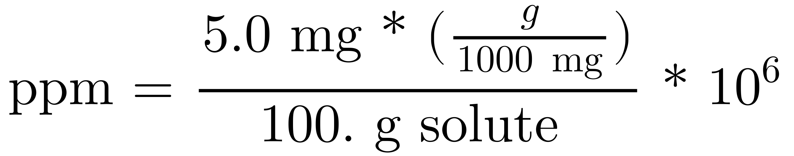
Calculations With ppm
Example: a pollutant is found in ground water at roughly 5.0 mg per 100. g total. Express this concentration in parts per million (ppm). Convert mg to g (1000 mg = 1 g)
Parts per million:
Answer = 50. ppm
MAR

Slide 25
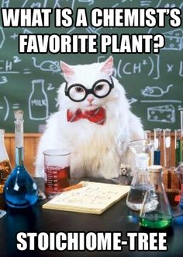
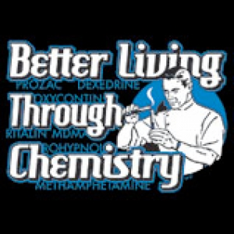
End of Chapter Six
See also:
Chapter Six Study Guide
Chapter Six Concept Guide
Important Equations (following this slide)
End of Chapter Problems (following this slide)
MAR

Slide 26
Important Equations, Constants, and Handouts
from this Chapter:
Understand how to find an empirical formula from mass percentages, and how to find the molecular formula from an empirical formula
Know how to use molarity with solution stoichiometry problems
Solute, solvent, solution
Molarity (M) = mol of solute per Liter of solution
M1V1 = M2V2
Also know mass percentages, parts per million

Slide 27
End of Chapter Problems: Test Yourself
Determine the molar mass for aluminum chloride, iron(III) oxide and phosphorus tribromide.
How many grams in 0.0255 mol of propanol (C3H7OH)? How many molecules? How many atoms of C?
Calculate the weight percent of lead in PbS, lead(II) sulfide. What mass of lead (in grams) is present in 10.0 g of PbS?
Succinic acid has an empirical formula is C2H3O2 and a molar mass is 118.1 g/mol. What is its molecular formula?
If 50.0 mL of 0.0135 M BaCl2 is diluted to a total of 400. mL, what is the new concentration of BaCl2?

Slide 28
End of Chapter Problems: Answers
133 g/mol, 160. g/mol, 271 g/mol
1.53 g C3H7OH, 1.54 x 10²² molecules, 4.62 x 10²² atoms C
86.59%, 8.66 g Pb
C4H6O4
0.00169 M

