Slide 1
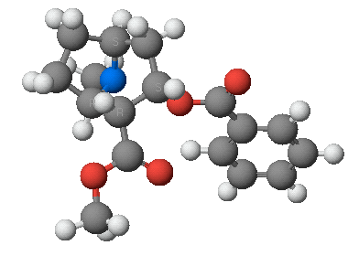
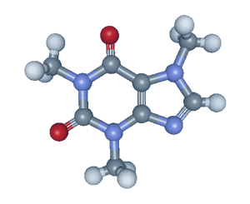
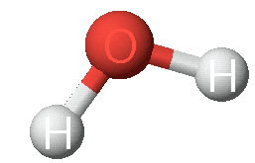
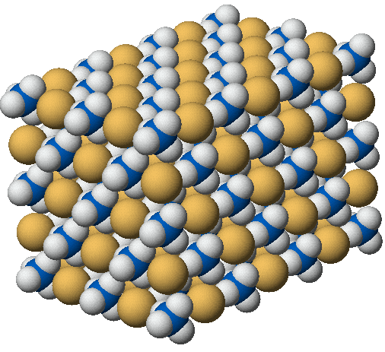

Chapter 4: Chemical Bonding and Molecular Geometry
Chemistry 221
Professor Michael Russell
http://mhchem.org/221
Last update:
7/7/25
MAR

Slide 2
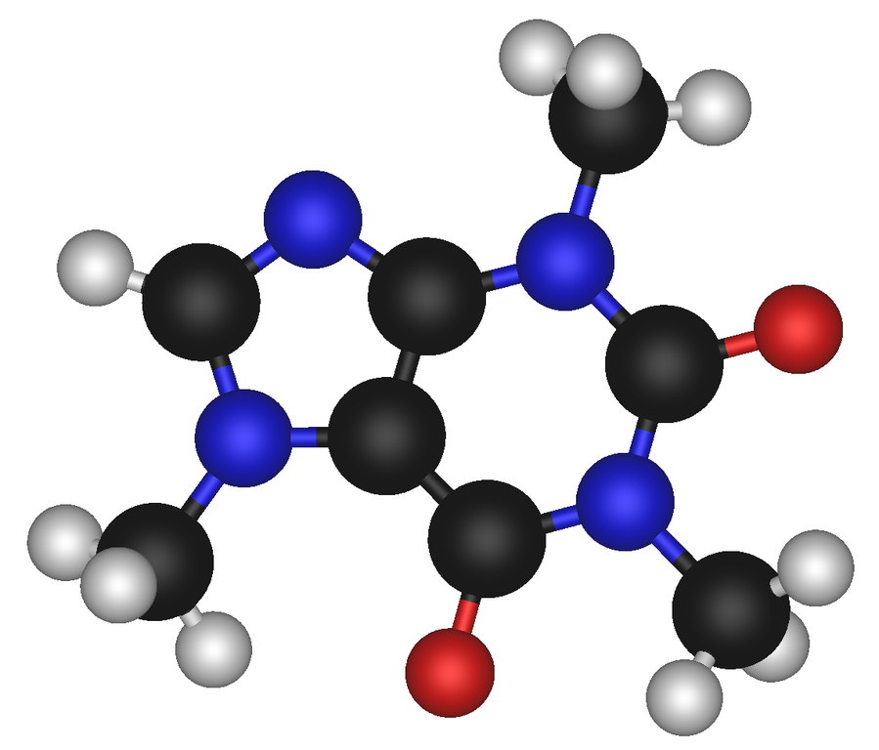
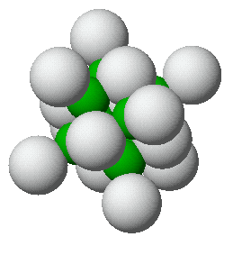

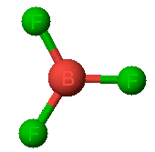
4.1 - Ionic (and Covalent) Bonding
  Problems and questions:
How are molecules and polyatomic ion held together?
Why are atoms distributed at strange angles?
Why are molecules not flat?
Can we predict the structure?
How is structure related to chemical and physical properties?
cocaine
caffeine
water
calcium fluoride
MAR
boron trifluoride
ammonia

Slide 3
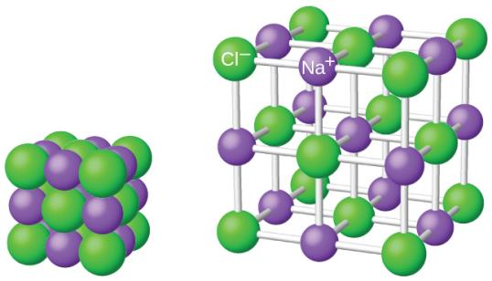
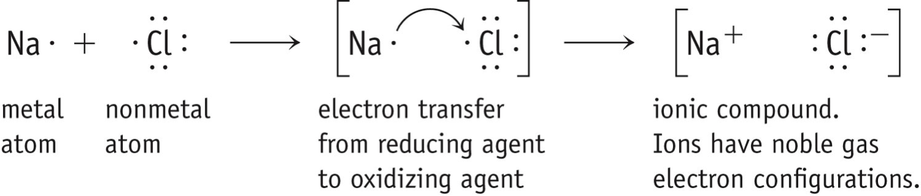
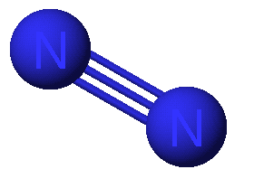
Two Extreme Forms of Chemical Bonds
Ionic - complete transfer of electrons from one atom to another, metals + nonmetals
Covalent - electrons shared between atoms, mostly nonmetals
Most bonds are somewhere in between
Also Metallic bonding (for metals) and Metavalent bonding (for metalloids)
sodium chloride
nitrogen (N2)
Important to know when a compound is ionic, covalent or metallic!
MAR
Notes:
Metavalent bonding proposed: https://www.chemistryworld.com/news/bonding-rethink-called-for-as-new-metavalent-bond-proposed/3009908.article (December 2018)

Slide 4
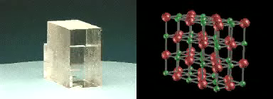
Ionic Bonds - Electrostatic Forces
The oppositely charged ions in ionic compounds are attracted to one another by Electrostatic Forces.
These forces are governed by Coulomb's Law.
MAR

Slide 5
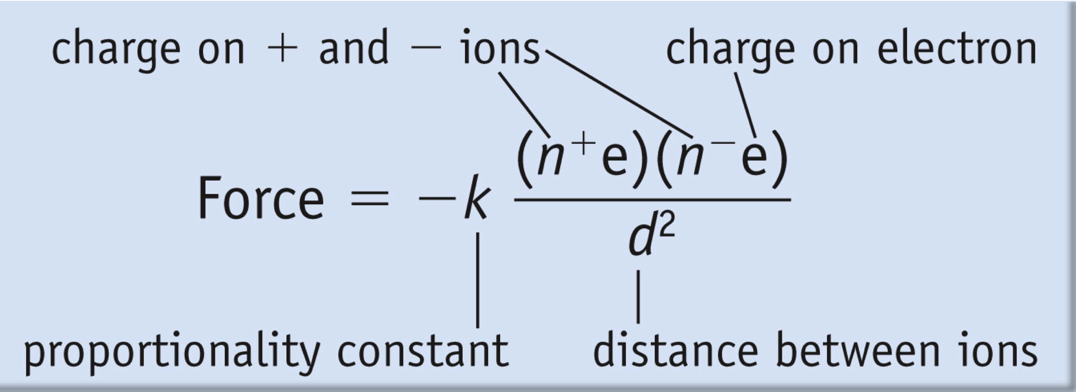
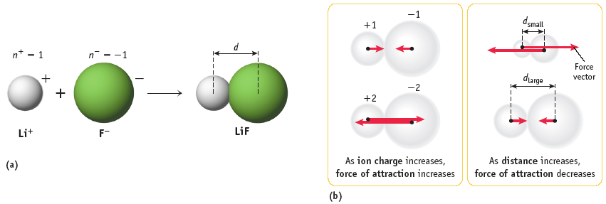
Coulomb's Law / Ionic Charges
Coulomb's Law describes electrostatic forces - the strength of ionic bonds
As ion charge increases, the attractive force _______________.
As the distance between ions increases, the attractive force ________________.
MAR

Slide 6
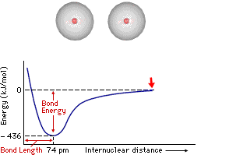
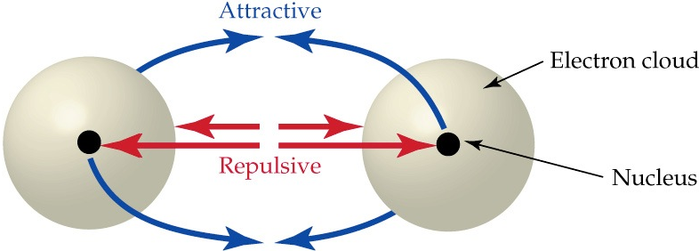

4.2 - Covalent Bonding
Covalent bonds arise from the mutual attraction of 2 nuclei for the same electrons.
A covalent bond is a balance of attractive
and repulsive forces.
MAR

Slide 7
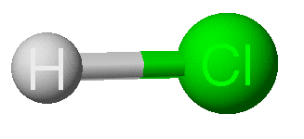
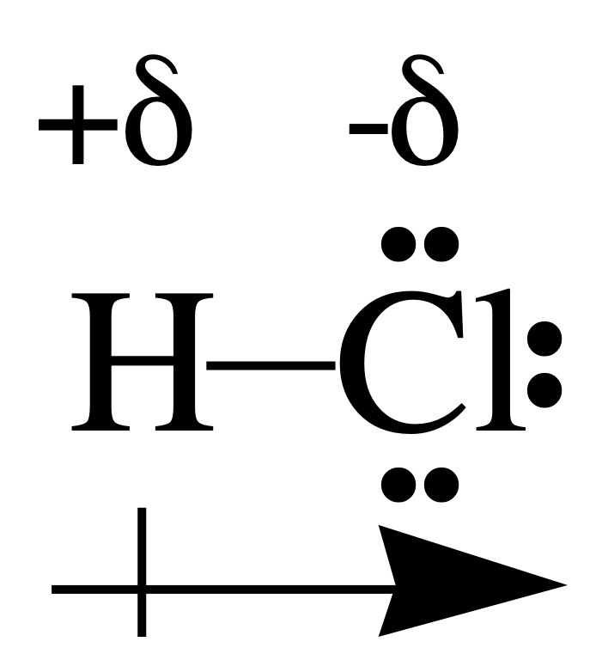
Pure vs. Polar Covalent Bonds
nitrogen (N2)
pure covalent bond
Some bonds have equal distribution of electrons (pure covalent)
Most bonds have unequal distribution of electrons (polar covalent).
HCl is polar (polar covalent) because it has a slightly positive end and a slightly negative end (dipoles).
Cl has a greater share in bonding electrons than does H.
Cl has slight negative charge (-δ) and H has slight positive charge (+δ)
MAR

Slide 8
Bond Polarity
Dipole moment, μ, can measure dipole strength by placing molecules in electrical field. Polar molecules will align when the field is on. Nonpolar molecules will not.
+
-
+
-
Polar molecules
Nonpolar molecules
MAR

Slide 9
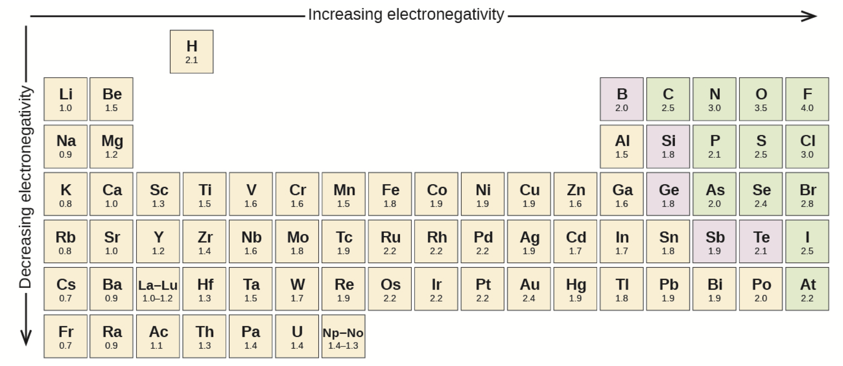
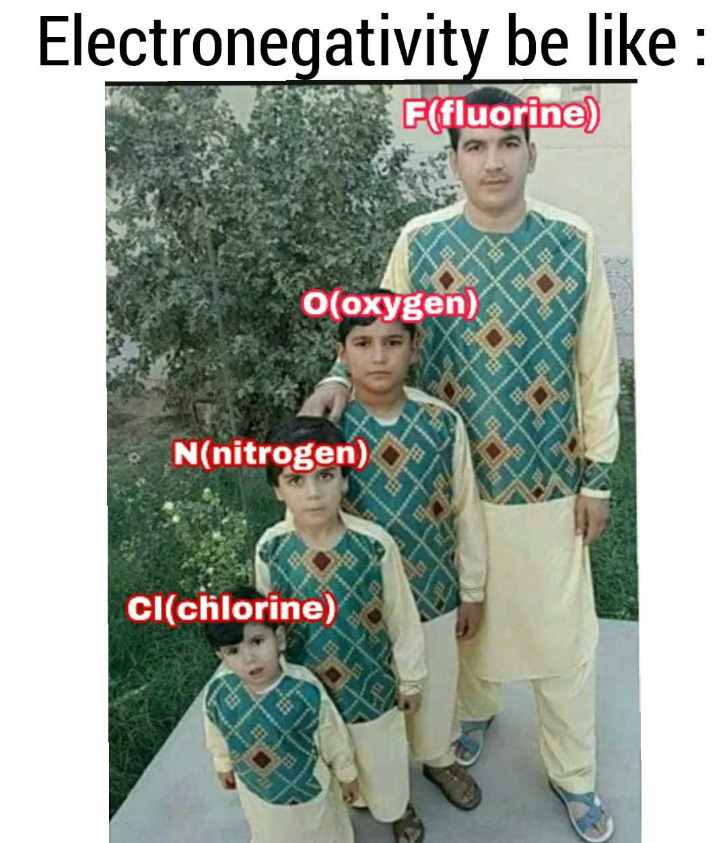
Electronegativity
Electronegativity, χ, is a measure of the ability of an atom in a molecule to attract electrons to itself.
Electronegativities tend to increase up and to the right on the periodic table
MAR

Slide 10
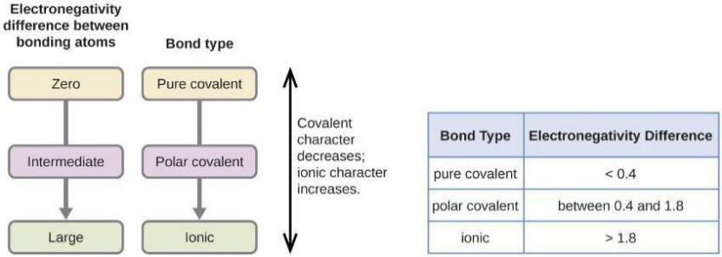
Electronegativity
F has maximum χ.
Atom with lowest χ is the center atom in most molecules.
Electronegativity differences determine bond type (and point of attack on a molecule).
As the electronegativity difference increases between two atoms, the bond becomes more ionic.
In our class, pure covalent bonds
will only be between identical atoms
(i.e. N2, F2, etc.)
MAR
We are using “traditional” electronegativity values,
but a new system has been introduced (January 2019)
Which of the following groups of elements is arranged correctly in order of increasing electronegativity?
  B < O < Al < F
  B < O < F < Al
  Al < B < O < F
  F < O < B < Al
Enter your response on
your i>Clicker now!
Answer = C,
Al < B < O < F
Notes:
Rahm, M; Zeng, T; Hoffman, R. J. Am. Chem. Soc., 2019, 141 (1), pp 342–351

Slide 11
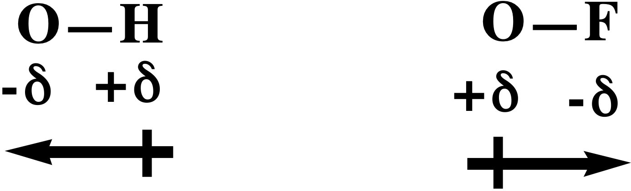
Bond Polarity
Which bond is more polar (or Dipolar)?
O-H O-F
χ 3.5 - 2.1 3.5 - 4.0
∆χ 1.4 0.5
∴ OH is more polar than OF
From electronegativity table
and polarity is "reversed"
MAR
Which of the following pairs of bonded atoms would be expected to have the greatest bond polarity?
  N - O
  K - F
  B - N
  S - Cl
  F - F
Enter your response on
your i>Clicker now!
Answer = B,
K - F

Slide 12
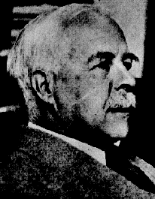
4.4 - Lewis Symbols and Structures
Electron distribution is depicted with Lewis electron dot structures
Valence electrons are distributed as shared or Bond Pairs (bp) and unshared or Lone Pairs (lp)
G. N. Lewis
1875 - 1946
MAR

Slide 13
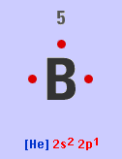
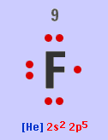
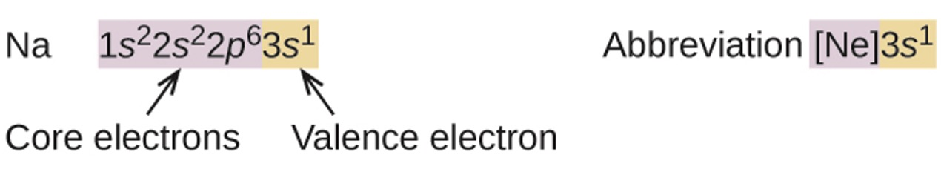
Valence Electrons, Core Electrons
Periodic table is arranged so that elements with similar chemical and physical properties are in the same group (column).
* Elements in the same group have similar valence electron configurations (outer electrons)
Lewis structures built with valence electrons
Main Group Elements: number of valence electrons = group number
* Example: Carbon has four valence electrons (group IVA) and six electrons total; C has 2 core electrons (6 - 4 = 2)
* Example: Bromine has seven valence electrons (group VIIA) and 35 electrons total; Br has 28 core electrons (35 - 7 = 28)
Boron has 3
valence electrons
and 2 core
electrons
Fluorine has 7
valence electrons
and 2 core
electrons
MAR
Enter your response on
your i>Clicker now!
How many valence electrons in phosphorus (P)?
2
3
4
5
6
Answer = D, 5
P is in group VA

Slide 14

Bonding Pairs and Lone Pairs
Always use lines for bonding pairs and dots for lone pairs
Do not use dots for bonding pairs and lines for lone pairs
Valence electrons are distributed as shared or bonding pairs (BPs) and unshared or lone pairs (LPs) in molecules
••
H
Cl
•
•
••
lone pair (LP)
shared or
bond pair
This is the Lewis Electron Dot structure for HCl
3 lone pairs + 1 bond pair = 4 pairs total
MAR

Slide 15
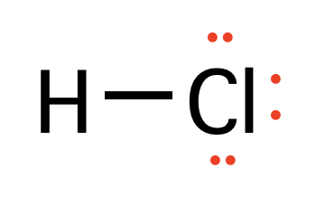

Building a Lewis Structure
For Groups 1A - 4A,
no. of bond pairs = group number
For Groups 5A - 7A,
no. of bond pairs = 8 - Group Number
Except for H (and sometimes atoms of 3rd and higher periods),
Bond Pairs + Lone Pairs = 4
This observation is called the Octet Rule, works most of the time (but not always! - more later)
MAR

Slide 16
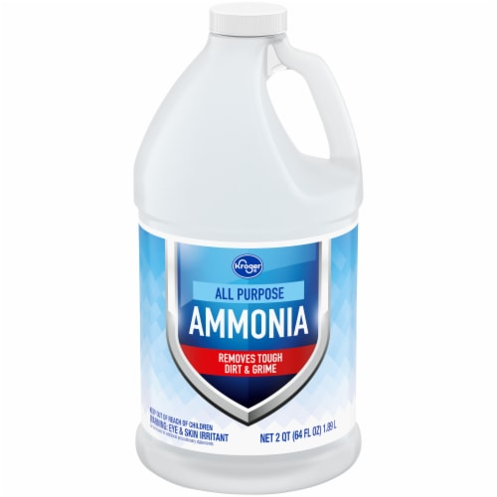
Building a Lewis Structure
Ammonia, NH₃
1. Count valence electrons
H = 1 and N = 5
Total = (3 x 1) + 5
= 8 electrons or
4 pairs of electrons
2. Decide on the central atom; never H.
Central atom is atom of lowest affinity for electrons (electronegativity)
Therefore, N is central atom
MAR

Slide 17
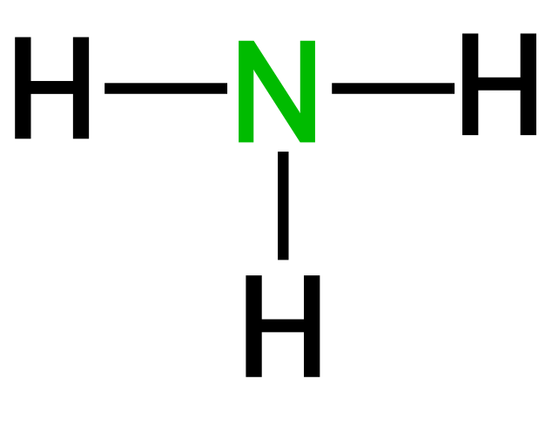
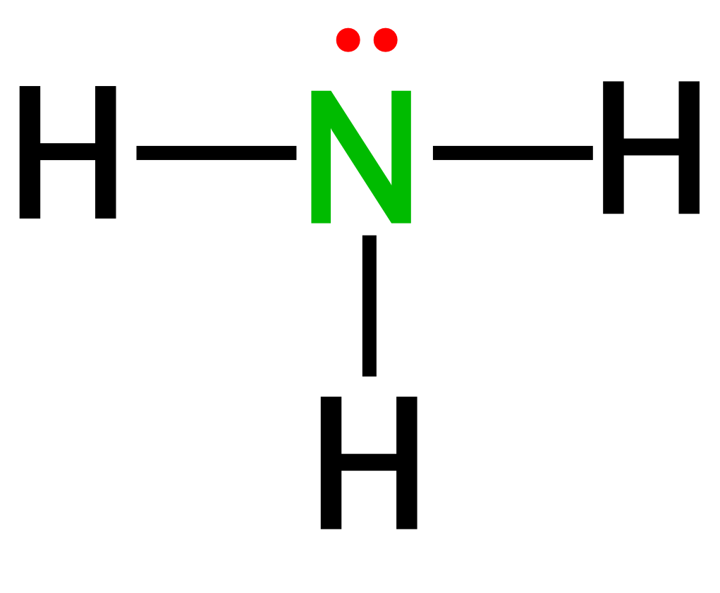

Building a Lewis Structure
3. Form a sigma bond (single bond) between the central atom and surrounding atoms.
1
.
H
N
3
H
.
H
P
H
H
H
Remaining electrons form LONE PAIRS to complete octet as needed.
2
.
4
H
O
H
.
H
F
3 BOND PAIRS and 1 LONE PAIR. Note that N has a share in 4 pairs (8 electrons), while H shares 1 pair.
Unshared electron pairs ("lone pairs")
take up more volume than
shared electron pairs ("bonding pairs")
See Building Lewis Structures handout
MAR
Which of the following Lewis structures is/are correct?
structure 1
structure 2
structure 3
structure 4
all four are correct
Enter your response on
your i>Clicker now!
Answer = C, 3

Slide 18
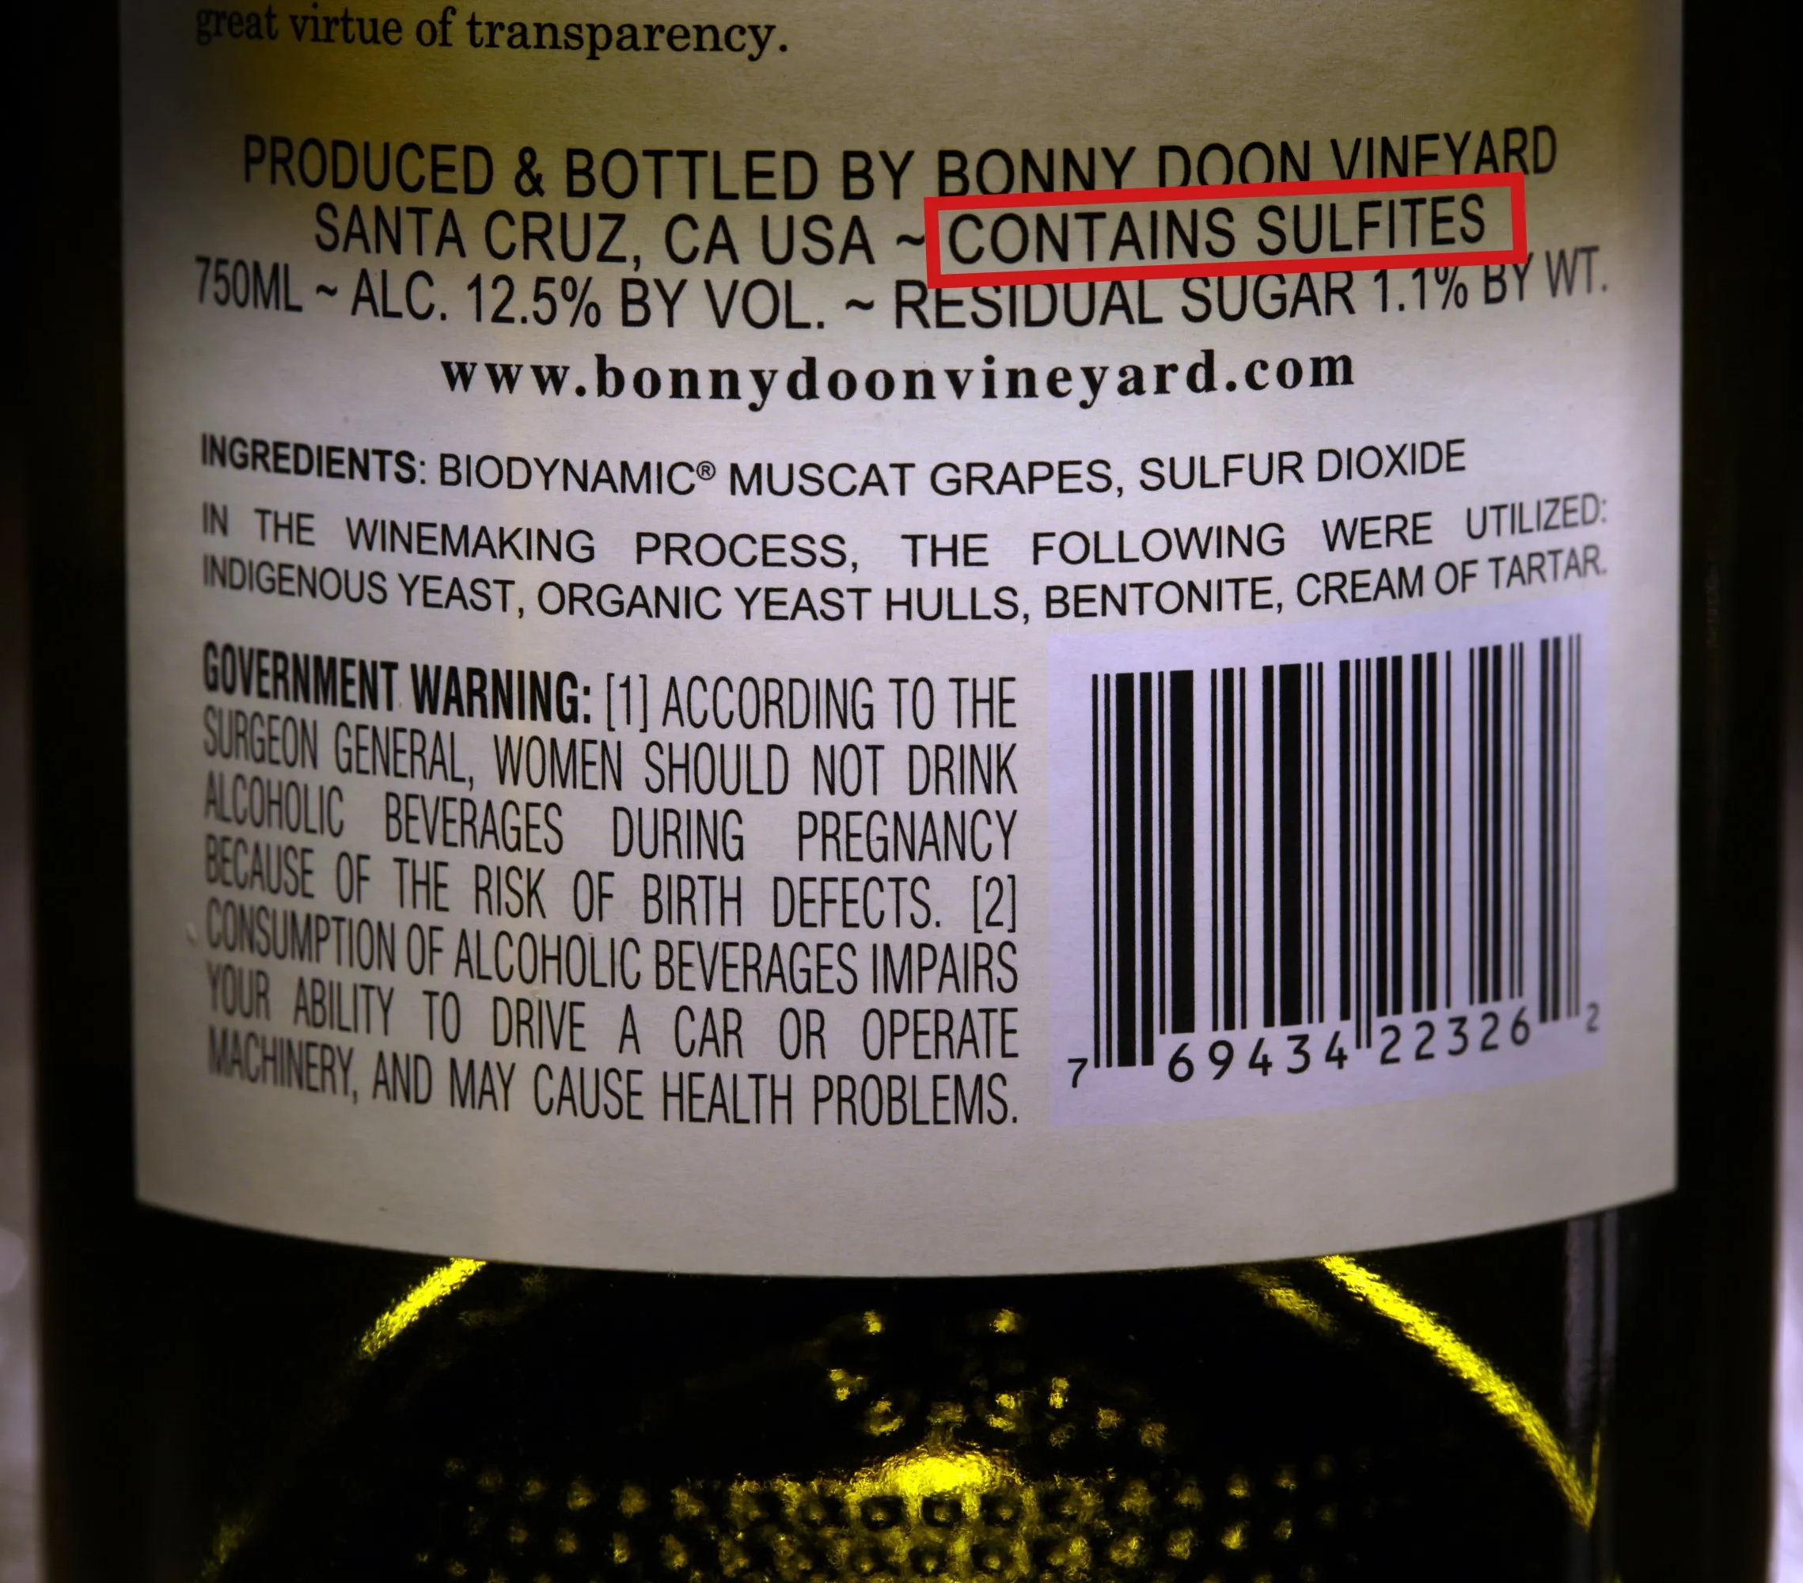
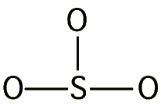
Lewis Structure: Sulfite ion, SO₃²⁻
Step 1. Central atom = S
Step 2. Count valence electrons
S = 6
3 x O = 3 x 6 = 18
Negative charge = 2
TOTAL = 26 e- or 13 pairs
Step 3. Form sigma bonds
10 pairs of electrons are
now left.
MAR

Slide 19
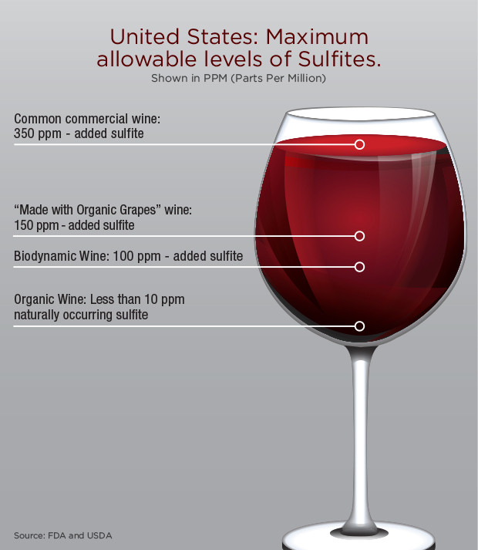
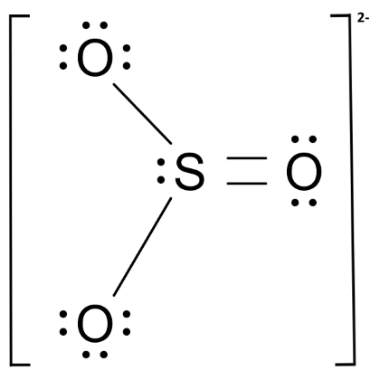
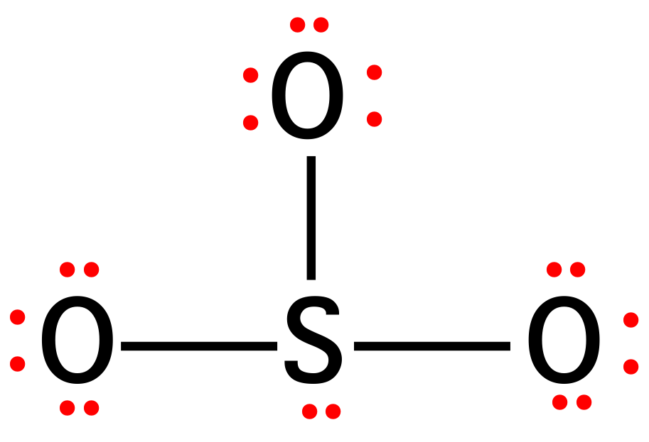
Lewis Structure: Sulfite ion, SO₃²⁻
Remaining pairs become lone pairs, first on outside atoms and then on central atom.
Charged species often in square brackets with charge outside
Sulfite slightly better with double bond - more later (formal charges!)
Each atom is surrounded by an octet of electrons.
MAR

Slide 20
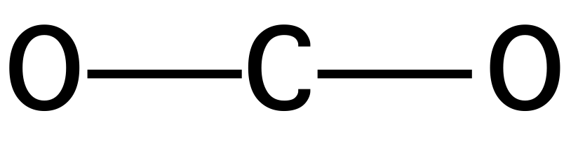
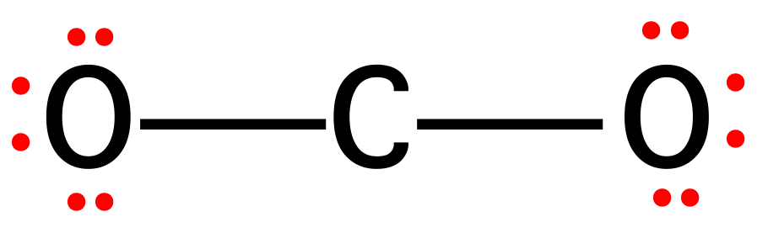
Lewis Structure: Carbon Dioxide, CO₂
1. Central atom = _______
2. Valence electrons = __ or __ pairs
3. Form sigma bonds.
This leaves 6 pairs.
4. Place lone pairs on outer atoms.
MAR

Slide 21
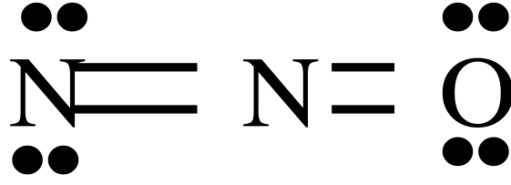
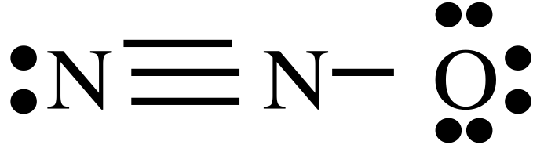
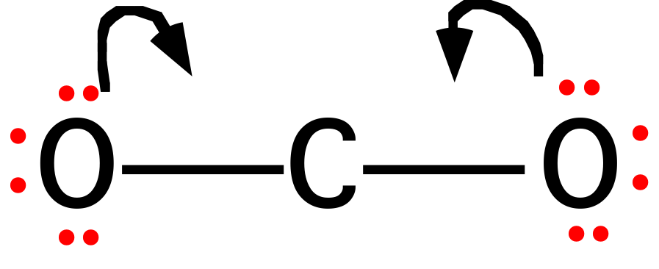
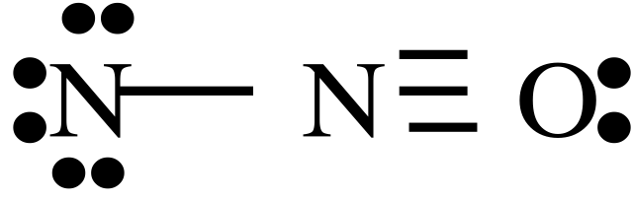
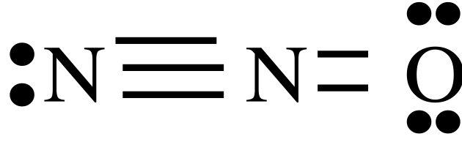
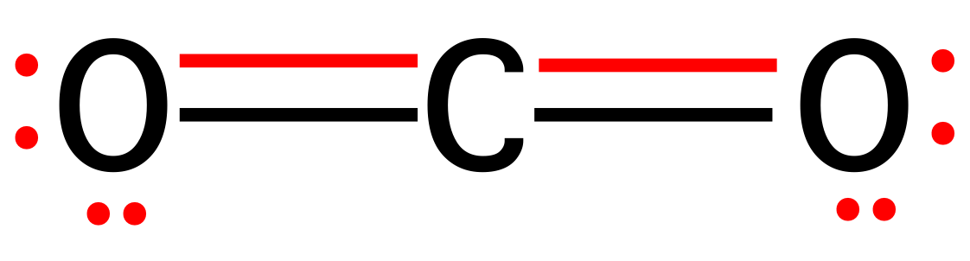
Lewis Structure: Carbon Dioxide, CO₂
4. Place lone pairs on outer atoms.
1.
2.
5. So that C has an octet, we shall form DOUBLE BONDS between C and O.
3.
4.
The second bonding pair forms a pi (𝝅) bond.
MAR
Which of the following Lewis resonance structures is incorrect for N2O?
1
2
3
4
all are correct
Enter your response on
your i>Clicker now!
Answer = D, 4

Slide 22
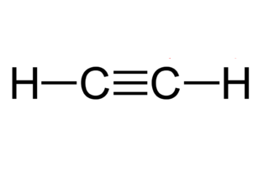
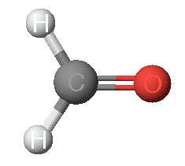
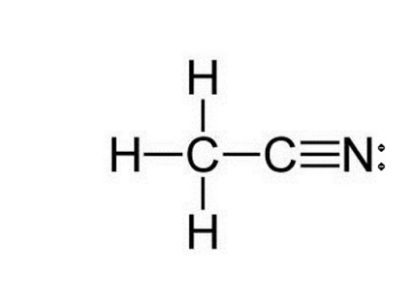
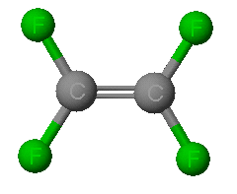
Double & triple bonds commonly observed for C, N, O, etc.
H₂CO
(formaldehyde)
C₂H₂ (acetylene)
CH₃CN
(methylcyanide)
Double bonds are shorter and have more energy than single bonds
Triple bonds are shorter and have more energy than double bonds
CO₂
(carbon dioxide)
C₂F₄
(tetrafluoroethylene)
MAR

Slide 23
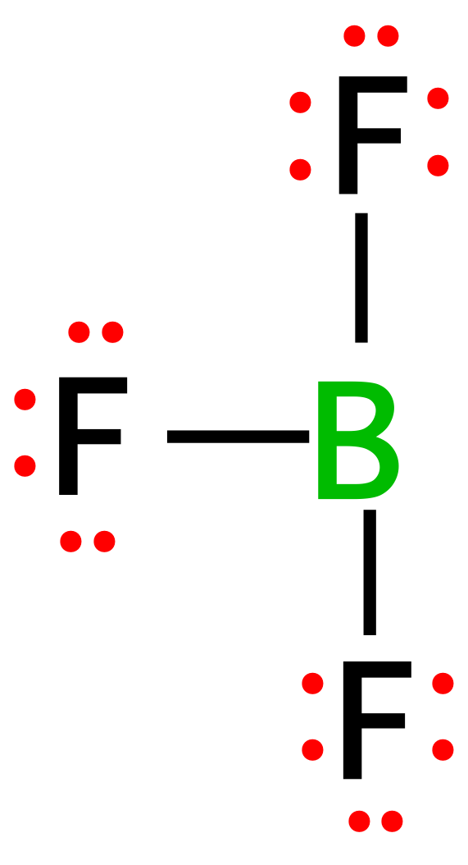
Violations of the Octet Rule
Some atoms may go under the octet rule, such as boron trifluoride, BF3
Central atom =
Valence electrons = or electron pairs =
Assemble dot structure
The B atom has a share in only 6 electrons (or 3 pairs). B atom in many molecules is electron deficient.
MAR
Also common for Al, Ga and Be

Slide 24
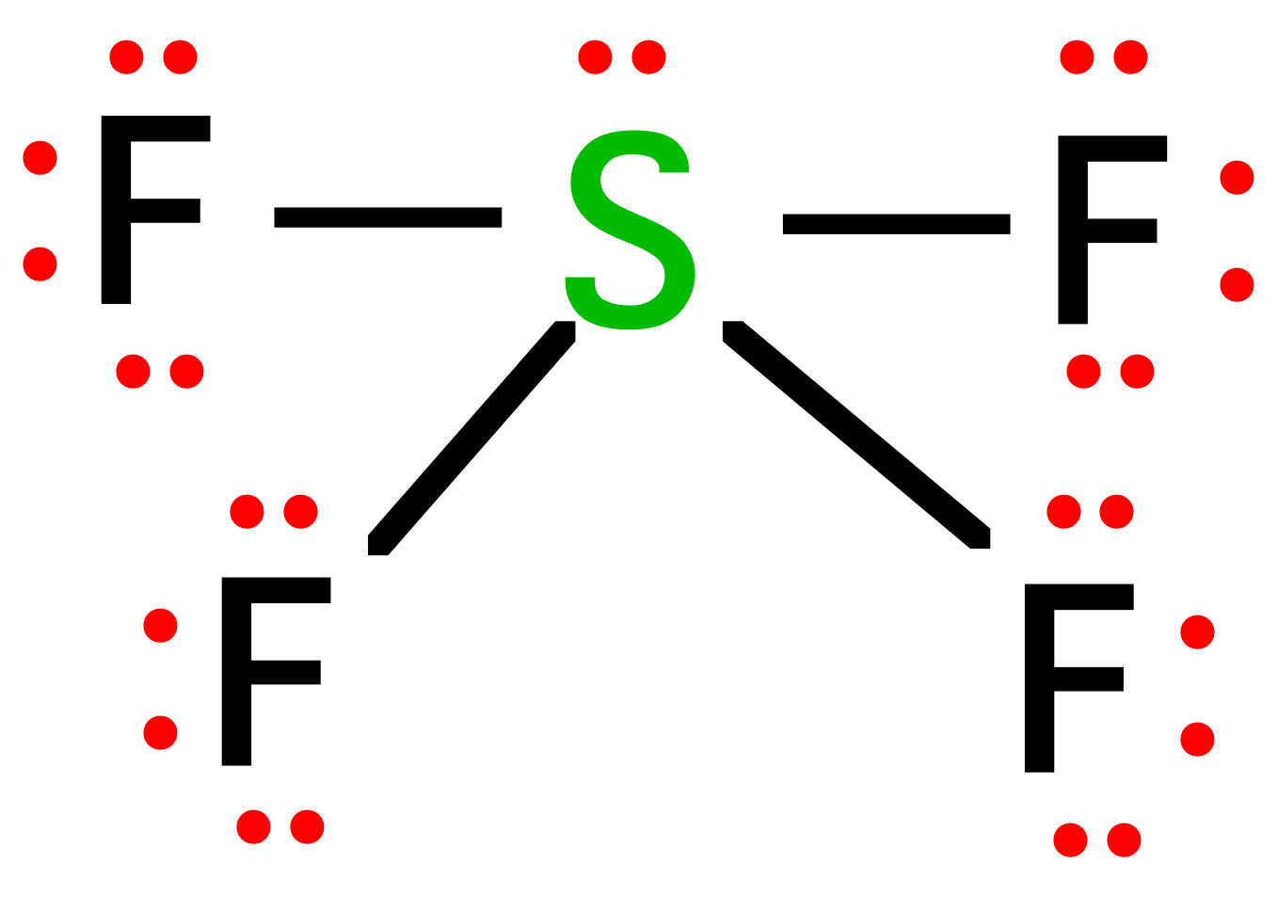
Violations of the Octet Rule
Some atoms may go over the octet rule, such as sulfur tetrafluoride, SF4
Central atom =
Valence electrons = ___ or ___ pairs.
Form sigma bonds and distribute electron pairs.
5 pairs around the S atom. A common occurrence outside the 2nd period.
Atoms in the 1st and 2nd periods cannot go over the octet rule
Atoms in the 3rd or greater periods can go over the octet rule
MAR

Slide 25
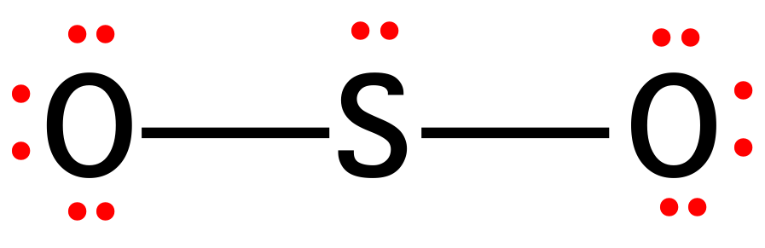
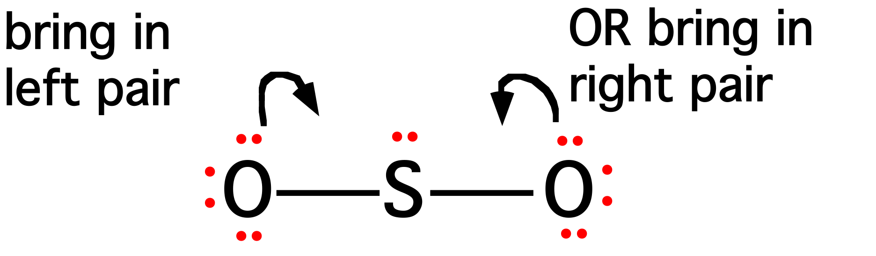
4.5 - Formal Charges and Resonance
Lewis Structure: Sulfur Dioxide, SO₂
1. Central atom = S
2. Valence electrons = 18 or 9 pairs
3. Form pi (𝝅) bond so that S has an octet - but note that there are two ways of doing this.
MAR

Slide 26

Lewis Structure: Sulfur Dioxide, SO₂
This leads to the following structures.
These equivalent structures are called Resonance Structures. The true electronic structure is a hybrid (mixture) of the two.
MAR

Slide 27

Odd # of electrons: NO₂
Paramagnetic compounds & free radicals
For NO₂, central atom = ___
Valence electrons = ___ or ___ pairs.
Odd e⁻ occupies its own "space"
Form sigma bonds and distribute electron pairs.
•
••
•
••
N
O
N
O
•
•
••
••
••
••
O
O
•
•
••
••
Paramagnetic substances often more reactive than diamagnetic substances
MAR

Slide 28
Formal Charges
Formal charges helpful in determining most stable Lewis resonance structure
Atoms in molecules often have a charge (+ or -). The predominant resonance structure of a molecule is the one with charges as close to 0 as possible.
Formal charge = Group Number (GN) - ¹/₂ (number bonding electrons) - (number lone pair electrons (lpe)),
or
FC = GN - bonds - lpe
Sum of all formal charges in a molecule must equal ionic charge
See Guide to Formal Charges
MAR

Slide 29



Formal Charges
Formal charge = Group Number (GN) - ¹/₂ (number bonding electrons) - (number lone pair electrons (lpe)),
or
FC = GN - bonds - lpe
more stable structure
0
0
0
0
+1
-1
MAR

Slide 30

Carbon Dioxide, CO₂
Formal Charges for Carbon Dioxide, CO2
FC = GN - bonds - lpe
6
-
(
1
/
2
)
(
4
)
-
4
=
0
•
Sum of formal charges =
= 0 + 0 + 0 = 0
which equals ionic charge on molecule
This is a good structure!
•
•
•
O
C
O
•
•
•
•
4
-
(
1
/
2
)
(
8
)
-
0
=
0
MAR

Slide 31

Formal Charges for Carbon Dioxide, CO2
FC = GN - bonds - lpe
Sum of formal charges =
= -1 + 0 + 1 = 0
which equals ionic charge on molecule
This is a valid resonance form, but not as good as previous slide
C atom formal charge is still 0.
MAR

Slide 32

Formal Charge Patterns
MAR

Slide 33


Formal Charges and Boron Trifluoride, BF3
+1
Calculate formal charge on B and double bonded F
F
•
•
•
•
••
-1
F
B
•
•
••
F
•
•
•
•
••
What if we form a B-F double bond to satisfy the B atom octet?
F never makes double bonds!
MAR
Determine the formal charges for the formate ion:
0 0 0
+1 -1 -1
+1 0 -1
0 0 -1
none of the above
Enter your response on
your i>Clicker now!
Answer = D

Slide 34

4.6 - Molecular Structure and Polarity
Scientists use VSEPR to determine geometry in molecules
Valence Shell Electron Pair Repulsion theory.
Most important factor in determining geometry is relative repulsion between electron pairs.
Molecule adopts the shape that minimizes the electron pair repulsions.
MAR
See Geometry and Polarity Guide

Slide 35


VSEPR
MAR
See Geometry and Polarity Guide

Slide 36


VSEPR
Electron Pair
Geometry
linear
trigonal
planar
MAR
See Geometry and Polarity Guide

Slide 37



VSEPR
Electron Pair
Geometry
linear
trigonal
planar
tetrahedral
MAR
See Geometry and Polarity Guide

Slide 38


Structure Determination by VSEPR
Ammonia, NH₃
1. Draw electron dot structure
2. Count BPs and LPs = 4
3. The 4 electron pairs are at the corners of a tetrahedron.
The Electron Pair Geometry (EPG) is tetrahedral.
The Molecular Geometry (MG) - the positions of the atoms - is Trigonal Pyramid
See Geometry and Polarity Guide
MAR

Slide 39






Structure Determination by VSEPR
Water, H₂O
1. Draw electron dot structure
2. Count BPs and LPs = 4
3. The 4 electron pairs are at the corners of a tetrahedron.
The electron pair geometry is Tetrahedral
The molecular geometry is bent
A caltrop
MAR
Based on the Valence Shell Electron Pair Repulsion Theory (VSEPR), which of the following corresponds most closely to the molecular geometry of SCl₂?
linear
bent (bond angle 120°)
T-shaped
bent (bond angle 109.5°)
none of the above
Enter your response on
your i>Clicker now!
Answer = D (bent, 109.5° angle)

Slide 40



Structure Determination by VSEPR
Methanol, CH₃OH
1. Draw electron dot structure
Methanol, CH₃OH
Angle 1 = 109º
Angle 2 = 109º
In both cases the atom is surrounded by 4 electron pairs.
2. Define bond angles 1 and 2
MAR

Slide 41



Structure Determination by VSEPR
Acetonitrile, CH₃CN
Define bond angles 1 and 2
Angle 1 = 109º
Angle 2 = 180º
One C is surrounded by 4 electron "clouds" and the other by 2 "clouds"
MAR

Slide 42
Structure Determination by VSEPR
In BF3, the B atom is surrounded by only 3 electron pairs.
Bond angles are 120°
Geometry described as trigonal planar
MAR

Slide 43



Structure Determination by VSEPR
5 electron pairs
MAR
See Geometry and Polarity Guide

Slide 44




Structure Determination by VSEPR
6 electron pairs
The game “Jacks”
MAR
See Geometry and Polarity Guide

Slide 45



Sulfur Tetrafluoride, SF4
Lone pair is in the equator because it requires more room.
Number of valence electrons = 34
Central atom = S
Dot structure
EPG = trigonal bipyramid (5 pairs around the S)
MG = seesaw
Unshared electron pairs ("lone pairs")
take up more volume than
shared electron pairs ("bonding pairs")
MAR

Slide 46


Other Molecular Geometries
MAR
Notes:
Cool animated gifs here: http://chemmybear.com/shapes.html :)

Slide 47



Molecular Polarity
Methane, CH4
16.05 g/mol
tetrahedral EPG
tetrahedral MG
Boiling point = -161 ˚C
Water, H2O
18.02 g/mol
tetrahedral EPG
bent MG
Boiling point = 100 ˚C
Why do water and methane differ so much in their boiling points?
Why do ionic compounds dissolve in water?
MAR

Slide 48


Molecular Polarity
Water molecules are attracted to balloons that have a static electric charge
MAR

Slide 49

Molecular Polarity
Molecules will be polar if
a) bonds are polar
AND
b) the molecule is NOT "symmetric"
All above are symmetric and NOT polar (nonpolar)
MAR

Slide 50

Polar or Nonpolar?
Compare CO₂ and H₂O. Which one is polar?
Polar bonds,
nonpolar molecule
Polar bonds,
polar molecule
MAR

Slide 51

Polar or Nonpolar?
Consider AB₃ molecules: BF₃, Cl₂CO, and NH₃.
MAR
Which of the following molecules is polar?
  BCl3
  CO2
  N2
  ClF
  all are nonpolar
Enter your response on
your i>Clicker now!
Answer = D,
ClF

Slide 52

CH₄ through CCl₄ Polarity
Methane (CH₄) and carbon tetrachloride (CCl₄) are symmetrical and NOT polar.
All other compounds asymmetrical and polar.
MAR

Slide 53







More on Molecular Polarity
acetylene (ethyne)
benzene
disilane
ethene
white
phosphorus
ferrocene
2,2-dimethylpropane
All of these molecules are nonpolar due to their symmetry.
MAR

Slide 54

End of Chapter 4
See:
Chapter Four Study Guide
Chapter Four Concept Guide
Geometry and Polarity Guide (handout)
Important Equations (following this slide)
End of Chapter Problems (following this slide)
MAR

Slide 55
Important Equations, Constants, and Handouts
from this Chapter:
know how to determine if ionic, covalent or metallic bonds are present
ionic bond strength determined by Coulomb’s Law
# valence electrons = group number (US periodic table!)
see Geometry and Polarity Guide and Bond Enthalpies and Electronegativities (handouts)
Formal Charge = Group Number - bonds - lone pair electrons
FC = GN - bonds - lpe
Lewis Structures / VSEPR: bonding pairs, lone pairs, valence electrons, core electrons, total electrons, sigma bond, pi bond, VSEPR names (EPG & MG), formal charge, bond angles, polar, nonpolar, paramagnetic, diamagnetic, resonance structures, isomers

Slide 56
End of Chapter Problems: Test Yourself
See the practice problem set and self quizzes for
Lewis Structure / VSEPR examples and practice
Which of the following elements are capable of forming compounds in which the indicated atom has more than four valence electron pairs?
N, As, C, O, Br, Be, S, Se
Which compound in each of the following pairs should require the higher temperature to melt?
a. KBr or CsBr
b. SrS or CaS
c. LiF or BeO
Describe the EPG and MG around N in NH2Cl.
Describe the EPG and MG around Cl in ClF5.
Describe the EPG and MG around Te in TeF4.
Which molecules are polar and which are nonpolar? H2O, NH3, CO2, ClF, CCl4

Slide 57
End of Chapter Problems: Answers
As, Br, S and Se
a. KBr b. CaS c. BeO
tetrahedral and trigonal pyramid
octahedral and square pyramid
trigonal bipyramid and seesaw
polar: H2O, NH3, ClF nonpolar: CO2, CCl4

