Slide 1
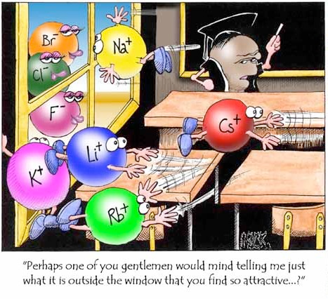
Chapter 2: Atoms, Molecules and Ions
Chemistry 221
Professor Michael Russell
http://mhchem.org/221
Last update:
7/7/25
MAR

Slide 2


Where Does Matter Come From?
2.1 - Early Ideas in Atomic Theory
Matter comes from the
The universe is 13.77 billion years old
Hydrogen and Helium important
MAR

Slide 3
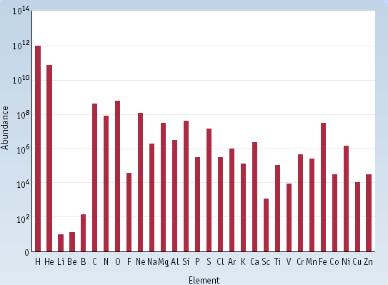
Element Abundance (Cosmic)
Most abundant elements in the Earth's
Crust: Silicon and oxygen
Atmosphere: nitrogen and oxygen
C
O
Al
Si
Fe
MAR
http://www.webelements.com/

Slide 4

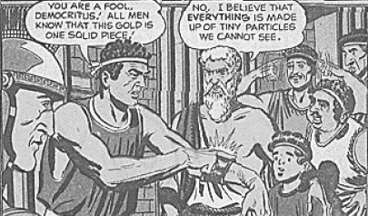
Early Ideas in Atomic Theory: Democritus
DEMOCRITUS (460 - 370 BCE) was a contemporary of Plato
The Universe consists of the void and atomos (atoms)
Atoms have structure and volume, smallest unit of matter
  "Gold can be divided into smaller pieces only so far before the pieces no longer retain the properties of gold"
MAR
Notes:
Democritus: Universe is "void" plus "being", and "being" is an infinity of indivisible particles - atoms. Atoms: a-toms, "toms" in Greek means to "slice", so "a-slice" means "something which cannot be sliced"; hence, atoms. "Void" is similar to what we call vacuum.

Slide 5

Early Ideas in Atomic Theory: John Dalton
1804 - Proposed Atomic Theory
* Matter composed of atoms (smallest unit of an element); atoms of one element are different from other element's atoms - proposed relative scale of atomic masses (now the amu)
* Compounds contain definitive whole number ratio of atoms (i.e. water always H2O, not HO or HO2, etc.)
* Atoms cannot be created or destroyed
The "Newton" of Chemistry,
colorblind scientist
1 atomic mass unit (amu) = 1.66054 * 10⁻²⁴ g = 1 Dalton (Da)
MAR
Notes:
"Daltonism" used for colorblindness in many countries

Slide 6
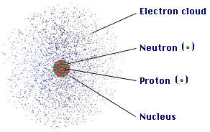
2.2 - Evolution of Atomic Theory
What are atoms composed of exactly?
Through the work of Thompson, Marie Curie and others:
Atoms contain protons, neutrons and electrons
Protons and neutrons in the nucleus
Protons positive, electrons negative, neutrons neutral
MAR

Slide 7
Atomic
Composition
Protons
  positive electrical charge (+1.6 x 10⁻¹⁹ C)
  mass = 1.672623 x 10⁻²⁴ g
  relative mass = 1.0073 atomic mass units (amu) where 1 amu = 1.66054 * 10⁻²⁴ g
Electrons
  negative electrical charge (-1.6 x 10⁻¹⁹ C)
  relative mass = 0.0005486 amu
Neutrons
  no electrical charge
  mass = 1.0087 amu
MAR
Place the three subatomic particles in order of increasing mass.
  neutron < proton < electron
  neutron < electron < proton
  proton < neutron < electron
  electron < proton < neutron
  electron < neutron < proton
Enter your response on
your i>Clicker now!
Answer = D,
electron < proton < neutron

Slide 8
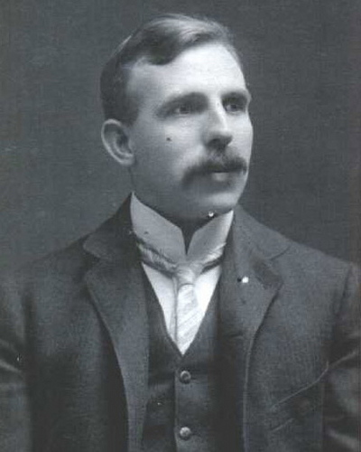
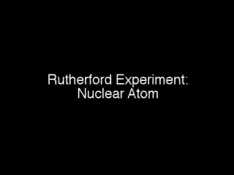
The modern view of the atom was developed by Rutherford (1910) with the "gold foil experiment"
The Current Model of the Atom
Low density atom with a highly dense, positively charged nucleus
Ernest
Rutherford
MAR
MAR

Slide 9
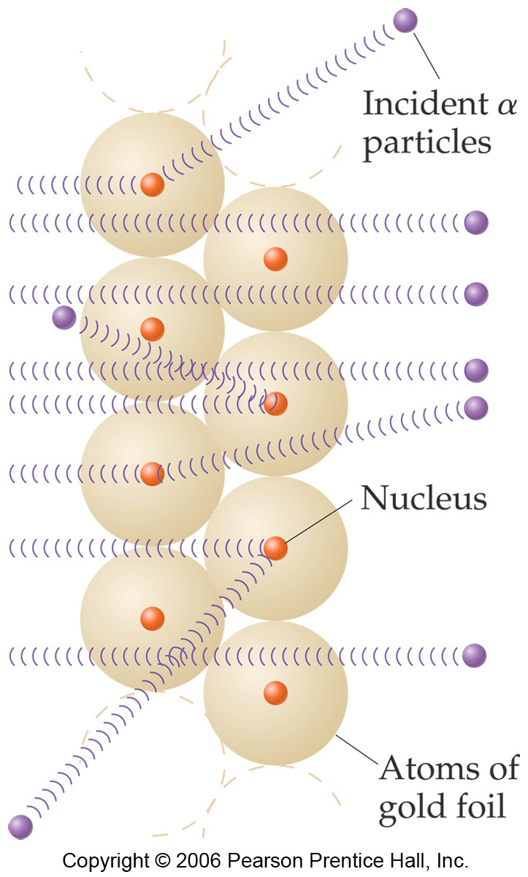
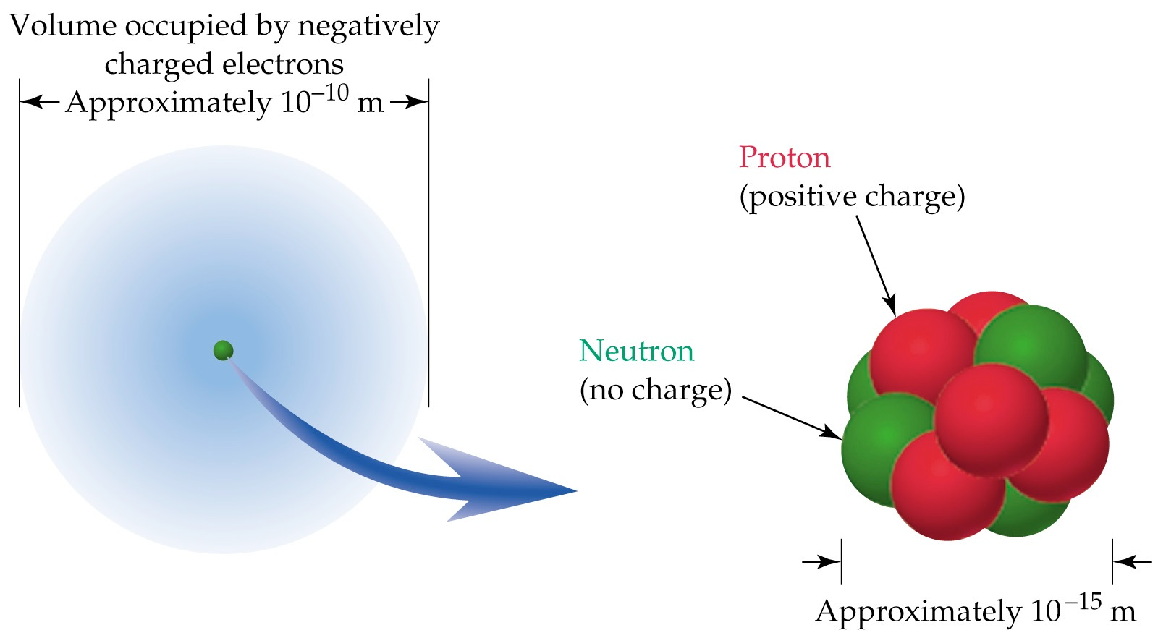
Structure of the Atom
MAR

Slide 10
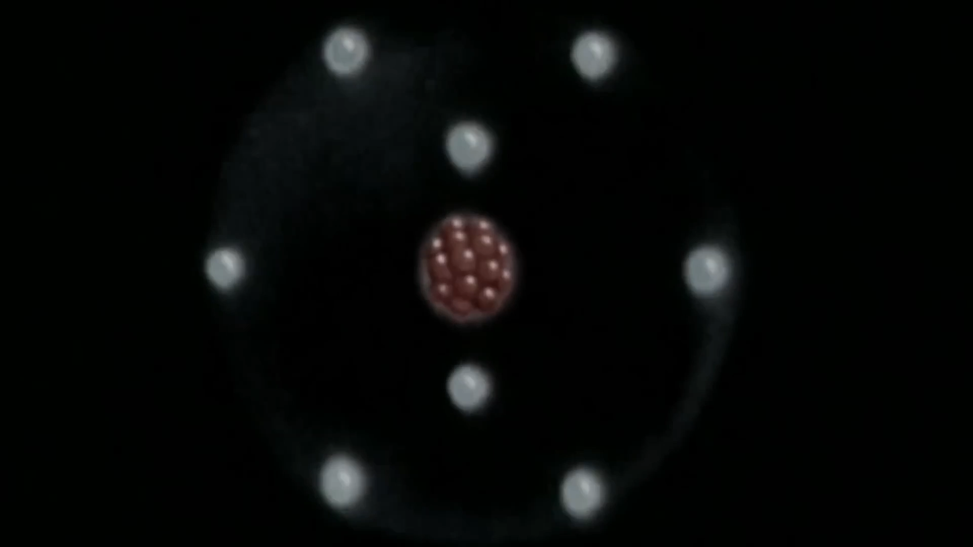
Atom Composition - overview
The atom is mostly empty space
protons & neutrons in the nucleus; nucleus very dense
electrons in space around nucleus
If # protons = # electrons, atom electrically neutral
Extremely small! One teaspoon of water has 3 times as many atoms as the Atlantic Ocean has teaspoons of water.
MAR
MAR

Slide 11
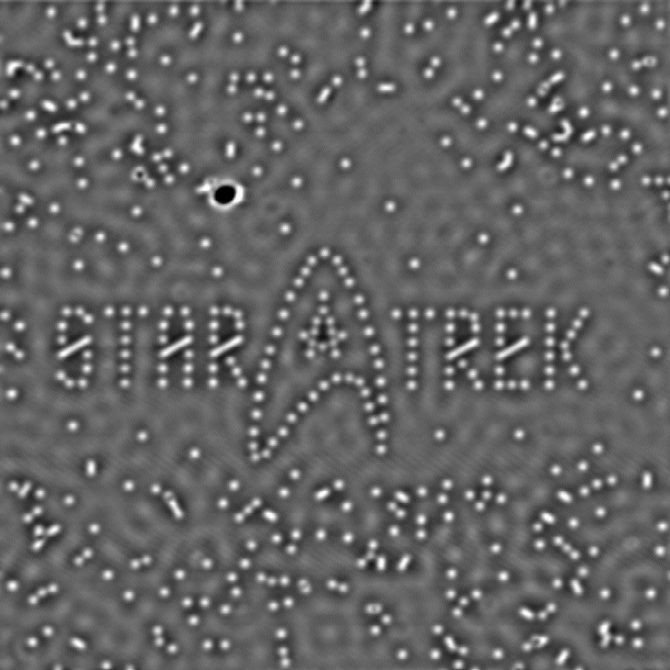
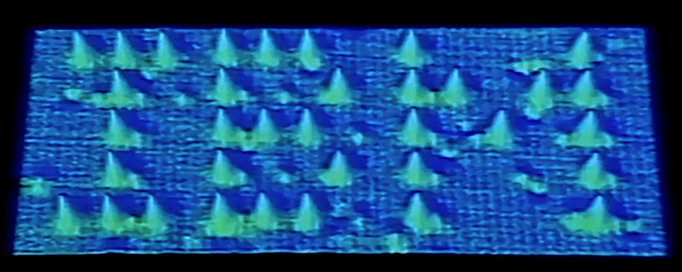

How Large is an Atom?
Image consists of 35 Xe atoms (spells IBM :)
Image created using Scanning Tunneling Microscopy (STM)
Diameter of an atom ~1 Å (1 Å = 10⁻¹⁰ m), nucleus ~10⁻¹⁵ m
MAR
More info: https://www.ibm.com/history/scanning-tunneling-microscope
MAR
Notes:
YouTube video posted April 30, 2013 (https://www.youtube.com/watch?v=oSCX78-8-q0&feature=player_embedded). Star Trek picture also made by IBM for release of “Star Trek Into Darkness” accessed September 18, 2014 (http://www.universetoday.com/101963/tiny-bubbles-star-trek-gets-an-atomic-look/)

Slide 12
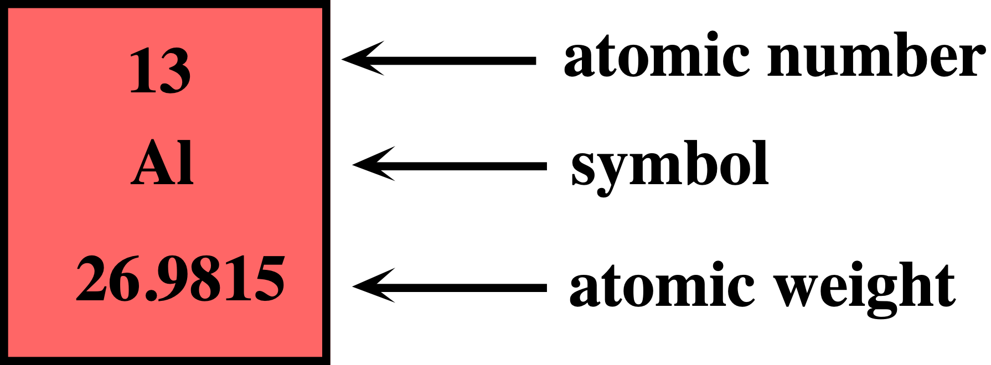
2.3 - Atomic Structure and Symbolism: Atomic Number, Z
All atoms of the same element have the same number of protons, Z (the atomic number)
Symbol: first letter capitalized, second letter lower case (if needed)
Z distinguishes atoms from one another!
mass
Henry Moseley determined the atomic number for each element in 1914 using x-ray scattering
MAR
MAR
What is the atomic number (Z) of oxygen?
  6
  8
  approximately 16
  16
  32
Enter your response on
your i>Clicker now!
Answer = B,
8 (O on the periodic table)

Slide 13
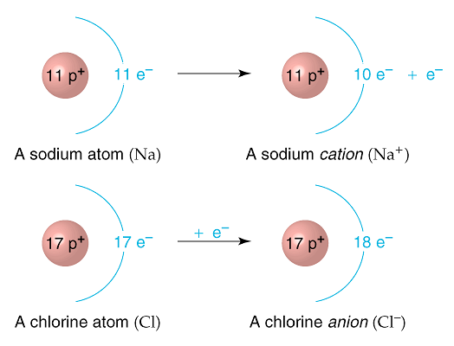
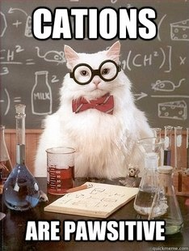
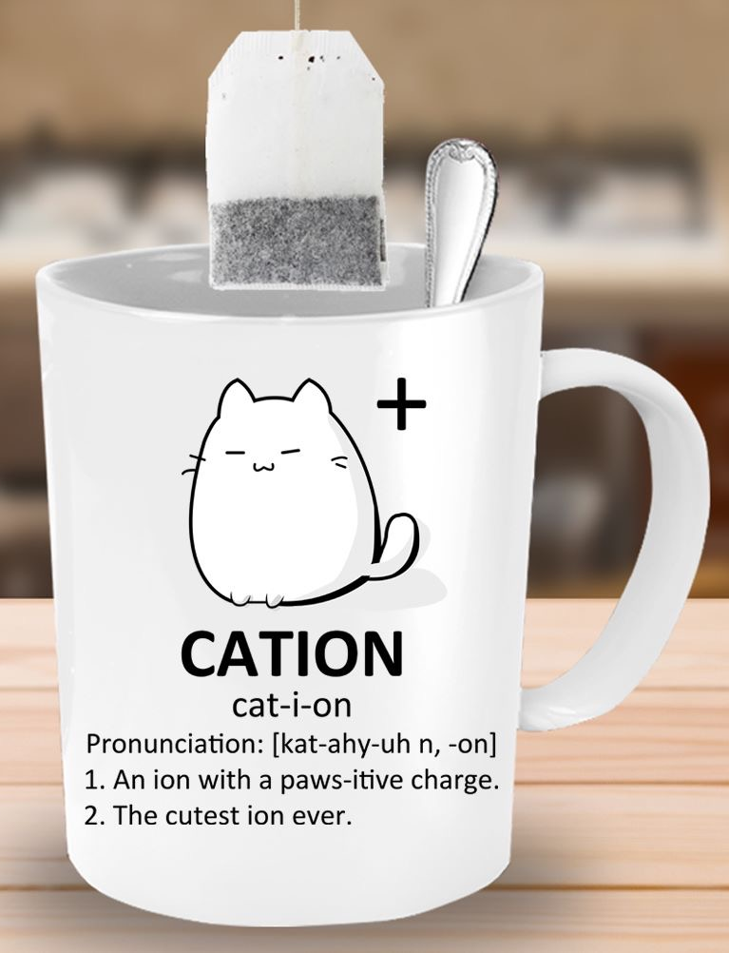

Ions
Atoms are neutral if the number of protons equals the number of electrons
Extra electrons: negative charge, becomes an anion (negative ion), gets -ide ending
Fewer electrons: positive charge, becomes a cation (positive ion)
Remember:
CATS have PAWS
CATions are PAWSitive
MAR
MAR

Slide 14
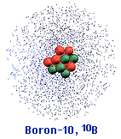
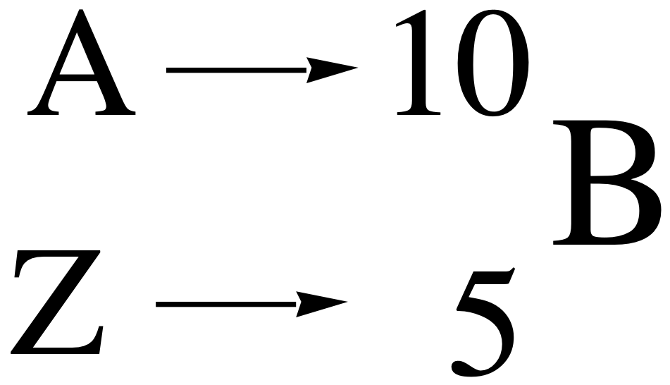
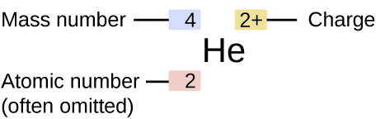
Mass Number, A
Mass number, A, usually in units of amu.
A = # of protons + # of neutrons
A boron atom can have
A = 5 p + 5 n = 10 amu
Method to display A, Z and element symbol:
MAR
MAR

Slide 15
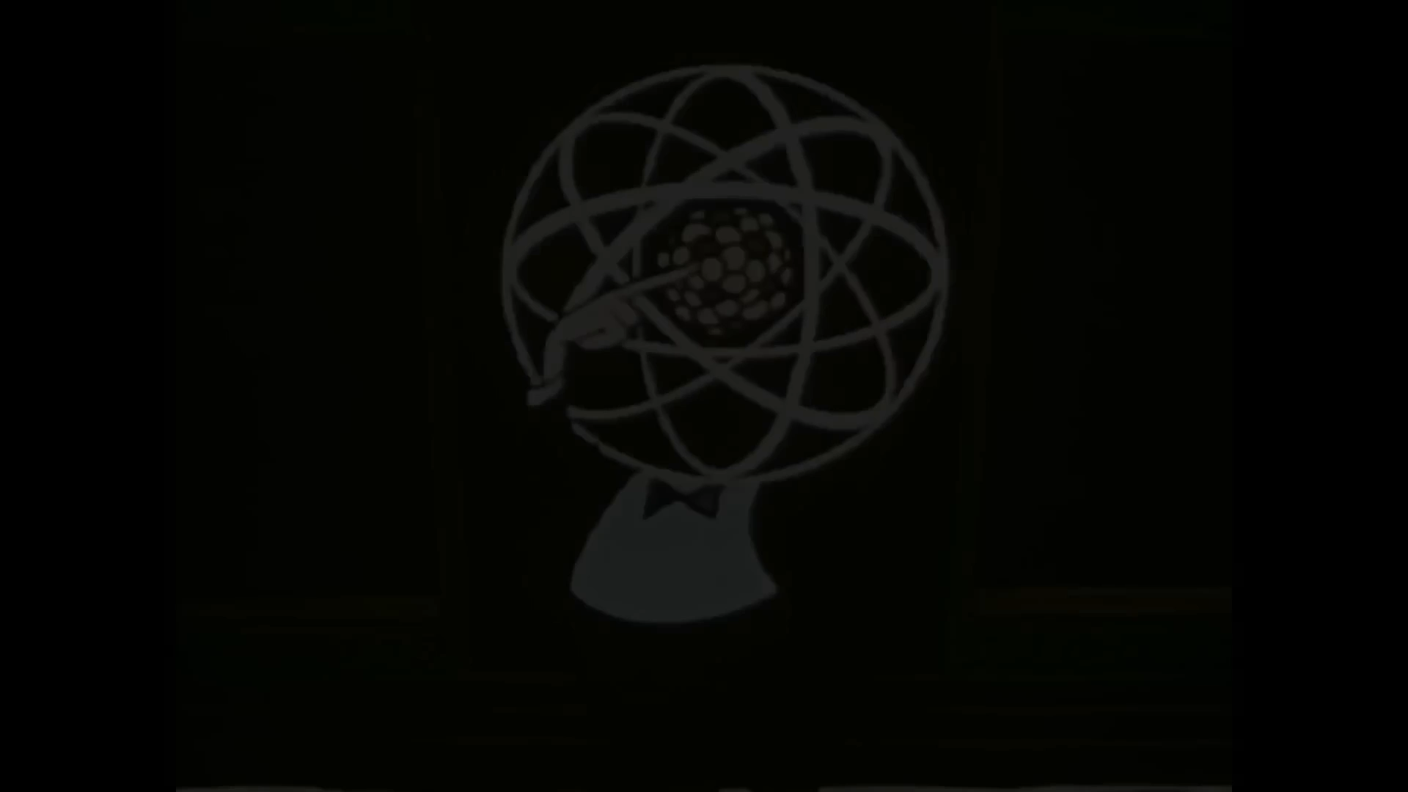
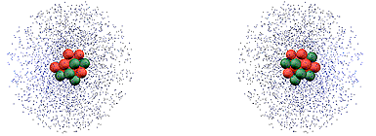
Isotopes
Atoms of the same element (same Z) often have different mass numbers (A) - isotopes (different masses (A), same element (Z)
Boron-10 (¹⁰B) has 5 p and 5 n
Boron-11 (¹¹B) has 5 p and 6 n
¹¹B
¹⁰B
MAR
MAR
How many neutrons in manganese-55?
  12
  25
  30
  55
  80
Enter your response on
your i>Clicker now!
Answer = C,
30 (Mn-55 has 55 - 25 = 30n, or A - Z)

Slide 16
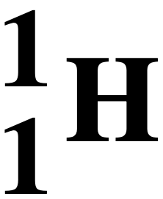
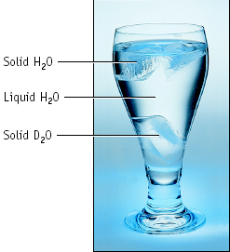
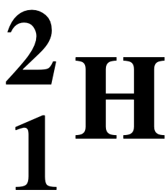
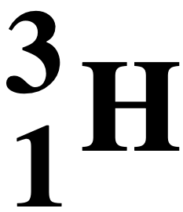
Hydrogen Isotopes
Hydrogen has three isotopes
1 proton and 0 neutrons, protium
1 proton and 1 neutron, deuterium
1 proton and 2 neutrons, tritium
radioactive
Element | Atomic Number | Number Protons | Number Neutrons | Mass (amu) | % Natural Abund.
hydrogen | 1 | 1 | 0 | 1.0078 | 99.989
 | 1 | 1 | 1 | 2.0141 | 0.0115
 | 1 | 1 | 2 | 3.01605 | trace
MAR

Slide 17
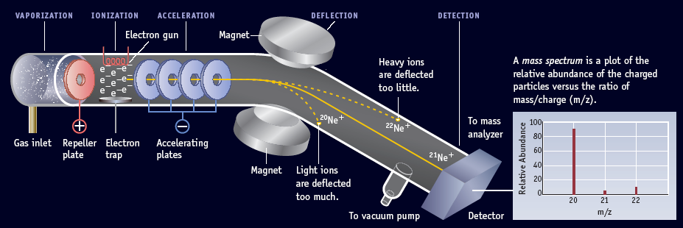
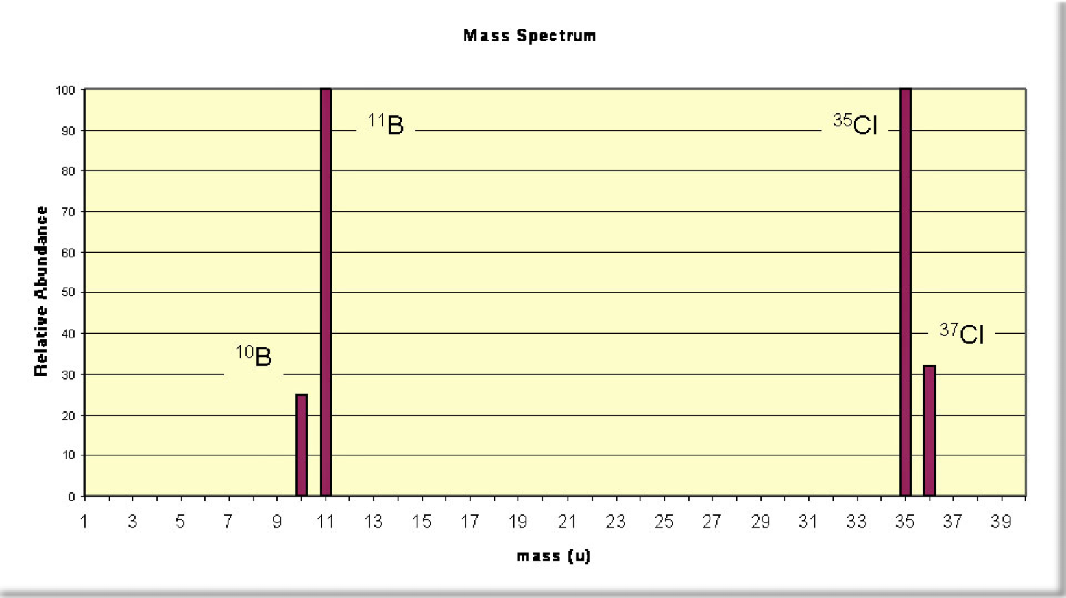
Masses of Isotopes Determined with a mass spectrometer
Samples vaporized and exposed to electron beam; electrically charged cations separated by mass and charge.
https://youtu.be/D77pACc0uF8
MAR
MAR
Notes:
Great video on how mass spectrometers work: https://www.youtube.com/watch?v=D77pACc0uF8&t=0s

Slide 18
Atomic Mass
¹¹B
¹⁰B
Because of the existence of isotopes, the mass of a collection of atoms has an average value.
Average mass = Atomic Mass (on periodic table)
Boron is 20% ¹⁰B and 80% ¹¹B. That is, ¹¹B is 80 percent abundant on the earth
To calculate the atomic weight for boron:
= Σ (abundancei * massi) (i = number of values)
= (abundance1 * mass1) + (abundance2 * mass2)
= 0.20 (10 amu) + 0.80 (11 amu) = 10.8 amu
MAR
See Isotopic Abundance Handout
MAR

Slide 19
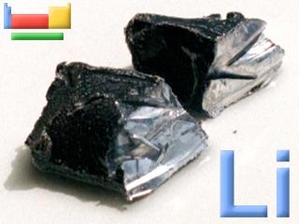
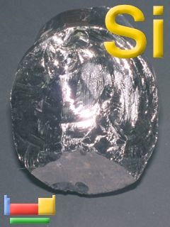
Isotopes & Atomic Mass
Because of the existence of isotopes, the mass of a collection of atoms has an average value.
⁶Li = 7.5% abundant and ⁷Li = 92.5%
  Atomic mass of Li = ______________
²⁸Si = 92.23%, ²⁹Si = 4.67%, ³⁰Si = 3.10%
  Atomic mass of Si = ______________
6.941
28.086
MAR
MAR
An element (E) has several naturally occurring isotopes, with the following abundances:
⁷²E, 54.5% ⁷³E, 15.6% ⁷⁴E, 29.9%
The most reasonable atomic mass for the element E would be
  72.1
  72.8
  73.4
  73.8
  74.0
Enter your response on
your i>Clicker now!
Answer = B,
72.8
somewhat greater than highest abundance
E-72 but less than 73
Notes:
answer = 72*.545 + 73*.156 + 74*.299 = 72.754 = 72.8

Slide 20
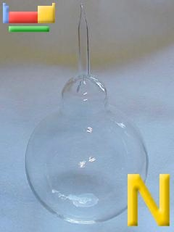
Isotopes & Atomic Mass
Example: Nitrogen has two main isotopes, ¹⁴N (14.0031 amu, 99.6299%) and ¹⁵N (15.0001 amu, 0.3701%). Calculate the average atomic mass.
Solution
Average atomic mass =
= (abundance1 * mass1) + (abundance2 * mass2)
= (0.996299*14.0031) + (0.003701*15.0001)
= 13.9512745 + 0.05551537
= 14.0068 amu
MAR
MAR
Notes:
(0.996299*14.0031) = 13.9512745 = 13.9513 (6 sig figs, stops at ten thousandths)
(0.0037010*15.0001) = 0.05551537 = 0.05552 (four sig figs, stops at hundred thousandths)
13.9512745 + 0.05551537 = 14.00678987 = 14.0068 (stops at ten thousandths)

Slide 21
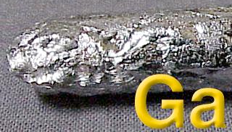
Isotopes & Atomic Mass
Example: Gallium has two main isotopes, ⁶⁹Ga (68.9257 amu) and ⁷¹Ga (70.9249 amu) with an average atomic mass of 69.723. Calculate the % abundance of each isotope.
Solution
Average atomic mass =
69.723 = x(⁶⁹Ga)*68.9257 + y(⁷¹Ga)*70.9249
but also
1 = x(⁶⁹Ga) + y(⁷¹Ga) (2 percentages equal 100%)
so y(⁷¹Ga) = 1 - x(⁶⁹Ga)
MAR
MAR

Slide 22
Isotopes & Atomic Mass
Example: Gallium has two main isotopes, ⁶⁹Ga (68.9257 amu) and ⁷¹Ga (70.9249 amu) with an average atomic mass of 69.723. Calculate the % abundance of each isotope.
Solution
69.723 = x(⁶⁹Ga)*68.9257 + y(⁷¹Ga)*70.9249, or
69.723 = x*68.9257 + (1 - x)*70.9249
Solve for x, get:
x(⁶⁹Ga) = 0.6012 (60.12%)
y(⁷¹Ga) = 1 - x = 0.3988 (39.88%)
MAR
See Isotopic Abundance Handout
MAR
Notes:
69.723 = x*68.9257 + (1 - x)*70.9249
69.723 = 68.9257*x + 70.9249 - 70.9249x combine x terms together; 68.9257-70.9249x = -1.9992x
69.723 = 70.9249 - 1.9992x subtract 70.9249 from both sides; 69.723 - 70.9249 = -1.2019 notice this number should stop at the thousandths position, or 4 sig figs!)
-1.2019 = -1.9992x now get x by itself, divide both sides by -1.9992; -1.2019/-1.9992 = 0.60119
(-1.2019/1.9992) = (-1.9992/1.9992 )x
0.60119 = x round to 4 sigs, so 0.6012, and times 100% = 60.12% of gallium-69
100% - 60.12% = 39.88% gallium-71

Slide 23
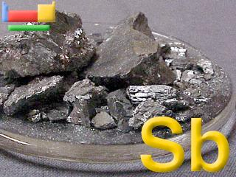
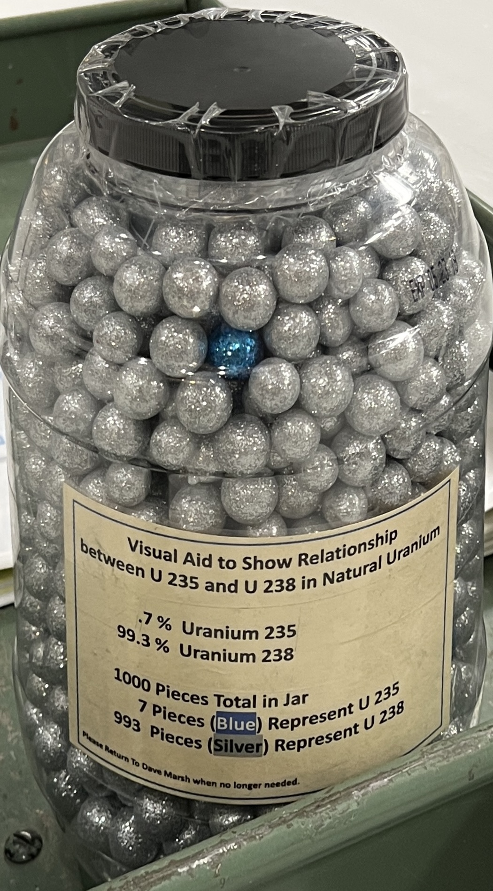
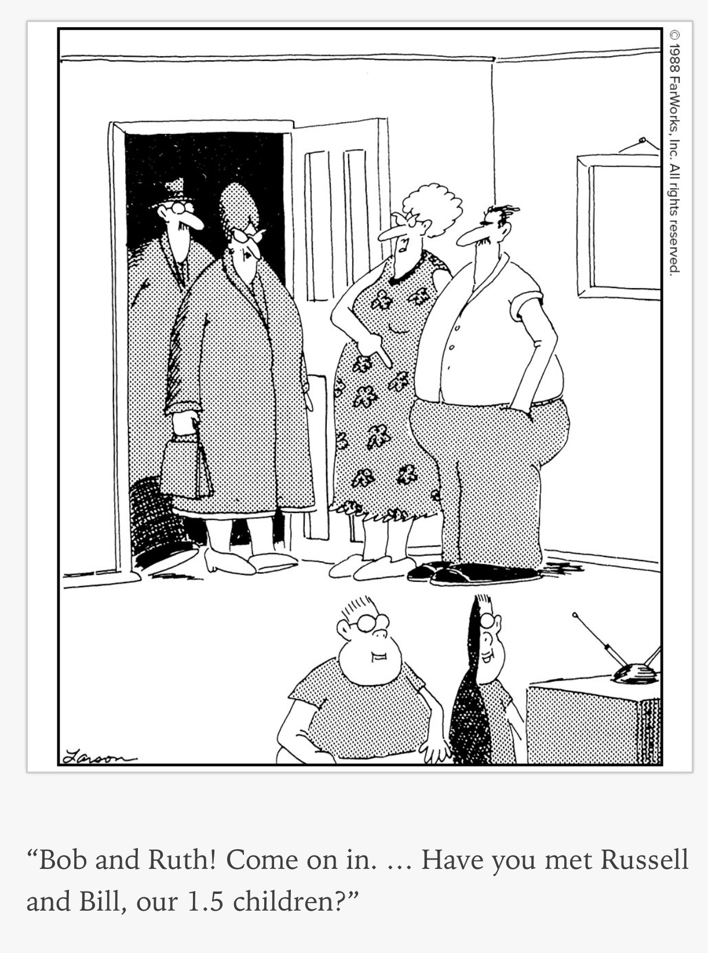
Isotopes & Atomic Mass
Antimony has two main isotopes:
¹²¹Sb (120.9038 amu, 57.20%) and
¹²³Sb (122.9042 amu, 42.80%)
Average atomic mass of Sb: 121.760
Will you have one atom of antimony with 121.760 amu?
No!
One atom of antimony will have a mass of 120.9038 amu 57.20% of the time
One atom of antimony will have a mass of 122.9042 amu 42.80% of the time
Average kids per family
in Oregon: 1.7-1.8 (2019)
MAR
MAR
Notes:
source: https://www.insider.com/the-average-number-of-kids-per-family-in-every-state-2019-2 (accessed Aug. 9, 2021)

Slide 24
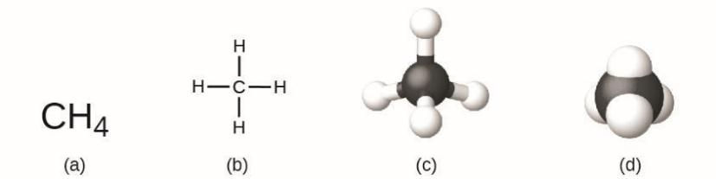
2.4 - Chemical Formulas
A molecular formula represents the type and number of atoms in a compound.
* Metals (cations) listed before nonmetals
* If all nonmetals, carbon is first, followed by hydrogen, oxygen, etc.
A structural formula shows the information of the molecular formula, but also includes how atoms are connected.
A methane molecule can be represented as (a) a molecular formula, (b) a structural formula, (c) a ball-and-stick model, and (d) a space-filling model. Carbon and hydrogen atoms are represented by black and white spheres, respectively.
MAR
MAR

Slide 25
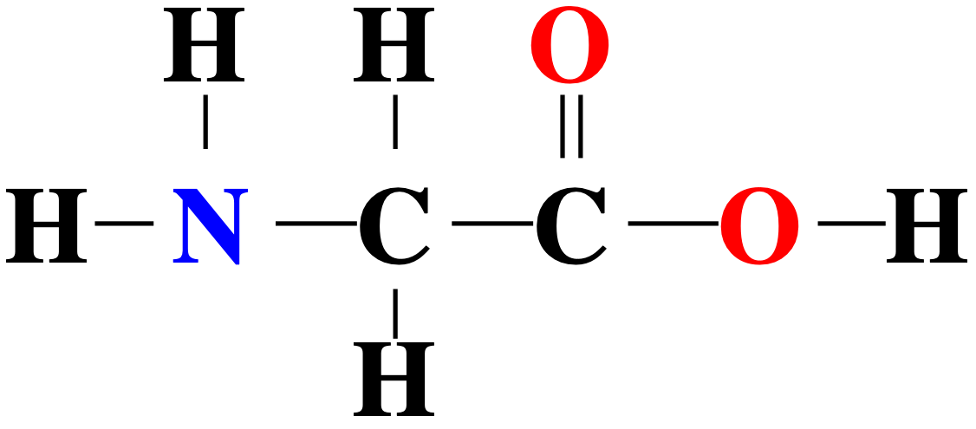
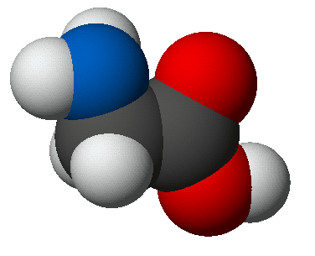
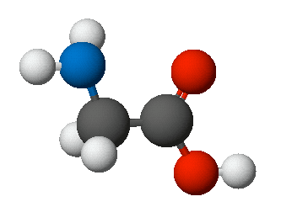
Writing Formulas
for Glycine
Glycine molecular formula: C₂H₅NO₂
Glycine structural formula: H₂NCH₂COOH
Lewis (structural) formula
Ball & stick
Space-filling
MAR

Slide 26
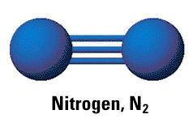
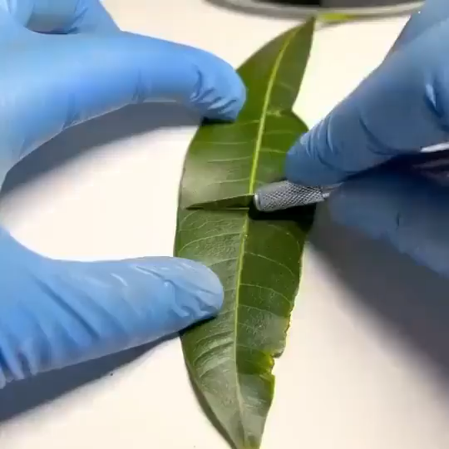
Elements as Molecules
Most elements exist as monoatomic ions (i.e. individual atoms)
Some elements exist as molecules (S8, P4, etc.)
Important: the seven diatomics!
"HONCl
BrIF"
Have Hydrogen, H₂
No Nitrogen, N₂
Fear Fluorine, F₂
Of Oxygen, O₂
Ice Iodine, I₂
Clear Chlorine, Cl₂
Brew Bromine, Br₂
MAR
MAR
Oxygen (O2) generated on a leaf
Notes:
Oxygen on a leaf video from https://t.co/GFdjN3PX8v (Twitter, "Microscopic Pictures" (@MicroscopePicsx), accessed April 23, 2023)

Slide 27
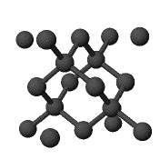
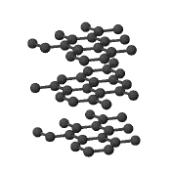
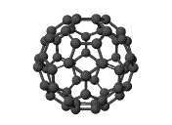
Elements as Allotropes
Many elements exist in more than one form - allotropes
Carbon exists as diamond, graphite, buckminsterfullerene, and several other forms
Oxygen exists as a diatomic O2 and ozone (O3)
graphite
diamond
Buckyball (C₆₀) or
Buckminsterfullerene
MAR
MAR

Slide 28
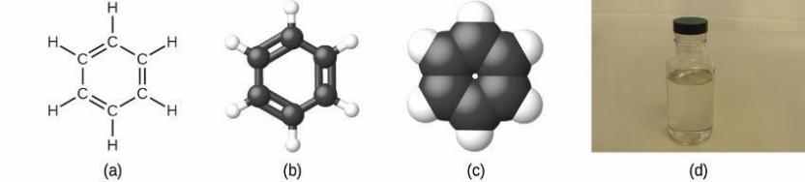
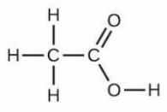
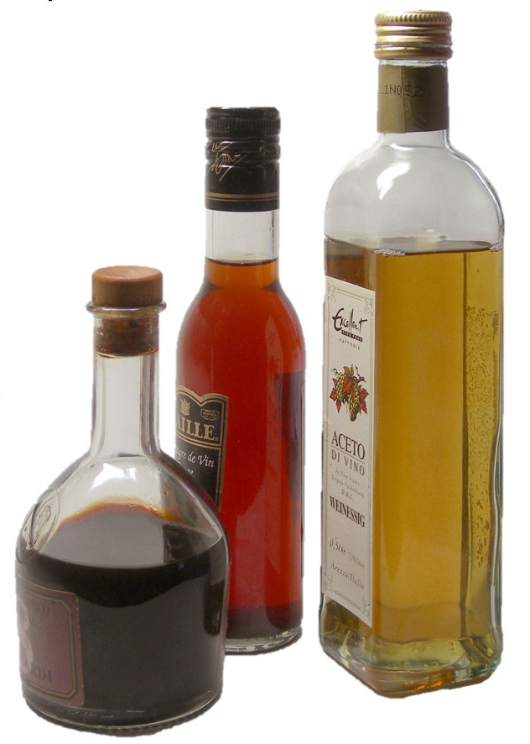
Empirical Formulas
An empirical formula represents the smallest whole number ratio of atoms in a compound
* Empirical formulas (EF) useful when determining the identity of a compound
* Knowing how to convert between the EF and molecular formula (MF) important!
benzene
Example: benzene
  Molecular formula = C₆H₆ Empirical formula = CH
Example: acetic acid
  Molecular formula = C₂H₄O₂ Empirical formula = CH₂O
acetic acid
(vinegar)
MAR
MAR
What is the empirical formula for P4O10?
  P8O20
  P4O10
  P2O5
  P1O2.5
  PO
Enter your response on
your i>Clicker now!
Answer = C,
  P2O5

Slide 29
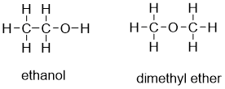
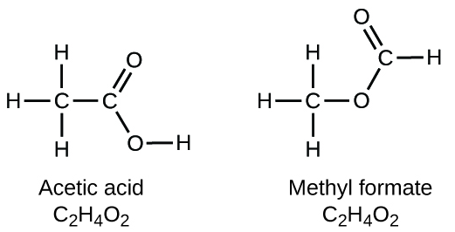
Isomers
Isomers are compounds with the same molecular formula but different molecular structures
* Very important to chemists; different structures, boiling points, etc.
C2H6O
C2H6O
MAR
MAR

Slide 30

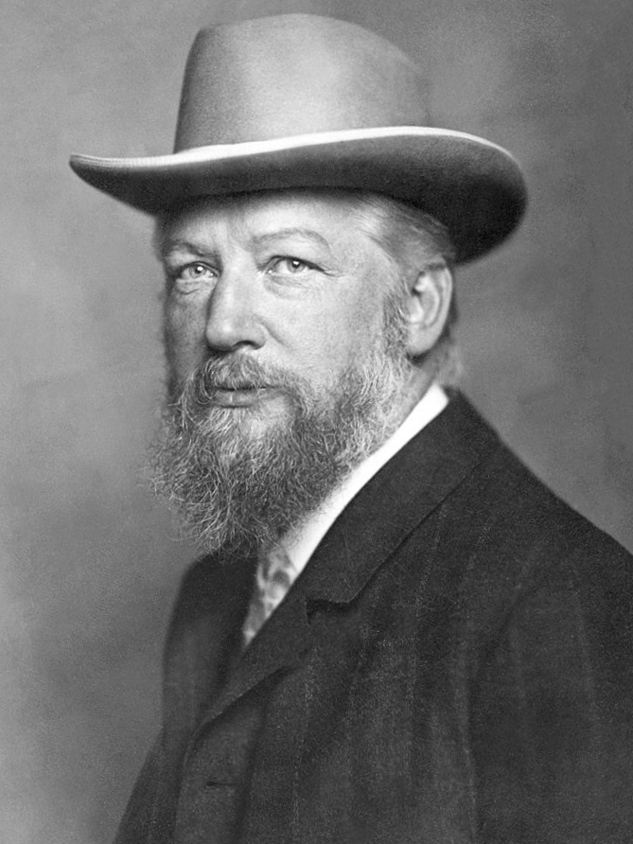
The Mole
Chemistry is a quantitative science - we need a "counting unit."
The MOLE!
A mole is similar to a dozen - you can have a dozen roses, a dozen donuts - you can also have a mole of roses, or a mole of donuts
Mole named by Wilhelm Ostwald in 1893
MAR
MAR

Slide 31

The Mole
The mole is defined as the same number of 'pieces' (atoms, molecules, etc.) as the number of atoms in a pure sample of carbon-12 with a mass of exactly 12 g.
This 'number of pieces' has been found to be 6.022 x 10²³ and is called Avogadro's number (NA)
Taking into account all of the isotopes of C, the molar mass of C is 12.011 g/mol
MAR
MAR

Slide 32

Molar Mass
The molar mass of an element (or compound) is the mass in grams of 1 mole of that substance expressed in units of grams per mole (g/mol).
The molar mass of any substance is numerically equivalent to its atomic mass in amu. Scientists get molar mass values from the periodic table!
Example:
A single ¹²C atom has a mass of 12 amu.
A mole of ¹²C atoms have a mass of 12 g.
One mole amounts
MAR
MAR

Slide 33

Molar Mass
Try to use at least four sig figs for molar mass
Element | Average Atomic Mass (amu) | Molar Mass (g/mol) | Atoms/Mole
C | 12.01 | 12.01 | 6.022 × 10²³
H | 1.008 | 1.008 | 6.022 × 10²³
O | 16.00 | 16.00 | 6.022 × 10²³
Na | 22.99 | 22.99 | 6.022 × 10²³
Cl | 35.45 | 35.45 | 6.022 × 10²³
MAR
One mole amounts
MAR
What is the molar mass of the element with an atomic number of 12?
  6
  12
  12.011
  24.3050
  47.88
Enter your response on
your i>Clicker now!
Answer = D,
24.3050
Atomic number 12 = Magnesium (Mg)

Slide 34



How many moles of Mg are represented by 0.200 g? How many atoms?
Example
Mg has a molar mass of 24.31 g/mol.
0.00822706...
How many atoms in this piece of Mg?
= 4.96 x 10²¹ atoms Mg
4.956106....E21
MAR
MAR
I have 3.011 x 10²³ atoms of pure Carbon-12. How many grams of Carbon-12 do I have?
  1.000 g
  3.011 g
  6.000 g
  6.022 g
  3.011 x 10²³
Enter your response on
your i>Clicker now!
Answer = C,
6.000 g
3.011 x 10²³ / 6.022 x 10²³ = 0.5000 mol C
0.5000 mol C * 12.00 g/mol C = 6.000 g C-12

Slide 35

What is the molar mass of ethanol, C₂H₆O?
Molar Mass of a Compound
1 mol contains
2 mol C (12.01 g C/1 mol) = 24.02 g C
6 mol H (1.01 g H/1 mol) = 6.06 g H
1 mol O (16.00 g O/1 mol) = 16.00 g O
TOTAL = molar mass = 46.08 g/mol
MAR

Slide 36


Tylenol
Molar Mass of a Compound
Formula = C₈H₉NO₂
Molar mass = 151.16 g/mol
MAR
Try to use at least four sig figs for molar mass
What is the molar mass of water (H2O)?
  18.02 g/mol
  34.02 g/mol
  17.01 g/mol
  36.04 g/mol
  41.17 g/mol
Answer = A,
  18.02 g/mol
  = 2*H + 1*O
  = 2*1.01 + 1*16.00
Enter your response on
your i>Clicker now!
Notes:
tylenol (aka acetaminophen) is N-acetyl-para-aminophenol

Slide 37



Molar Mass of a Compound - Example
A packet of an artificial sweetener contains 0.0400 g of saccharin (C₇H₅NO₃S, molar mass = 183.18 g/mol) How many saccharin molecules and carbon atoms are in a 0.0400 g sample of saccharin?
saccharin
MAR
Notes:
tylenol (aka acetaminophen) is N-acetyl-para-aminophenol

Slide 38



End of Chapter 2
See also:
Chapter Two Study Guide
Chapter Two Concept Guide
Important Equations (following this slide)
End of Chapter Problems (following this slide)
MAR

Slide 39
Important Equations, Constants, and Handouts
from this Chapter:
the “gold foil experiment”
protons, neutrons, electrons
mass number, atomic number
isotopes
atomic weight and molar mass
empirical formulas
molecular formulas
structural formulas
isomers
Avogadro’s number
Molar mass
A mole is the amount of any substance containing 6.022 x 10²³ particles
Periodic table: how to find the molar mass of an element or compound

Slide 40

End of Chapter Problems: Test Yourself
How many protons in a magnesium atom with 15 neutrons? What is the mass number of this isotope?
How many neutrons in:
Thallium has two stable isotopes, ²⁰³Tl and ²⁰⁵Tl. Knowing that the atomic weight of thallium is 204.4, which isotope is the more abundant of the two?
Gallium has two naturally occurring isotopes, ⁶⁹Ga and ⁷¹Ga, with masses of 68.9257 u and 70.9249 u, respectively. Calculate the percent abundances of these isotopes of gallium.
Calculate the mass in grams of 2.5 mol of aluminum.
Calculate the amount (moles) represented by 0.012 mol Li. How many atoms of Li are present?
A cylindrical piece of sodium is 12.00 cm long and has a diameter of 4.5 cm. The density of sodium is 0.971 g/cm³. How many atoms does the piece of sodium contain? (The volume of a cylinder is V = π x r² x length.)
The compound 1-butanol has a structural formula of CH3CH2CH(OH)CH2OH. Write a molecular formula and an empirical formula for this compound.

Slide 41
End of Chapter Problems: Answers
12 protons, mass number = 27
33 neutrons
205
⁶⁹Ga abundance is 60.12%, ⁷¹Ga abundance is 39.88%
68 g Al
1.7 x 10⁻³ mol Li, 1.0 x 10²¹ atoms Li
4.9 x 10²⁴ atoms Na
C4H10O2, C2H5O

