Slide 1
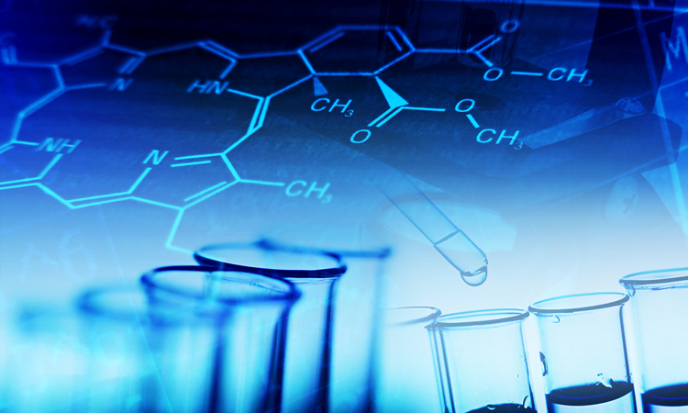
Chemistry 151: Basic Chemistry
Chapter 7 Section 7.1: The Chemical Reaction
Last update:
1/10/25

Slide 2
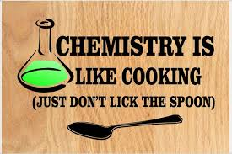
Chemical Equations
Chemical equations are like recipes in cooking: They tell a chemist how to make something ("products") and what you'll need to make it ("reactants")
Having balanced amounts critical in cooking: too much flour can make a cake dry, and too little flour can prevent the cake from forming. Same in chemistry!
We will learn how to create a balanced chemical equation in this chapter, and in the next section, we will explore the quantities needed to actually make the products.

Slide 3
Chemical Equations
Chemical equation: An expression in which symbols and formulas are used to represent a chemical reaction.
Reactant: A substance that undergoes change in a chemical reaction; written on left side of the reaction arrow
Product: A substance that is formed in a chemical reaction; written on right side of reaction arrow

Slide 4
Chemical Equations
Equations depict the kind of reactants and products and their relative amounts in a reaction.
4 Al(s) + 3 O₂(g) ---> 2 Al₂O₃(s)
The numbers in the front are called
stoichiometric coefficients
The letters (s), (g), (l) and (aq) are the physical states of compounds:
s = solid, g = gas, l = liquid,
aq = solution in water (aqueous)
MAR

Slide 5
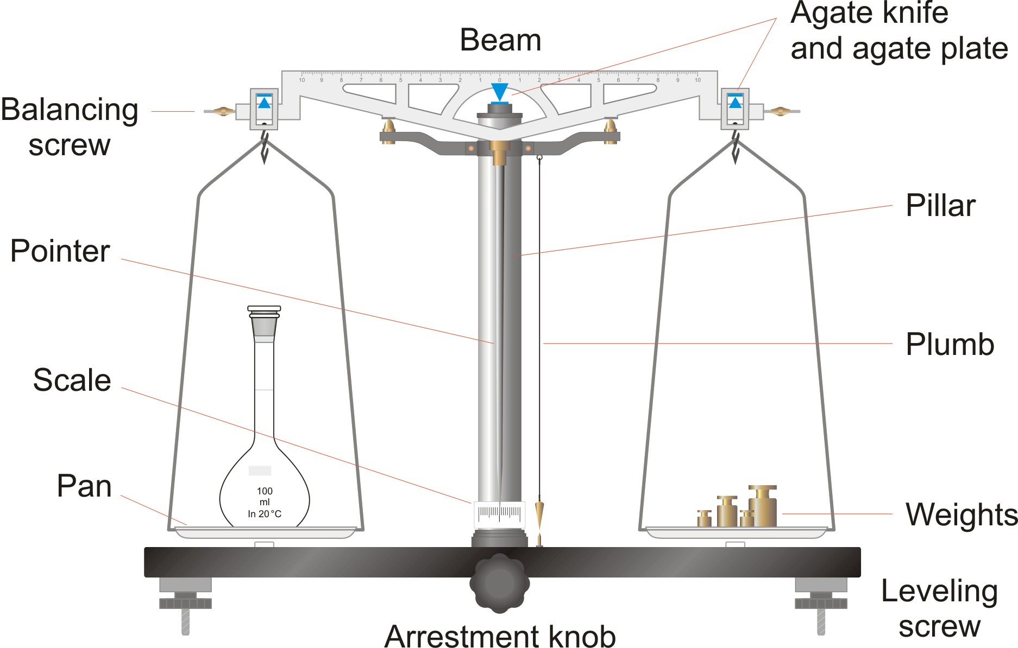
The Law of conservation of mass states that matter cannot be created or destroyed in any chemical reaction
The bonds between atoms in the reactants are rearranged to form new compounds, but none of the atoms disappear, and no new atoms are formed.
So: Chemical equations must be balanced, meaning the numbers and kinds of atoms must be the same on both sides of the reaction arrow.
The numbers placed in front of formulas to balance equations are called coefficients, and they multiply all the atoms in the chemical formula.

Slide 6
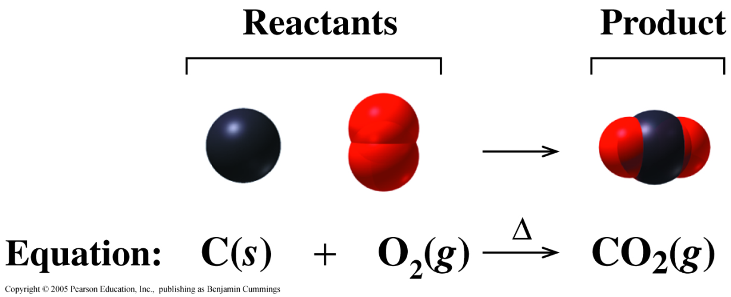
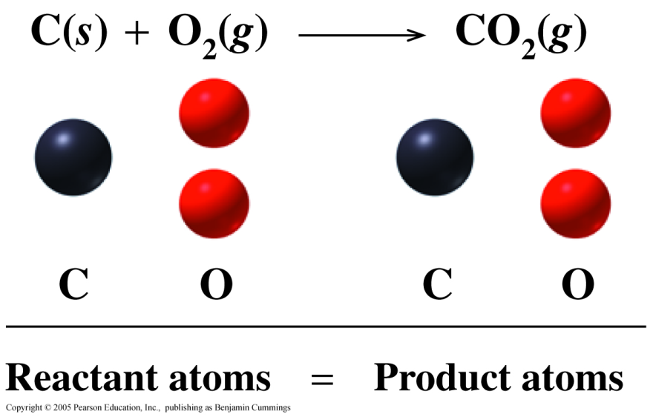
Chemical Equations are Balanced
In a balanced
chemical reaction:
atoms are not gained or lost.
the number of reactant atoms is equal to the number of product atoms.

Slide 7
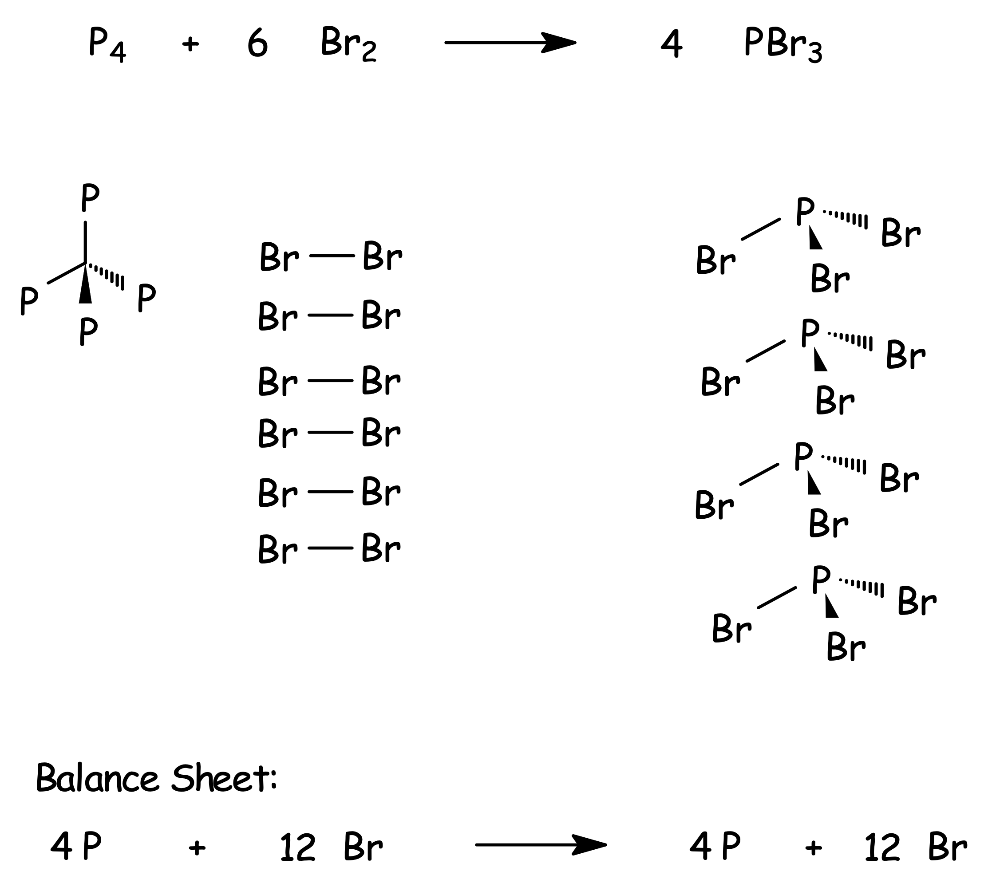

Slide 8
Balancing Chemical Equations
The following four steps can be used as a guide to balance chemical equations.
Example: Sulfuric acid reacts with sodium hydroxide to create sodium sulfate and water. Balance this chemical reaction.
Step 1: Write an unbalanced equation, using correct formulas for all reactants and products.

Slide 9
Step 2: Add appropriate coefficients to balance the numbers of atoms of each element.
Step 3: Check the equation to make sure the numbers and kinds of atoms on both sides of the equation are same.
Step 4: Make sure the coefficients are reduced to their lowest whole-number value (ok here).

Slide 10
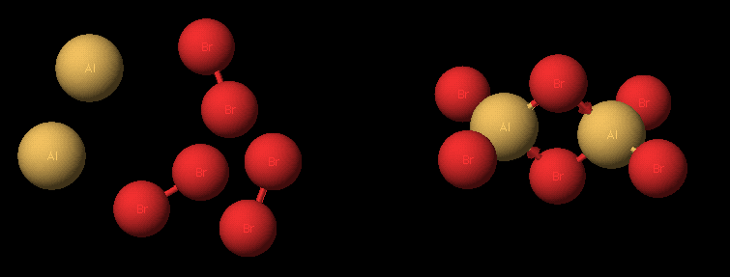
Balancing Equations
_ Al(s) + _ Br₂(liq) ---> _ Al₂Br₆(s)

Slide 11
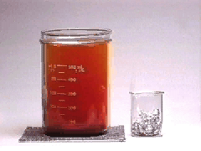
Balancing Equations
2 Al(s) + 3 Br₂(liq) ---> Al₂Br₆(s)

Slide 12
Balancing Equations
____C₃H₈(g) + _____ O₂(g) -->
_____CO₂(g) + _____ H₂O(g)

Slide 13
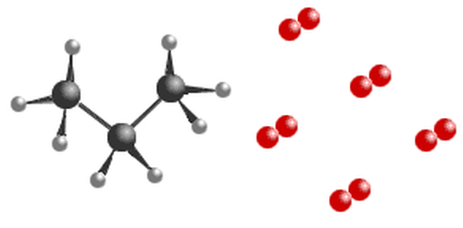
Balancing Equations
C₃H₈(g) + 5 O₂(g) ---->
3 CO₂(g) + 4 H₂O(g)

Slide 14
Balancing Equations
Balance the following:
Calcium + nitrogen → Calcium nitride
remember nitrogen is a diatomic!
3 Ca + N2 → Ca3N2

Slide 15
Balancing with Polyatomic Ions
Magnesium chloride + sodium phosphate →
magnesium phosphate + sodium chloride
MgCl₂(aq) + Na₃PO₄(aq) → NaCl(aq) + Mg₃(PO₄)₂(s)
Leave polyatomic ions as "units", don't break up when balancing, usually balance them first before other atoms
MgCl₂(aq) + 2Na₃PO₄(aq) → NaCl(aq) + Mg₃(PO₄)₂(s)
3MgCl₂(aq) + 2Na₃PO₄(aq) → 6NaCl(aq) + Mg₃(PO₄)₂(s)
_{2 PO}4³⁻ ₌ _{2 PO}4³⁻
3 Mg²⁺ = 3 Mg²⁺
6 Na⁺ = 6 Na⁺
6 Cl⁻ = 6 Cl⁻
Balanced!

Slide 16
Balancing Equations
Balance the following. To save time, balance polyatomic ions as units (not individual atoms):
BaCl₂ + Na₃PO₄ → Ba₃(PO₄)₂ + NaCl
3 BaCl₂ + 2 Na₃PO₄ → Ba₃(PO₄)₂ + 6 NaCl

Slide 17
Balancing Equations - Hints
Balance those atoms which occur in only one compound on each side
Balance the remaining atoms
Reduce coefficients to smallest whole integers
Check your answer
Remember the seven diatomics! HONCl BrIF

Slide 18
Test Yourself
Balance the following reactions:
K_{(s)} + H₂O_{(l)} → H_{2(g)} + KOH_{(aq)}
2 K_{(s)} + 2 H₂O_{(l)} → H_{2(g)} + 2 KOH_{(aq)}
Ba_{(s)} + H₃AsO_{4(aq)} → H_{2(g)} + Ba₃(AsO₄)_{2(aq)}
3 Ba_{(s)} + 2 H₃AsO_{4(aq)} → 3 H_{2(g)} + Ba₃(AsO₄)_{2(aq)}
PCl_{5(s)} + H₂O_{(l)} → H₃PO_{4(aq)} + HCl_{(aq)}
PCl_{5(s)} + 4 H₂O_{(l)} → H₃PO_{4(aq)} + 5 HCl_{(aq)}
KClO_{3(s)} → KCl_{(s)} + O_{2(g)}
2 KClO_{3(s)} → 2 KCl_{(s)} + 3 O_{2(g)}
practice, practice, practice!

Slide 19
Types of Reactions
Most chemical reactions can be grouped into one of these six categories:
Combination A + B → AB
Decomposition AB → A + B
Single Replacement AB + C → CB + A or
MY + X → MX + Y
(Metals replace metals; nonmetals replace nonmetals)
Combustion CxHy + O2 → CO2 + H2O
Acid-Base HX + MOH → MX + H2O
Precipitation AX + BY → AY(s) + BX

Slide 20
Combination (Addition)
In a combination reaction, two or more reactants form one product or simple compounds combine to form one product.
+
2 Mg(s) + O₂(g) 2 MgO(s)
2 Na(s) + Cl₂(g) 2 NaCl(s)
SO₃(g) + H₂O(l) H₂SO₄(aq)
Combination reactions are also known as addition reactions.
A
B
A
B

Slide 21
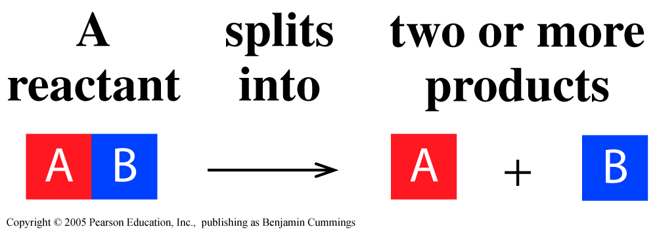
Decomposition
In a decomposition reaction, one substance splits into two or more simpler substances.
2 HgO(s) 2 Hg(l) + O₂(g)
2 KClO₃(s) 2 KCl(s) + 3 O₂(g)

Slide 22
Learning Check
Classify the following reactions as
combination or decomposition.
H₂(g) + Br₂(g) 2 HBr(l)
Al₂(CO₃)₃(s) Al₂O₃(s) + 3 CO₂(g)
4 Al(s) + 3 C(s) Al₄C₃(s)
Combination
Decomposition
Combination

Slide 23
Single Replacement Reactions
Single replacement reactions:
A + BC → AC + B
X + BY → BX + Y
Metal (A and B) replace metals;
Non-metals (X and Y) replace non-metals

Slide 24
Single Replacement
In a single replacement reaction, one element takes the place of a different element in a reacting compound.
Metals (Zn and Ag) replacing metals:
Zn(s) + 2 AgCl(aq) ZnCl₂(aq) + 2 Ag(s)
Nonmetals (Br and Cl) replacing nonmetals:
Br₂(g) + 2 NaCl(aq) 2 NaBr(aq) + Cl₂(g)

Slide 25
Learning Check
Complete and balance the following single replacement equation:
Metals replace metals:
zinc + silver nitrate →
Zn + 2 AgNO3 → Zn(NO3)2 + 2 Ag
Non-metals replace non-metals:
chlorine + sodium iodide →
Cl2 + 2 NaI → 2 NaCl + I2

Slide 26
Combustion Reactions
In a combustion reaction, a hydrocarbon (containing C, H and/or O) reacts with oxygen (O2) to make carbon dioxide and water. These are very common in organic chemistry (and in your combustion gasoline car!)
C₂H₄(g) + 3 O₂(g) → 2 H₂O(g) + 2 CO₂(g)
C6H12(g) + 9 O2(g) → 6 CO2(g) + 6 H2O(g)
2 C2H4O(g) + 5 O2(g) → 4 CO2(g) + 4 H2O(g)

Slide 27
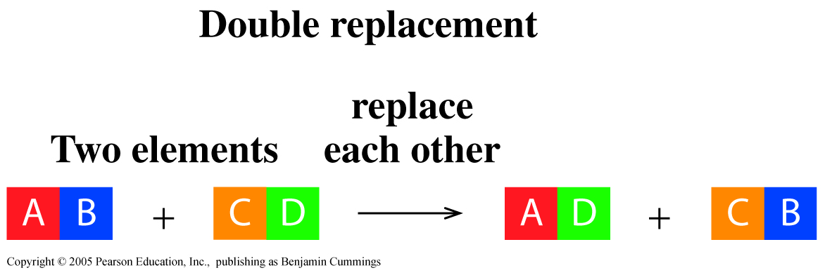
Acid-Base Reactions
In an acid-base reaction, an acid (H listed first) reacts with a base (metal hydroxide) to create water and a "salt"
HNO₃(aq) + NaOH(aq) H₂O(l) + NaNO₃(aq)
Acid-Base reactions are also a type of double displacement or exchange reactions
acid
base
water
salt

Slide 28
Acid-Base Reactions
When equal amounts (moles) of acids (H⁺) and bases (OH⁻) are mixed together, both acidic and basic properties disappear because of a neutralization reaction. The neutralization reaction produces water and a salt.
Example: HCl_{(aq)} + NaOH_{(aq)} → H₂O_{(l)} + NaCl_{(aq)}
acid
base
water
salt

Slide 29
Acid-Base Reactions
Example: HCl_{(aq)} + NaOH_{(aq)} → H₂O_{(l)} + NaCl_{(aq)}
acid
base
water
salt

Slide 30
Precipitation Reactions
In a precipitation reaction, reactants exchange cations, and at least one of the products is a solid (a precipitate)
AgNO₃(aq) + NaCl(aq) AgCl(s) + NaNO₃(aq)
Precipitation reactions are also a type of double displacement or exchange reactions
precipitate

Slide 31
Precipitation Reactions
Solubility: The amount of a compound that will dissolve in a given amount of solvent at a given temperature.
When solubility exceeded, precipitates form
Pb(NO₃)₂(aq) + 2 KI(aq) → PbI₂(s) + 2 KNO₃(aq)

Slide 32
Test Yourself
Balance and classify the following reactions:
C5H12_{(l)} + O₂(g) →
C5H12_{(l)} + 8 O₂(g) → 6 H₂O(g) + 5 CO2(g)
combustion
HCl(aq) + Pb(NO₃)_{2(aq)} → PbCl_{2(s) is a product}
2 HCl(aq) + Pb(NO₃)_{2(aq)} → PbCl_{2(s)} + 2 HNO_{3(aq)}
precipitation
HI(aq) + LiOH(aq) →
HI(aq) + LiOH(aq) → H₂O(l) + LiI(aq)
acid-base
practice, practice, practice!

Slide 33
End of Chapter 7 Section 7.1

