Slide 1
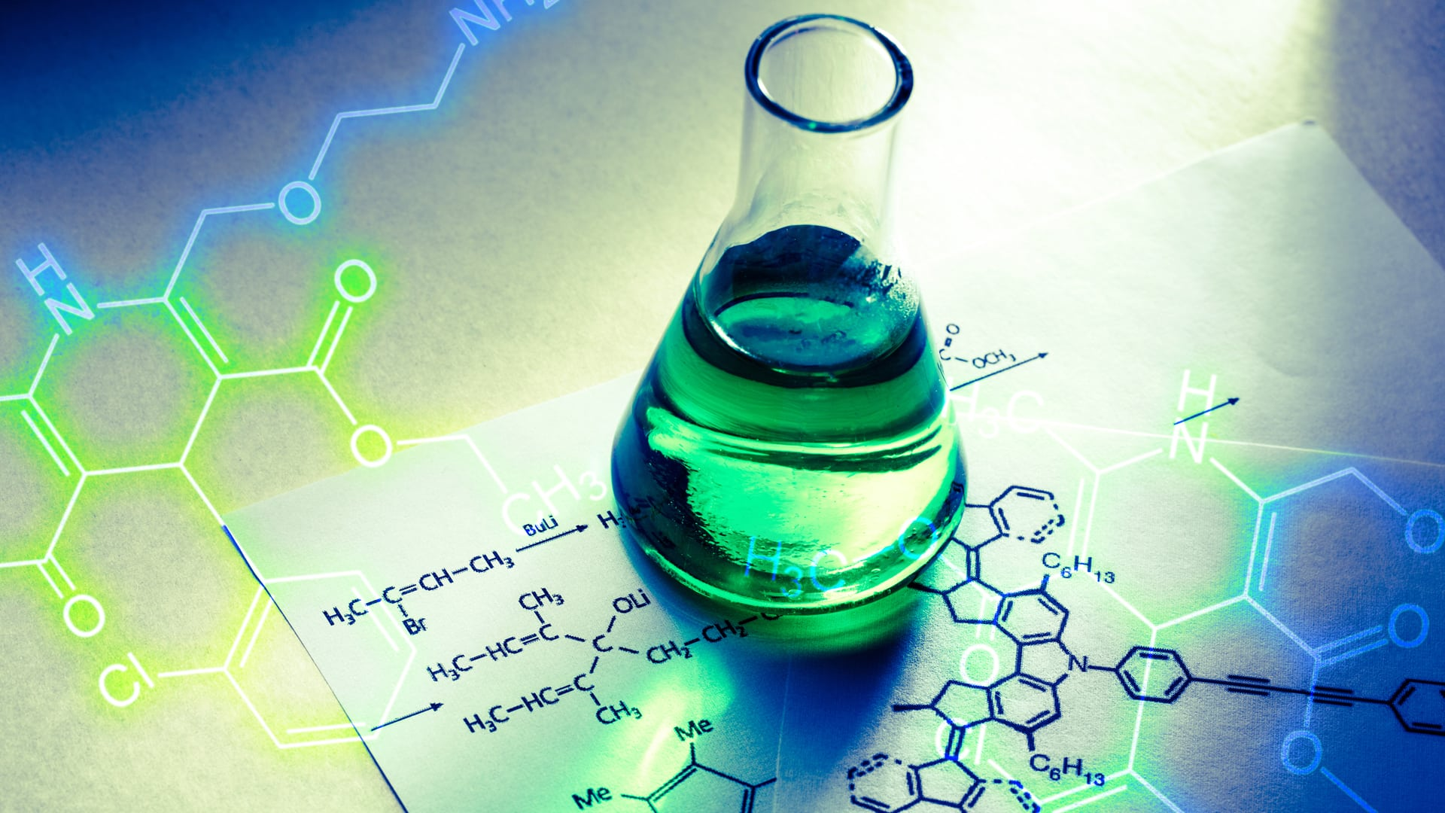
Chemistry 151: Basic Chemistry
Welcome! & Chapter 1
Get the
CH 151 Companion!
Last update:
12/9/24

Slide 2
Welcome to Chemistry 151!
Chemistry 151 is the gateway to a successful experience in the "majors level" chemistry classes (Chemistry 221, Chemistry 222 and Chemistry 223 at Mt. Hood Community College)
CH 151 offers students the chance to acquaint themselves with chemistry, math and more before tackling the higher level (and faster paced) classes.
The goals of CH 151: learn chemistry, understand sig figs and dimensional analysis, explore math skills needed for chemistry, and have fun! :)

Slide 3
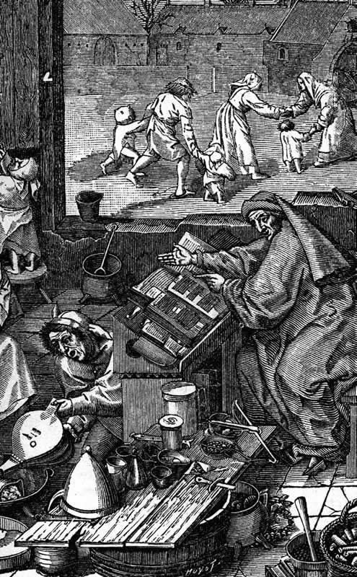
What is Chemistry?
"Keme" (earth)
"Kehmeia" (transmutation)
"Al-Khemia" (Arabic)
"alchemy" (Europe's Dark Age)
"chymistry" (Boyle's 1661 publication)
"chemistry" (modern)
Khemeia - ancient Egyptian processes for embalming the dead, later extended to metallurgy
Khemeia (and later chemistry) seen as "occult" by laymen, extended to modern age
Chemistry is the study of matter and energy

Slide 4
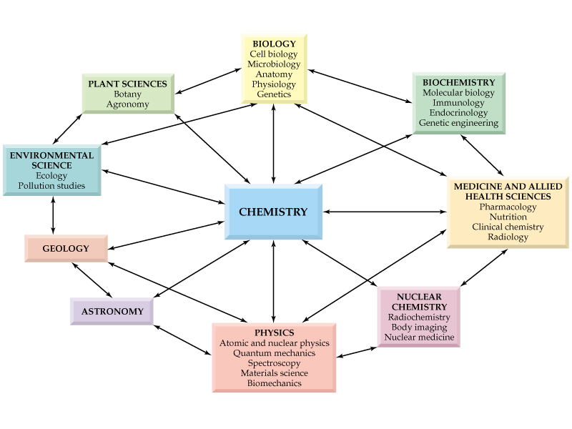
Chemistry: The Central Science
Chemistry is often referred to as “The Central Science” because it is crucial to all other sciences.

Slide 5
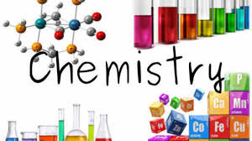
The Branches of Chemistry
Organic - carbon, nitrogen, oxygen
Inorganic - metals, everything “non-carbon”
Analytical - Spectroscopy, “how much”, “what kind”
Physical - measurement, where physics meets chemistry
Biochemical - the chemistry of life
also: geochemistry, astrochemistry, radiochemistry, medicinal chemistry, etc.

Slide 6
Metric System
Scientists use the metric system to record measurements (length, mass, volume, temperature, etc.) The metric system uses prefixes which correspond to a power of ten:
COMMON METRIC PREFIXES
PREFIX ABBREV. MEANING NUMERICAL VALUE
mega- M one million 1,000,000 (10⁶)
kilo- k one thousand 1,000 (10³)
deci- d one tenth 0.1 (10⁻¹)
centi- c one hundredth 0.01 (10⁻²)
milli- m one thousandth 0.001 (10⁻³)
micro- μ one millionth 0.000001 (10⁻⁶)
nano- n one billionth 0.000000001 (10⁻⁹)

Slide 7
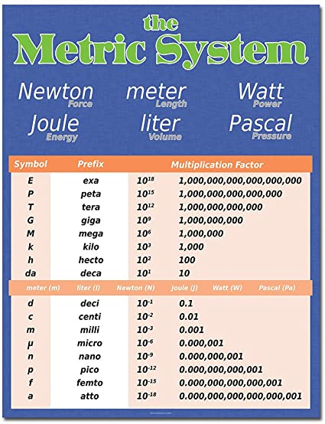
Metric System
The same prefixes are used with different types of measurements.
Length Mass Volume Time
(meter, m) (gram, g) (liter, L) (second, s)
megameter megagram megaliter megasecond
kilometer kilogram kiloliter kilosecond
decimeter decigram deciliter decisecond
centimeter centigram centiliter centisecond
millimeter milligram milliliter millisecond
micrometer microgram microliter microsecond
nanometer nanogram nanoliter nanosecond
...and many more!

Slide 8
Metric System
Relationships can be obtained from prefix meanings; just replace the prefix with its numerical equivalent
1 kilometer = 1000 meters (kilo = 10³ or 1000)
1 decimeter = 0.1 meters (deci = 10⁻¹ or 0.1)
1 centimeter = 0.01 meters (centi = 10⁻² or 0.01 - note that this is equivalent to saying 100 cm = 1 meter)
1 millimeter = 0.001 meters (milli = 10⁻³ or 0.001 - equivalent to 1000 mm = 1 meter)
1 milligram = 0.001 grams (or 1000 mg = 1 g)
1 milliliter = 0.001 liters = 1 cm³ = 1 cc
1 microgram = 0.000001 grams (or 1,000,000 𝝻g = 1 g) (micro = 10⁻⁶ or 0.000001)
1 nanogram = 0.000000001 grams (or 1,000,000,000 ng = 1 g) (nano = 10⁻⁹ or 0.000000001)

Slide 9
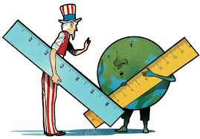
Metric System
Common “Bridges” Between English and Metric Systems
QUANTITY BRIDGE
Length 2.54 cm = 1.00 in
1.61 km = 1.00 mile
Mass 454 g = 1.00 lb
Volume 1.00 L = 1.06 qts
Try to use the metric system at all times!

Slide 10
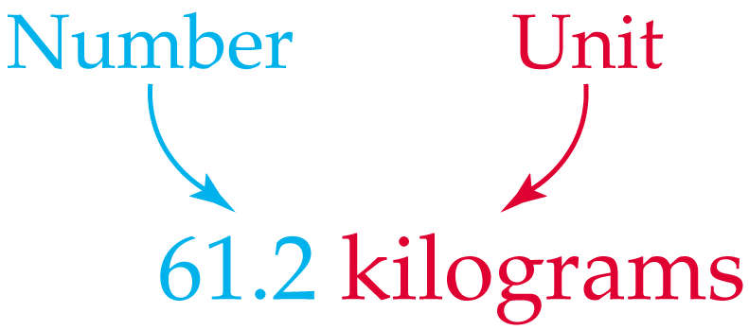
Physical Quantities
Measurable physical properties such as height, volume, and temperature are called Physical quantity. A number and a unit of defined size is required to describe physical quantity.

Slide 11
Physical Quantities
A number alone doesn’t say much!
Say an average textbook weighs 1.
The question would then be asked 1 what? 1 pound? 1 kilogram? 1 ounce?
You have to mention the unit of mass along with the number for the statement to be meaningful.

Slide 12
Physical Quantities
Physical quantities measured using many different units. Mass can be measured in pounds, kilograms, ounces, etc.
To avoid confusion, scientists around the world have agreed to use a set of standard units known as the International System of Units or SI units for some common physical quantities.

Slide 13
SI Units
In SI Units,
mass measured in kilograms (kg)
length measured in meters (m)
volume measured in cubic meters (m³)
time measured in seconds (s).
Many other units derived from SI units.
speed measured in meters per second (m/s)
density measured in grams per cubic centimeter (g/cm³).

Slide 14
Measuring Mass
Mass is a measure of amount of matter in an object.
Weight is a measure of gravitational pull on an object.
At the same location, two objects with identical masses have identical weights (gravity pulls them equally).
Thus masses of objects determined by comparing the weight of the object to the weight of a known reference.

Slide 15
Measuring Length
The Meter (m) is the standard measure of length or distance in both SI and metric system. One meter is 39.37 inches.
Centimeter (cm; ¹/₁₀₀ m) and millimeter (mm; ¹/₁₀₀₀ m) commonly used for most measurements in chemistry and medicine.

Slide 16
Measuring Volume
Volume is the amount of space occupied by an object.
SI unit for volume is the cubic meter (m³)
Liter (L) is commonly used in chemistry.
1 L = 0.001 m³ = 1000 mL
A milliliter is often called a cubic centimeter
1 mL = 1 cm³

Slide 17
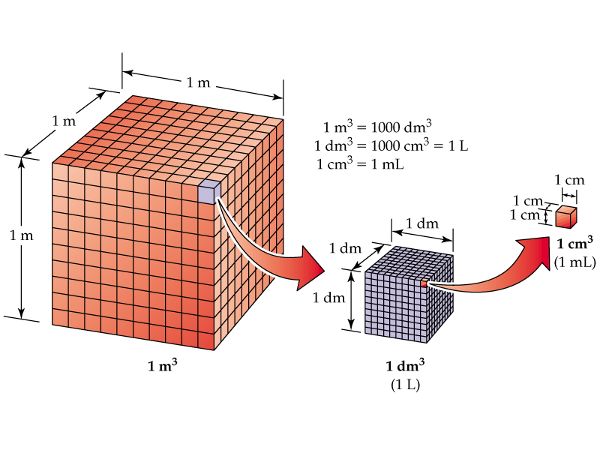

Slide 18
Scientific Notation
Scientific notation used by scientists to express very large and very small numbers in a compact fashion.
To express a number in scientific notation we rewrite the quantity as a number (between 1 and 9) multiplied by 10 raised to a power (exponent) that tells us how we moved the decimal point.
Multiply the number by 10⁰. (Remember 10⁰ = 1)
Move the decimal point to give a number between 1 and 10.
Every time we shift the decimal point to the left by one place we increase the value of the exponent by one.
Every time we shift the decimal point to the right by one place we reduce the value of the exponent by one.

Slide 19
Scientific Notation
Example: Write 120,000 in scientific notation.
120,000 = 120,000 x 10⁰ = 1.2 x 10⁵
Example: Write 0.0000012 in scientific notation.
0.0000012 = 0.0000012 x 10⁰ = 1.2 x 10⁻⁶

Slide 20
Scientific Notation
To express a scientific notation number as a non-exponential "regular" number:
Move the decimal point the same number of places as the value of the exponent and eliminate the exponential part of the number.
If the exponent is positive, we move the decimal to the right, to the same number of places as the value of the exponent. (The result should be a number greater than 1.)
If the exponent is negative, we move the decimal to the left, to the same number of places as the value of the exponent. (The result should be a number less than 1.)

Slide 21
Scientific Notation
Example: Write 1.23 x 10⁶ in non-exponential form.
1.23 x 10⁶ = 1,230,000
Example: Write 1.11 x 10⁻⁵ in non-exponential form.
1.11 x 10⁻⁵ = 0.0000111
Remember: If we make the exponent larger we must make the number part smaller, and if we make the exponent smaller we must make the number part larger.

Slide 22
Calculations Using Scientific Notation on Your Calculator
Let’s see how you are at using your calculators. Try the following and don’t forget about cancelling units where appropriate. Record your answers in scientific notation, rounded to one digit past the decimal. (Rounding rule: 5 or bigger, round up.)
1. (1.5 x 10⁵ in²)(1.2 x 10⁻² in) = ?
(It saves time to use your exponent button. EE, exp, 10^{x})
1.5EE5x1.2EE(-)2 [Enter] = 1800 in³ = 1.8 x 10³ in³
2. 4.3 x 10⁵ ft / 5.1 x 10⁻⁶ ft = ? (try this yourself!)
= 8.4 x 10¹⁰
1800 exact
8.43137.... E10

Slide 23
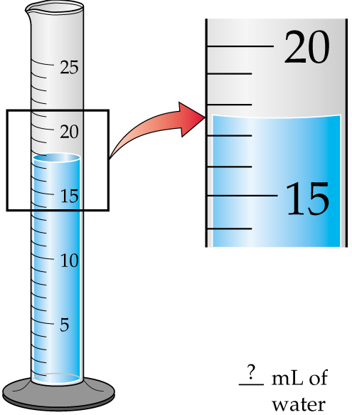
Measurement and Significant Figures
Every experimental measurement, no matter how precise, has a degree of uncertainty because there is a limit to the number of digits that can be determined.

Slide 24
Measurement and Significant Figures
To indicate the precision of the measurement, the value recorded should use all the digits known with certainty plus one additional estimated digit ("doubtful digit") that usually is considered uncertain by plus or minus 1 (+ 1)
The total number of digits used to express such a measurement is called the number of significant figures.
Example: The quantity 65.07 g has four significant figures and 7 is the "doubtful digit"

Slide 25
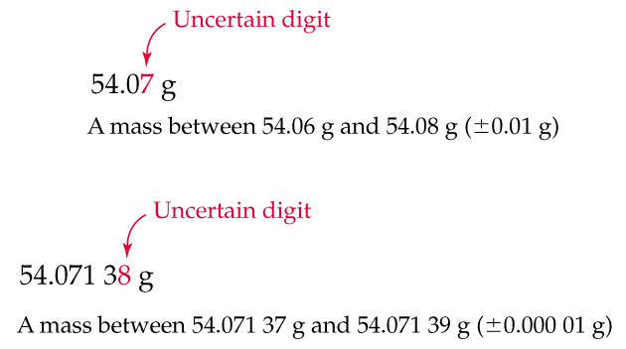
Measurement and Significant Figures

Slide 26
Rules for Determining Significant Figures
1. Zeroes in the middle of a number are significant. 69.08 g has four significant figures, 6, 9, 0, and 8.
2. Zeroes at the beginning of a number are not significant. 0.0089 g has two significant figure, 8 and 9.
3. Zeroes at the end of a number and after the decimal points are significant. 2.50 g has three significant figures 2, 5, and 0. 25.00 m has four significant figures 2, 5, 0, and 0.
Significant Figures often abbreviated as "sig figs"

Slide 27
Rules for Determining Significant Figures
4. Zeroes at the end of a number and before an implied decimal points may or may not be significant. 1500 kg may have two, three, or four significant figures. Zeroes here may be part of the measurements or for simply to locate the unwritten decimal point.

Slide 28
Test Yourself: How Many Significant Figures?
94.072 g
Five sig. figs. (9, 4, 0, 7, 2)
Three sig. figs. (8, 3, 4)
Four sig. figs. ( 2, 9, 0, 7)
Six sig. figs, (1, 3, 8, 2, 0, 0)
Anywhere from two (2, 3) to five (2, 3, 0, 0, 0)
Five sig. figs (2, 3, 0, 0, 0)
0.0834 cm
0.02907 mL
138.200 m
23,000 kg
23,000. kg

Slide 29
How Many Significant Figures?
35
uncertain
digit 0.1
30
32.5˚C
3 sig figs
Thermometer

Slide 30
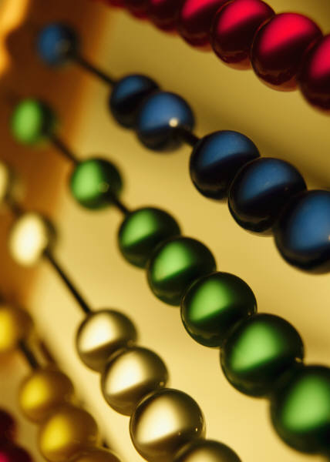
Rounding off Numbers
Often calculators produce large numbers as a result of a calculation although the number of significant figures is good only to a few numbers, less than the calculator has produced
In this case the large number may be rounded off to a smaller number keeping only significant figures.

Slide 31
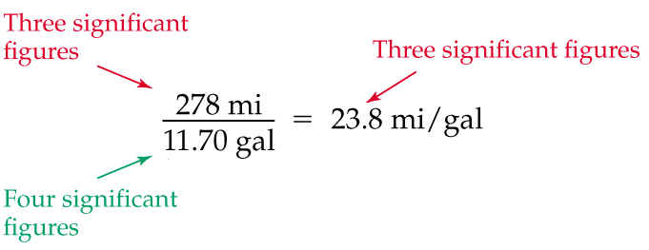
Rules for Rounding off Numbers
Rule 1 (For multiplication and divisions): The answer can’t have more significant figures than either of the original numbers.
23.76068....

Slide 32
Rules for Rounding off Numbers
Rule 2 (For addition and subtraction): The number can’t have more digits after the decimal point than either of the original numbers.

Slide 33
Rules for Rounding off Numbers
Rule 3: Once you decide how many numbers to keep, you may need to round off your answer:
If the first digit you remove is between 0 and 4, drop it and all remaining digits.
If the first digit you remove is between 5 and 9, round the number up by adding 1 to the digit to the left of the one you drop
Example: 2.4271 becomes 2.4 when rounded to two significant figures
Example: 4.5816 becomes 4.6 when rounded to two significant figures

Slide 34
Factor-Label Method of Unit Conversions
Quantities measured in the lab usually have units (labels) which tell us the type of measurement made.
For example:
5.2 cm - the unit (cm) tells us the type of measurement made is length.
16.237 g - the unit (g) tells us the type of measurement made is mass.
Often we must convert one kind of unit for a measurement to a different kind. For example, we may need to convert 28 inches into a certain number of feet. The factor-label method (also known as the dimensional analysis method) uses conversion factors and units (labels) to solve problems of this type.

Slide 35
Factor-Label Method of Unit Conversions
Conversion factors are fractions that relate two kinds of units. One way in which they may be obtained is from equalities.
For example: 12 in = 1 ft is an equality which leads to two equivalent fractions (conversion factors) generated by dividing one side of the equality by the other side.
12 in 1 ft
1 ft 12 in
Another common conversion factor: there are 4 quarters in a dollar ($):
4 quarters 1 $
1 $ 4 quarters
And:

Slide 36
Factor-Label Method of Unit Conversions
And yet another common example:
60 min = 1 hr is an equality which leads to two equivalent conversion factors.
60 min 1 hr
1 hr 60 min
Other forms : 60 min = 60 min/hr = 60 min per hr 1 hr
When you are new to the factor-label method, it is most helpful to use the form that has a numerator and denominator term (and not 60 min/hr)
Some conversion factors are considered exact and have unlimited sig figs, but most conversion factors obey sig fig rules.

Slide 37
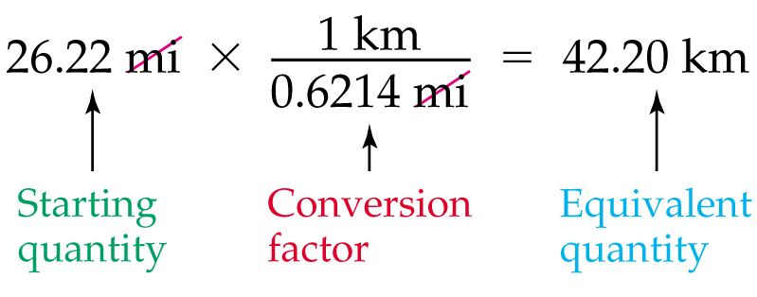
When solving a problem, set up an equation so that all unwanted units cancel, leaving only the desired unit. For example, we want to find out how many kilometers are there in 26.22 miles. We will get the correct answer if we multiply 26.22 mi by the conversion factor km/mi.
42.195043....

Slide 38
Some Exact Conversions
1 km = 1000 m = 10⁵ cm = 10¹² nm
12 in = 1 ft 5280 ft =1 mile
1 in = 2.54 cm
1 cm³ = 1 mL 1000 mL = 1 L
1 g = 1000 mg 1 kg = 1000 g
Length
Volume
Mass
These conversions have unlimited sig figs by definition. Most other conversions inexact… and follow sig fig rules!

Slide 39
Test yourself: How many hours in 3.5 weeks?
Starting quantity: 3.5 weeks
Conversion Factor #1: 1 week = 7 days (exact)
Conversion Factor #2: 1 day = 24 hours (exact)
so:
3.5 weeks * (7 days / 1 week) * (24 hours / 1 day) = 590 hours (two sig figs) 588 exact

Slide 40
Test yourself: How many quarters will a tourist need to travel 555 km? Car: 22 miles per gallon, gas: $1.37/gallon, 1.61 km = 1 mile
Starting quantity: 555 km
Conversion Factor #1: 4 quarters = 1 $ (exact)
Conversion Factor #2: 22 miles = 1 gallon (2 sig figs)
Conversion Factor #3: 1 gallon = $1.37 (3 sig figs)
Conversion Factor #4: 1 mile = 1.61 km (3 sig figs)
so:
555 km * (1 mile / 1.61 km) * (1 gallon / 22 miles) * ($1.37 / gallon) * (4 quarters / $1) = 86 quarters (2 sig figs)
85.86674.......

Slide 41
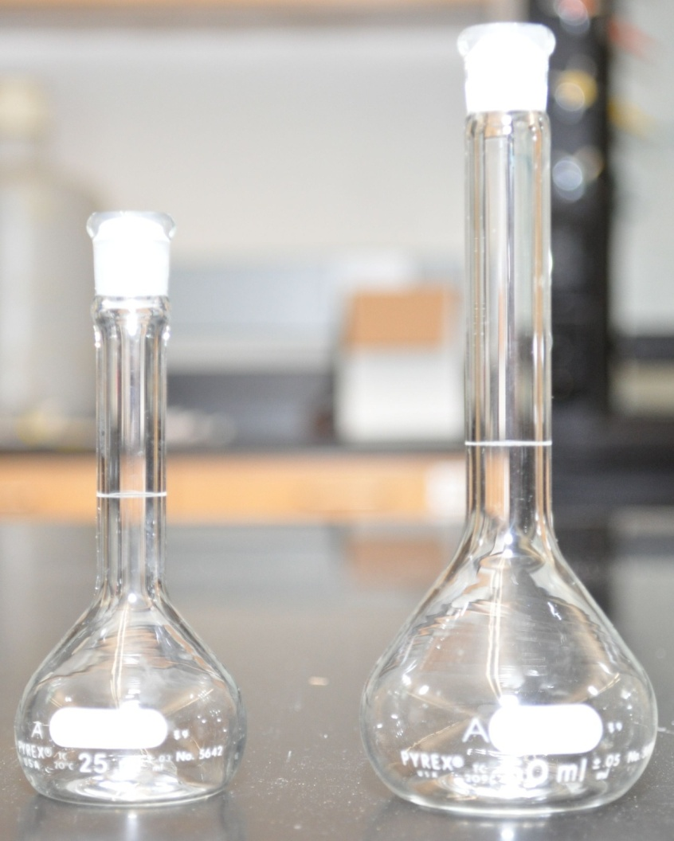
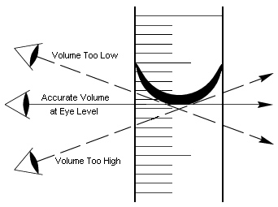
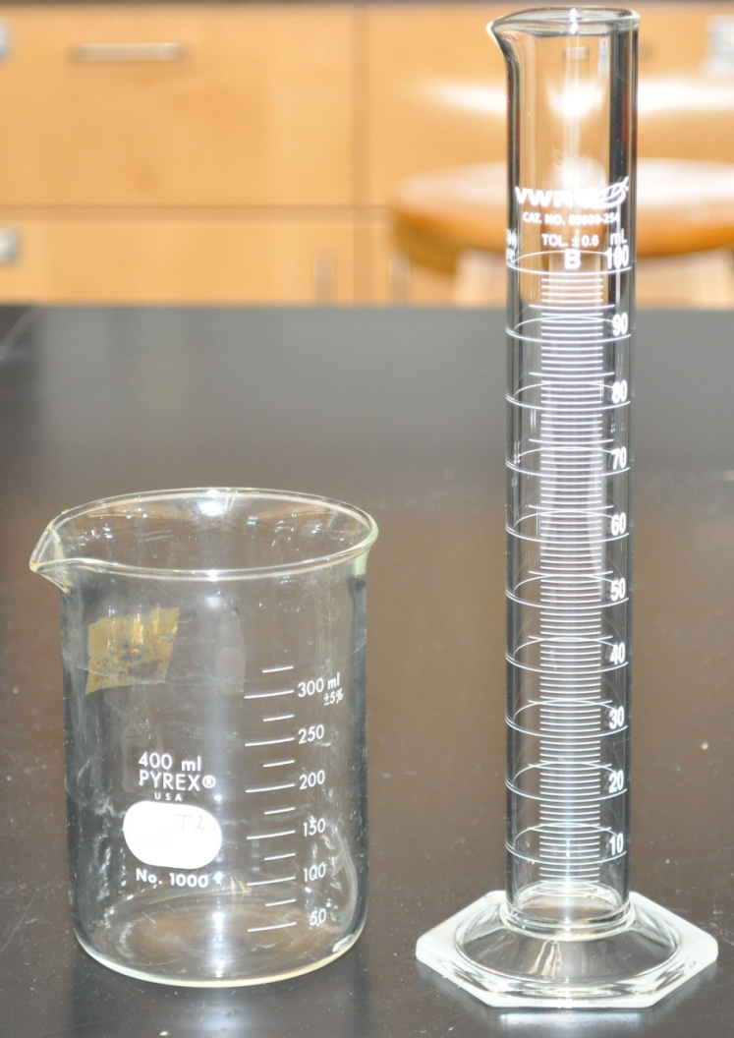
How do we measure the volume of a liquid?
volumetric
flasks
Beaker (left), graduated cylinder (right)
read volume from bottom of meniscus at eye level

Slide 42
Density
Density relates the mass of an object with its volume.
Density is usually expressed in:
Gram per cubic centimeter (g/cm³) (solids)
Gram per milliliter (g/mL) (liquids)
Mass (g)
Density =
Volume (mL or cm³)

Slide 43
Test yourself: Mercury has a density of 13.6 g/mL. How many L of Hg are there in 42.7 kg of Hg?
Starting quantity: 42.7 kg
Conversion Factor #1: 13.6 g/mL
Conversion Factor #2: 1 L = 1000 mL
Conversion Factor #3: 1 kg = 1000 g
so:
42.7 kg * (1000 g / 1 kg) * (1 mL / 13.6 g) * (1 L / 1000 mL) = 3.14 L of Hg 3.139705882.....

Slide 44
Measuring Temperature
Temperature, the measure of how hot or cold an object is, is commonly reported either in Fahrenheit (ºF) or Celsius (ºC). The SI unit of temperature is, however, the Kelvin (K).
Kelvin temperatures are always positive and they do not use the degree (º) symbol.
Kelvin used in calculations, Celsius in the lab.
Temperature in K = Temperature in ºC + 273.15
Temperature in ºC = Temperature in K - 273.15

Slide 45
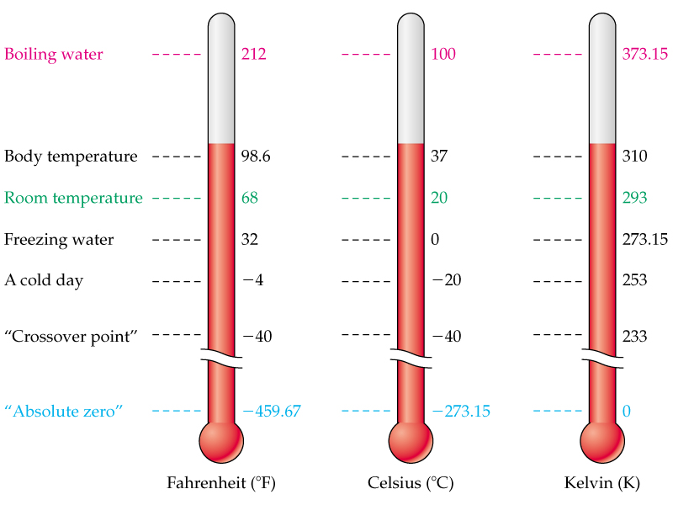
Comparison of the Fahrenheit, Celsius, and Kelvin Scales

Slide 46
Converting between Fahrenheit and Celsius scales is similar to converting between different units of length or volume.
The following formulas can be used for the conversion:
oF = 1.8 x oC + 32 oF
oC = (oF – 32 oF) / 1.8

Slide 47
Test yourself: Mars often has temperatures around -70. °C. Express this in K and °F.
Starting quantity: -70. °C
Conversion Factor #1: T(K) = T(°C) + 273.15
Conversion Factor #2: T(°F) = 1.8*(T°C) + 32
so:
T(K) = -70. + 273.15
T(K) = 203 K 203.15 exact
T(°F) = 1.8(-70.) + 32
T(°F) = -94 °F -94 exact

Slide 48
End of Chapter 1

